Slide 2
Arduino : Introduction & Programming
Shyam Sharma

Slide 3
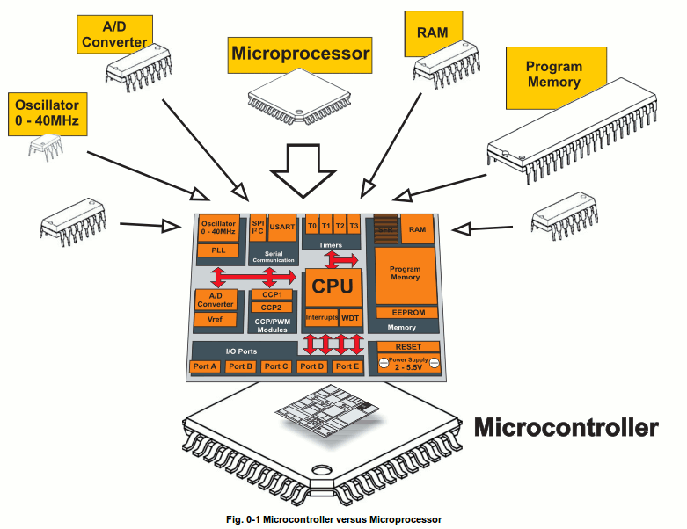
What is a Microcontroller
www.mikroe.com/chapters/view/1
A small computer on a single chip
containing a processor, memory, and input/output
Typically "embedded" inside some device that they control
A microcontroller is often small and low cost
Examples

Slide 4
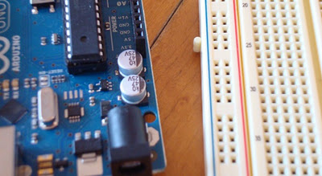
What is a Development Board
A printed circuit board designed to facilitate work with a particular microcontroller.
Typical components include:
power circuit
programming interface
basic input; usually buttons and LEDs
I/O pins

Slide 5
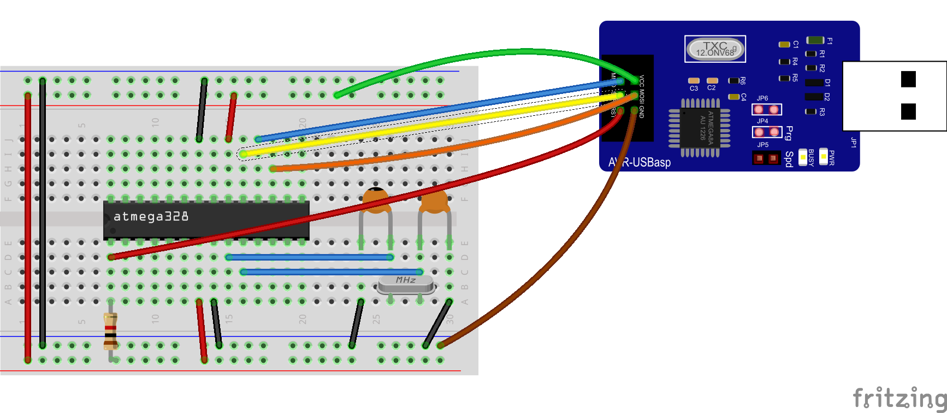
Why Arduino..?

Slide 6

Lets Start Arduino…!

Slide 7

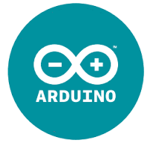
Arduino Basics
arduino ( arrr-dween-oh )
(n.) It's an open-source physical computing platform based on a simple microcontroller board, and a development environment for writing software for the board.

Slide 8
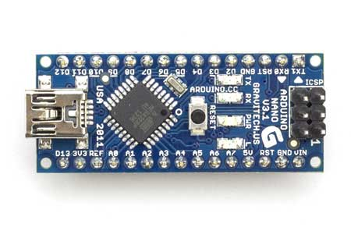
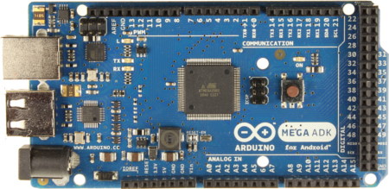
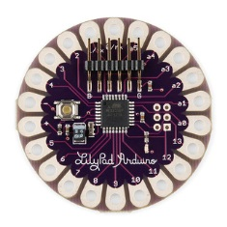
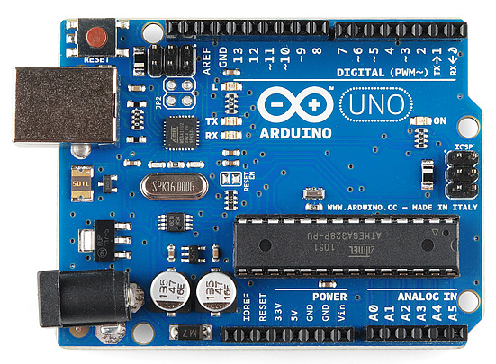
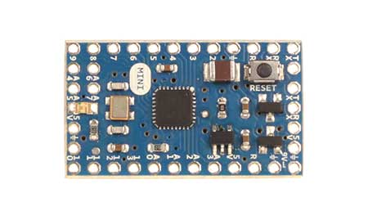
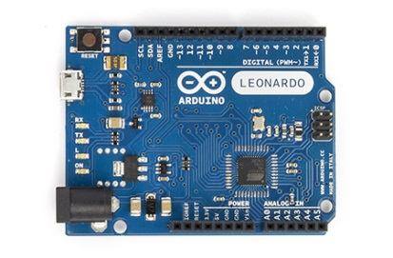
Types of Arduino Boards
Arduino Nano
Arduino Mega
Arduino LilyPad
Arduino Uno
Arduino Mini
Arduino Leonardo

Slide 9
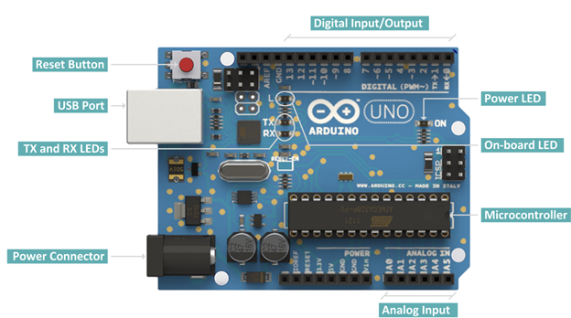
Arduino Uno
Digital pins:
14 digital IO pins
6 are PWM pins (3, 5, 6, 9, 10, and 11).
Analog pins:
6 analog pins(A0, A1, A2, A3, A4, and A5)
Takes analog values as an input

Slide 10
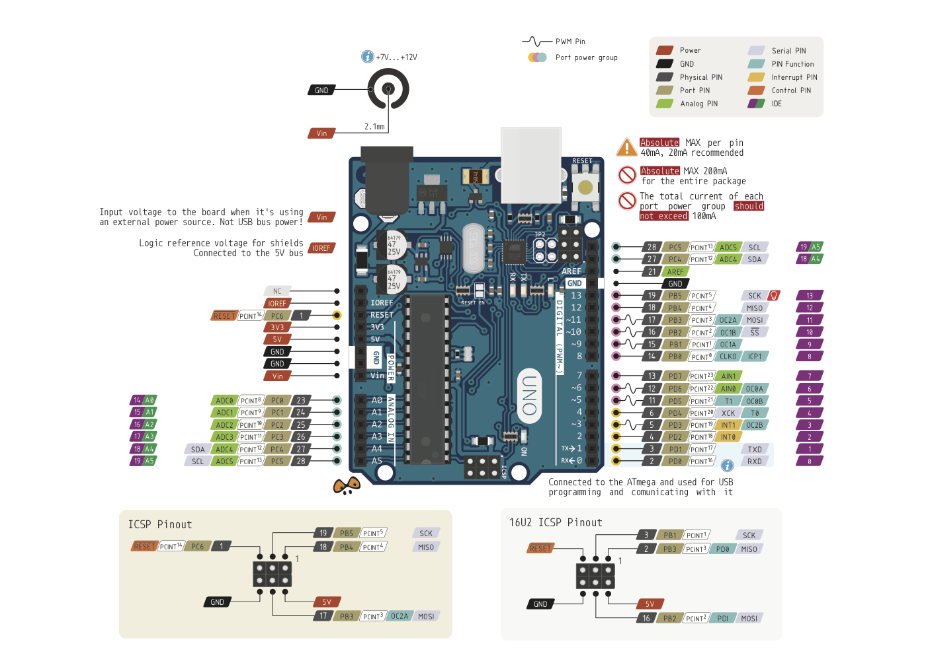

Slide 11
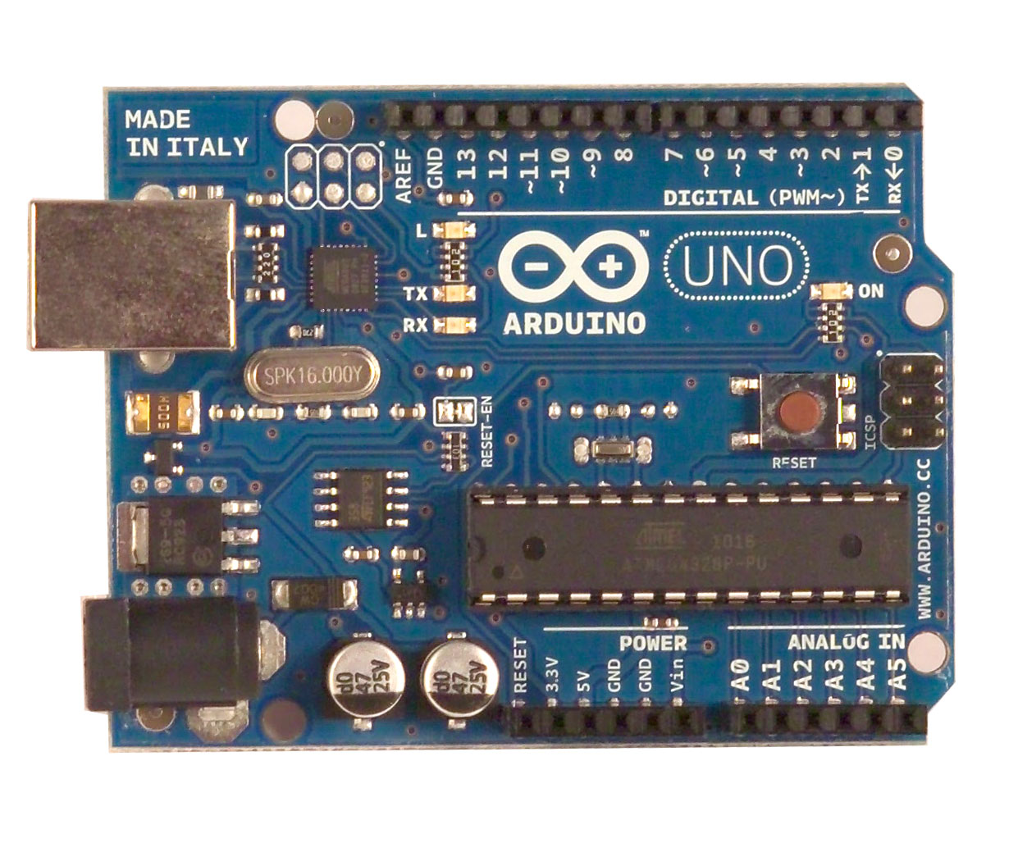
What is an Arduino ?
Open Source electronic prototyping platform based on flexible easy to use hardware and software.

Slide 12

Uses of Arduino

Slide 13
Getting started with Programming

Slide 14

Concepts: INPUT vs. OUTPUT
Referenced from the perspective of the microcontroller (electrical board).
Inputs is a signal / information going into the board.
Output is any signal exiting the board.
Almost all systems that use physical computing will have some form of output
What are some examples of Outputs?

Slide 15
Concepts: INPUT vs. OUTPUT
Referenced from the perspective of the microcontroller (electrical board).
Inputs is a signal / information going into the board.
Output is any signal exiting the board.
Examples: Buttons Switches, Light Sensors, Flex Sensors, Humidity Sensors, Temperature Sensors…
Examples: LEDs, DC motor, servo motor, a piezo buzzer, relay, an RGB LED

Slide 16
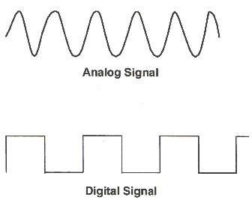
Concepts: Analog vs. Digital
Microcontrollers are digital devices – ON or OFF. Also called – discrete.
analog signals are anything that can be a full range of values. What are some examples? More on this later…
5 V
5 V
0 V
0 V

Slide 17
Bare minimum code
void setup() { // put your setup code here, to run once:
}
void loop() { // put your main code here, to run repeatedly:
}

Slide 18
Bare minimum code
setup : It is called only when the Arduino is powered on or reset. It is used to initialize variables and pin modes
loop : The loop functions runs continuously till the device is powered off. The main logic of the code goes here. Similar to while (1) for micro-controller programming.

Slide 19
PinMode
A pin on arduino can be set as input or output by using pinMode function.
pinMode(13, OUTPUT); // sets pin 13 as output pin
pinMode(13, INPUT); // sets pin 13 as input pin

Slide 20
Reading/writing digital values
digitalWrite(13, LOW); // Makes the output voltage on pin 13 , 0V
digitalWrite(13, HIGH); // Makes the output voltage on pin 13 , 5V
int buttonState = digitalRead(2); // reads the value of pin 2 in buttonState

Slide 21
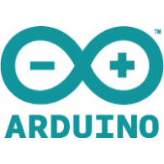
Open up Arduino
Hints:
For PC Users →
Let the installer copy and move the files to the appropriate locations, or
Create a folder under C:\Program Files (x86) called Arduino. Move the entire Arduino program folder here.
For Mac Users →
Move the Arduino executable to the dock for ease of access.
Resist the temptation to run these from your desktop.

Slide 22
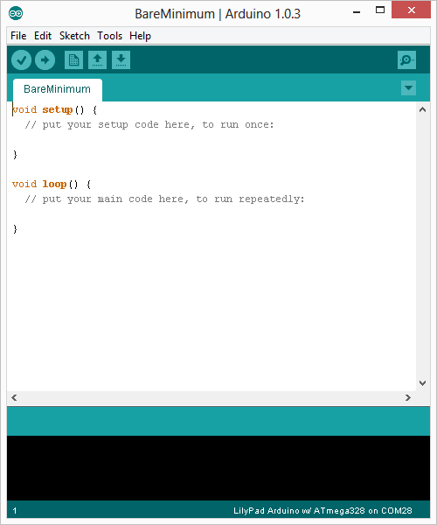
Arduino Integrated Development Environment (IDE)
Two required functions / methods / routines:
void setup()
{
// runs once
}
void loop()
{
// repeats
}
error & status messages
Notes:
Be sure to point out the what all of the buttons do.

Slide 23
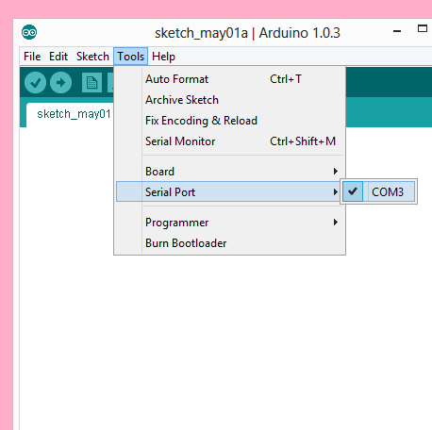
Settings: Tools → Serial Port
Your computer communicates to the Arduino microcontroller via a serial port → through a USB-Serial adapter.
Check to make sure that the drivers are properly installed.
Notes:
All connections to computers- mice, printers etc use a serial port. Gotta pick the right one.

Slide 24
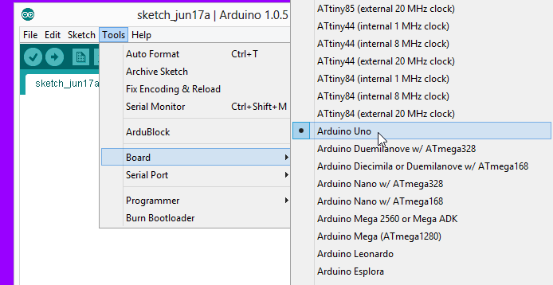
Settings: Tools → Board
Next, double-check that the proper board is selected under the Tools→Board menu.
Notes:
All connections to computers- mice, printers etc use a serial port. Gotta pick the right one.

Slide 25
“How much more Arduino can do is only left to your imagination”

