Slide 1
Serial Communication Interface

Slide 2
Agenda
Basic Definitions
Detailed Information
Concrete Examples

Slide 3
Learning Objectives
Describe the Difference Between Serial and Parallel Communication
Explain Asynchronous Communication
Determine Time Needed to Transmit a Block of Data
Describe a Common Error Detection Mechanism
Serial Communication with Arduino

Slide 4
Data Transmission Tree
Data Transmission
Parallel
Serial
Synchronous
Asynchronous

Slide 5
Types of communication
2 main types
  Serial
    Telegraph
    Light Signal
  Parallel
    ISDN line
    Factory line

Slide 6
Definition: Parallel
Data is sent and received more than one bit at a time
Transmission on multiple wires

Slide 7
Parallel Communication
Many lines of communication, synchronized bursts of data
Transmitter
Receiver
Time

Slide 8
Endianness, how it relates to communication
Big Endian- MSB first, less significant bytes in descending order
Little Endian- MSB last, data in ascending order
Endian type determines how the data is interpreted, and how it should be sent in both serial and parallel communication.

Slide 9
Definition: Serial
Data is sent and received one bit at a time
Transmission on single wire

Slide 10
Serial Communication
One line of communication, long string of data
Signal
Time

Slide 11
RS232, SCI, and SPI
RS232- Typical computer COM port
SCI- Serial Communication interface, uses the universal asynchronous receiver/transmitter or UART
SPI Serial peripheral interface, part of Port D.

Slide 12
Why Serial?
Fewer wires translates to
  Lower cost
  Simpler set-up

Slide 13
Definition: Synchronous
Sender and receiver have their clocks synchronized
Transmissions occur at specified intervals
Advantage:
  Faster

Slide 14
Definition: Asynchronous
Devices are not synchronized
Transmissions happen at unpredicted intervals
Advantages:
  Simpler
  More robust

Slide 15
Please Note:
Both synchronous and asynchronous must have agreed upon bit transfer rate

Slide 16
Why Asynchronous?
Disadvantage:
  Slower due to overhead
Advantages:
  Simpler
  Cheaper
  Information can be sent when ready

Slide 17
FYI Term: “UART”
Universal
Asynchronous
Receiver-
Transmitter
“…a computer component that handles asynchronous serial communication.”
www.webopedia.com

Slide 18
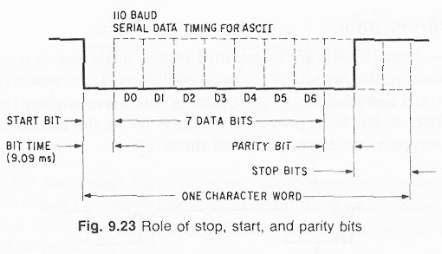

Slide 19
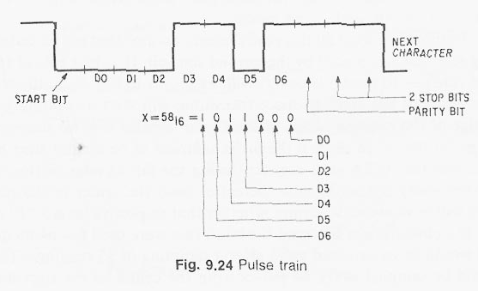

Slide 20
Definitions
Start Bit
  Signals the beginning of the data word
  A low bit after a series of high bits
Data Bits
  The meat of the transmission
  Usually 7 or 8 bits

Slide 21
Definitions Continued
Parity Bit
  An error check bit placed after the data bits
  Can be high or low depending on whether odd parity or even parity is specified
Stop Bit/s
  One or two high bits that signal the end or the data word
Data Word
  Start Bit, Data Bits, Parity Bit, & Stop Bit/s

Slide 22
BAUD RATE
BIT RATE

Slide 23
Baud Rate
Baud Rate = bits transferred/second
baud rate INCLUDES start, stop, and parity
“bit rate” refers to JUST data bits transferred per second (may include parity)
baud rate > bit rate

Slide 24
Baud Rate Example
Calculate baud rate
  1/bit time = 1/9.09ms = 110 baud
Time to transmit word:
  (11 bits) x (9.09ms) = 0.1 s
Word rate
  1/0.1s = 10 char/s
Bit rate
  (10 char/s) x (8 bits/char) = 80 bits/s

Slide 25
Error Minimization
samples bit 3 times around center
reduces drift error
1
noise
0
clock cycles
Samples at center
8 RT cycles
single bit width, 16 RT cycles

Slide 26
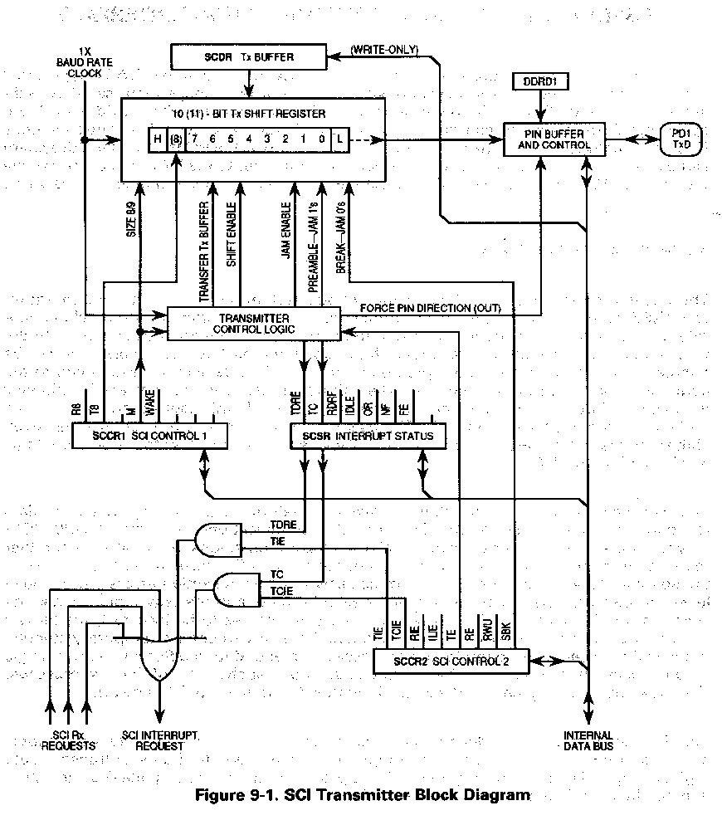
The Transmitter

Slide 27
The Transmitter
Double Buffered
  Transmit Shift Register
  SCDR
Break/Idle
  Break Signal - String of all zeros
  Idle Signal - String of all ones
    Resynchronizes or wakes up Receiver

Slide 28
The Transmitter
Normal Transmission
Interrupts
  Transmission Data Register Empty
  Transmission Complete
  Only one Interrupt Vector for the SCI
    ISR must read SCSR to determine which flag caused the interrupt

Slide 29
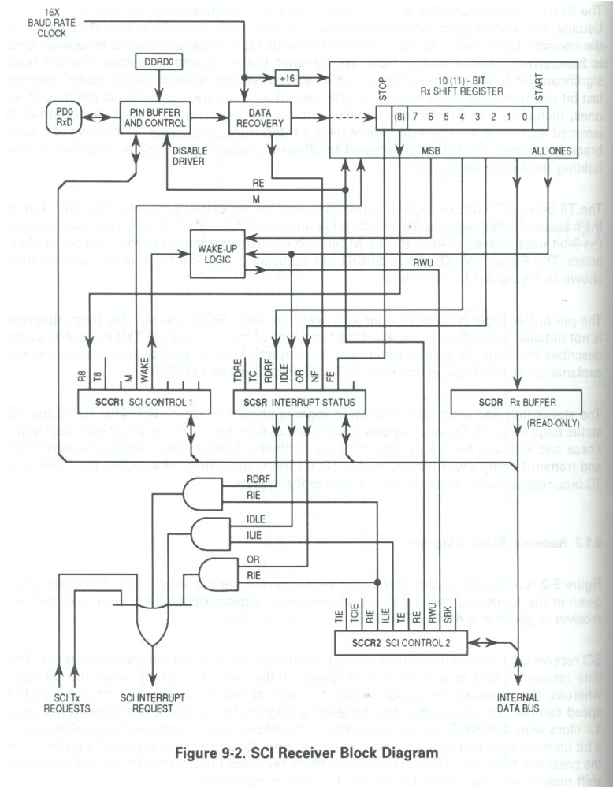
The Receiver

Slide 30
The Receiver
Double Buffered
Synchronizes internal clock (RT clock) with incoming data
Internal clock runs 16 times faster than the baud rate
8 bit data tolerates ±4.5% BAUD error
9 bit data tolerates ±4% BAUD error
Interrupt
  Receive Data Register Full

Slide 31
The Receiver
Ready to receive…
  Checks for Start bit
    Three highs followed by a low (RT clock resets)
    Checks RT3, RT5, RT7
      If any 2 are high, Receiver resumes search for Start Bit
    Checks RT8, RT9, RT10
      If ones are detected, NF set, but Start Bit still verified
  Checks each data bit
    Checks each RT8, RT9, RT10
      Goes with majority, but will set NF

Slide 32
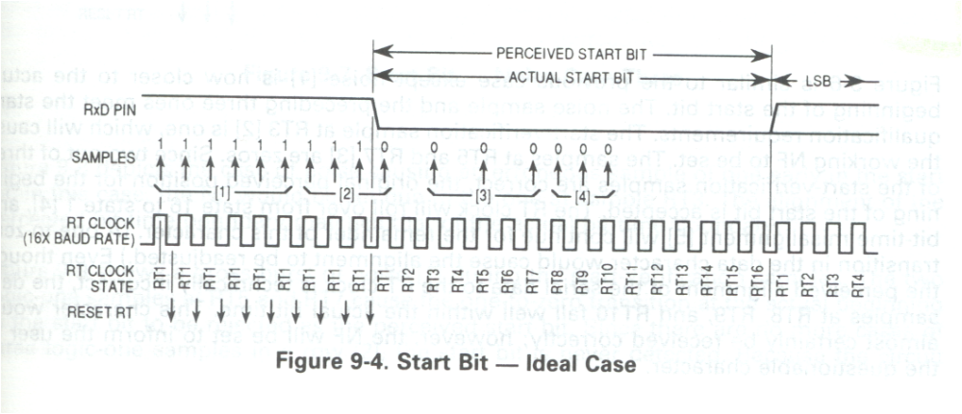
Start Bit Check Ex.1

Slide 33
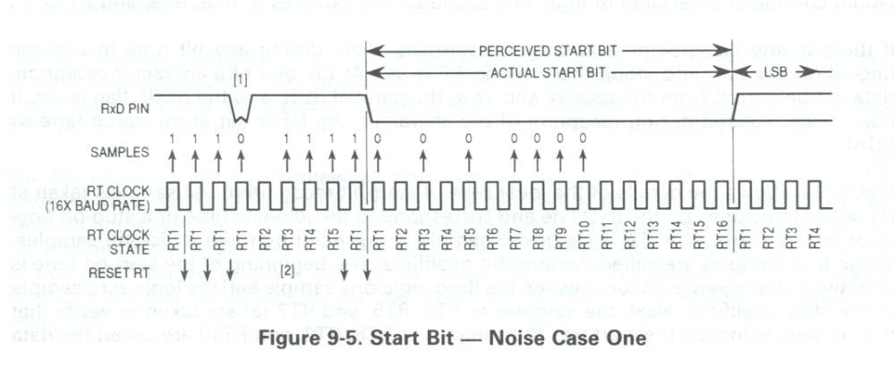
Start Bit Check Ex. 2

Slide 34
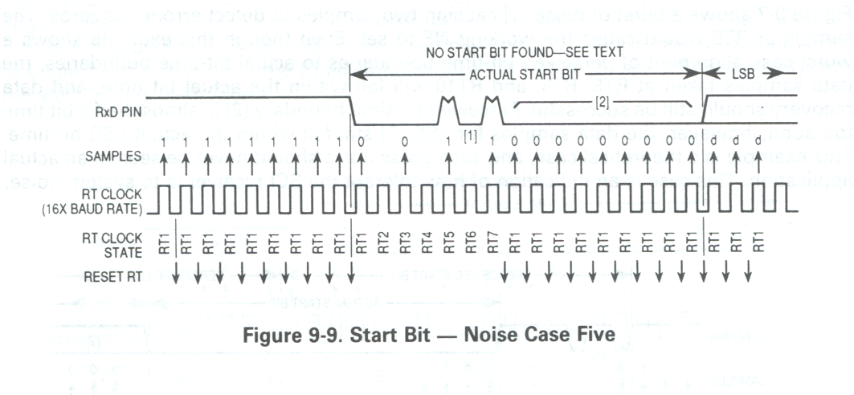
Start Bit Check Ex. 3

