Slide 1
Pulse Width Modulation
Starting with Arduino

Slide 2
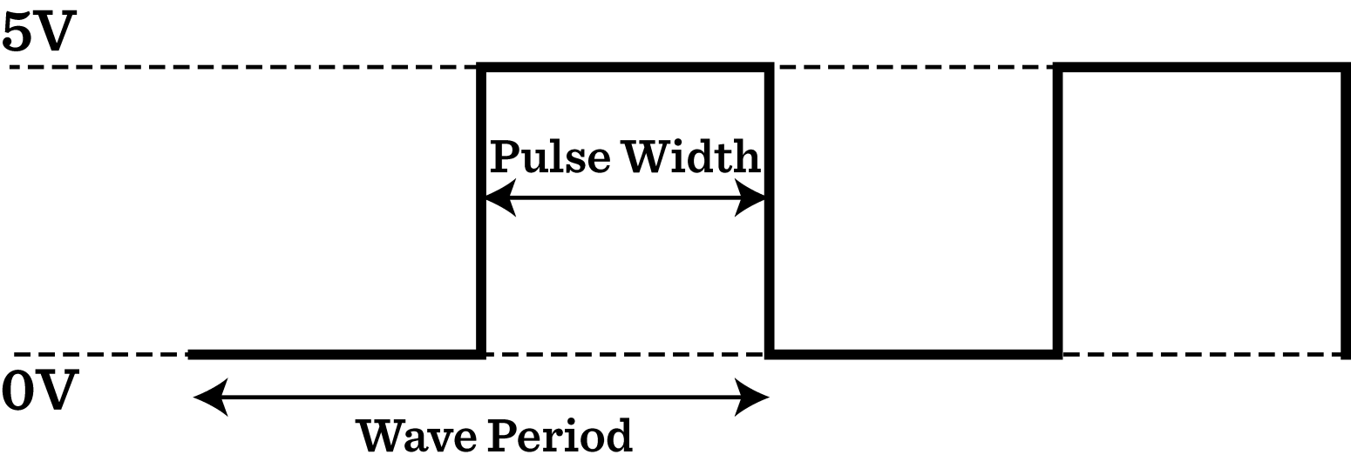
PWM (Pulse Width Modulation)
Basic terms
Duty cycle = Pulse Width / Wave Period

Slide 3
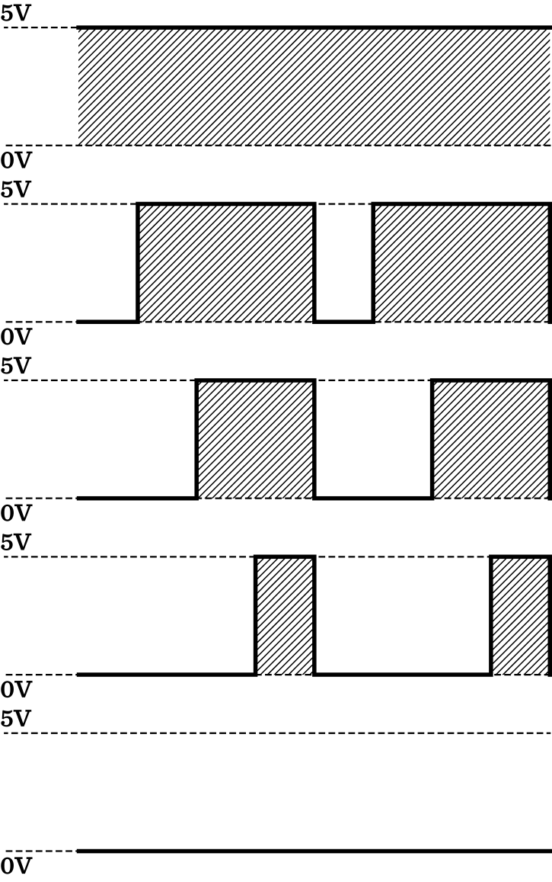
Duty cycle
100 %
75 %
50 %
←Ideal Square Wave
25 %
0 %

Slide 4
PWM Applications
Servomotor angle control
DC motor speed control
LED Dimming
Audio generation
Digitally generating analog voltages (requires filtering)

Slide 5
PWM with Uno
Total of 6 pins with PWM capability (~ symbol)
PWM frequency
Pins 5 & 6: default: 980Hz ~1kHz
(62.5kHz base with 64 as prescaler)
Pins 3,9,10,11: default 490Hz ~0.5kHz
(31.25 kHz base with 64 as prescaler)
Can be adjusted (30Hz-62.5kHz) with setPwmFrequency();
http://playground.arduino.cc/Code/PwmFrequency
CAUTION: Affects the delay() millis() and Servo functions

Slide 6
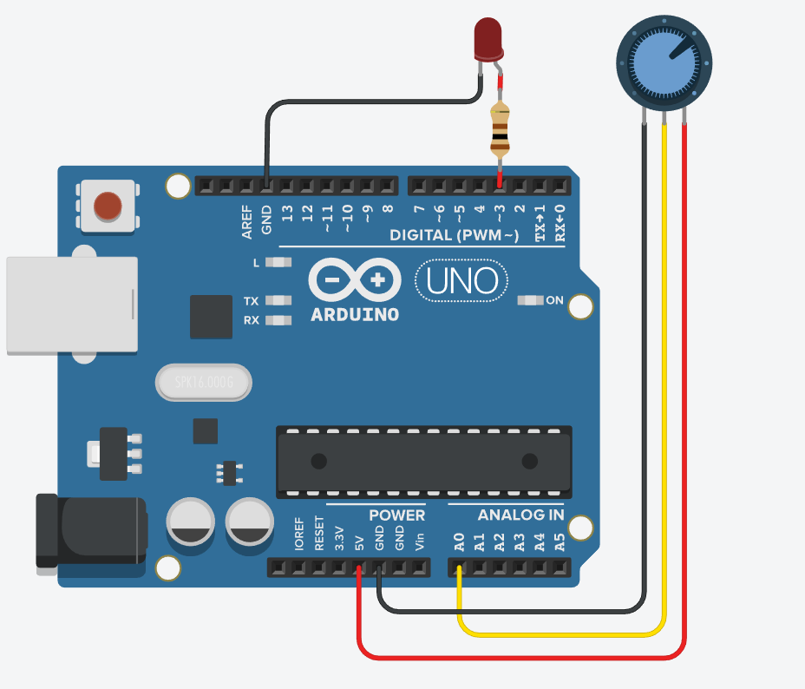
Example 2 – Control PWM LED
Using an analog input to control a PWM LED
Longer pin

Slide 7
Example 2 - Analog I/O
Potentiometer controlled PWM LED
int ledPin = 3; //Variable to store the pin number
int potPin = A0; //Variable to store the pin number
void setup()
{
pinMode(ledPin, OUTPUT); //set ledPin as output
pinMode(potPin, INPUT); //set potPin as input
}
void loop()
{
int potValue = analogRead(potPin); //Read the value of the potentiometer
int ledValue = map(potValue, 0, 1023, 0, 255); //map to correct range
analogWrite(ledPin, ledValue); //Read the value of the potentiometer
delay(10); //To run the loop ~100 times a second
}

