Slide 1
Convolutional Neural Network for FASHION MNIST DATASET

Slide 2
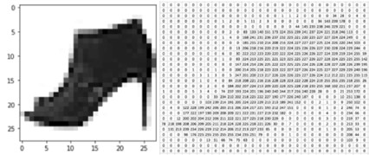

Slide 3
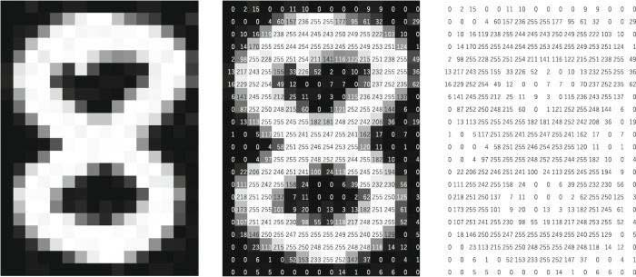

Slide 4
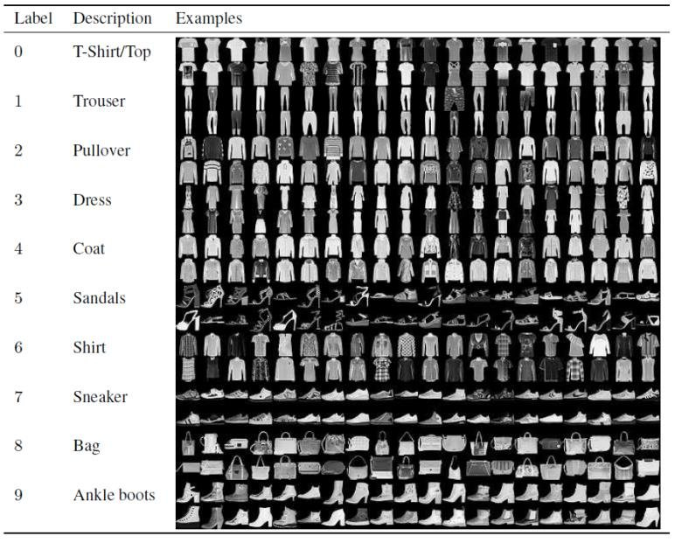

Slide 5
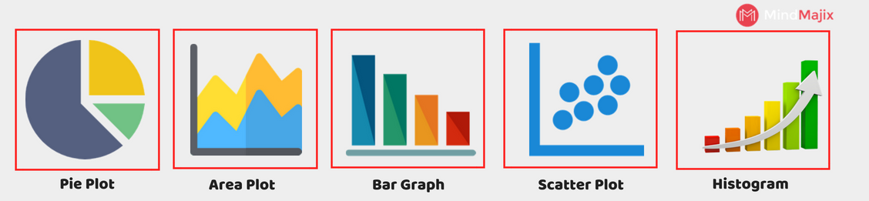
Matplotlib
Matplotlib is a Python 2D plotting library that produces high-quality charts and figures, which helps us visualize extensive data to understand better. Pandas is a handy and useful data-structure tool for analyzing large and complex data.And pyplot function makes some change to a figure: e.g., creates a figure, creates a plotting area in a figure, plots some lines in a plotting area, decorates the plot with labels, etc.

Slide 6
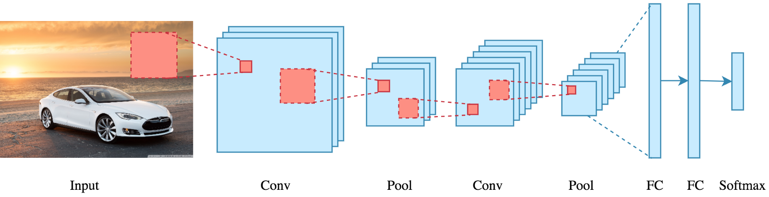
CONVOLUTIONAL NEURAL NETWORK
Convolutional Neural Networks or CNN is a type of deep neural networks that are efficient at extracting meaningful information from visual imagery.
The role of the CNN is to reduce the images into a form that is easier to process, without losing features that are critical for getting a good prediction.

Slide 7
Parameters in CNN
filters: Integer, the dimensionality of the output space (i.e. the number of output filters in the convolution).
kernel_size: An integer or tuple/list of 2 integers, specifying the height and width of the 2D convolution window. Can be a single integer to specify the same value for all spatial dimensions.
strides: The amount by which the filter shifts is the stride
padding: one of "valid" or "same" (case-insensitive). "valid" means no padding. "same" results in padding with zeros evenly to the left/right or up/down of the input such that output has the same height/width dimension as the input. Padding is simply a process of adding layers of zeros to our input images so as to avoid the problems
activation: Activation function to use. If you don't specify anything, no activation is applied

Slide 8
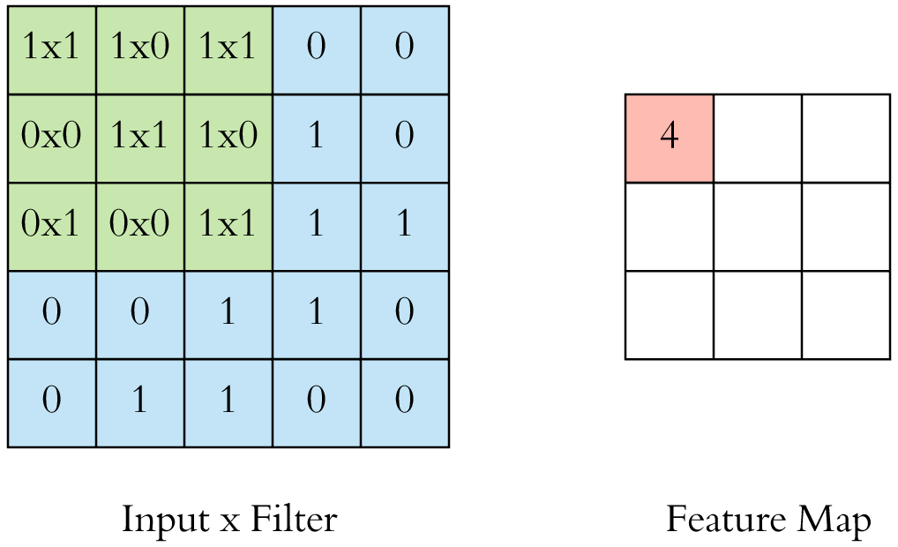
CNN layer working

Slide 10
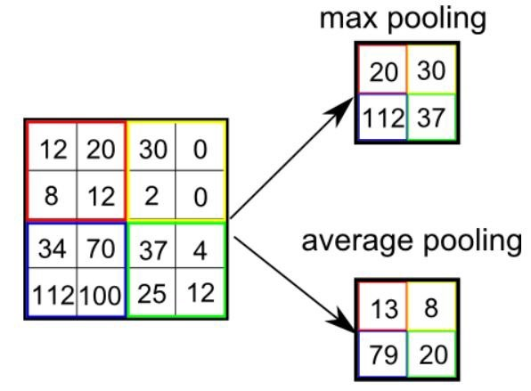
POOLING LAYER:
Similar to the Convolutional Layer, the Pooling layer is responsible for reducing the spatial size of the Convolved Feature.
This is to decrease the computational power required to process the data by reducing the dimensions.
There are two types of pooling average pooling and max pooling.

Slide 11
DENSE LAYER
The dense layer is a neural network layer that is connected deeply, which means each neuron in the dense layer receives input from all neurons of its previous layer. The dense layer is found to be the most commonly used layer in the models.
Keras Dense Layer Parameters
Let us see main parameters of dense layer function of Keras below –
1. Units
The most basic parameter of all the parameters, it uses positive integer as it value and represents the output size of the layer.
It is the unit parameter itself that plays a major role in the size of the weight matrix along with the bias vector.
2. Activation
The activation parameter is helpful in applying the element-wise activation function in a dense layer. By default, Linear Activation is used but we can alter and switch to any one of many options that Keras provides for this.

Slide 12
ACTIVATION FUCNTIONS – RELU, SOFTMAX
RELU :
The rectified linear activation function or ReLU for short is a piecewise linear function that will output the input directly if it is positive, otherwise, it will output zero. It has become the default activation function for many types of neural networks because a model that uses it is easier to train and often achieves better performance.
SOFTMAX:
The softmax function squashes the outputs of each unit to be between 0 and 1, just like a sigmoid function. But it also divides each output such that the total sum of the outputs is equal to 1 (check it on the figure above).
The output of the softmax function is equivalent to a categorical probability distribution, it tells you the probability that any of the classes are true.

Slide 13
STEPS INVOLVED
Import all the libraries ,packages
Load the data from tensorflow or keras
Split the data
Pre-process the data into the appropriate form
a) normalize
Start creating model
Add all the layers sequentially
Compile, train and validate
Predict and print the predicted labels with respective objects

Slide 14
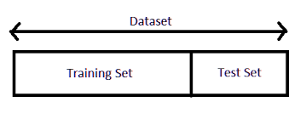
Importing dataset and splitting
LOADING DATASET
tf.keras.datasets.cifar10.load_data()
Or
keras.datasets.cifar10.load_data()
SPLITTING OF DATASET
Further the data is splitted into training and testing set based on size of the dataset .

Slide 15
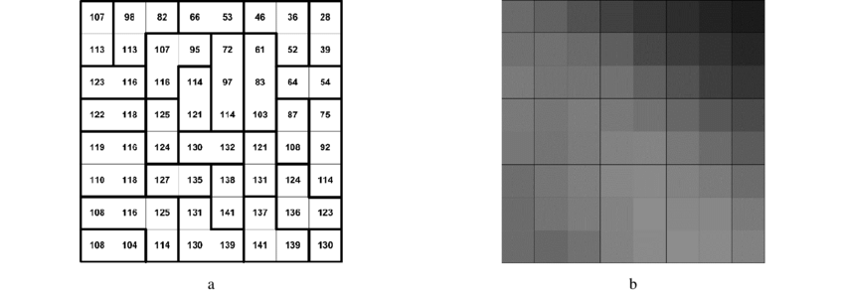
PRE-PROCESSING -NORMALIZATION
In image processing, normalization is a process that changes the range of pixel intensity values.
Normalization is an important step which ensures that each input parameter (pixel, in this case) has a similar data distribution. This makes convergence faster while training the network
Most probably the images are converted to gray scale as the pixels range will be
0-255 only

Slide 16
IMPORTING LAYERS and ADDING LAYERS
FROM KERAS
from keras.models import Sequential
from keras.layers import Dense, Dropout, Conv2D, MaxPool2D, Flatten
From tensorflow
from tensorflow.keras.models import Sequential
from tensorflow.keras.layers import Dense, Conv2D, Dropout, Flatten, MaxPooling2D
We add layer my using add () function in sequential order as we chose sequential model

Slide 17
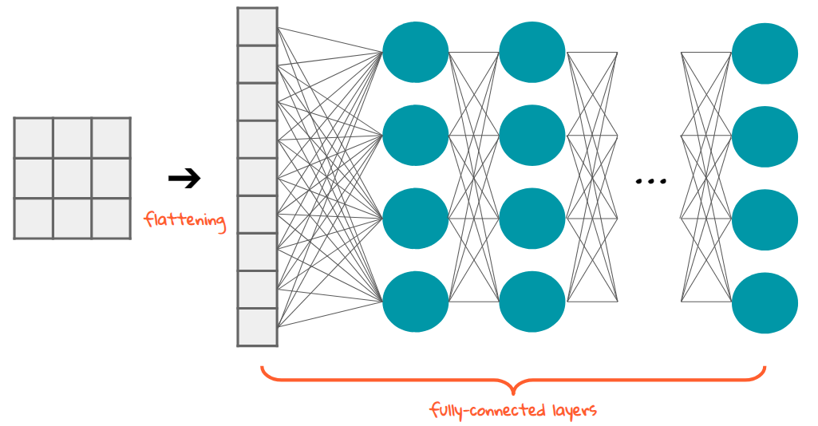
FLATTEN LAYER
Flattening is converting the data into a 1-dimensional array for inputting it to the next layer. We flatten the output of the convolutional layers to create a single long feature vector.
And it is connected to the final classification model, which is called a fully-connected layer

Slide 18
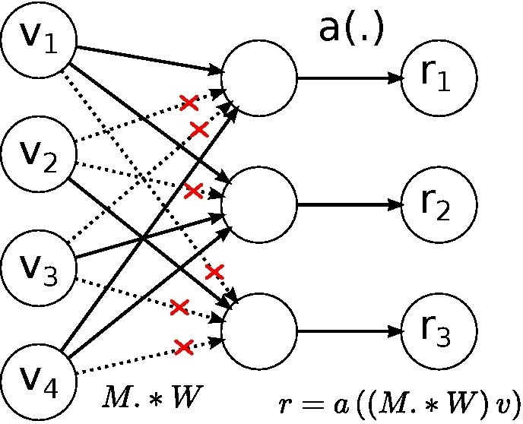
Dropout is a way to regularize the neural network. During training, it may happen that neurons of a particular layer may always become influenced only by the output of a particular neuron in the previous layer. In that case, the neural network would overfit. Dropout prevents overfitting and regularizes by randomly cutting the connections (also known as dropping the connection) between neurons in successive layers during training
Dropout

Slide 19
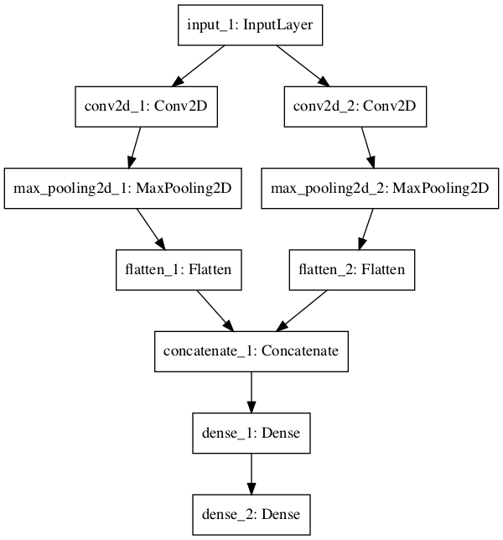

Slide 20
Compiling model
Compile defines the loss function, the optimizer and the metrics. It has nothing to do with the weights and you can compile a model as many times as you want without causing any problem to pretrained weights. You need a compiled model to train (because training uses the loss function and the optimizer
compile(
optimizer,
loss = None,
metrics = None,
loss_weights = None,
sample_weight_mode = None,
weighted_metrics = None,
target_tensors = None
)
The important arguments are as follows −loss function,Optimizer,metrics

Slide 21
LOSS :
The error for the current state of the model must be estimated repeatedly. This requires the choice of an error function, conventionally called a loss function, that can be used to estimate the loss of the model so that the weights can be updated to reduce the loss on the next evaluation.
METRICS :
Metrics is used to evaluate the performance of your model. It is similar to loss function, but not used in training process. Keras provides quite a few metrics as a module, metrics and they are as follows
accuracy
binary_accuracy
categorical_accuracy
sparse_categorical_accuracy
OPTIMIZER :
Optimization is an important process which optimize the input weights by comparing the prediction and the loss function. Keras provides quite a few optimizer as a module, optimizers .
Adam is the best optimizers. If one wants to train the neural network in less time and more efficiently than Adam is the optimizer.

Slide 22
from tensorflow.keras.models import Sequential
from tensorflow.keras.layers import Dense, Conv2D, Dropout, Flatten, MaxPooling2D
model = Sequential()
model.add(Conv2D(28, kernel_size=(3,3), input_shape=input_shape))
model.add(MaxPooling2D(pool_size=(2, 2)))
model.add(Flatten())
model.add(Dense(128, activation=tf.nn.relu))
model.add(Dropout(0.2)) model.add(Dense(10,activation=tf.nn.softmax))

Slide 23
TRAINING MODEL
model.fit(X_train, Y_train, batch_size=128, epochs=20,validation_data=(X_test, Y_test))
the batch size is a number of samples processed before the model is updated.
The number of epochs is the number of complete passes through the training dataset.
The size of a batch must be more than or equal to one and less than or equal to the number of samples in the training dataset.

Slide 24
EVALUATE , PREDICT
EVALUATE:
Evaluating the model requires that you first choose a holdout dataset used to evaluate the model. This should be data not used in the training process so that we can get an unbiased estimate of the performance of the model when making predictions on new data.
model.evaluate(X_test, Y_test)
PREDICT
Making a prediction is the final step in the life-cycle. It is why we wanted the model in the first place.
It requires you have new data for which a prediction is required, e.g. where you do not have the target values.
model.predict(X_test[100:105])

Slide 25
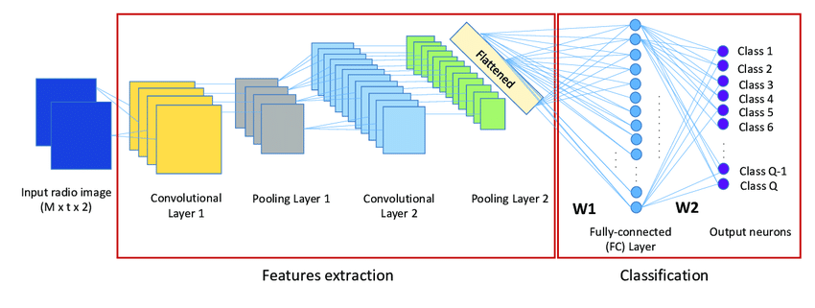
Input object

