Slide 1
Graphs

Slide 2
Introduction
A graph is a data structure that consists of a set of nodes (vertices) and a set of edges that connect the nodes to each other.
Formal Definition:
A graph G is a collection of two sets V and E represented as G(V, E) where,
V – Collection of vertices represented as V(G) = V_{0,} V_{1,} V_{2,} V₃ ……… V_{n-1}
E – Collection of edges represented as E(G) = E_{1,} E_{2,} E₃ ……… E_{n}
Each edge is a tuple (V_{x}, V_{y}), where V_{x}, V_{y} in V

Slide 3
Types of graph
Undirected Graph
Undirected graphs have edges that do not have a direction.
If there is any edge between Vx to Vy then it can be represented (V_{x}, V_{y} ) or (V_{y}, V_{x} )
Assume a graph G(V, E) where,
V(G) = {1,2,3,4,5}
E(G) = {(1,2), (1,3), (1,5), (2,5), (3,4), (4,5)}
1
2
4
3
5

Slide 4
Types of graph (Cont…)
2. Directed Graph
Directed graphs have edges with direction.
If there is any edge between Vx to Vy then it can be presented only (V_{x}, V_{y} )
Let assume a graph G(V, E) where,
V(G) = {1,2,3,4,5}
E(G) = {(1,2), (1,5),(2,1), (2,4), (3,1), (3,4), (5,4)}
1
2
4
3
5

Slide 5
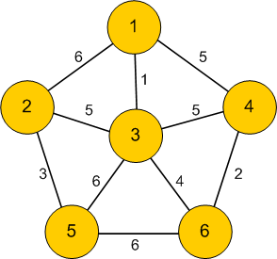
Graph Terminology
1. Weighted Graph: a graph in which each edge is given a numerical weight.
2. Adjacent nodes: Two vertices are called adjacent if they share a common edge.
Eg.
Nodes 4 and 6 are adjacent
Nodes 1 and 5 are not adjacent

Slide 6
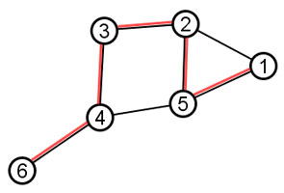
Graph Terminology (Contd…)
3. Path: A way to reach the destination node from an origin or source node by traversing edges in the graph.
For example, one path from node 6 to 1 is highlighted with red in below graph:
A path P is represented as ordered list of directed edges as follows :
P = ((v₁,v₂),(v₂,v₃),...,(v_{k},v_{k+1})).
The first vertex of the first edge of a path is the origin and the second vertex of the last edge is the destination.
4. Length of a path: the number of edges in a path.
e.g. the length of the red path in the above graph is 5.

Slide 7
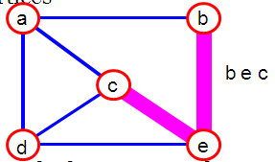
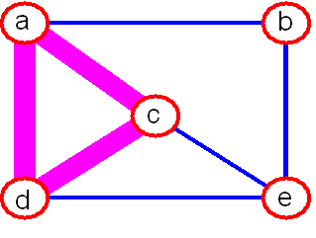
Graph Terminology (Contd…)
5. Simple path : A path that does not repeat the vertices.
6. Cycle : A path in which the source vertex is also the destination vertex of the path.
Fig: bec is a simple path
Fig: acda is a cycle

Slide 8
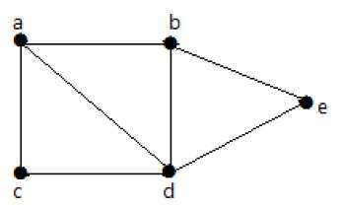
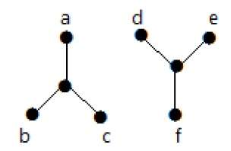
Graph Terminology (Contd…)
7. Connected graph: A graph is said to be connected if there is a path between every pair of vertex.
In a connected graph, from every vertex to any other vertex, there should be some path to traverse.
connected
not connected

Slide 9
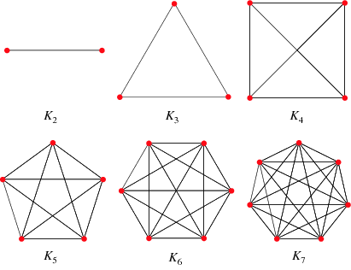
Complete Graph
8. Complete graph: A graph in which every pair of vertices is connected by an edge.
The complete graph with n vertices is denoted by Kn.

Slide 10
Representation of graph
Two ways to represent a graph in computer memory –
Adjacency matrix
Adjacency list

Slide 11
Adjacency matrix
Graph is represented using matrix (2D array)
Matrix keeps the information about the adjacent nodes for each node
If node is adjacent then put 1 at (i,j) location; otherwise put 0
i.e. Mat[i][j] = 1 if there is an edge from node i to j
= 0 if there is no edge from node i to j
If graph is weighted graph then adjacency matrix will contain following –
Mat[i][j] = weight on edge if there is an edge from node i to j
= 0 if there is no edge from node i to j

Slide 12
Adjacency matrix (cont…)
A B C D E
A
C
A B C D E
0 | 0 | 1 | 0 | 1
1 | 0 | 1 | 0 | 0
0 | 0 | 0 | 0 | 1
0 | 0 | 1 | 0 | 0
0 | 1 | 0 | 1 | 0
D
B
E
A
A B C D E
A B C D E
0 | 1 | 1 | 1 | 0
1 | 0 | 0 | 1 | 0
1 | 0 | 0 | 1 | 1
1 | 1 | 1 | 0 | 0
0 | 0 | 1 | 0 | 0
C
D
B
E

Slide 13
Adjacency matrix (cont…)
A B C D E
A
3
C
2
A B C D E
0 | 0 | 3 | 0 | 3
1 | 0 | 4 | 0 | 0
0 | 0 | 0 | 0 | 8
0 | 0 | 2 | 0 | 0
0 | 7 | 0 | 5 | 0
1
8
D
4
3
5
B
E
7
Memory required to store graph G(V,E) using adjacency matrix is
O(V²)

Slide 14
Adjacency List
Graph is represented using linked list
One adjacency list is used per vertex.
Adjacency list keeps the information about edges

Slide 15
Adjacency List (cont…)
A
E
C
A
C
D
B
A
C
B
E
E
C
struct Hnode{
int INFO;
struct Hnode *LINK;
struct Node *ALINK;
};
D
C
E
D
B
The adjacency list node structure –
struct Node{
int AINFO; // AINFO stores value of vertex
struct Node *Next;
};

Slide 16
Adjacency List (cont…)
A
E 3
C 3
A
3
C
2
D
B
A 1
C 4
1
8
4
3
5
B
E
E 8
7
C
D
C 2
E
D 5
B 7
If graph is weighted graph then adjacent list structure –
struct Node{
int AINFO; // AINFO stores value of vertex
int weight; // ‘weight’ stores weight of edge
struct Node *link;
} ;

Slide 17
Adjacency matrix Vs Adjacency List
Sr. | Adjacency matrix | Adjacency List
1 | Representation is easier to implement and follow. | Representation is difficult to implement and follow.
2 | More memory requirement; space required in worst case is O(|V|²) | Less memory requirement; overall space complexity is O(|V|+|E|)
3 | Even if the graph is sparse (contains less number of edges), it consumes the same space. | Memory usage depends on the number of edges (not number of nodes). Therefore, memory can be saved if the graph has less number of edges.
4 | Adding new node operation needs O(|V|²) time | Adding new node operation is efficient and require a constant time.
5 | To add an edge say from i to j, matrix[i][j] = 1 which requires O(1) time. | Adding a new edge is comparatively more time consuming process and takes O(|V|) time.
6 | Removing an edge takes O(1) time. | Removing an edge takes O(|V|+|E|) time.
7 | To determine whether there is an edge from vertex ‘u’ to vertex ‘v’ is efficient and can be done O(1). | To determine whether there is an edge from vertex ‘u’ to vertex ‘v’ is is slightly slower and can take up to O(|V|+|E|) time.

Slide 18
Operations on graph
Searching
Insertion
Deletion
Traversing
Sorting

Slide 19
Adjacency list structure
As mentioned earlier the structures of nodes and header nodes are –
struct Node{
int AINFO;
struct Node *Next;
};
struct Hnode{ // structure for header node
int INFO;
struct Hnode *LINK; // pointer to store address of next node in header list
struct Node *ALINK; // pointer to store address of first node in adjacency list
};
Hnode *Graph_start;

Slide 20
Searching
Node Searching –
Algorithm Node_search(Graph_start, Item): This algorithm finds the location of Item(vertex) in a Graph pointed by Graph_start. It returns the LOC (location of vertex) if vertex is found.
Hnode* LOC = NULL
Hnode *Temp
Temp = Graph_start
While Temp != NULL
If Temp->INFO = = Item
Set LOC = Temp
Return LOC
Temp = Temp->LINK
Return LOC
struct Hnode{
int INFO;
struct Hnode *LINK;
struct Node *ALINK;
};
Worst case time complexity= O(n)

Slide 21
Searching (Cont…)
Edge Searching –
Algorithm Edge_search(Graph_start, src, dst): This algorithm finds the location of destination (dst) vertext the adjacency list corresponding to source vertex of edge in Graph pointed by Graph_start. It returns the LOC (location of destination vertex) if vertex is found.
Struct Node* LOC = NULL
Struct Node* Atemp
Struct Hnode *LocSrc, *LocDst
LocSrc = Node_search(Graph_start, src)
LocDst = Node_search(Graph_start, dst)
If LocSrc == NULL OR LocDst == NULL
Print “Edge does not exist”
Retrun NULL
Else
ATemp = LocSrc ->ALINK
While Atemp!=NULL
If ATemp->AINFO = = dst
Set LOC = ATemp
Return LOC
ATemp = ATemp->NEXT
Return LOC
struct Node{
int AINFO;
struct Node *Next;
};
struct Hnode{
int INFO;
struct Hnode *LINK;
struct Node *ALINK;
};

Slide 22
Insertion
Node Insertion –
Algorithm Insert_Node(Graph_start, Item): This algorithm inserts the new node Item in graph. The node will be inserted at the beginning of the of the header list (vertically downward linked list).
Struct Hnode *New_node
New_node = Allocate memory
New_node ->INFO = Item
New_node ->ALINK = NULL
New_node ->LINK= Graph_start
Graph_start= New_node
struct Hnode{
int INFO;
struct Hnode *LINK;
struct Node *ALINK;
};
Worst case time complexity : O(1)

Slide 23
Edge Insertion
Algorithm Insert_Edge(Graph_start, src, dst): This algorithm inserts an edge in the graph. src is source vertex and dst is destination vertex. Insertion will be done as new node in the beginning on the adjacency list corresponding the source vertex of the edge.
Struct Hnode *LocSrc, *LocDst
struct Node *New_node
New_node = Allocate memory
New_node ->AINFO = dst
LocSrc = Node_search(Graph_start, src)
LocDst = Node_search(Graph_start, dst)
If LocSrc == NULL OR LocDst == NULL
Exit
New_node->Next= LocSrc->ALINK
LocSrc->ALINK=New_node
struct Node{
int AINFO;
struct Node *Next;
};
struct Hnode{
int INFO;
struct Hnode *LINK;
struct Node *ALINK;
};
Time complexity : O(V)

Slide 24
Deletion
Algorithm Delete_Edge(Graph_start, src, dst): This algorithm deletes an edge from directed graph. src is source and dst is destination vertex.
Struct Hnode *LocSrc, *LocDst
Struct Node *Temp, *Temp1
Set Flag = 0
LocSrc= Node_search(Graph_start, src)
LocDst= Node_search(Graph_start, dst)
If LocSrc == NULL or LocDst == NULL
Exit
Temp = LocSrc ->ALINK
If Temp==NULL // Empty adjacency list
Exit
If Temp-> AINFO == dst // dst found as first node in adjacency list
LocSrc->ALINK = Temp->NEXT
Flag=1
Else
Temp1 = Temp
Temp = Temp->NEXT

Slide 25
While Temp != NULL
If Temp-> AINFO == dst
Temp1->NEXT = Temp->NEXT
Set Flag = 1
Go to Step 24
Temp1 = Temp
Temp= Temp->NEXT
If Flag == 0
Display “No Edge”
Exit
Free Temp

Slide 26
Deletion (Cont…)
Algorithm Delete_Node(Graph_start, Item): This algorithm deletes a node and edges connected with this node from directed graph. Item is a vertex to be deleted.
Struct Hnode *LocNode, *Temp1, *Temp2, *Temp3
Struct Node *Current
LocNode= Node_search(Graph_start, Item)
If LocNode == NULL // node does not exist
Exit
Current = LocNode ->ALINK
While Current!=NULL // delete complete list corresponding to given vertex
Delete_Edge(Graph_start, Item, Current ->AINFO)
Current = LocNode ->ALINK
Temp3 = Graph_start
While Temp3!=NULL // delete all the edges incident on given vertex
Delete_Edge(Graph_start, Temp3->INFO, Item)
Temp3=Temp3->LINK
Temp1= Graph_start
If Graph_start == LocNode // given vertex is start vertex
Graph_start = Graph_start >LINK
Else
Temp2=Temp1
Temp1=Temp1->LINK

Slide 27
While Temp1!= NULL
If Temp1-> INFO == Item
Temp2->LINK = Temp1->LINK
go to step 26
Temp2 = Temp1
Temp1= Temp1->LINK
Free Temp1

Slide 28
Graph Traversal
Visiting and processing of each node once
Two ways - (for directed and undirected graph)
1. Breadth first search (BFS)
2. Depth first search (DFS)
Both of these algorithms are efficient to visit each node exactly once
Traversal algorithms start at some vertex.
Which vertex?
Generally, graphs don’t have any starting vertex.
So we can start from any vertex

Slide 29
Breadth First Search (BFS)
In BFS after visiting a vertex v (say), we must visit all its adjacent vertices
w1, w2, w3, ..., before going down next level to visit vertices adjacent to w1
etc.
The method can be implemented using a queue data structure.
Algorithm BFS(Graph)
Enqueue the starting vertex // take any vertex as start
while(queue is not empty)
Dequeue a vertex v from the queue
Visit v and add v to visited list (BFS order)
Enqueue all the adjacent vertices of v that were not Enqueued earlier.
Note:
Adjacent vertices can be enqueued in any order but to obtain a unique
traversal, we will enqueue them in alphabetical order.

Slide 30
BFS: Start with Node 5; Enqueue 5
5
2
0
1
3
7
4
6
Queue
5
Visited list (BFS order)

Slide 31
BFS: Visit 5 and enqueue 1 and 2
5
2
0
1
3
7
4
6
Queue
1 2
Visited list (BFS order)
5

Slide 32
BFS: Visit 1 and enqueue 0 and 4
5
2
0
1
3
7
4
6
Queue
2 0 4
Visited list (BFS order)
5 1

Slide 33
BFS: Visit 2 (enqueue nothing)
5
2
0
1
3
7
4
6
Queue
0 4
Visited list (BFS order)
5 1 2

Slide 34
BFS: Visit 0 and enqueue 3 and 7
5
2
0
1
3
7
4
6
Queue
4 3 7
Visited list (BFS order)
5 1 2 0

Slide 35
BFS: Visit 4 (enqueue nothing)
5
2
0
1
3
7
4
6
Queue
3 7
Visited list (BFS order)
5 1 2 0 4

Slide 36
BFS: Visit 3 (enqueue nothing)
5
2
0
1
3
7
4
6
Queue
7
Visited list (BFS order)
5 1 2 0 4 3

Slide 37
BFS: Visit 7 and enqueue 6
5
2
0
1
3
7
4
6
Queue
6
Visited list (BFS order)
5 1 2 0 4 3 7

Slide 38
BFS: Visit 6 (enqueue nothing)
5
2
0
1
3
7
4
6
Queue
Empty
Visited list (BFS order)
5 1 2 0 4 3 7 6

Slide 39
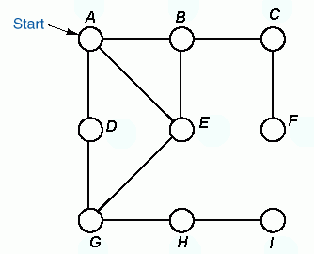

Example of BFS
BFS-tree:
Order of
Traversal
A B D E C G F H I

Slide 40
Complexity analysis of BFS
For a Graph G=(V, E) and n = |V| and m=|E|
When Adjacency List is used
Complexity is O(m + n)
When Adjacency Matrix is used
Complexity is O(n²)

Slide 41
Depth First Search (DFS)
In DFS after visiting a starting vertex v (say), neighbour w of v is visited , then
neighbour x of w is visited that has not been visited before and so on.
When it gets stuck, the DFS backtracks until it finds the first vertex that still has a
neighbour that has not been visited before. It continues with this neighbour until it
has to backtrack again. Eventually, it will visit all vertices reachable from v.
Must keep track of vertices already visited to avoid cycles.
The method can be implemented using stack data structure.
Algorithm DFS(Graph)
Push the starting vertex in the empty stack
while(stack is not empty)
Pop a vertex from the stack, call it v
if v is not already visited, visit it and add v to visited list (DFS order)
Push all the vertices adjacent to v that are not visited earlier.
Note:
Adjacent vertices can be pushed in any order but to obtain a unique traversal, we will push them in reverse alphabetical order.

Slide 42
DFS: Start with Node 5
5
5
2
0
1
3
7
4
6
Push 5

Slide 43
DFS: Visit 5 and push 2 and 1
1
2
5
2
0
1
3
7
4
6
Push 2, Push 1
Visited list (DFS order)
5

Slide 44
DFS: Visit 1 and push 4, 2, 0
0
2
4
2
5
2
0
1
3
7
4
6
Push 4, Push 2, Push 0
Visited list (DFS order)
5 1

Slide 45
DFS: Visit 0 and push 7, 3
3
7
2
4
2
5
2
0
1
3
7
4
6
Push 7, Push 3
Visited list (DFS order)
5 1 0

Slide 46
DFS: Visit 3 and push 2
2
7
2
4
2
5
2
0
1
3
7
4
6
Push 2
Visited list (DFS order)
5 1 0 3

Slide 47
DFS: Visit 2 (push nothing)
7
2
4
2
5
2
0
1
3
7
4
6
Visited list (DFS order)
5 1 0 3 2

Slide 48
DFS: Visit 7 and push 6
6
2
4
2
5
2
0
1
3
7
4
6
Push 6
Visited list (DFS order)
5 1 0 3 2 7

Slide 49
DFS: Visit 6 (push nothing)
2
4
2
5
2
0
1
3
7
4
6
Visited list (DFS order)
5 1 0 3 2 7 6

Slide 50
DFS: Pop 2 (don’t visit)
4
2
5
2
0
1
3
7
4
6
Pop 2 (don’t visit)
Visited list (DFS order)
5 1 0 3 2 7 6

Slide 51
DFS: Visit 4 (push nothing)
2
5
2
0
1
3
7
4
6
Visited list (DFS order)
5 1 0 3 2 7 6 4

Slide 52
DFS: Pop 2 (don’t visit)
Empty
5
2
0
1
3
7
4
6
Visited list (DFS order)
5 1 0 3 2 7 6 4

Slide 53
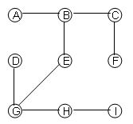
Example of DFS
DFS Tree:
Order of
Traversal
A B C F E G D H I

Slide 54
Important Points –
The BFS and DFS traversal of a graph G is not unique. A traversal depends both on the starting vertex, and on the order of traversing the adjacent vertices of each node.
In an undirected graph, starting from any vertex, we can not visit all vertices if the traversed graph is disconnected.
In a directed graph, starting from a particular vertex, we may not visit all vertices if the traversed graph is weakly connected

