Slide 1
RPR-Net: A Point Cloud-based Rotation-aware
Large Scale Place Recognition Network
Zhaoxin Fan, Zhenbo Song, Wenping Zhang， Hongyan Liu, Jun He, and Xiaoyong Du

Slide 2
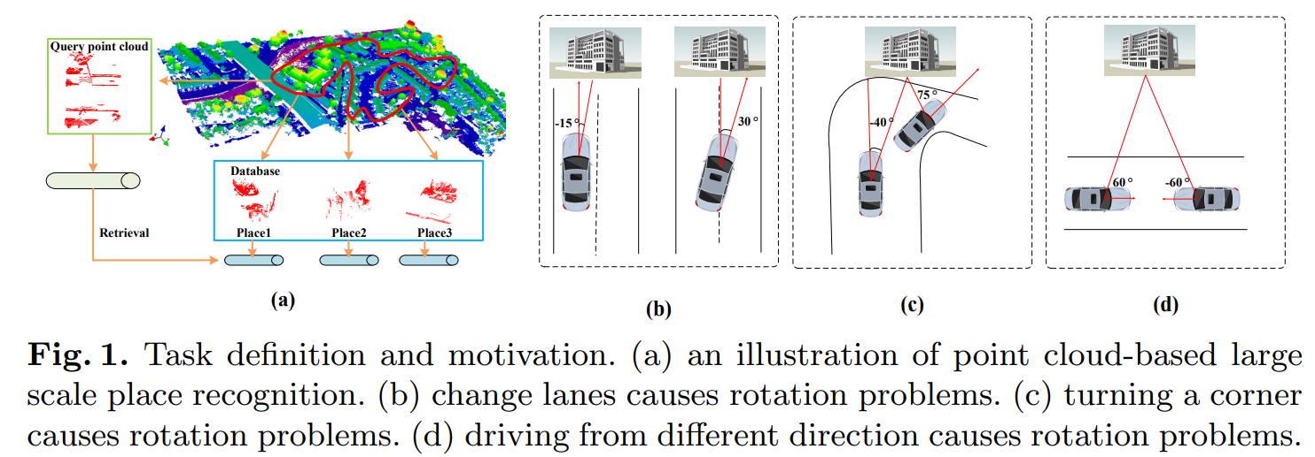
Motivation
Catastrophic collapse caused by rotation should be solved

Slide 3
Contribution
A novel model named RPR-Net, the first strictly rotation-invariance dense network designed for point cloud-based large scale place recognition.
An Attentive Rotation-Invariant Convolution operation, which learns rotation-invariant by mapping low-level rotation-invariant features into attended convolutional kernels.

Slide 4
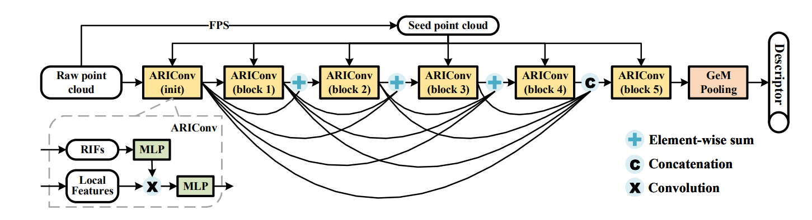
Network Structure

Slide 5
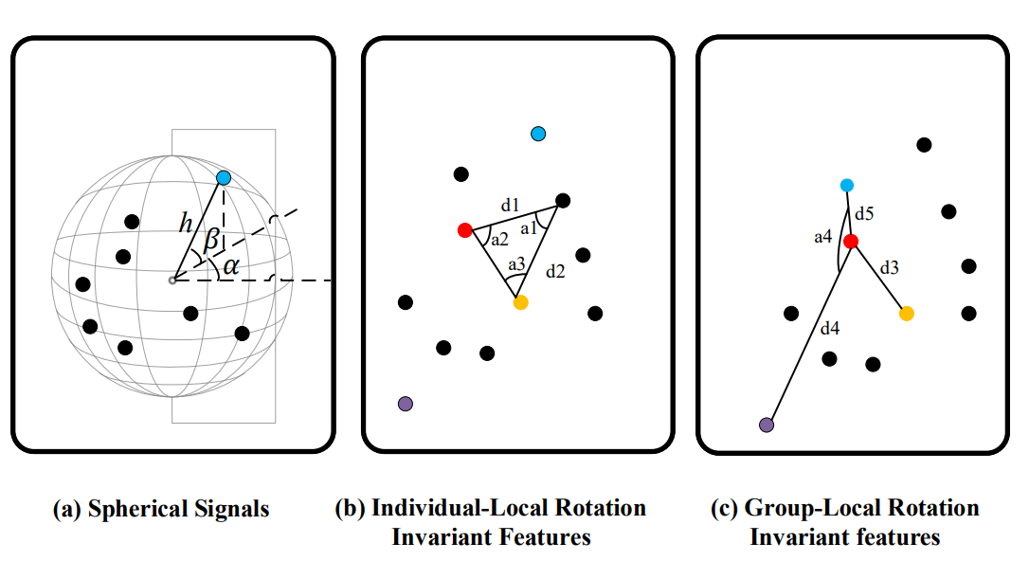
Rotation-Invariant Features

Slide 6
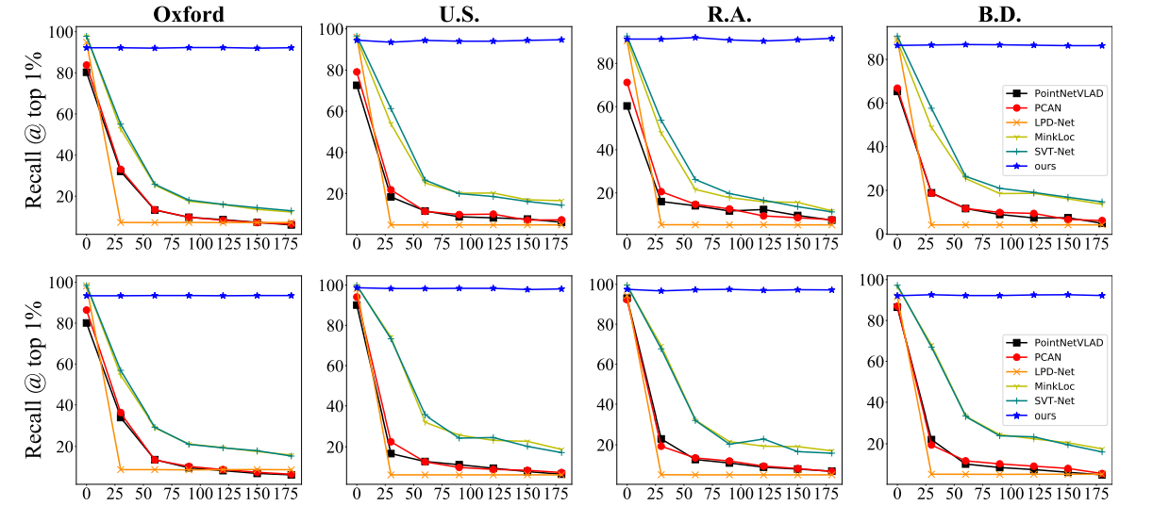
Results

Slide 7
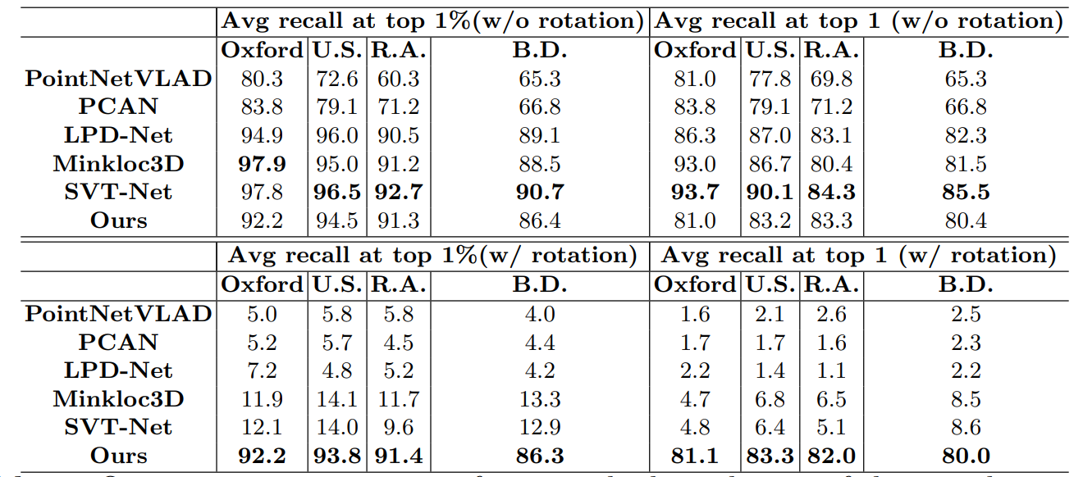
Results

Slide 8
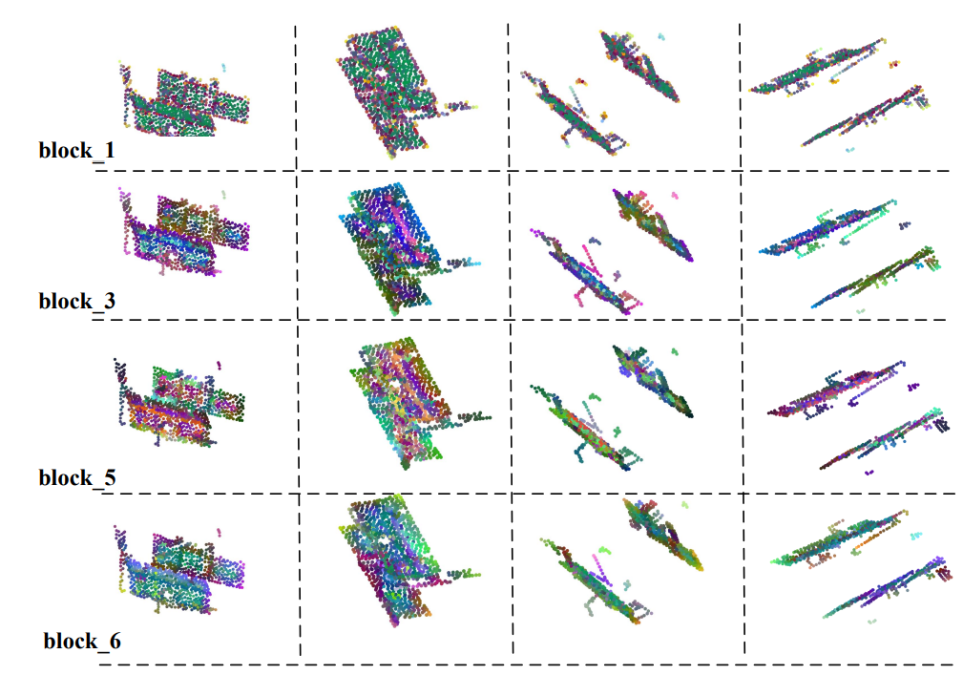
Results

Slide 9
Conclusion
Rotation-aware Large Scale Place Recognition Network (RPR-Net)
Rotation-Invariant Features (RIFs)
Attentive Rotation-Invariant Convolution

Slide 10
Thanks for your interest!!!

