Slide 1
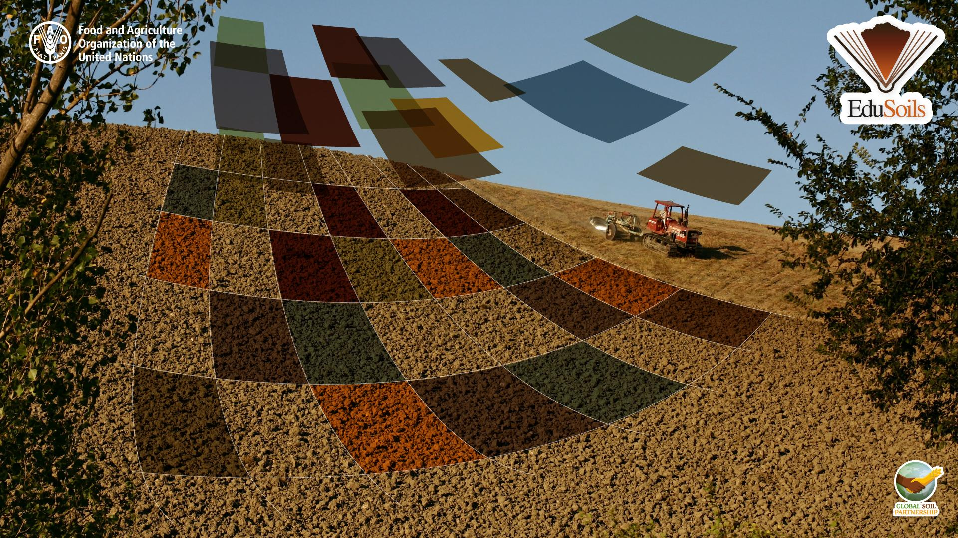



Digital Soil Mapping in R Video 2 – Software & Training Data Set

Slide 2
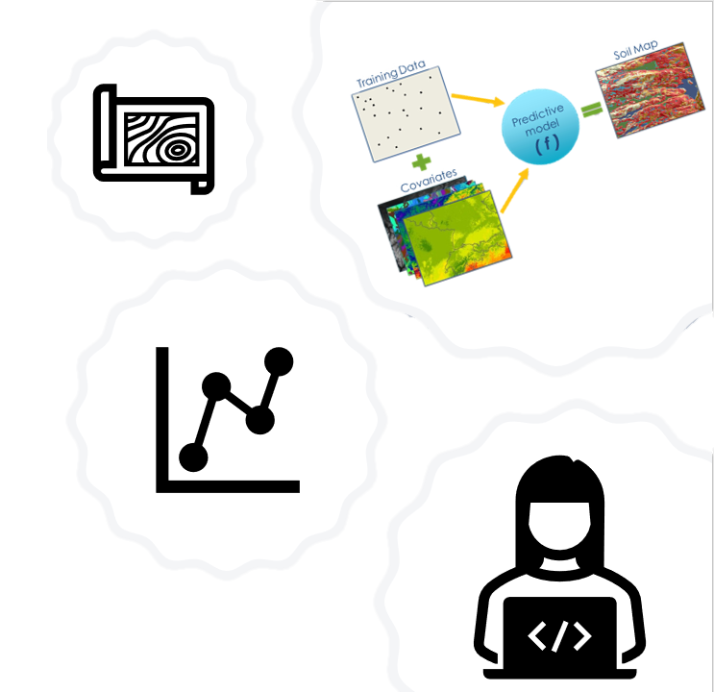

Video Content
The training material
The folder structure
How to install R, RStudio and QGIS

Slide 3
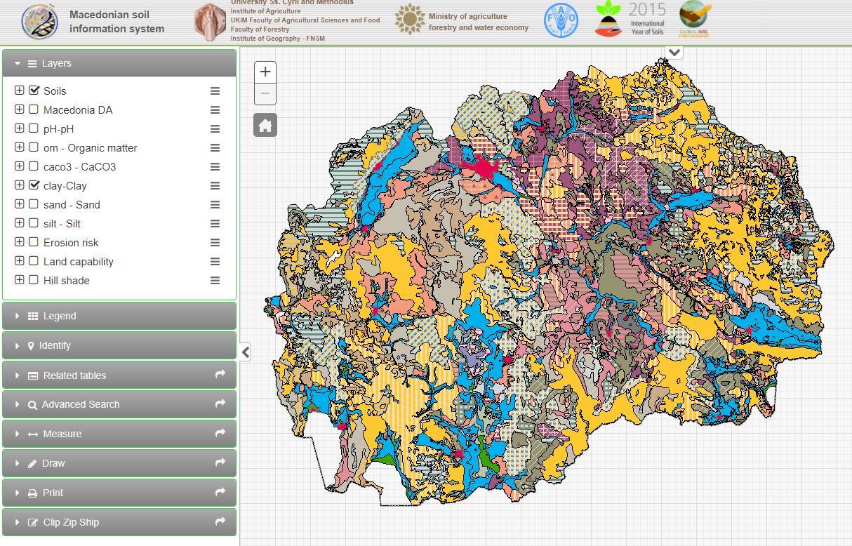
The training material
R scripts used in this course
A practice data set from the Macedonian Soil Information System (MASIS)
Pre-prepared spatial covariates
A pdf version of the GSOCmap Cookbook
http://www.maksoil.ukim.mk/masis/index.html?lang=en&

Slide 4
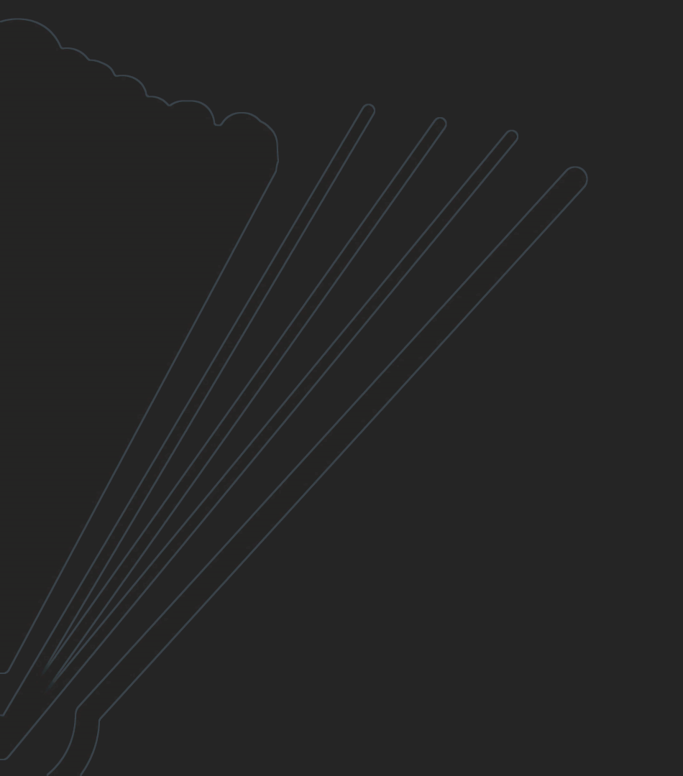
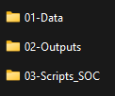
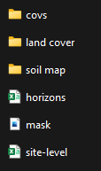
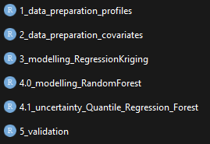
The folder structure

Slide 5

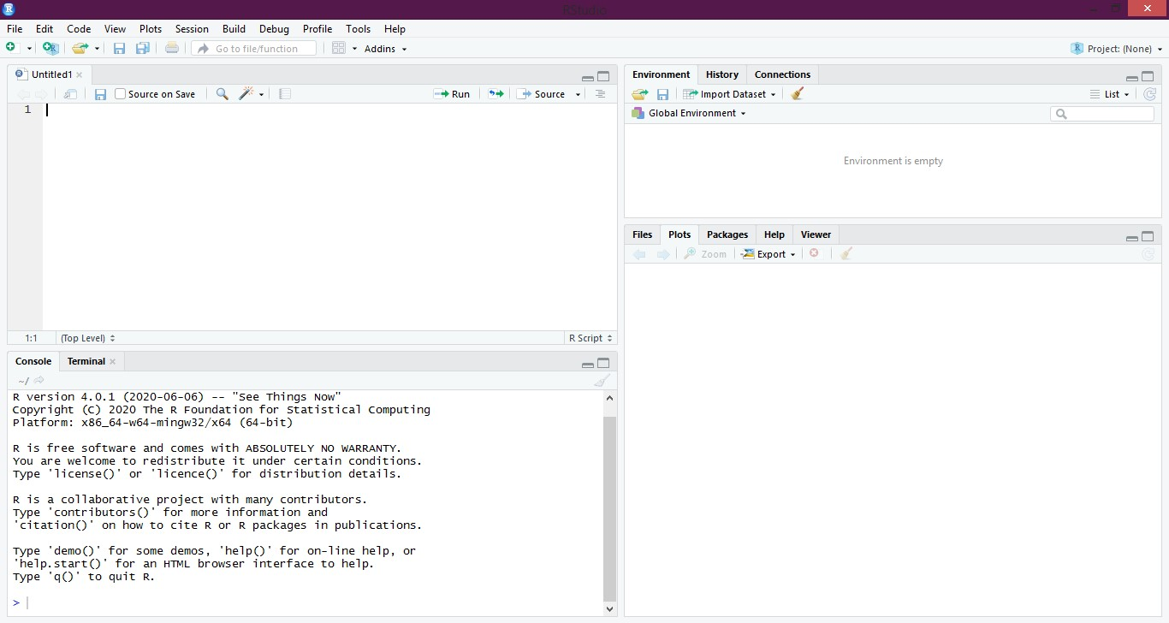
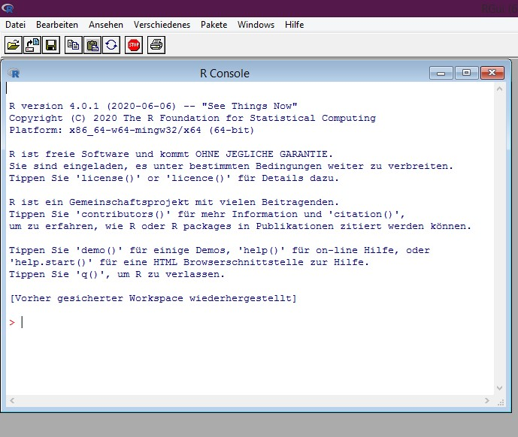
How to install R, RStudio and QGIS
R and R studio are two different entities
R is the general interface, while R Studio is a Graphical User Interface (GUI) that sits on top of R
In order to work with RStudio we first have to install R Base.
2) R studio - Graphical User Interface:
1) R Console - general interface:

Slide 6
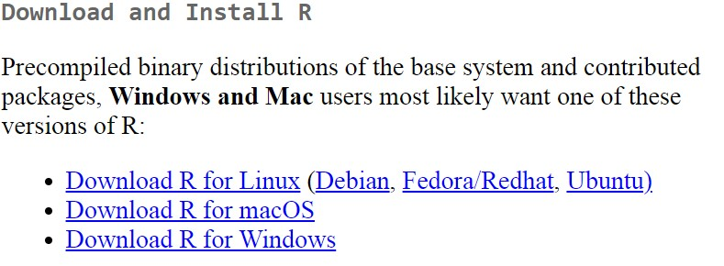
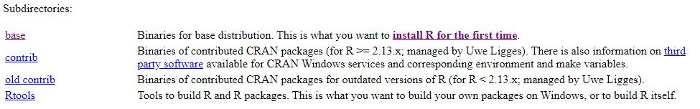
How to install R, RStudio and QGIS
Installation guide:
Step 1: go to https://cran.r-project.org/
Step 2: Select and download the correct version based on your operating system…
… and select “base”
Step 3: launch the .exe file to run the installation process
Step 4: Select “English” as the installation language, you can always change it afterwards :)

Slide 7
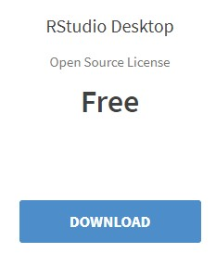
How to install R, RStudio and QGIS
Step 5: Select the bit rate of your system (either 32-bit or 64-bit). Check the computer’s properties to see which one applies to yours.
Step 6: Select “NO(accept defaults)” for the Startup options
RStudio
Step 7: After having successfully installed R base, go to
https://www.rstudio.com/products/rstudio/download/ to download and install RStudio Desktop
Step 8: Install based on the operating system and run the .exe file

Slide 8
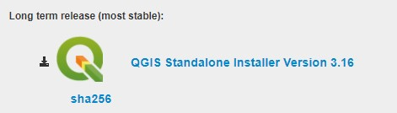
How to install R, RStudio and QGIS
QGIS
Step 1: go to https://www.qgis.org/en/site/forusers/download.html
Step 2: Select the QGIS Long term release Standalone Installer Version based on your bit rate (either 32-bit or 64-bit)
Step 3: Download and run the .exe file in order to install QGIS
Step 4: Follow the installation instructions

Slide 9


