Slide 1

Conditional Latin Hypercube Sampling
An Introduction to the cLHS Methodology
Luis Rodriguez Lado - GSP

Slide 2
Sampling approaches
Model-based
Non-probabilistic
The sample distribution is optimised to make a statistical model more accurate
Assumes that the covariates represent the variability of our target soil property
It is useful for mapping the most probable values
Most common method: cHLS, geostatistics
Design-based
Probability sampling
The sample distribution is based on random distribution
Strata can represent the variability of the landscape
Useful for estimating parameters of the population (mean SOC of an area) or for validating an existing map.
Most common method: Stratified Simple Random Sampling

Slide 3
Agenda
What is Latin Hypercube Sampling?
Conditional Latin Hypercube Sampling (cLHS)
Advantages and Limitations of cLHS
Case Studies
Contents in the exercise
Acknowledgements
References

Slide 4
What is Latin Hypercube Sampling?
LHS (Latin Hypercube Sampling):
Latin Hypercube Sampling (LHS) is a statistical sampling technique that divides the sample space into equally probable regions or strata and performs a stratified random sampling at each stratum ensuring that each stratum is represented by exactly one sample, minimizing bias in the sampling process.
It is used to efficiently explore the parameter space of system while ensuring a diverse and representative set of samples for statistical analysis.
LHS does not take constraints into account. It is primarily used for exploring the entire parameter space or conducting sensitivity analyses without regard to specific constraints.

Slide 5
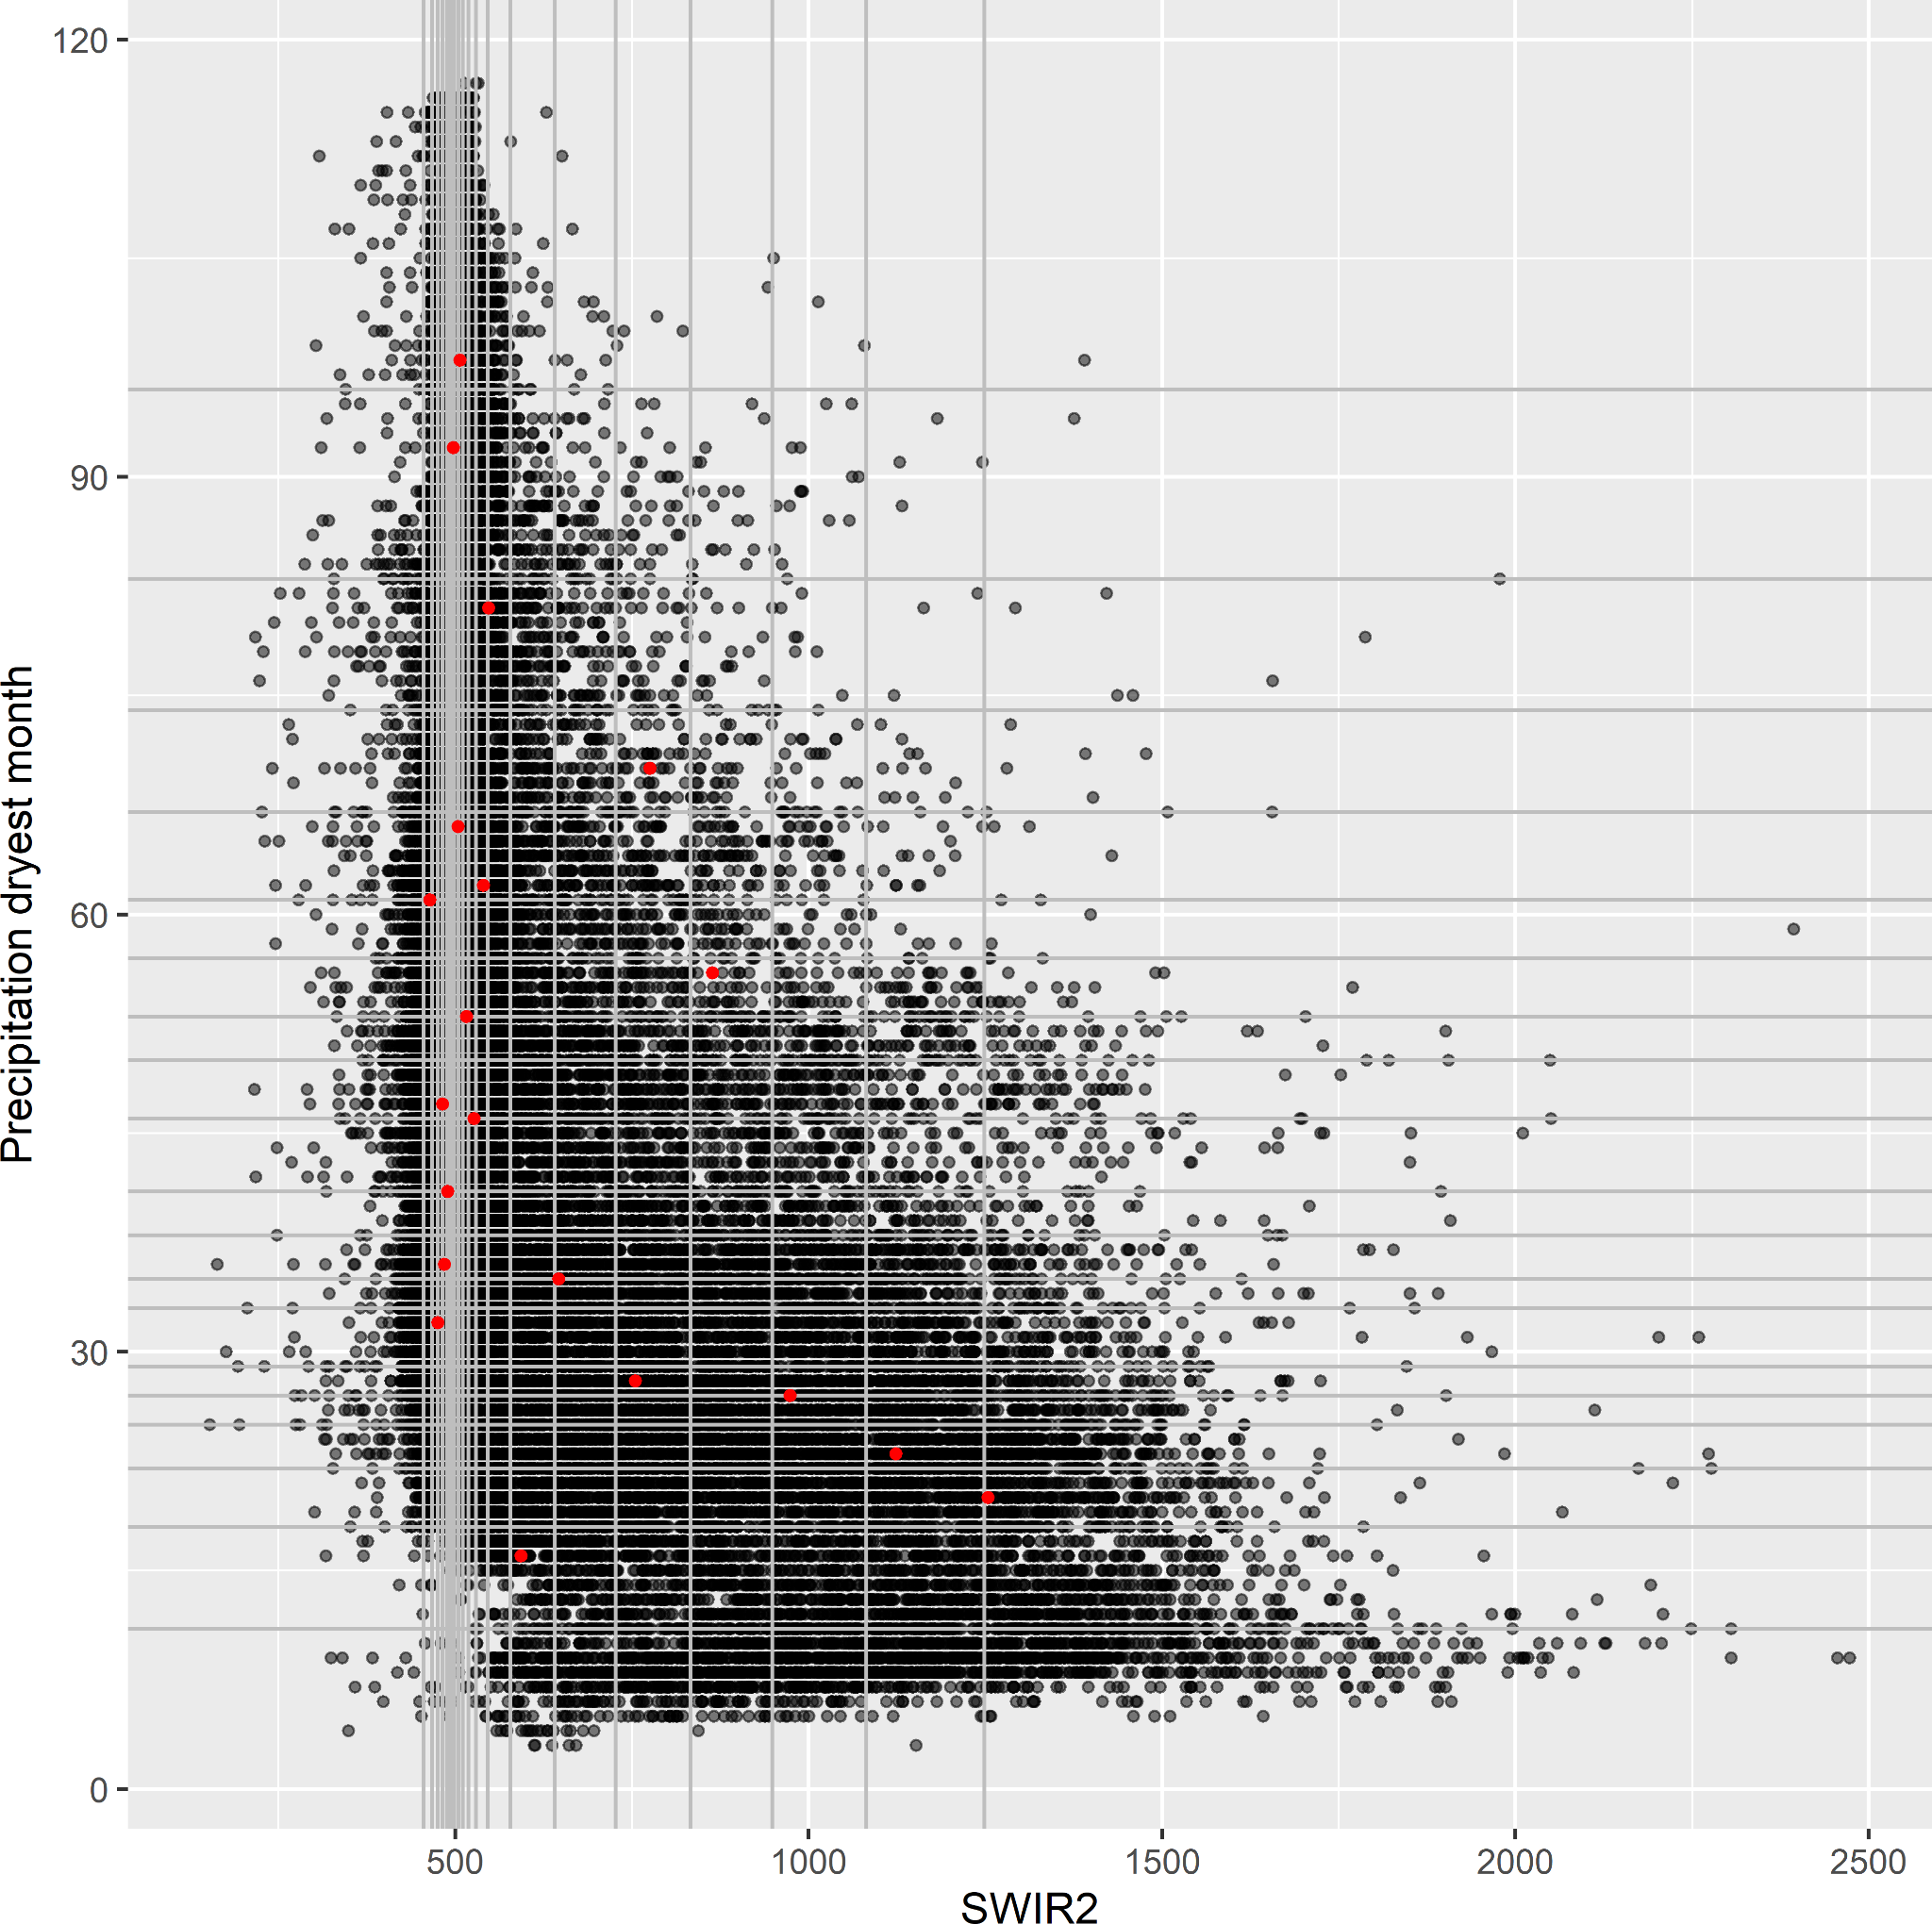
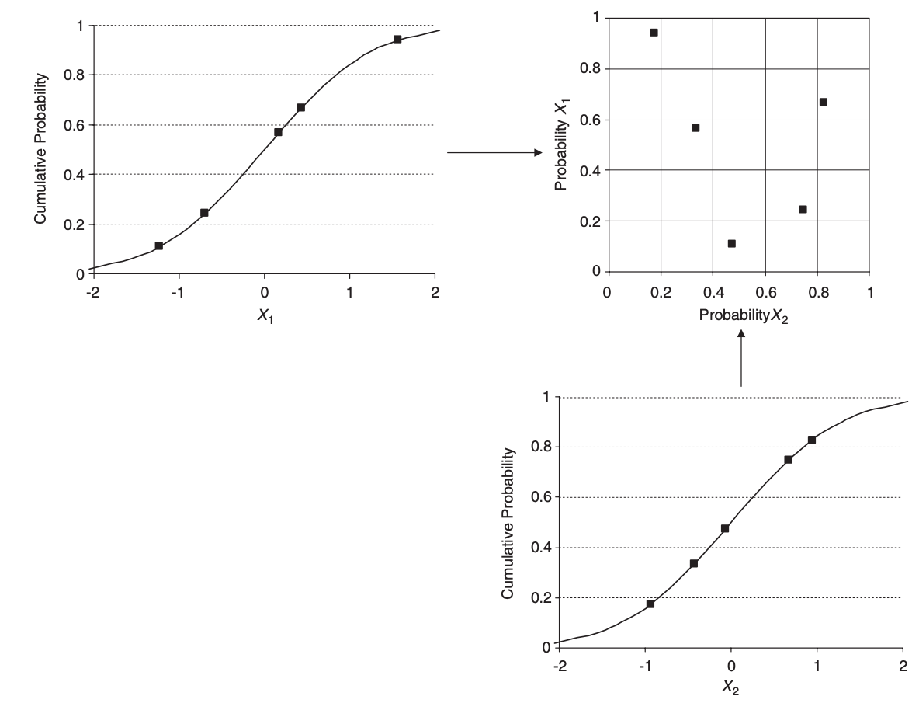
What is Latin Hypercube Sampling?
Minasny & McBratney, 2006
Brus, 2022

Slide 6
What is conditional Latin Hypercube Sampling?
cLHS (Conditional Latin Hypercube Sampling):
Is an extension of Latin Hypercube Sampling (LHS) which:
Incorporates Constraints: cLHS is designed to handle situations where constraints or conditions are present in the parameter space.
Satisfying Constraints: It focuses on exploring and sampling within the regions of the parameter space that meet the defined conditions.
Applications: cLHS is especially useful in scenarios where it's crucial to consider constraints, such as accessibility limitations in real-world field work.

Slide 7
Conditional Latin Hypercube Sampling (cLHS)
Incorporation of constraints into the sampling process.
Constraints could represent physical limits, travel constraints, risk areas or environmental regulations.
Initially, cLHS performs a Latin Hypercube Sampling (LHS) without considering any constraints.
cLHS applies a filtering process. It evaluates each sample to check whether it satisfies the defined constraints. Samples that meet the constraints are retained, while those that do not are discarded.
If a number of initial samples do not meet the constraints, cLHS continues generating new samples using LHS and filtering them until a sufficient number of valid samples meeting the constraints are obtained.
cLHS aims to strike a balance between satisfying the constraints and maintaining the diversity of the sample distribution. It ensures that the resulting samples are not clustered in a limited region of the sample space but are spread out effectively while adhering to the constraints.
The final output of cLHS is a set of samples that are not only representative of the overall distribution but also satisfy the specified conditions or constraints. These samples can then be used for further analysis, modeling, or simulations with the assurance that they meet the desired criteria.

Slide 8
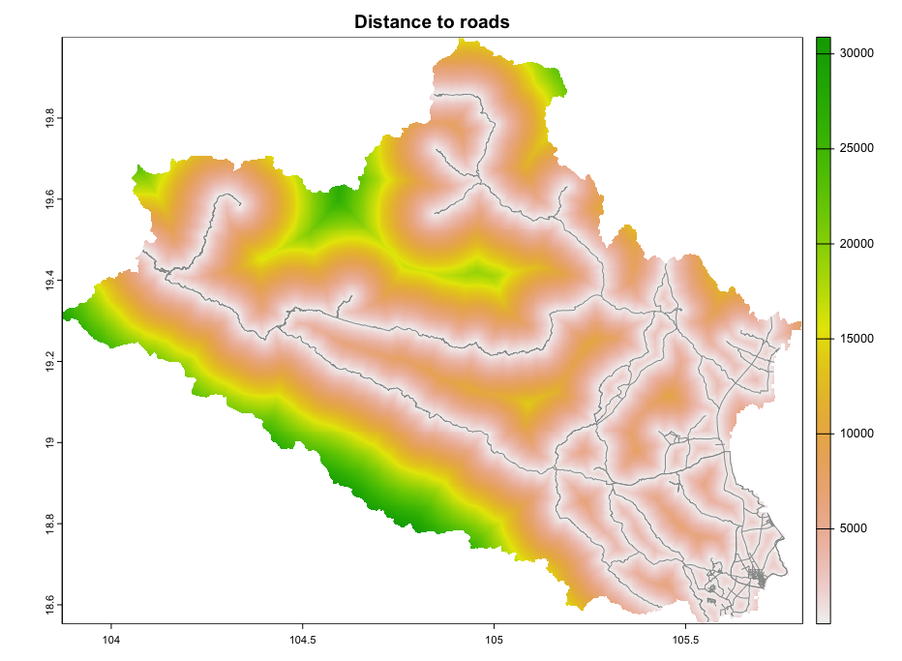
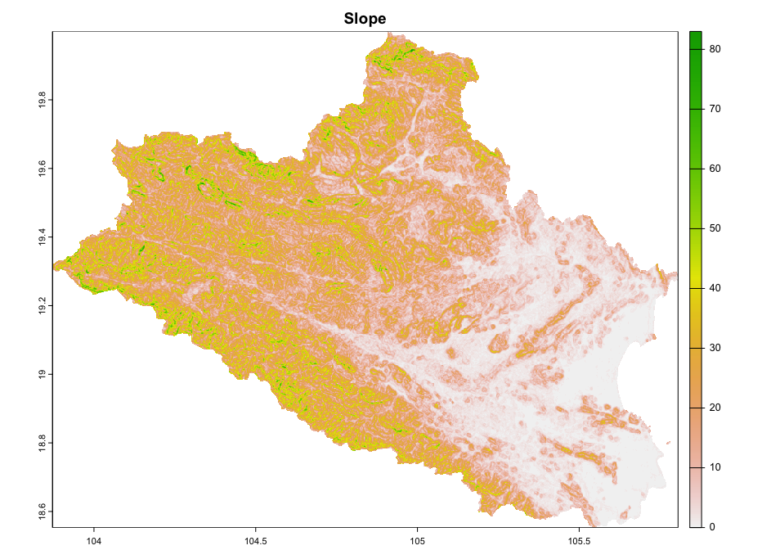
Conditional Latin Hypercube Sampling (cLHS)
Examples of constraints.

Slide 9
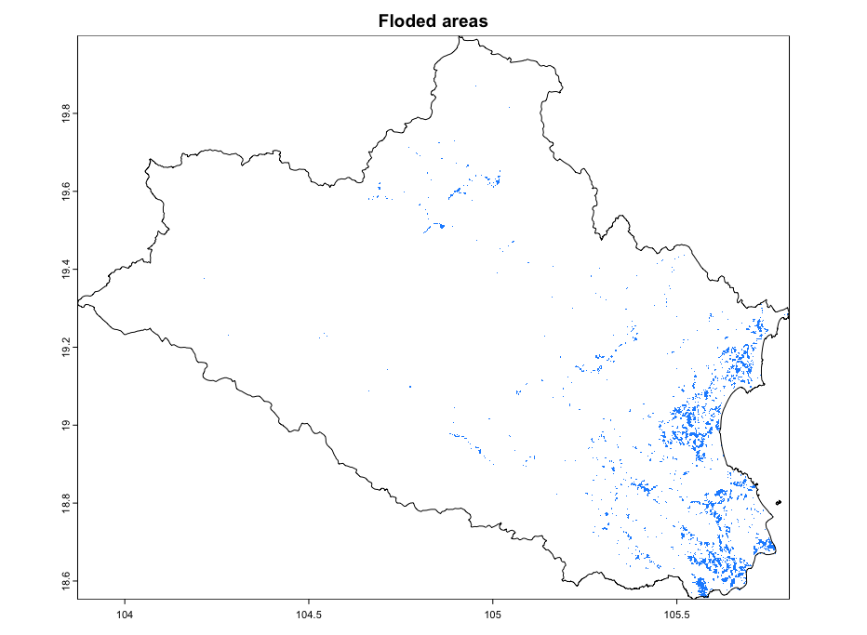
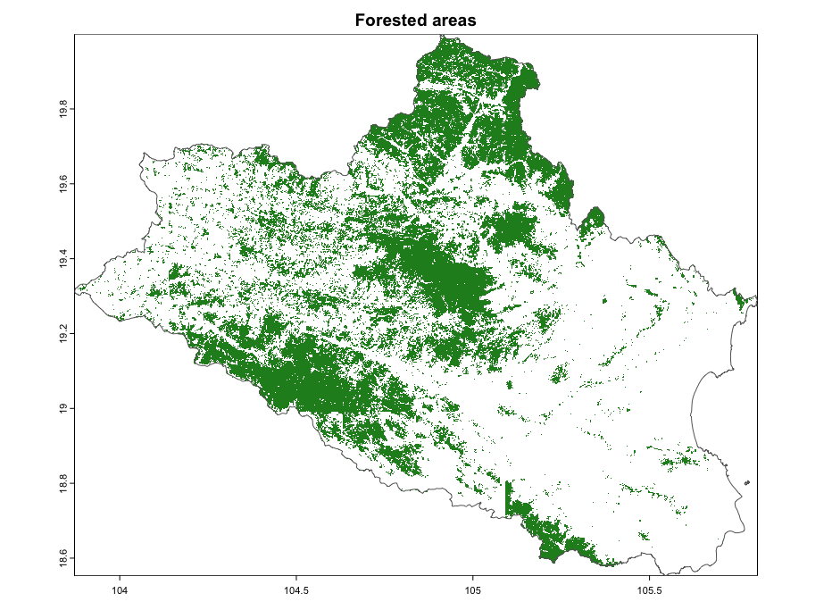
Conditional Latin Hypercube Sampling (cLHS)
Examples of constraints.

Slide 10
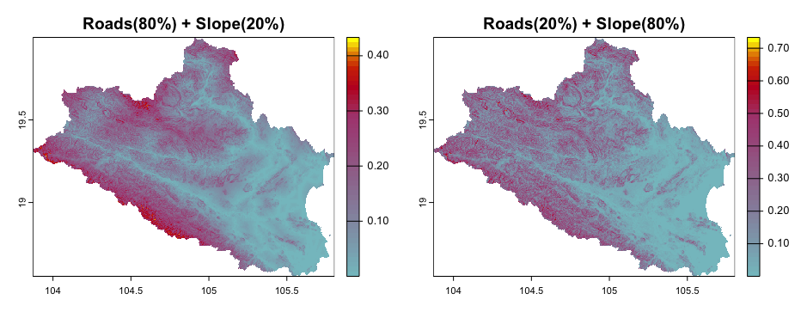
Conditional Latin Hypercube Sampling (cLHS)
Examples of constraints.
Anisotropic accumulated cost

Slide 11
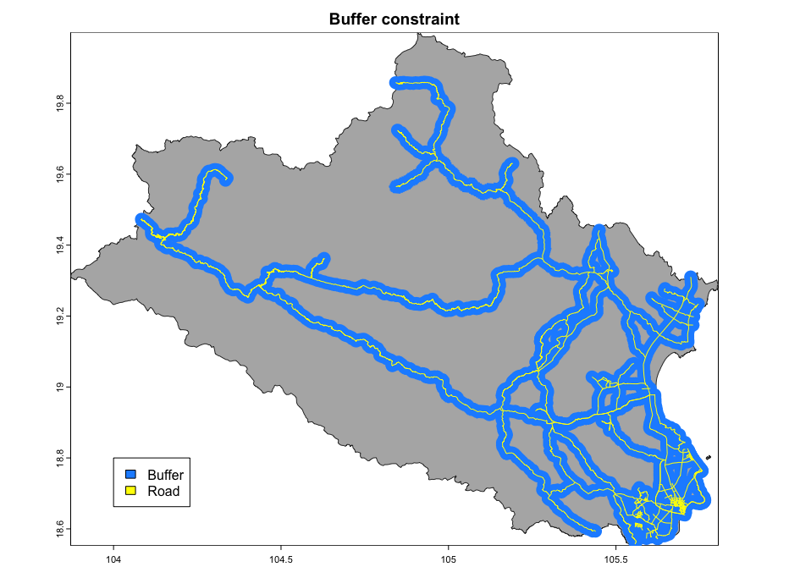
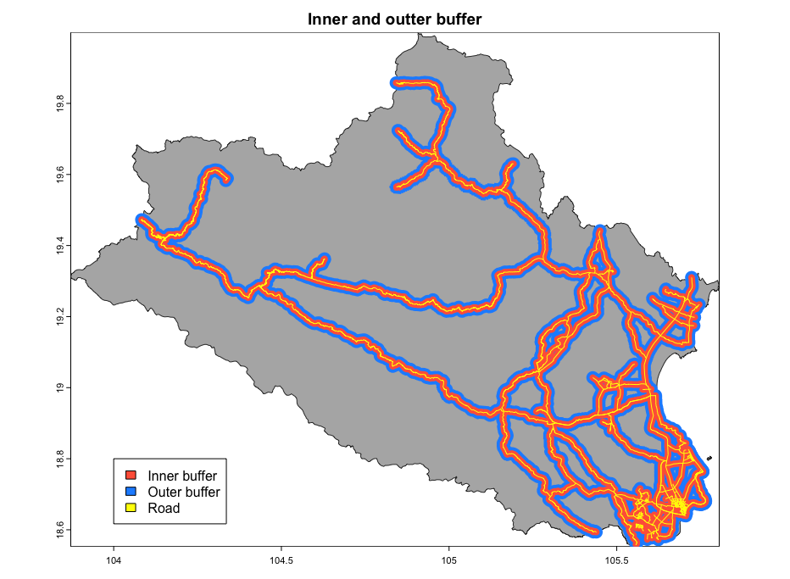
Conditional Latin Hypercube Sampling (cLHS)
Examples of constraints.
Buffer Options

Slide 12
Advantages of cLHS
Improved Representativeness: cLHS provides a more representative sample of the parameter space by ensuring that sampled points satisfy specified constraints.
Efficient Exploration of Constrained Spaces: cLHS efficiently explores constrained parameter spaces.
Flexibility: cLHS is highly flexible and adaptable to various applications. It can handle different types of constraints, including equality and inequality constraints.

Slide 13
Limitations of cLHS
Computational Demanding: cLHS can be computationally intensive, especially when dealing with high-dimensional parameter spaces complex constraints.
Constraint Definition: The effectiveness of cLHS heavily depends on how well the constraints are defined. If constraints are not well-defined or too restrictive, it can be challenging to obtain a sufficient number of feasible samples.
Trade-off Between Exploration and Exploitation: While cLHS efficiently explores constrained spaces, there is a trade-off between exploration (discovering new regions) and exploitation (sampling regions of high interest). Striking the right balance may require careful tuning of parameters.
Limited Applicability for Certain Problems: cLHS may not be suitable for all types of problems. In some cases, where constraints are highly non-linear or have multiple optima, it may be challenging to achieve the desired level of representativeness.
Algorithm Sensitivity: The performance of cLHS can be sensitive to the settings of sampling algorithm, the number of samples, covariate resolution, number of quantiles, and how constraints are integrated into the sampling process. Users should set appropriate settings for their specific problem.

Slide 14
Case study
Training material in ‘Nghe’ Province (Vietnam)
68 environmental parameters (Available at as GEE assets)
Shapes of province boundaries, rivers, roads.
R packages:
sgsR
clhs
Additional functions from Daniel Saurette et al. (mininimum and optimal sample size)

Slide 15
Contents in the exercise
Latin Hypercube Sampling without constraints (sgsR).
Conditional Latin Hypercube Sampling with legacy data (sgsR).
Conditional Latin Hypercube Sampling for large raster data (sgsR).
Conditional Latin Hypercube Sampling with cost constraint layers (distance to roads) (sgsR).
Conditional Latin Hypercube Sampling with legacy data, cost (slope) and accessibility constraints (sgsR).
Identification of replacement locations in cLHS.

Slide 16
Acknowledgments
We want to acknowledge the following authors for the distribution of the R scripts/data included partially in this manual.
@Malone et al
@Saurette et al
Vietnam

Slide 17
References
Goodbody, T.R., Coops, N.C. & Queinnec, M. 2023. Structurally guided sampling. (also available at https://cran.r-project.org/package=sgsR).
Roudier, P., Brugnard, C., Beaudette, D., Louis, B., Daust, K. & Clifford, D. 2011. Clhs: A r package for conditioned latin hypercube sampling. (also available at https://cran.r-project.org/web/packages/clhs/).
Minasny, B. & McBratney, A. 2006. A conditioned latin hypercube method for sampling in the presence of ancillary information. Computers & Geosciences, 32: 1378–1388. https://doi.org/10.1016/j.cageo.2005.12.009
Malone, B.P., Minansy, B. & Brungard, C. 2019. Some methods to improve the utility of conditioned latin hypercube sampling. PeerJ, 7: e6451. https://doi.org/10.7717/peerj.6451
Saurette, D. , Biswas, A., Heck, R.J., Gillespie, A.W., Berg, A.A. 2022. Determining minimum sample size for the conditioned Latin hypercube sampling algorithm, Pedosphere.
Saurette, D. , Heck, R.J., Gillespie, A.W., Berg, A.A., Biswas, A. 2022. Divergence metrics for determining optimal training sample size in digital soil mapping, Geoderma, 436.

Slide 18
Index of the script
0 - Set working directory and load packages
1 - User-defined variables
2 - Import national data
3 - Compute clhs
4 - Identify under-sampled areas
5 - Including existing legacy data in a cLHS sampling design
6 - Working with large raster data
7 - Cost–constrained cLHS sampling
8 - Replacement areas in cLHS design
9 - Polygonize replacement areas by similarity
10 - Constrained cLHS sampling accounting accessibility and legacy data
11 - Plot sample density over covariates
12 - Calculate minimum and and optimal sample size with opendms

Slide 19
Contact Information
luis.rodriguezlado@fao.org
marcos.angelini@fao.org

