Slide 1
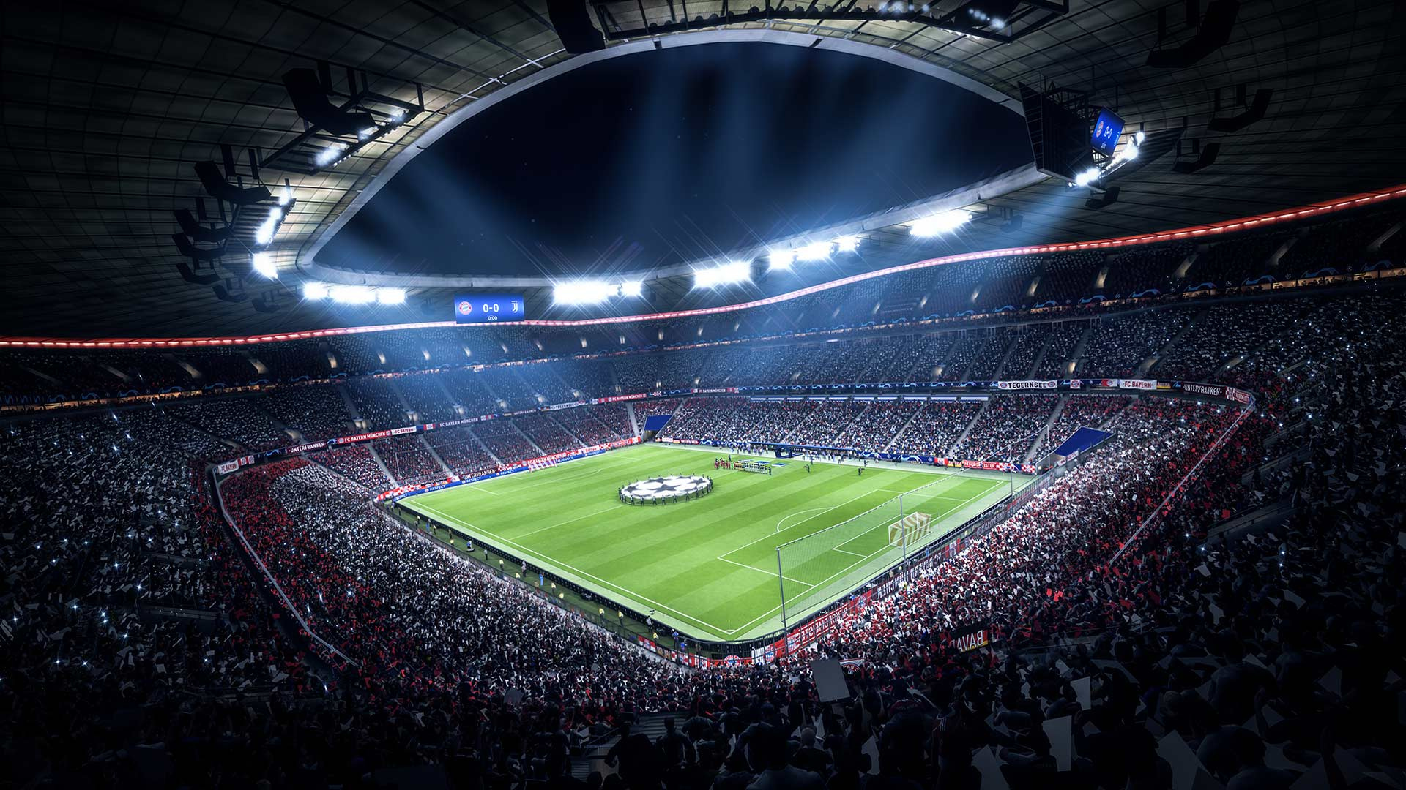
FIFA
DATA SCIENCE
PROJECT
By Matan Farchy

Slide 2

FIFA
About The Game
FIFA is a football video game , one of the most famous game in the world.
Developed and released by Electronic Arts under the EA Sports labal.
It is available for multiple gaming systems like Gaming consoles and PC.
Listed in Guinness World Records as the best-selling sports video game franchise in the world.
A new version of the game is released every September.
There are a lot of game modes such as playing with friends offline, online, career mode, and even creating a new players to play with.

Slide 3
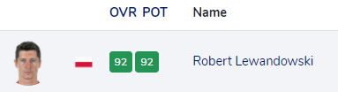
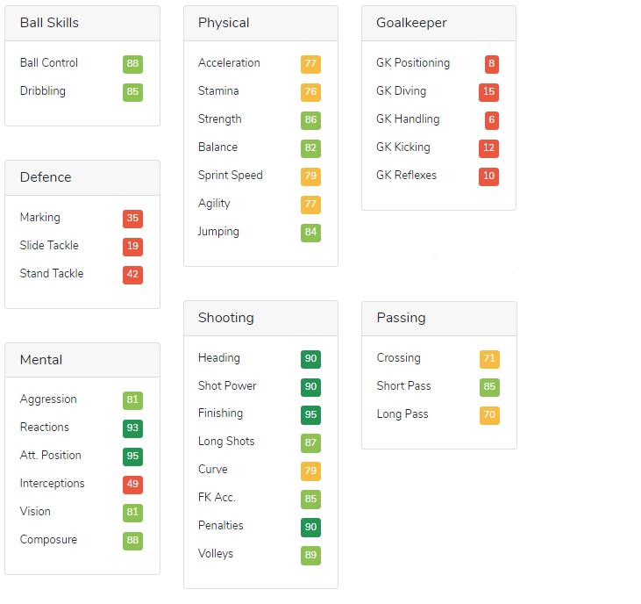
A Background About The Project
Each player in the game is rated by an overall score that represents the player's level.
The higher the score, the better the player.
The score is determined by a variety of attributes:
"ball control", "pass", "shot", "goal keeping attributes" and more.

Slide 4
My 2 Major Goals
1
2
Discover which attributes makes a player get a better score
Predict an overall score of a player

Slide 5
Roadmap
1
2
3
4
5
Data Scraping
Data Handling
Exploring Data
Machine learning
Conclusions
Web crawling for collecting and obtaining the data
Cleaning, formatting and filtering the data
Visualizing and understanding the data
Clustering the data into groups, modeling and algorithms.
Final chosen model and Summary

Slide 6
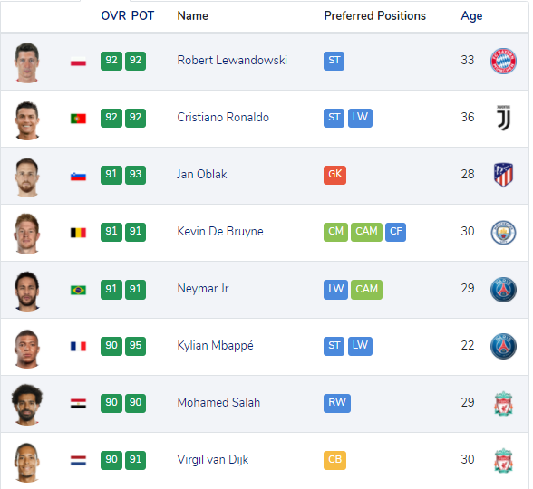
Web Crawling
Scraping the data from
https://www.fifaindex.com/players/
By using "beautifulsoup".
Stage 1:
Finding all players' link in pages.
Stage 2:
In every link - find all wanted data.

Slide 7
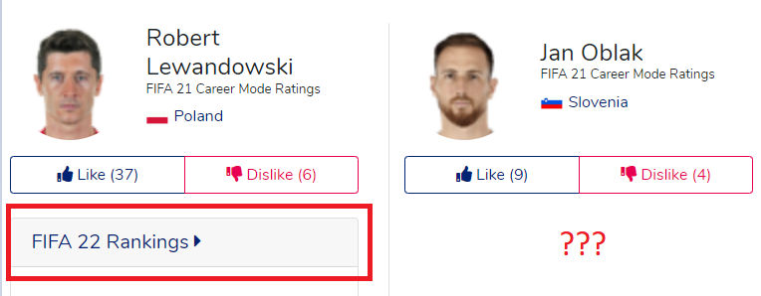
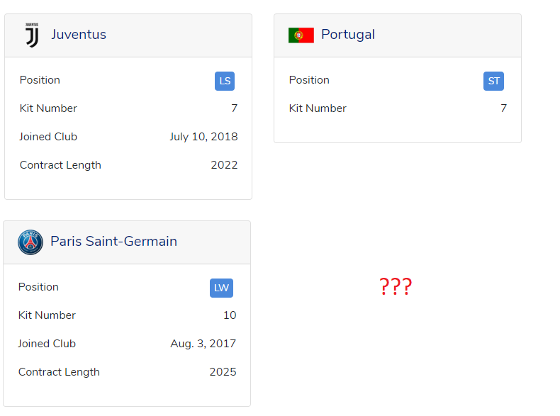
Web Crawling
Stage 3:
Not all pages are the same - so i had to find the differences between them and continue scraping the data accordingly
Player 1
________________________________________
Stage 4:
Put all players' data in a data frame using "pandas".
Player 2
Back

Slide 8
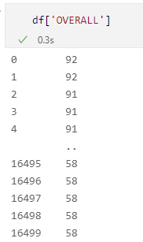
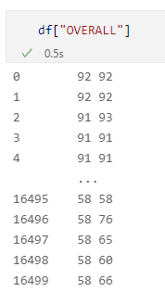
Data Handling
Stage 1:
Check for missing values.
Stage 2:
Check for duplicate values.
Stage 3:
Formatting string values to "string" format and numeric variable into "int" format (All the data was in "Object" format).
Stage 4:
The name and the OVR/POT were presented together so I had to split them.
Overall score was presented with potential score so I had to split between them and delete the potential.
Stage 5:
Creating a new data frame with numeric values only - and without age value , because all string values are unnecessary for the ML process.
Back

Slide 9
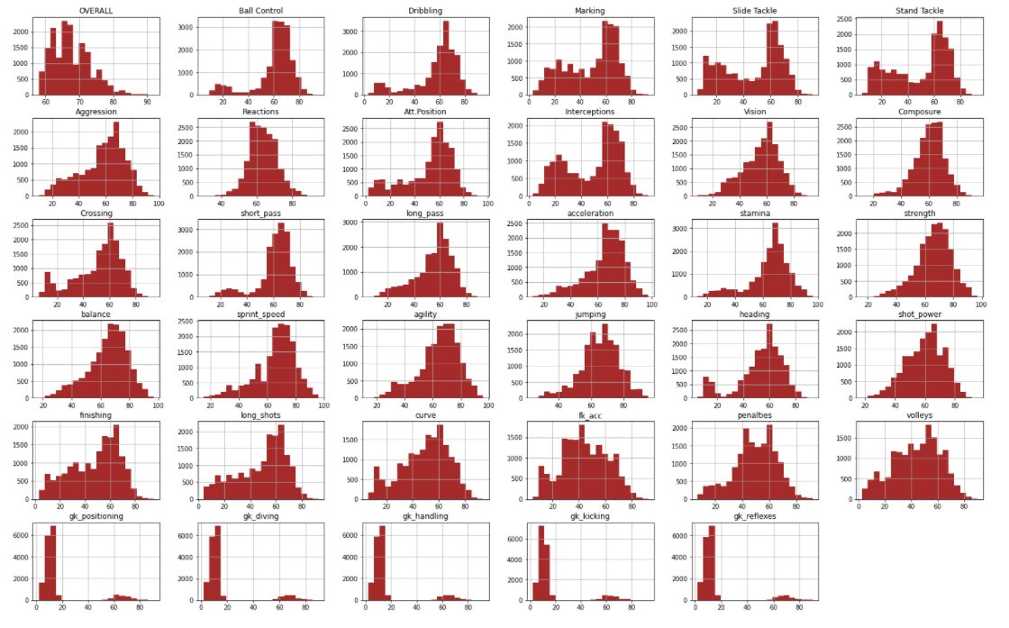
Exploring Data & Visualizing
Histograms that shows that all the values of the attributes are in range between 0-100 so I don’t need to do a scale transformation.
The bottom four histograms shows "goal keeper attributes".
The bins on the left show us that we have a lot of low values - it represents all the field players - they are not goalkeepers so they don't have high values of goalkeepers. The right bins represent all the gk.

Slide 10
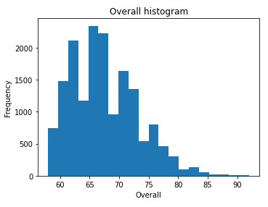
Exploring Data & Visualizing
Histogram that shows us all the Overall scores and their frequency

Slide 11
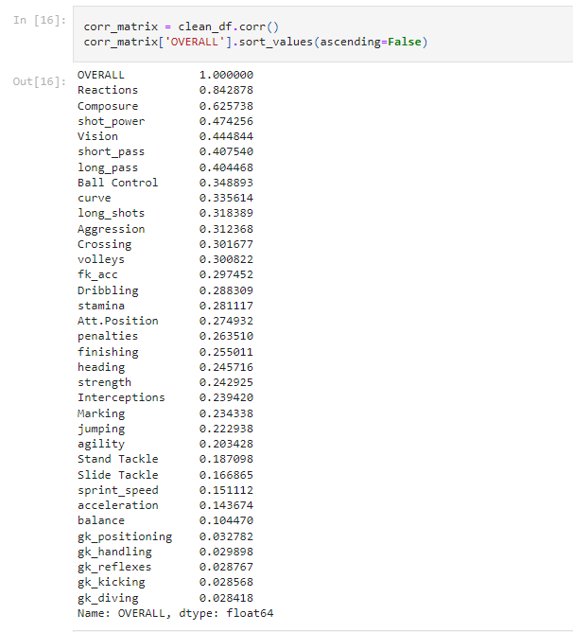
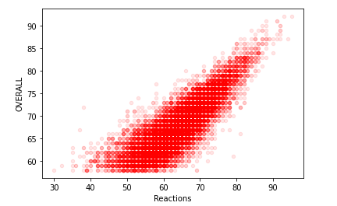
Exploring Data & Visualizing
I wanted to find if there is a connection between the Overall score and the other attributes - so i used the correlation function.
I found out that there is a strong connection between "Recation" score and Overall - 0.84 !
The higher the "Reaction" score - the better the Overall score.
Back

Slide 12


Machine Learning
Clustering the data into groups:

Slide 13



Machine Learning
I tried three types of algorithms :
LinearRegression
DecisionTree
RandomForest
I tested each algorithm using 3 tests - "R2" score, "RMSE" score and Cross-Validation scores - Results in "Conclusions".

Slide 14
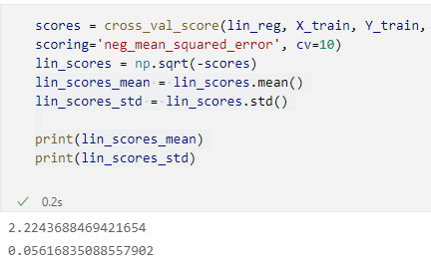
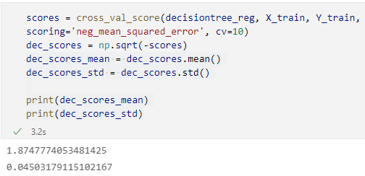
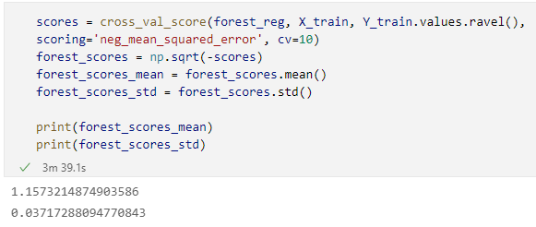
Machine Learning
Cross-validation tests
Back

Slide 15
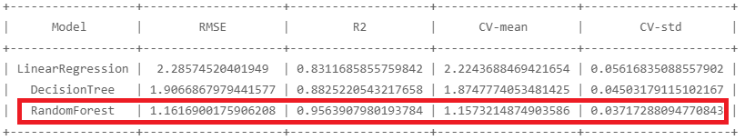
Conclusions
RandomForest algorithm gave me the best results in all parameters!

Slide 16
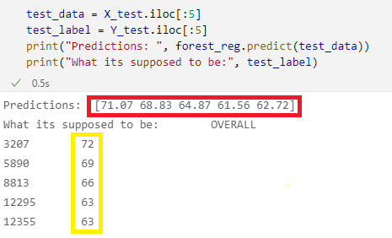
Conclusions
From these results we learn that the RandomForest algorithm can predict the results with 96% accuracy and 4% deviation
Back

Slide 17
Thank you!

