Slide 1

Chapter 4
Digital Transmission
Copyright © The McGraw-Hill Companies, Inc. Permission required for reproduction or display.

Slide 2
4-1 DIGITAL-TO-DIGITAL CONVERSION
In this section, we see how we can represent digital data by using digital signals. The conversion involves three techniques: line coding, block coding, and scrambling. Line coding is always needed; block coding and scrambling may or may not be needed.
Topics discussed in this section:
Line Coding
Line Coding Schemes
Block Coding
Scrambling

Slide 3
Line Coding
Converting a string of 1’s and 0’s (digital data) into a sequence of signals that denote the 1’s and 0’s.
For example a high voltage level (+V) could represent a “1” and a low voltage level (0 or -V) could represent a “0”.

Slide 4

Figure 4.1 Line coding and decoding

Slide 5
Mapping Data symbols onto Signal levels
A data symbol (or element) can consist of a number of data bits:
  1 , 0 or
  11, 10, 01, ……
A data symbol can be coded into a single signal element or multiple signal elements
  1 -> +V, 0 -> -V
  1 -> +V and -V, 0 -> -V and +V
The ratio ‘r’ is the number of data elements carried by a signal element.

Slide 6
Relationship between data rate and signal rate
The data rate defines the number of bits sent per sec - bps. It is often referred to the bit rate.
The signal rate is the number of signal elements sent in a second and is measured in bauds. It is also referred to as the modulation rate.
Goal is to increase the data rate whilst reducing the baud rate.

Slide 7

Figure 4.2 Signal element versus data element

Slide 8
Data rate and Baud rate
The baud or signal rate can be expressed as:
S = c x N x 1/r bauds
where N is data rate
c is the case factor (worst, best & avg.)
r is the ratio between data element & signal element

Slide 9

Example 4.1
A signal is carrying data in which one data element is encoded as one signal element ( r = 1). If the bit rate is 100 kbps, what is the average value of the baud rate if c is between 0 and 1?
Solution
We assume that the average value of c is 1/2 . The baud rate is then

Slide 10

Note
Although the actual bandwidth of a digital signal is infinite, the effective bandwidth is finite.

Slide 11
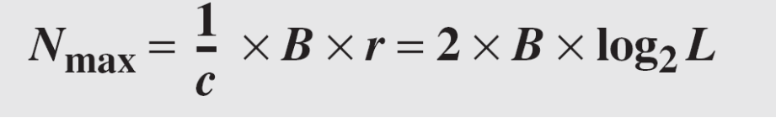
Example 4.2
The maximum data rate of a channel (see Chapter 3) is N_{max} = 2 × B × log₂ L (defined by the Nyquist formula). Does this agree with the previous formula for N_{max}?
Solution
A signal with L levels actually can carry log₂L bits per level. If each level corresponds to one signal element and we assume the average case (c = 1/2), then we have

Slide 12
Considerations for choosing a good signal element referred to as line encoding
Baseline wandering - a receiver will evaluate the average power of the received signal (called the baseline) and use that to determine the value of the incoming data elements. If the incoming signal does not vary over a long period of time, the baseline will drift and thus cause errors in detection of incoming data elements.
A good line encoding scheme will prevent long runs of fixed amplitude.

Slide 13
Line encoding C/Cs
DC components - when the voltage level remains constant for long periods of time, there is an increase in the low frequencies of the signal. Most channels are bandpass and may not support the low frequencies.
This will require the removal of the dc component of a transmitted signal.

Slide 14
Line encoding C/Cs
Self synchronization - the clocks at the sender and the receiver must have the same bit interval.
If the receiver clock is faster or slower it will misinterpret the incoming bit stream.

Slide 15

Figure 4.3 Effect of lack of synchronization

Slide 16
Example 4.3
In a digital transmission, the receiver clock is 0.1 percent faster than the sender clock. How many extra bits per second does the receiver receive if the data rate is
1 kbps? How many if the data rate is 1 Mbps?
Solution
At 1 kbps, the receiver receives 1001 bps instead of 1000 bps.
At 1 Mbps, the receiver receives 1,001,000 bps instead of 1,000,000 bps.

Slide 17
Line encoding C/Cs
Error detection - errors occur during transmission due to line impairments.
Some codes are constructed such that when an error occurs it can be detected. For example: a particular signal transition is not part of the code. When it occurs, the receiver will know that a symbol error has occurred.

Slide 18
Line encoding C/Cs
Noise and interference - there are line encoding techniques that make the transmitted signal “immune” to noise and interference.
This means that the signal cannot be corrupted, it is stronger than error detection.

Slide 19
Line encoding C/Cs
Complexity - the more robust and resilient the code, the more complex it is to implement and the price is often paid in baud rate or required bandwidth.

Slide 20

Figure 4.4 Line coding schemes

Slide 21
Unipolar
All signal levels are on one side of the time axis - either above or below
NRZ - Non Return to Zero scheme is an example of this code. The signal level does not return to zero during a symbol transmission.
Scheme is prone to baseline wandering and DC components. It has no synchronization or any error detection. It is simple but costly in power consumption.

Slide 22

Figure 4.5 Unipolar NRZ scheme

Slide 23
Polar - NRZ
The voltages are on both sides of the time axis.
Polar NRZ scheme can be implemented with two voltages. E.g. +V for 1 and -V for 0.
There are two versions:
  NZR - Level (NRZ-L) - positive voltage for one symbol and negative for the other
  NRZ - Inversion (NRZ-I) - the change or lack of change in polarity determines the value of a symbol. E.g. a “1” symbol inverts the polarity a “0” does not.

Slide 24

Figure 4.6 Polar NRZ-L and NRZ-I schemes

Slide 25
Note
In NRZ-L the level of the voltage determines the value of the bit.
In NRZ-I the inversion
or the lack of inversion
determines the value of the bit.

Slide 26
Note
NRZ-L and NRZ-I both have an average signal rate of N/2 Bd.

Slide 27
Note
NRZ-L and NRZ-I both have a DC component problem and baseline wandering, it is worse for NRZ-L. Both have no self synchronization &no error detection. Both are relatively simple to implement.

Slide 28
Example 4.4
A system is using NRZ-I to transfer 1-Mbps data. What are the average signal rate and minimum bandwidth?
Solution
The average signal rate is S= c x N x R = 1/2 x N x 1 = 500 kbaud. The minimum bandwidth for this average baud rate is B_{min} = S = 500 kHz.
Note c = 1/2 for the avg. case as worst case is 1 and best case is 0

Slide 29
Polar - RZ
The Return to Zero (RZ) scheme uses three voltage values. +, 0, -.
Each symbol has a transition in the middle. Either from high to zero or from low to zero.
This scheme has more signal transitions (two per symbol) and therefore requires a wider bandwidth.
No DC components or baseline wandering.
Self synchronization - transition indicates symbol value.
More complex as it uses three voltage level. It has no error detection capability.

Slide 30

Figure 4.7 Polar RZ scheme

Slide 31
Polar - Biphase: Manchester and Differential Manchester
Manchester coding consists of combining the NRZ-L and RZ schemes.
  Every symbol has a level transition in the middle: from high to low or low to high. Uses only two voltage levels.
Differential Manchester coding consists of combining the NRZ-I and RZ schemes.
  Every symbol has a level transition in the middle. But the level at the beginning of the symbol is determined by the symbol value. One symbol causes a level change the other does not.

Slide 32

Figure 4.8 Polar biphase: Manchester and differential Manchester schemes

Slide 33
Note
In Manchester and differential Manchester encoding, the transition
at the middle of the bit is used for synchronization.

Slide 34
Note
The minimum bandwidth of Manchester and differential Manchester is 2 times that of NRZ. The is no DC component and no baseline wandering. None of these codes has error detection.

Slide 35
Bipolar - AMI and Pseudoternary
Code uses 3 voltage levels: - +, 0, -, to represent the symbols (note not transitions to zero as in RZ).
Voltage level for one symbol is at “0” and the other alternates between + & -.
Bipolar Alternate Mark Inversion (AMI) - the “0” symbol is represented by zero voltage and the “1” symbol alternates between +V and -V.
Pseudoternary is the reverse of AMI.

Slide 36

Figure 4.9 Bipolar schemes: AMI and pseudoternary

Slide 37
Bipolar C/Cs
It is a better alternative to NRZ.
Has no DC component or baseline wandering.
Has no self synchronization because long runs of “0”s results in no signal transitions.
No error detection.

Slide 38
Multilevel Schemes
In these schemes we increase the number of data bits per symbol thereby increasing the bit rate.
Since we are dealing with binary data we only have 2 types of data element a 1 or a 0.
We can combine the 2 data elements into a pattern of “m” elements to create “2^{m}” symbols.
If we have L signal levels, we can use “n” signal elements to create L^{n} signal elements.

Slide 39
Code C/Cs
Now we have 2^{m} symbols and L^{n} signals.
If 2^{m} > L^{n} then we cannot represent the data elements, we don’t have enough signals.
If 2^{m} = L^{n} then we have an exact mapping of one symbol on one signal.
If 2^{m} < L^{n} then we have more signals than symbols and we can choose the signals that are more distinct to represent the symbols and therefore have better noise immunity and error detection as some signals are not valid.

Slide 40
Note
In mBnL schemes, a pattern of m data elements is encoded as a pattern of n signal elements in which 2^{m} ≤ L^{n}.

Slide 41
Representing Multilevel Codes
We use the notation mBnL, where m is the length of the binary pattern, B represents binary data, n represents the length of the signal pattern and L the number of levels.
L = B binary, L = T for 3 ternary, L = Q for 4 quaternary.

Slide 42

Figure 4.10 Multilevel: 2B1Q scheme

Slide 43
Redundancy
In the 2B1Q scheme we have no redundancy and we see that a DC component is present.
If we use a code with redundancy we can decide to use only “0” or “+” weighted codes (more +’s than -’s in the signal element) and invert any code that would create a DC component. E.g. ‘+00++-’ -> ‘-00--+’
Receiver will know when it receives a “-” weighted code that it should invert it as it doesn’t represent any valid symbol.

Slide 44

Figure 4.11 Multilevel: 8B6T scheme

Slide 45
Multilevel using multiple channels
In some cases, we split the signal transmission up and distribute it over several links.
The separate segments are transmitted simultaneously. This reduces the signalling rate per link -> lower bandwidth.
This requires all bits for a code to be stored.
xD: means that we use ‘x’ links
YYYz: We use ‘z’ levels of modulation where YYY represents the type of modulation (e.g. pulse ampl. mod. PAM).
Codes are represented as: xD-YYYz

Slide 46

Figure 4.12 Multilevel: 4D-PAM5 scheme

Slide 47
Multitransition Coding
Because of synchronization requirements we force transitions. This can result in very high bandwidth requirements -> more transitions than are bits (e.g. mid bit transition with inversion).
Codes can be created that are differential at the bit level forcing transitions at bit boundaries. This results in a bandwidth requirement that is equivalent to the bit rate.
In some instances, the bandwidth requirement may even be lower, due to repetitive patterns resulting in a periodic signal.

Slide 48

Figure 4.13 Multitransition: MLT-3 scheme

Slide 49
MLT-3
Signal rate is same as NRZ-I
But because of the resulting bit pattern, we have a periodic signal for worst case bit pattern: 1111
This can be approximated as an analog signal a frequency 1/4 the bit rate!

Slide 50
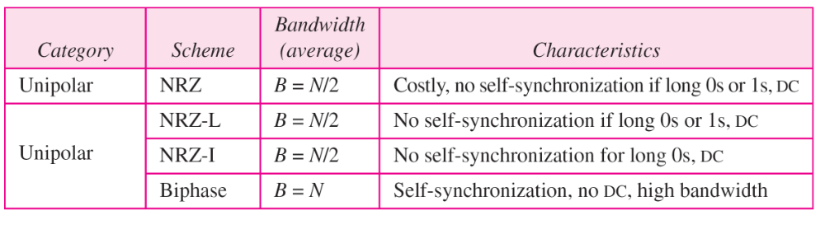

Table 4.1 Summary of line coding schemes

Slide 51
Block Coding
For a code to be capable of error detection, we need to add redundancy, i.e., extra bits to the data bits.
Synchronization also requires redundancy - transitions are important in the signal flow and must occur frequently.
Block coding is done in three steps: division, substitution and combination.
It is distinguished from multilevel coding by use of the slash - xB/yB.
The resulting bit stream prevents certain bit combinations that when used with line encoding would result in DC components or poor sync. quality.

Slide 52
Note
Block coding is normally referred to as mB/nB coding;
it replaces each m-bit group with an
n-bit group.

Slide 53

Figure 4.14 Block coding concept

Slide 54

Figure 4.15 Using block coding 4B/5B with NRZ-I line coding scheme

Slide 55
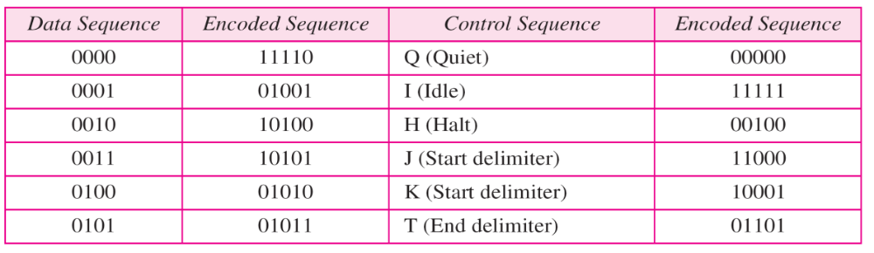

Table 4.2 4B/5B mapping codes

Slide 56

Figure 4.16 Substitution in 4B/5B block coding

Slide 57
Redundancy
A 4 bit data word can have 24 combinations.
A 5 bit word can have 25=32 combinations.
We therefore have 32 - 26 = 16 extra words.
Some of the extra words are used for control/signalling purposes.

Slide 58
Example 4.5
We need to send data at a 1-Mbps rate. What is the minimum required bandwidth, using a combination of 4B/5B and NRZ-I or Manchester coding?
Solution
First 4B/5B block coding increases the bit rate to 1.25 Mbps. The minimum bandwidth using NRZ-I is N/2 or 625 kHz. The Manchester scheme needs a minimum bandwidth of 1.25 MHz. The first choice needs a lower bandwidth, but has a DC component problem; the second choice needs a higher bandwidth, but does not have a DC component problem.

Slide 59

Figure 4.17 8B/10B block encoding

Slide 60
More bits - better error detection
The 8B10B block code adds more redundant bits and can thereby choose code words that would prevent a long run of a voltage level that would cause DC components.

Slide 61
Scrambling
The best code is one that does not increase the bandwidth for synchronization and has no DC components.
Scrambling is a technique used to create a sequence of bits that has the required c/c’s for transmission - self clocking, no low frequencies, no wide bandwidth.
It is implemented at the same time as encoding, the bit stream is created on the fly.
It replaces ‘unfriendly’ runs of bits with a violation code that is easy to recognize and removes the unfriendly c/c.

Slide 62

Figure 4.18 AMI used with scrambling

Slide 63
For example: B8ZS substitutes eight consecutive zeros with 000VB0VB.
The V stands for violation, it violates the line encoding rule
B stands for bipolar, it implements the bipolar line encoding rule

Slide 64

Figure 4.19 Two cases of B8ZS scrambling technique

Slide 65
HDB3 substitutes four consecutive zeros with 000V or B00V depending
on the number of nonzero pulses after the last substitution.
If # of non zero pulses is even the substitution is B00V to make total # of non zero pulse even.
If # of non zero pulses is odd the substitution is 000V to make total # of non zero pulses even.

Slide 66

Figure 4.20 Different situations in HDB3 scrambling technique

