Slide 1



TOXICITY testing AND BIOASSAY
(ACUTE,SUB ACUTE,CHRONIC,TERATOGENICITY,CARCINOGENICITY,MUTAGENICITY)
Presented by:
Fathima Nazrin P A
2 ^{nd} MSc Zoology

Slide 2
Acute toxicity
Refers to the adverse effects of a substance on living organisms over a short period, usually within 24 to 48 hours.
It can be a single or multiple exposure.
Observation period-14 days.

Slide 3



MOST COMMON ACUTE TOXICITY TEST ARE:
Testing of Acute toxicity
Acute toxicity tests are used to determine the dose or concenteration of a particular test chemical or effluent that will produce a specific response or effect on a group of test organisms during short term exposures under controlled conditions.
Lethality test
Irritation studies
Potentiation / Sensitivity agents

Slide 4

LETHALITY TEST
Most common way to express acute toxicity.
LC 50 is the statistical estimate of the dose necessary to kill 50% of a large population of test species under specific conditions
Rats, mice, rabbits, Guinea pigs are the most commonly used test organisms.

Slide 5

LD 50
LD 50 measurement is based on dose response relationship which describes the relationship between the dose of a substance administered and the proportion of individuals affected by it.
In LD 50 the response is death.
LD50 values are determined using statistical methods to estimate the dose of a substance that is lethal to 50% of the test population.
It involves administering different doses of the substance to groups of animals and observing the mortality rates.

Slide 6


Procedure:
Selection of Test Animals: The first step in determining LD50 involves selecting appropriate test animals, typically rodents such as rats or mice.
Dosing Regimen: Test animals are divided into groups, each receiving a different dose of the test substance. The doses are usually selected to cover a range from very low to potentially lethal levels. A control group may also be included, which receives a vehicle or inert substance to serve as a baseline for comparison.
Observation Period: Following dosing, the test animals are observed over a specified observation period, typically ranging from a few hours to several days. During this time, the animals are monitored for signs of toxicity, such as changes in behavior, appearance, and physiological parameters.

Slide 7


Data Analysis: After the observation period, the number of surviving animals in each dose group is recorded. Statistical analysis is then performed to determine the LD50 value, which represents the dose of the test substance that is lethal to 50% of the test population.
Reporting: The LD50 value, along with any relevant findings and observations, is reported in scientific publications or regulatory submissions. This information is used to assess the acute toxicity of the test substance and to establish safety guidelines for human exposure.

Slide 8

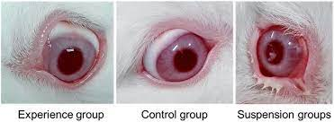

Irritation test
Eye Irritation Test: This evaluates the potential for a substance to cause irritation or damage to the eyes. Test substances are applied directly to the eyes of animals, typically rabbits, and observed for signs of irritation, such as redness, swelling, or discharge.

Slide 9
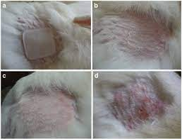
Skin Irritation Test: Similar to the eye irritation test, this assesses the potential for a substance to cause irritation or damage to the skin. Test substances are applied to the skin of animals, usually rabbits, and observed for signs of irritation, such as redness, swelling, or blistering.

Slide 10

POTENTIATION
Potentiation in acute toxicity testing refers to the phenomenon where the toxic effect of one substance is increased (potentiated) in the presence of another substance, even though the second substance may not be toxic on its own or may have a lesser toxic effect when administered alone.
The primary irritantelicits its effect immediately on one application.
The sensitising agent may show no primary irritation but when applied or injected may combine with the protein molecule and act as antigenic agent which inturn produces antibody
If the compound is applied or injected an antigen antibody reaction may occur producing either minor or serious allergic condition which could lead to death or illness.

Slide 11

Sub acute toxicity
Subacute toxicity refers to the adverse effects of a substance that occur after repeated or continuous exposure over a relatively short period, typically ranging from a few days to several weeks or months.
Subacute toxicity studies typically involve repeated administration of the test substance to animals over a defined period, usually ranging from 14 days to 90 days.
Subacute toxicity studies may include multiple dose levels to evaluate dose-response relationships and determine the no-observed-adverse-effect level (NOAEL) or the lowest-observed-adverse-effect level (LOAEL).
TESTS:
Repeated Dose 28-Day Oral Toxicity Test
Subacute Dermal Toxicity Test
Subacute Neurotoxicity Test

Slide 12
Repeated Dose 28-Day Oral Toxicity Test: This test assesses the toxic effects of a substance when administered orally on a daily basis for 28 days. Test animals are dosed with the substance, usually in the form of a solution or suspension, and observed for signs of toxicity, changes in body weight, food consumption, and organ pathology.
Subacute Neurotoxicity Test: This test focuses on assessing the potential neurotoxic effects of a substance when administered repeatedly over a subacute period. It includes behavioral assessments, neurochemical analyses, and histopathological examinations of the nervous system.
Subacute Dermal Toxicity Test: This assesses the toxic effects of a substance when repeatedly applied to the skin over a subacute period, usually 28 days. Test substances are applied to the skin of animals, and observations are made for signs of irritation, systemic toxicity, and other adverse effects.

Slide 13
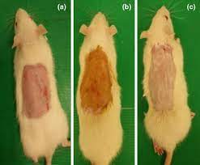

DERMAL TOXICITY

Slide 14
CHRONIC TOXICITY
Refers to the adverse effects of a substance that occur following repeated or continuous exposure over a prolonged period, typically spanning months to years.
Chronic toxicity studies focus on evaluating the long-term health hazards associated with prolonged exposure to a substance.
Chronic toxicity studies assess a wide range of endpoints, including mortality, clinical signs of toxicity, changes in body weight, food and water consumption, hematological parameters, clinical chemistry parameters, organ weights, histopathological findings, and functional observations. These endpoints help to identify systemic, organ-specific, or functional effects that may develop over time.

Slide 15


TEST:
Reproductive and Developmental Toxicity Study
Immunotoxicity Study
Carcinogenicity Study

Slide 16
Reproductive and Developmental Toxicity Study
Reproductive and developmental toxicity testing assesses the potential adverse effects of a substance on reproductive performance, fertility, embryo-fetal development, and postnatal growth and development.
These studies are crucial for identifying reproductive and developmental hazards associated with exposure to substances and are essential for regulatory decision-making regarding product safety.
Reproductive and developmental toxicity studies are typically conducted in accordance with regulatory guidelines, such as those issued by the Organization for Economic Co-operation and Development (OECD) or the U.S. Environmental Protection Agency (EPA). The study design includes considerations such as the selection of test species, duration of exposure, dose levels, and endpoints to be evaluated.

Slide 17
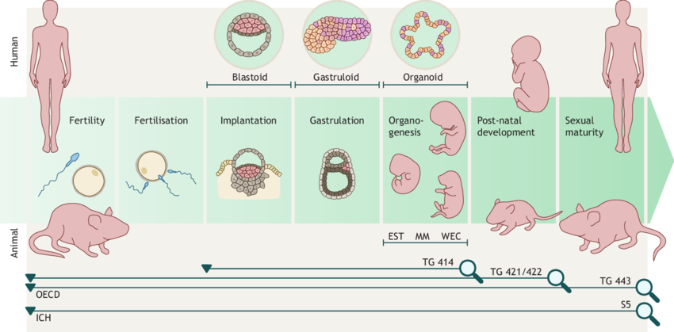

Slide 18
Endpoints Evaluated:
Reproductive Parameters: These include assessments of estrous cyclicity, mating behavior, fertility, gestation length, and parturition.
Developmental Parameters: These include evaluations of embryo-fetal development, such as fetal viability, growth, external and internal abnormalities, and skeletal and visceral malformations.
Maternal Parameters: These include assessments of maternal toxicity, such as changes in body weight, food and water consumption, clinical signs of toxicity, organ weights, and histopathological findings in maternal tissues.
Postnatal Parameters: These include evaluations of postnatal growth and development, such as litter size, survival, body weight, physical and functional development, and behavioral assessments.

Slide 19
Immunotoxicity Study: Chronic immunotoxicity studies assess the effects of a substance on the immune system when administered repeatedly to animals (often rodents) over a prolonged period. Immunological parameters, such as antibody production, cellular immune responses, and histopathological findings in immune organs, are evaluated.
Carcinogenicity Study: Chronic carcinogenicity studies evaluate the potential of a substance to induce cancer when administered to animals (often rodents) over a prolonged period, typically lasting two years. Animals are observed for tumor development, changes in body weight, clinical signs of toxicity, and histopathological findings.

Slide 20
Teratogenicity
Teratogenicity refers to the ability of a substance to cause structural or functional abnormalities in the developing fetus when exposure occurs during pregnancy. Teratogenic effects can result in congenital malformations, developmental delays, or other adverse outcomes in offspring.
Teratogenicity testing is essential for identifying potential hazards to fetal development and informing regulatory decisions regarding product safety.
Teratogenicity studies typically involve exposing pregnant animals to the test substance during the period of organogenesis, which is the critical window of fetal development when organs and structures are forming.
Exposure may occur during different stages of pregnancy, depending on the test species and regulatory guidelines.

Slide 21

TESTS:
Rodent Teratology Study
Micromass Test

Slide 22


Rodent Teratology Study
This is the most common type of teratogenicity study and involves exposing pregnant rodents (usually rats or mice) to the test substance during organogenesis, which is the critical period of fetal development when organs and structures are forming.
The offspring are then evaluated for external and internal malformations, developmental delays, and functional deficits.

Slide 23

MICROMASS TEST
The Micromass Test, also known as the Micromass Teratogenicity Assay or Micromass Embryotoxicity Test, is an in vitro assay used to assess the potential teratogenic effects of substances on developing embryos. The test is typically conducted using cultured embryonic cells, often derived from rodent or amphibian embryos, and it evaluates the impact of the test substance on embryonic development and differentiation.

Slide 24
PROCEDURE:
The test begins by isolating embryonic cells, usually from rodent or amphibian embryos, such as rats, mice, or frogs. These cells are then cultured in vitro under controlled conditions to form a three-dimensional cell aggregate known as a micromass.
The micromass cell aggregates are exposed to varying concentrations of the test substance, typically dissolved in culture medium. The cells are incubated with the test substance for a specified period, allowing the substance to interact with the developing embryonic cells.
After exposure, the micromass cell aggregates are evaluated for changes in embryonic development, such as alterations in cell proliferation, differentiation, or morphogenesis. Various endpoints may be assessed, including cell viability, cell morphology, tissue organization, and gene expression patterns.

Slide 25

The effects of the test substance on embryonic development are quantified and compared between treated and untreated (control) cell aggregates. This may involve techniques such as microscopy, immunohistochemistry, flow cytometry, or molecular assays to assess cellular and molecular changes associated with teratogenicity.
The results of the Micromass Test are analyzed to determine the potential teratogenic effects of the test substance. The concentration-response relationship is evaluated to identify dose-dependent effects, and the test substance is classified based on its teratogenic potential.

Slide 26

Carcinogenicity
Carcinogenicity refers to the ability of a substance to cause cancer, either by initiating or promoting the development of malignant tumors in living organisms.
Carcinogenic substances can induce genetic mutations, disrupt cellular processes, or promote uncontrolled cell growth, leading to the formation of tumors.
Carcinogenicity testing is crucial for identifying potential hazards to human health and informing regulatory decisions regarding product safety.
TESTS:
Two-Year Rodent Bioassay
In Vitro Carcinogenicity Assays
Transgenic Mouse Models

Slide 27
Two-Year Rodent Bioassay: This is the most common type of carcinogenicity test and involves exposing rodents (usually rats or mice) to the test substance for two years, which is equivalent to a significant portion of the animal's lifespan. Animals are monitored throughout the study for the development of tumors, and the incidence, type, and severity of tumors are recorded.
In Vitro Carcinogenicity Assays: In vitro assays use cell culture models to assess the potential carcinogenic effects of substances on cultured cells. These assays include tests such as the Ames test, which evaluates the mutagenic potential of substances, and the in vitro mammalian cell transformation assay, which assesses the ability of substances to induce malignant transformation in cultured cells.
Transgenic Mouse Models: Transgenic mouse models involve genetically engineered mice that are more susceptible to developing certain types of tumors. These models are used to assess the carcinogenic potential of substances more quickly and efficiently compared to traditional two-year bioassays.

Slide 28

MUTAGENiCITY
Mutagenicity refers to the ability of a substance to cause changes in the genetic material (DNA) of living cells, leading to mutations.
Mutations can result in alterations to the DNA sequence, which may have various consequences, including increased risk of cancer, birth defects, or other adverse health effects.
Mutagenicity testing is crucial for identifying potential hazards to human health and informing regulatory decisions regarding product safety.
TESTS:
Ames Test
In vitro Chromosomal Aberration Assay
In vivo Mammalian Bone Marrow Micronucleus Test

Slide 29
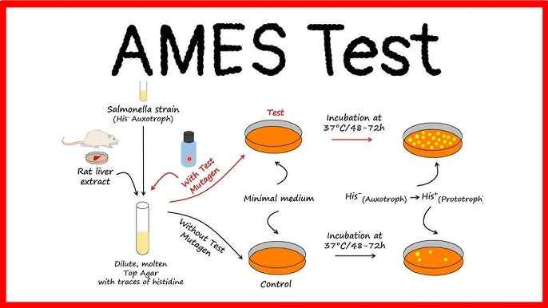

Slide 30
AMES TEST:
The Ames test, named after its inventor Dr. Bruce Ames, is a widely used bacterial reverse mutation assay used to evaluate the mutagenic potential of chemical compounds. It is primarily employed to detect substances that can induce point mutations or frameshift mutations in the DNA of bacterial cells.
The Ames test typically utilizes strains of the bacterium Salmonella typhimurium (S. typhimurium) or Escherichia coli (E. coli) that carry specific mutations in genes involved in histidine synthesis.
In the standard Ames test, the test substance is incorporated into agar plates containing the mutant bacterial strains along with a metabolic activation system (e.g., liver microsomal fraction) derived from rat liver, which mimics the metabolic activation process that occurs in living organisms. The test substance is added to the agar in wells, and bacteria are spread over the surface. After incubation, colonies that grow in the presence of the test substance are counted and compared to control plates to determine mutagenicity.

Slide 31
In vitro Chromosomal Aberration Assay: This assay assesses the ability of a substance to induce structural or numerical changes in chromosomes. Cultured mammalian cells, such as human lymphocytes, are exposed to the test substance, and the frequency of chromosomal aberrations (e.g., breaks, exchanges, deletions) is determined.
In vivo Mammalian Bone Marrow Micronucleus Test: This test evaluates the potential of a substance to induce chromosomal damage in dividing cells in vivo. Test animals are dosed with the substance, and bone marrow cells are collected and examined for the presence of micronuclei, which are indicative of chromosomal damage.

Slide 32

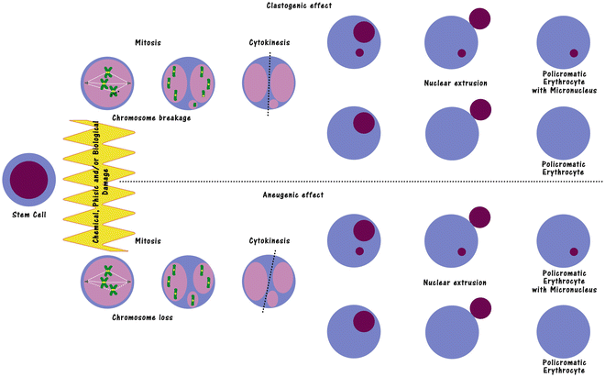
In vitro chromosomal Aberration assay
In vivo Mammalian Bone marrow Micro nucleus test

Slide 33
THANK YOU

