Slide 1
HOTEL CHAIN MANAGEMENT SYSTEM

Slide 2
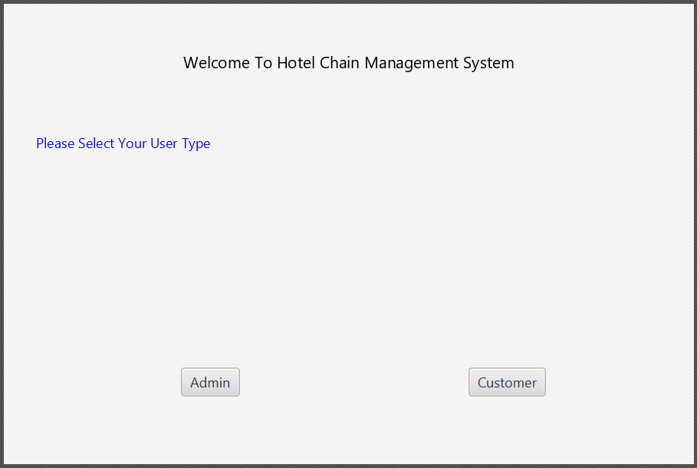



Slide 3
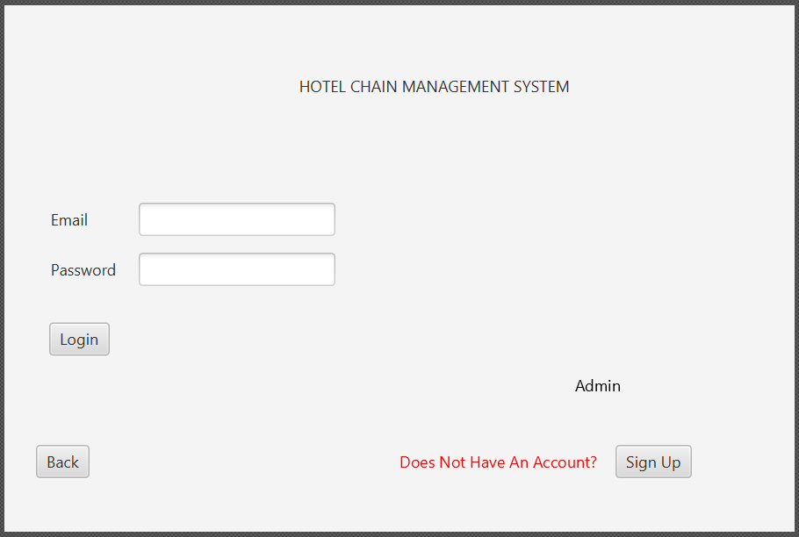

Slide 4
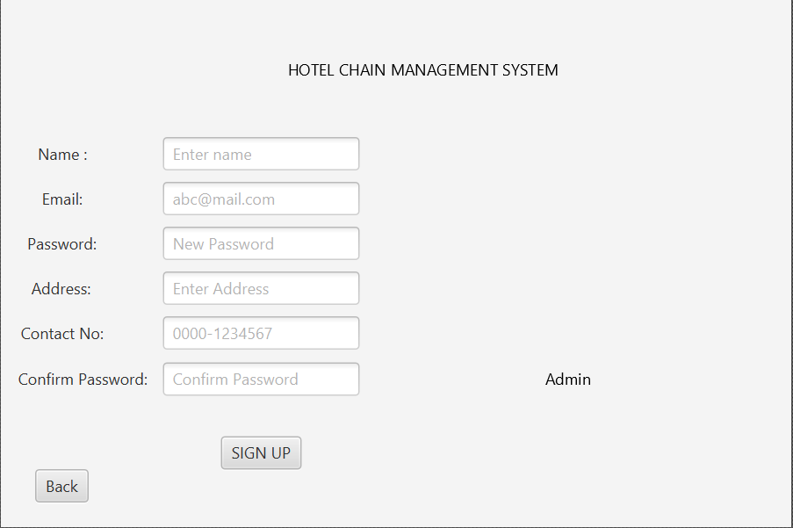

Slide 5
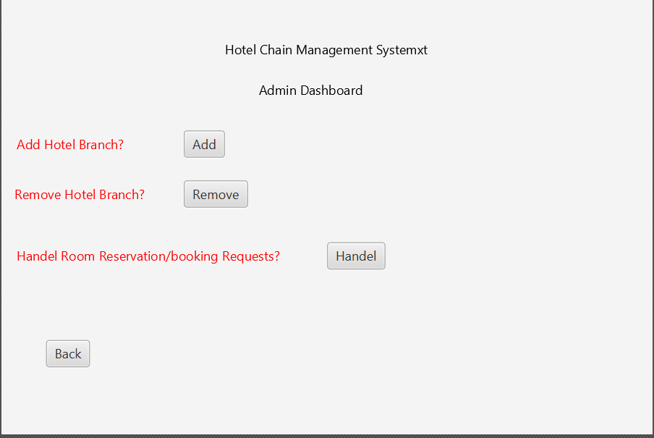


Slide 6
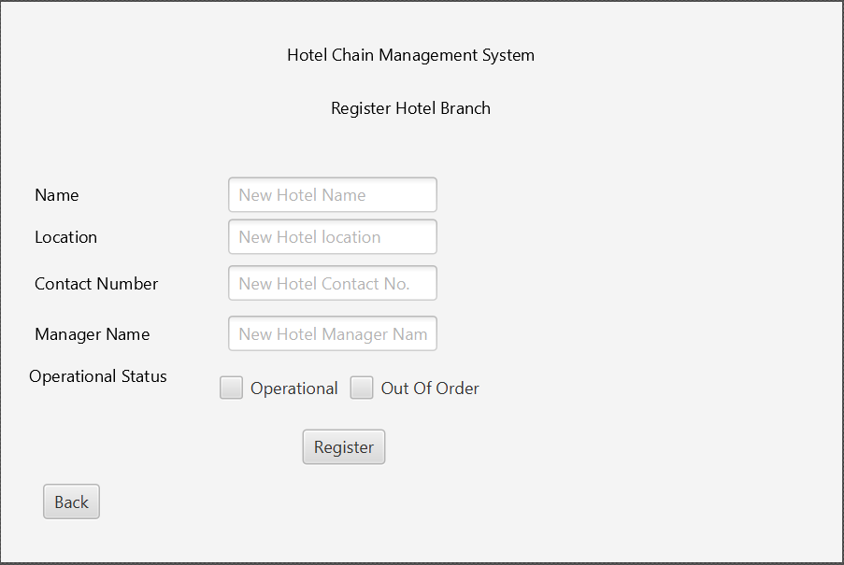

Slide 7
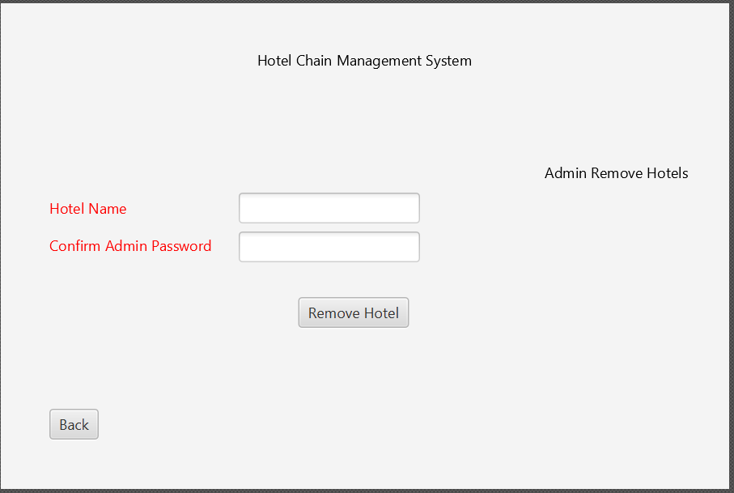

Slide 8
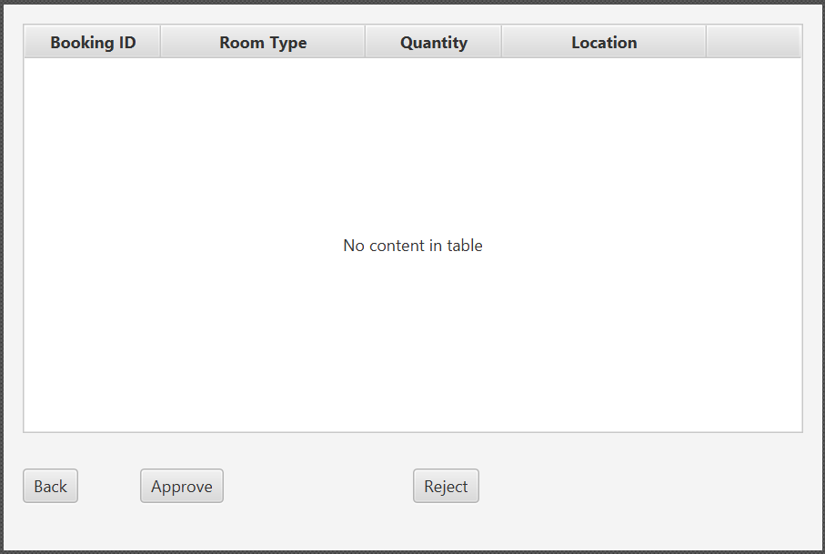

Slide 9
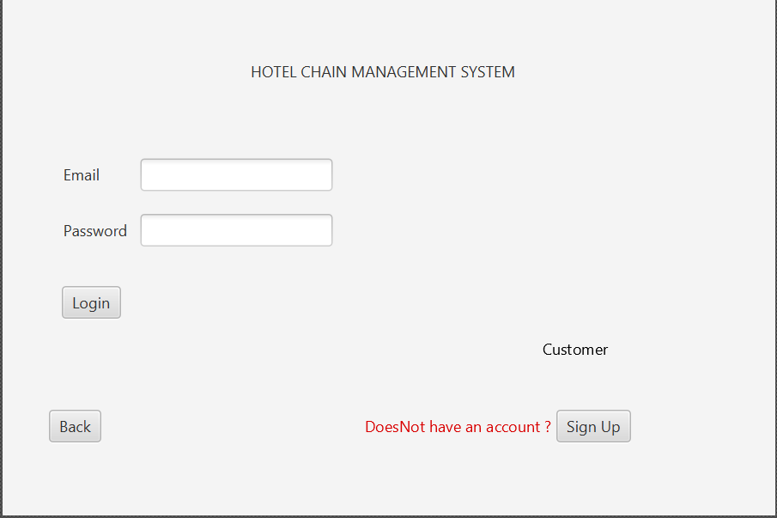

Slide 10
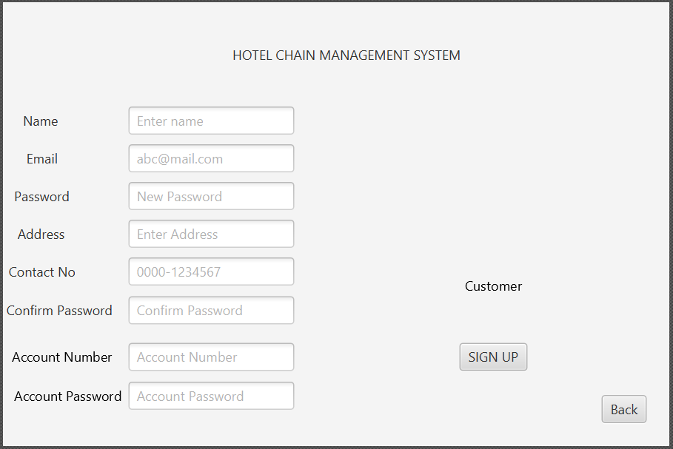

Slide 11
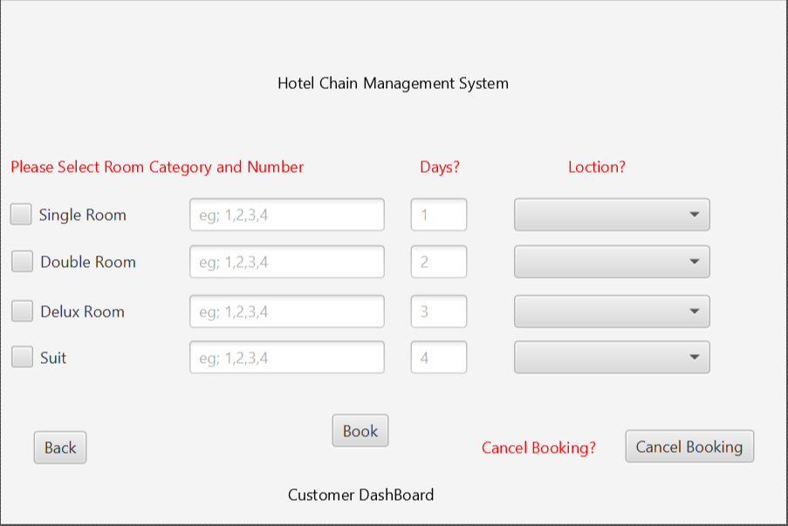

Slide 12
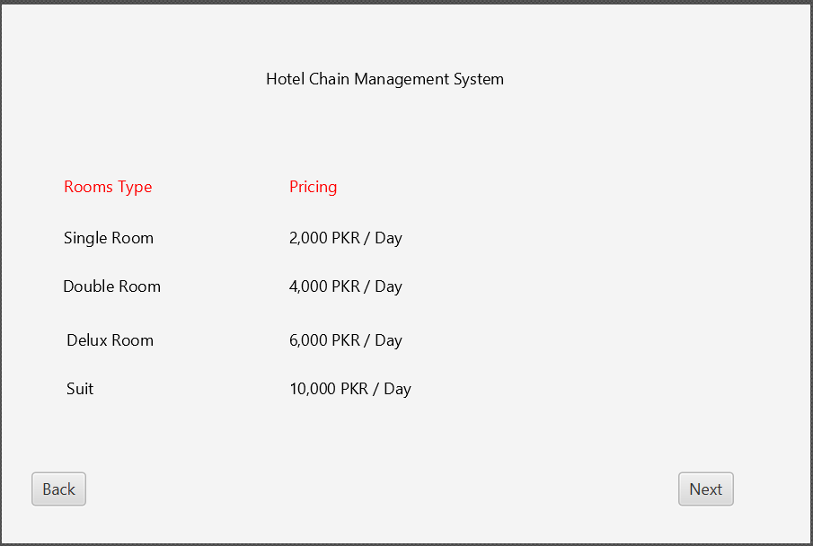


Slide 13
SYSTEM SEQUENCE DIAGRAMS

Slide 14
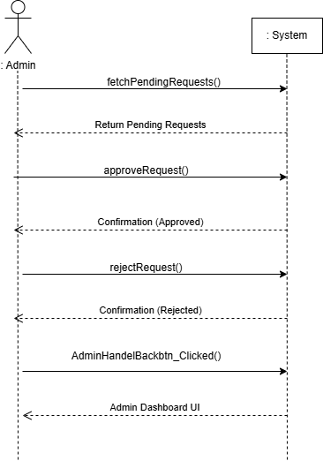
USE CASE: Handling Booking Requests

Slide 15
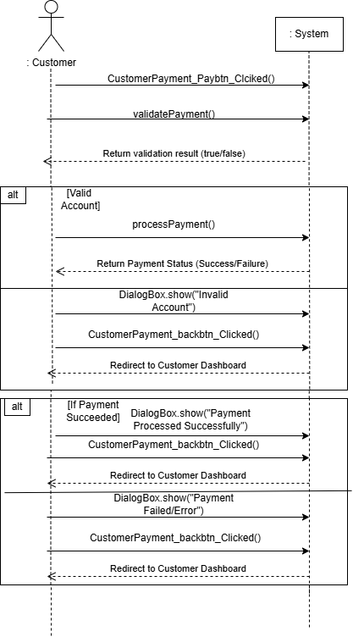
USE CASE: Processing Customer Payments

Slide 16
SEQUENCE DIAGRAMS

Slide 17
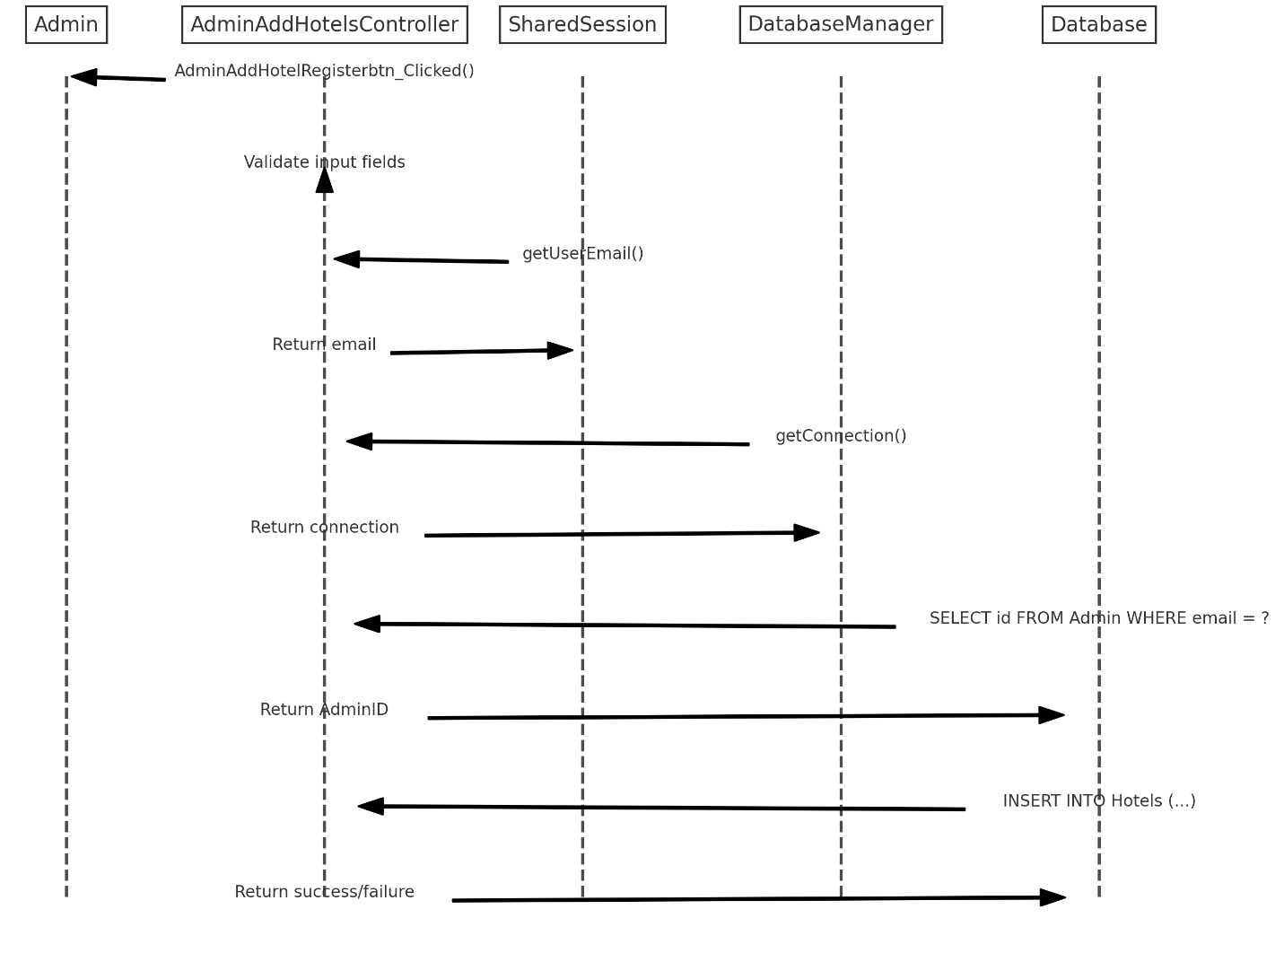
USE CASE: Adding new hotels

Slide 18
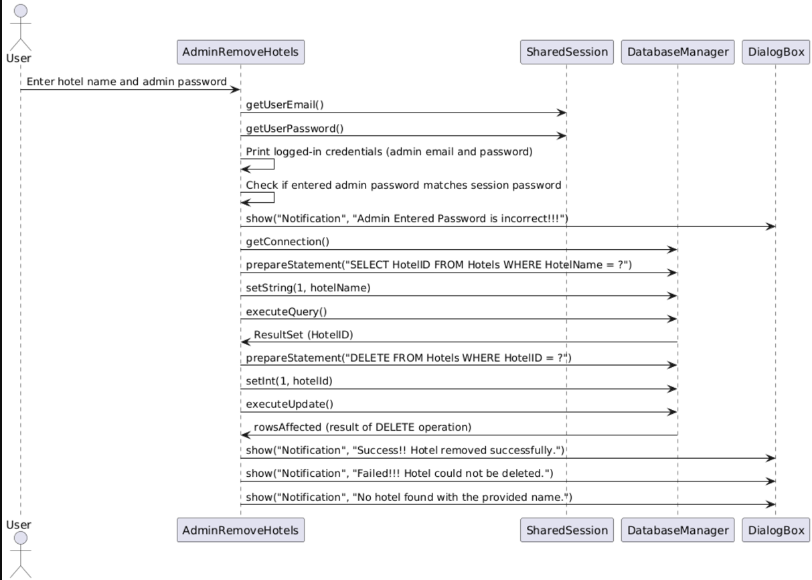
USE CASE: Removing hotels

Slide 19
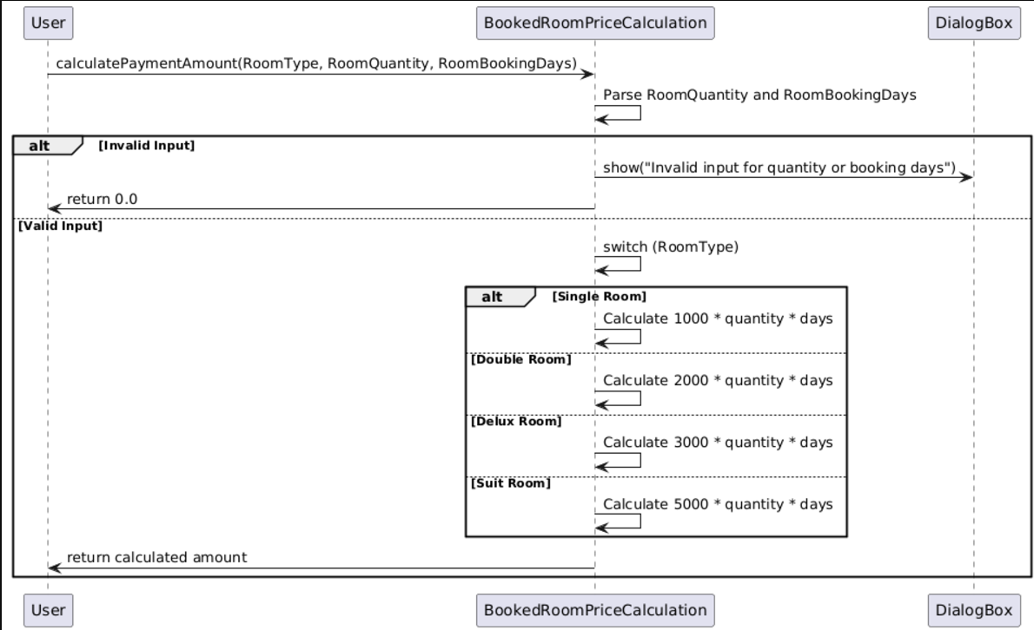
USE CASE: Price Calculation for Booked Rooms

Slide 20
GRASP PATTERNS

Slide 21
GRASP
1. INFORMATION EXPERT:
USED IN: SharedSession.java
DESCRIPTION: The SharedSession class is responsible for storing and managing user session data (email, password). It encapsulates the logic of managing this data, which aligns with the Information Expert pattern. The class acts as the "expert" for handling session-related information.
2. CONTROLLER
USED IN: All the Controller classes (e.g., AdminLoginController, UserLoginController, AdminDashboardController, AdminAddHotelsController, etc.)
DESCRIPTION: Each controller handles the flow of data between the UI and the backend logic. The controllers manage the user input and act as intermediaries between the view and the model (e.g., managing login, registration, hotel addition, etc.).

Slide 22
3. LOW COUPLING:
USED IN: Throughout the code
DESCRIPTION: The code is designed to minimize dependencies between classes. For example, AdminLoginController is responsible for the login process, while DatabaseManager handles database connections. This separation ensures that each class has a specific responsibility, and changes in one class are less likely to affect others.
4. HIGH COHESION:
USED IN: SharedSession, DatabaseManager, and the controller classes
DESCRIPTION: Each class has a clear responsibility. For example, SharedSession manages session-related operations, DatabaseManager handles database connections, and the controllers manage specific UI functionality. This clear separation of concerns leads to high cohesion.

Slide 23
DESIGN PATTERNS

Slide 24
1. SINGLETON
USED IN: SharedSession.java, DatabaseManager.java
DESCRIPTION: Both SharedSession and DatabaseManager classes follow the Singleton design pattern, ensuring that only one instance of these classes exists during the runtime of the application. SharedSession:
Ensures a single session instance is responsible for storing and accessing user session data.
DatabaseManager:
Ensures a single instance manages the database connection, preventing multiple connections being opened unnecessarily.

Slide 25
2. COMPONENTS
USED IN: The entire project can be considered as a component-based structure, where each Java class or module (e.g., AdminLoginController, DatabaseManager, SharedSession) represents a self-contained unit of functionality. However, there are no external third-party components or libraries in use beyond standard JavaFX, JDBC, and the database.

Slide 26
3. PACKAGE
DESCRIPTION: The entire project is encapsulated under one package.

Slide 27
4. FACTORY
DESCRIPTION: The Factory Pattern is about creating objects without specifying their concrete classes. We didn’t use it extensively, but the DatabaseManager’s connection method can be seen as a simple factory for providing database connections.

