Slide 1
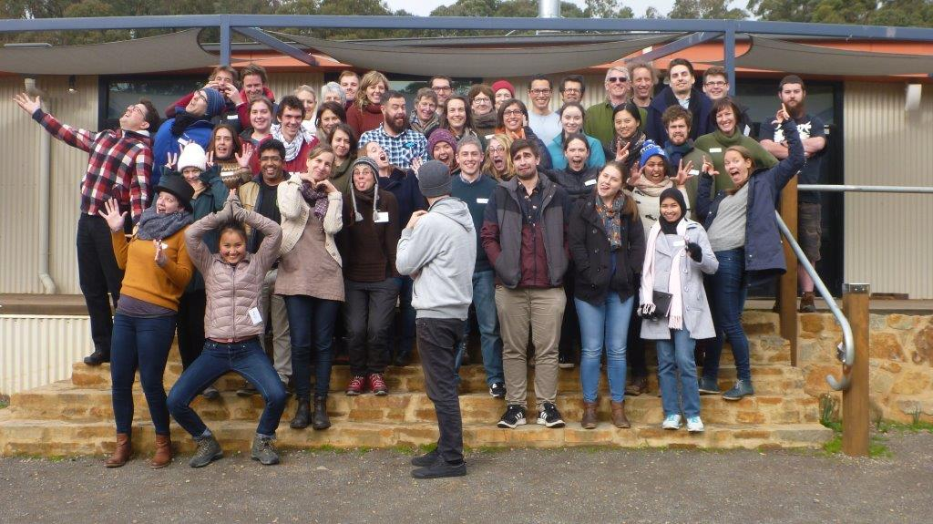
QAECO/CEBRA Retreat 2017
July 20-21, 2017

Slide 2
Welcome
Feedback in the DIG box
Wifi code:
Take pictures!
If you are going off site (for a walk, for example) please follow the buddy system! And make sure someone at camp knows you are leaving and when you plan to return.
Re: evening activities: Let’s keep noise levels down and be respectful of everyone’s personal choices.

Slide 3
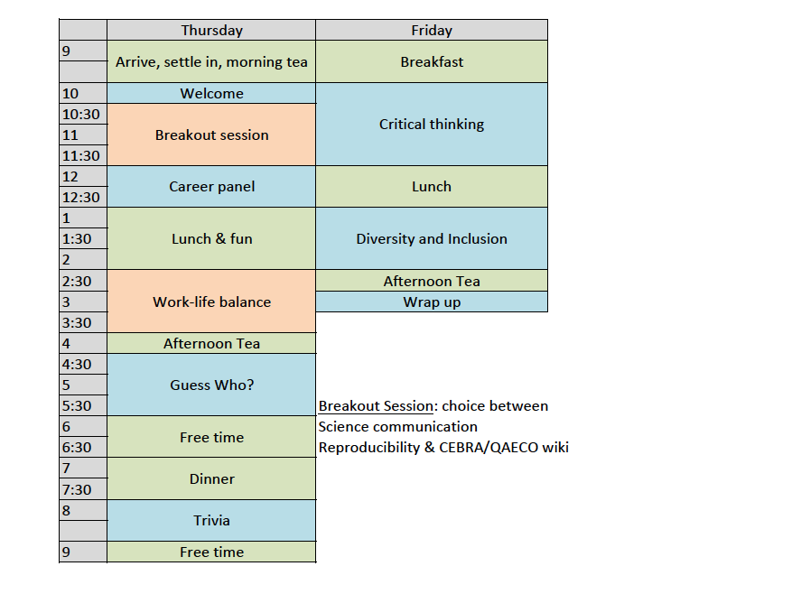

Slide 4
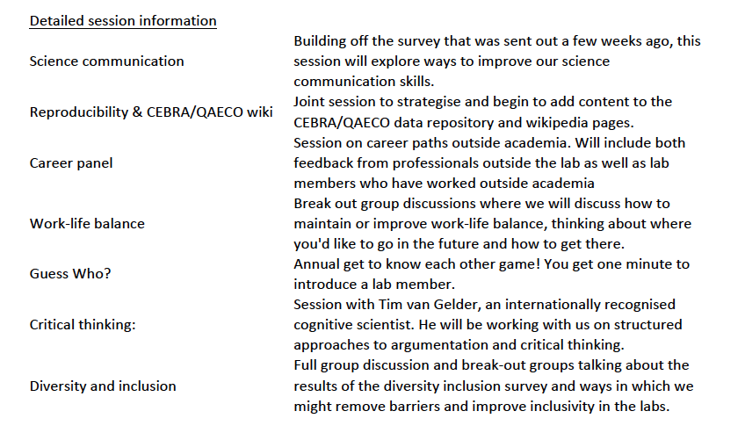

Slide 5
Thank you
Forces of nature
Pauline Byron
Dolla Boutros
Session organisers
Tianxiao Hao
Kylie Soanes
Jian Yen
Reid Tingley
Elise Gould
Casey Visintin
Libby Rumpff
Natasha Cadenhead
Dave Duncan
Trivia
Nick Golding
Career panel
Peter Vesk
Kat Selwood
DIG committee
Edith Arndt
Manisha Bhardwaj
Natasha Cadenhead
Nick Golding
Elise Gould
Rebecca Groenewegen
Cindy Hauser
Bronwyn Hradsky
Simon Kapitza
Liz Martin
Kat Selwood
CeQROC
Emily McColl-Gausden
Natasha Cadenhead
James Camac
Peter Vesk
Saras Windecker
Lab PIs for funding!
Jane Elith
Mick McCarthy
Andrew Robinson
Pete Vesk
Brendan Wintle

