Slide 1


Conducting Systematic Literature Reviews and Meta-analyses
Lucie Bland and Saras Windecker
May 2017

Slide 2
Why conduct a review?
Synthesizing literature on a topic.
Identifying research gaps.
Quantitatively reviewing evidence from multiple studies.
Testing ecological theory.
Informing conservation decisions and policy.
Three types of reviews:
Narrative reviews
Systematic literature reviews
Meta-analyses
Notes:
Lucie
Where our inspiration came from

Slide 3
Quantitative reviews vs narrative reviews
Issues with narrative reviews:
Difficult to conduct by novices (PhDs, post-docs).
Do not transparently synthesize pros and cons.
Can be difficult to publish.
Quantitative reviews:
Reproducible and transparent.
Summarize the literature in a more objective way.
Inform evidence-based decisions.
Can be updated (~ 10 years).
Lucie’s systematic review on collapse:
We aim to bridge the gap between theory and practice by synthesizing evidence on ecosystem collapse across contrasting biomes (marine pelagic ecosystems and temperate forests).
Notes:
Lucie
We developed recommendations for a consistent framework for defining ecosystem collapse based on the outcomes from the review.

Slide 4
Systematic literature review vs meta-analysis
Meta-analysis includes a systematic review (i.e. systematic search).
Systematic literature review more appropriate when studies are diverse and use different methods, and emerging areas.
Meta-analyses record parameters from models and therefore rely on consistent methods.
Differences in how you extract, code, and display data.
BOTH: should have your question, objectives and analyses in mind ahead.
Saras’ meta-analysis of functional recovery in restored wetlands:
How do the functional composition of a wetland vegetation community and the biogeochemical functions of a wetland differ in restored and natural wetlands, and what factors impact the heterogeneity of that relationship?
Notes:
Saras

Slide 5
Meta-analysis aim
Estimate an overall effect
Explain heterogeneity Covariates to describe between study variation
Fixed-effects model Assume no variation between study effects
Factorial
Factors and interactions
Mixed effects Both fixed and random effects are included
Fixed effects
Compare fixed categories or levels of variables
Notes:
Saras

Slide 6
Questions and objectives
Lucie’s systematic literature review on collapse:
Aim: We aim to bridge the gap between theory and practice by synthesizing evidence on ecosystem collapse across contrasting biomes (marine pelagic ecosystems and temperate forests).
Outcomes: Saras’ meta-analysis on …
Aim: We seek to understand the functional recovery of wetland ecosystems How does the functional composition of a wetland vegetation community differ in restored and natural wetlands, and what factors impact the heterogeneity of that relationship?
Outcomes: How do biogeochemical functions of a wetland differ in restored and natural wetlands, and what factors impact the heterogeneity of that relationship?
Notes:
Lucie

Slide 7
Where to begin?
What broad areas impact your topic.
What are important components to understand?
What literature do you already know that is relevant? (what methods, terms, and ideas are used?).
Have narrative or quantitative reviews already been done on the topic?
Quantitative reviews are an iterative process and take time.
Notes:
Lucie

Slide 8
Work flow
https://www.griffith.edu.au/environment-planning-architecture/griffith-school-environment/research/systematic-quantitative-literature-review
Notes:
Lucie

Slide 9
Define topic
What it is (where, what taxa/groups, what methods …).
What it’s NOT (this will inform your exclusion criteria).
Research questions and objectives (expect many gaps).
Links to management?
1. How many papers?
2. Who publishes?
3. Where has research been done?
4. What disciplines do research on this topic?
5. What methods are used?
6. What has been found/ demonstrated?
7. What is missing, what are the gaps?
Notes:
Saras

Slide 10
Search the literature
Identify keywords (synonyms, plurals, uses in different disciplines).
Include grey literature?
Search databases (talk to librarians! Don’t use Google Scholar!).
Keywords must be edited for each database.
Refine keywords based on preliminary search (to exclude irrelevant stuff).
Lucie’s collapse review keywords:
Results: 438
(from Web of Science Core Collection)
You searched for: TOPIC: (Marine AND open ocean* OR shelf OR upwelling) AND TOPIC: (Ecosyst* OR communit*) AND TOPIC: (collaps* OR "ecological shift*" OR regime shift* OR phase shift* OR state shift* OR catastrophic shift* OR "community shift*" OR abrupt shift* OR catastrophic chang* OR abrupt chang* OR "state chang*" OR trophic cascad* OR alternat* stat* OR hysteresis OR tipping point* OR reference point*) AND DOCUMENT TYPES: (Article) NOT TOPIC: (mangrove OR coral OR oyster OR mussel OR reef OR estuar* OR lagoon OR bay OR *bacteri* OR microb* OR aquaculture OR quaternary OR palaeo* OR holocene OR triassic OR rocky OR intertidal OR kelp OR urchin)
Notes:
Saras

Slide 11

Selecting papers
Abstract and title, then full text
Exclusion criteria.
Assess quality.
Number of screened papers: 1,500. 3% make it to full text screening and 1% are eligible.
Search reference lists of selected papers.
Saras’ exclusion criteria:
Restored wetlands had to be recreated where wetlands had once occurred and created wetlands were defined as those built where no wetlands previously existed.
Articles must compare measurements of structural components and biogeochemical processes in restored or created and reference wetlands at a known age.
Data must not be averaged over more than 5 years.
Data must not be averaged across size patches differing by more than one order of magnitude.
Restored and reference conditions must be comparable.
Restored wetlands should not have imported allochthonous substrate, non-native vegetation, or un-natural hydrological regimes.
Notes:
Saras

Slide 12
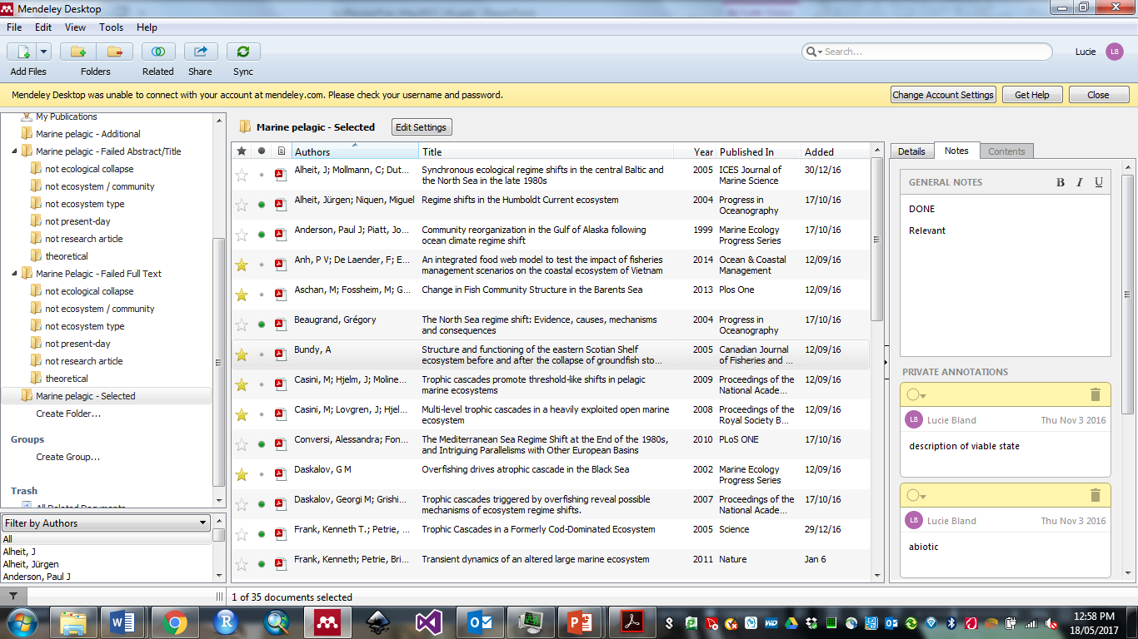
Record papers
Reference manager importance (Endnote vs Mendeley). BACKUP !!!!
What to record.
Notes:
Lucie

Slide 13
PRISMA Statement
Preferred Reporting Items for Systematic reviews and Meta-Analyses statement
Step | Marine pelagic | Temperate forests
Publications identified in electronic databases | 304 (Web of Science) 52 (Science Direct) | 432 (Web of Science) 70 (Science Direct)
Additional Publications identified in reference lists | 18
Publications after duplicates removed | 316 | 454
Publications screened | 316 | 452
Publications excluded at abstract stage | 227 | 365
Publications assessed for eligibility (full-text) | 90 | 87
Publications excluded after full-text assessment | 73 | 39
Publications included in quantitative synthesis and analysis | 35 | 48
Moher, D., A. Liberati, J. Tetzlaff, D. G. Altman, and P. G. The. 2009. Preferred Reporting Items for Systematic Reviews and Meta-Analyses: The PRISMA Statement. PLoS Med 6:e1000097.
Notes:
Lucie

Slide 14
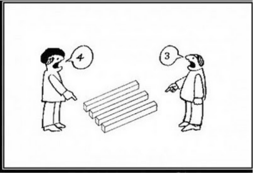
Extract data
Helpful to extract a portion, say 10%, then check for strategy.
Review search words, exclusion criteria, and database.
You HAVE to do it if multiple people are involved (Kappa statistic).
Notes:
Lucie

Slide 15
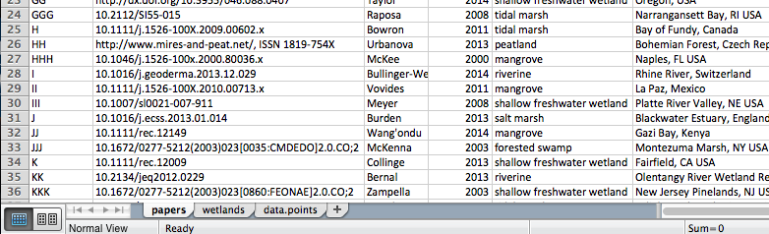
Structure your master database
Bibliographic info + geographic info (think of your figures/tables)
Research methods
Scoring as categorical variables
Evidentiary in how you score things
Studies are published with different objectives – poses challenges for extracting your topic of interest
Data may be in figures or in supplement
Notes:
Saras
- Screenshot excel with multiple tabs

Slide 16
Effect sizes
Your measure for comparison
One of the most common types of meta-analysis data is comparison of two means. For example, before and after treatment, across your studies.
For this, we might use a standardised difference of means. The most common measure of which is Hedges’ d.
It is unaffected by unequal sample variances, and includes a correction factor for small sample sizes.
An alternative effect size is ratio of means.
The Response Ratio R is a measure of the ratio of means of two groups.
Ratios have poor statistical quality, so we tend to transform R using the natural logarithm.
Notes:
Saras

Slide 17
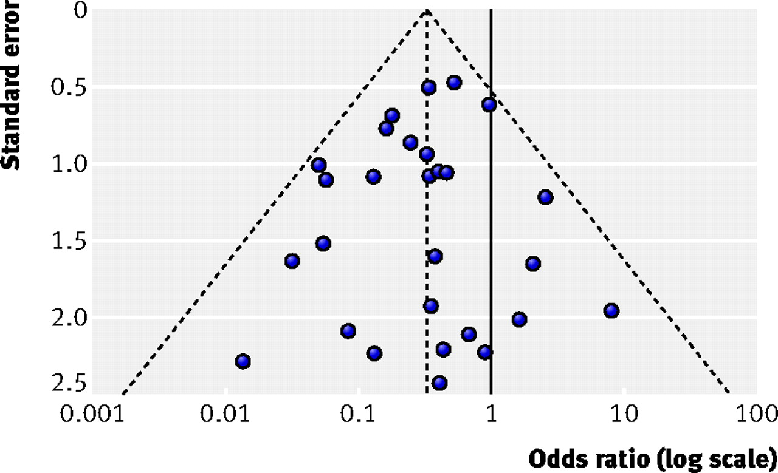
Publication bias
Need to detect potential publication bias in effect size estimates due to narrow bias or to exclusion of studies.
Many ways to examine bias, one example is funnel plots.
Sterne J, Sutton A, Ioannidis J, Terrin N, Jones D, Lau J et al. Recommendations for examining and interpreting funnel plot asymmetry in meta-analyses of randomised controlled trials. BMJ 2011; 343:d4002.
Egger M, Davey Smith G, Schneider M, Minder C. Bias in meta-analysis detected by a simple, graphical test. BMJ 1997; 315:629-34
Notes:
Saras

Slide 18
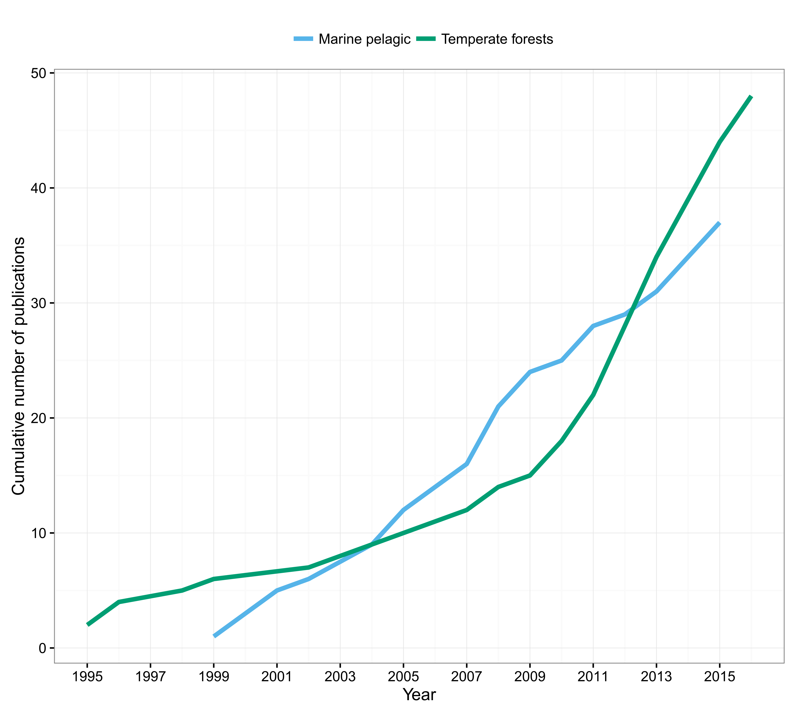
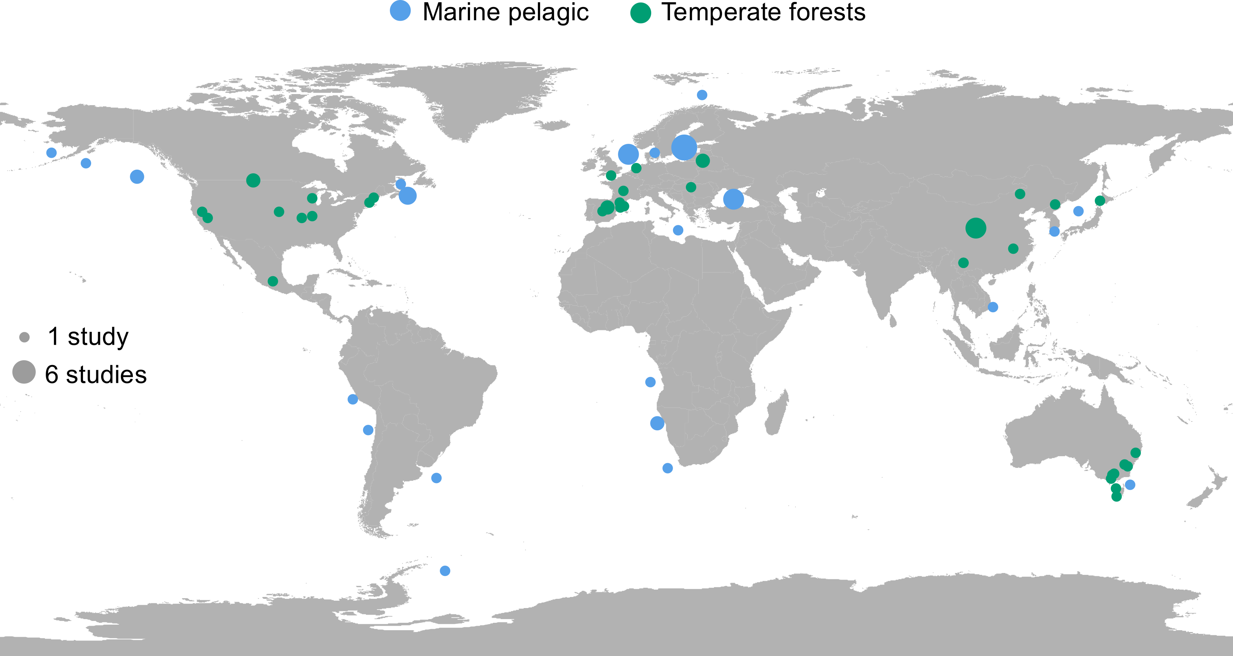
Summarise your data
 |  | Percentage studies
Category |  | Marine pelagic | Temperate forests
Research methods
Observational†** |  | 84 | 48
Experimental |  | 0 | 4
Predictive modelling |  | 24 | 52
Spatial comparison†** |  | 0 | 21
Temporal comparison |  | 100 | 94
Ecosystem definition
Biota†* |  | 97 | 75
Environment†* |  | 92 | 67
Processes |  | 78 | 71
Distribution |  | 76 | 81
All aspects of definition |  | 49 | 21
Collapse definition
Quantitative |  | 65 | 79
Collapse transition
Trophic restructuring Climatic shift Community shift Eutrophication recovery Distribution shift |  | 46 40 11 3 0 | 0
 |  |  | 23
 |  |  | 4
 |  |  | 0
 |  |  | 52
Disturbance shift |  | 0 | 6
Stochastic disturbance |  | 0 | 15
Reversible collapsed state |  | 6 | 4
Notes:
Lucie

Slide 19
Publishing your systematic review
Some journals that publish literature reviews:
Frontiers in Ecology and the Environment (any type, mostly narrative, 3,500 words)
Global Change Biology (any type, 8,000 words)
Diversity and Distributions (any type, 5,000 words)
Journal of Applied Ecology (any type, 8,000 words)
Global Ecology and Biogeography (Meta-analysis, Research reviews)
Biological Conservation (Review 12,000, Systematic review 8,000)
Conservation Biology (Reviews, 7,500)
Notes:
Lucie

Slide 20
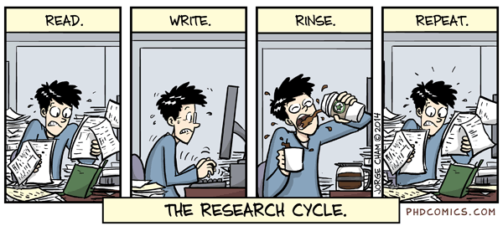
Conclusions
Quantitative reviews are more useful and have better chance at publications.
The benefit of hindsight.
The devil is in the detail.
Your eyes will hurt, and you will never want to read again.
Notes:
Saras

Slide 21

Dive in!
Lucie Bland
l.bland@deakin.edu.au
Saras Windecker
windeckers@student.unimelb.edu.au
Resources:
https://www.griffith.edu.au/environment-planning-architecture/griffith-school-environment/research/systematic-quantitative-literature-review
Handbook of Meta-analysis in Ecology and Evolution – Gurevitch, Mengersen, & Koricheva
Notes:
Saras

