Slide 1
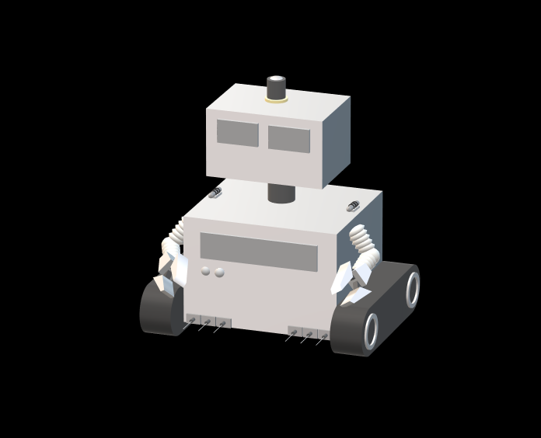
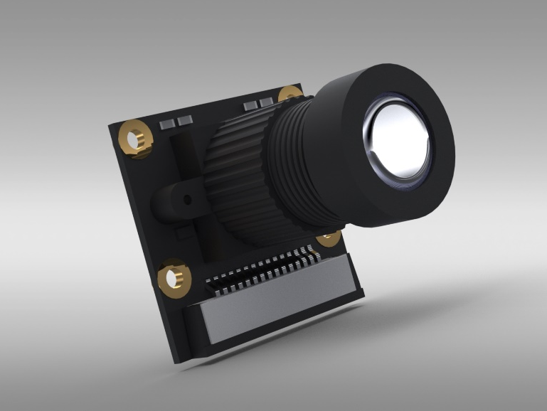
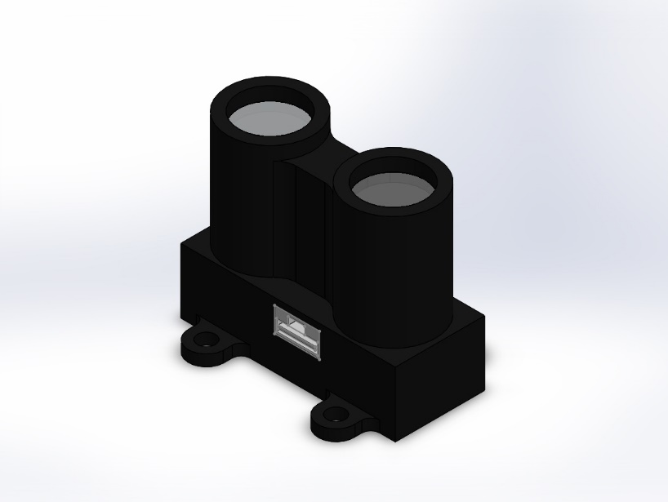
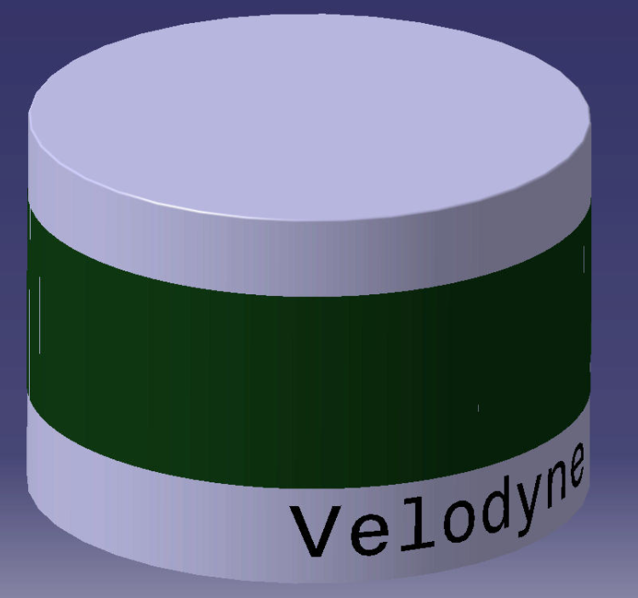
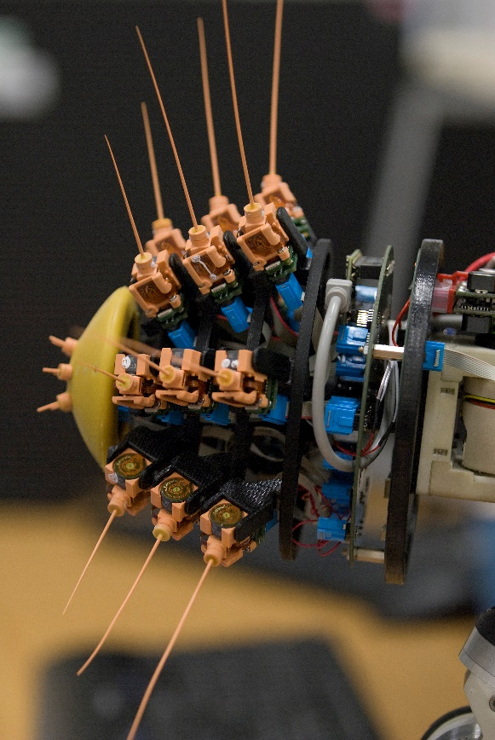
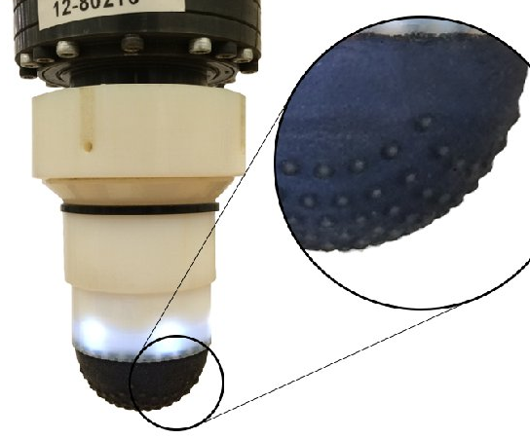
L.I.D.A.R – Light Detection and Ranging. Emits a laser to detect nearby walls and surfaces. Useful in Low light Conditions
Camera – Low resolution camera for navigation, high resolution for sample collecting
Temperature Sensors – One on each side for detecting proximity heat sources
Whisker Sensors – Tactile sensor able to discern material surface textures
A camera will allow you to see what your robot is seeing.
Pros: It’s very intuitive to use as it is a substitute for your eyes
Cons: Like your eyes, it’s not very good in low light conditions.
It also produces a lot of information which has to be sent back to you, aka ‘high bandwidth’ so the live feed is low quality
LIDAR is the short name for “light detection and ranging” or “laser imaging, detection and ranging”.
This sensor shoots a pulsed laser beam, that will bounce off an object in its path, and collects the return signal. By analysing the travelling time between the emitting and receiving laser pulses the sensor can calculate the distance to that object.
Pros: It doesn’t care about the light conditions of the environment. It can collect a great amount of data and it is very accurate.
Cons: Its performance can be affected by refractive surfaces and noisy obstructions.
Often we make the sensor spin so we can collect information about the area in front
The ‘whisker sensor’ is actually a mash up of two real world sensors! – the vibrissae sensor (Pearson ’11) and the Tactip (Lepora ’17).
The vibrissae has long sticks attached to switches. When they touch something, the vibrissae trigger telling the robot something is there..On the end of these vibrissae, we could put Tactips.
The Tactips and tactile sensors with a squishy cup on the end. When pushed onto a surface the cup deforms, allowing the robot to sense information about the texture it has touched.
When combined with ‘machine learning’ the robot can learn to recognise what textures correspond to which materials too.
Pros: It will allow our robot to collect tactile/ texture data.
Cons: The robot has to physically be really close to the object to collect it.

