Slide 1
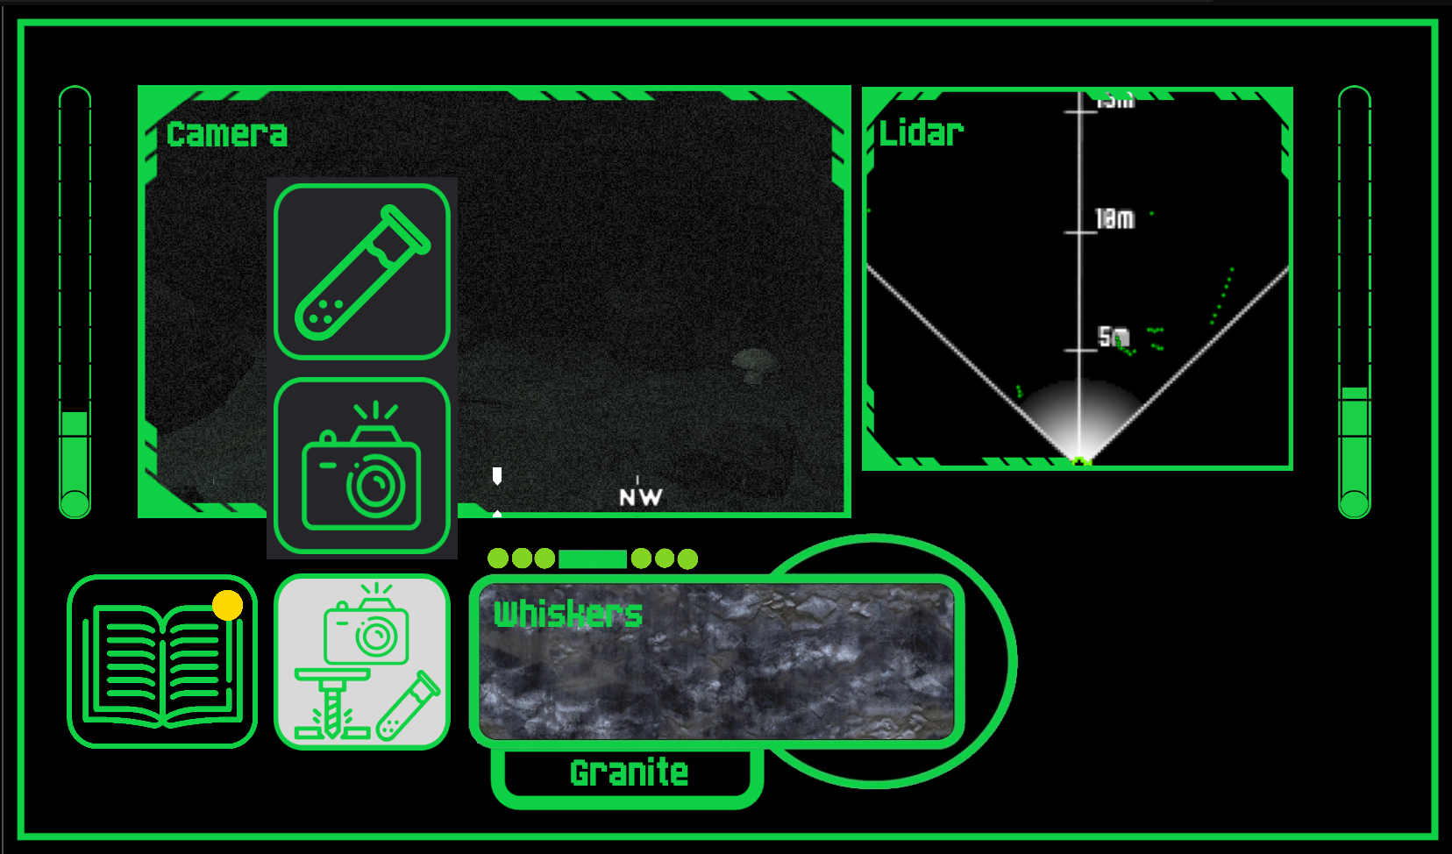


Click to take a sample
Use joystick, WASD or arrow keys to move
Click to take a high resolution photo
Click to access Special Actions
Journal and Mission Log

Slide 2
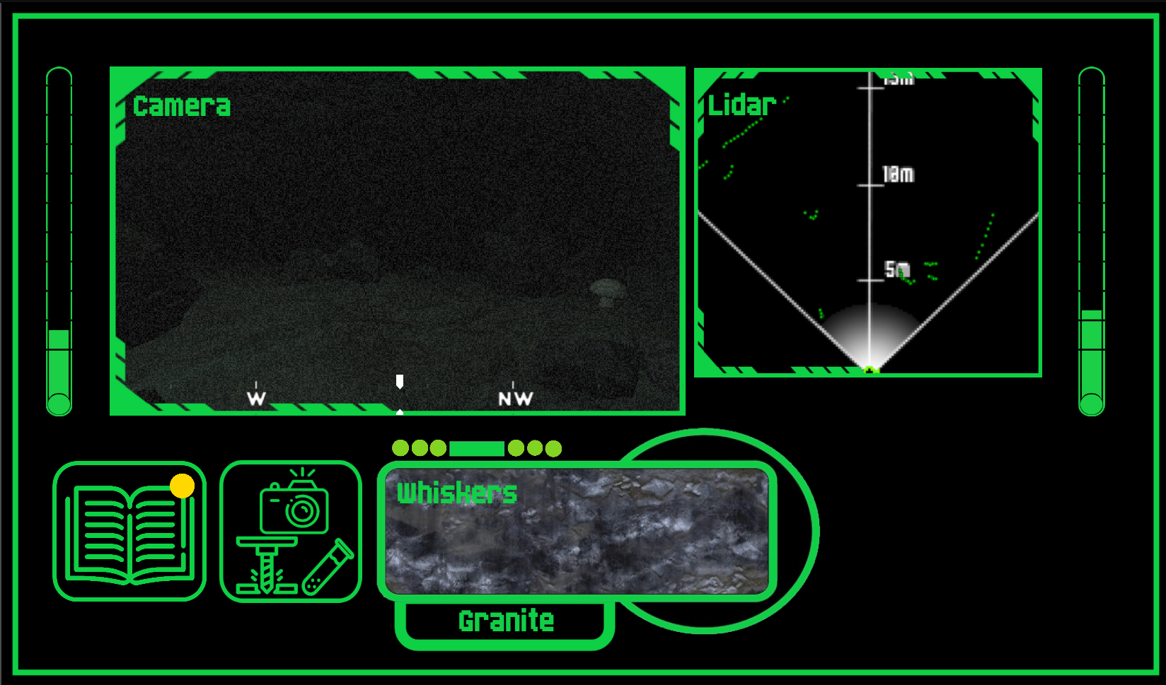
Left Temperature Sensor
Right Temperature Sensor
Front Facing Camera View
High
Compass
Low
Objective Updated Indicator

Slide 3
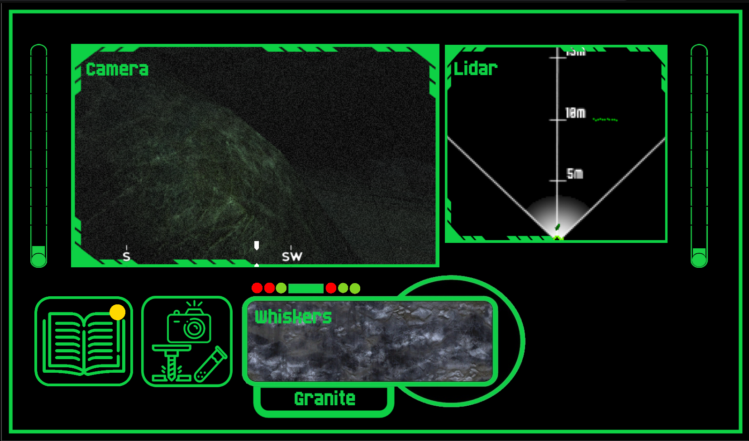
Front Facing Lidar
(Green dots show obstacles/walls)
Which whisker on the front of the robot detected the object
Whisker Detected Texture
Whisker Material Detected

