Slide 1

Expert elicitation - Cotopaxi
28-Feb-2025

Slide 2
Experts' weights
Expert elicitation 28-Feb-2025

Slide 3
Experts' weights
Expert elicitation 28-Feb-2025
Equal weight = 10.00
For Cookes' method, below threshold weight does not mean zero score. It simply means that this expert's knowledge was already contributed by other experts and adding this expert would not change significantly the results.
Expert ID | Cooke
Exp1 | Below threshold
Exp2 | Below threshold
Exp3 | Below threshold
Exp4 | Below threshold
Exp5 | Below threshold
Exp6 | Below threshold
Exp7 | Below threshold
Exp8 | Below threshold
Exp9 | 61.44
Exp10 | 38.56

Slide 4
Seed Answers
Expert elicitation 28-Feb-2025

Slide 5
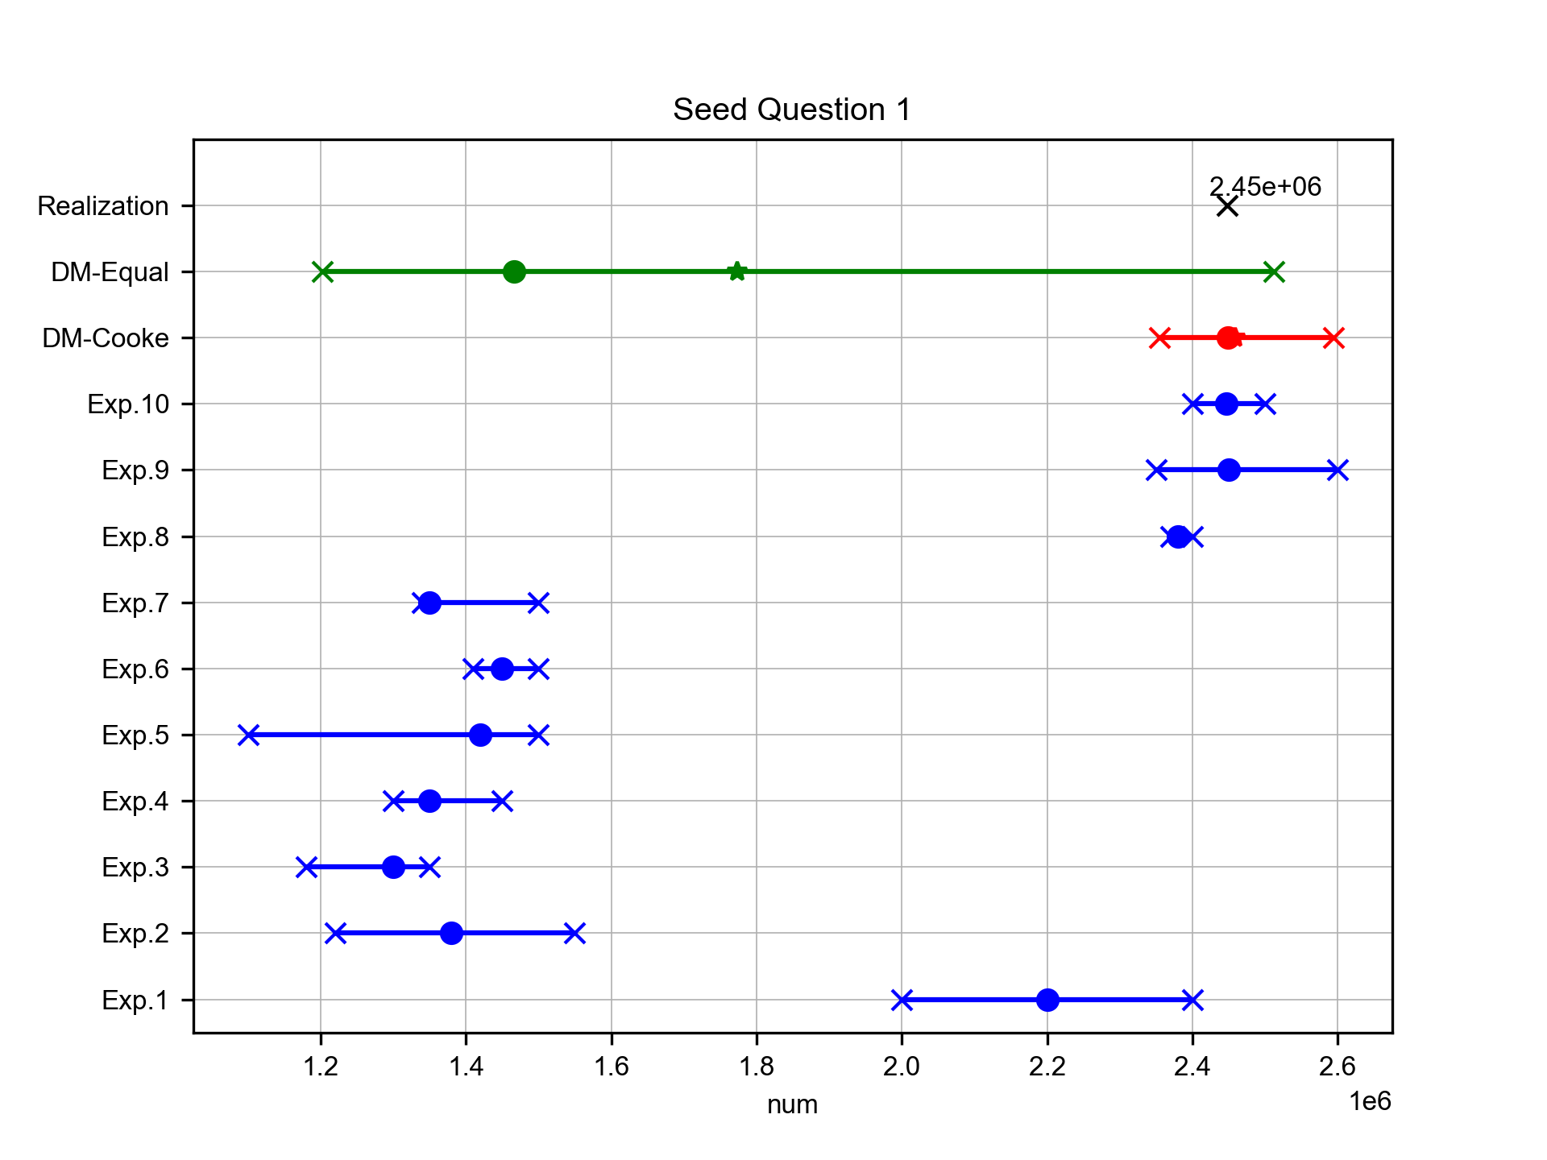
Total Containers Flow in 2024 (TEUs)
Expert elicitation 28-Feb-2025
The guess for the total container throughput at Genoa in 2022 is

Slide 6
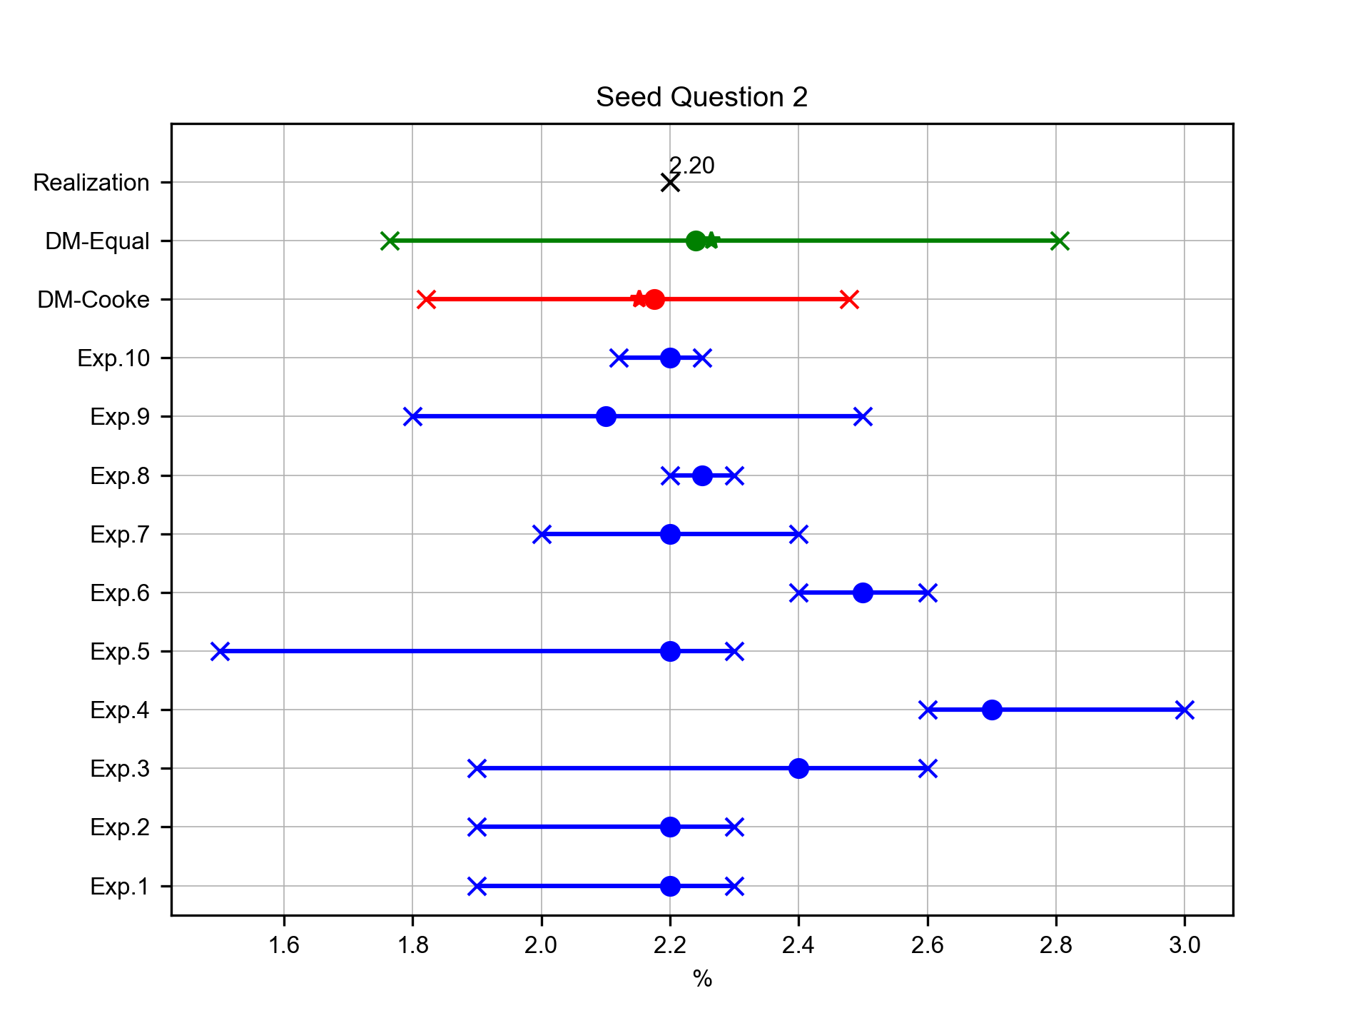
Growth Rate of Container Traffic 2023 to 2024 (%)
Expert elicitation 28-Feb-2025
The guess for the annual growth rate of container traffic in Genoa ports (2022-2024)

Slide 7
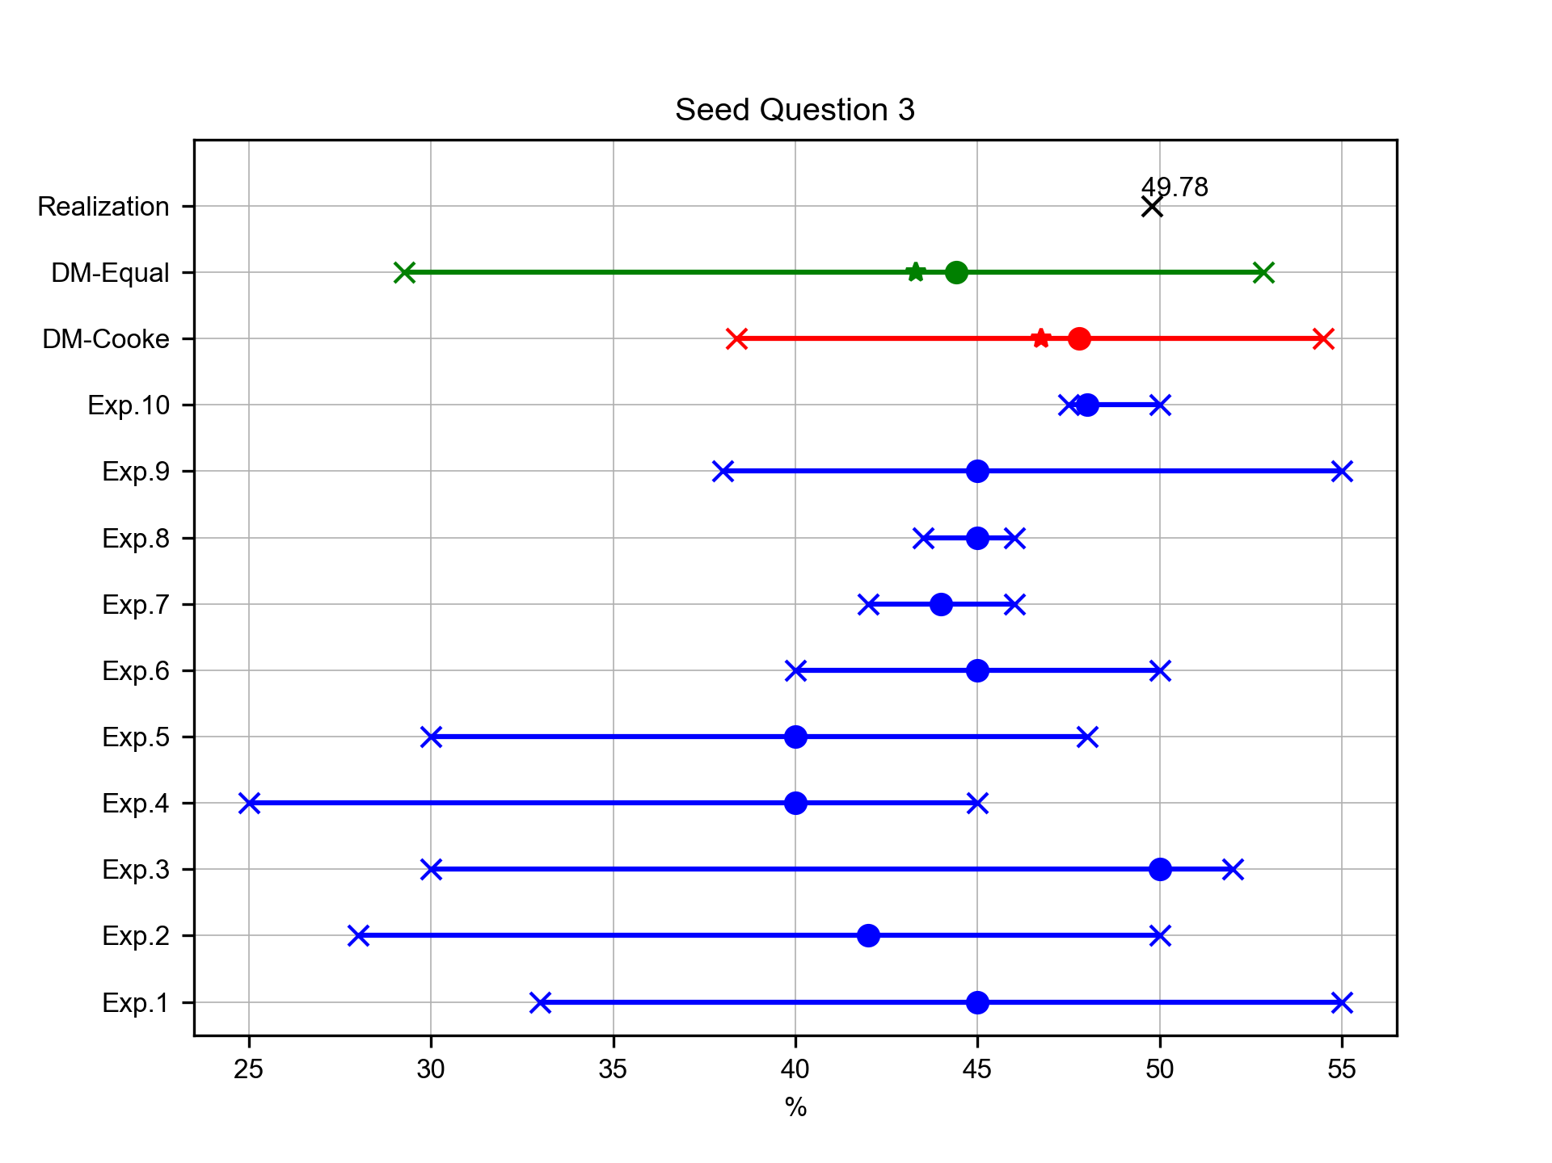
Import flow type percentage in 2024 (%)
Expert elicitation 28-Feb-2025
The guess for the percentage of North Italy’s total trade flow handled by the Port of Genoa

Slide 8
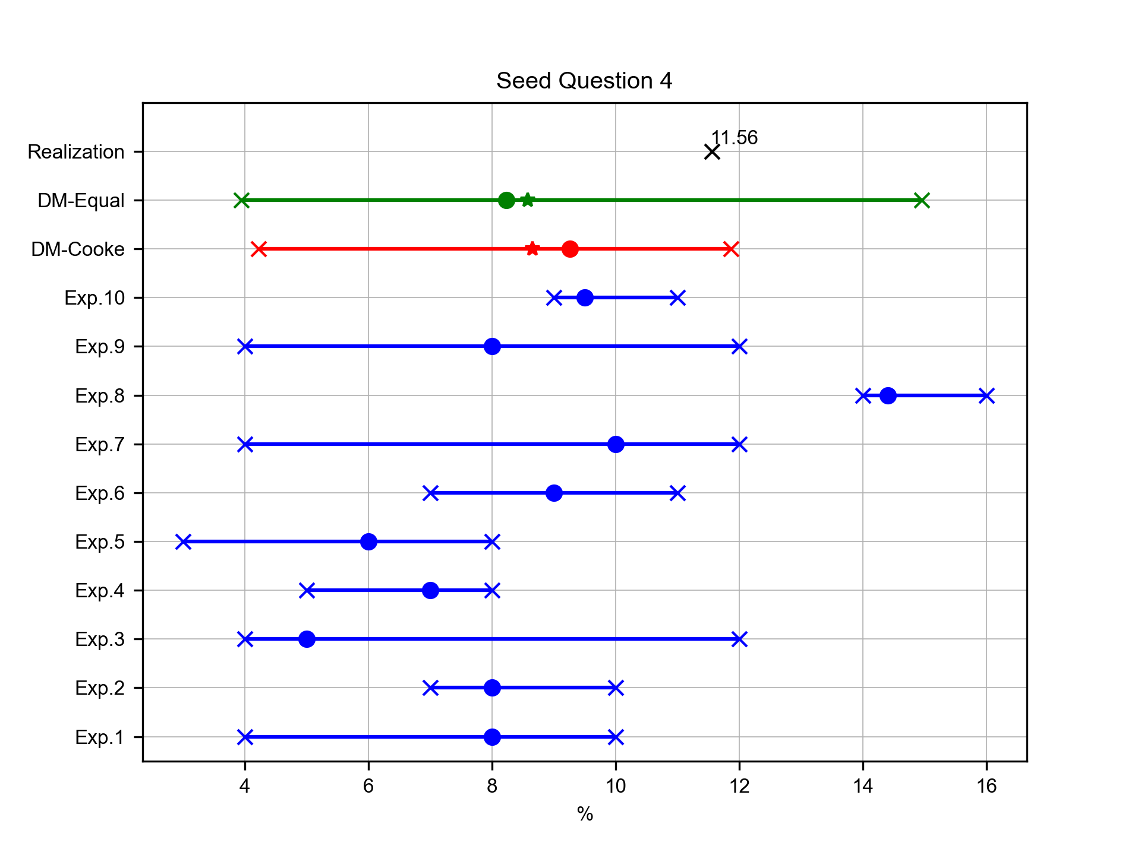
Transhiped flow mode percentage in 2024 (%)
Expert elicitation 28-Feb-2025
The guess for the average turnaround time for container vessels at major North Italy ports in 2024 i

Slide 9
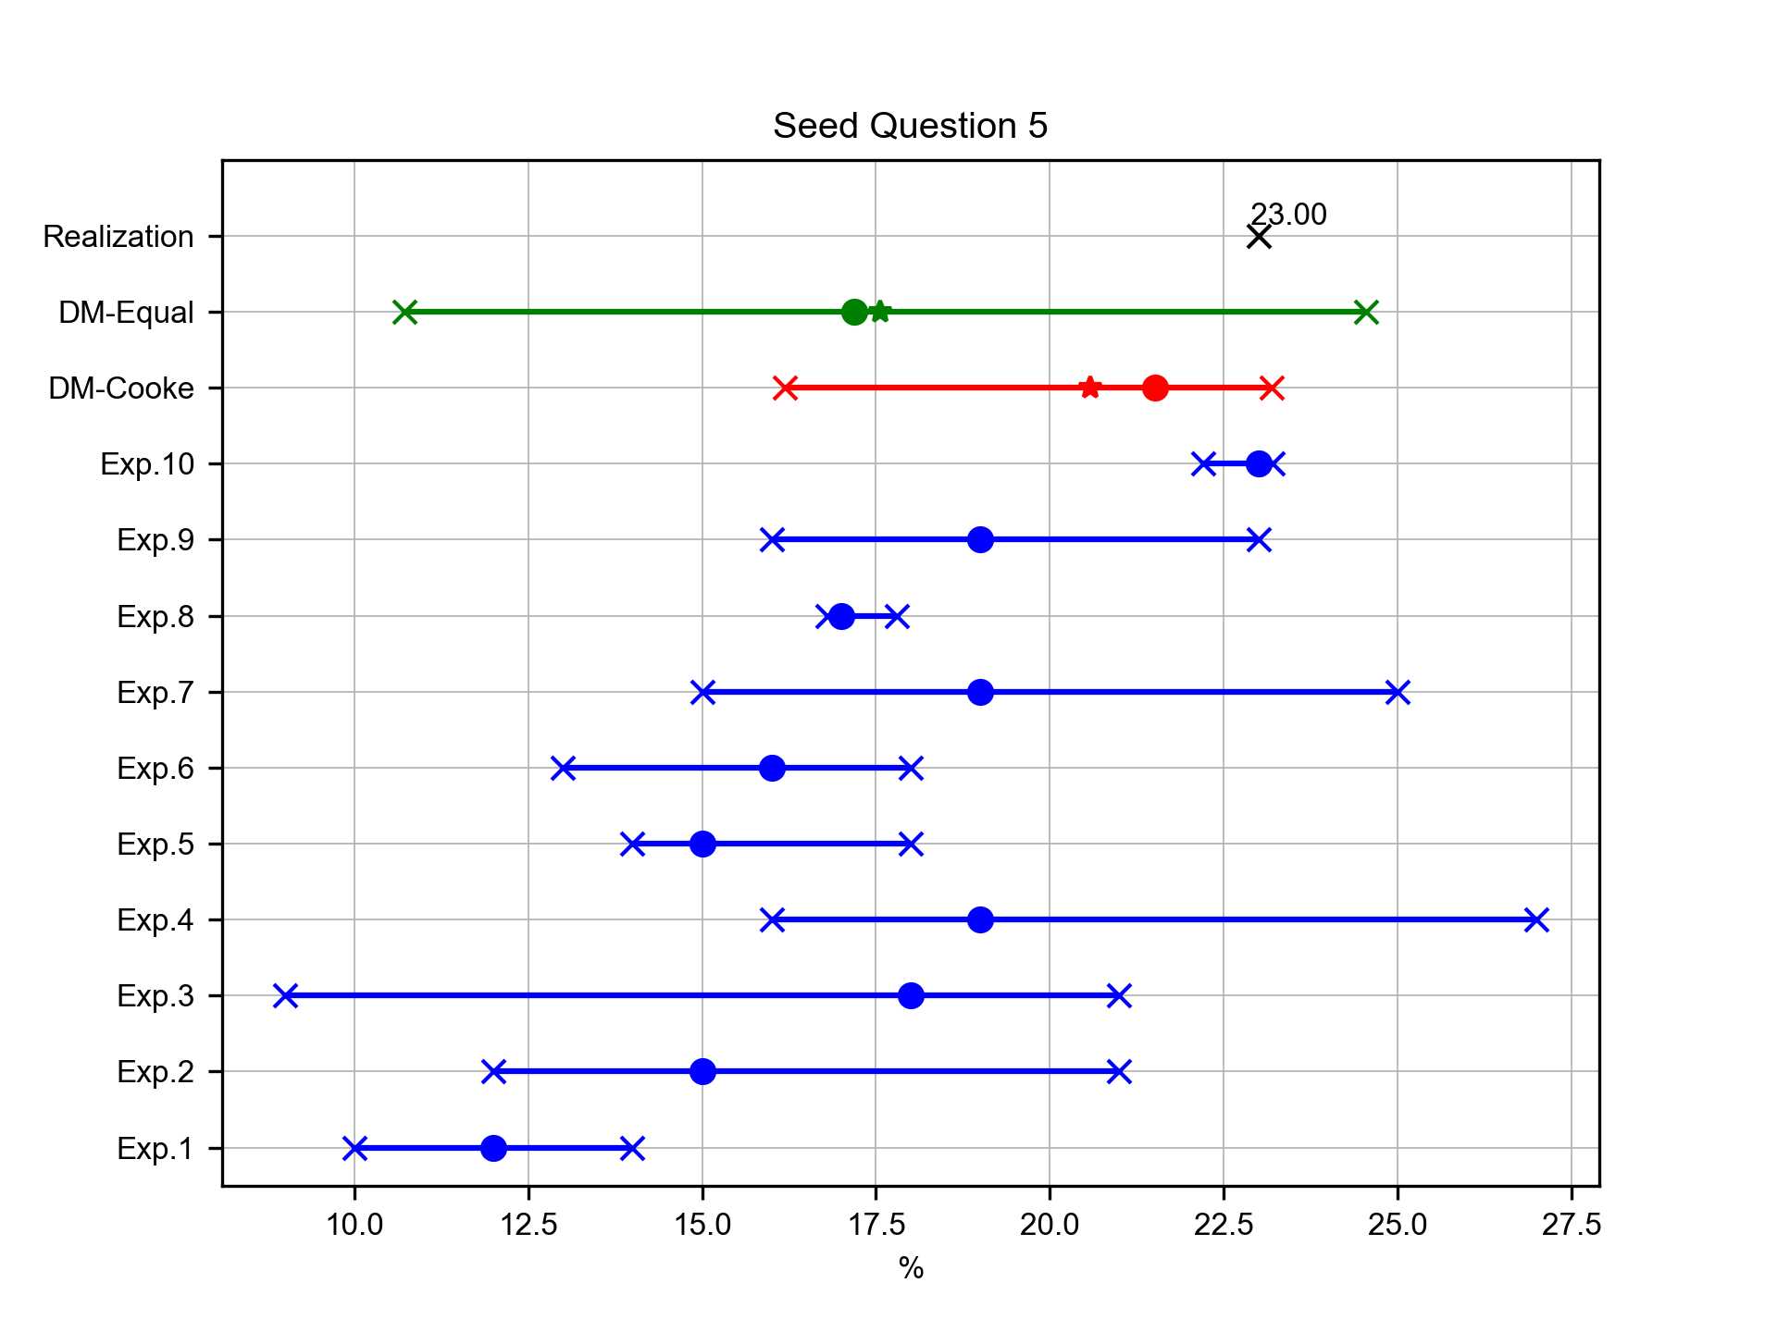
Empty containers percentage in 2024 (%)
Expert elicitation 28-Feb-2025
The guess for the total number of operational cranes at the Major North Italy Ports in 2024

Slide 10
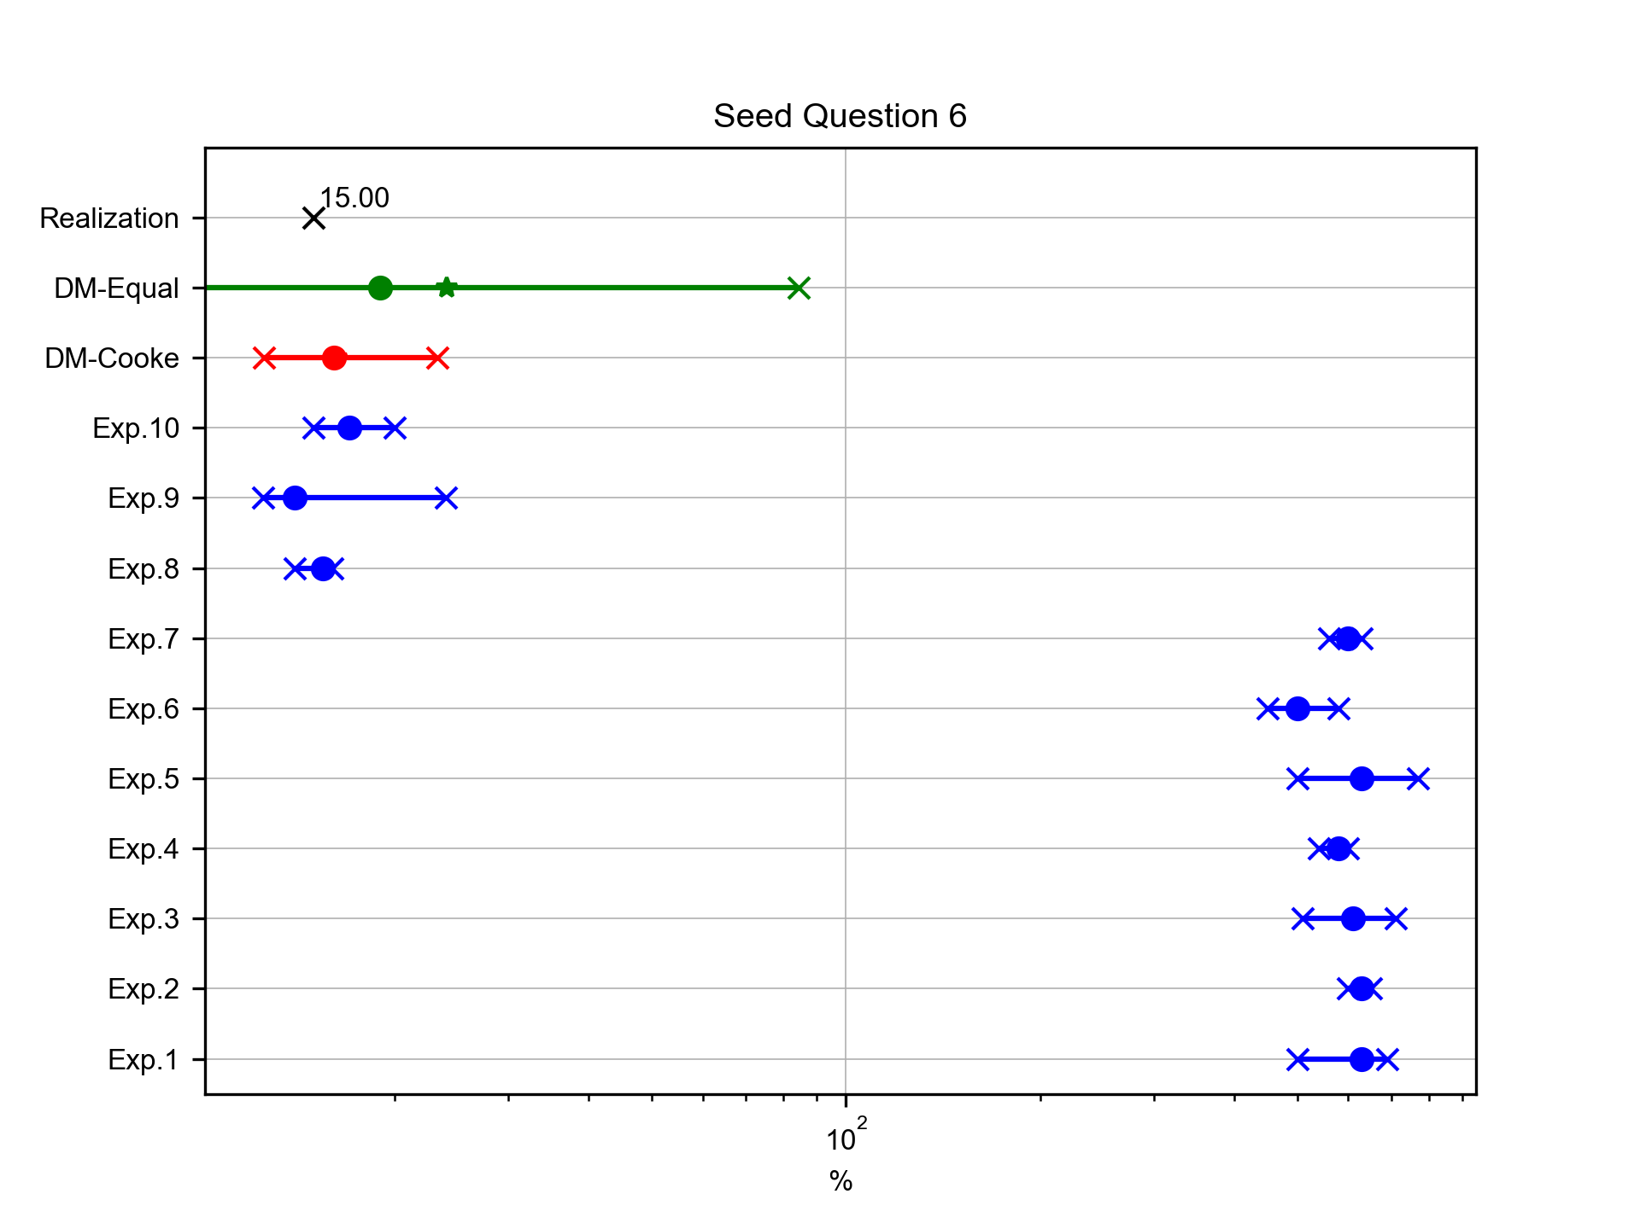
Total gateway container flow was transported by rail in 2024 (%)
Expert elicitation 28-Feb-2025
The guess for the TEUs handled per crane per day in Genoa ports in 2024

Slide 11
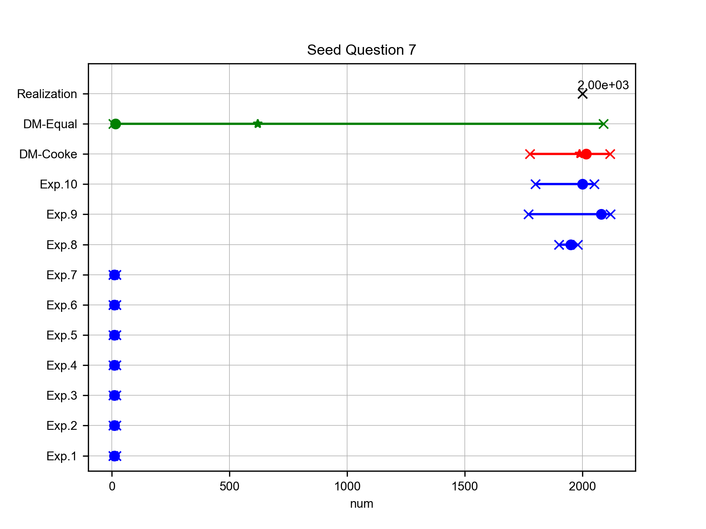
Number of train operated genova to paduva in 2024
Expert elicitation 28-Feb-2025
The guess for the percentage of total cargo transport handled by trains at the Port of Genoa in 2024

Slide 12
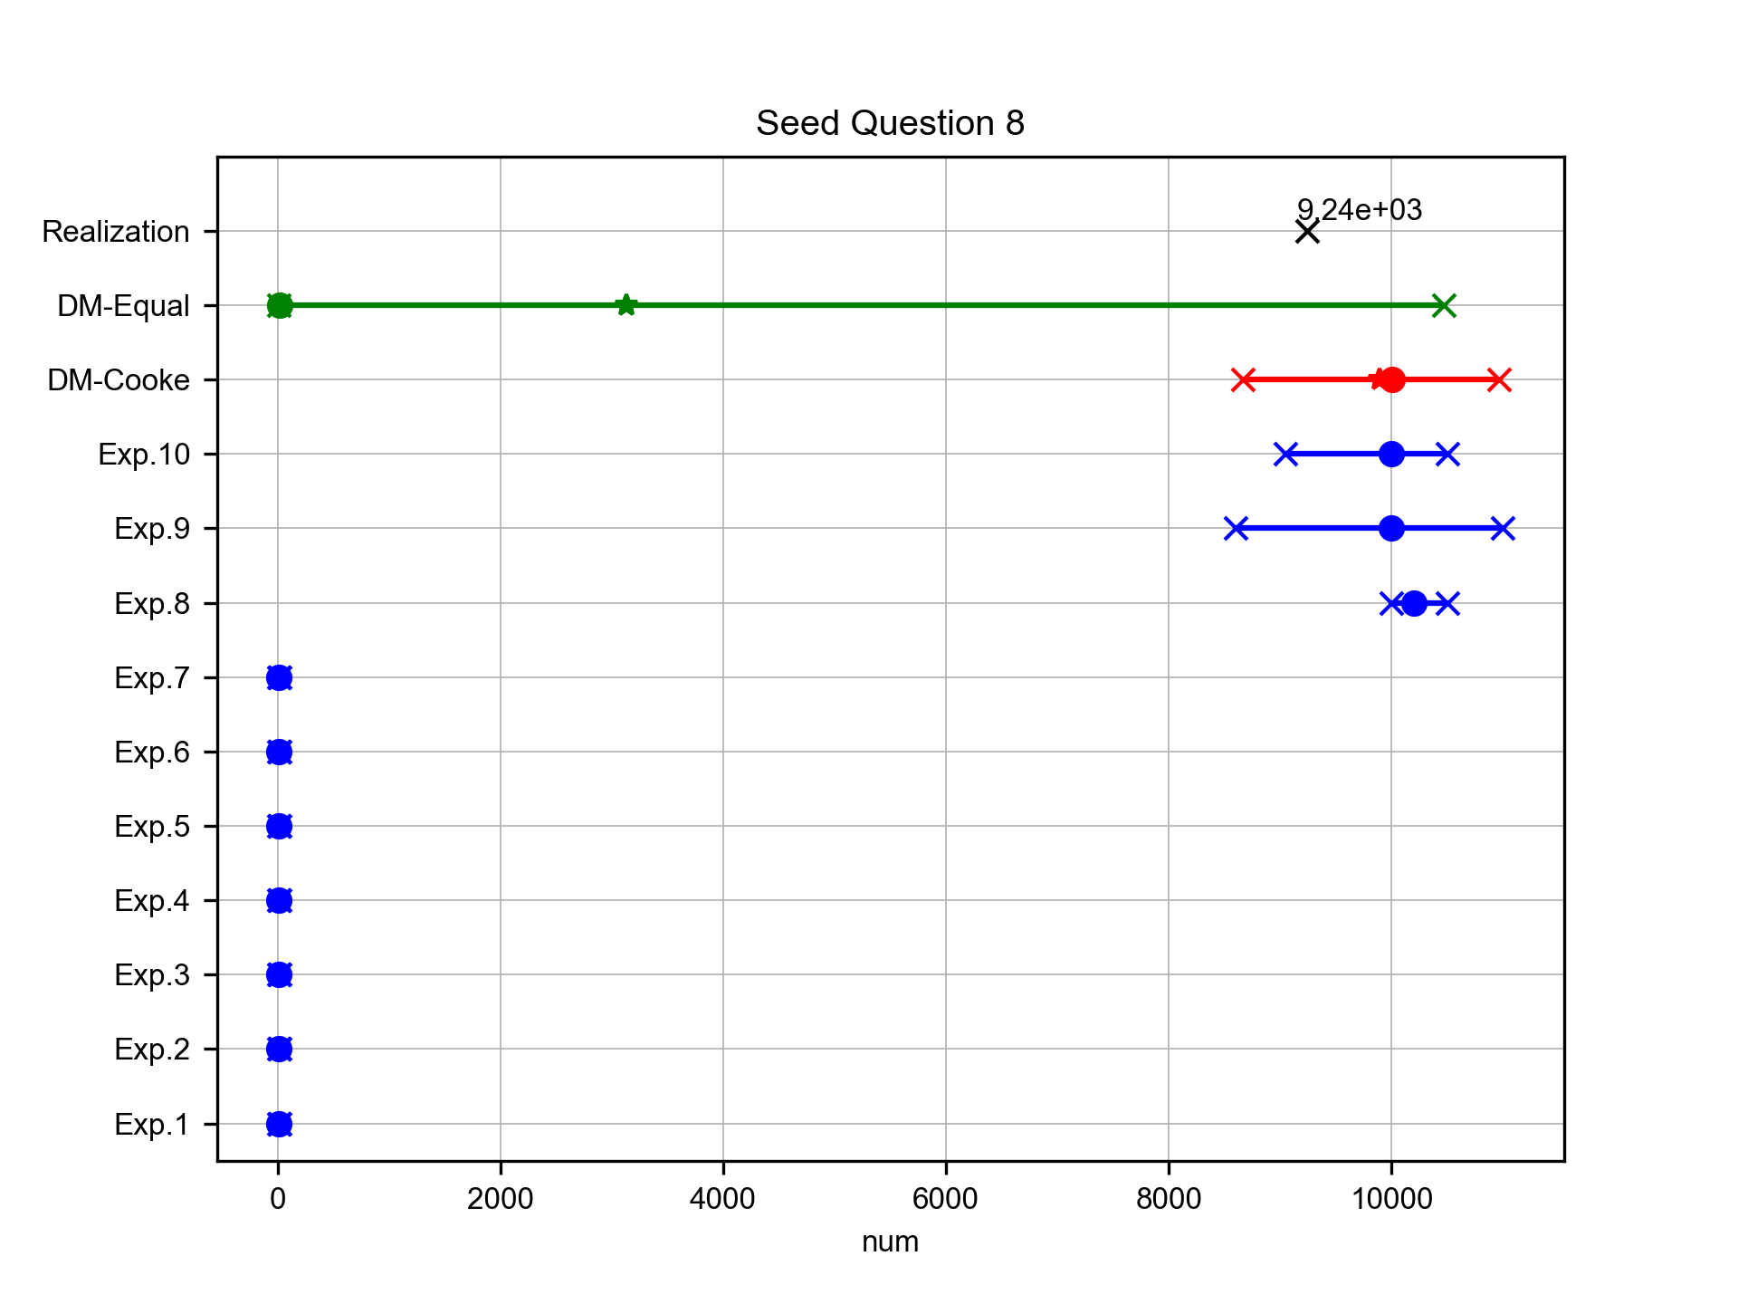
Total number of train in 2024
Expert elicitation 28-Feb-2025
The guess for the average delay due to customs processing at the Port of Genoa in 2024

Slide 13
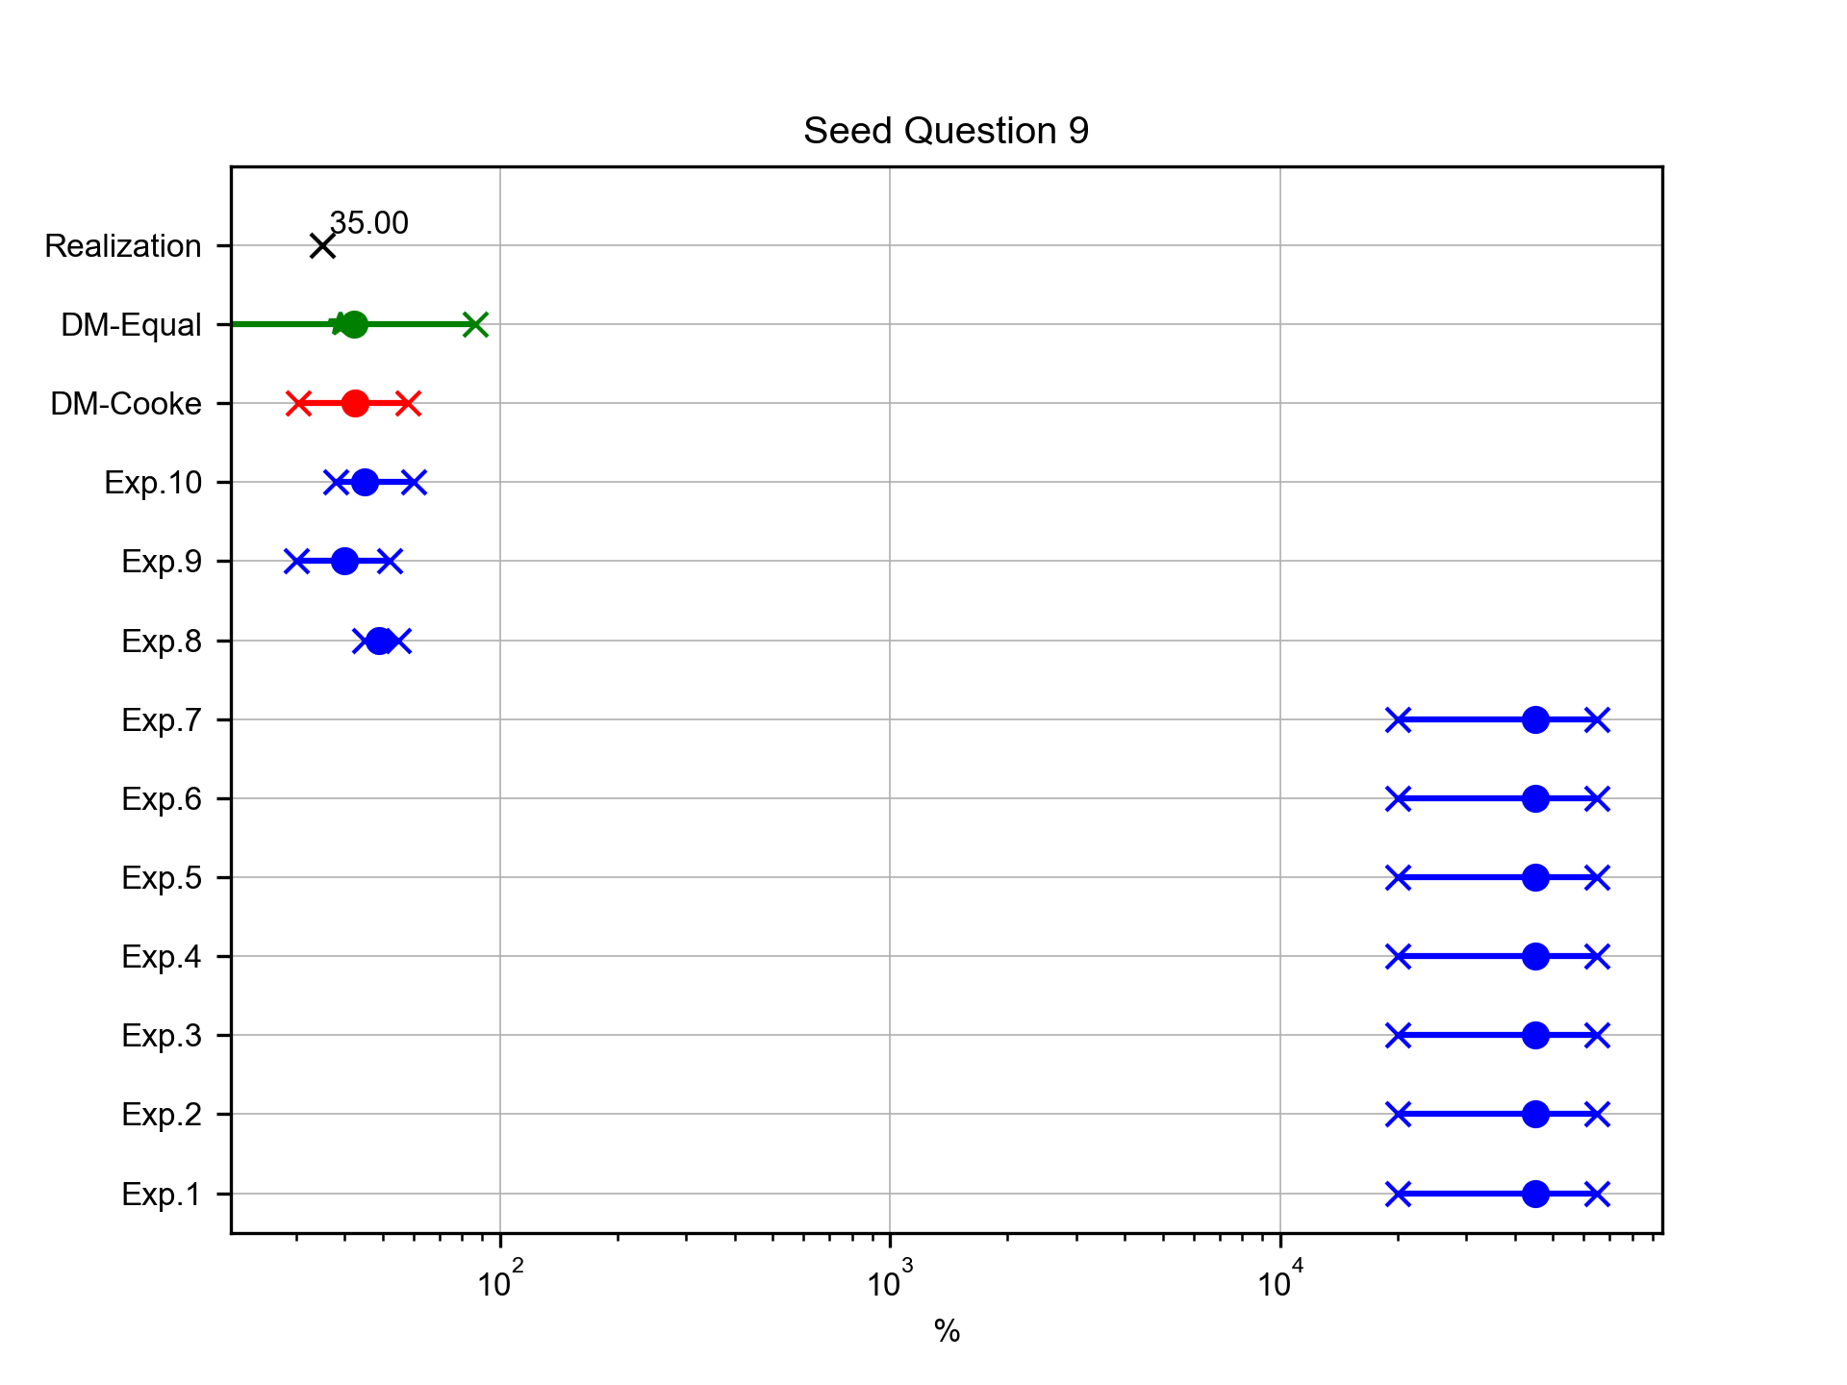
Percentage of train modes destination is Lombardy in 2024 (%)
Expert elicitation 28-Feb-2025
The guess for the number of TEUs carried by a feeder ship arriving at the Port of Genoa

Slide 14
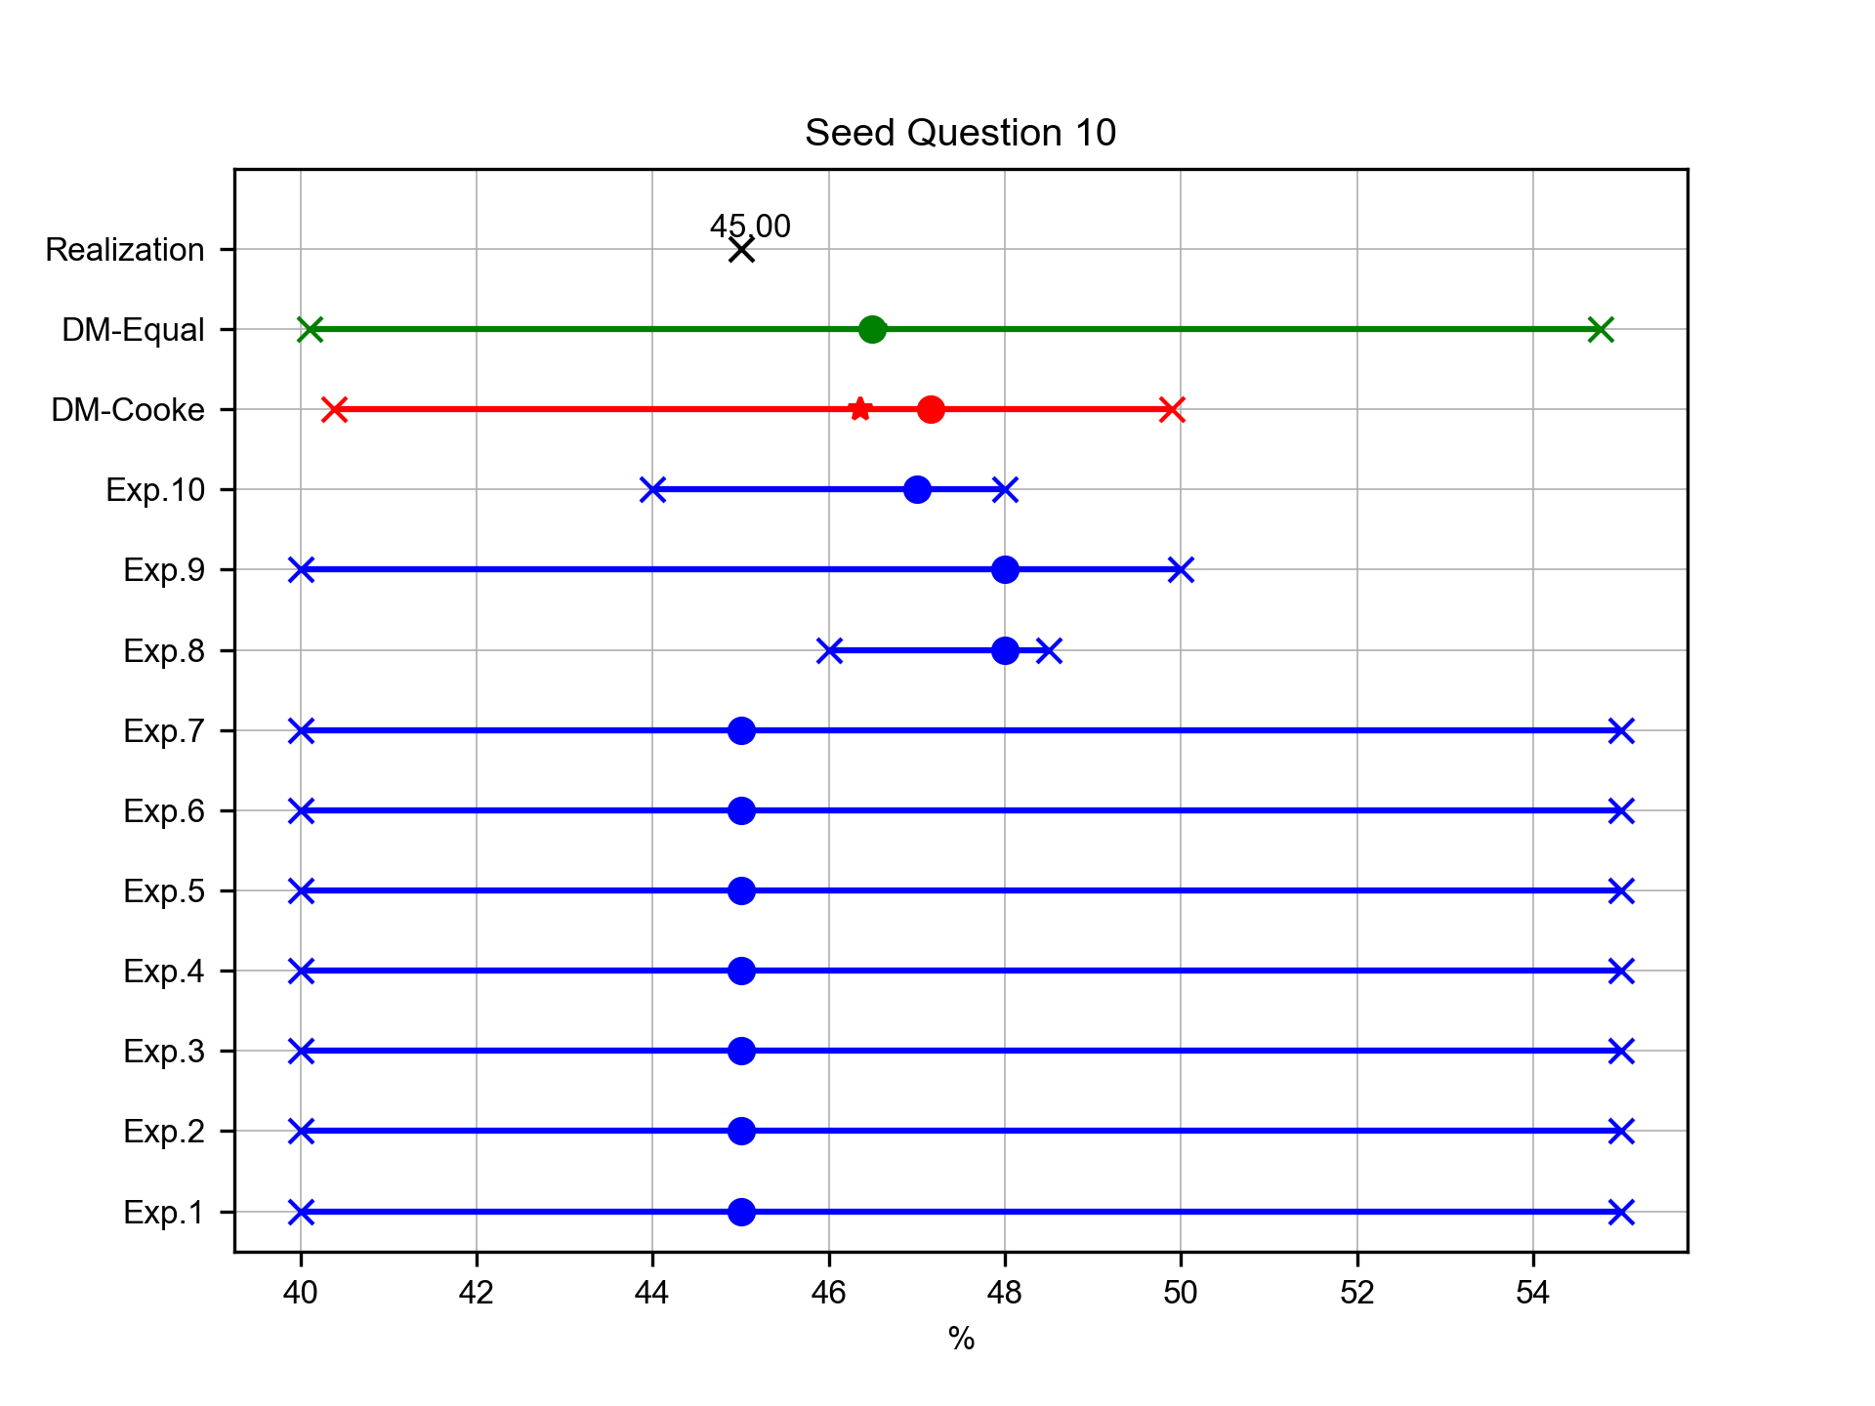
Percentage of total containers transported by train is departure (%)
Expert elicitation 28-Feb-2025
The guess for the percentage of 20ft containers (TEUs) in Genoa

Slide 15
Target Answers
Expert elicitation 28-Feb-2025

Slide 16
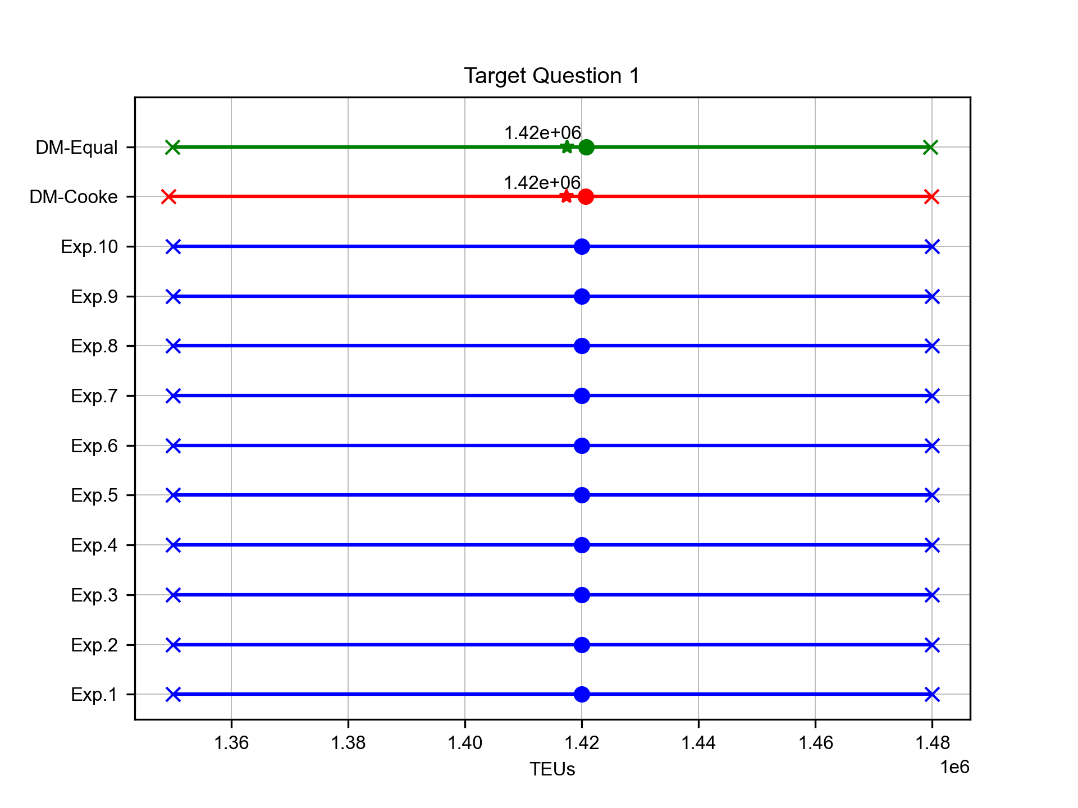
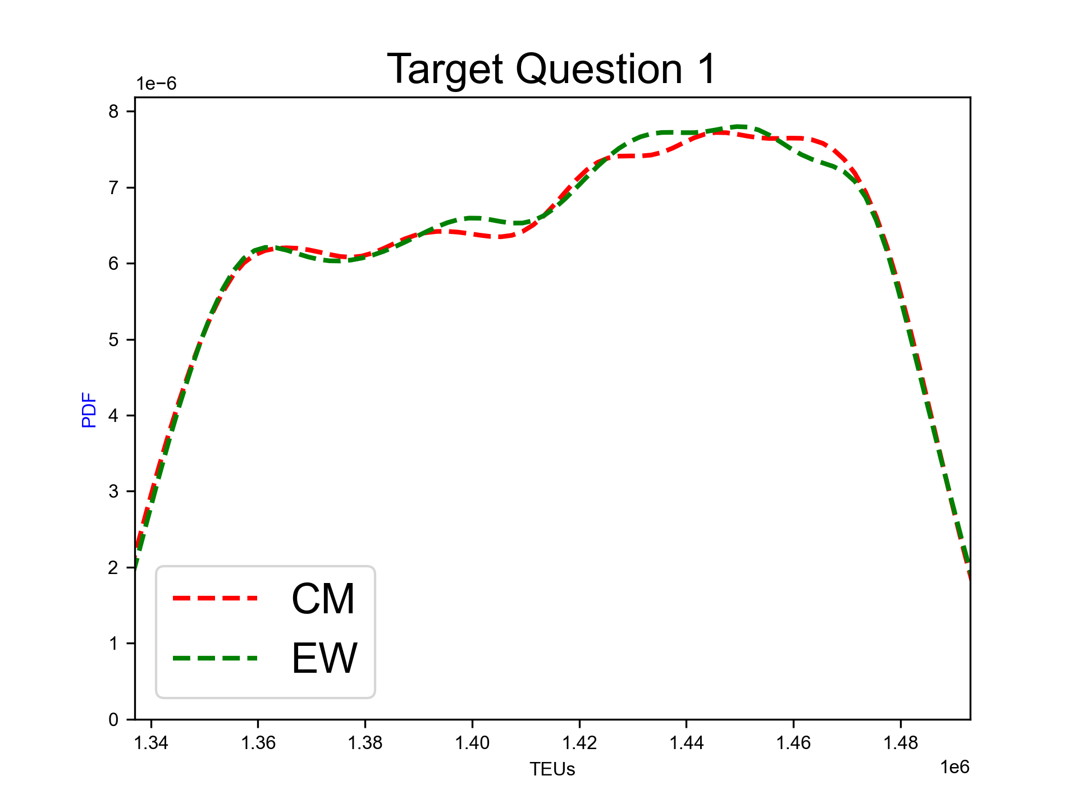
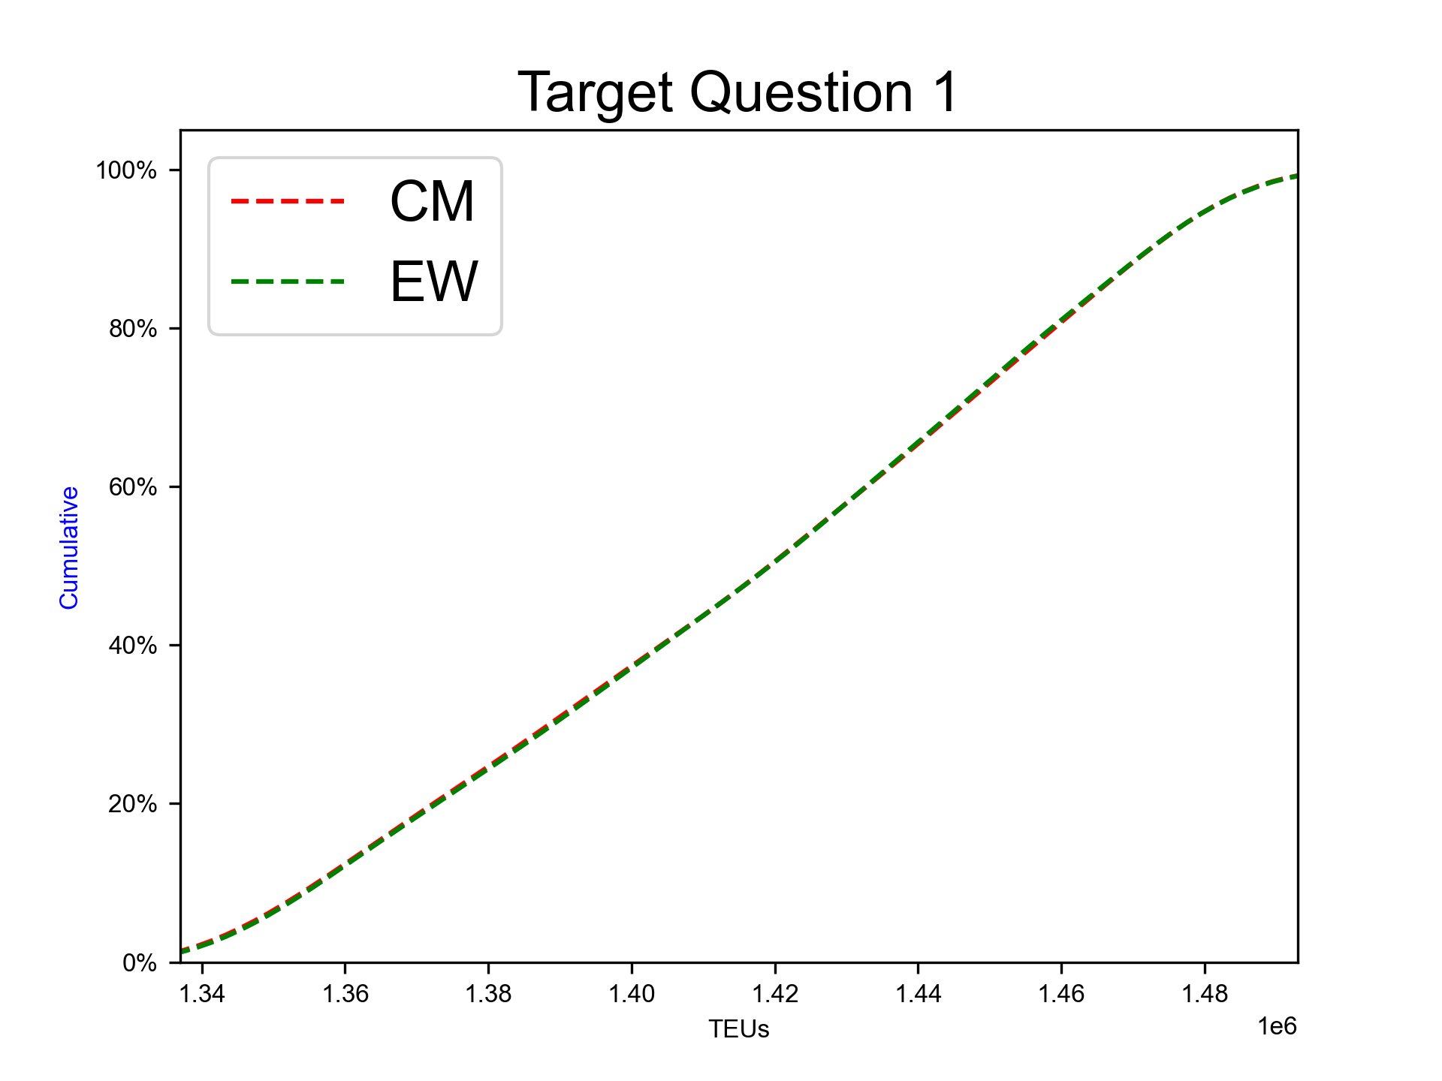
Expected TEU in 2025
Expert elicitation 28-Feb-2025
The guess for the total number of TEUs passing through the Port of Genoa in 2025

Slide 17
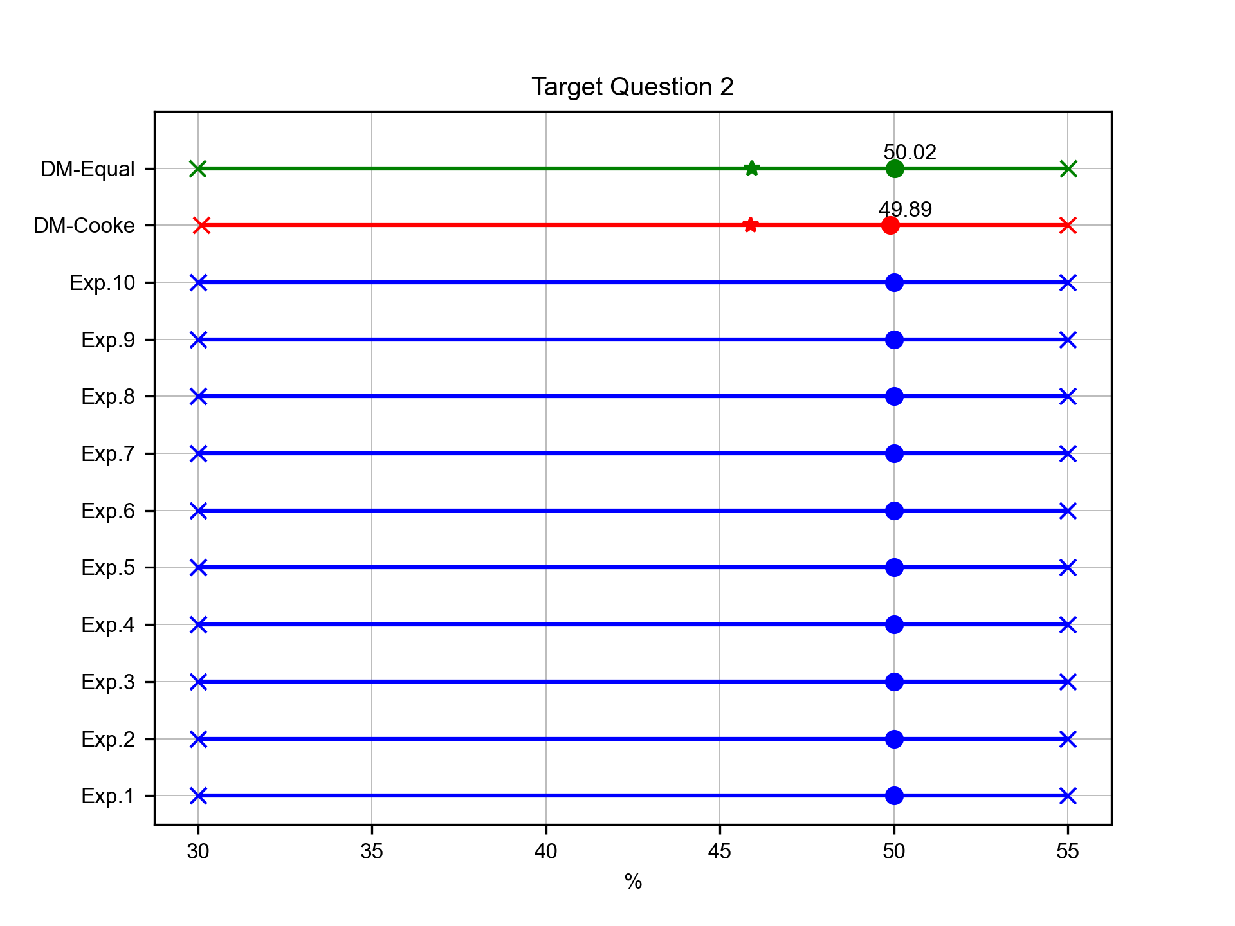
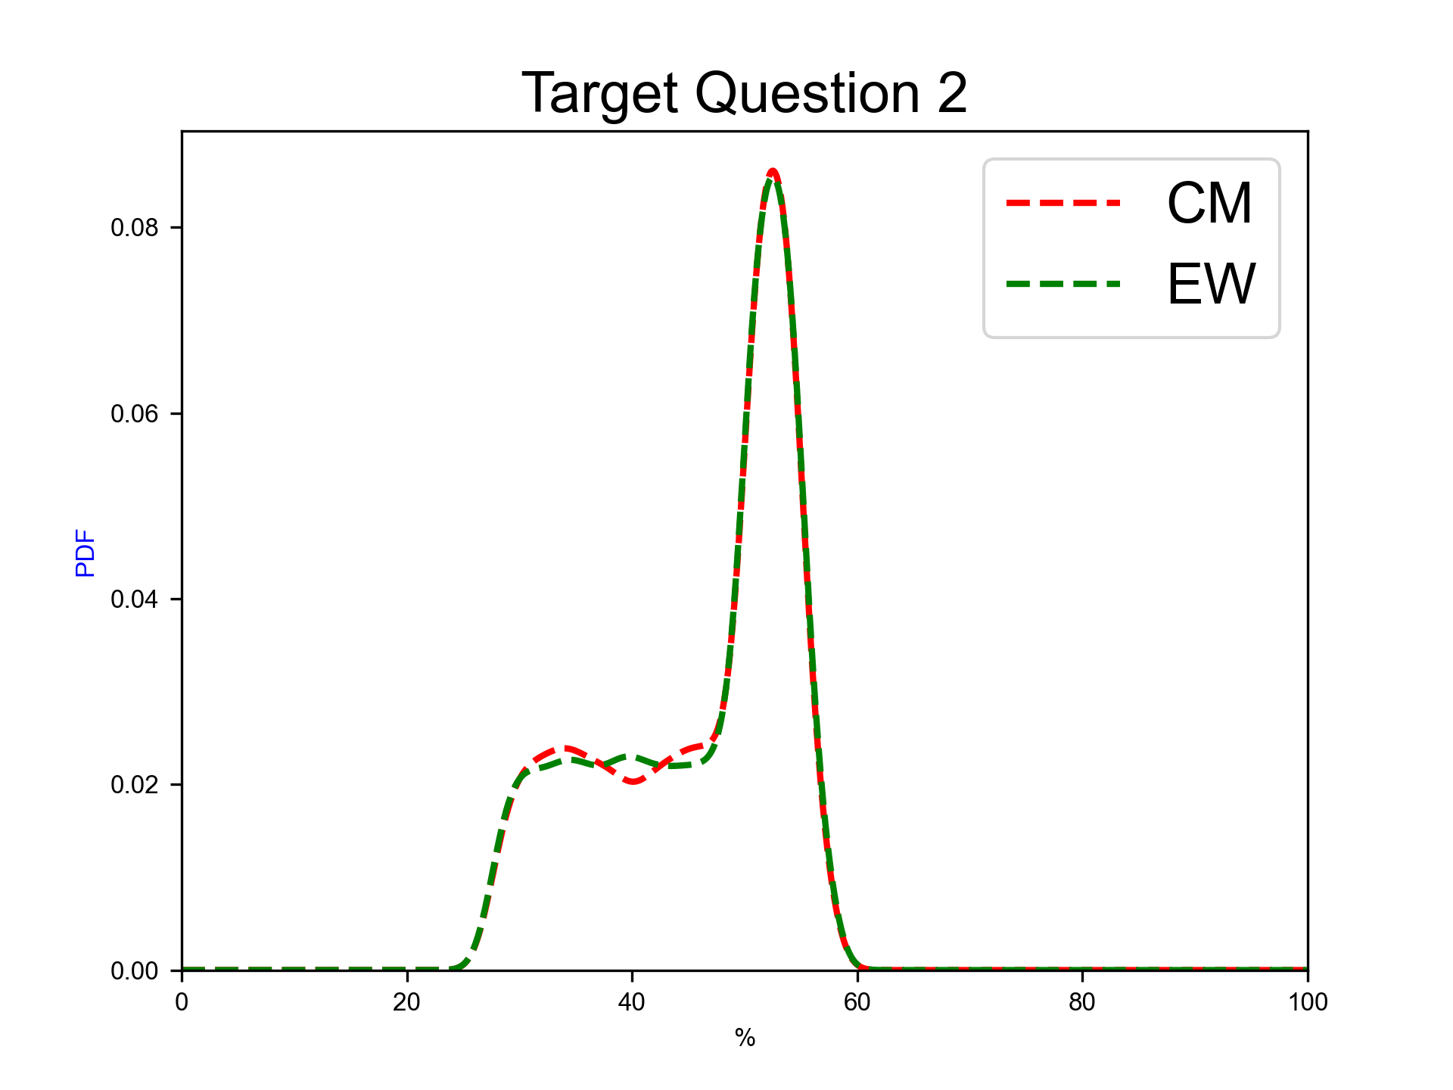
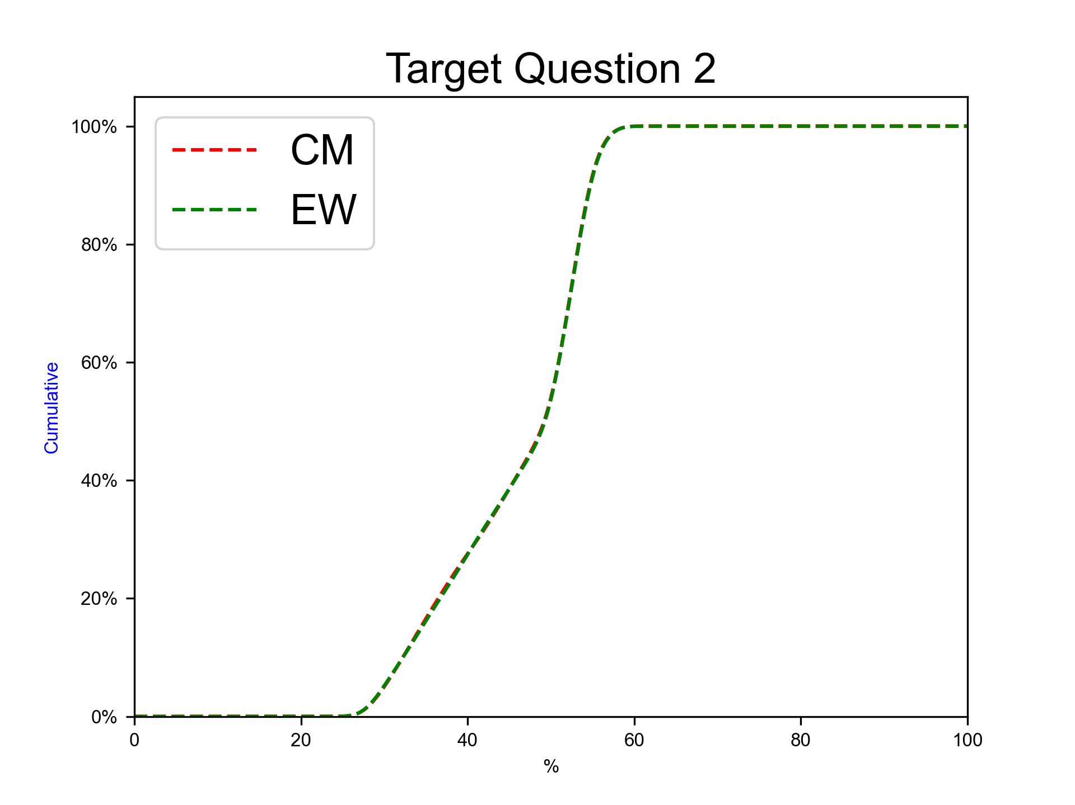
Shift from Truck to Train Transport (%)
Expert elicitation 28-Feb-2025
The guess for the percentage of total cargo transport shifting from trucks to trains at the Port of Genoa in 2025

Slide 18
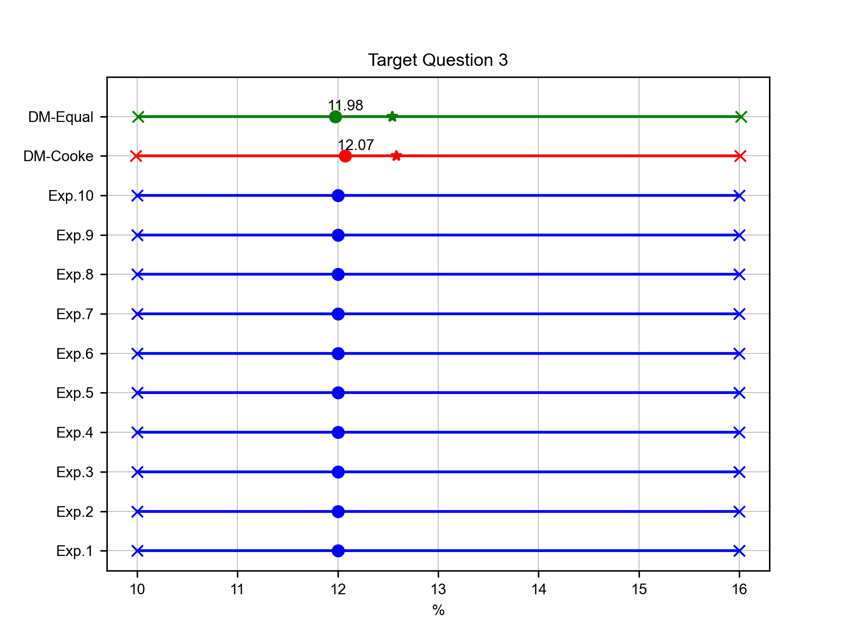
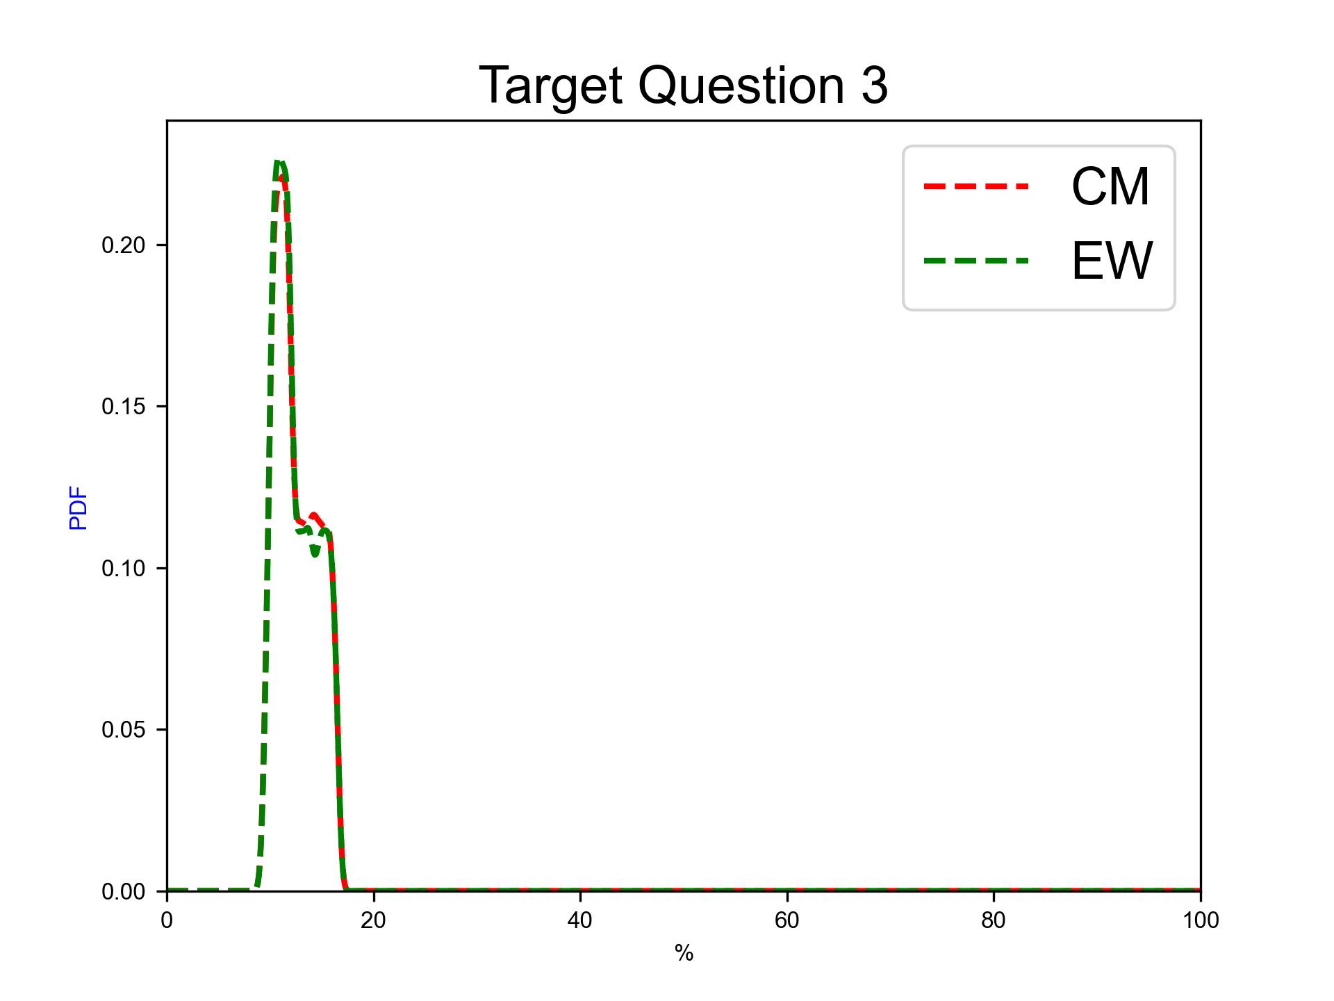
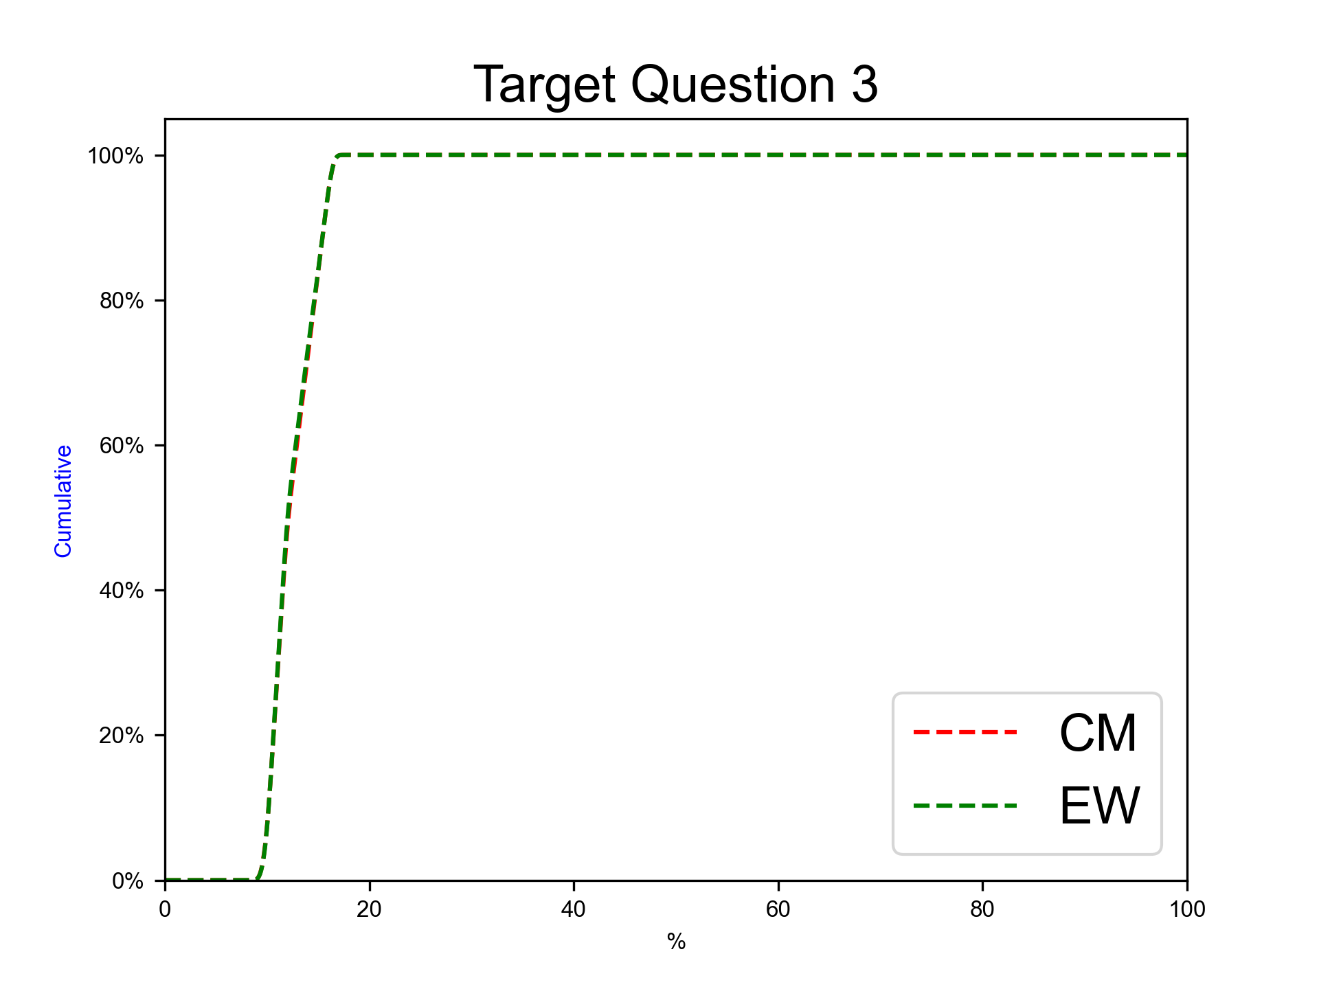
percetage of 20 feet containers (%)
Expert elicitation 28-Feb-2025
The guess for the percentage of hazardous cargo containers in total port flow

Slide 19
Target Percentiles
Expert elicitation 28-Feb-2025

Slide 20
Percentiles of target questions
Expert elicitation 28-Feb-2025
 | Q05 (EW) | Q50 (EW) | Q95 (EW) | Qmean (EW) | Q05 (Cooke) | Q50 (Cooke) | Q95 (Cooke) | Qmean (Cooke)
TQ 1 | 1.35E+06 | 1.42E+06 | 1.48E+06 | 1.42E+06 | 1.35E+06 | 1.42E+06 | 1.48E+06 | 1.42E+06
TQ 2 | 29.99 | 50.02 | 55.02 | 45.92 | 30.11 | 49.89 | 54.99 | 45.87
TQ 3 | 10.01 | 11.98 | 16.02 | 12.54 | 9.99 | 12.07 | 16.01 | 12.58

Slide 21
Index plots
Expert elicitation 28-Feb-2025

Slide 22
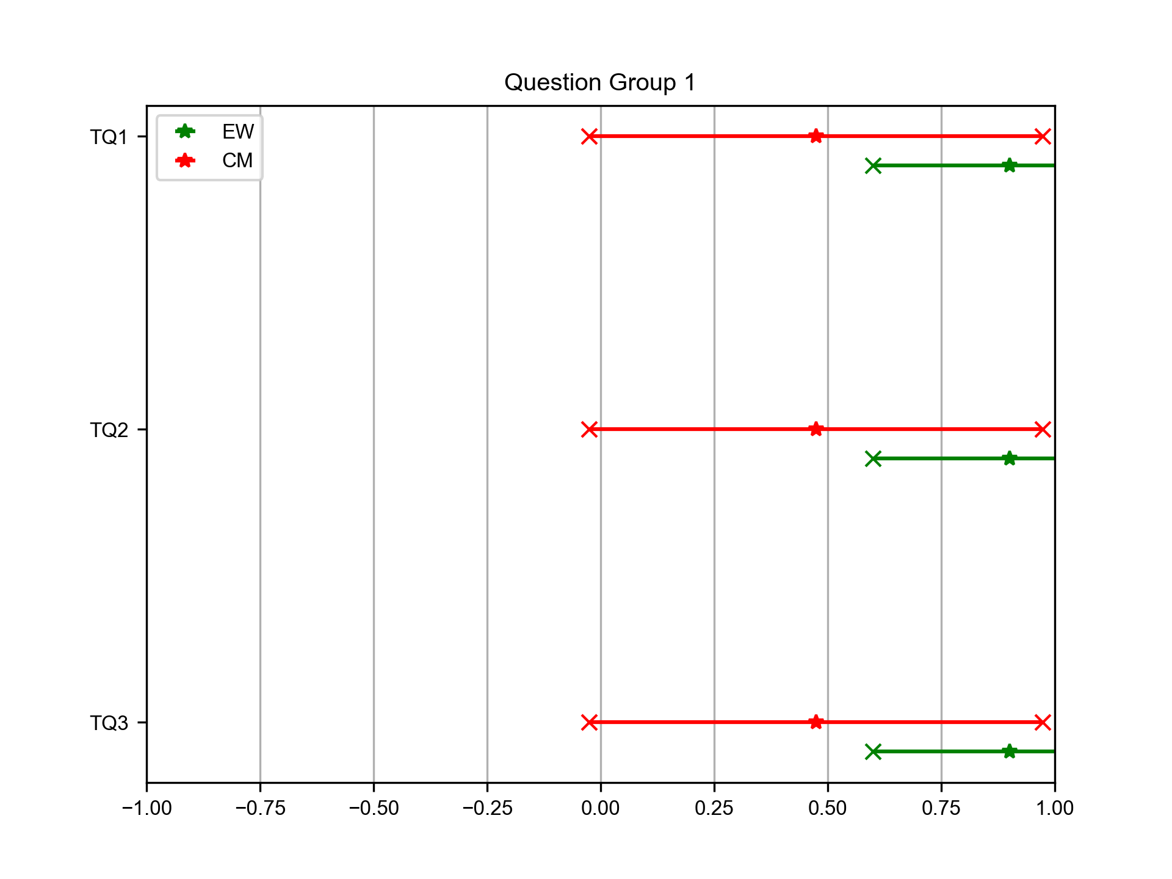
Target questions Group 1
Expert elicitation 28-Feb-2025
TQ1. Expected TEU in 2025.
TQ2. Shift from Truck to Train Transport (%).
TQ3. percetage of 20 feet containers (%).
Intervals show mean and standard error of the index.

Slide 23
Trend plots
Expert elicitation 28-Feb-2025

Slide 24
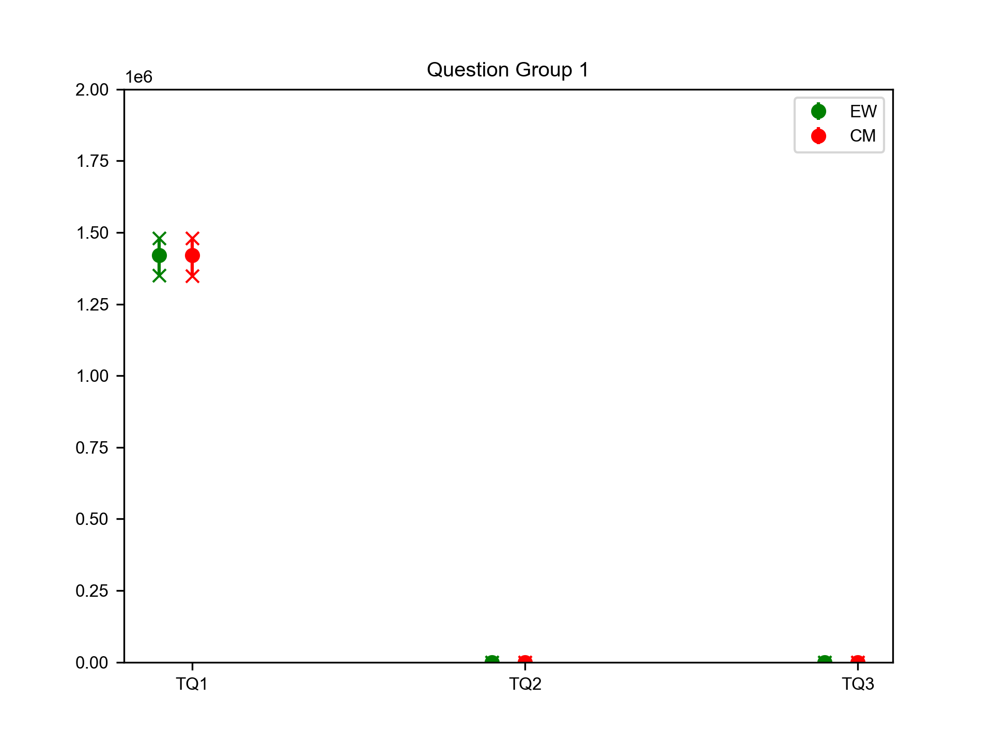
Target questions Group 1
Expert elicitation 28-Feb-2025
TQ1. Expected TEU in 2025.
TQ2. Shift from Truck to Train Transport (%).
TQ3. percetage of 20 feet containers (%).

Slide 25
Violin plots
Expert elicitation 28-Feb-2025

Slide 26
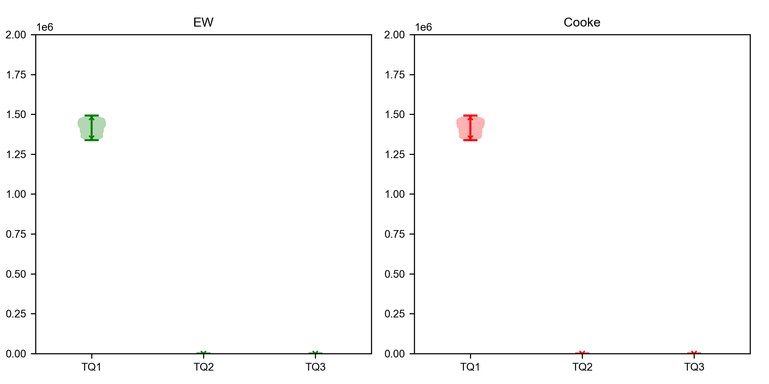
Target questions Group 1
Expert elicitation 28-Feb-2025
TQ1. Expected TEU in 2025.
TQ2. Shift from Truck to Train Transport (%).
TQ3. percetage of 20 feet containers (%).

Slide 27
Pie charts
Expert elicitation 28-Feb-2025

Slide 28
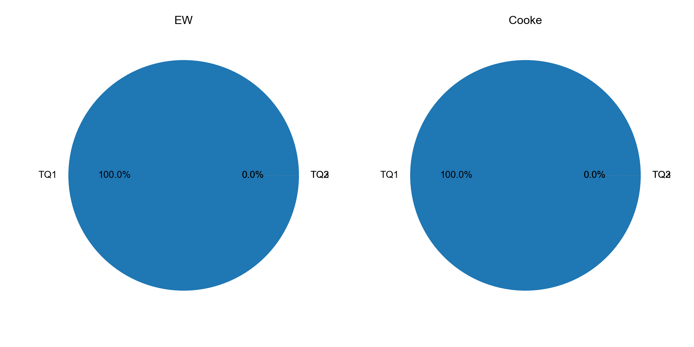
Target questions Group 1
Expert elicitation 28-Feb-2025
TQ1. Expected TEU in 2025.
TQ2. Shift from Truck to Train Transport (%).
TQ3. percetage of 20 feet containers (%).

Slide 29
Target Barplots
Expert elicitation 28-Feb-2025

Slide 30
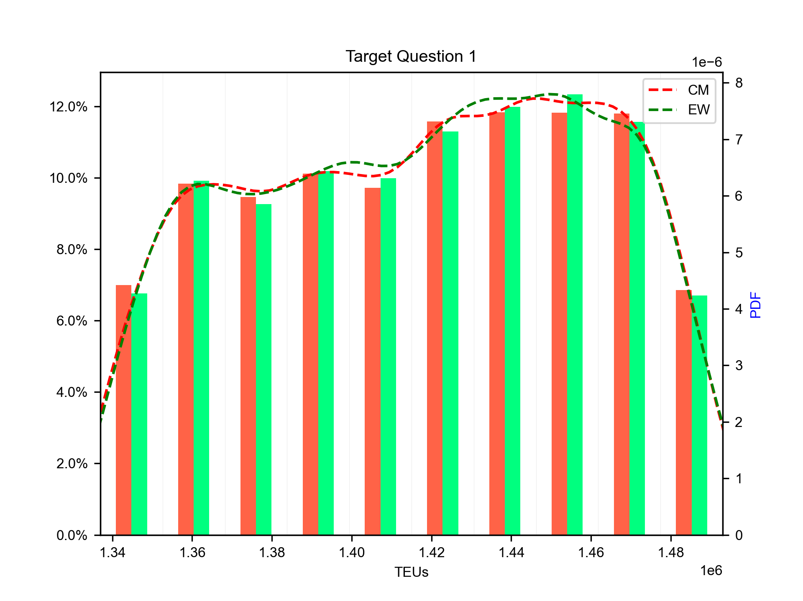
Expected TEU in 2025
Expert elicitation 28-Feb-2025
The guess for the total number of TEUs passing through the Port of Genoa in 2025
 | Q05 | Q50 | Q95 | Qmean
Cooke | 1.35E+06 | 1.42E+06 | 1.48E+06 | 1.42E+06
EW | 1.35E+06 | 1.42E+06 | 1.48E+06 | 1.42E+06

Slide 31
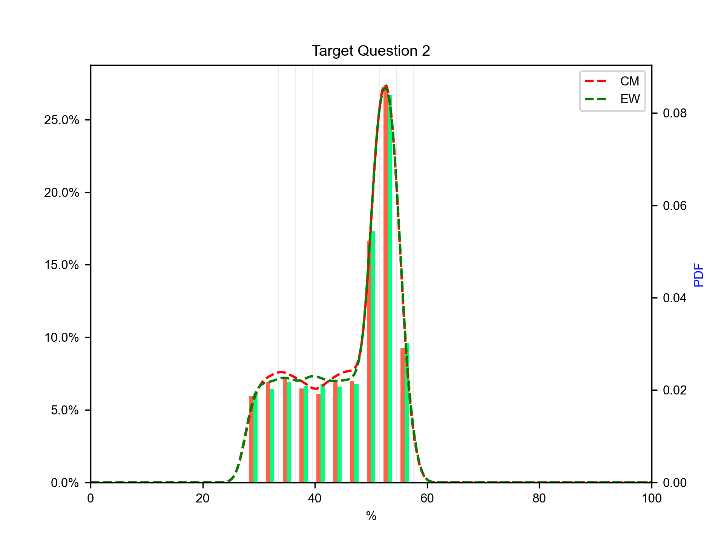
Shift from Truck to Train Transport (%)
Expert elicitation 28-Feb-2025
The guess for the percentage of total cargo transport shifting from trucks to trains at the Port of Genoa in 2025
 | Q05 | Q50 | Q95 | Qmean
Cooke | 3.01E+01 | 4.99E+01 | 5.50E+01 | 4.59E+01
EW | 3.00E+01 | 5.00E+01 | 5.50E+01 | 4.59E+01

Slide 32
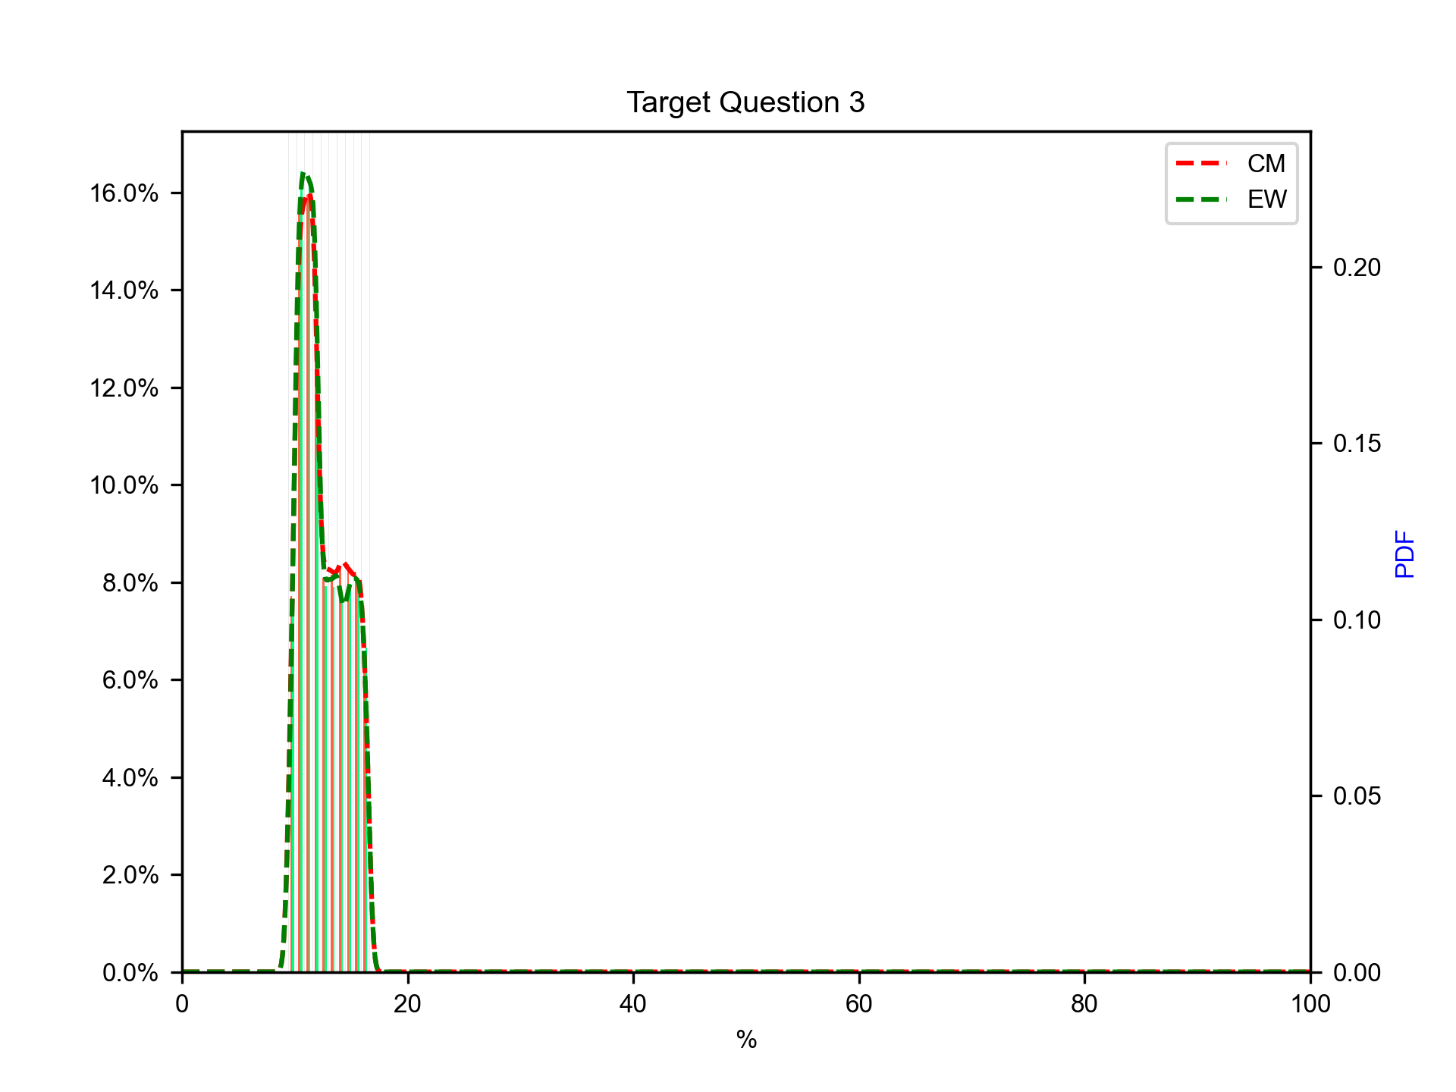
percetage of 20 feet containers (%)
Expert elicitation 28-Feb-2025
The guess for the percentage of hazardous cargo containers in total port flow
 | Q05 | Q50 | Q95 | Qmean
Cooke | 9.99E+00 | 1.21E+01 | 1.60E+01 | 1.26E+01
EW | 1.00E+01 | 1.20E+01 | 1.60E+01 | 1.25E+01

