Slide 1

Contract Intelligence System for Legal Teams
An AI-powered tool revolutionising legal contract analysis.

Slide 2
Introduction: The Legal Landscape Challenge
In today's fast-paced legal environment, managing contracts presents significant hurdles for in-house legal teams and product managers.
Lengthy and Complex
Manual Review Burden
Need for Speed & Precision
Contracts are often hundreds of pages long, filled with dense, technical jargon.
Traditional review processes are time-consuming and resource-intensive, leading to bottlenecks.
Teams require tools that can deliver rapid, accurate insights without compromising legal rigour.

Slide 3
Problem Statement: The Perils of Manual Contract Review
Reliance on manual processes introduces critical risks and inefficiencies that can impact legal operations and business outcomes.
1
Missed Risks
2
Deadline Overruns
3
Lack of Quick Insights
Manually detecting subtle, risky clauses in vast legal documents is prone to human error, potentially leading to significant liabilities.
Critical contractual deadlines are frequently overlooked, resulting in non-compliance, penalties, and missed opportunities.
Extracting summarised, actionable insights from complex contracts takes disproportionate time, delaying strategic decision-making.

Slide 4
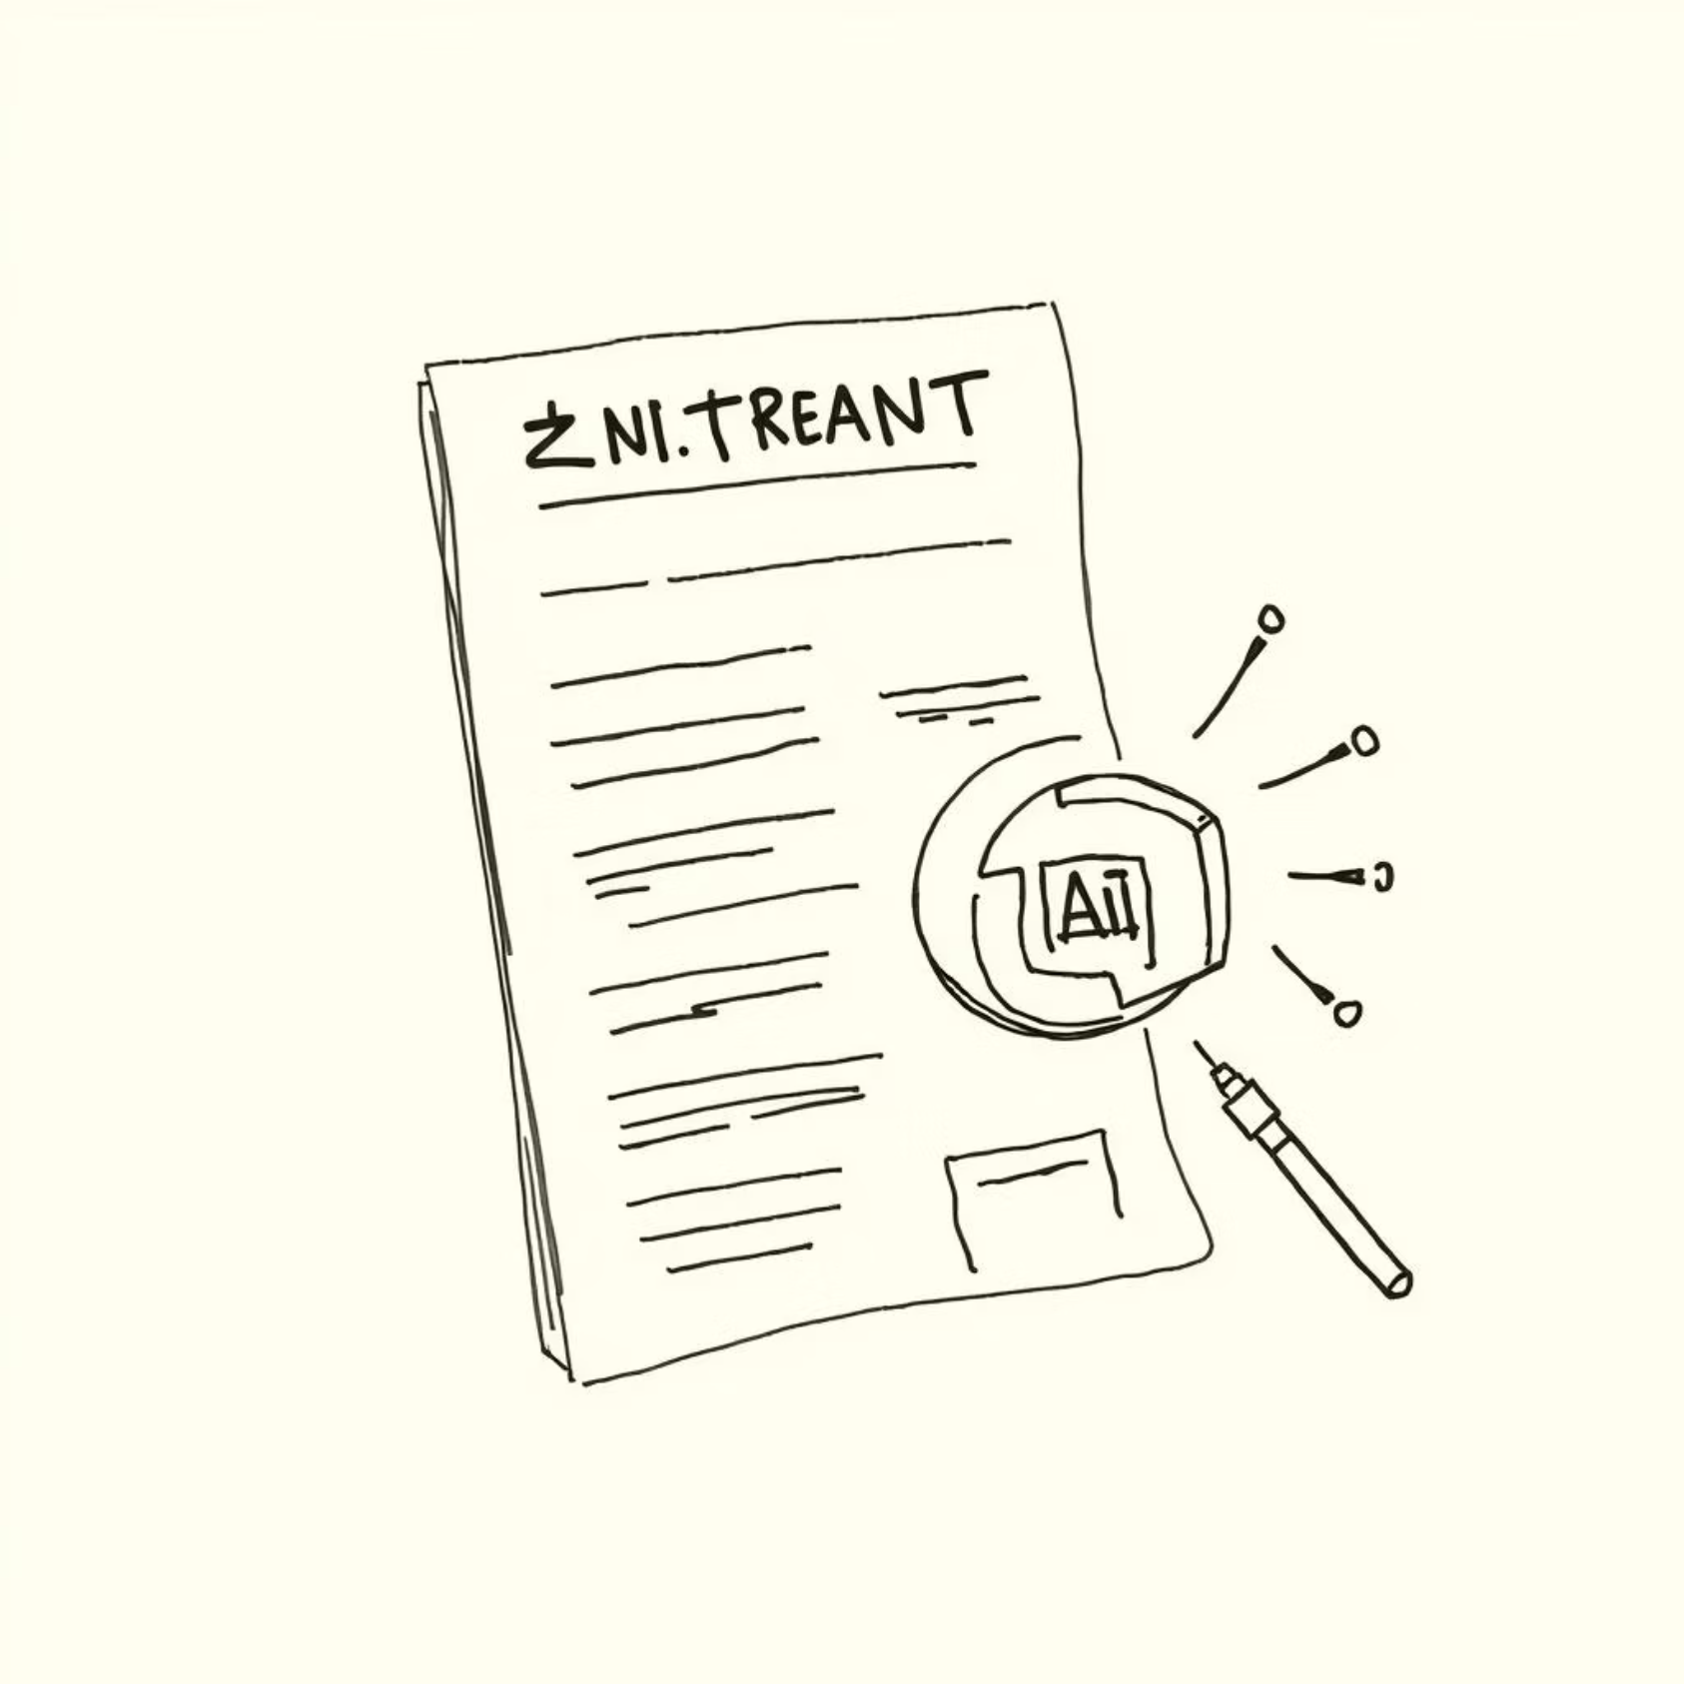



Our Solution: Introducing the Contract Intelligence System
This AI-driven system is designed to transform how legal teams interact with contracts, offering unparalleled efficiency and accuracy.
Automated Clause Analysis
Effortlessly identifies and categorises contract clauses, eliminating manual deep dives.
Identifies Risks & Deadlines
Pinpoints potential risks and critical deadlines that might otherwise be missed.
Summarises Key Sections
Provides concise summaries of essential contract segments, streamlining review.

Slide 5
Key Features: Empowering Legal Professionals
The system boasts a robust set of features engineered to meet the sophisticated demands of legal analysis.
Multi-Format Upload
1
Supports seamless upload of PDF, DOCX, CSV, XLSX, and TXT files for comprehensive analysis.
Advanced Classification
2
Leverages Legal-BERT for precise contract clause classification, ensuring high accuracy.
PEGASUS Summarisation
3
Utilises PEGASUS for generating high-quality, relevant summaries of extensive legal texts.
Risk & Deadline Extraction
4
Automatically extracts critical risk factors and crucial deadlines from documents.
Downloadable Reports
5
Generates detailed reports that can be easily downloaded for further review and archival.

Slide 6
Technological Foundations: Our Robust Tech Stack
Built on cutting-edge technologies, our system ensures reliability, scalability, and security.
Frontend
Streamlit: For an intuitive and responsive user interface.
Backend Models
HuggingFace Transformers (Legal-BERT, PEGASUS): State-of-the-art NLP models for legal intelligence.
Key Libraries
PyMuPDF, pandas, docx, FPDF, scikit-learn: For document parsing, data handling, and machine learning utilities.
Authentication
Gmail OTP Verification: Ensuring secure and convenient user access.

Slide 7












System Workflow: A Seamless Analysis Process
Our streamlined architecture guides documents through an efficient analytical pipeline from upload to actionable insights.
2. Extract & Split
1. Upload Contract
Text is extracted and divided into individual clauses.
Securely upload your legal documents.
6. Display & Download
3. Predict Clause Type
Results are presented and available for download.
Legal-BERT classifies each clause's legal category.
5. Detect Deadlines & Risks
4. Generate Summary
AI identifies critical dates and potential hazards.
PEGASUS creates concise summaries for key sections.

Slide 8
Tangible Results & Findings
The Contract Intelligence System delivers measurable improvements in accuracy, speed, and overall efficiency for legal operations.
93%
70%
100%
75%
Accuracy
Speed
Critical Insight
Time Savings
Highly accurate clause classification, significantly reducing review errors.
Up to 75% faster summarisation compared to manual review, accelerating insights.
Reliable identification of risky and deadline-sensitive clauses, enhancing compliance.
Estimated 50% reduction in time and effort for legal teams, freeing up valuable resources.

Slide 9
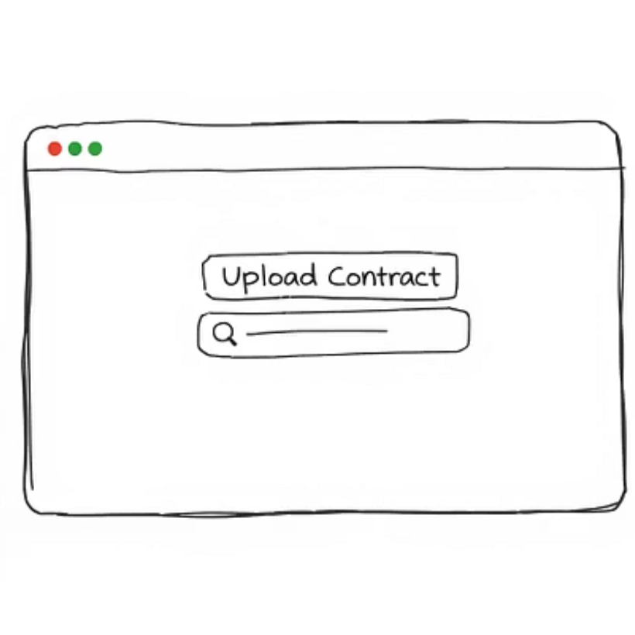
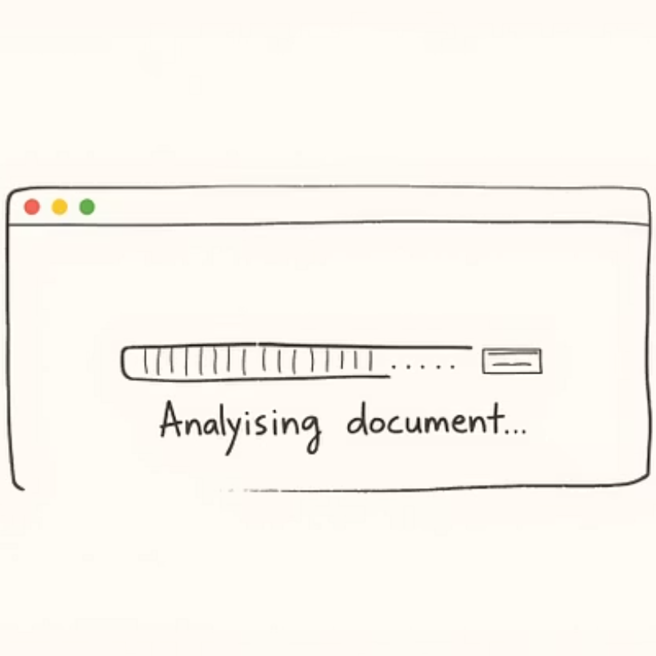
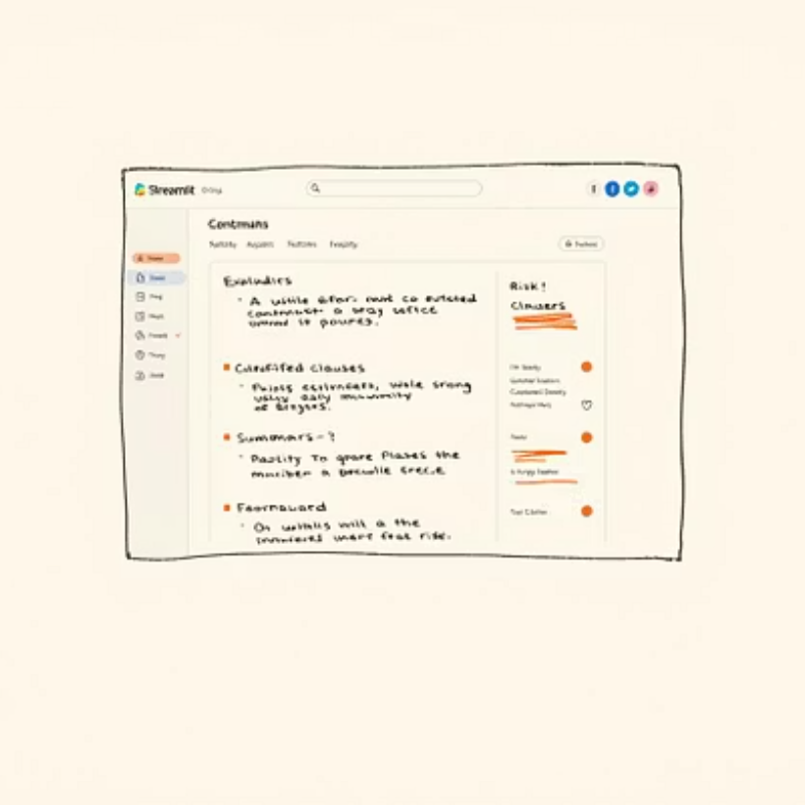
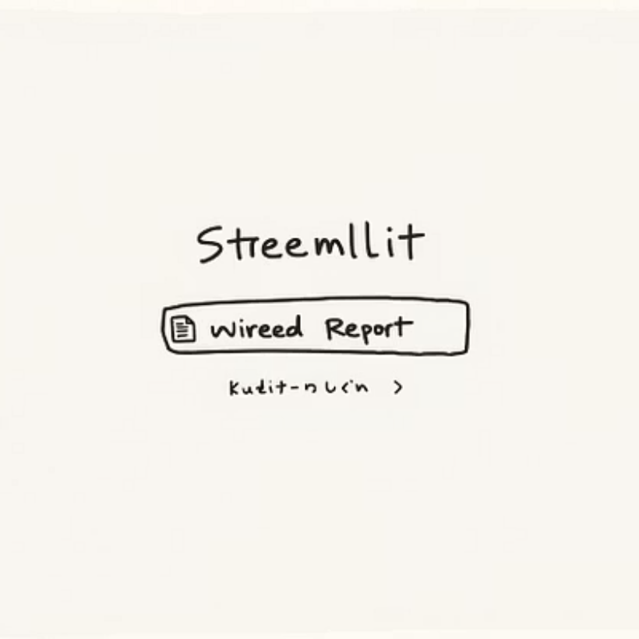
Visualising the Power: A Glimpse into the Interface
The Streamlit interface is designed for intuitive navigation, guiding users through the analysis process.
From secure upload to comprehensive report generation, every step is designed for user-friendliness and efficiency.

Slide 10
Conclusion & Future Directions
The Contract Intelligence System represents a significant leap forward in legal tech, with exciting possibilities for expansion.
Current Successes
Future Work & Enhancements
Successful automation of arduous contract review processes.
Multilingual Support: Expanding capabilities to analyse contracts in various languages.
Tangibly aids legal teams in achieving higher efficiency and accuracy.
Chatbot Integration: Implementing an AI chatbot for interactive queries and quick information retrieval.
Reduces operational burden and accelerates legal insights.
Larger Datasets: Continuous training with broader datasets for enhanced accuracy and versatility.
We are committed to continuous innovation, ensuring our system remains at the forefront of legal technology.

