Slide 1
Semi-Supervised Methods in Condition Monitoring
Master Thesis
Ralph Fehrer
„Intelligente Eingebettete Mikrosysteme“
2012-2013

Slide 2
Overview
Condition Monitoring Framework
Feature Extraction Methods
Mel Frequency Cepstral Coefficients (MFCC)
Higuchi Fractal Dimensions (HFD)
Kurtosis
One Class Classification
Construction of One-Class-Classifiers
Selected One-Class-Classifiers
Experiments
Complete Semi-Supervised CM framework
Feature Reduction with Random Forest

Slide 3
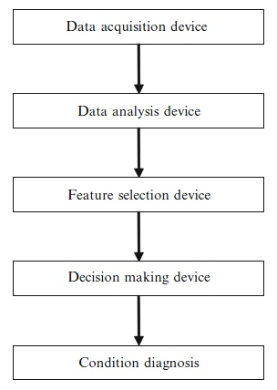
Condition Monitoring Framework
gdgfd

Slide 4
Condition Monitoring Framework
gdgfd

Slide 5
Condition Monitoring Framework
gdgfd

Slide 6
Condition Monitoring Framework
gdgfd

Slide 7
Condition Monitoring Framework
gdgfd

Slide 8
Condition Monitoring Framework
gdgfd

Slide 9
Condition Monitoring Framework
gdgfd

Slide 10
Condition Monitoring Framework
gdgfd

Slide 11
Condition Monitoring Framework
gdgfd

Slide 12
Data Analysis / Feature Extraction

