Slide 1
Outlier Detection in Condition Monitoring
Master Thesis
Ralph Fehrer
„Intelligente Eingebettete Mikrosysteme“
2012-2013

Slide 2
Overview
Condition Monitoring Framework
Feature Extraction Methods
Mel Frequency Cepstral Coefficients (MFCC)
Higuchi Fractal Dimensions (HFD)
Kurtosis
One Class Classification
Construction of One-Class-Classifiers
Selected One-Class-Classifiers
Experiments
Complete Semi-Supervised CM framework
Feature Reduction with Random Forest

Slide 3
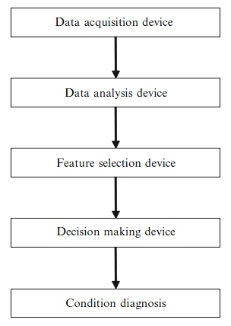
Condition Monitoring Framework
gdgfd

Slide 4
Condition Monitoring Framework
gdgfd

Slide 5
Condition Monitoring Framework
gdgfd

Slide 6
Condition Monitoring Framework
gdgfd

Slide 7
Condition Monitoring Framework
gdgfd

Slide 8
Condition Monitoring Framework
gdgfd

Slide 9
Condition Monitoring Framework
gdgfd

Slide 10
Condition Monitoring Framework
gdgfd

Slide 11
Condition Monitoring Framework
gdgfd

Slide 12
Data Analysis / Feature Extraction

Slide 13
One-Class-Classification

Slide 14
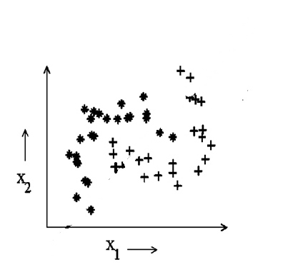
Supervised Classification
Multi-class-training

Slide 15
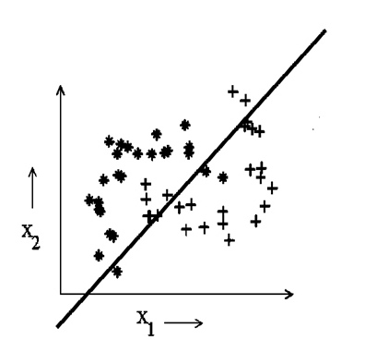
Supervised Classification
Multi-class-training

Slide 16
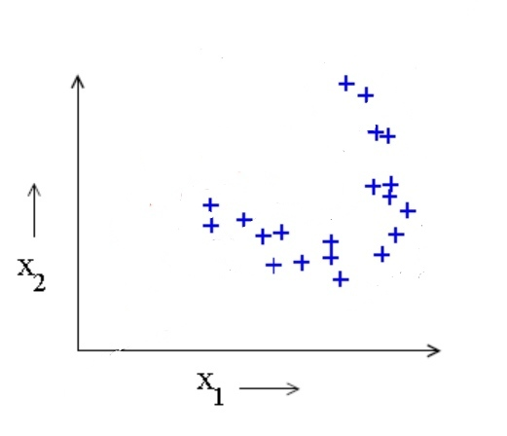
Classification
One-class-training

Slide 17
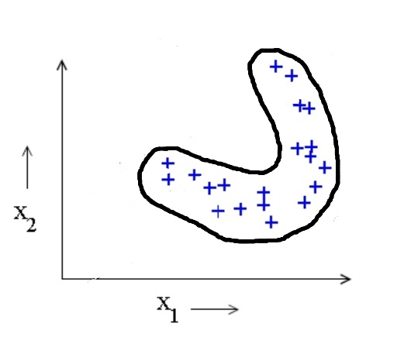
Classification
One-class-training

Slide 18
One Class Classification
One-Class-Classifier Composition

Slide 19
Support Vector Data Description

Slide 20
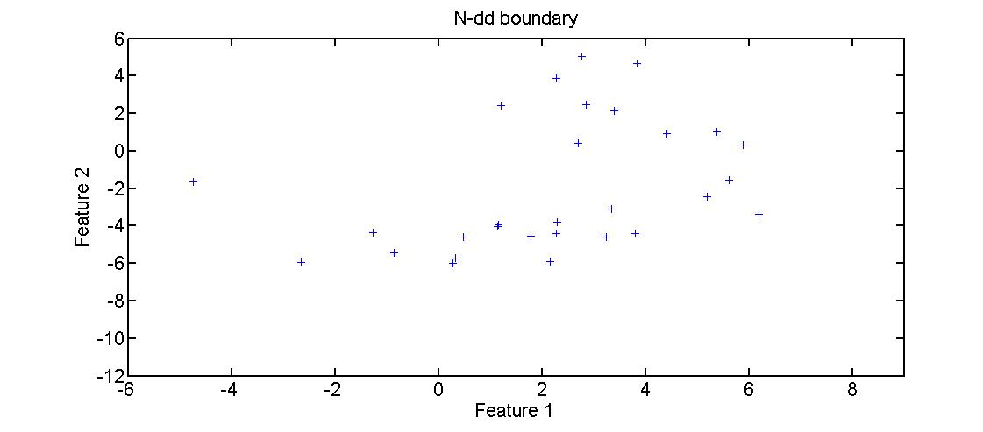
Support Vector Data Description

Slide 21
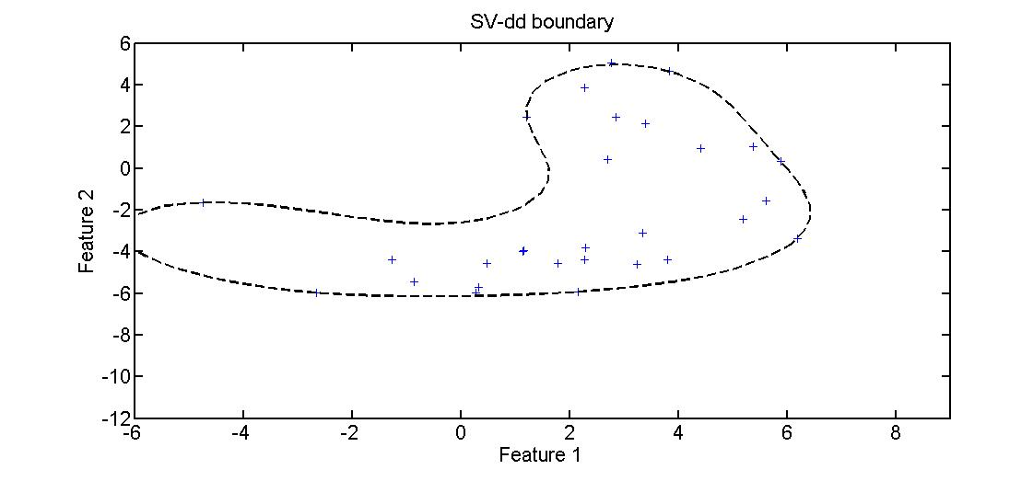
Support Vector Data Description

Slide 22
K-Center Data Description

Slide 23
K-Center Data Description

Slide 24
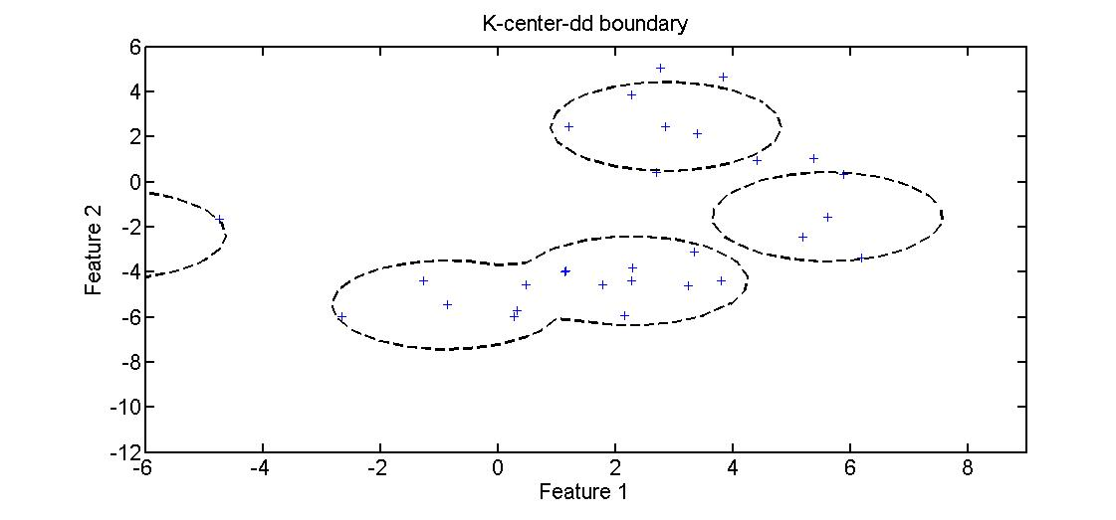
K-Center Data Description

Slide 25
K-Means Data Description

Slide 26
K-Means Data Description

Slide 27
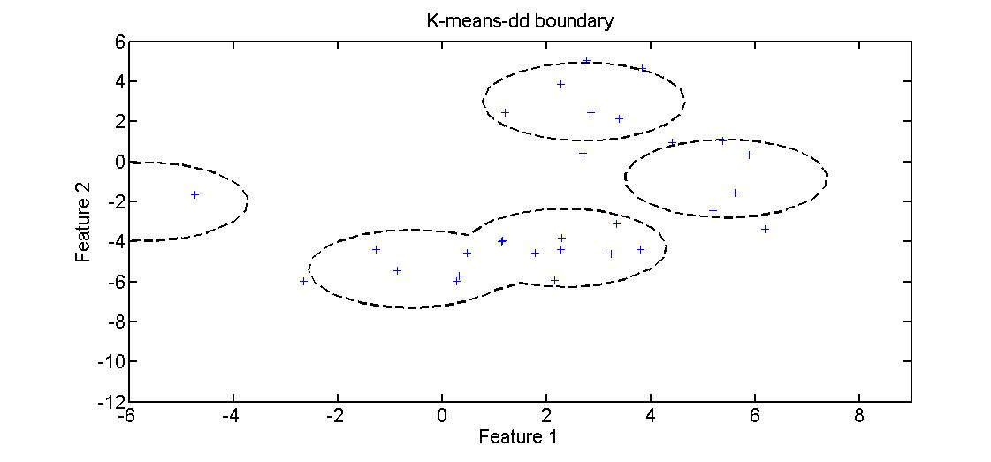
K-Means Data Description

Slide 28
Nearest Neighbor Data Description

Slide 29
Nearest Neighbor Data Description

Slide 30
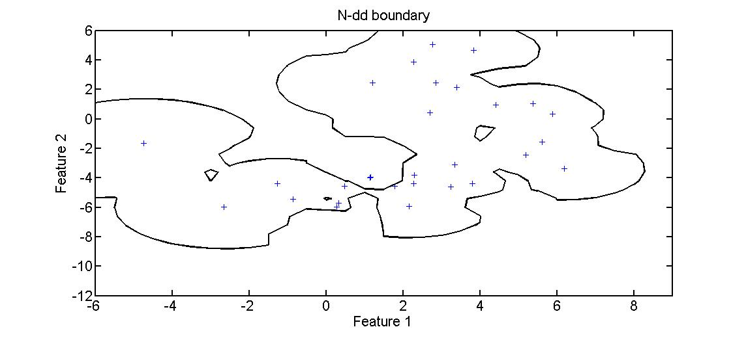
Nearest Neighbor Data Description

Slide 31
Parzen Window Data Description

Slide 32
Parzen Window Data Description

Slide 33
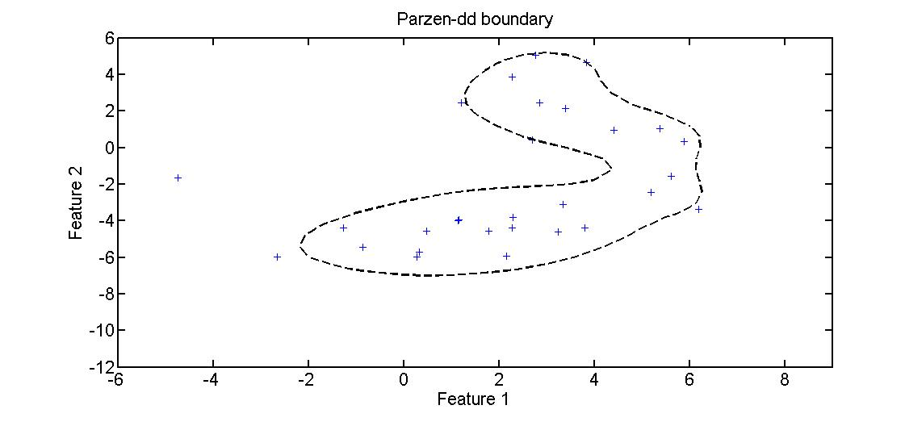
Parzen Window Data Description

Slide 34
SOM Data Description

Slide 35
SOM Data Description

Slide 36
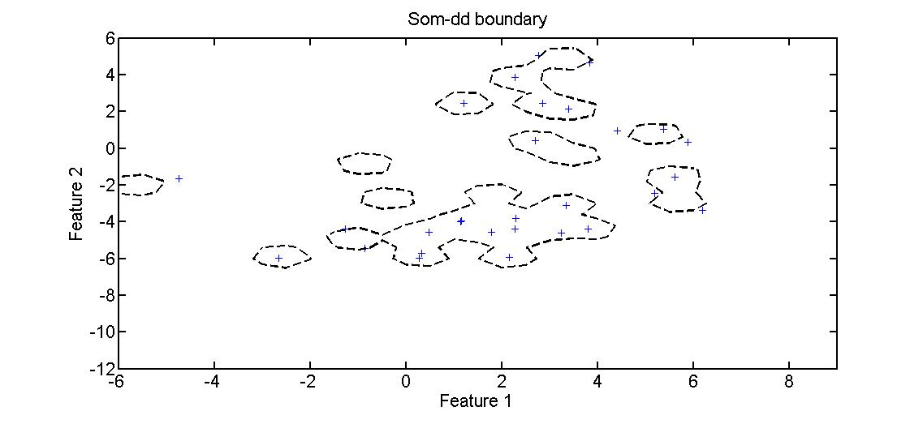
SOM Data Description

