Slide 1
Outlier Detection in Condition Monitoring
Master Thesis
Ralph Fehrer
Intelligente Eingebettete Mikrosysteme
2012-2013

Slide 2
Overview
Condition Monitoring
Feature Extraction Methods
One Class Classification
Experiments
Summary
Outlook

Slide 3
Condition Monitoring

Slide 4
Condition Monitoring
„Condition Monitoring is a process
of monitoring a system
by studying certain selected parameters
in such a way,
that significant changes of those parameters
are related to developing failures“
Artur G. O. Musambara , Harare 2012

Slide 5
Condition Monitoring
Benefits of (computerized) Condition Monitoring
Predictive maintenance approach, based on machine conditions
Prevention of machine failure
Lifetime prediction
Overall reduction of operating costs

Slide 6
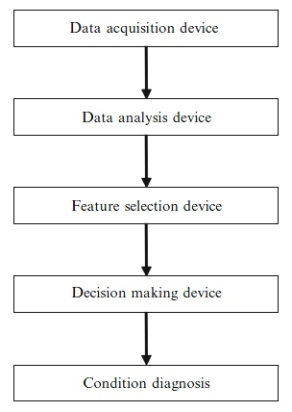
Condition Monitoring Framework
Marwala, 2012
Sensors atttached to monitored system (accelerometers, thermometers…)
Feature Extraction (Fourier, Short Time Fourier, Wavelet Transform…)
Selection of most significant features
(Principal Component Analysis…)
Classification / Outlier Detection
(Machine Learning/Pattern Recognition)
Lifetime prediction, maintenance scheduling…

Slide 7
Condition Monitoring Framework
Marwala, 2012
Focus of this Thesis

Slide 8
Data Analysis Feature Extraction

Slide 9
Data Analysis / Feature Extraction
Mel Frequency Cepstral Coefficients (MFCC)
Higuchi Fractal Dimensions (HFD)
Kurtosis

Slide 10
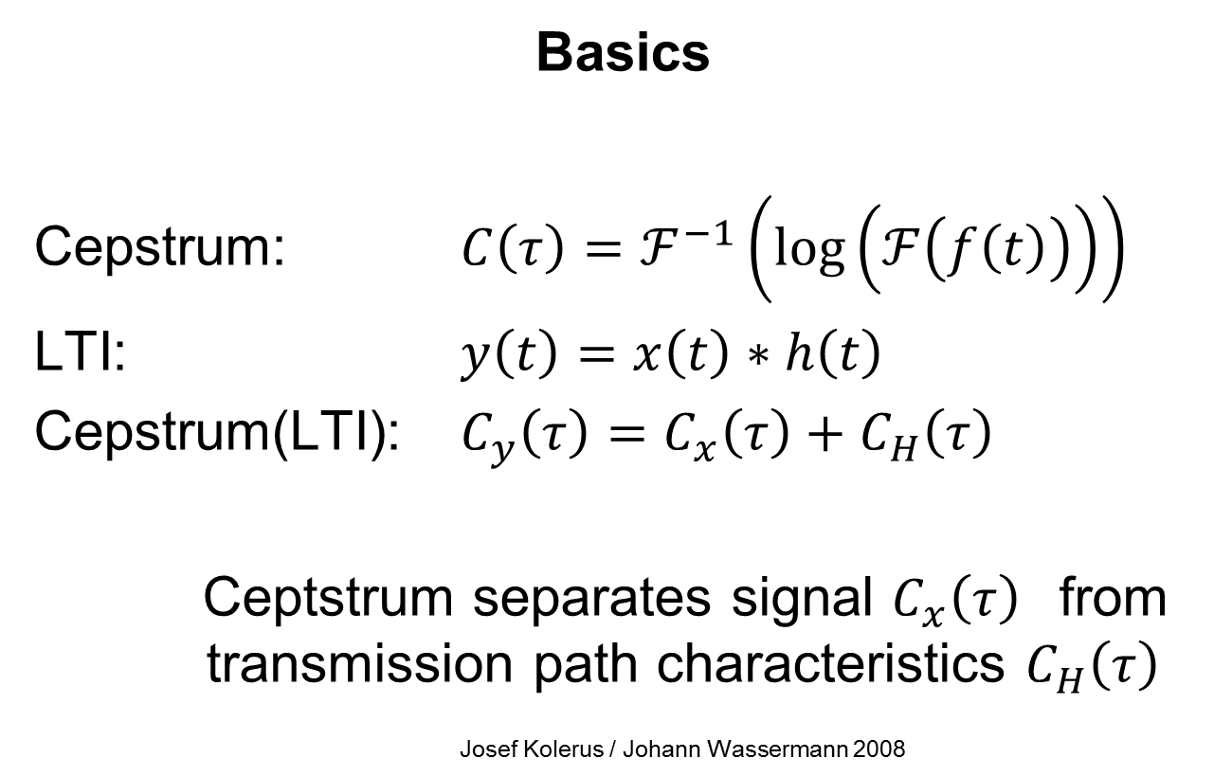
Mel Frequency Cepstral Coefficients
Basics
Cepstrum: $C\left(τ\right)=ℱ^{−1}\left(log\left(ℱ\left(f\left(t\right)\right)\right)\right)$
LTI: $y\left(t\right)=x\left(t\right)∗h\left(t\right)$
Cepstrum(LTI): $C_{y}\left(τ\right)=C_{x}\left(τ\right)+C_{H}\left(τ\right)$
Ceptstrum separates signal $C_{x}\left(τ\right)$ from transmission path characteristics $C_{H}\left(τ\right)$
Josef Kolerus / Johann Wassermann 2008

Slide 11
Mel Frequency Cepstral Coefficients
MFCC feature extraction method
Short Time Fourier Transform (STFT) of time signal
transformation into time frequency domain
Mel transform of frequency spectrum
adaption to frequency response of human
auditory system
Transformation of logarithmic frequency spectrum to time domain through Discrete Cosine Transform

Slide 12
Fractal Dimensions
FD in time signal analysis
Measure for the irregularity of signal shape
Fractal Dimensions of a signal are in the range between 1 and 2
Several methods exist, usually measuring length at different scales
Higuchi algorithm implemented for this thesis (Matlab)

Slide 13
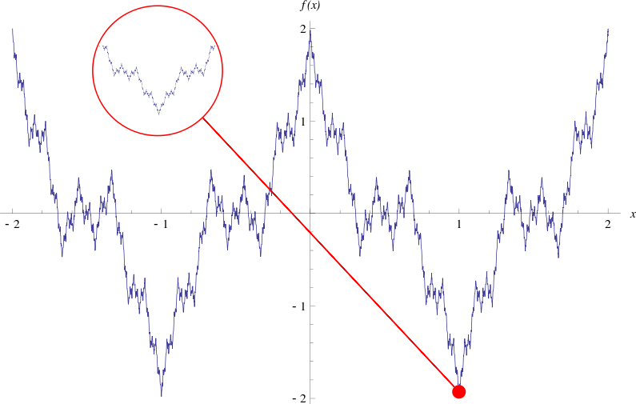
Fractal sample
Weierstraß function with known fractal dimension
used to validate Higuchi algorithm

Slide 14
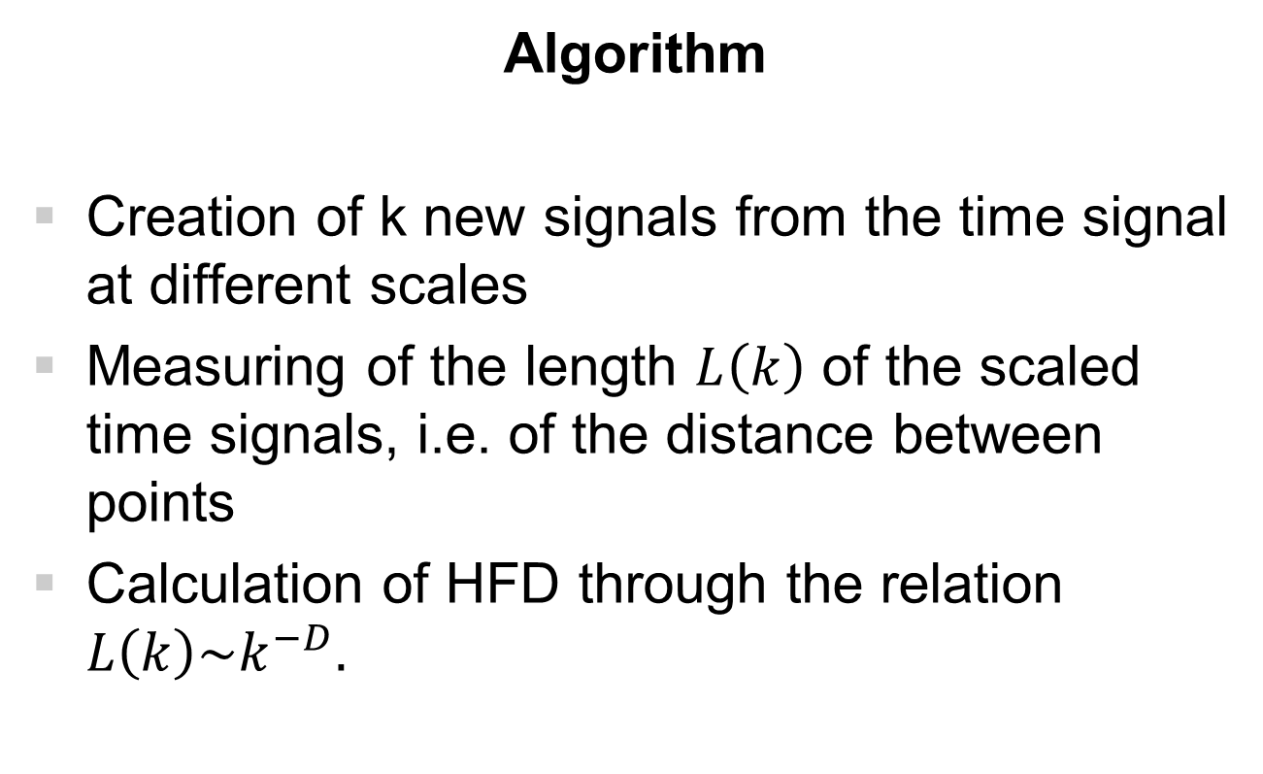
Higuchi Fractal Dimensions
Algorithm
Creation of k new signals from the time signal at different scales
Measuring of the length $L\left(k\right)$ of the scaled time signals, i.e. of the distance between points
Calculation of HFD through the relation $L\left(k\right)\sim k^{−D}.$

Slide 15
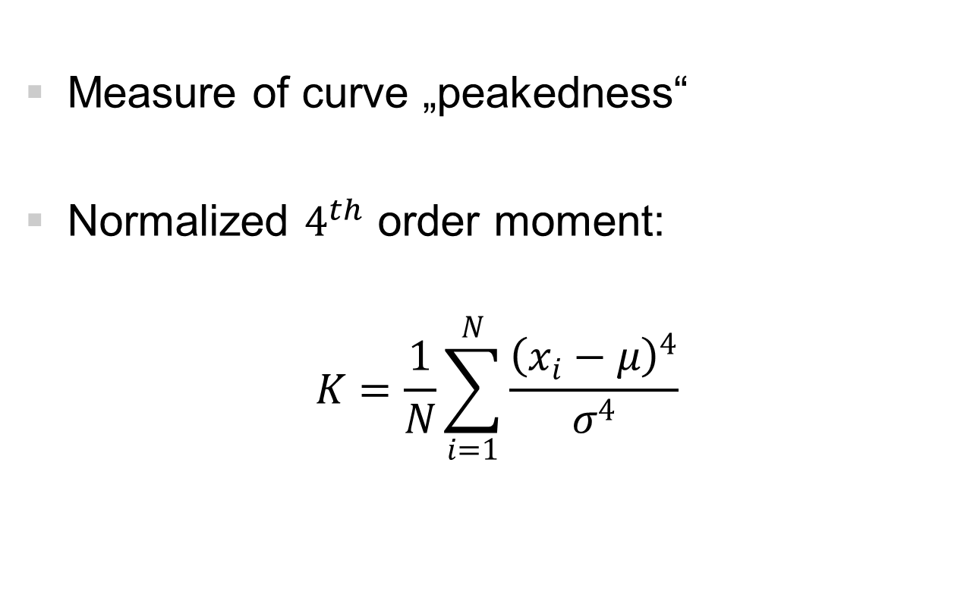
Kurtosis
Measure of curve „peakedness“
Normalized $4^{th}$ order moment:
$$K=\frac{1}{N}\sum_{i=1}^{N}{\frac{{\left(x_{i}−μ\right)}^{4}}{σ^{4}}}$$

Slide 16
Decision Making Classification

Slide 17
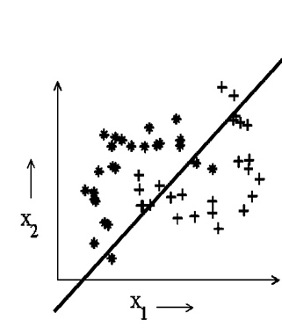
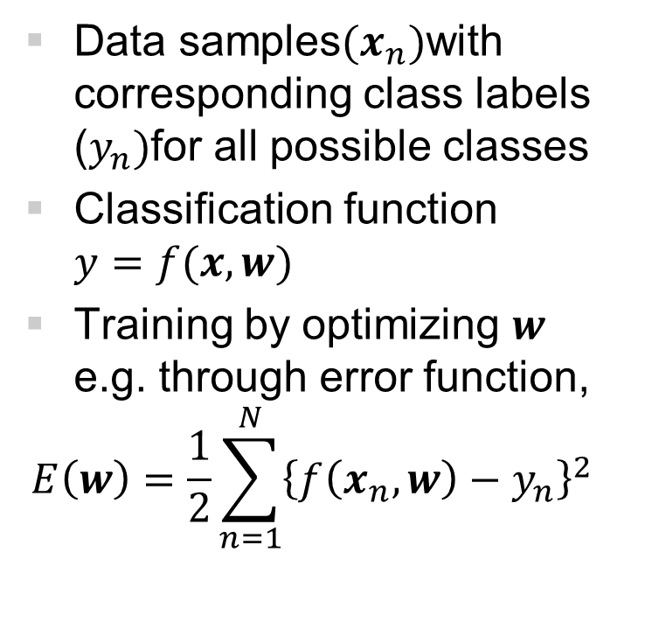
Classification
Supervised, multi-class
Data samples${(x}_{n})$with corresponding class labels ($y_{n})$for all possible classes
Classification function $y=f(x,w)$
Training by optimizing $w$ e.g. through error function,
$$E\left(w\right)=\frac{1}{2}\sum_{n=1}^{N}{{\left\{f\left(x_{n},w\right)−y_{n}\right\}}^{2}}$$

Slide 18
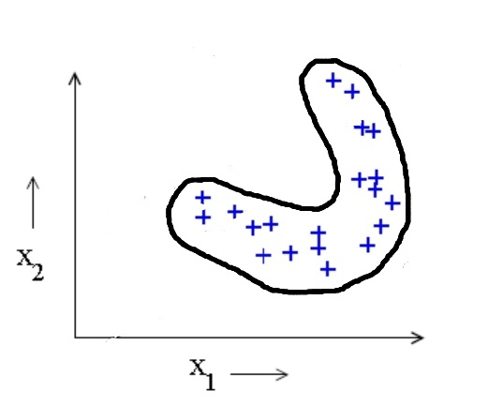
One Class Classification
Supervised, one-class
Typical Condition Monitoring scenario: Only samples for one class (normal conditions)
Strategy: Precise descrip-tion of target class (e.g. through closed boundary)
Also known as: Data Description, Domain Description, Outlier or Novelty Detection
Outlier objects
Target objects
*
*
*

Slide 19
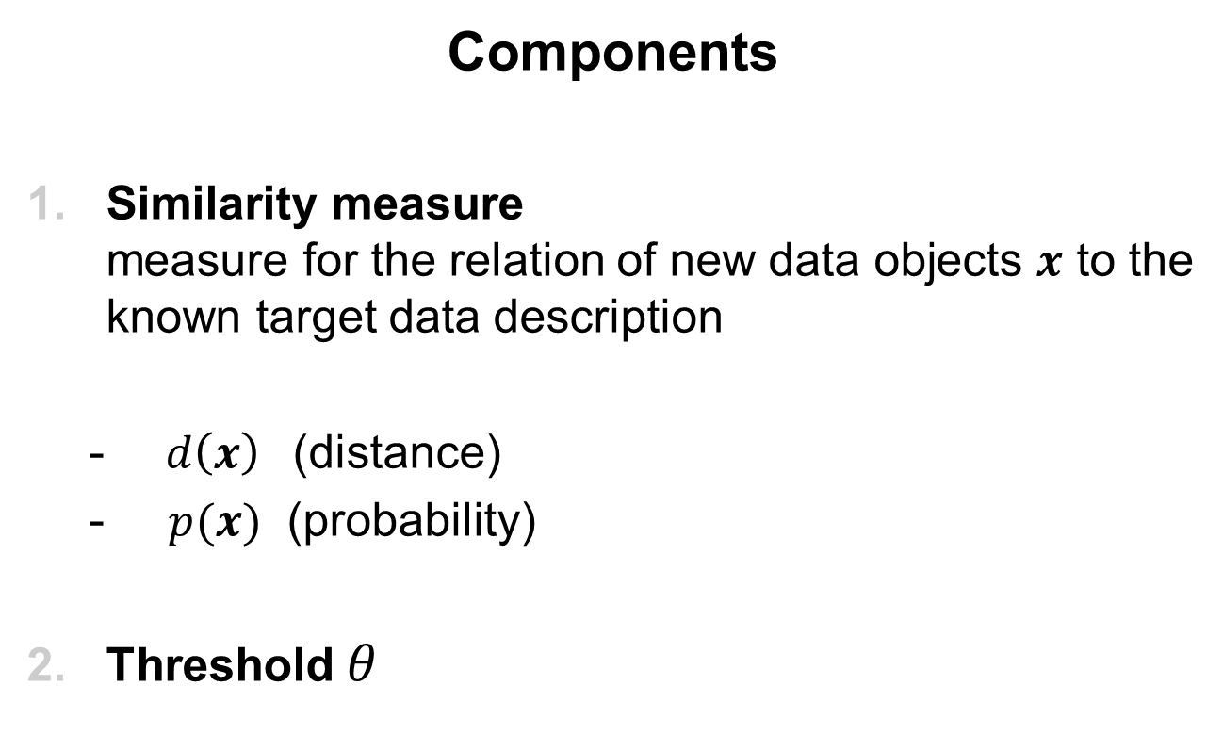
One Class Classification
Components
Similarity measure measure for the relation of new data objects $x$ to the known target data description
$d\left(x\right)$ (distance)
$p(x)$ (probability)
Threshold $θ$

Slide 20
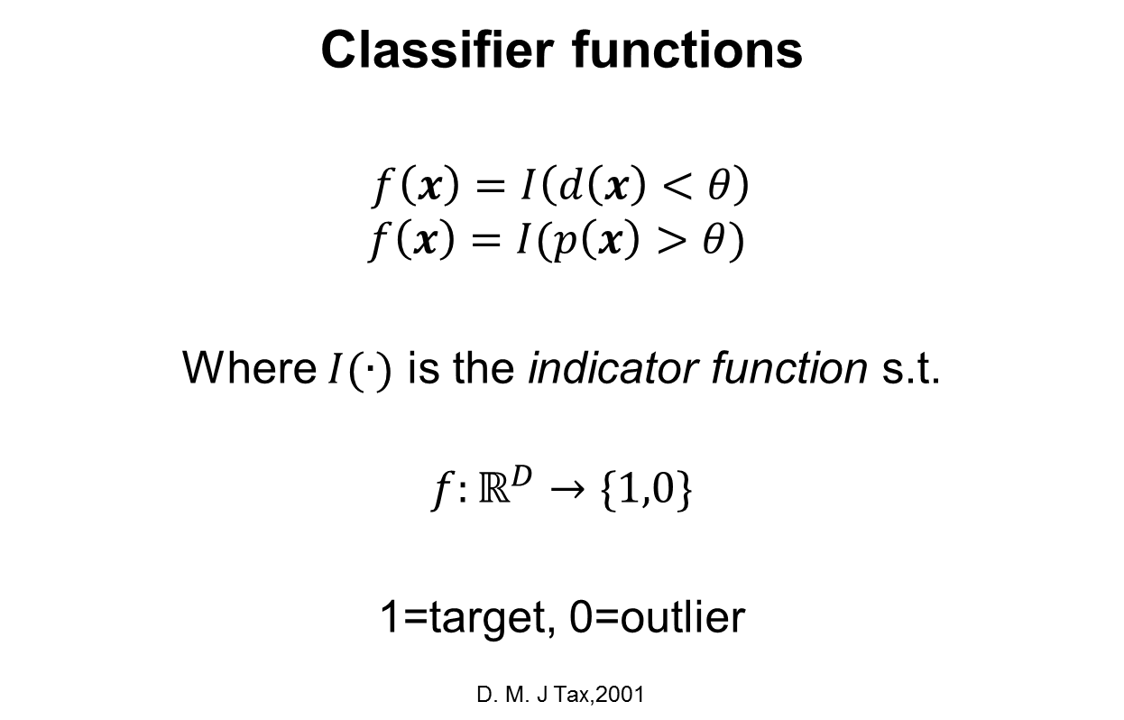
One Class Classification
Classifier functions
$$f\left(x\right)=I\left(d\left(x\right)<θ\right)$$
$$f\left(x\right)=I(p\left(x\right)>θ)$$
Where $I(∙)$ is the indicator function s.t.
$$f:ℝ^{D}→\{1,0\}$$
1=target, 0=outlier
D. M. J Tax,2001

Slide 21
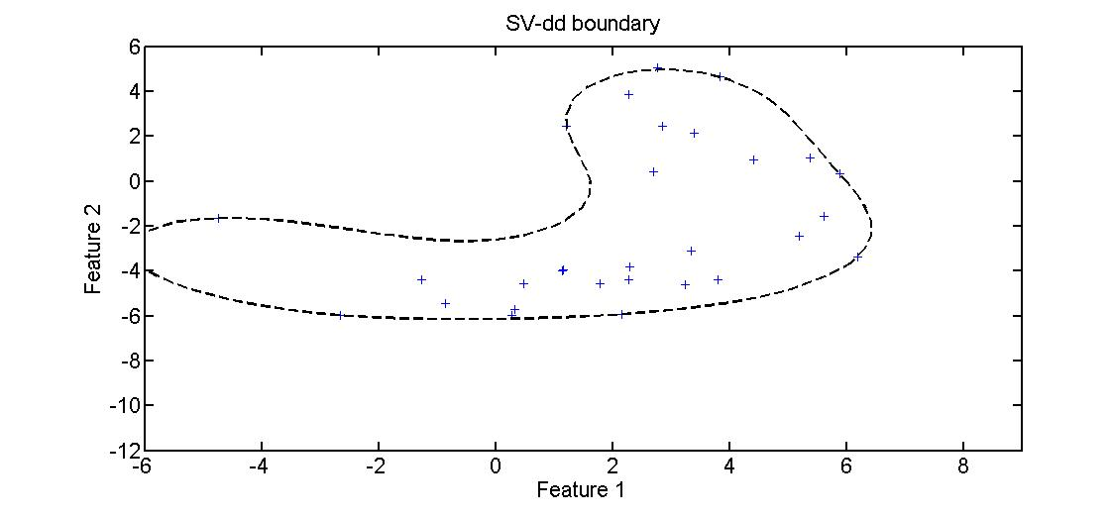
Support Vector Data Description
Principle: Support objects defining a hypersphere with radius
R and center a
Training: Minimization of R such that most traning target objects are inside hypersphere
Classification: new objects are target objects if they are inside the
boundary, outliers otherwise
SV-dd boundary

Slide 22
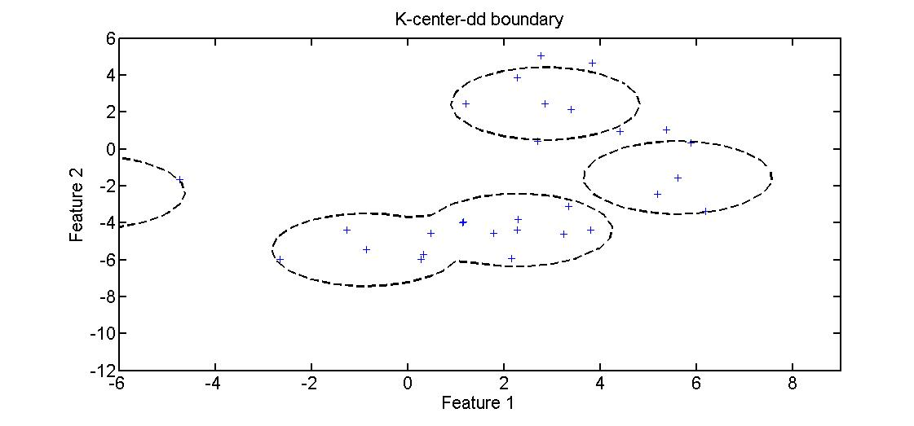
K-Center Data Description
Principle: K support objects surrounded by Receptive Fields of equal radius R, data objects belong to the receptive fields of the nearest support object
Training: Selection of support objects such that R is minimal and all sample objects are inside receptive fields
Classification: new objects are target objects if their distance to the nearest support object is smaller than the threshold
K-Center-dd boundary

Slide 23
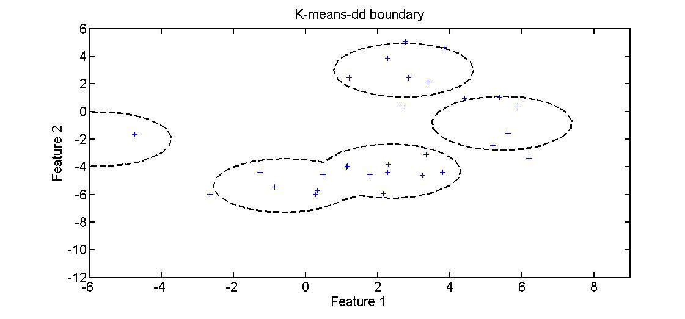
K-Means Data Description
Principle: K clusters, data objects belong to the clusters of the nearest cluster center
Training: recalculation of cluster centers as means of the objects in a cluster, until convergence
Classification: new objects are target objects if their distance to the nearest cluster center is smaller than the predefined threshold
K-Means-dd boundary

Slide 24
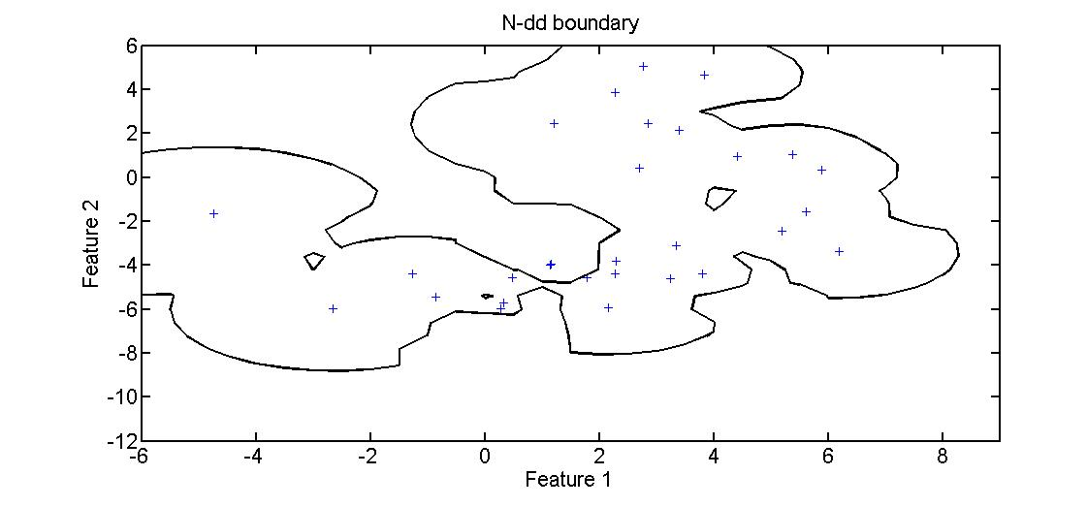
Nearest Neighbor Data Description
Principle: Distances between nearest data objects
Training: No training, but calculation and memorization of distances
Classification: new objects are target objects if their distance to the nearest sample set object is smaller than the distance between the nearest sample set object to its nearest neighbor in the sample set,
NN-dd boundary

Slide 25
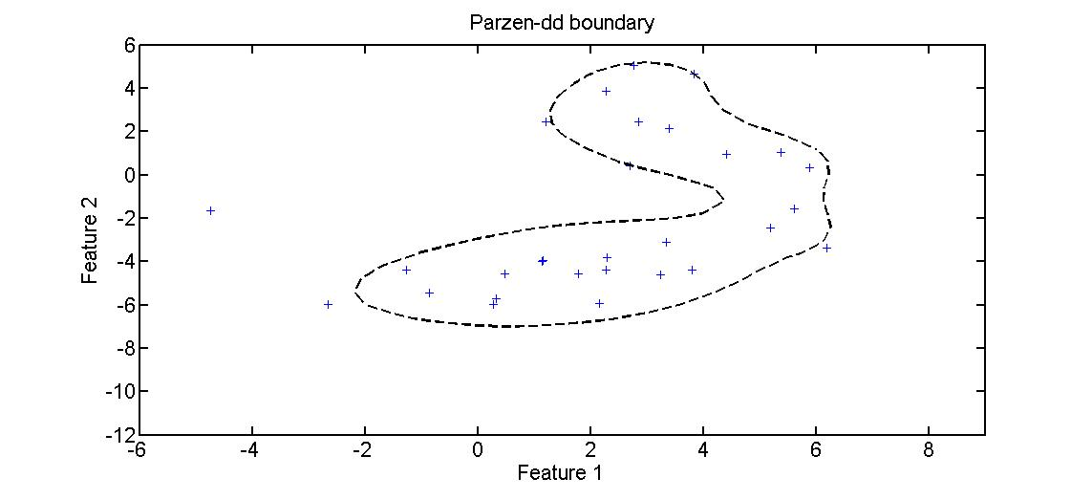
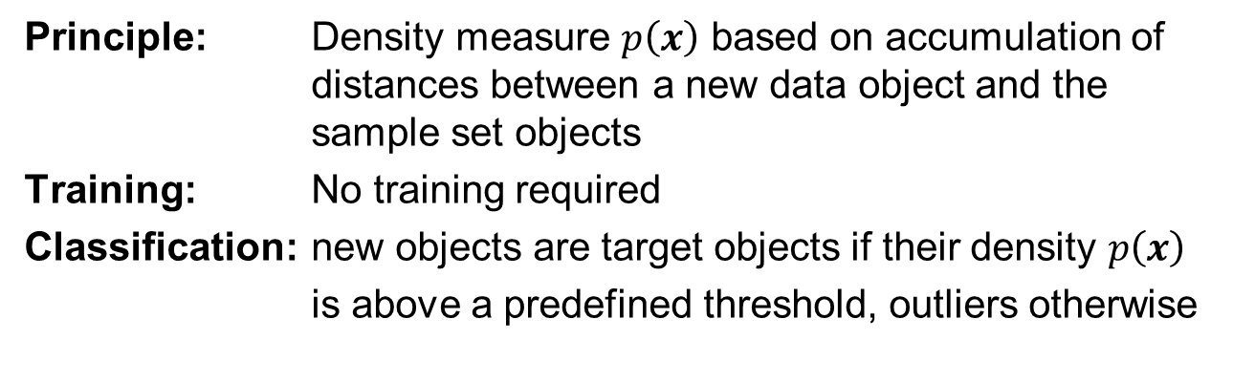
Parzen Window Data Description
Principle: Density measure $p\left(x\right)$ based on accumulation of distances between a new data object and the sample set objects
Training: No training required
Classification: new objects are target objects if their density $p\left(x\right)$
is above a predefined threshold, outliers otherwise
Parzen-dd boundary

Slide 26
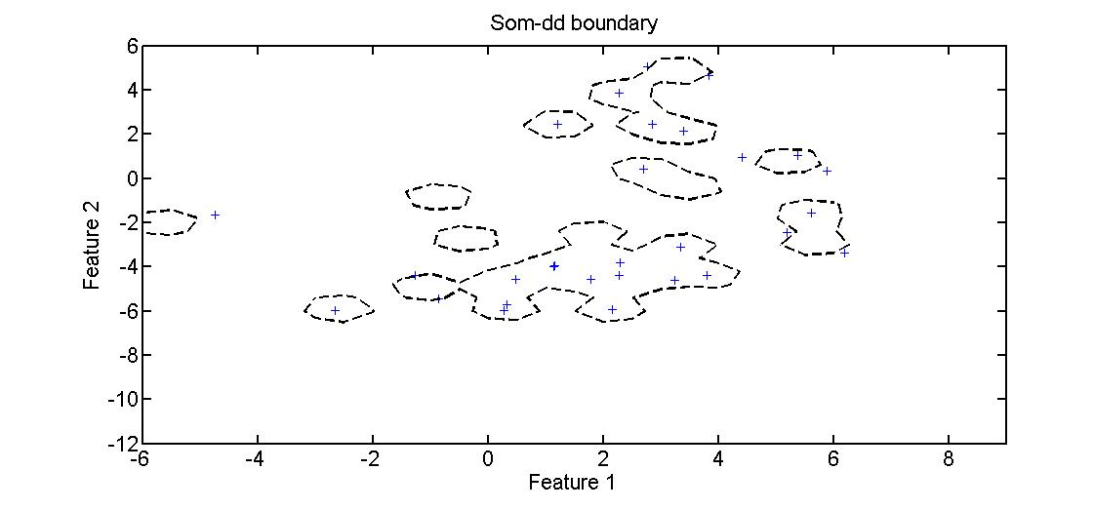
SOM Data Description
Principle: prototypes representing clusters of sample set objects
Training: sequential presentation of sample set objects,
update of nearest and of the surrounding prototypes
Classification: new objects are target objects if their distance to the nearest prototype is below the predefined threshold, outliers otherwise
SOM-dd boundary

Slide 27
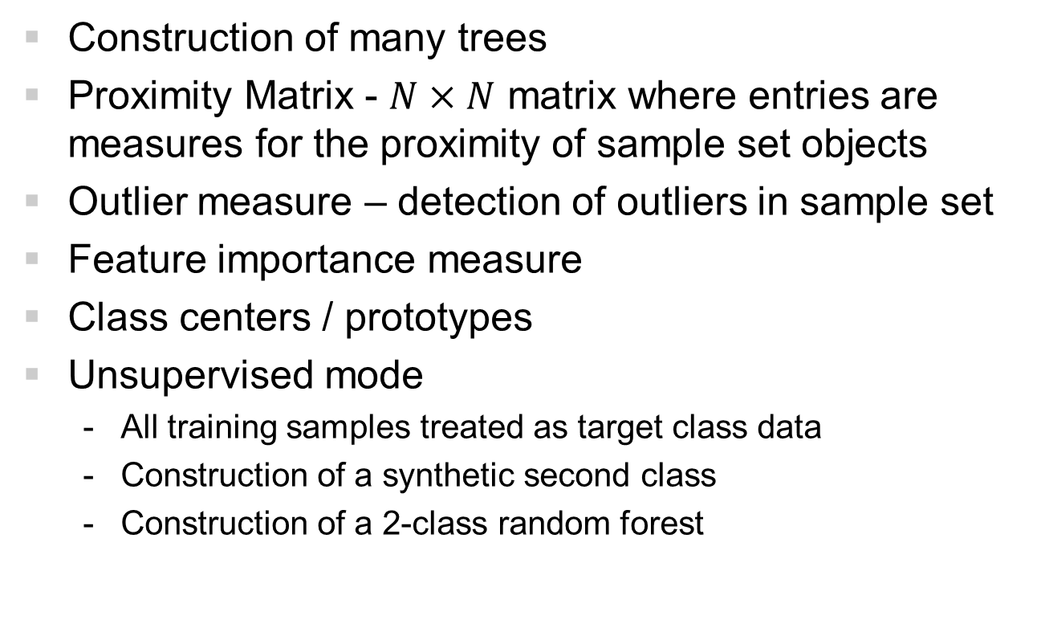
Random Forest
Construction of many trees
Proximity Matrix - $N×N$ matrix where entries are measures for the proximity of sample set objects
Outlier measure – detection of outliers in sample set
Feature importance measure
Class centers / prototypes
Unsupervised mode
All training samples treated as target class data
Construction of a synthetic second class
Construction of a 2-class random forest

Slide 28
Random Forest Data Description
Principle: See above
Training: Random Forest in unsupervised mode, calculation of target class center(s) / prototype(s)
Classification: new objects are target objects if their distance to
the (nearest) target class prototype is below a pre-
defined threshold, outliers otherwise
Implemented for this thesis in R and Matlab, proof of concept in experiment part

Slide 29
Experiments

Slide 30
Experiments
Based on Roller Bearing benchmark data from Case Western University
Implemented as Matlab Scripts
Experiment 1
Preprocessing
Feature Extraction
Classifier training and classification (repeated with sampled training and test set)
Evaluation
Experiment 2
Similar sequence as in experiment 1
Additional feature reduction through Random Forest Variable Importance measure

Slide 31
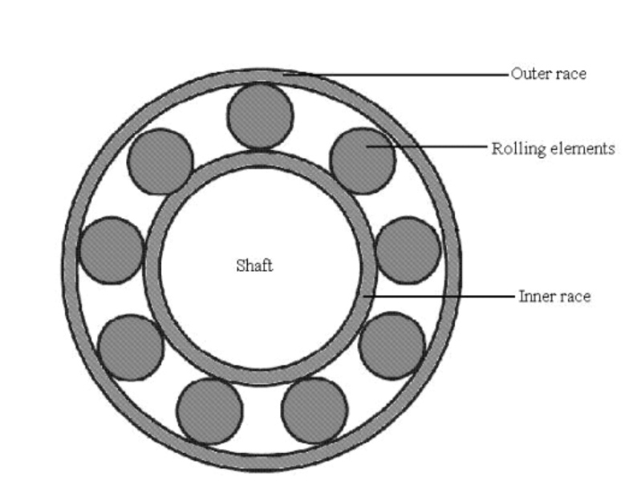
Data Acquisition/Roller Bearing Data
Vibration Data
(accelerometers)

Slide 32
Data Analysis/Preprocessing
4 vibration signals: 1.normal conditions 2.ball fault conditions 3.inner raceway fault 4.outer raceway fault
Obtained from Case Western University
Split signals into segments
corresponding to 5 revolutions
of Roller Bearing

Slide 33
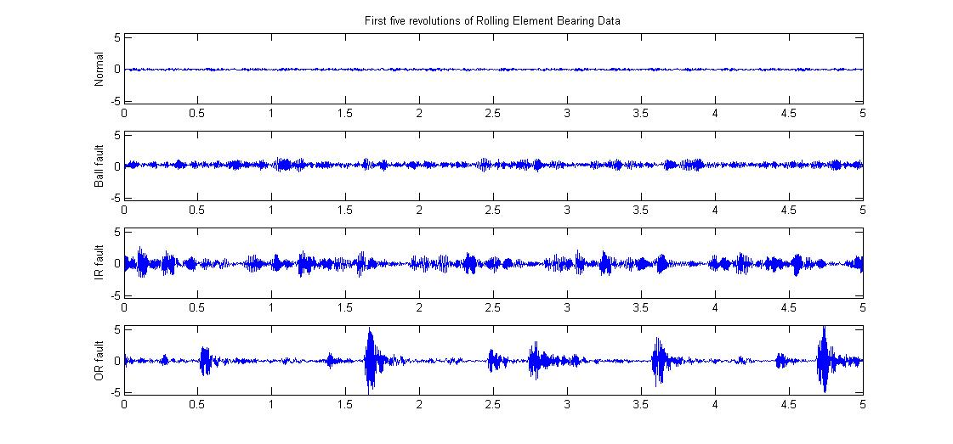
Data Analysis/ Data sample
Normal
conditions
Ball fault
conditions
Inner raceway fault
conditions
Outer raceway fault
conditions
1 segment corresponding to 5 revolutions of Roller Bearing

Slide 34
Data Analysis/Feature Extraction
~450 signal segments
per condition signal
For each segment
Extract n MFCCs
Extract n HFDs
Calculate Kurtosis

Slide 35
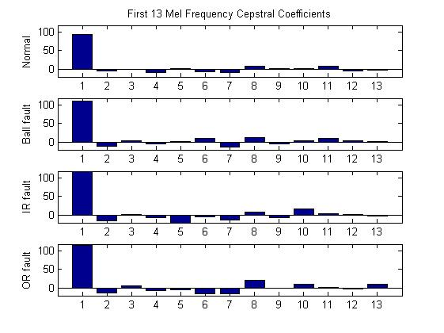
Data Analysis/Feature Extraction
Mel Frequency Cepstral Coefficients
(MFCC) of first segment
Normal condition
Ball fault
Inner raceway fault
Outer raceway fault

Slide 36
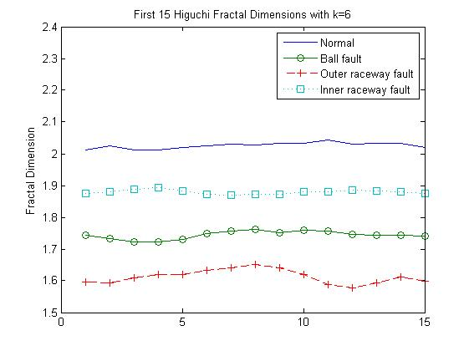
Data Analysis/Feature Extraction
Higuchi Fractal Dimensions
(HFD)

Slide 37
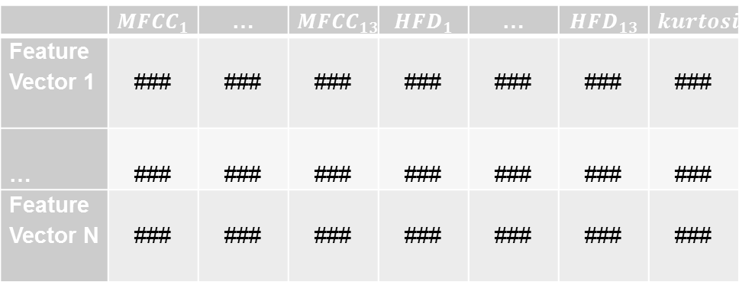
Data Analysis/Feature Extraction
Feature data set
construction
 | $${MFCC}_{1}$$ | … | $${MFCC}_{13}$$ | $${HFD}_{1}$$ | … | $${HFD}_{13}$$ | $$kurtosis$$
Feature Vector 1 | ### | ### | ### | ### | ### | ### | ###
… | ### | ### | ### | ### | ### | ### | ###
Feature Vector N | ### | ### | ### | ### | ### | ### | ###
1 feature data set per condition signal

Slide 38
Decision Making/ OCC-training
Training with normal
features only
K-Center-dd
K-Means-dd
NN-dd
SV-dd
Parzen-dd
SOM-dd
RF-dd
Trained models

Slide 39
Evaluation
Test set consisting of normal features (not used for training) and features of each fault condition
(sampled)
Trained classifiers
Classification of test set and calculation of
Fraction of rejected normals (Error I)
Fraction of accepted outliers (Error II)
Accuracies

Slide 40
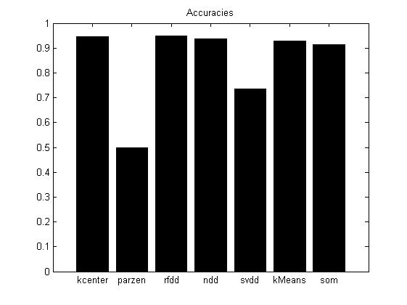
Evaluation

Slide 41
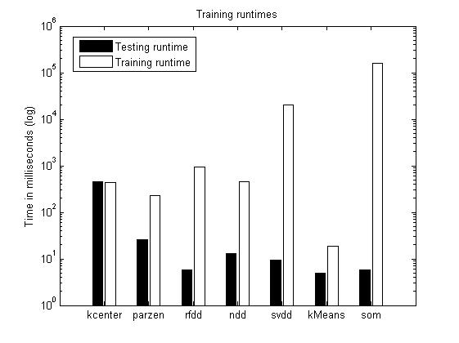
Evaluation

Slide 42
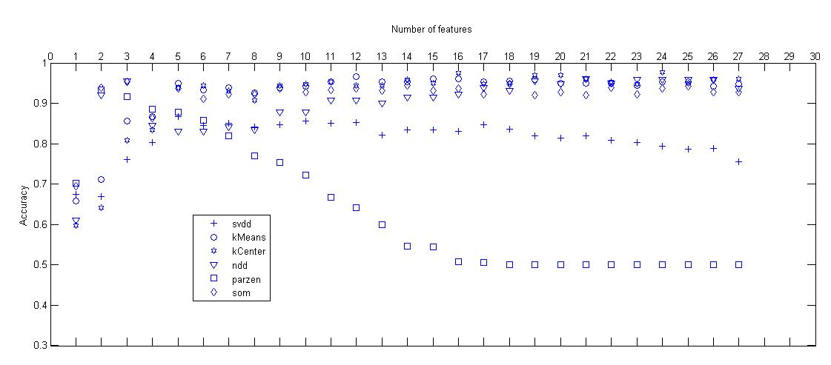
Evaluation
Feature reduction with random forest
variable importance measure

Slide 43
Conclusions
Altogether good results with the combination of Feature Extraction methods and One-Class-Classifiers for the Roller Bearing dataset
excellent results with the new Random Forest One-Class-Classifier concept
huge differences in training times (not that important in real world applications)
underperformers: SV-dd (w.r.t. time and accuracy), Parzen Window (worst classifier)

Slide 44
Outlook
Combination of One-Class-Classifiers in Ensemble Methods (Batch / AdaBoost) for more reliable results
Calculation of several Random Forest class centers/prototypes for better coverage of the target samples distribution
Application of One-Class-Classifiers in semi-supervised setting

Slide 45
End
Thank You!

