Slide 1
Outlier Detection in Condition Monitoring
Master Thesis
Ralph Fehrer
„Intelligente Eingebettete Mikrosysteme“
2012-2013

Slide 2
Overview
Condition Monitoring Framework
Feature Extraction Methods
Mel Frequency Cepstral Coefficients (MFCC)
Higuchi Fractal Dimensions (HFD)
Kurtosis
One Class Classification
Construction of One-Class-Classifiers
Selected One-Class-Classifiers
Experiments
Complete Semi-Supervised CM framework
Feature Reduction with Random Forest

Slide 3
Condition Monitoring

Slide 4
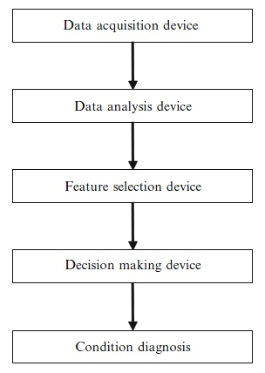
Condition Monitoring Framework
gdgfd

Slide 5
Condition Monitoring Framework
gdgfd

Slide 6
Condition Monitoring Framework
gdgfd

Slide 7
Condition Monitoring Framework
gdgfd

Slide 8
Condition Monitoring Framework
gdgfd

Slide 9
Condition Monitoring Framework
gdgfd

Slide 10
Condition Monitoring Framework
gdgfd

Slide 11
Condition Monitoring Framework
gdgfd

Slide 12
Condition Monitoring Framework
gdgfd

Slide 13
Data Analysis / Feature Extraction

Slide 14
One-Class-Classification

Slide 15
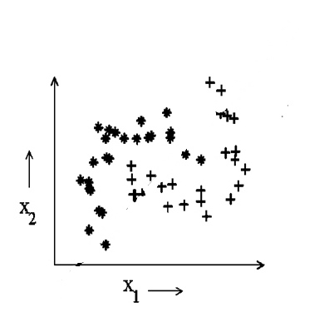
Supervised Classification
Multi-class-training

Slide 16
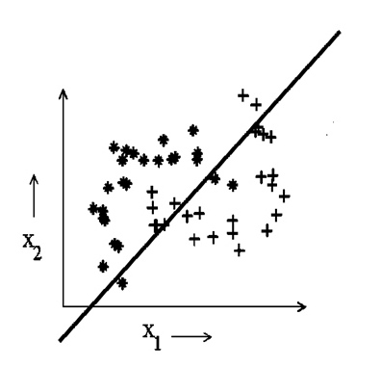
Supervised Classification
Multi-class-training

Slide 17
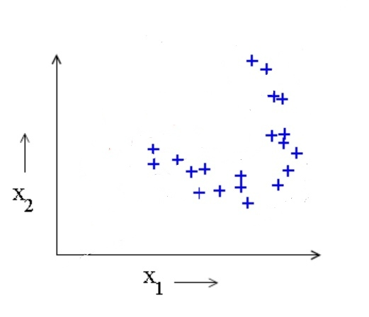
Classification
One-class-training

Slide 18
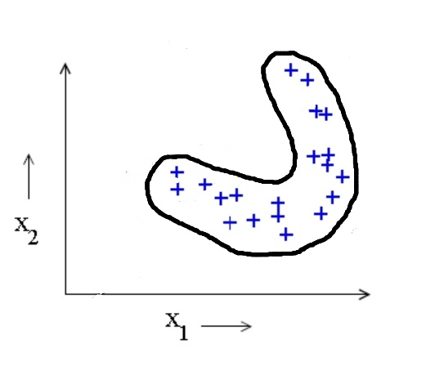
Classification
One-class-training

Slide 19
One Class Classification
One-Class-Classifier Composition

Slide 20
Support Vector Data Description

Slide 21
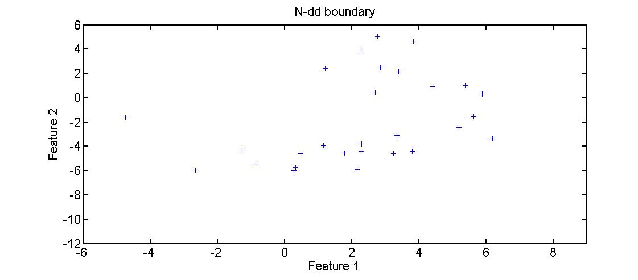
Support Vector Data Description

Slide 22
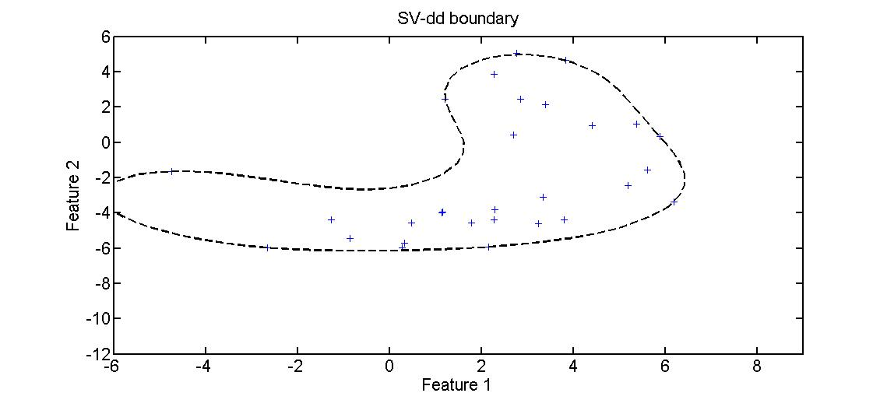
Support Vector Data Description

Slide 23
K-Center Data Description

Slide 24
K-Center Data Description

Slide 25
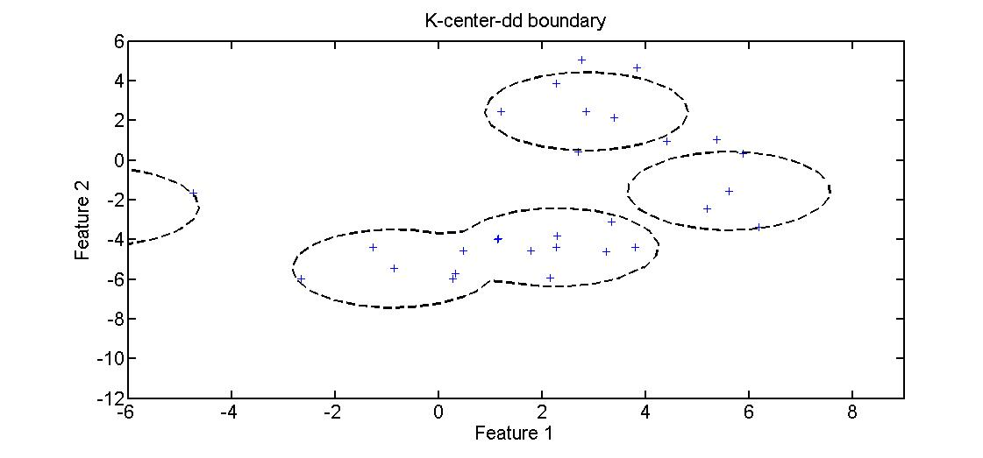
K-Center Data Description

Slide 26
K-Means Data Description

Slide 27
K-Means Data Description

Slide 28
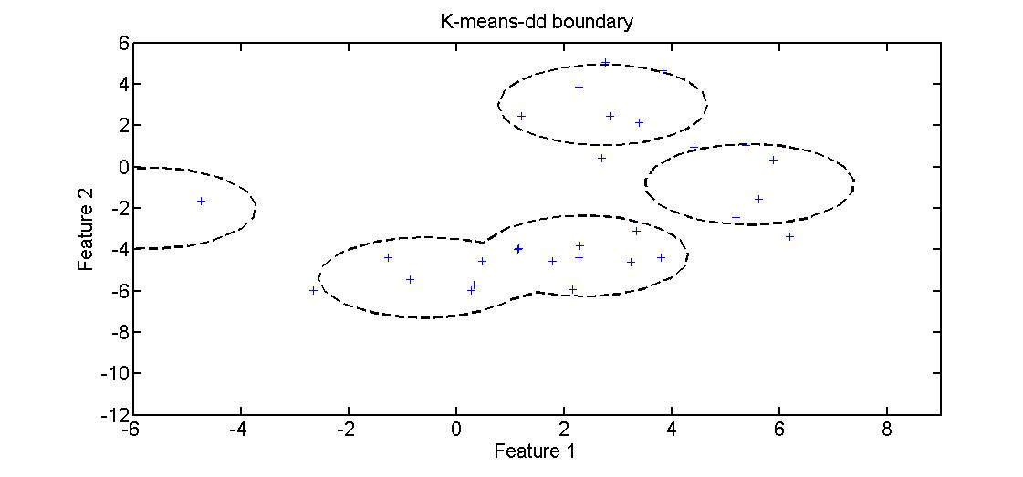
K-Means Data Description

Slide 29
Nearest Neighbor Data Description

Slide 30
Nearest Neighbor Data Description

Slide 31
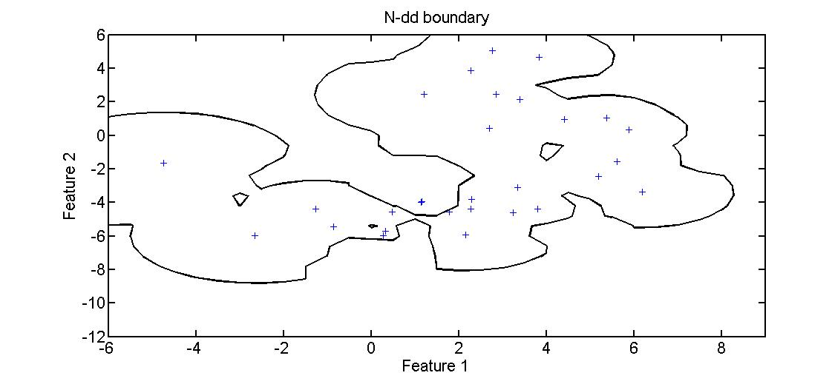
Nearest Neighbor Data Description

Slide 32
Parzen Window Data Description

Slide 33
Parzen Window Data Description

Slide 34
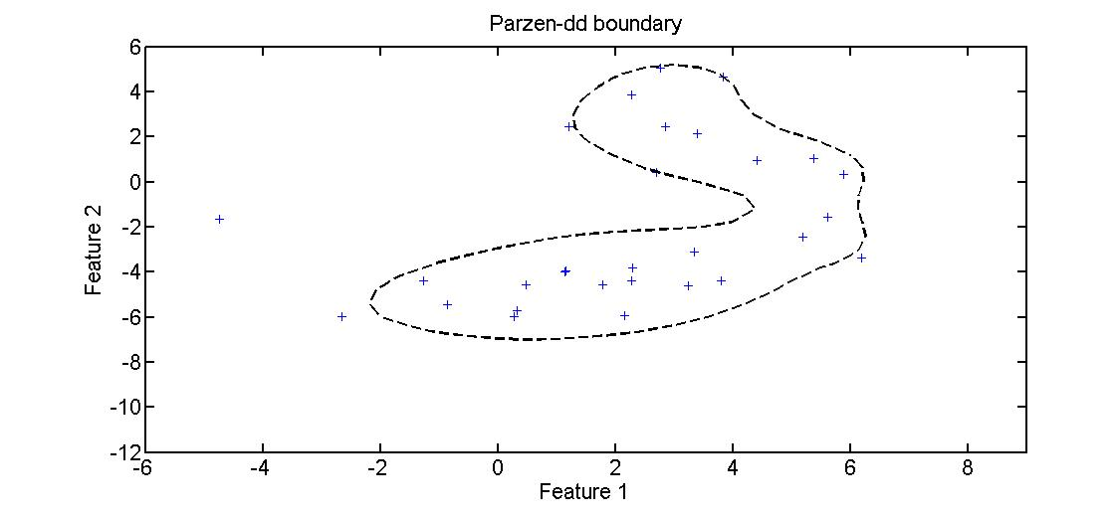
Parzen Window Data Description

Slide 35
SOM Data Description

Slide 36
SOM Data Description

Slide 37
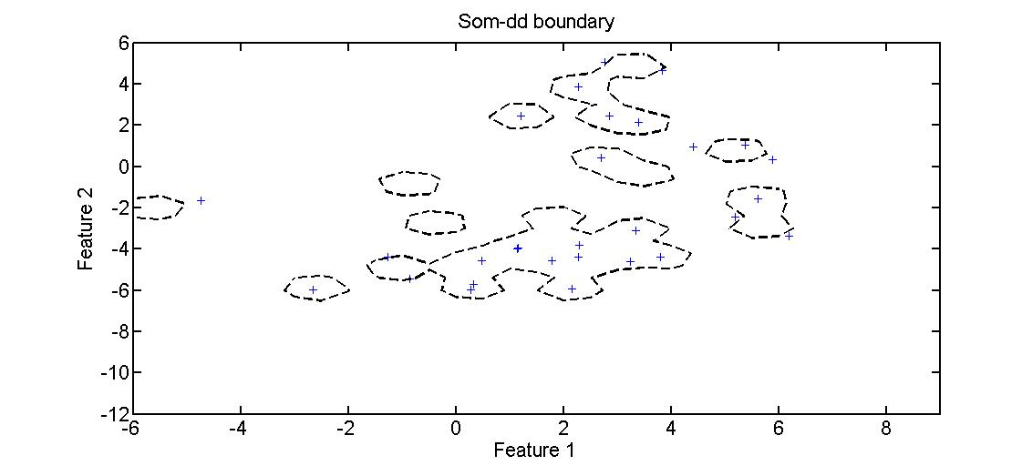
SOM Data Description

Slide 38
Random Forest data description

Slide 39
Experiments
Roller Bearing Data
Preprocessing
Split into segments of 5 Roller Bearing revolutions
Feature Extraction
One Class Classification / Outlier Detection
Evaluation
Fraction Of Rejected Normalls/Fraction Of Accepted Outliers/ Accuracy / Time

Slide 40
Experiments
Roller Bearing Data
Preprocessing
Split into segments of 5 Roller Bearing revolutions
Feature Extraction
One Class Classification / Outlier Detection
Evaluation
Fraction Of Rejected Normalls/Fraction Of Accepted Outliers/ Accuracy / Time

Slide 41
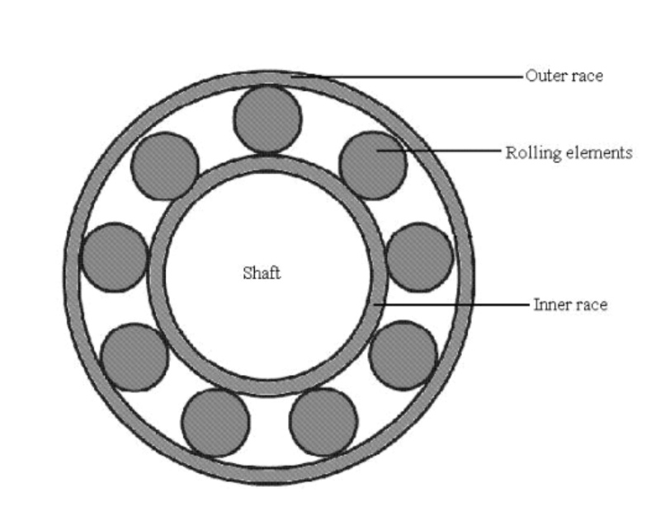
Roller Bearing Data
Vibration Data
(Accelerometers)

Slide 42
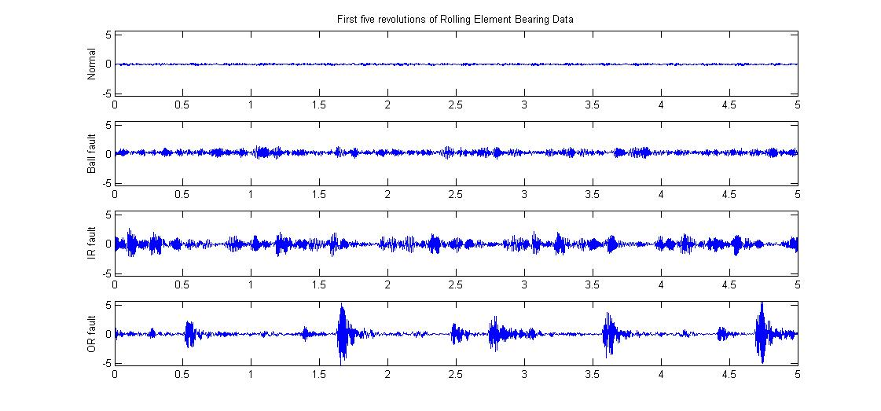
Preprocessing
Split raw signals
Normal condition
Ball fault
Inner Raceway fault
Outer Raceway fault
Feature Extraction

Slide 43
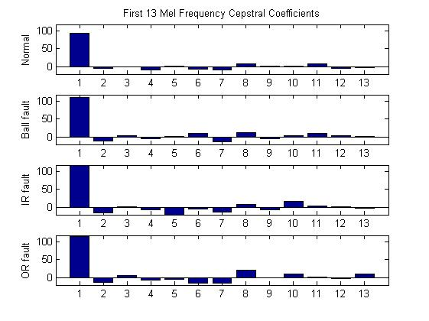
Feature Extraction
Mel Frequency Cepstral Coefficients
(MFCC)
Normal condition
Ball fault
Inner Raceway fault
Outer Raceway fault

Slide 44
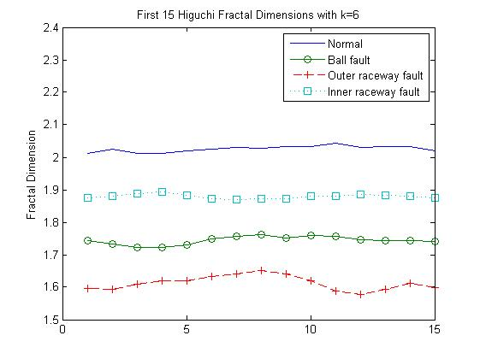
Feature Extraction
Higuchi Fractal Dimensions
(HFD)

Slide 45
Feature Extraction

Slide 46
Outlier Detection
Training of OC-Classifiers with
normal condition features only
K-Center-dd
K-Means-dd
NN-dd
SV-dd
Parzen-d
SOM-dd
RF-dd
Evaluation

Slide 47
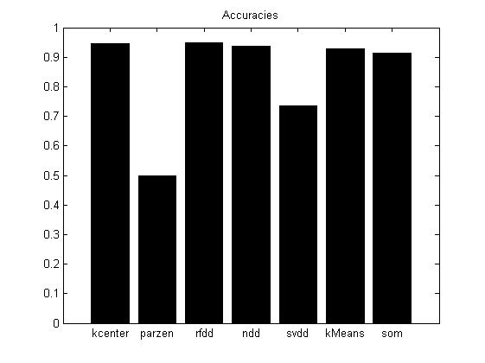
Evaluation
Classification of normal and fault condition
test features

Slide 48
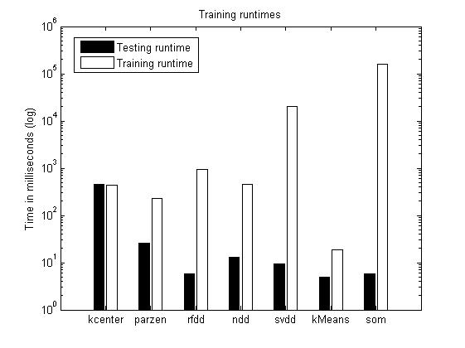
Evaluation
Training and test runtimes

Slide 49
Outlook

