Slide 1
Project Setting
Eclipse CDT Setting
Sang-Wook Lee
2009.08.22

Slide 2
Environment
Eclipse
http://www.eclipse.org/
Eclipse CDT
http://www.eclipse.org/cdt/
MinGW: Minimalist GNU for Windows
http://www.mingw.org/
Cygwin
http://www.cygwin.com/

Slide 3
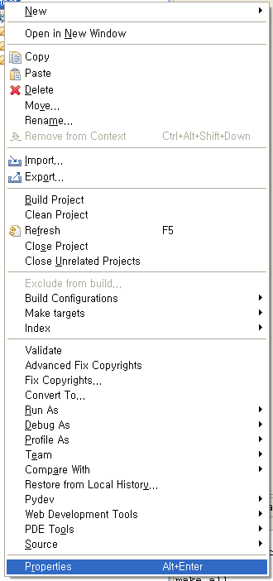
Project Setting: All
Properties of a project

Slide 4
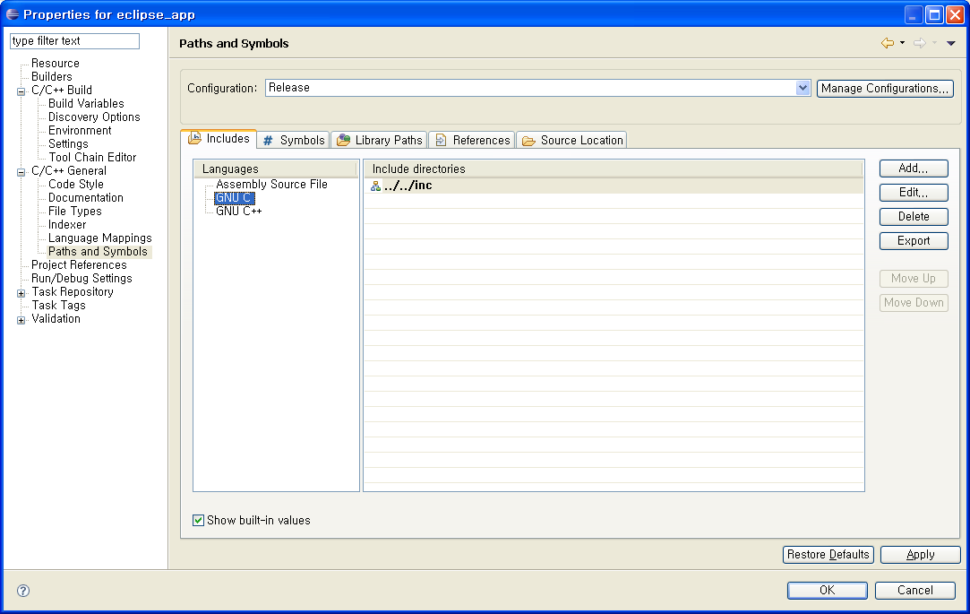
Project Setting: All
C/C++ General ➔ Includes

Slide 5
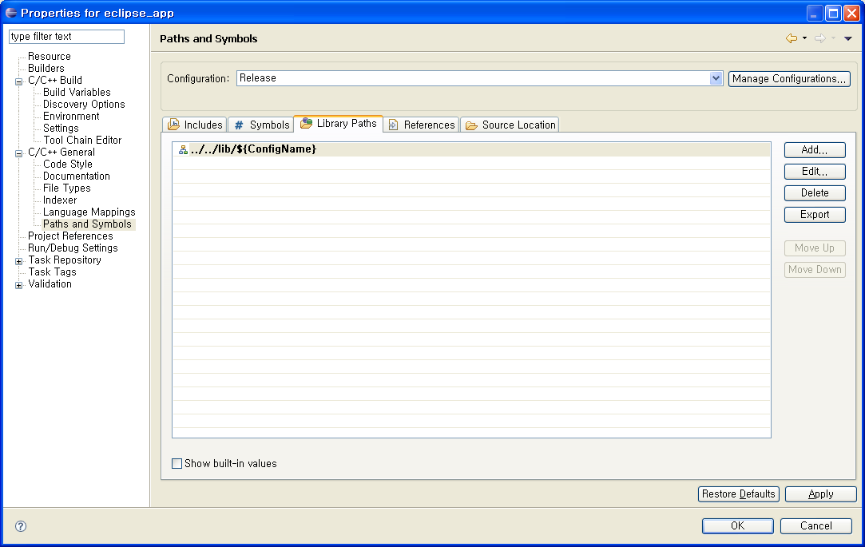
Project Setting: All
C/C++ General ➔ Library Paths

Slide 6
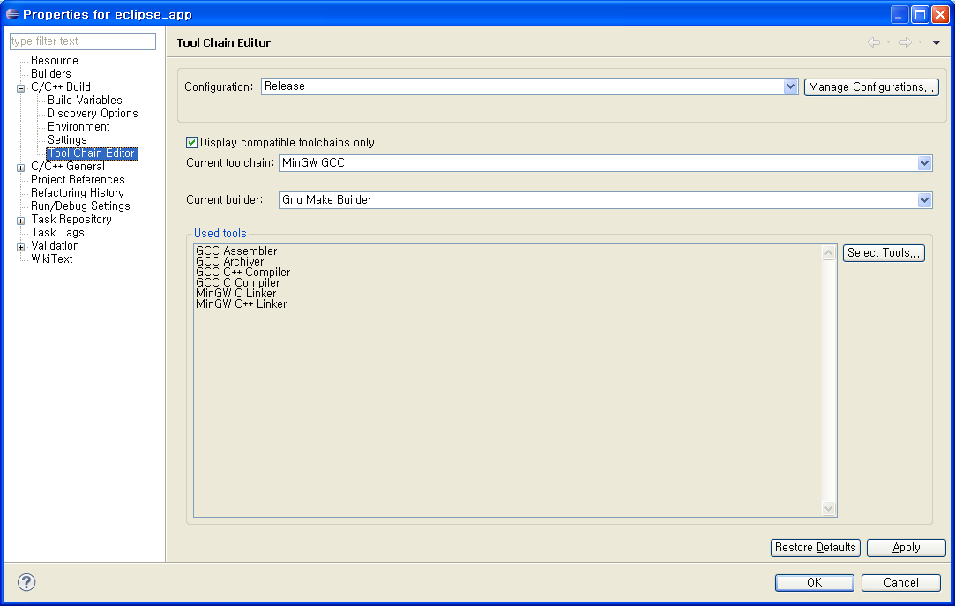
Project Setting: All
C/C++ Build ➔ Tool Chain Editor (MinGW)

Slide 7
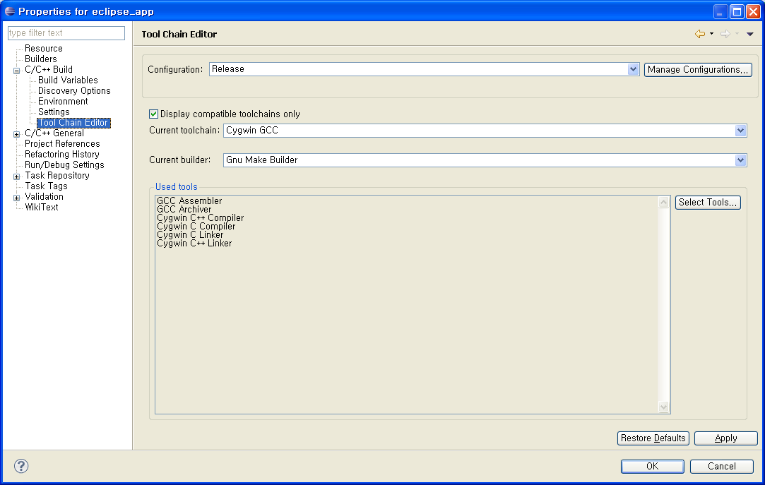
Project Setting: All
C/C++ Build ➔ Tool Chain Editor (Cygwin)

Slide 8
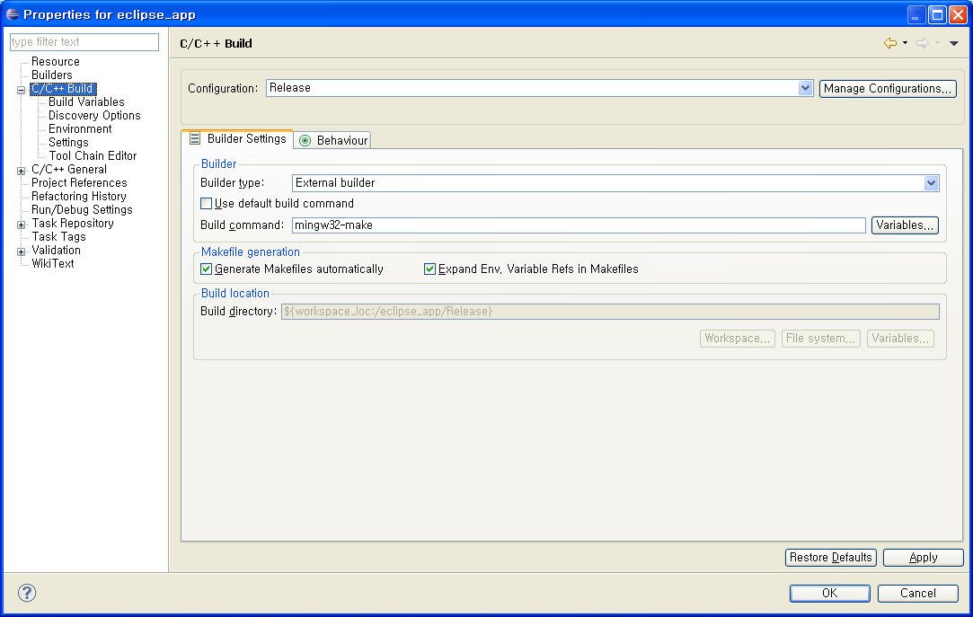
Project Setting: All
C/C++ Build (MinGW)

Slide 9
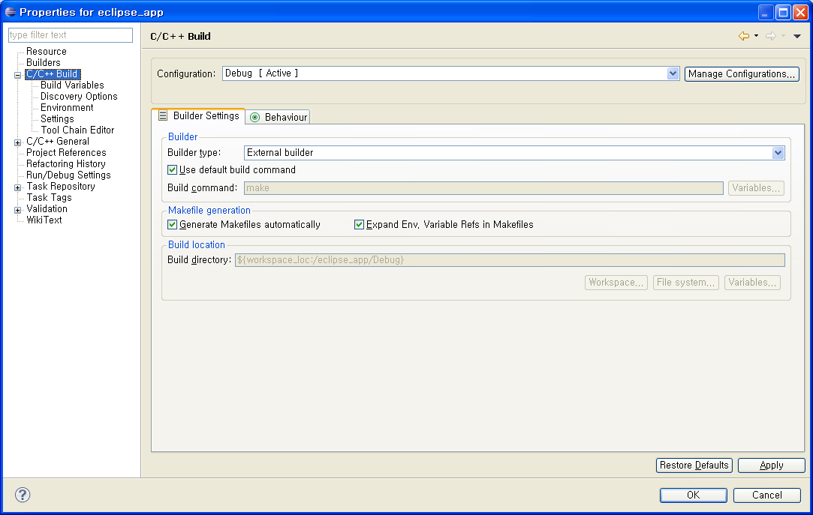
Project Setting: All
C/C++ Build (Cygwin)

Slide 10
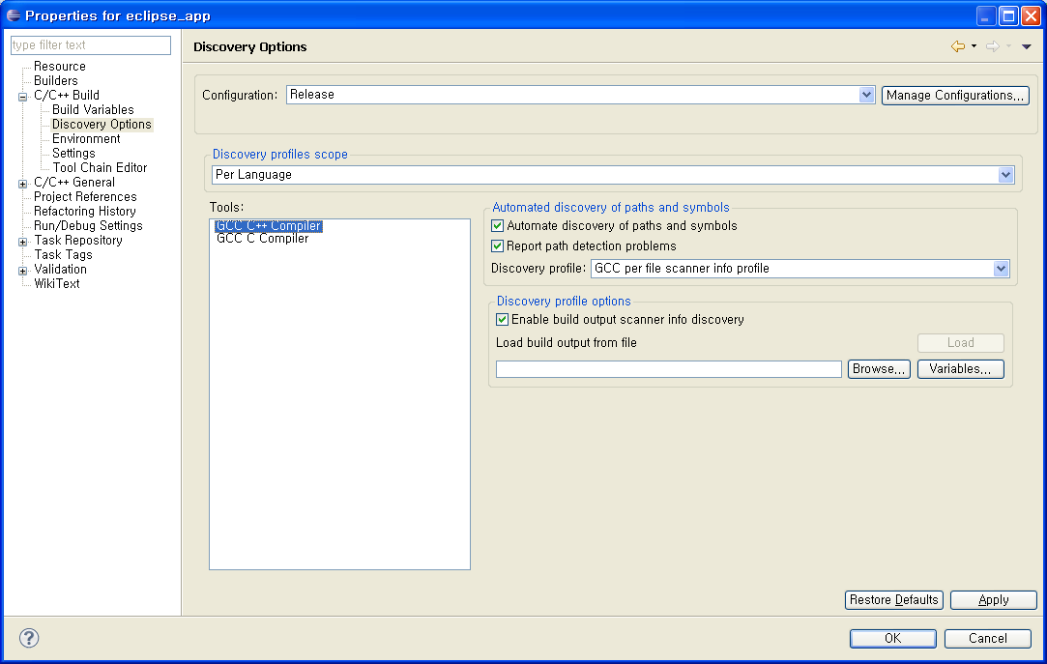
Project Setting: All
C/C++ Build ➔ Discovery Options (MinGW)

Slide 11
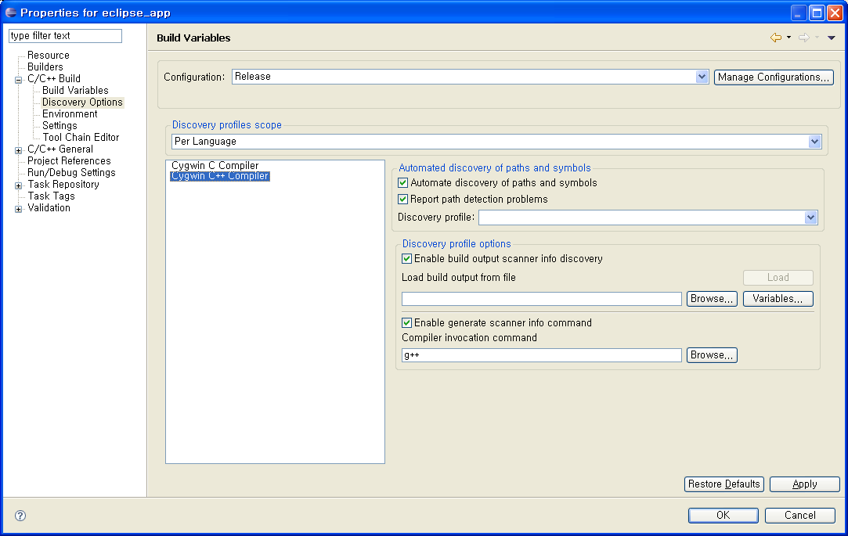
Project Setting: All
C/C++ Build ➔ Discovery Options (Cygwin)

Slide 12
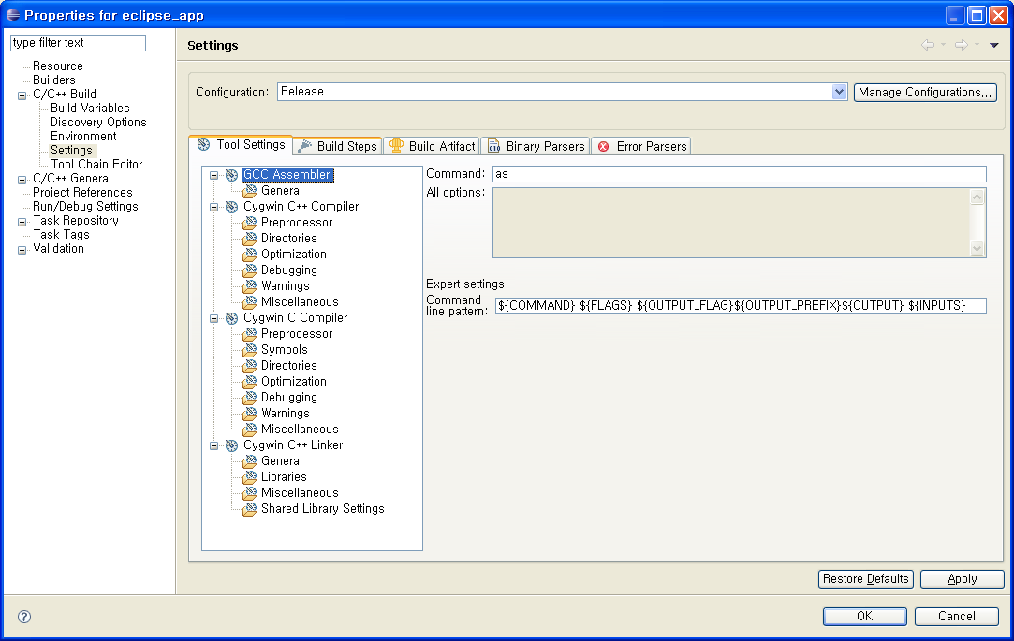
Project Setting: All
C/C++ Build ➔ Settings ➔ Assembler

Slide 13
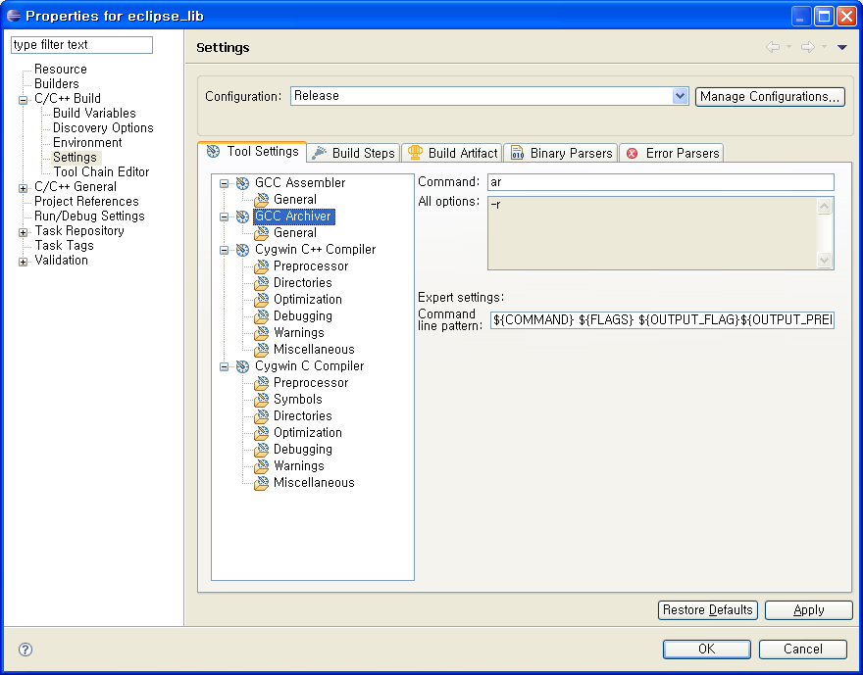
Project Setting: Static Library
C/C++ Build ➔ Settings ➔ Archiver

Slide 14
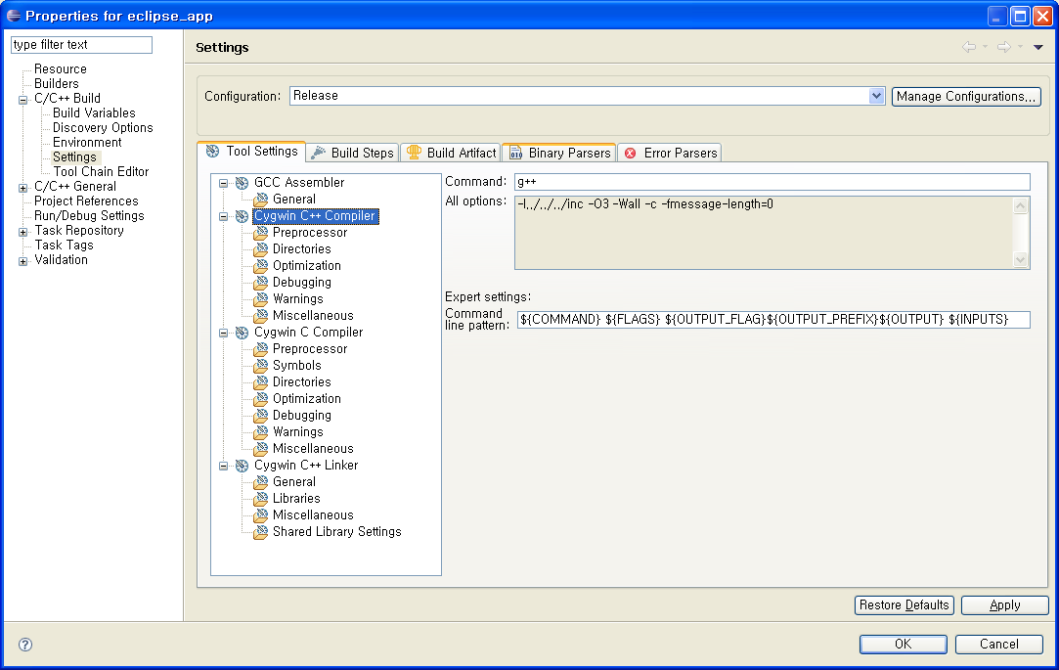
Project Setting: All
C/C++ Build ➔ Settings ➔ Compiler
MinGW의 경우 mingw32-g++.exe 또는 mingw32-gcc.exe 사용 가능.

Slide 15
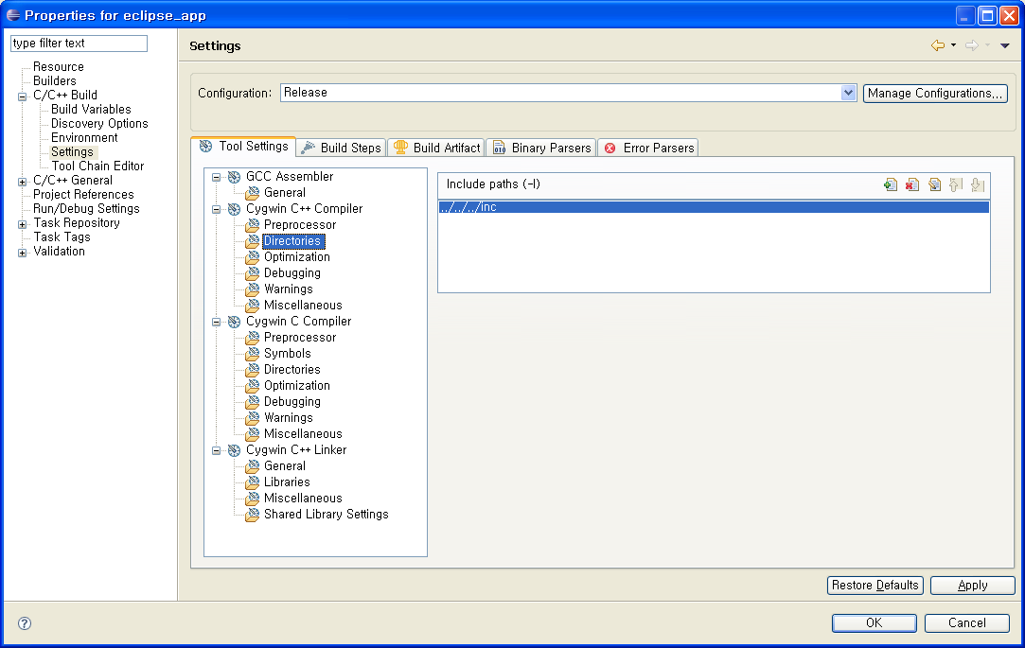
Project Setting: All
C/C++ Build ➔ Settings ➔ Compiler ➔ Directories

Slide 16
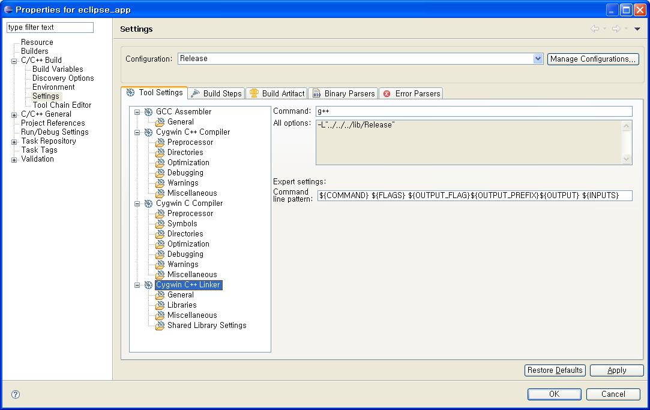
Project Setting: Exe & Shared
C/C++ Build ➔ Settings ➔ Linker
MinGW의 경우 mingw32-g++.exe 사용 가능.

Slide 17
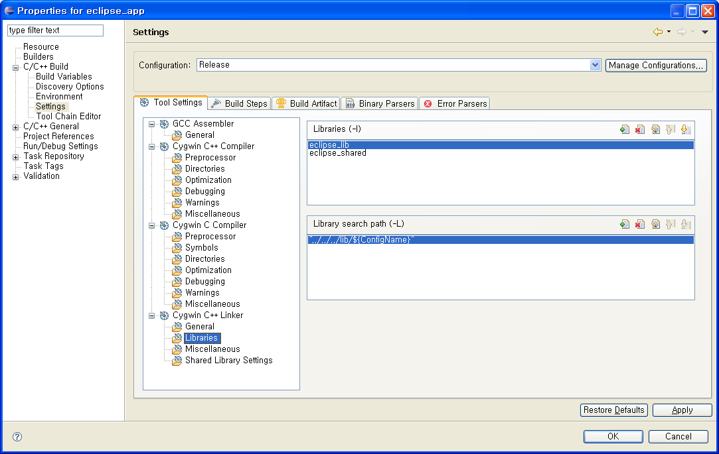
Project Setting: All
C/C++ Build ➔ Settings ➔ Linker ➔ Libraries
Library를 지정할 때 prefix(lib)와 extention(.a or .lib)은 생략한다.
1. in case of a static library: libeclipse_lib.a → eclipse_lib
2. in case of a shared library:
libeclipse_shared.a or eclipse_shared.lib → eclipse_shared

Slide 18
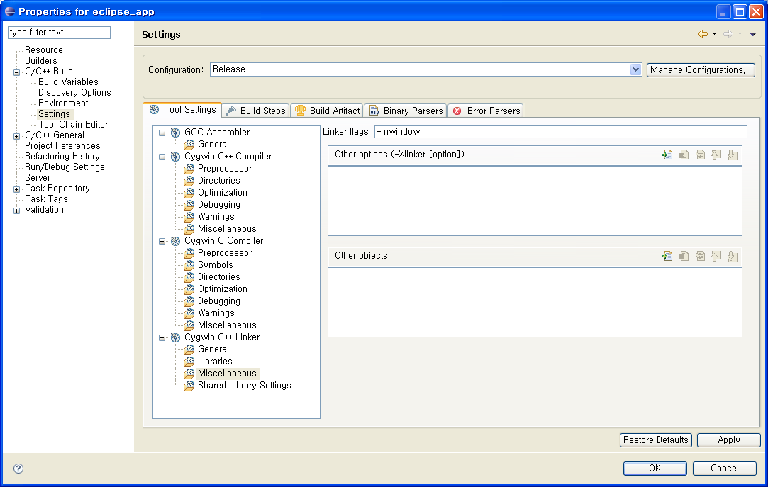
Project Setting: Executable
C/C++ Build ➔ Settings ➔ Linker ➔ Miscellaneous
MinGW을 이용해 window programming을 하는 경우, console window를 없애준다.

Slide 19
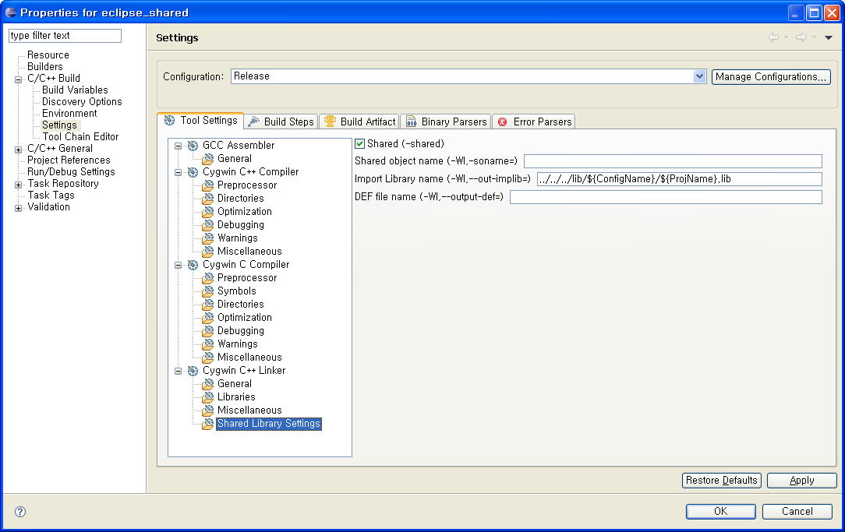
Project Setting: Shared Library
C/C++ Build ➔ Settings ➔ Linker ➔ Shared Library Settings

Slide 20
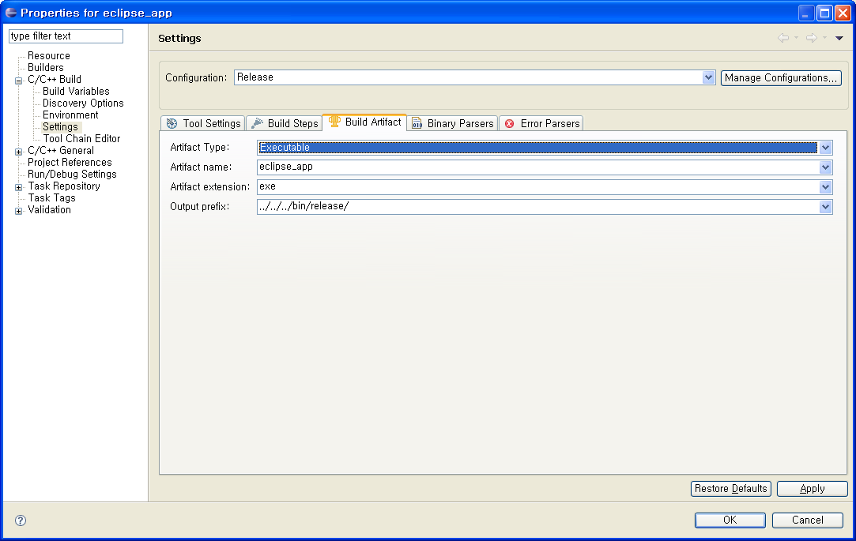
Project Setting: Executable
C/C++ Build ➔ Settings ➔ Build Artifact

Slide 21
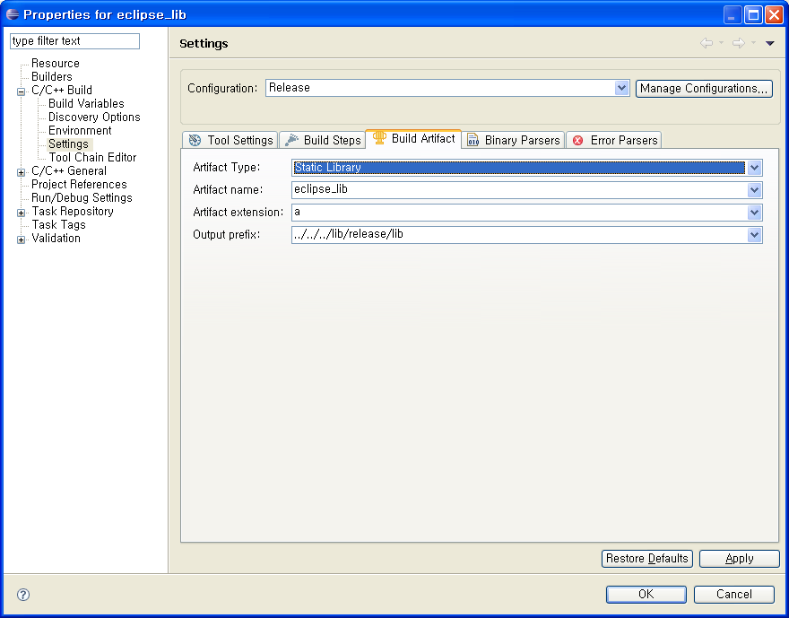
Project Setting: Static Library
C/C++ Build ➔ Settings ➔ Build Artifact

Slide 22

Project Setting: Shared Library
C/C++ Build ➔ Settings ➔ Build Artifact

Slide 23
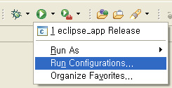
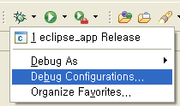
Run/Debug Configurations

Slide 24
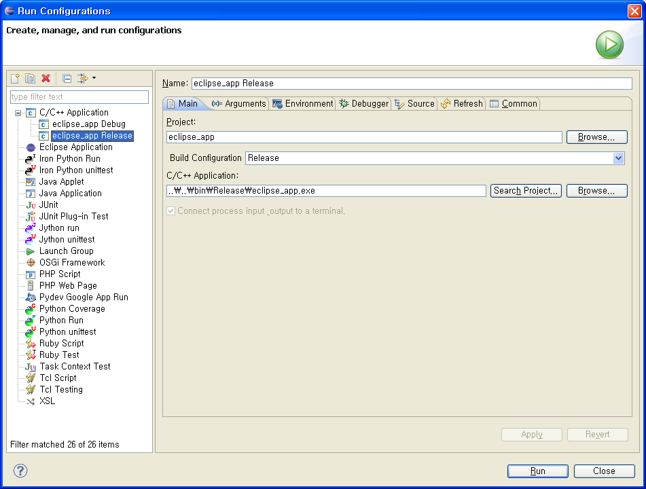
Run/Debug Configurations
C/C++ Local Application ➔ Main

Slide 25
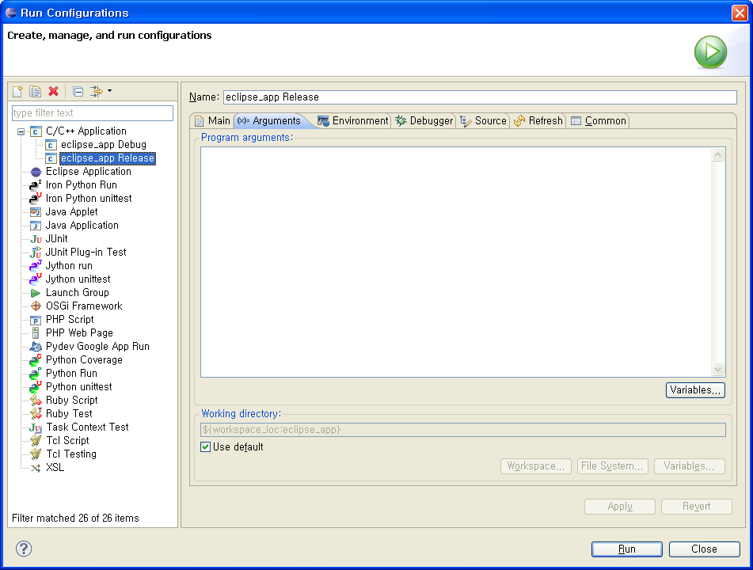
Run/Debug Configurations
C/C++ Local Application ➔ Arguments

Slide 26
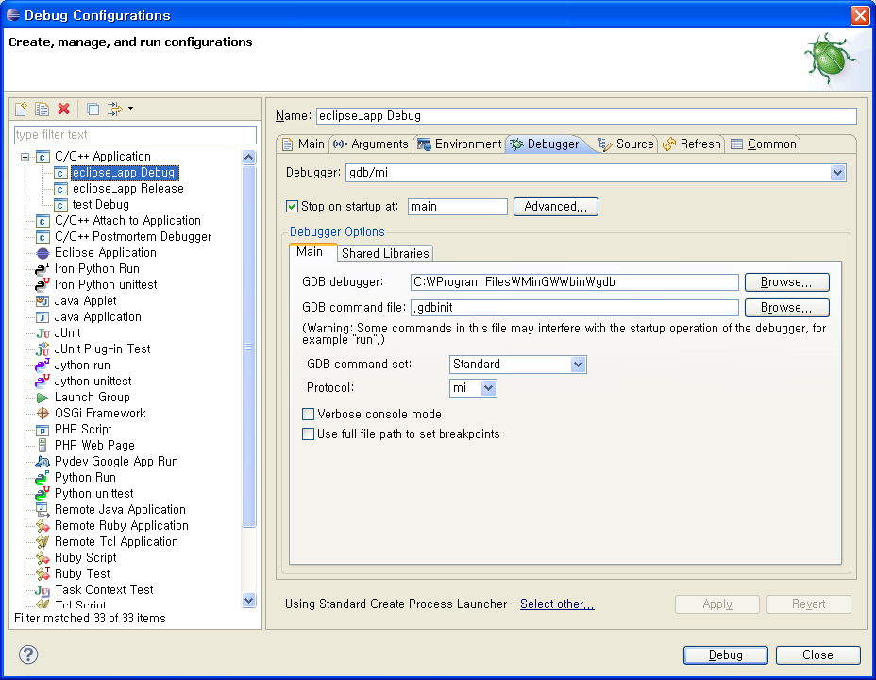
Run/Debug Configurations
C/C++ Local Application ➔ Debugger ➔ Main
이전 버전의 MinGW에서는 gdb가 포함되어 있었으나, MinGW-5.0.2에는 gdb가 포함되어 있지 않다.
따라서 gdb를 내려받아 MinGW가 설치된 디렉토리에 설치하여야 한다.

Slide 27
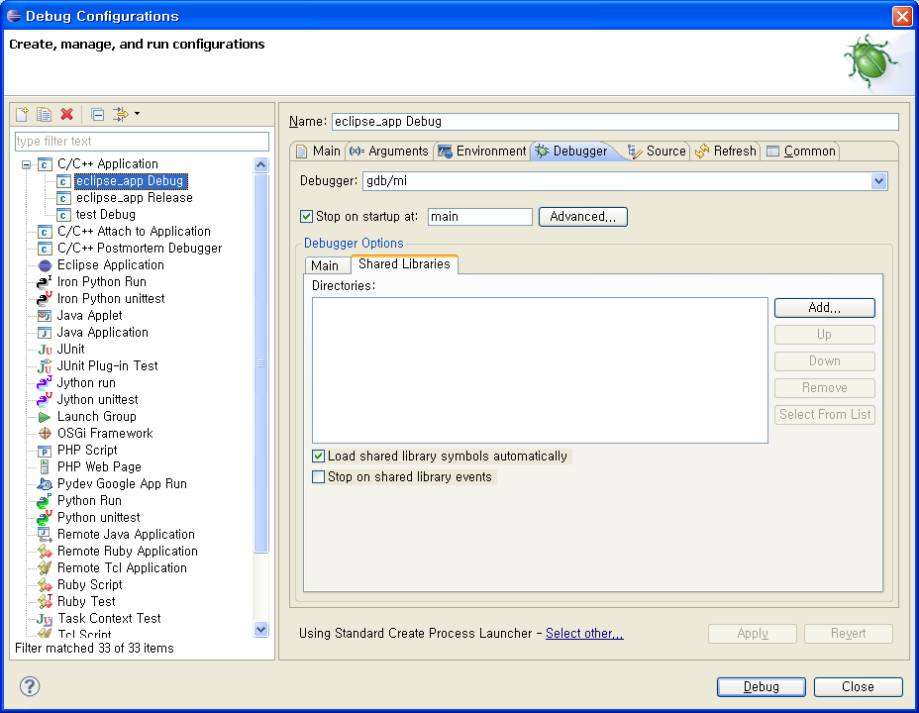
Run/Debug Configurations
C/C++ Local Application ➔ Debugger ➔ Shared Libraries

