Slide 1
Project Setting
Development Environment
Sang-Wook Lee
2009.06.17

Slide 2
Environment
OS
Windows XP
Service Pack 3
Compiler
C/C++ Compiler
Microsoft Visual C++ 8
IDE
Visual Studio 2005

Slide 3
Environment
Version Control System
Subversion
Server
http://subversion.tigris.org/
Client
TortoiseSVN
http://tortoisesvn.net/
Web Browser를 이용하는 경우
Subversion repository URL을 web browser의 주소창에 입력하면 repository의 내용을 볼 수 있음
단, 수정은 되지 않음
SSL에서 사설 인증서를 사용하고 있어 접속 시 보안 경고가 나오나 무시하고 계속 진행하면 됨

Slide 4
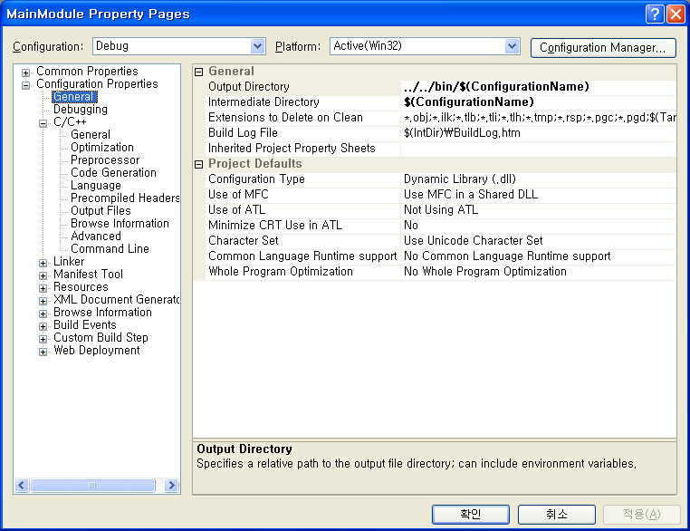
Compiler Setting
Use MFC Shared DLLs
Use Unicode Character Set

Slide 5
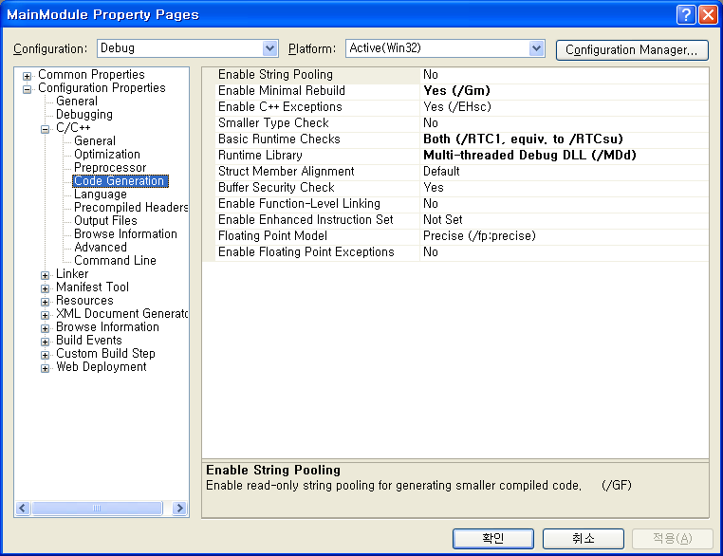
Compiler Setting
Use Multi-threaded Runtime Libraries

Slide 6
Subversion Repository
SWL project
file:///e:/svnrepos/swl/
Sandbox project
Subversion test를 위한 project
file:///e:/svnrepos/sandbox

Slide 7
3rd Party Library
Boost
Version: 1.39.0
Site
http://www.boost.org/
Library directory
{SWL_REPO}/3rd/inc/boost OpenCV
Version: 1.0.0
Site
http://sourceforge.net/projects/opencvlibrary/
http://opencv.willowgarage.com/wiki/
Library directory
{SWL_REPO}/3rd/inc/opencv
MRPT
Version: 0.7.0
Site
http://babel.isa.uma.es/mrpt/
Library directory
{SWL_REPO}/3rd/inc/mrpt

