Slide 1
Generating FPGA-based In-line Accelerators
By: Maysam Lavasani
Under supervision: Prof. Derek Chiou
Notes:
Thanks for coming to my proposal session. The title of my proposal is

Slide 2
Committee
Derek
Patt
Andreas
Mattan
Jacob
Eric
(Pingalli?)

Slide 3
Outline
Motivation and background
Gorilla
Architecture view
Automation view
Case studies and experimental results
Plan for future

Slide 4
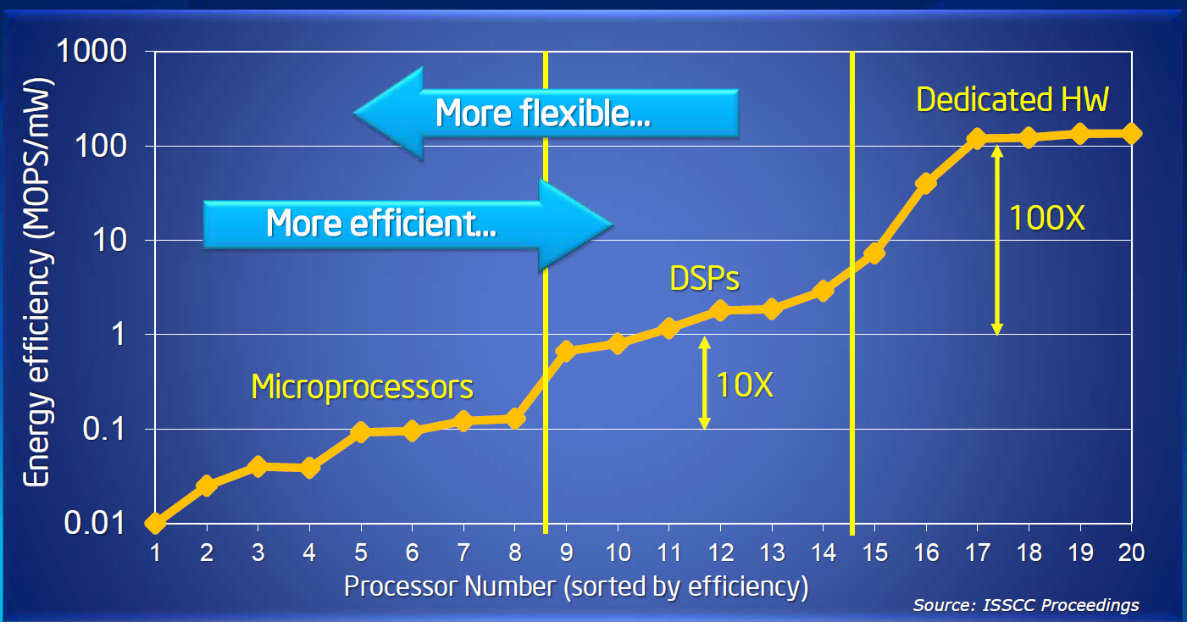
Benefit of customization
Notes:
This graph shows energy efficiency of 20 different fabricated chips which have publication in ISSCC before 2000. The graph is not implementation of single application using different substrate. The efficiency is based on the max throughput of chip among different benchmarks. The operation is basic ALU operation for that particular chip.

Slide 5
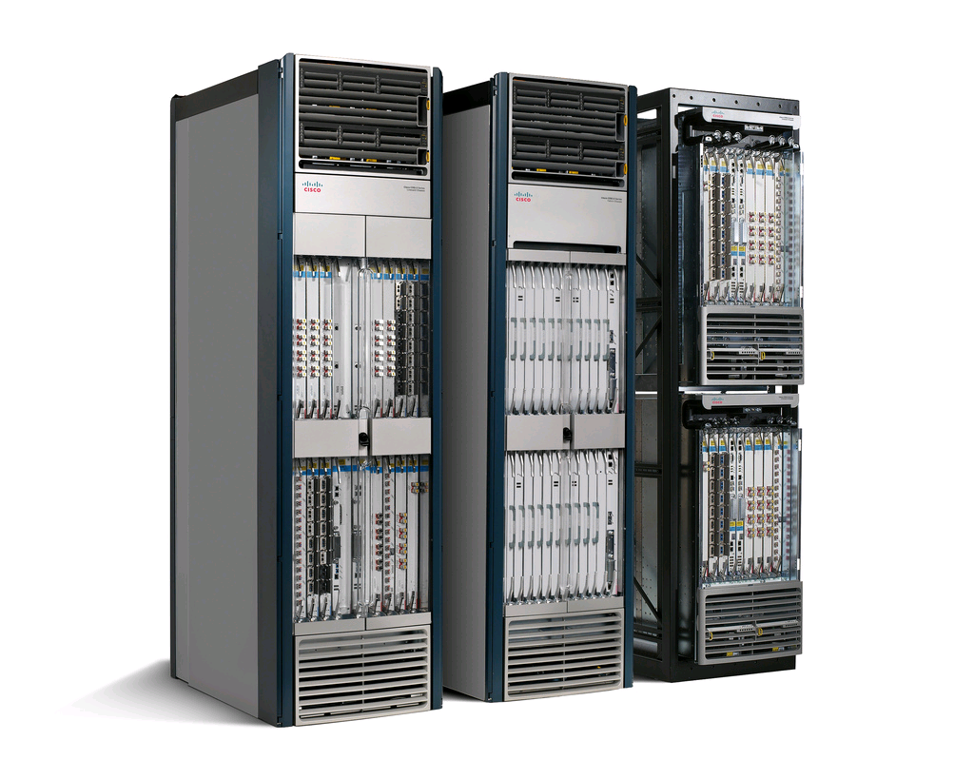
Internet core routers
CISCO CRS-3 (Carrier Routing System)
Multi-chassis system
322Tbps aggregate bandwidth
Download the entire Library of Congress content < 1 sec
Simultaneous video call for everyone in China
Almost one instruction/ingress bit
Almost one memory access/bit
1GIPS < 0.1Watts
Indepnent threads
Notes:
Internet routers are a successful practice in customization with respect to computation, memory, and IO resources. Lets briefly look at the Internet routers architecture which is my role model in this research.
The highest capacity router I could find
2.73 Watts per Gbps (total power)
Compute power : 35%

Slide 6
In-line acceleration in core routers
Slow-path processor
Metro NP (CRS-1 2007)
188 32-Bit embedded RISCs
96Gbps bandwidth
5xQDR+9xFCRAM+2xTCAM channels
Interconnect
Throughput machines
IO intensive
Irregularity in control-flow
High bandwidth random memory accesses
Customization at various levels
Network interfaces
Inter-core communication
Memory interfaces
Core architecture
Fast-path accelerator
Cores
Memory
Notes:
We show a simplified view of a router architecture.
Fast-path accelerator = Data-plane accelerator = In-line accelerator
FCRAM: Fast cycle RAM: more aggressive pipelining on handling DRAM commands

Slide 7
Research highlights
FPGA-based high-end network processors?
Generalize such technique to other applications?
Notes:
Like many other researchers my reasearc can be summarized

Slide 8
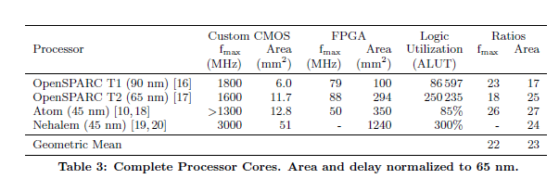
FPGAs
Comparing FPGA vs Custom CMOS and the Impact on Processor Microarchitecture, H. Wong et al, FPGA 2011
Notes:
Unlike ASICs, FPGAs are a highly flexible substrate for specialization. However they have the area and timing overhead of building logic, memory, and interconnects through programmable components.
An important question is whether the benefit of customization can out weight the FPGAs overhead?

Slide 9
Thesis statement
FPGA-based resources, if used with efficient overlay microarchitecture, can improve the throughput and/or energy efficiency of a class of networking and big data applications.
I present a template based methodology for generating FPGA-based accelerators and showcase the methodology by accelerating targeted applications.
Notes:
This can be done using (i)Automatic Slicing the applications into fast path/slow (ii)a template based design process which enables design space exploration as the first class character in the process for designing the fast path.

Slide 10
Our focus
FPGA-based accelerator
In-line accelerator
High-level programmable
Notes:
There are research on FPGA accelrators, In-line accelerators, and HLS. We focus on the intersection of these three

Slide 11
Targeted Applications
Networking
IPv4/IPv6 routing, MPLS switching
Datacenter applications
Memcached, Kmeans, Page rank, Word count
The common characteristic of such applications are
Input/Output data through system NIC
Hot computational kernels
Irregular data parallel
Control flow
memory access
Notes:
Networking and data center applications are an important class of applications which can use specialization for improving the energy. Like many other data parallel applications such applications can utilize large number of hardware execution contexts. Since specialization enables better ratio of required resources(both transistors and energy) over unit of throughput we can increase number of execution units for a particular aggregate resource budget and consequently achieve better efficiency.
Our targeted applications have two important characteristics which differentiate them with other types of data parallel architectures, (i)irregularity and (ii)requirement to access shared resources.

Slide 12
Contributions
Gorilla methodology/toolset
Template based design methodology
Functional parallelization templates
HLS optimizations for fused operations
Showcasing Gorilla
Generating core network processors
Generating big data accelerators
Comparing energy efficiency against GPP
Notes:
Design space exploration as first order requirement
The process is not completely automated though.

Slide 13
Evaluation methodology
Performance: all accelerators realized at Verilog level
Throughput
Energy efficiency: Energy/operation
Productivity: development time

Slide 14
FPGA/CPU/GPGPU comparison
 | CPU based solution |  | GPU based solution
Application | Throughput | Energy efficiency | Throughput | Energy efficiency
Routing IPv4 | 16x | 100x | 4x
Memcached | 10x | 50x
This translates into almost 50% power saving at system level
Notes:
Unfortunately I don’t have the performance numbers for all targted applications across all these three platform.
But thanks to other people publications I am comparing the FPGA-based solution I built with CPU and GPGPU based solution from related works.

Slide 15
Architecture related work – Overview
 |  | Application |  | In-line features |  | Programmablity
 |  | Layer 2&3 | Above layer 3 | Slow path coupling | Zero-copy packet | FPGA-based | High level programmable
NetFPGA
L3+ FPGA networking
Network processors
Networking with General purpose hardware
Smart NIC
Integrated NIC
Datacenter Acclerator chip
TCP slicing
Magilla

Slide 16
Automation related work – Overview
 |  | Data flow FIFO interfaces | Offloading / shared state | Pipeline synthesis | Parallelization template | Architecture decoupling | HLS
Vivado
Architectural HLS
HGL
FPGA Overlay
Synch Dataflow on FPGA
Green droid
Legup
Magilla

Slide 17
Gorilla: Template based design

Slide 18
Gorilla Methodology
Domain expert writes in stylized C (domain code)
Hardware designer writes parameterized hardware components (hardware template)
Parameters may be values or code
Functional parameters
E.g., IPv4 code or IPv6 code
Performance parameters
Number of threads, packets in flight, scheduling policy
Tools automatically
Merge domain code with hardware templates
Explore the design space to meet the design constraints
Sharp contrast with C-to-gates approaches
Gorilla uses predesigned template for the target hardware

Slide 19
Gorilla Design Process
Domain code
Select a hardware template
Library of hardware templates
Manual step
Automatic step
Functional parameters specialization
Hardware designer adds new template or change the current template
Find initial seeds for performance parameters
No
Performance parameters specialization
Possible?
Yes
Work loads
Performance evaluation
Performance goals
Met goals?
No
Architectural enhancement by changing parameters
Yes

Slide 20
Architecture

Slide 21
Execution Model
A single processing kernel is applied on each input data element and generates an output data (infinite loop)
kernel is modeled as a set of processing steps

Slide 22
Domain Code - Programming Model
instr_addr_t IP_CLASSIFY()
{ IP_protocol_t wordx;
//Lookup the destination address
Dport = LOOKUPX.search(Da);
//Read the TTL and Chksum fields
wordx = MEMX.read(PP, TTL_WORD);
TTL = wordx.TTL;
Chksum = wordx.CHKSUM;
TTL = TTL – 1;
Chksum = Update_chksum(Chksum);
switch (TTL == 0) {
case OK: Next_step = NP_INSTR_EMIT;
default: Next_Step = NP_INSTR_EXCEPTION;
}
}
Each processing step (G-block)
Arithmetic/logic operation on program input and context variables (globally visible to all functions)
call to special purpose offload engines
Explicit, computed jump to next step

Slide 23
A Programmable Engine
Engine
Context memory
Control state
Offload engine
Off-chip Memory

Slide 24
Scaling Throughput
Engine
Context memory
Control state
Offload engine
Off-chip Memory
Multiple engine contexts
Multi-threaded engines
Multiple engines
Contexts increase performance until an offload engine becomes the bottleneck

Slide 25
Pipelined Engines
Multithreading the engines and engine duplication are not the only ways for increasing the throughput
Pipelining the engine is possible providing
No backward jumps between processing steps
Access to an accelerator is restricted to a given pipe stage
Pipelining has sometimes lower overhead than other solutions
No thread management overhead
No duplication overhead

Slide 26
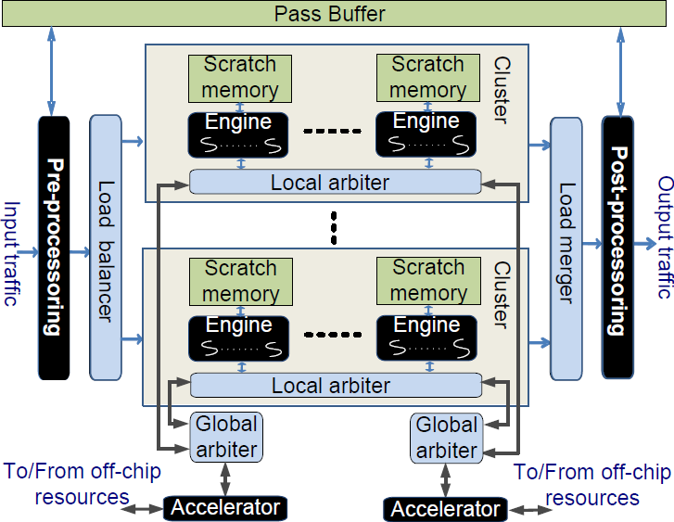
Packet Processing Hardware Template

Slide 27
General purpose cores collaboration
In-line accelerator
Stream in
Load balancer
Engine
General purpose core
General purpose core
Compute engine
Stream out
Load merger
Off-load engine
$
$
Configuration/Status registers
Off-load engine
Coherent memory system

Slide 28
Automation view

Slide 29
Chisel

Slide 30
Leg up

Slide 31
Engines
Input valid
Engine
Output valid
Input control
Output control
Input data
Output data
Input ready
Output ready
FrameIO
Request
Reply
OffloadIO
FifoIO
Offload engine
Notes:
Mix this with Chisel code

Slide 32
Intra engine parallelization patterns
Pipelining
Multithreading

Slide 33
Engine generation
Val lookup = PIPED_ENGINE(“trieLookup.c”)
Val ipv4Engine = MT_ENGINE(“ipv4.c”, num_of_threads)

Slide 34
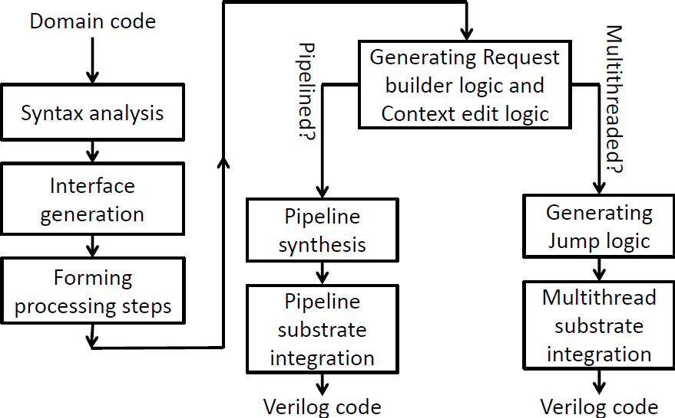
Gorilla Compilation Process
Written in ANTLR

Slide 35
Multi-engine parallelism patterns (I)
Course grain pipeline
Replication

Slide 36
Multi-engine parallelism patterns (I)
Offload
Offload filter

Slide 37
Parallelization patterns – Replication
Val headerProcessor =
OFFLOAD(REPLICATION(module=cluster,
count=num_of_clusters, loadBalancePolicy=roundRobin), QDRlookup, arbitrationPolicy=roundRobin)

Slide 38
Parallelization patterns – Coarse grain pipeline
val packetForwarder =
CG_PIPE(disassembler,
SEQ_REORDER(headerProcessor),
reorder,
assembler);

Slide 39
Kmeans accelerator
Val KmeansPipe =
PIPELINED_ENGINE(“kmeans_pipe.c”)
Val KmeansDataFeed =
MT_ENGINE(“Kmeans_control.c”, 1)
Val KmeansCoresCluster =
REDUCE(REPLICATE(OFFLOADER(
KmeansDataFeed, KmeansPipe), coreCounts), kmeansReducer)
Val Kmeans_accl =
CG_PIPELINE (Streamer,
LambdaCoresClusters, Streamer)

Slide 40
Preliminary results

Slide 41
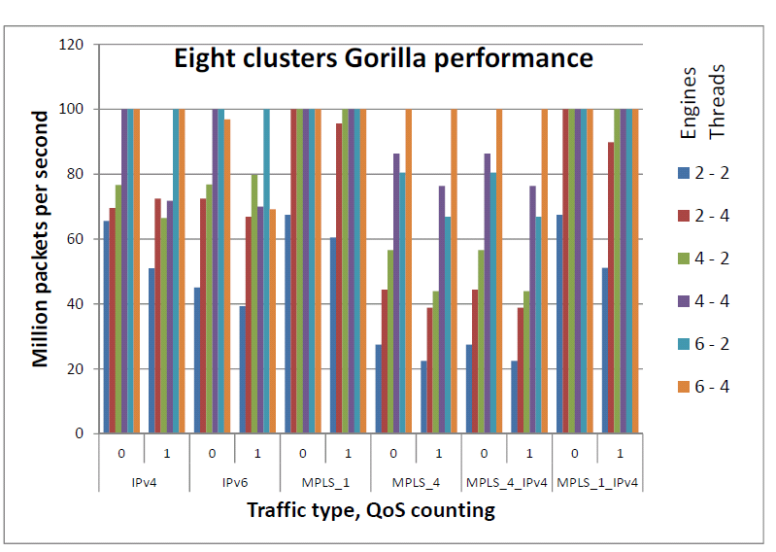
Routing experimental Results - 100MPPS on Virtex-6 VHX380T

Slide 42
Board Implementation
Gorilla-generated network processor
IPv4 only on ML605
Xilinx Virtex-6 XC6VLX240T
Emulate QDRs with accurate timing in BRAMs
16-3-2 configuration delivers 100MPPS
Most of the logic running at 100Mhz
Consistent with simulation results
Random packet generator and statistics collector
Core power (excluding the I/O) less than 4 watts
Notes:
A picture from board required here

Slide 43
CPU/GPGPU/ASIP comparison
Core router NP on a single FPGA
Xilinx Virtex-7 VHX870T FPGA
200MPPS throughput (100 Gbps)
More than 6x performance of 32 Nehalem cores
Routebricks[SOSP09]
Twice the performance of 8 Nehalem cores, 2 Nvidia GTX480 GPUs
Packetshader[Infocom10]
Fastest network processor – 400MPPS

Slide 44
Memcached evaluation

Slide 45
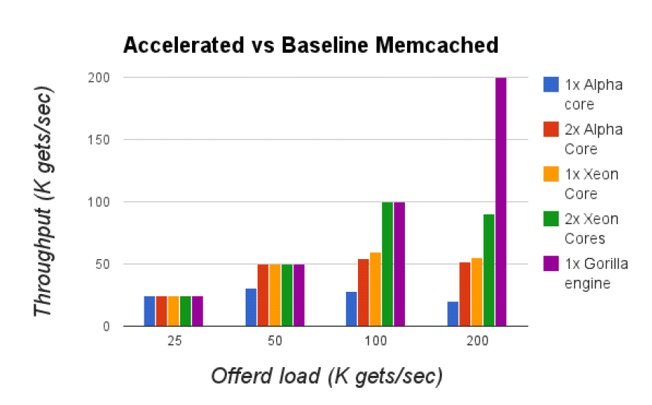
Memcached Get throughput

Slide 46
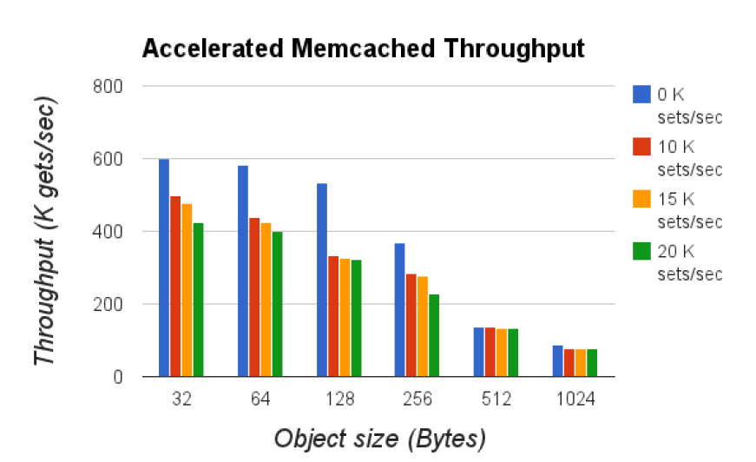
Accelerated Memcached throughput

Slide 47
K-means Results

Slide 48
Future work
HLS optimizations
Full integration between Chisel based HW generator and HLS compiler
Complete implementation of page rank and word count
Generating some intermediate results from deign space exploration to undestnad the performance

Slide 49
Gaunt chart
Task/Month | 1 | 2 | 3 | 4 | 5 | 6 | 7 | 8 | 9 | 10
HLS optimizations
Chisel-HLS integration
Implement Page rank and word count
DSE
Thesis

Slide 50
Courses
UT Courses | Instructor | grade
SOC design – Fall 08 | Dr. Jacob Abraham | A
Comp Arch: User/system interplay – Spring 09 | Dr. Mattan Erez | A
Parallel systems – Spring 09 | Dr. Calvin Lin | A
Parallel comp arch – Fall 09 | Dr. Derek Chiou | A-
Communication systems – Fall 09 | Dr. Yin Zhang | A
Microarchitecture – Spring 10 | Dr. Yale Patt | A-
Comp Arch: Parallelism and Locality – Fall 10 | Dr. Mattan Erez | A

Slide 51
Related publications
Maysam Lavasani, Larry Dennison, and Derek Chiou. "Compiling High Throughput Network Processors." Proceedings of the 20th ACM/SIGDA International Symposium on Field-Programmable Gate Arrays, Monterary, CA, Feb, 2012.
Maysam Lavasani, Larry Dennison, and Derek Chiou. "Methodology for Leveraging Reconfigurability in Domain Specific Languages." The First Workshop on the Intersections of Computer Architecture and Reconfigurable Logic (CARL 2010), December 2010

Slide 52
Thank you

Slide 53
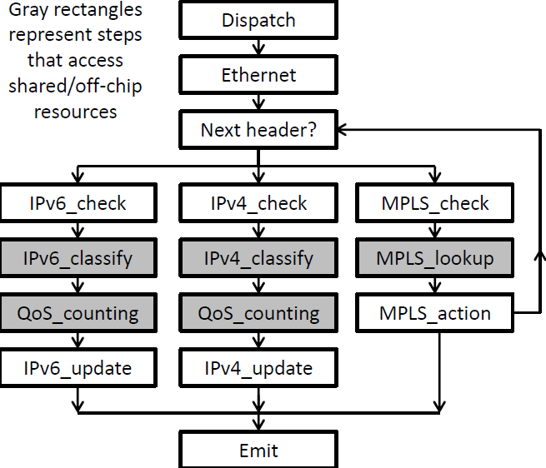
Packet Header Processing

Slide 54
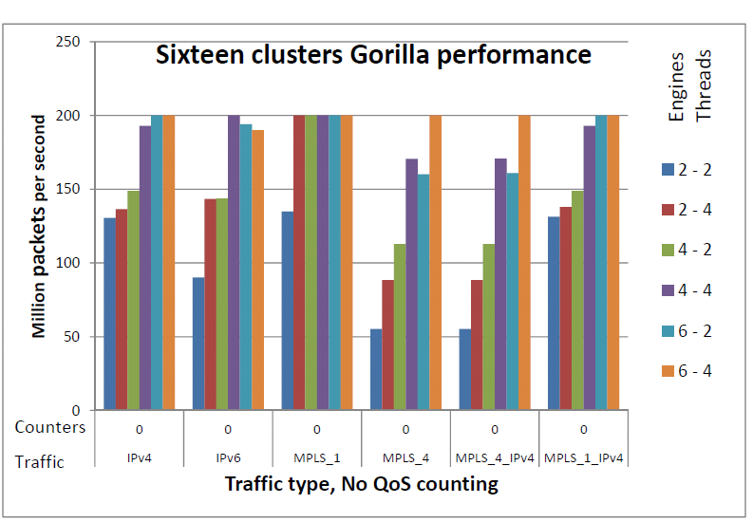
Experimental Results - 200MPPS on Virtex-7 VHX870T

Slide 55
Understanding the performance (work in progress)

Slide 56
Simplified performance projection
Assumptions (Engines limit performance)
Enough parallelism
Ideal inter engine interconnection
Ideal load balancer
Enough memory bandwidth
Performance = P0 x C x P x M x F
C: In-cycle operations compaction factor
P: Intra engine parallelism
M: Multiple engine parallelism
F: Cycle time

Slide 57
Area efficiency/Resource balance
Smaller engines - larger M
Application specific data path width
Application specific functional units
Applications specific Register file
Application specific level of threading/pipelining
Resource imbalance - smaller M
Large number of required double-precision units
Large amount of on-chip memory

Slide 58
Methodology
Identify contributions to performance
Timing model for a sea of simple cores
multi-threaded 5-stage pipeline cores
connection through NOC
Gorilla type architecture on FPGA

Slide 59
Performance contributors – FPGA tax
Frequency tax
Area tax

Slide 60
Performance contributors – Intra-engine Benefits
Customized data path
Wide combinational logics
Chained combinational logics
Register access
Distributed
Large
Customized pipelining
Simplified front-end
Multi-threading + no branch prediction

Slide 61
Performance contributors – Inter-engine Benefits
Pushing data elements vs pulling
Multi-port to offload engines
Through memory operations
Customized communication
Small engines - larger engine counts

Slide 62
Coherent fast-path acceleration

Slide 63
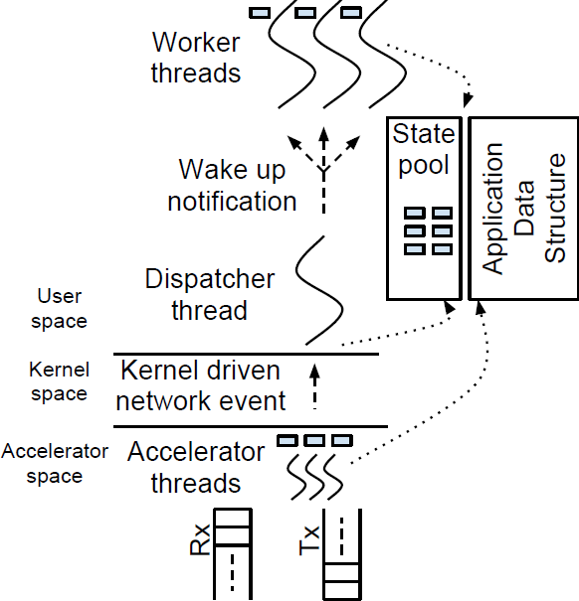
Execution model

Slide 64
Memcached

Slide 65
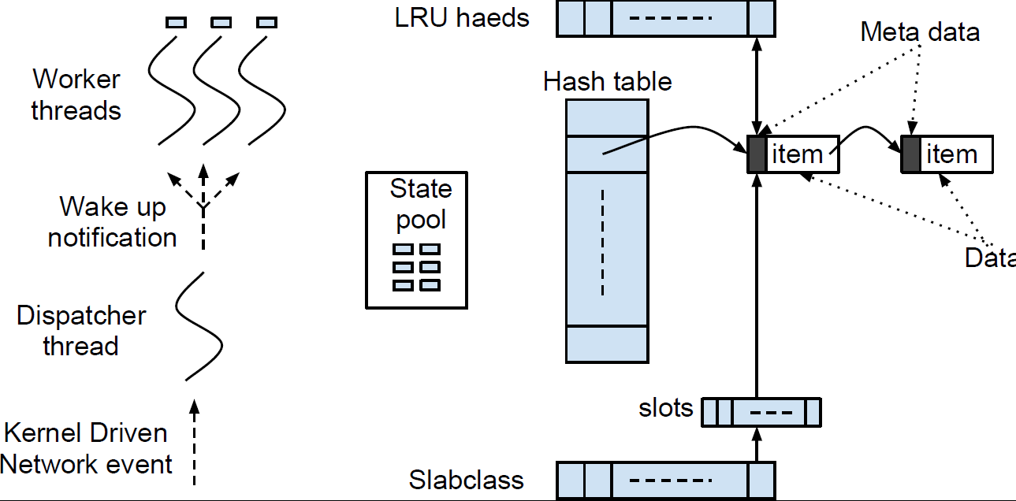
Memcached Internal

Slide 66
Memcached performance results

Slide 67
Related works

Slide 68
Related works categories
Computation model
System level research
Architecture level research
FPGA related research
CAD related research
Notes:
This is an FPGA implementation of an interesting application at system level using different architectural techniques and CAD techniques.So naturally it has many related works.

Slide 69
Show casing template-base design
Magilla
Difference:
Not only engines but also accelerators/pre-processor/post-processor can be programmed using Gorila instructions
Multiple engines/Engines clustering
Mulitple frequency domain
Jason Cong DATE 2012 and other StreamIt on FPGA
Similarity: Design space exploration for both fine-grain as well as coarse-grain architecture parameters
Different because of shared data

Slide 70
Show casing template-base design
(continue)
Scott Hulk ...
Simmilarity: Data parallel mostly by pipelineing
Difference: no multithreading and shared state
NISC
Convey

Slide 71
Greendroid
Different application
Different substrate

Slide 72
Smart/Integrated NIC
Smart NIC
Batching
Multiple queues (Per core queue) –RSS
Segment offloading – NIC can packetize messages
Integrated NIC
On-loading (Rienhart paper)

Slide 73
Generalizing the In-line acceleration – FPGA based application accelerator
SQL
Honeypot
Memcached accelerator
FPGA based machine learning for search
Other paper from HP lab referenced by Memcached FPGA2013

Slide 74
Generalizing the In-line acceleration – NP based
ANCS 2009 – Web server acceleration
Open onload

Slide 76
Understanding the contribution to performance
Eric's paper

Slide 77
Primitive interface bundles
valid
valid
valid
Source
Sink
data
data
data
ready
ready
ready
class FifoIO[T <: Data] () (dataType: => T) extends Bundle {
val valid = Bool(Output)
val ready = Bool(Input)
val flit = dataType
}
//More code …
source.io.output <> sink.io.input

Slide 78
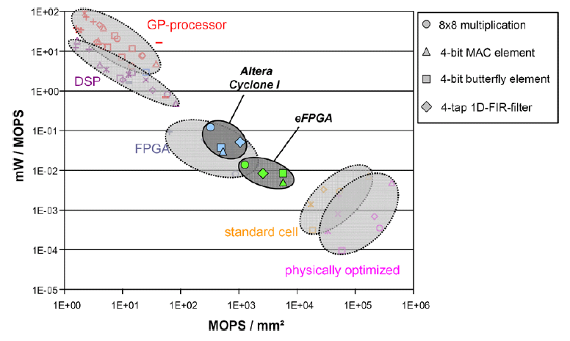
GPP-ASIC gap
Five orders of magnitude gap
Reconfigurable components for application-specific processor architectures, Nolll, T et al.

Slide 79
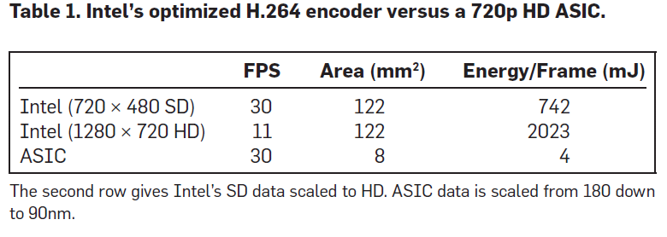
GPP-ASIC gap
Understanding the source of inefficiencies in general-purpose chips, ISCA 2010, Horowitz. M. et al.
Notes:
Pentium 4 with SSE 2.8Ghz

Slide 80
Fast path realization process
Fast path realization using hardware templates
Combining application code with templates
Balance between different parallelization
Engine level
Thread level
Pipeline level
Through memory engines
Slicing the application into fast path/slow path
fast/slow path synchronization/communication

Slide 81
Top level design process
A canonical architecture containing both general purpose cores(GPCs) and special purpose cores(SPCs) is proposed.
A program is sliced between hot path running on SPCs and cold path running on GPCs. The hot path is sliced further into state-less and state-full components.

Slide 82
Synthesis process
For designing the SPCs a class of functionality independent templates for throughput oriented processing engines are proposed. Engine template has tunable degree of specialization in terms of instruction supply, data path, and context memory is proposed. It also has tunable degree of parallelism i.e multithreading, pipelining. Also coarse grain templates for building architectures by composing processing engines are proposed.
Such flexibility (i) splits the design effort between domain expert programmer and hardware designer (ii) enables the design space exploration tool to find virtually the least expensive solution for a given application with specific performance goals.

Slide 83
Design space exploration and refinement
Although there are several languages for hardware design a language is proposed with the main focus on efficient design space exploration. Also the appropriate tools are developed for compiling the templates into the hardware as well as exploring the design space for enhancing the template architectures.

Slide 84
Related work

Slide 85
Related work layout
Although we want to focus on hybrid GPC, SPC architectures for a particular application class (networking and data center) on particular HW substrate (FPGA), in order to compare our work with relative work, a broader view at SPC design is presented.

Slide 86
Hybrid GPC/SPC design disciplines for data parallel applications
Parallelization
Parallelization model
Dependency, shared state, and ordering
Architecture
GPC/SPC HW coupling model
SPC HW substrate
Design automation
SPC course grain architecture
SPC mapping
SPC fine grian synthesis/programming
SPC refinenment

Slide 87
Parallelizon models
Transaction level
Producer/consumer level
Fine grained data level
Slicing (special class of pluralization hardware resources are different (asymmetric multi-core or GPC/SPC))

Slide 88
Application slicing model
SPC is acting as an off-load component for GPC - encryption coprocessor
GPC is acting as an exception path for SPC - router
GPC is acting in pipeline fashion along SPC - Is this GPU?
Combination of above

Slide 89
GPC/SPC coupling model
Coupling level
core level
chip level
board level (FSB)
system level (PCI-X)
*Data path level
Coupling mechanism
Messaging
Shared memory

Slide 90
SPC synthesis/programming
Multi-engine architecture
multi-engine composition
producer/consumer engines
parallel engines
state-less/state-full engines
mem access engines
Engine architecture
data path synthesis
pipelining
split-pipelining
multithreading
combination of above
control synthesis
engine programming

Slide 91
SPC HW substrate
Instruction based (ASIP)
FPGA
Patching
No programmability

Slide 92
Related work (focus on parallelization and mapping)
Project | Target application | Slicing model | Programming model | Coupling model | SPP synthesis | SPP HW substrate
StreamIt |  |  |  | N/A | N/A | FPGA

Slide 93
Related work (focus on architecture only)
Project | Target application | Slicing model | Programming model | Coupling model | SPP synthesis | SPP HW substrate
ReMap |  |  |  | MP | N/A | FPGA

Slide 94
Related work (focus on synthesis only)
Project | Target application | Slicing model | Programming model | Coupling model | SPP synthesis | SPP HW substrate
NISC | Embedded | N/A | N/A | N/A | single engine -automatic micro code generation | N/A

Slide 95
Related work (focus on architecture and synthesis)
Project | Target application | Slicing model | Programming model | Coupling model | SPP synthesis | SPP HW substrate
Green droid | Mobile | Automatic | Implicit | MP,L1 | single engine- state machine | ASIC

Slide 96
GPC/SPC systems in action
Router
CPU/GPU

Slide 97
Our project

Slide 98
FlitIO
valid
Source
Sink
data
ready
FifoIO
Class FifoIO[T <: Data] (FlitType: => T) extends Bundle {
val valid =
val ready =
val flit =
}

Slide 99
Interfaces in Chisel
class PushIO extends FifoIO
class OffloadIO[T <: Data]
(offloadType: => T) extends Bundle {
val req = (new PushIO()) {offloadType}
val rep = (new PushIO()) {offloadType}.flip
}

Slide 100
Outline
Methodology
Gorilla: A methodology for designing a class of data parallel accelerators using reconfigurable hardware (and maybe more)
Applications
Core Router
Memcached Accelerator
Open flow switch
Deep packet inspection
Exotic applications

Slide 101
Gorilla Methodology

Slide 102
Gorilla objective
Decouple the performance related programming (by hardware designer) from functionality related programming (domain programmer)
Give the right job to the right person
Enable design exploration from ground up by using highly parametrized hardware templates
Makes the hardware programmer job harder?
Give necessary tools to architect to not only reuse the hardware modules but also the architectural enhancement techniques
Makes the hardware programmer job easier

Slide 103
Gorilla overview
A highly parametrized template architecture (canonical architecture) will be designed by a performance savvy programmer (hardware designer) for a class of applications. It will be specialized later using domain code by domain expert programmer.
The template parameters consist of functional and performance parameters
Functional parameters enable us to specialize an architecure for particular application.
Performance parameters enable us to commit to a specific parameter at the late stages of the design to meet performance constraints (Power, Latency, Throughput, and Area.)

Slide 104
Does hardware design process still need improvement?
For many applications customized hardware has a meaningful performance difference with software+general purpose hardware but NRE charge and lack of programmability is an obstacle for using customized hardware except for big markets with well established standards
Design cost is a large part of NRE
Many design efforts in a particular project is thrown away and not used for next projects
Constraints like power and routablity has become more important and they can't be evaluated without having low level information (post synthesis)

Slide 105
Why current tools/methods are not enough?
SystemC/TLM - More about simulation feasiblity and simulation performance
Bluespec - Does not include architectural enhancement features, though it can be used as a substrate for Gorilla.
HLS - Quality of the hardware is not suitable for serious applications
ASIP - Flexiblity for changing instructions. Lack of macro level architectural enhancent.
NISC - building control store for a given datapath for single core only. We want to even improve the datapath. Also we want to improve the hardware at multiple processing engines.
Convey/ROCCC - No macro level customization and architectural enhancment

Slide 106
Architecture level description of hardware rather than RTL
Defining the (synthesizable) hardware modules which process data units at course level
Keep modules parametrized for
Reuse (Not just the hardware component but also the architectural technique)
Architectural exploration for meeting design constraints
Specialization for a particular application
Module level throughput (frequency) tuning
DVFS enabled architecture from ground up

Slide 107
Abstract hardware modules: SPM/CRM
A Gorilla SPM (Stateless Processing Module) is a hardware component which can process the input data and generates the output data. SPM is stateless, meaning that previous processings do not affect consequent processing through the change on internal SPM resources.
A Gorilla CRM (Common Resource Module) is exactly like SPM except that it might contain logically/physically shared resources.

Slide 108
Modules
Input valid
SPM
Output valid
Input control
Output control
Input data
Output data
Input credit
Output credit
CRM

Slide 109
(some) Parallelism patterns for SPMs

Slide 110
(some) Parallelism patterns for SPMs+CRMs

Slide 111
(some) Parallelism patterns for SPMs+CRMs

Slide 112
(some) Parallelism patterns for SPMs+CRMs

Slide 113
Input to Methodology
Hardware templates including canonical architecutre for a set of applicaitons
Domain code
Work loads
Performance targets
Architectural enahancment library

Slide 114
Domain code
Select a canonical architecture
Library of templates
Functional parameter specialization
Hardware designer adds either new template or new architectural enhancement
Initial seed for performance parameters
Work loads
Performance goals
No
Found?
Performance evaluation
Enhance Architecture
Meet goals?
No
architectural enhancmenet search
Library of architectural enhancements
Yes

Slide 115
Modules data access
Through registers
Through input memory and output memory
Through input/output memory (in-place compuation)

Slide 116
Execution substrate
Processing of the input data by SPM can be done by:
Customized pipelined hardware
Customized multithreaded state machine
Genralized datapath with/without instruction memory

Slide 117
Infrastructure modules
Load balancer/Load merger
Scheduler
Arbiter
Reorder Queue
scratchpad memory
Interface wrappers

Slide 118
Automatic architectural enhancemnet
A generalized form for design space exploration
Intra module: One code should be able to run on any SPM execution substrate and translation is done automatically
Inter moules: Moving code between modules
Tuning sizing parameters: Number of threads, processing engines, ...
Structural: Next example

Slide 119
A sample architecture
100Mhz
A
B

Slide 120
A sample architecture enahncment
Arch_enhancement BOOST_SOURCE_FREQ_DUPLICATE_SINK_MODULES
Given A{SPM} -> B{SPM} =>
A_new := A; //A_New is the same type as A
B1_new := B;
B2_new := B;
A_new<frequency=2*A:frequency>;
A_new ->lb::Load_balancer(size =2);
lb.out[0]->ra0::Rate_adapter->B1_new;
lb.out[1]->ra1::Rate_adapter->B2_new;
A.in => A_new.in;
B.out => merge[B1_new.out, B2_new_out];

Slide 121
A sample architecture
200Mhz
100Mhz
lb
B0_new
A_new
B1_new

Slide 122
A sample architecture
A::Fetch <code = "fetch.c", width=1>;
B::Decode <code="ARM_decoder.c", width=1>;
A -> B; //same as A.out -> in.B;
A,B interface : 32 bit communication through registers
A
B

Slide 123
A sample architecture
A::Ethernet_checker<code="Eth_chk.c">;
B::MPLS<code="MPLS_proc.c">;
A -> B; //same as A.out -> in.B;
A, B interface: Memory based FIFO
A
B

Slide 124
Gorilla methodology example: An out of order processor
Template <...> Core (...)
Icache -> Fetch -> Decode;
Decode-> Rename_Reg -> in.Exec;
ROB.reg_commit -> Rename_Reg ;
Exec.out -> exec_retire.ROB;
Exec.lsu <-> Dcache;
Dcache <-> mem_commit.ROB;

Slide 125
An out of order processor (continue)
Template <...> Exec (...)
in -> Dispatcher;
Dispatcher.add -> RS_add -> Broadcast_bus;
Dispatcher.mul -> RS_mul -> Broadcast_bus;
Dispatcher.lsu -> RS_lsu -> Broadcast_bus;
Broadcast_bus -> out;
RS_add <-> FU_add;
RS_mul <-> FU_mul;
RS_lsu <-> lsu;

Slide 126
Methodology for constructing the methodology
Desiging serious applications and learn from that

Slide 127
Gorilla Applications

Slide 128
Why focusing on data center and networking applications?
Using specialized hardware is beneficial because of high throughput requirement
Loosely coupled accelerators limit the performance benefit due to communication overhead - In-line accelerators does not have the processor/coprocessor communication overhead

Slide 129
Applications
Network processor
High throughput
Power
Virtualization
Power aware data center load balancer
Reduce server
Memcached server

Slide 130
Core router network processor

Slide 131
Virtualization
Finding the best configuration for consolidating a set of NPs

Slide 132
Load adaptive power saving
Cache/Compute replacement on demand
NP/TM/... consolidation on demand

Slide 133
Datacenter Networking Accelerator (DNA)
Multi Tier Network
DNA
DNA
Access Ethernet switch
Access Ethernet switch
NIC
PCIe
Mem
CPU

Slide 134
Inside DNA
Board
Control processor
Ethernet PHY
SerDes interfaces
FPGA
MAC controller
Memory
Mem controller
Gorilla hardware
Mem controller
Memory
MAC controller
SerDes interfaces
Ethernet PHY

Slide 135
DNA applications
Using DNA we can
Augment the current networks to migrate into openflow - Just an implemnetation, not intersted
Offload the TCP/IP stack of all access servers into the DNA - Big implementation
Smart load balancing decision for power saving purpose - Need to study more

Slide 136
Power aware datacenter load balancer - Related work
Reddi et al., Mobile processors for energy-efficient web search
"[For Microsoft Bing] The Atom is 5x more energy-efficient .... Search queries on Atom encounter higher latencies, different page results, and diminished robustness for complex queries.... Despite these challenges, quality-of-service is maintained for most, common queries [when running Bing on Atom]."

Slide 137
Power aware datacenter load balancer - Related work
Jingjia Tang et al., The impact of memory subsystem resource sharing on datacenter applications
"We observe performance swings of up to 25% for web search and 40% for other applications based on how application threads are mapped to cores"
Applications
web search
bigtable
content analyzer
image stiching
protocol buffer

Slide 138
Memcached
From Wiki: "Memcached's APIs provide a giant hash table distributed across multiple machines. When the table is full, subsequent inserts cause older data to be purged in least recently used (LRU) order. Applications using Memcached typically layer requests and additions into RAM before falling back on a slower backing store, such as a database"

Slide 139
Memcached - Popularity
From Wiki: "The system is used by sites including YouTube,[2] Reddit,[3] Zynga,[4] Facebook,[5][6] Orange,[7] and Twitter.[8] Heroku (now part of Salesforce) offers a Couchbase-managed memcached add-on service[9] as part of their platform as a service. Google App Engine, AppScale and Amazon Web Services also offer a memcached service through an API.[10][11][12] Memcached is also supported by some popular CMSs such as Drupal,[13] Joomla, and WordPress.[14]"

Slide 140
Memcached - usage example
function get_foo(int userid) { /* first try the cache */ data = memcached_fetch("userrow:" + userid); if (!data) { /* not found : request database */ data = db_select("SELECT * FROM users WHERE userid = ?", userid); /* then store in cache until next get */ memcached_add("userrow:" + userid, data); } return data; }

Slide 141
Memcached accelerator
Board
Ethernet PHY
FPGA
SerDes interfaces
Soft processor
MAC controller
Gorilla hardware
Mem controller
Mem controller
Mem controller
Mem controller
Memory
Memory
Memory
Memory

Slide 142
Potential Papers
Gorilla and network processor [FPGA2012]
Power on network processors-submit to ANCS
Hardware modleing using Gorilla methodology-submit on DAC
Comparing FPGA/ASIC/processor based version of network processing-submit on ASPLOS/MICRO : Where does the performance come from
Data center networking accelerator
Memcached

Slide 143
Derek's Comments
Good, I think basing the thesis on applications using Gorilla is good
You should do a complete, non-trivial application that really runs and is better than any ASIC or standard processor.
You need to explain why the performance is better
It has to be significantly easier to program
Infrastrucure costs must be reasonable

Slide 144
Show casing template-base design
Magilla
Difference:
Not only engines but also accelerators/pre-processor/post-processor can be programmed using Gorila instructions
Multiple engines/Engines clustering
Mulitple frequency domain
Jason Cong DATE 2012 and other StreamIt on FPGA
Similarity: Design space exploration for both fine-grain as well as coarse-grain architecture parameters
Different because of shared data

Slide 145
Design process - goals
Design cost
major obstacle for specialization
Rare case handling
Protocol processing
Control plane/Data plane
Decouple functionality from architecture
Domain expert/Architect
Eliminate system layers
Common architecture enhancement patterns
Large number of design alternatives
design space exploration-first order requirements

Slide 146
Design process - characteristics
Slice the application into fast/slow path based on profiling result
A library of parallelization templates
A compiler for generating
MT engines
Pipelined engines
Instruction based engin
A tool to explore the design space performance parameters in templates

Slide 147
Design process - contributions
Fast path/slow path slicing process for targeted applications
Decoupling the functionality and architecture of fast path for targeted applications
A library based architecture enhancement patterns

Slide 148
Related work - System level
Commodity HW packet processing systems
Routbricks
Packetshader
NetFPGA
Many-core Memcached
GPU accelerated Dryad LINQ

Slide 149
Related work - Architecture
Processor architecture
Network processors
Heavily threaded architectures (Niagra)
Many-core (Tilera)
Processor-NIC integration
On-loading
Customized cores
Green droid

Slide 150
Related work - FPGA related
Overlay architectures
Anderson's student thesis for packet processing
Scott haulk

Slide 151
Related work-Computation model
StreamIt

Slide 152
Related work - CAD
HLS
Legup
NISC

Slide 153
Requirement for programability
Change in specification
Change in workload
Amortizing NRE cost
Notes:
Justifying that fixed HW can't be the solution. somthing like the frequent change in workload characteristic/specification ....

Slide 154
Cluster Engine
Cluster Engine
QDR lookup

