Slide 1
Generating Network-attached Accelerators: Methodology and Applications
Proposal for PhD thesis by: Maysam Lavasani
Advisor: Prof. Derek Chiou
Notes:
Thanks for coming to my proposal session. The title of my proposal is

Slide 2
Outline
Problem statement – 3 slides
Solution statement – 4 slides
Detail solution - Gorilla++ – 17 slides
Initial results – 6 slide
Plan for future – 1 slide

Slide 3
Specialized Hardware
Pros
Orders of magnitude more energy efficient than general-purpose processors
Cons
Inflexible
Solution: FPGAs flexibility
Hard to design
Solution for a class of applications: Gorilla++
Notes:
I think it is not a secret that the disruption in dennards scaling is one of the main challenges in current micro-preprocessor industry because of the
Damage to processors energy efficiency.
One of the solutions for this problem is using specialized hardware also known as accelerators.

Slide 4
High-Level Synthesis (HLS)
HLS built around sequential programming model
Can exploit fine-grain parallelism automatically
Cannot exploit coarse-grain parallelism automatically
Available solutions
User assistance/annotations
Detecting parallelism
Finding the right micro-architecture mechanism to exploit the parallelism
Non-sequential programming model

Slide 5
Targeted Applications
Networking
IPv4/IPv6 routing, MPLS switching
Big data applications
Memcached, distributed K-means, distributed PageRank
Common characteristics
Network intensive
Data parallel e.g., packet, request
Access to shared global memory
Irregular control flow
Random memory access
Notes:
Networking and data center applications are an important class of applications which can use specialization for improving the energy. Like many other data parallel applications such applications can utilize large number of hardware execution contexts. Since specialization enables better ratio of required resources(both transistors and energy) over unit of throughput we can increase number of execution units for a particular aggregate resource budget and consequently achieve better efficiency.
Our targeted applications have two important characteristics which differentiate them with other types of data parallel architectures, (i)irregularity and (ii)requirement to access shared resources.

Slide 6
Solution statement

Slide 7
System-Level Architecture
Fast path
Slow path
FPGA
Network
Rx Fifo
Tx Fifo
General purpose core
General purpose core
$
$
Shared memory/Interconnect
Notes:
One solution for the first problem is using a hybrid FPGA/CPU architecture. We can split the application into two parts the part that handles the common requests and the part that handles the uncommon requests. And put only the common case part into the FPGA and let the uncommon case to be handled by the general purpose cores.
However, the second problem, dealing with application modifications, is still here. In a paper we published recently in computer architecture letter we proposed a solution we call In-line accleartion to solve both of these problems.

Slide 8
Network-Attached Accelerator
Fast path
Slow path
FPGA
Network
Rx Fifo
Tx Fifo
General purpose core
General purpose core
$
$
Shared memory/Interconnect
Implemented on FPGA substrate
Composed of design components – data flows in/out
Notes:
One solution for the first problem is using a hybrid FPGA/CPU architecture. We can split the application into two parts the part that handles the common requests and the part that handles the uncommon requests. And put only the common case part into the FPGA and let the uncommon case to be handled by the general purpose cores.
However, the second problem, dealing with application modifications, is still here. In a paper we published recently in computer architecture letter we proposed a solution we call In-line accleartion to solve both of these problems.

Slide 9


Gorilla++ Methodology (High-level)
Router: Inport → Classify → QoSCount → Outport
Classify(Input) {
if (Input.protocol == ICMP)
ProcessICMP();
else
Output.port = Lookup();
Output.packet = Input; return Output;}
FPGA-based accelerator
High throughput
High energy efficiency
Classify_1
QoSCount
Slice
Classify_2
Classify(Input) {
if (Input.protocol == ICMP) BailOut();
else
Output.port = Lookup();
Output.packet = Input; return Output;}
Refinement rules
Classify
QoSCount
Classify.backPressure = 0.8
QoSCount.stallTime = 0.75
Profile
Synthesis
Notes:
Now that we know the concept of template at high level. We can introduce Gorilla++ methodology. Please know that the description of Gorilla++ methodology is at very high level in order to give an abstract idea of our goal. We will look at the Gorilla++ methodology in more details later and also we see some specific techniques that are the main enablers for this methodology as the contributions of this thesis.

Slide 10
Thesis Statement
FPGA-based accelerators can improve the performance and energy efficiency of a class of network-intensive applications. Such accelerators can be generated using a design process that facilitates micro-architecture refinements using generic predefined rules.
Notes:
This can be done using (i)Automatic Slicing the applications into fast path/slow (ii)a template based design process which enables design space exploration as the first class character in the process for designing the fast path.

Slide 11
Gorilla++

Slide 12
History
Magilla - developed in Avici company
Network processing on FPGA
Gorilla - FPGA2012 paper
Decoupling the functionality and micro-architecture
Gorilla++ - work in progress
Composition templates
Automatic refinement

Slide 13
Design Components
Composite component A
Engine component B
Engine component D
Engine component C
Memory components E, F
Design is a hierarchy of components
Composite components
Application specific engines
Infrastructure components - Memory / Cache / Lock engine

Slide 14
Design components – contd.
Component
Notes:
In order to present the thesis statement

Slide 15
Composition Templates
Chain
Distributer
Aggregator
MapReduce
Replicate is an special case for MapReduce
Divide the work between same components

Slide 16
Composition Templates – contd.
Main
Offload
Offloaded

Slide 17
Gorilla++ Development Process
Application Code
Slicing
Input data
Building base
Micro-architecture
Gorilla++ Methodology
Performance goals
Refining the
Micro-architecture
Accelerator Verilog Model

Slide 18
Gorilla++ Development Process
Application Code
Slicing
Input data
Building base
Micro-architecture
Performance goals
Refining the
Micro-architecture
Accelerator Verilog Model

Slide 19
Gorilla++ Application Code
Application Code
Structured dataflow graph of computation engines
Composition code: Scala
Dataflow connectivity graph
Engines code: Stylized C
Engine state machine
Slicing
Input data
Building base
Micro-architecture
Performance goals
Refining the
Micro-architecture
Accelerator Verilog Model

Slide 20
Composing a Network Processor (NP)
val Lookup = Engine(“Lookup.c”)
val IPv4Engine = Engine(“IPv4.c”)
#pragma INPUT NP_EthIPv4Header_t
#pragma OUTPUT NP_EthIPv4Header_t
#pragma OFFLOAD(lookup, uint32_t, uint8_t)
#pragma STATELSS
GS_ParseEthernet() {/*Body of processing step*/}
GS_ParseIPv4() {/*Body of processing step*/}
GS_LookupOutPort() {/*Body of processing step*/}
GS_UpdateQoS() {/*Body of processing step*/}
GS_UpdatePacketFeilds() {/*Body of processing step*/}
GS_Exception() {/*Body of processing step*/}

Slide 21
Composing a NP – contd.
val IPv4Engine = Engine(“IPv4.c”)
val Lookup = Engine(“Lookup.c”)
val HeaderProcessor = Offload (Replicate(IPv4Engine, count=2), Lookup)
val HighPerformanceIPv4 = Replicate(IPv4, count=2)
Load balancer
Load merger
IPv4
IPv4
Arbiter
Lookup

Slide 22
Composing a NP – contd.
val Gorilla_NP = MapReduce (Disassembler,
(SeqReorder (HeaderProcessor),
PassBuffer), Assembler);
(Chain (Seq, HeaderProcessor, Reorder),
Pass Buffer
Disassembler
Seq
Header processor
Reorder
Assembler

Slide 23
Gorilla++ Slicing
Application Code
Profile the engine codes
Marks frequently used instruction traces as hot traces
Replaces all jumps that exit the hot traces with bailout code
User should write appropriate bailout code
For some server applications bailout code is simple to write
Slicing
Input data
Building Base
Micro-architecture
Performance goals
Refining the
Micro-architecture
Accelerator Verilog Model

Slide 24
Gorilla++ Base Micro-architecture
Application Code
Engine compiler
Pipelined (loop-free CFG)
Multi-threaded
Composition compiler
For engines calls engine compiler
For infrastructure components instantiate them as Chisel component
For composition templates creates enclosing component
Compose components using latency-insensitive interfaces
Use thunks for deferred execution
Slicing
Input data
Building Base
Micro-architecture
Performance goals
Refining the
Micro-architecture
Accelerator Verilog Model

Slide 25
Gorilla++ Base Micro-architecture
Application Code
Performance counters
Links Backpressure
Engine Stall time
Engine utilization factor
Generic refinement rules
Refine the micro-architecture
Change performance parameters
Restructure the connectivity graph
Slicing
Input data
Building Base
Micro-architecture
Performance goals
Refining the
Micro-architecture
Accelerator Verilog Model

Slide 26
Refinement Rules
Target | Predicate | Action | ID
Improve Throughput | Bottleneck engine | Pipeline | 1
 | Bottleneck Engine / stalled on offload | Multi-thread | 2
 | Bottleneck component | Replicate | 3
 | Bottleneck component | Boost frequency | 4
Save Area | Outlined function in engine | Offload | 5
 | Low utilization replicated engine | Reduce replication factor | 6
 | Low thread utilization | Reduce #threads | 7
Combined rules (avoid local maximums) |  | 5, 3, 2 | 8
 |  | 5,1,2 | 10

Slide 27
Refinement Rules Example
x
y
Predicate
Assuming that there is a chain relation between components x and y
If the amount of backpressure on y input is more than a threshold
No backpressure from any other output/offload port on y
y is a concurrent safe and order insensitive
Action
Replace y with REPLICATE(y, count=2)
Compile/Profile
Objective / side effect
Increase throughput / increase area , decrease frequency

Slide 28
Refinement Rules Example – contd.
y1
x
y2

Slide 29
Automatic step
Domain code
Manual step
Input
Base template library
Extract fast path
Select/build a base template
Library
Modify base template or add new micro-architecture refinement or hands off
Process transition
Engine/Composition synthesis
Input dependency
No
Work loads
Performance evaluation
Perform refinement
Yes
Possible refinement?
Performance goals
No
DSE engine
Micro-architecture refinement library
Goals met?
Yes
Contributions of this proposal

Slide 30
Initial Results / Plan for Future

Slide 31
Gorilla-NP Base Component
Pass Buffer
Disassembler
IPv4 Engine
Assembler
Lookup

Slide 32
Gorilla-NP Refined Template
Pass Buffer
IPv4 Engine
Disassembler
Load balancer
Load merger
Assembler
IPv4 Engine
Arbiter
Lookup Engine

Slide 33
NP Performance Refinement Map
Normalized value to maximum

Slide 34
Manually Refined Designs
Gorilla-NP – FPGA conference 2012
VHX870T FPGA: 200MPPS throughput (100 Gbps)
More than 6x performance of 32 Nehalem cores
Memcached accelerator – CAL/Hot Chips 2013
Xeon+ VHX240T FPGA: 3.2MRPS throughput
3.6X more energy efficient than base-line Xeon
K-means accelerator – DAC user track 2013
Performance comparison (work in progress)

Slide 35
Contributions
Gorilla++ methodology
Functional composition with Offload to access shared resources
Multi-threading support in HLS
Automatic rule-based refinement
Fast path / Slow path slicing
Hot trace
Rollback
Gorilla network processor
Exploration of design space for infrastructure components
Notes:
Design space exploration as first order requirement
The process is not completely automated though.

Slide 36
Comparison to Closely Related Work
 | Main feature(s) | Difference(s)
Architecture-centric HLS (e.g., NISC) | Micro-code generation for datapath | Composition / MT / refinement
Multi-level HLS SDF (e.g, J.Cong DATE 2012) | Compile time scheduling | Offload-MT / variable latency kernels
Streaming-based HDL (e.g., Streams-C) | Sequential nodes connected through streaming pipes | Offload-MT / refinement
Hardware generators (Genesis) | Hardware parameterization | Composition / refinement
Chisel/Bluespec (Bakrak/Arvind) | Modern language features – atomic rules (Bluespec only) | Offload operation-MT / refinement
TRS-based refinement (Arvind) | Automatic refinement through rule combining and rule scheduling | Programming model – Profile-based refinements vs. compile-time
Hardware patterns (Bakrak) | Use common patterns in the design as a based parameterized hardware | Composition / Profile-based refinements
Magilla (Avici) | FPGA-based networking | Composition / refinement
Modern HLS (e.g. Vivado) | Micro-architecture directives | Offload-MT/Refinement

Slide 37
Future Work
Implement some important refinement rules
Replicate/Multi-thread/Pipeline/Offload/Combined rules
Add support for multi-stage computation
Compare refinement with a generic optimization algorithm (e.g., hill climbing)

Slide 38
Evaluation Methodology
Verilog-level simulation / power estimation
Performance
Throughput
Energy efficiency: throughput/power
Productivity
Code conciseness
Performance refinement map
Performance improvement just by applying predefined rules

Slide 39
Gantt Chart
Task/Month | 1 | 2 | 3 | 4 | 5 | 6 | 7 | 8 | 9 | 10
Composition Functions
Implement Page Rank/K-means
Implement some important refinement rules
Performance refinement map
Writing the thesis

Slide 40
Courses
UT Courses | Instructor | Grade
SOC design – Fall 08 | Dr. Jacob Abraham | A
Comp Arch: User/system interplay – Spring 09 | Dr. Mattan Erez | A
Parallel systems – Spring 09 | Dr. Calvin Lin | A
Parallel comp arch – Fall 09 | Dr. Derek Chiou | A-
Communication systems – Fall 09 | Dr. Yin Zhang | A
Microarchitecture – Spring 10 | Dr. Yale Patt | A-
Comp Arch: Parallelism and Locality – Fall 10 | Dr. Mattan Erez | A

Slide 41
Related Publications
Maysam Lavasani, Larry Dennison, and Derek Chiou. “A Methodology for Leveraging Reconfigurability in Domain Specific Languages" The First Workshop on the Intersections of Computer Architecture and Reconfigurable Logic (CARL 2010), December 2010
Maysam Lavasani, Larry Dennison, and Derek Chiou. "Compiling High Throughput Network Processors“, Proceedings of the 20th ACM/SIGDA International Symposium on Field-Programmable Gate Arrays, Feb, 2012
Maysam Lavasani, Eric Chung, and John Davis. “Synthesizable, Application-Specific NOC Generation using CHISEL”, Design Automation Conference – Designer Track, March, 2013
Maysam Lavasani, Hari Angepat, and Derek Chiou. “An FPGA-based In-line Accelerator for Memcached”, Computer Architecture Letters, May 2013 – Hot Chips, August 2013

Slide 42
Thank You

Slide 43
Execution Model
Control state
Offload component
Engine execution model
A computation kernel is applied on each input data element
For each input corresponding output data element(s) are generated
Kernel is composed of a set of processing steps
Notes:
Each component has one input, one output, and n offloads

Slide 44
A Multi-Threaded Engine
Engine
Context memory
Control state
Offload component
Improves performance unless
Engine becomes bottleneck
One of the offloaded components becomes bottleneck

Slide 45
A Pipelined Engine
Increase the throughput
Pipelining caveats
No backward jumps
Access to an off-load engine is restricted to a given pipe stage

Slide 46
Processing Steps
instr_addr_t ProcessingStep_1()
{ IP_protocol_t wordx;
//Lookup the destination address
Dport = LOOKUPX(Da);
//Read the TTL and Chksum fields
wordx = MEMX.read(PP, TTL_WORD);
TTL = wordx.TTL;
Chksum = wordx.CHKSUM;
TTL = TTL – 1;
Chksum = Update_chksum(Chksum);
switch (TTL == 0) {
case OK: Next_step = NP_INSTR_EMIT;
default: Next_Step = NP_INSTR_EXCEPTION;
}
}
Processing step
Arithmetic/logic operations
program input
context variables
Call to special purpose offload engines
Jump logic to next step

Slide 47
High-Level Synthesis (HLS)
while (true) {
if (InputPacket.newPacket) {
packet=Parse(InputPacket);
OutputPacket=Update(packet);}}
HLS
InputPacket
OutputPacket

Slide 48
Annotating High-Level Synthesis
Set_directive_dataflow
while (true) {
if (InputPacket.newPacket) {
packet=Parse(InputPacket);
OutputPacket=Update(packet);}}
HLS
InputPacket
OutputPacket

Slide 49
Data-flow High-Level Synthesis
Input→ Parse() → Update() → Output
HLS
InputPacket
OutputPacket

Slide 50
SDF Module Selection / Transformation
Synchronous Data-Flow
No side-effect
Constant delay for computation nodes
Predetermined number of in/out tokens
Parse Update
Integer linear programming solver

Slide 51
Accelerators Flexibility Challenge
More specialization
Quantity
Application changes
FPGA TAX
Merit of specialization
FPGA-based accelerators? (for the target applications)
ASIP/DSP
ASIC
The energy efficiency of twelve different designs published in ISSCC conferences (ISCA keynote 2012 – Justin Rattner)
Projected energy efficiency on FPGA substrate (not a real data)

Slide 52
What Gorilla++ is not?
A new model of computation
Communicating Sequential Processes (CSPs)
Dead-lock free

Slide 53
Accelerator Substrates
ASIC accelerator
Large market size
Well established standard and protocol
ASIP accelerator
Can handle application changes
Same substrate for different applications
FPGA accelerator?
Less efficient than ASIC (FPGA overhead)
Hard to program
Fully flexible
application changes
smaller market size

Slide 54
FPGA-based Accelerators
What if the merit of specialization > FPGA overhead?
What if we can program the FPGAs like software?

Slide 55
Iterative Micro-architecture Refinement
A set of generic predefined rules
Work on the graph of compositions
Look at the components performance counters
Templates hide some performance counters in the design
Find potential bottleneck / source of inefficiency
Change parameters and/or
Rewrite the graph of compositions

Slide 56
Gorilla++ Programming Environment
Concise programming model
Engine template
Composition functions
Engine compiler
Accepts stylized C code
Written using ANTLR
Composition functions
Accepts Chisel code
Written in Chisel/Scala
Object-oriented
Functional

Slide 57
Programming an Engine
Engine
Functionality = “IPv4HeaderProcessing.c”
MicroArchType = MultiThreaded
InputType = PacketHeader_t
OutputType = PacketHeader_t
Offloads = [lookup1, lookup2]
NumOfThreads = 2
Scheduler= RoundRobin
InputStyle = MemoryMapped
ConcurrentSafe = true
OrderSensitive = false
PerformanceCounting = True
Notes:
In order to present the thesis statement

Slide 58
Programming Constructs
Engine template
Primitive, domain specific, programmable template
One of the parameters is the functionality as C code
Composition function
Accepts templates as arguments
Generates a composite template

Slide 59
Processing Steps
instr_addr_t ProcessingStep_1()
{ IP_protocol_t wordx;
//Lookup the destination address
Dport = LOOKUPX.search(Da);
//Read the TTL and Chksum fields
wordx = MEMX.read(PP, TTL_WORD);
TTL = wordx.TTL;
Chksum = wordx.CHKSUM;
TTL = TTL – 1;
Chksum = Update_chksum(Chksum);
switch (TTL == 0) {
case OK: Next_step = NP_INSTR_EMIT;
default: Next_Step = NP_INSTR_EXCEPTION;
}
}
Processing step
Arithmetic/logic operations
program input
context variables
Call to special purpose offload engines
Jump logic to next step

Slide 60
Performance Counters
Performance counters are hidden in templates
Engine utilizations
Link utilizations
Input / Output backpressures
Offload backpressures
Offload stall time
Efficiency
Arbiters
Schedulers

Slide 61
Infrastructure Components
Memory structures
Multi-bank scratch pad – high frequency
Interconnect
Time (de)multiplexer
Synchronization
Lock table
Arbiters
Load balancers/mergers

Slide 62
Deterministic Resource Planning?
SDF-based solutions
Consider worse case latency for elements
Not the optimized solutions
Contention is not considered
Imperfect components schedulers/arbiters
Deterministic methods can be a complement

Slide 63
Offload as a SDF with Loop
SDF: compile time scheduling
Fixed latency
Pure-functional
Loop free
Extensions made to support feedbacks
Gorilla++: improves the designer productivity
Area-frequency-throughput-latency
Offload can be modeled as a SDF with loop
But, offloading and multi-threading are important enough to be first order constructs
More efficient micro-architecture
More effective refinement rules

Slide 64
Safety of Composition
User specifies the characteristics of primitive components
Ordered
Concurrent safe
Safety in base template – programmer’s responsibility
Safety for refinements
Every refinement has a safety caveat
E.g., Only replicate the concurrent safe
Loop-free dependency graph
Not a new model of computation
An alternative for traditional HDL for a class of computations

Slide 65
Refinement Selection Algorithm
Prioritize some refinements
Combined refinements
Select the objective with largest gap with the goal value
Apply the refinement
Highest priority
Target the objective

Slide 66
NP Design Space Explorations
Complexity backfires
Smart thread scheduler
High-frequency packet memories
Smart arbiter (RR vs. Opportunistic-fair)
Support for irregularity has cost

Slide 67
Gorilla/CPU Gap
No instructions
Registers (number of registers/ports)
Customized data-path
Single-clock packing
Width
Pipelining
Customized number of threads/engines
Packet FIFO (not specific to FPGAs)
Customized interconnect
Offloaded operations (not specific to FPGAs)
No speculation/forwarding/renaming

Slide 68
Timing-insensitive Interfaces
Input valid
Meta data
Request
Input data
Reply
Input ready
FifoIO
OffloadIO
Notes:
Mix this with Chisel code

Slide 69
A Programmable Engine
Engine
Context memory
Control state
Offload engine
Off-chip Memory

Slide 70
Scaling Throughput
Engine
Context memory
Control state
Offload engine
Off-chip Memory
Multiple engine contexts
Multi-threaded engines
Multiple engines
Contexts increase performance until an offload engine becomes the bottleneck

Slide 71
Multi-threaded Engine Micro-architecture
Engine
-Execute
-Requests to offload interfaces
Read context
-Jump
-Context Edit
Engine source bus
Packet memory helper
Engine sink bus

Slide 72
Related Work
HPC
Gene sequencing
Signal processing
Simulation
NetFPGA
Database acceleration
High-frequency trading
Network processors
Network Intensive Processors
FPGA-based Accelerators
Spatial computing
Overlay architectures
Multiple personality
Profile-based offloading
Magilla
High-Level Synthesis / Hardware generators
Architecture centric HLS
Flat HLS
-Generic HLS with directives
-Pipeline makers
Hardware generators
-Parameter-based (Genesis/Chisel/Bluespec)
-Composition (Chisel/Bluespec)
-Refinement
-TRS-based (Term Rewriting System)
-Algorithm/HW co-design (Spiral)
Multi-level HLS
-Language support
-Directive
Hardware patterns
Notes:
There are research on FPGA accelrators, In-line accelerators, and HLS. We focus on the intersection of these three

Slide 73
Criteria for using Accelerators
Application A
Application B
Accelerators
General purpose cores
Large market size (quantity)
Large enough portion of apps amenable to acceleration
Merit of specialization (accelerated part) is large
Limited communication between ACC and GPC
Enough area resources for implementing accelerator
Accelerated part requires limited/no changes
Need flexibility in accelerator to handle changes

Slide 74
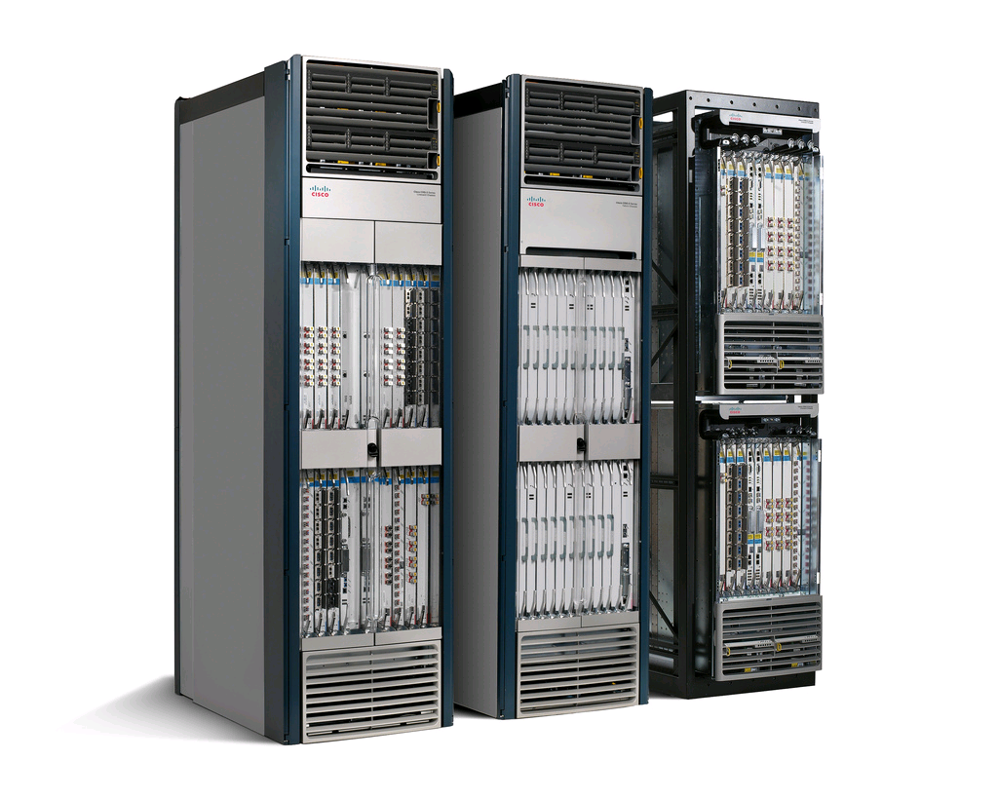
Internet Core Routers
CISCO CRS-3 (Carrier Routing System)
Multi-chassis system
322Tbps aggregate bandwidth
Download the entire Library of Congress content < 1 sec
Simultaneous video calls for everyone in China
Specialization in various levels
Computation
Memory
Input/output
1GIPS < 0.1Watts
Independent threads
>10X efficiency over CPU
Notes:
GPU: 0.2 GFLOPS/Watt
CPU: Peak 0.3 GIPS for networking it is 1 GIPS
Internet routers are a successful practice in customization with respect to computation, memory, and IO resources. Lets briefly look at the Internet routers architecture which is my role model in this research.
The highest capacity router I could find
2.73 Watts per Gbps (total power)
Compute power : 35%

Slide 75
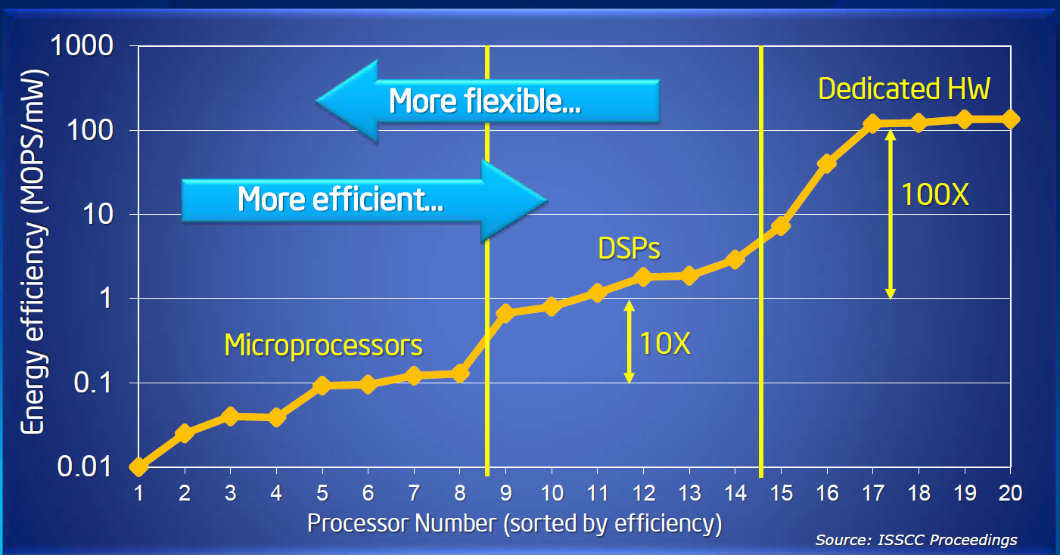
Benefits of Customization
Figure is from ISCA 2012 Keynote by Justin Rattner
Notes:
This graph shows energy efficiency of 20 different fabricated chips which have publication in ISSCC before 2000. The graph is not implementation of single application using different substrate. The efficiency is based on the max throughput of chip among different benchmarks. The operation is basic ALU operation for that particular chip.

Slide 76
A Composition Function
def Offload (a: (gComponentMD, () => gComponent),
b: (gComponentMD, () => gComponent),
offPort: String) = {
val res = () => new gOffloadedComponent // arguments are not shown
val (left, right) = a._1.offloadDataGen.span( _._1 == offPort)
val restOfOffloadedDataMain = { if (right.isEmpty) left else left ++ right.tail}
val offoff = mergeOffloads(restOfOffloadedDataMain, b._1.offloadDataGen)
(new gComponentMD(a._1.inDataGen, b._1.outDataGen, offoff), res)
}

Slide 77
A Composition Function – contd.
class gOffloadedComponent extends gComponent
//arguments not shown (main, off, offPort)
{
//…Find the result offloaded interfaces,, put it in offoff variable
io += offoff
io.in <> main.io.in
io.out <> main.io.out
//…mainOff is the offload interface of the main component
for ((n, i) <- mainOff.elements) {
if (n != "in" && n != "out" && n == offPort) {
i.req <> off.io.in
i.rep <> off.io.out
} //if
} // for }

Slide 78
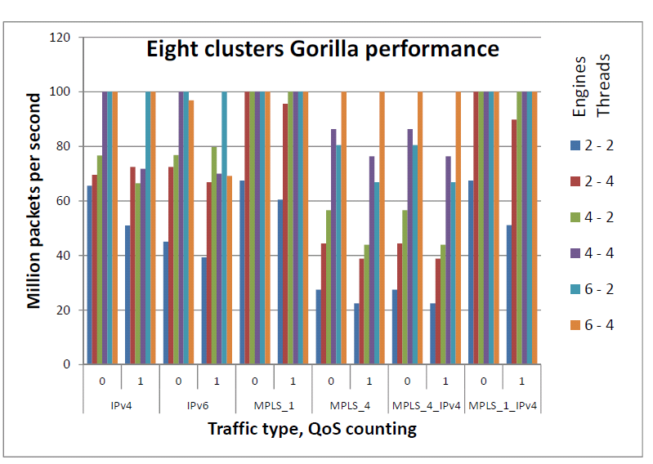
Routing Experimental Results - 100MPPS on Virtex-6 VHX380T

Slide 79
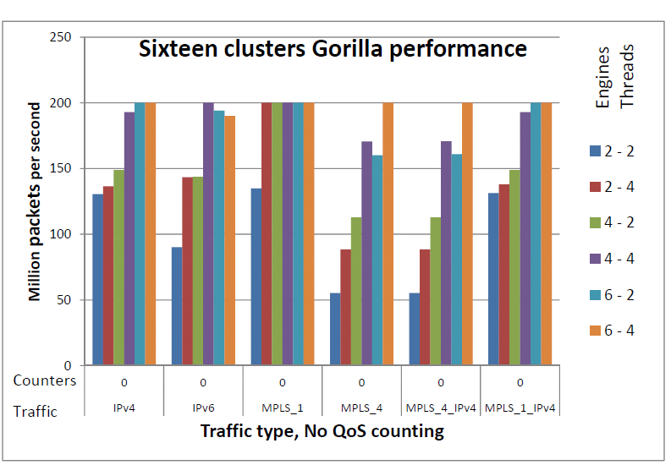
Routing Experimental Results - 200MPPS on Virtex-7 VHX870T

Slide 80
Generating Memcached Accelerator
Memcached 1.4.10
Threading model: Libevent
10687 LOCs
Update
Retrieval
Remove
s
t
t
Hot trace: ~ all Get ops
Hot routines LOCs: 963
Hot instructions: <2000
Slicer
Template-based HLS
57 complex states
Each 1-30 clock cycles
e.g., IP/UDP parsing: 4 states
Retrieval
Remove
Roll back code: 30 LOCs
Mem Annotations:22 LOCs
Notes:
We applied this methodology on Memcached. Memcached has 10687 lines of code.
It is using libevent and as the result it has the threading model that we want.
After passing the memcached through the slicer, it is not a surprise that the hot trace
Contains most of the get operations on top of UDP. Get operations that hit expired item is not in the hot path.
The hot routines contains only 963 lines of code and hot instructions are only 2000 static instructions.
The roll back code is only 30 lines of code and there are few lines of code for annotating the memory types.
And then we pass the hot trace plus the rollback code to the HLS tool and generate the hardware.
The generated hardware has 57 FSM states. I should mention that each state is performing large set of operations and for example parsing the IP and UDP is done in 4 steps.

Slide 81
Accelerator code
Automatic step
Process transition
Manual step
Build a base template
Input dependency
Input
Library
Add new micro-architecture refinement or hands off
Engine / composition compilation
Synthesis
No
Perform refinement
Yes
Possible refinement?
Work loads
Performance evaluation
Performance goals
No
Design space explorer
Micro-architecture refinement library
Goals met?
Yes

Slide 82
Fast Path Performance/Power
1 Watt, 590K RPS, 590 Reqs/J
64 bytes items
27x more energy efficient
8 Watts, 175K RPS, 21.8 Reqs/J
Xeon frequency: 2.2 Ghz
FPGA frequency: 100 Mhz
Xeon core performance from Langsto el al., “Enhancing the scalability of Memcached”
Xeon power breakdown: McPAT, FPGA power: Xilinx xPower
Notes:
In this graph we compare the accelerator performance with the best software implementation which is heavily tuned by Intel on top of Xeon processor.
We are showing the performance for one and two inline accelerator engine. And one and two Xeon cores.
X axis is the offered load and Y axis is the sustained throughput. We can see that single accelerator engine can deliver 590 thousand requests per second while consuming only one watt and the Xeon core can deliver 175 thousand requests per second while consuming eight watts.
This translates into 27X energy efficiency gap between the accelerator and the Xeon core.
Please note that this experiment only contains the fast path operations that all can be handled using FPGA.
But what we are really interested is the real work load with slow path as well as fast path operations when there is a overhead for bail out, synchronization between fast path and slow path, and cache coherency overhead.

Slide 83
Simulation Environment and Parameters
Client
Server
Fast path extension
to NIC state machine
(NS DP83820)/100Mhz
Update
Retrieval
Remove
MCBlaster
1Gbits/s
s
Linux 2.6.38
Network
t
Alpha core single-issue
In-order/4Ghz
t
Linux 2.6.38
Alpha core single-issue In-order/4Ghz
$
2 MB LLC
Full system stack cycle-accurate simulation using Gem5 simulator
Populate phase: one million items before test
Measurement: throughput based on 1ms time out
Notes:
In order to measure the performance of in-line accelerator cooperating with general purpose core,
We spent a good deal of time to simulate the full system stack of both client and server system in Gem5 environment. We changed the server NIC model and added the fast path state machine to NIC state machine.
On the client we are running mcblaster and on the server we are running original memcached with some changes in libc library.

Slide 84
Hybrid Architecture Performance
Single Engine Accelerator Throughput
64 bytes items
Xeon core: 175K Gets/sec
Xeon core performance from Langsto, et al. “Enhancing the scalability of Memcached”
Notes:
And this is the performance of a hybrid FPGA/general purpose core when we have both slow path operations which are the set operations as well as the fast path operations which are the get operations.
The X axis is the different set operation rates and the Y axis is the maximum throughput for single engine.
As we see having some slow path operations mixed with fast path operations degrades the performance of the system. However we still far higher than Xeon core pure Get performance and of course the big win is the gap between the power consumption of these two hardware.

Slide 85
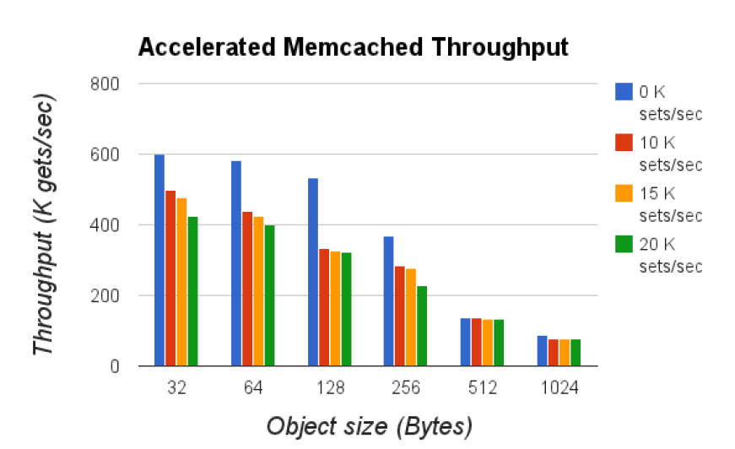
Accelerated Memcached throughput

Slide 86
Board Implementation
Gorilla-generated network processor
IPv4 only on ML605
Xilinx Virtex-6 XC6VLX240T
Emulate QDRs with accurate timing in BRAMs
16-3-2 configuration delivers 100MPPS
Most of the logic running at 100Mhz
Consistent with simulation results
Random packet generator and statistics collector
Core power (excluding the I/O) less than 4 watts
Notes:
A picture from board required here

Slide 87
Kmeans Accelerator
Val KmeansPipe =
PIPELINED_ENGINE(“kmeans_pipe.c”)
Val KmeansDataFeed =
MT_ENGINE(“Kmeans_control.c”)
Val KmeansCoresCluster =
REPLICATE(OFFLOAD(
KmeansDataFeed, KmeansPipe), coreCounts,
reduce = kmeansReducer)
Val Kmeans_accl =
Offload(Streamer, KmeansCoresClusters)

Slide 88
Timing-insensitive Interfaces
Input valid
Meta data
Request
Input data
Reply
Input ready
FifoIO
OffloadIO
Notes:
Mix this with Chisel code

Slide 89
Component
Component
Notes:
Mix this with Chisel code

Slide 90
Definition of Back-pressure
On a given interface back-pressure happens if the number of cycles that valid signal is one and ready signal is zero is larger than a threshold (T1 threshold)

Slide 91
Definition of Bottleneck
An engine is bottleneck if it back-pressures on the input and not back-pressures on the output or any request side of the offload interfaces

Slide 92
Definition of Offload-inefficient
An engine is offload-inefficient if the ratio of offload time in at least one of the offload interfaces over the total computation time is higher than a threshold (T2 threshold)

Slide 93
Refinement Rules
Rule 1
Pred-1:Is there any engine that is bottleneck
Pred-2:Is the CFG of the engine loop-free?
Action: pipeline it
Rule 2
Pred: Is there any engine that is offload-inefficient
Action: multi-thread it

Slide 94
K-means Domain Code
Engine(“k-means.c”)
K-meansEngine() {
//OUTPUT Point_t; INPUT Point_t;
Int closestId;
Distance_t centers[n], distances[n], closestDistance;
closestDistance = INFINITI;
for (i=0; i<n; i++) {
float c = center[i];
float d = distance (input, c);
if (d < closestDistance) closestDistance = d;
closestId = i;} //end of for loop
distances[closestId] += closestDistance;}
distance

Slide 95
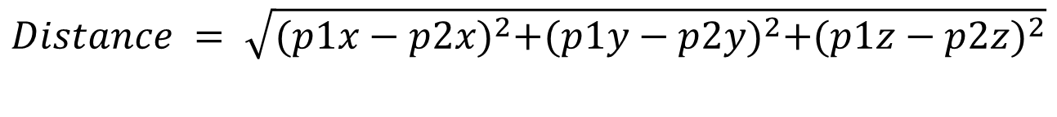
Distance Function
Point_t distance(Point_t p1, Point_t p2) {
output = sqrt(sqr(p1.x-p2.x), sqr(p1.y- p2.y), sqr(p1.z-p2.z))
}
$$Distance = \sqrt{{(p1x−p2x)}^{2}+{(p1y−p2y)}^{2}+{(p1z−p2z)}^{2}}$$

Slide 96
Offload Maker Operation
Objective: If there are enough Heavy operations in a CDFG sub-graph outline it (outlining is a compiler technique)
Memory operations
Floating point operations
Make a new offloaded engine
The input/output are the packed input/output arguments of outlined function
The offloaded interfaces are the set of offloaded interfaces in the outlined code

Slide 97
K-means Original Engine
Engine(“k-means.c”)
distance
Distance:
Request side is two ThreeDimFloat
Reply side is on ThreeDimFloat
Output = sqrt(sqr(in1.x-in2.x), sqr(in1.y-in2.y), sqr(in1.z-in2.z))
Notes:
Mix this with Chisel code

Slide 98
Intra Engine Parallelization Patterns
Pipelining
Multithreading

Slide 99
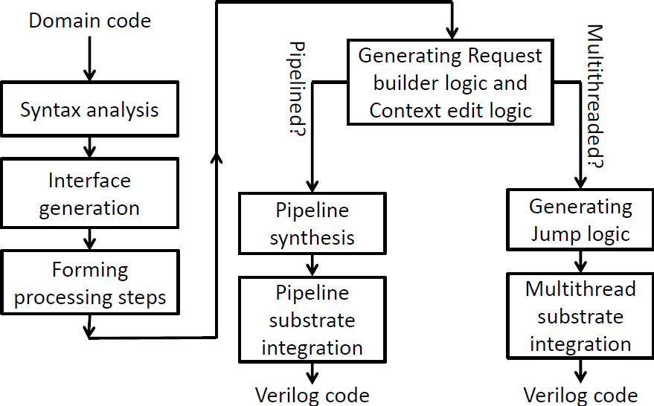
Gorilla Compilation Process
Written in ANTLR

Slide 100
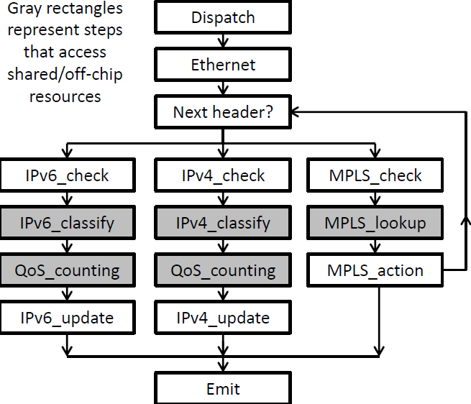
Packet Header Processing

Slide 101
In-line Acceleration in Core Routers
Slow-path processor
Metro NP (CRS-1 2007)
188 32-Bit embedded RISCs
96Gbps bandwidth
Interconnect
Throughput machines
IO intensive
Irregularity in control-flow
High bandwidth random memory accesses
Customization at various levels
Network interfaces
Inter-core communication
Memory interfaces
Core architecture
Line card
Network processor
Memory
Notes:
We show a simplified view of a router architecture.
Fast-path accelerator = Data-plane accelerator = In-line accelerator
FCRAM: Fast cycle RAM: more aggressive pipelining on handling DRAM commands

Slide 102
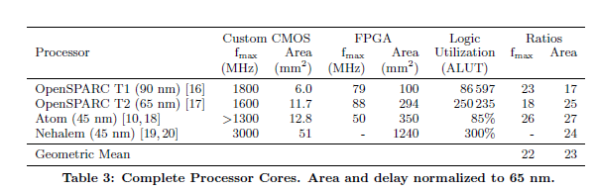
FPGA Overheads
From: H. Wong et al, “Comparing FPGA vs Custom CMOS and the Impact on Processor Microarchitecture”, FPGA 2011
Notes:
Unlike ASICs, FPGAs are a highly flexible substrate for specialization. However they have the area and timing overhead of building logic, memory, and interconnects through programmable components.
An important question is whether the benefit of customization can out weight the FPGAs overhead?

Slide 103
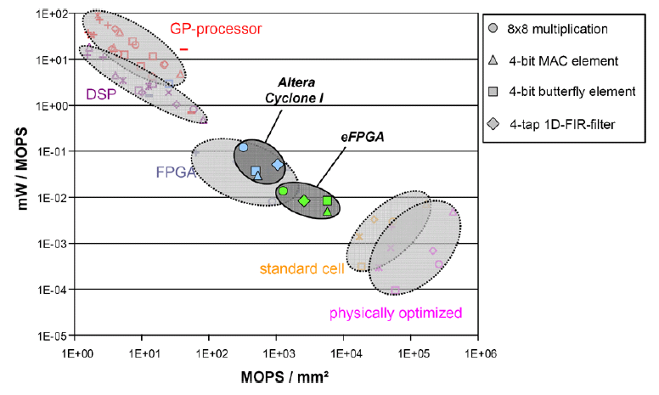
GPP-ASIC Gap
Five orders of magnitude gap
Reconfigurable components for application-specific processor architectures, Nolll, T et al.

Slide 104
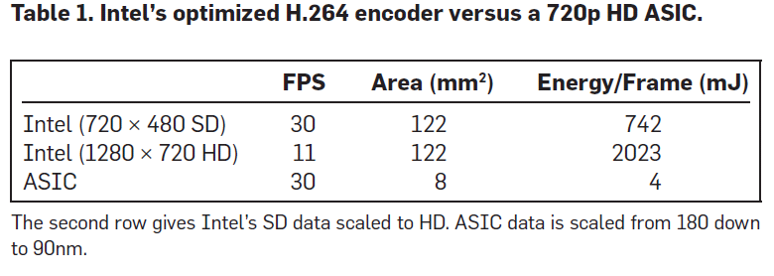
GPP-ASIC Gap
Understanding the source of inefficiencies in general-purpose chips, ISCA 2010, Horowitz. M. et al.
Notes:
Pentium 4 with SSE 2.8Ghz

Slide 105
Gorilla++ Methodology (High-level)
Router: Inport → Classify → CountQoS → Outport
Classify(Input) {
if (Input.protocol == ICMP) ProcessICMP();
Lookup(); return Output;}
FPGA-based accelerator
High throughput
High energy efficiency
Slice
Router: Inport → Classify → CountQoS → Outport
Classify(Input) {
if (Input.protocol == ICMP) BailOut();
Lookup(); return Output;}
Refinement rules
Build base template
A
B
A.backPressure = 0.8
B.stallTime = 0.75
Profile
Synthesis
Classify();
QoSCount();

Slide 106
Gorilla++ Methodology (High-level)
FPGA-based accelerator
High throughput
High energy efficiency
Router(Input) {
if (Input.protocol == ICMP) ProcessICMP();
Classify();
return Output;}
Profile
Slice
RouterFastPath(Input) {
if (Input.protocol == ICMP) Bailout();
Classify();
return Output;}
Refinement rules
- Select a base template
- Refactor the code
Profile
Synthesis
A
B
A.backPressure = 0.8
B.stallTime = 0.75
process();
Generate();

Slide 107
Accelerators Flexibility Challenge
Rarely used accelerators not justifiable
Part of specialization is traded for some flexibility
Cover larger set of computations
Amortize the cost of specialized hardware
Achieve flexibility using FPGAs
Lower performance than ASIC but high flexibility
FPGA-based network-attached accelerators?
Notes:
When we do not build a customized hardware for a computation? (i) Not fit into hardware (ii) Not used frequent enough

Slide 108
Accelerators Design Challenge
Design challenges for accelerators
Complex hardware design/verification process
FPGA-based hardware requires very efficient micro-architecture
Both domain expertise and hardware knowledge
High Level Synthesis
For complex designs, designer assistance is required
Large number of HLS directives
Reduce/eliminate directives for the target accelerators?

Slide 109
Flexibility Challenge for Accelerators
ASICs: specialization → less flexibility
Covering smaller variety of computations
Demanded quantity of accelerator is high → works
Demanded quantity of accelerator is not high enough → problem
Cost of the specialization not justifiable
Buy back some flexibility to cover more computations
FPGAs: both specialization and flexibility
FPGA overhead
Less efficient than ASIC
Merit of specialization > FPGA overhead?
FPGA-based accelerator for target applications

Slide 110
Design Challenge for Accelerators
HLS (High-Level Synthesis) quality of results
Less efficient than hand-designed micro-architectures
Efficient micro-architectures: exploits different types of parallelisms
Conventional HLS: exploits only few types
Designer provides micro-architecture: Architecture-centric HLS
Designer provides hints about micro-architecture: Modern HLS tools
Start from non-sequential programming model: e.g., SDF
Regular computation
A methodology to improve designer’s productivity?
Exploits different parallelization opportunities automatically
More generic applications than SDF

Slide 111
Scaling the Performance - Projection
Scaling the Performance - Projection
Network: 30% (3G bits/sec)
FPGA area: 40% (69600 LUTs)
Memory BW: 2.3% (1.15G bytes/sec)
Two Xeons
Number of cores/engines is labeled for each data point
Projecting the performance of Xeon + In-line accelerator
Assumes unused cores can be clock gated
Almost the same 3.15M reqs/sec throughput as dual package configuration
Eight engines (fast path) + single Xeon core (slow path) + Xeon un-core
3.6X more energy efficient
Notes:
To study the design space of adding our automatically generated hardware accelerator engines to an existing system, we designed a model of incrementally adding engines to a baseline Xeon-based system
In this figure I am showing power vs. throughput of a Xeon processor as well as the projected power vs. throughput of a Xeon processor + an in-line accelerator.
The Xeon performance and power is reported from Intel experience. And as you see the performance scales linearly with number of cores.
For the system with in-line accelerator we are assuming that we have FPGA resources as big as the Virtex-6 part we saw before. We are also assuming that we can power gate the Xeon cores except one for processing slow path operations.
As you can see using 8 engines we can deliver almost the same performance as two processors performance. However, we can save a lot of power and improve the energy efficiency by 3.6x.
We still have scaling headroom in terms of network and memory bandwidth, as well as FPGA resources, allowing for larger configurations with equal power budgets rather than equal performance.

