Slide 1
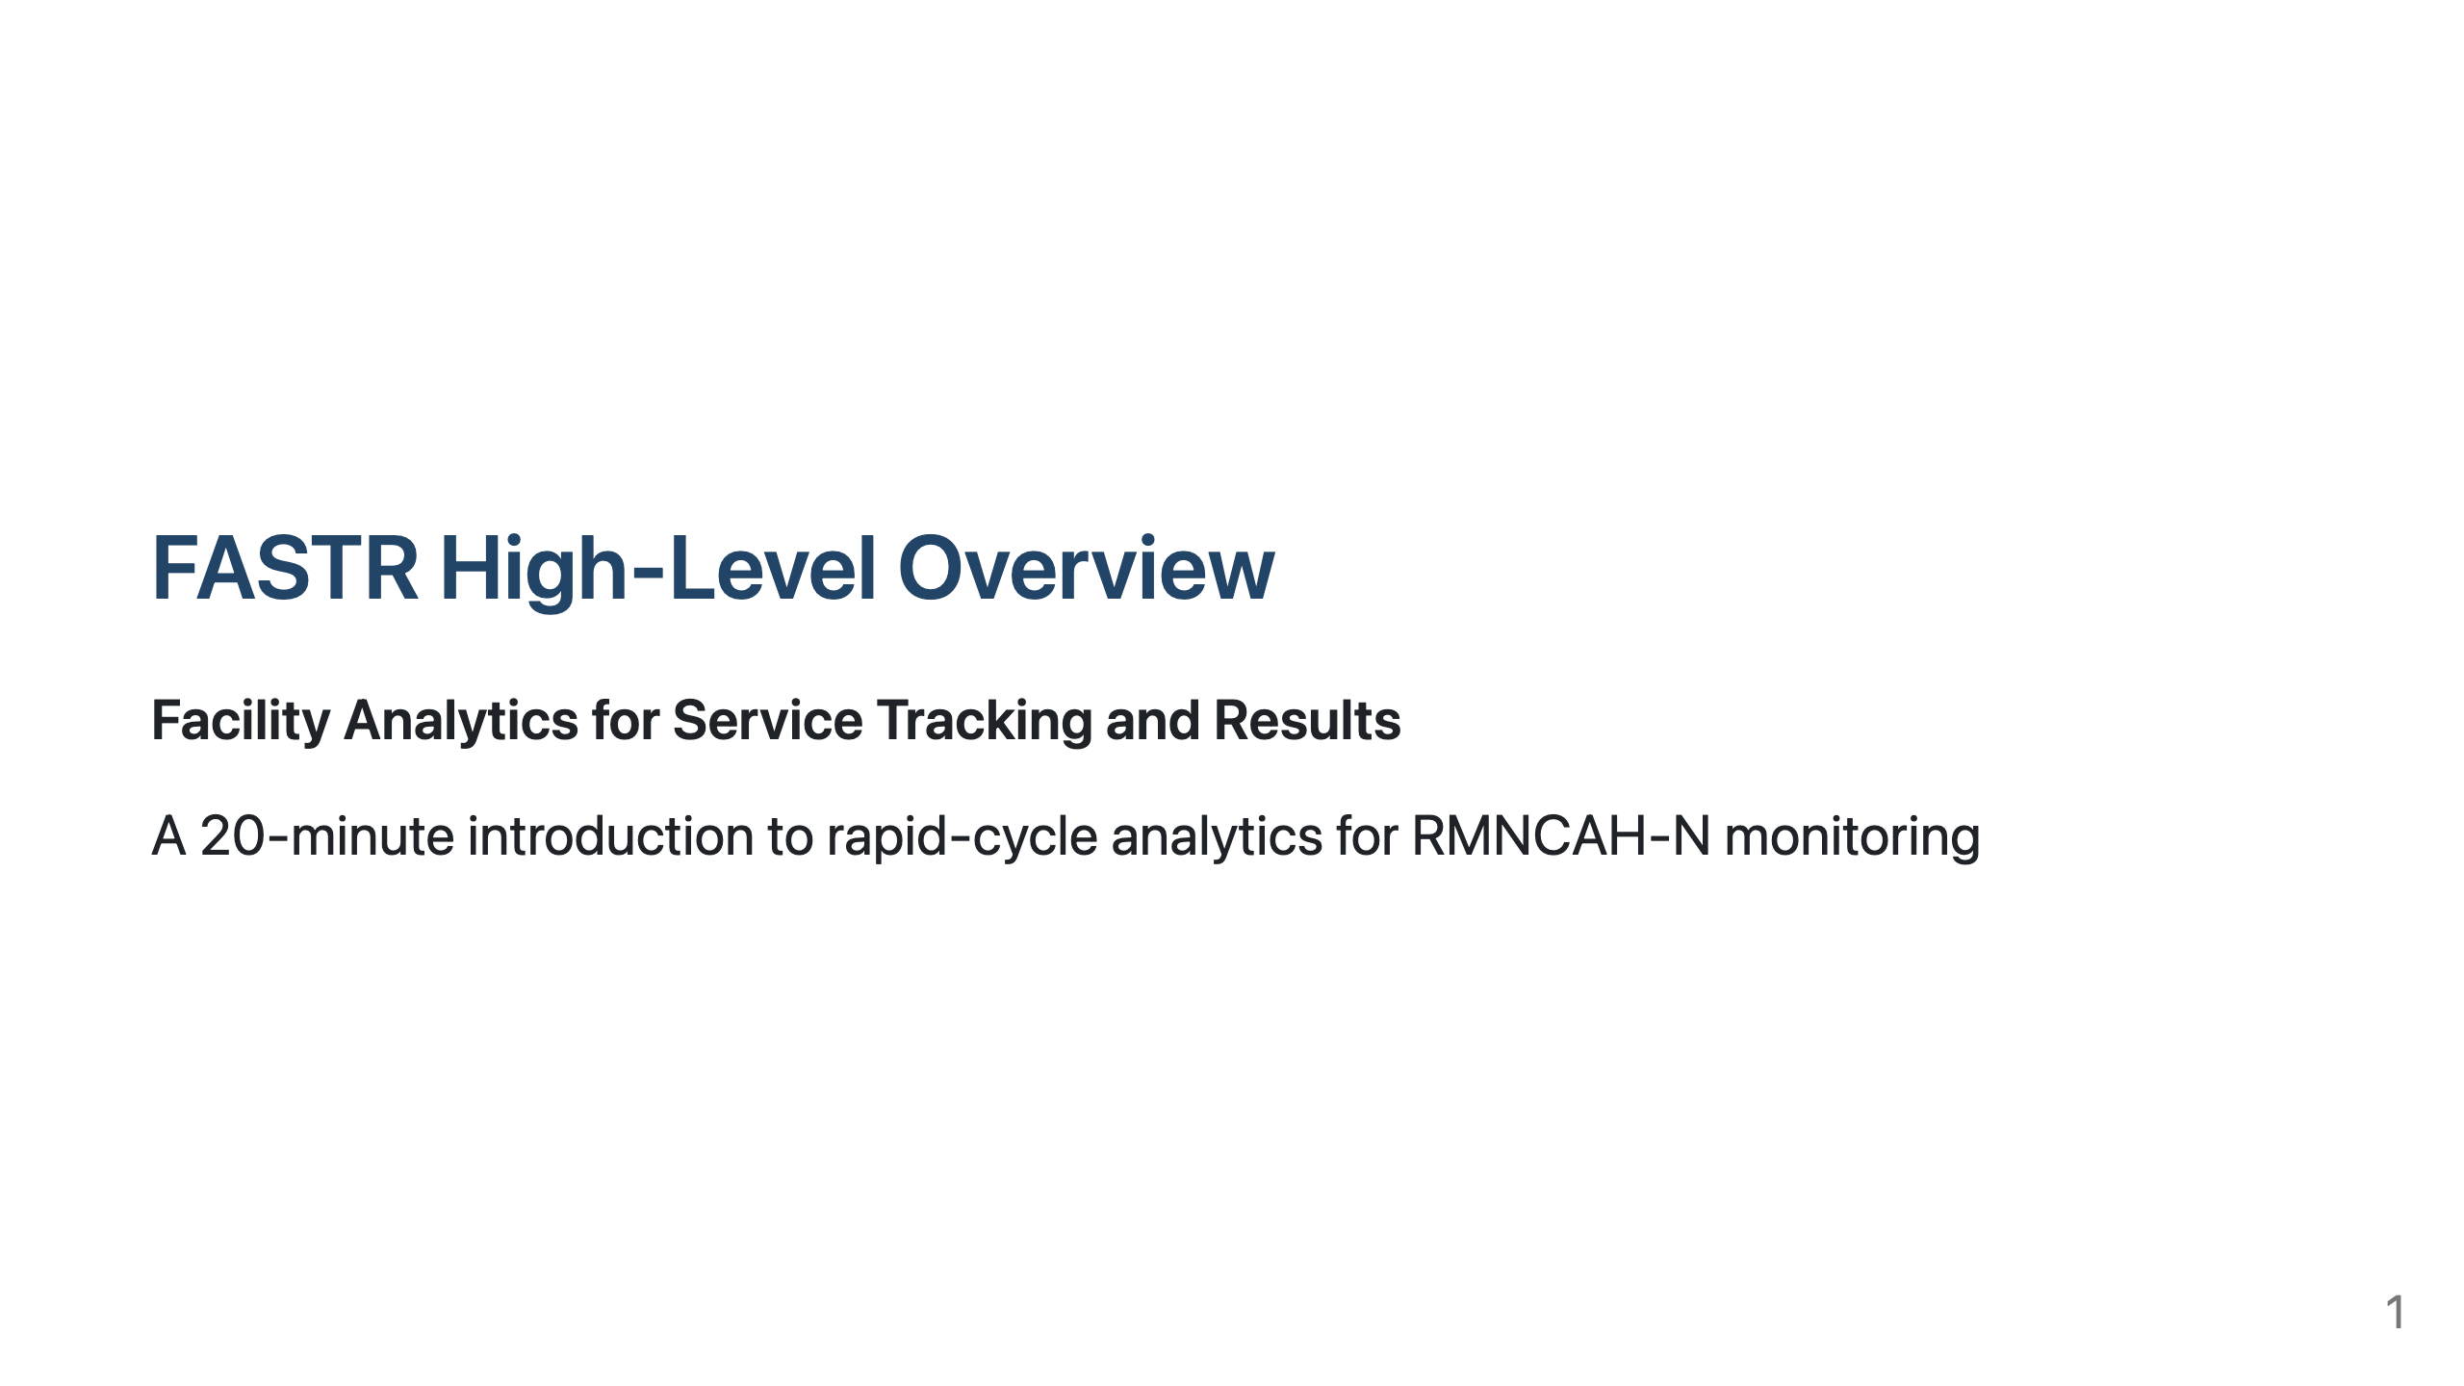

Slide 2
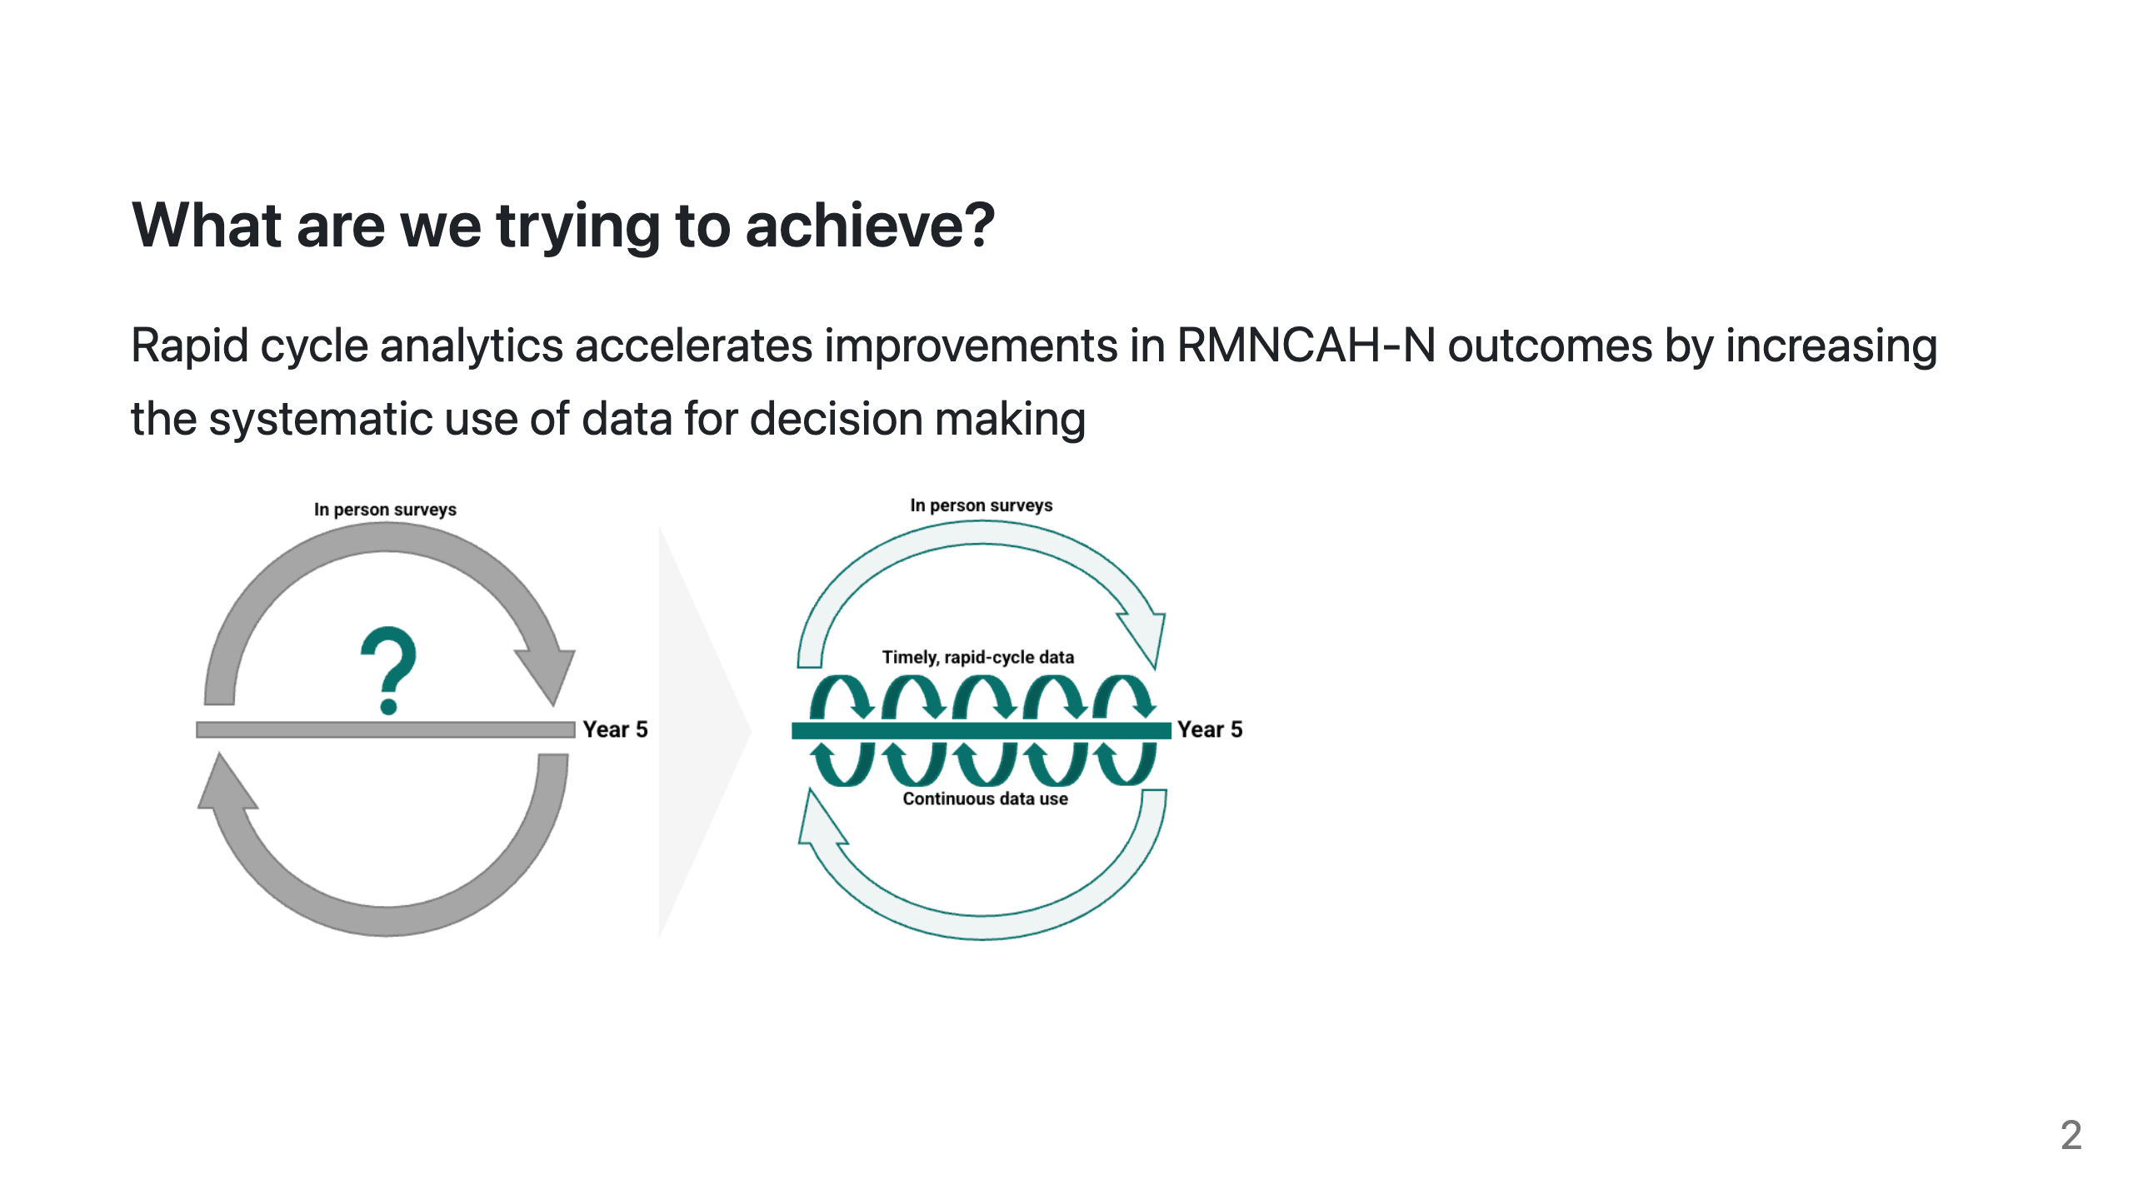

Slide 3
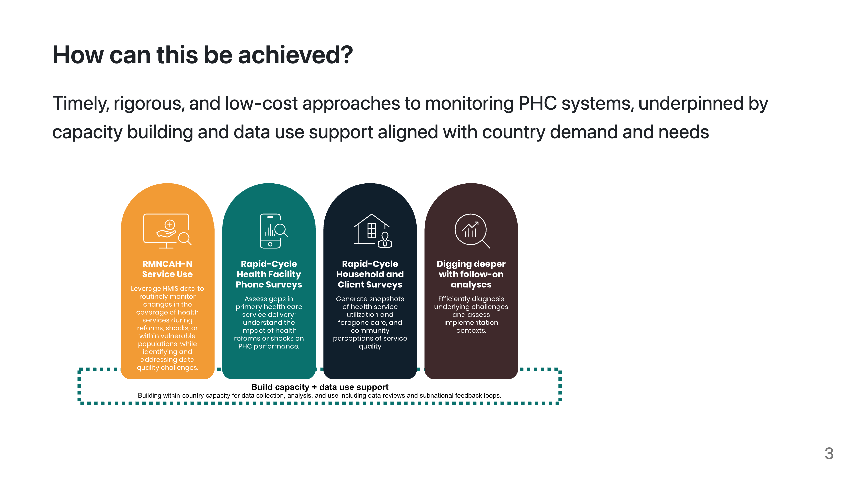

Slide 4
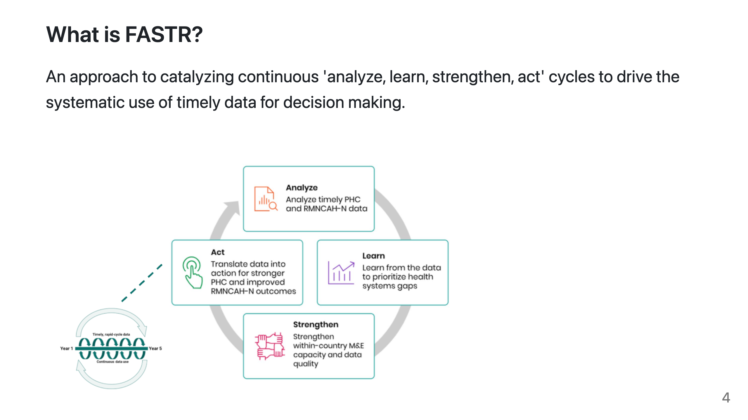
Notes:
PRESENTER NOTES: - Routine health information systems are a critical source of data, but often underused due to concerns about data quality and long delays between data collection and analysis - Traditional household and facility surveys, while essential, are resource-intensive and infrequent - FASTR's rapid-cycle analytics address this gap by providing: - Timely insights aligned with country decision cycles - Continuous learning rather than one-off assessments - Direct feedback loops between data, analysis, and action

Slide 5
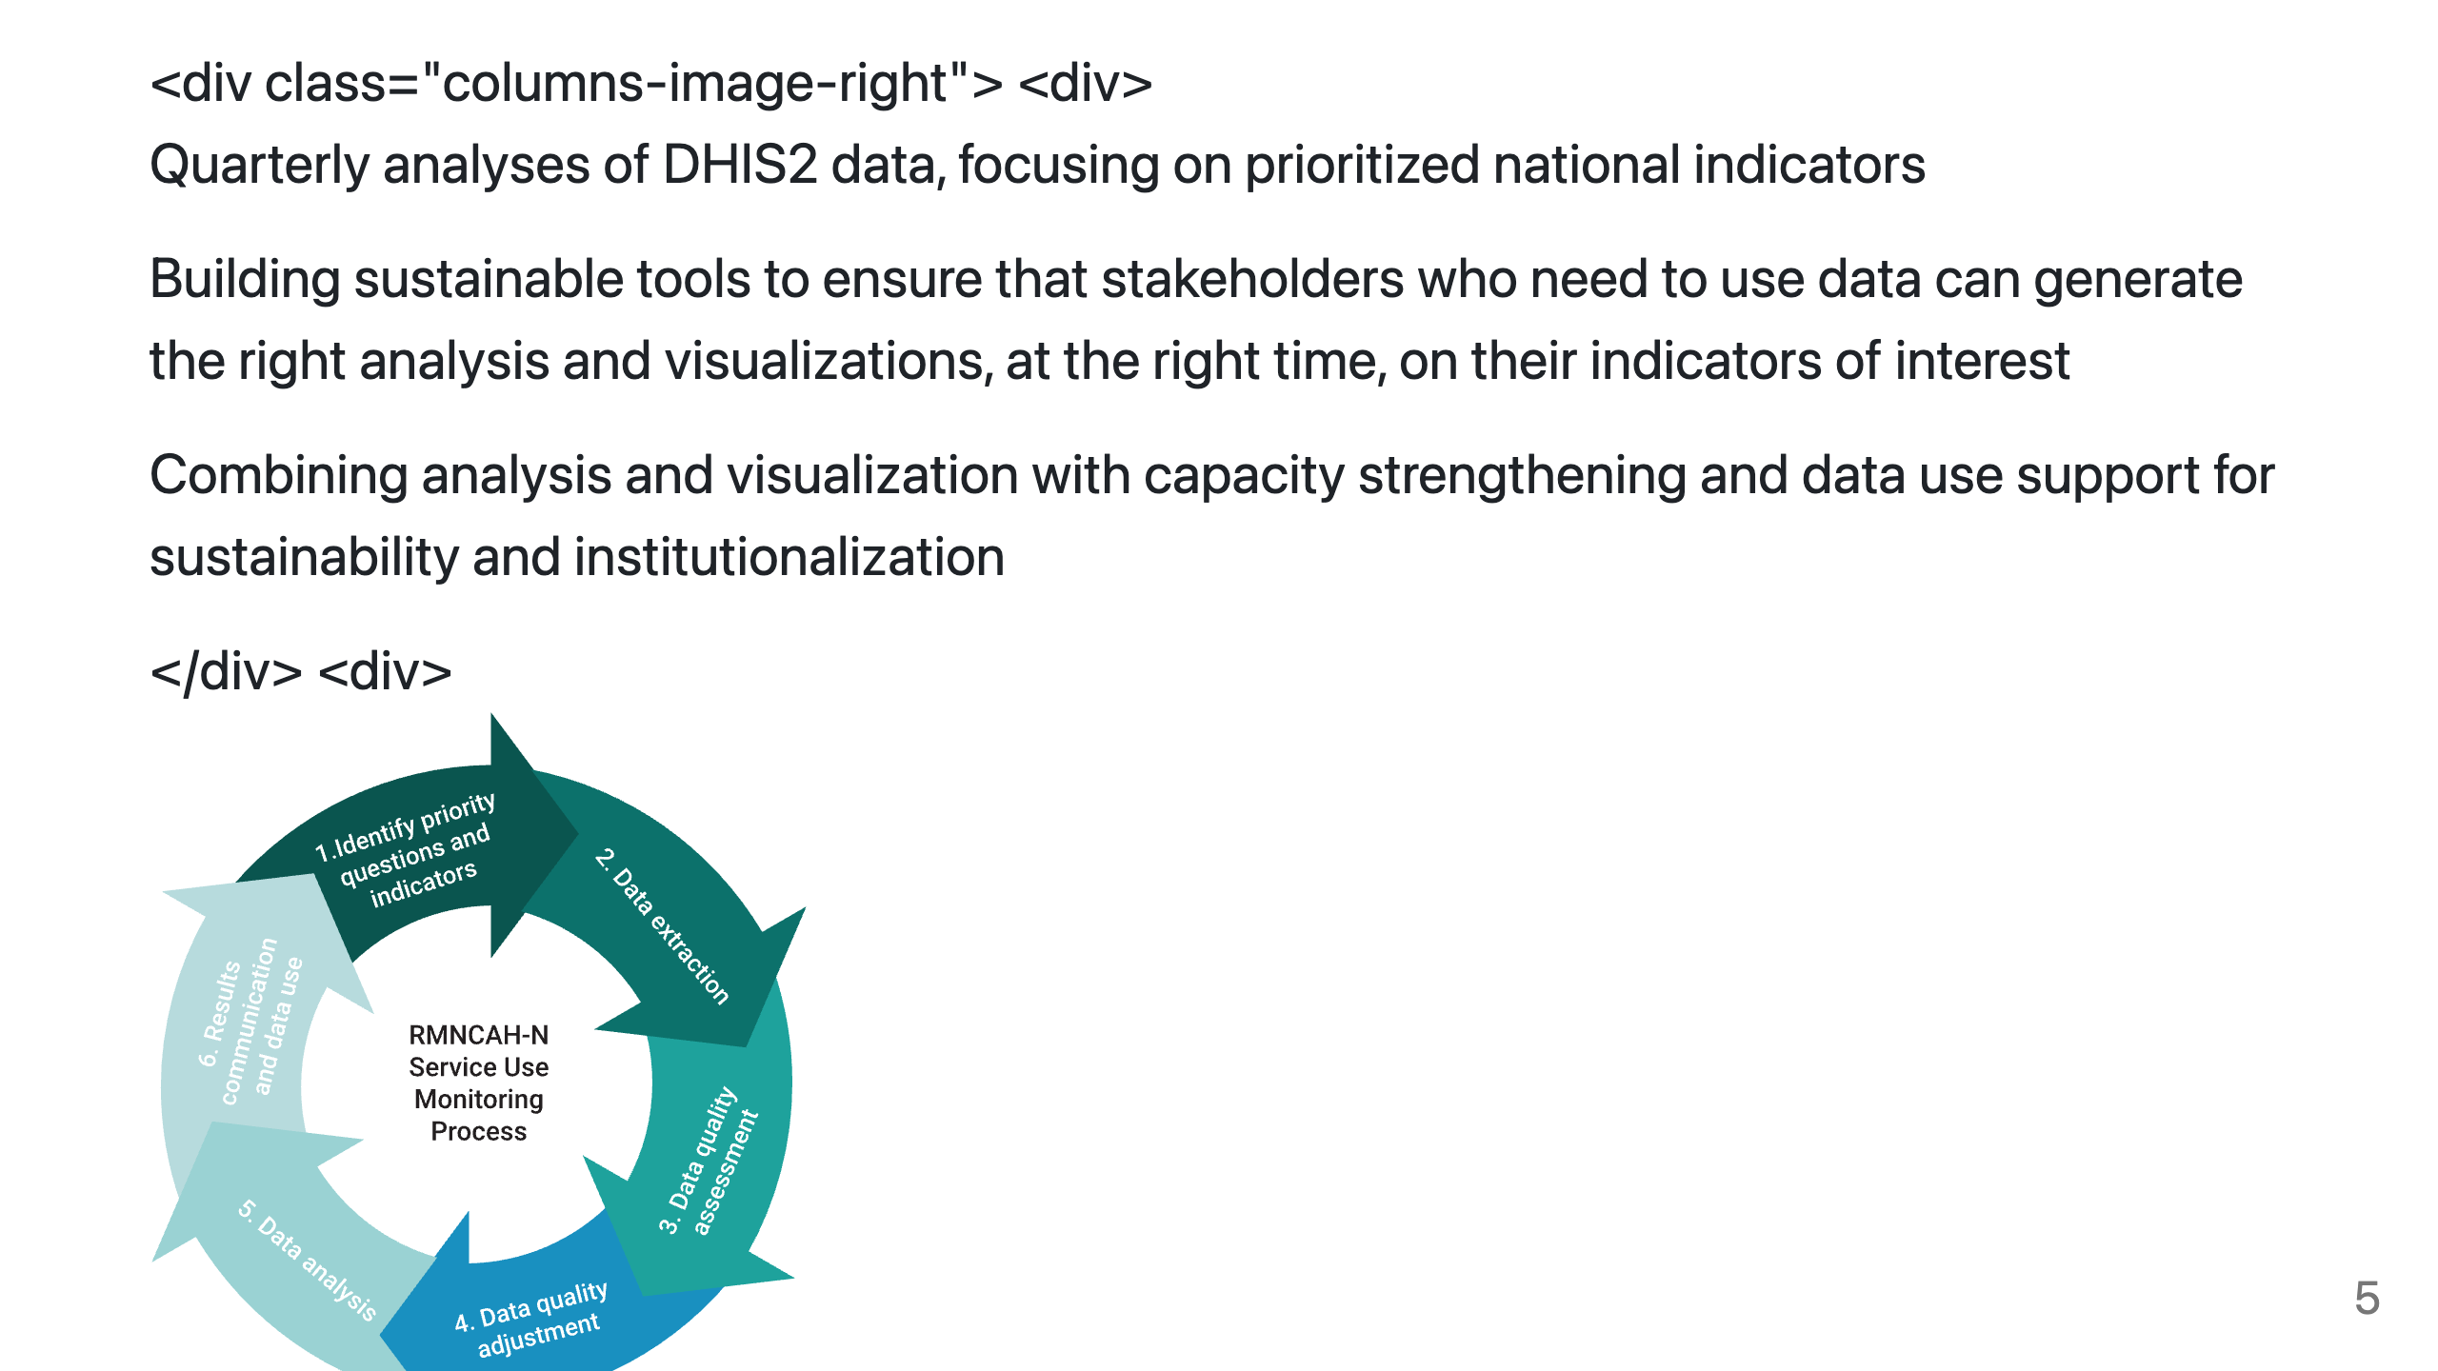

Slide 6
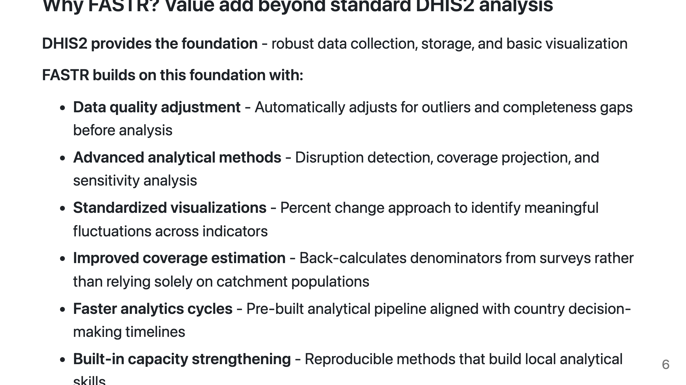
Notes:
PRESENTER NOTES: - DHIS2 is excellent for data collection and basic visualization - FASTR complements it - Key differentiator: data quality adjustment before analysis - Coverage methodology goes beyond simple HMIS/population ratios - Goal is to enable faster, more rigorous analysis for decision-making

Slide 7
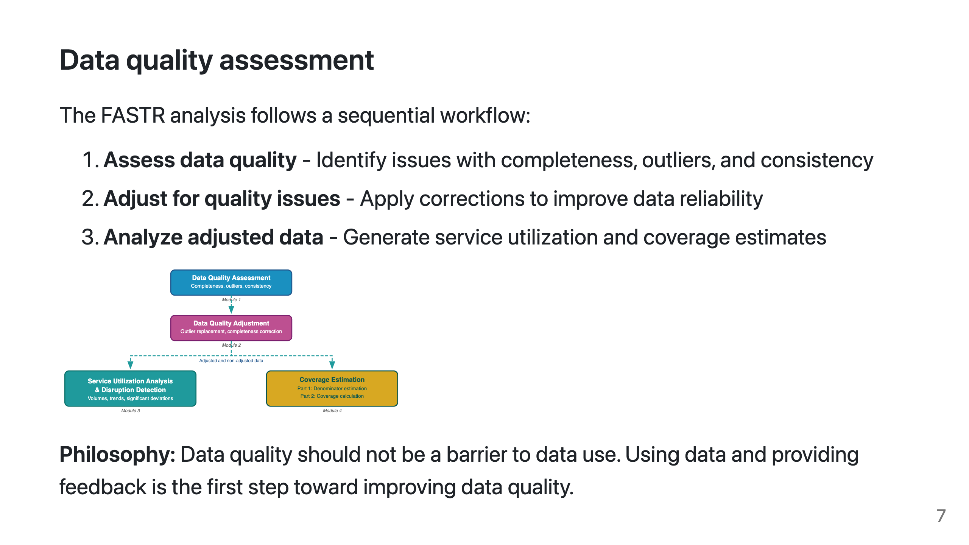
Notes:
PRESENTER NOTES: - FASTR takes a multi-pronged approach to data quality - Focus on high-volume indicators for more stable estimates - Emphasize variation over time and space rather than point estimates - Interpret results collaboratively with in-country decision-makers

Slide 8
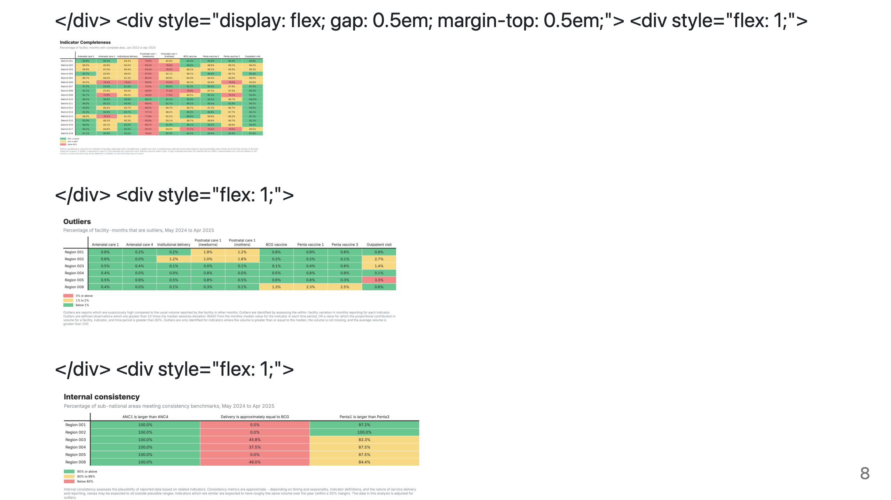
Notes:
PRESENTER NOTES: - Completeness: Are facilities that should report actually reporting? - Outliers: Only flags HIGH values (low values may be real service disruptions) - Consistency: Assessed at district level to account for patient movement between facilities

Slide 9
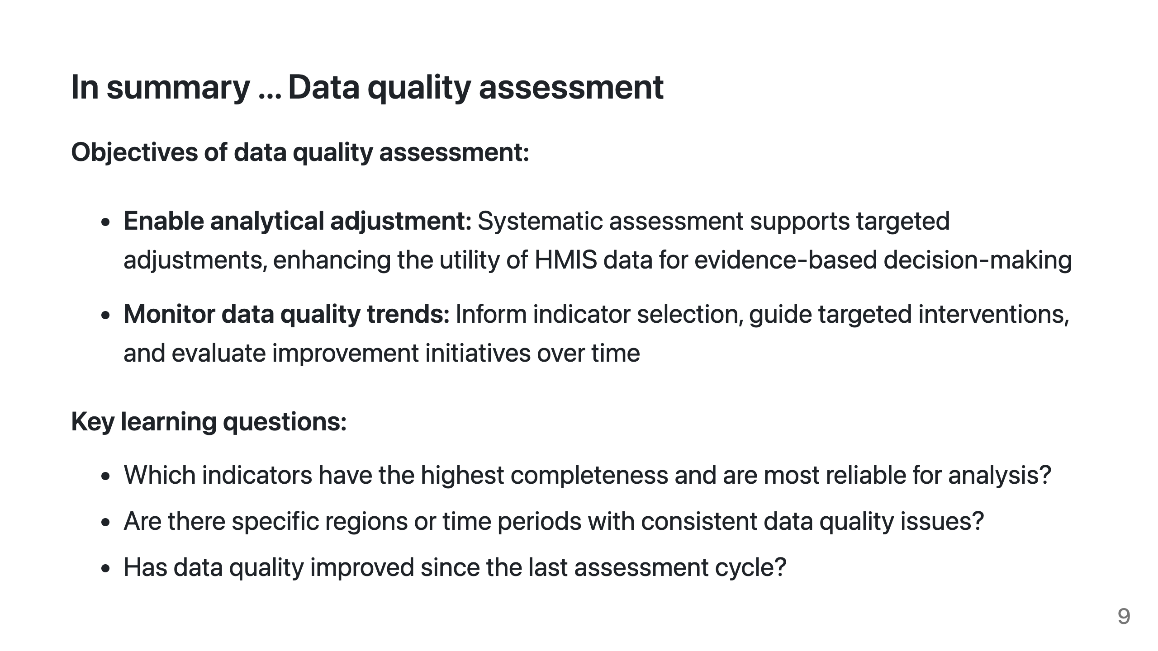
Notes:
PRESENTER NOTES: - DQA is not about rejecting data, but understanding its limitations - High-quality indicators can be used with more confidence - Low-quality indicators may need adjustment or careful interpretation

Slide 10
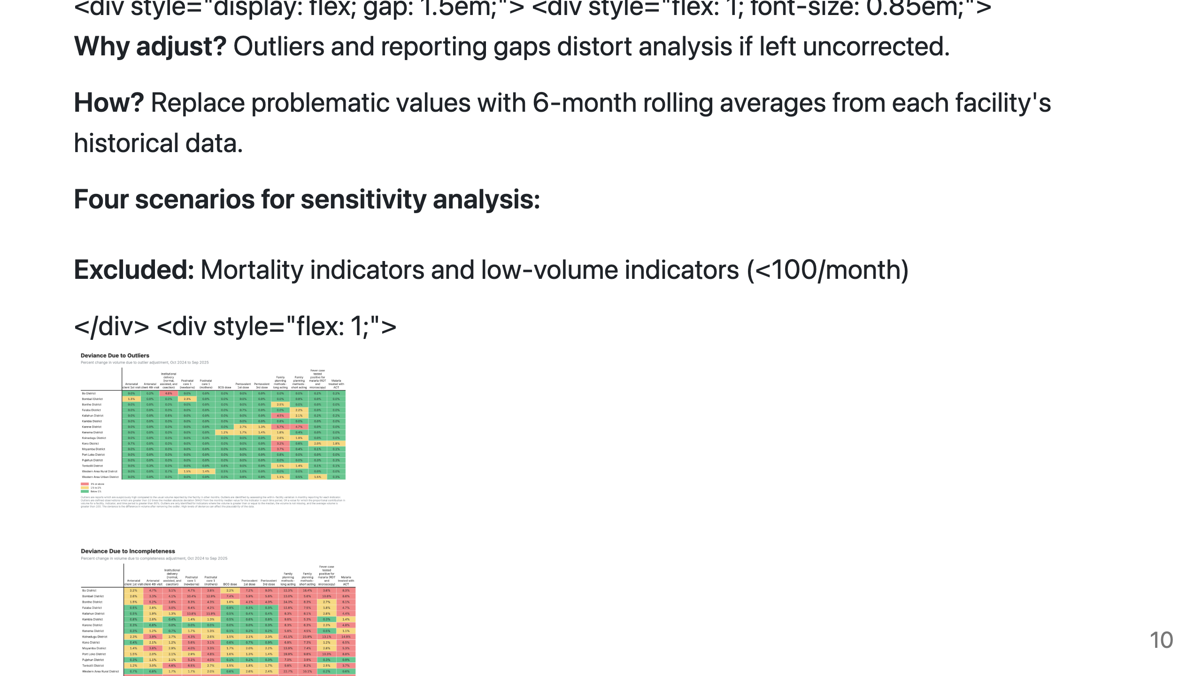
Notes:
PRESENTER NOTES: - Comparing scenarios shows how much results depend on adjustment choices - Outlier adjustment typically reduces volume (removes inflated values) - Completeness adjustment typically increases volume (fills gaps) - Large adjustments indicate areas needing data quality attention

Slide 11
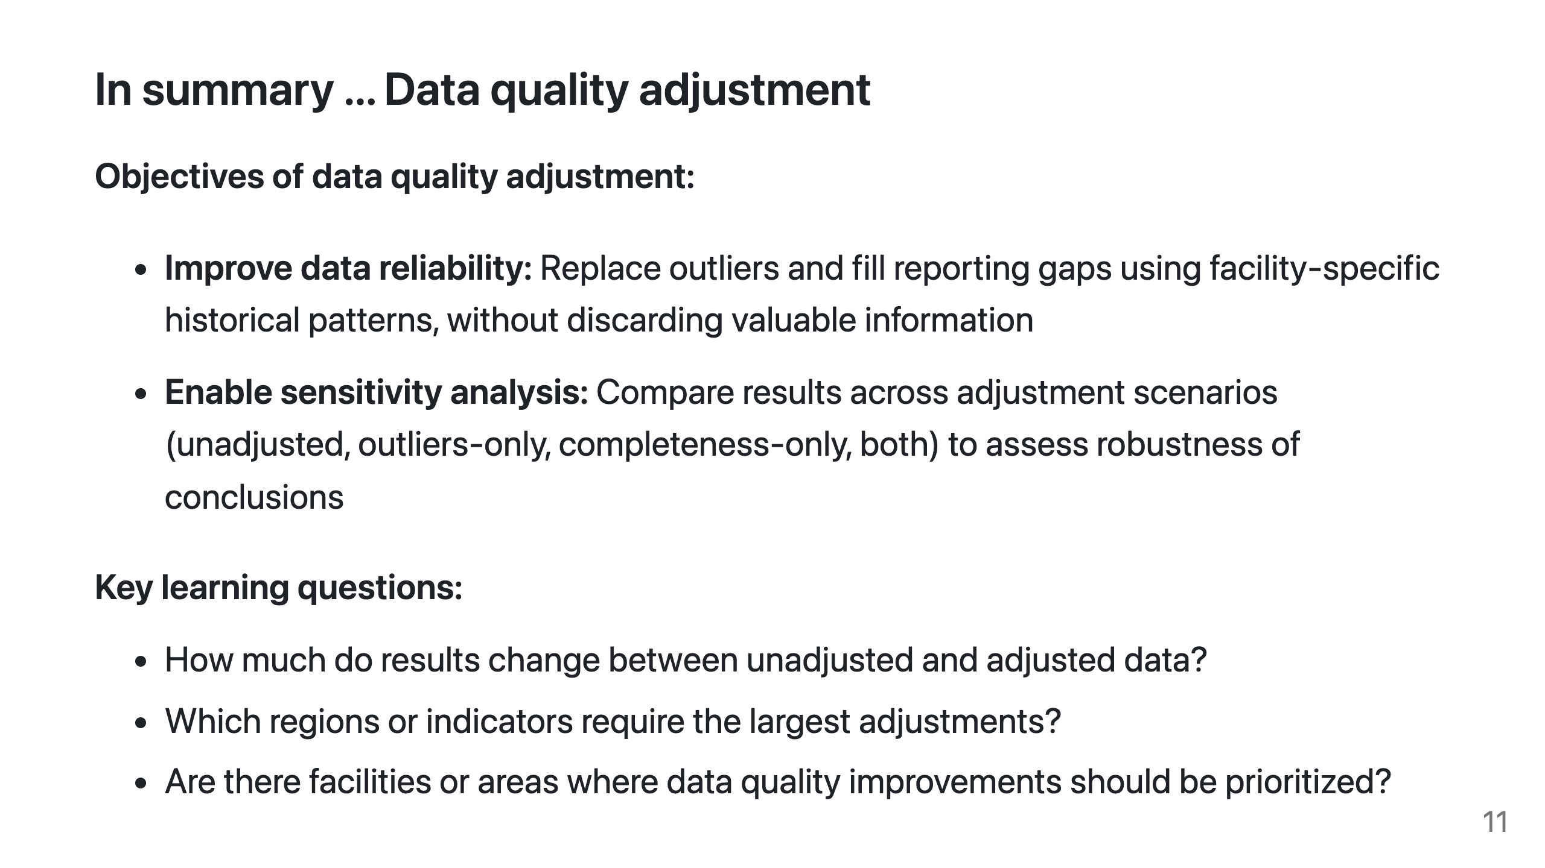
Notes:
PRESENTER NOTES: - Adjustment is transparent - we can see exactly what changed - Large adjustments indicate areas needing data quality attention - Sensitivity analysis builds confidence in findings

Slide 12
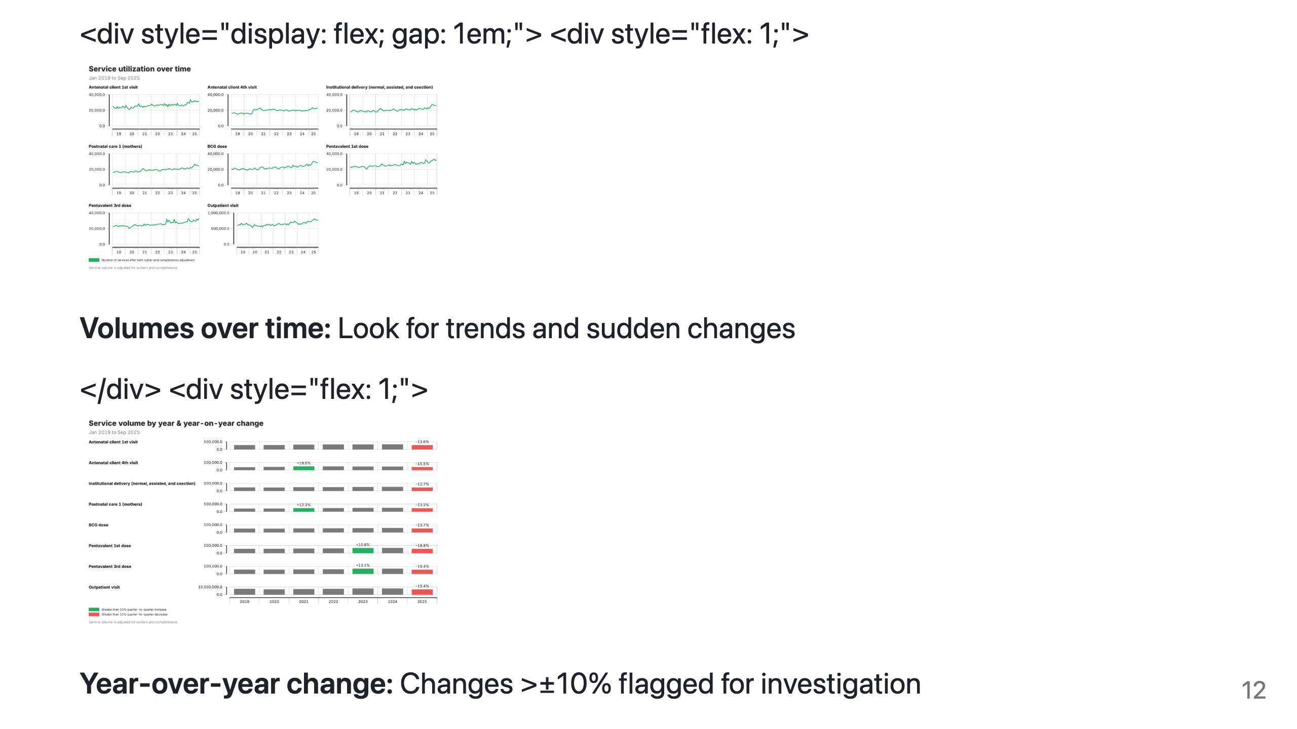
Notes:
PRESENTER NOTES: - Service volumes don't require population denominators - useful when denominators uncertain - YoY comparison controls for seasonal variation - Disruption = sustained deviation below expected, not just a single bad month - When flagged changes appear, ask: data quality issue, real program change, or external event?

Slide 13
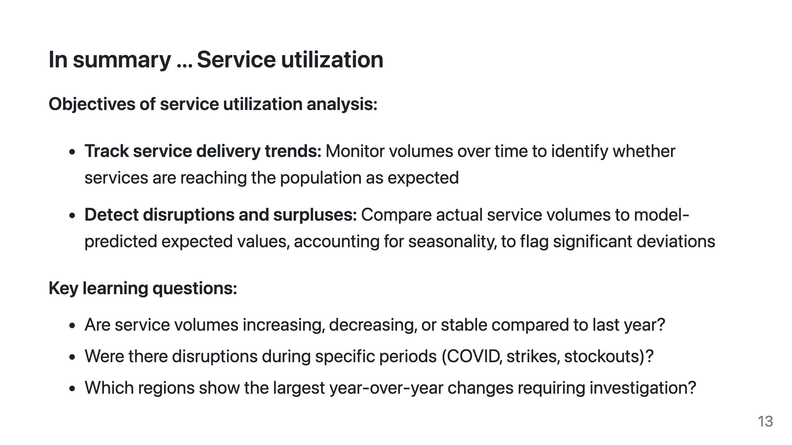
Notes:
PRESENTER NOTES: - Utilization analysis doesn't require denominators - useful when population data uncertain - Flagged changes trigger investigation, not automatic conclusions - Triangulate with local knowledge to understand root causes

Slide 14
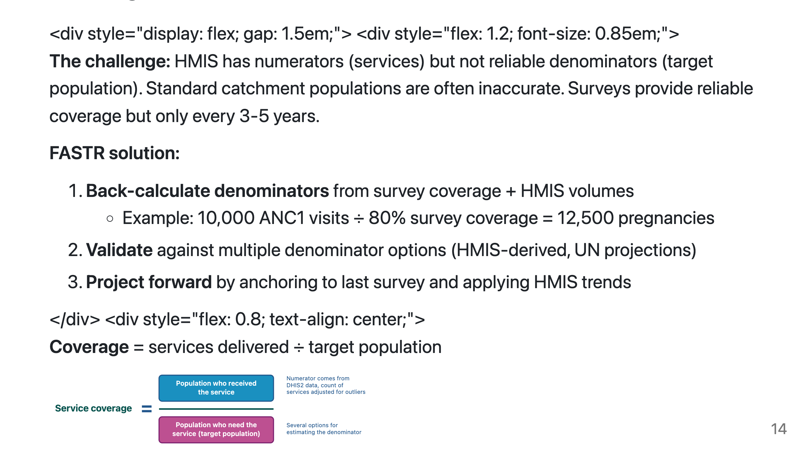
Notes:
PRESENTER NOTES: - Key insight: we can derive denominators from the data itself - Multiple denominator options compared to find best fit with survey benchmarks - Projections extend survey estimates forward using HMIS trends - Result: more reliable, timely coverage estimates for monitoring

Slide 15
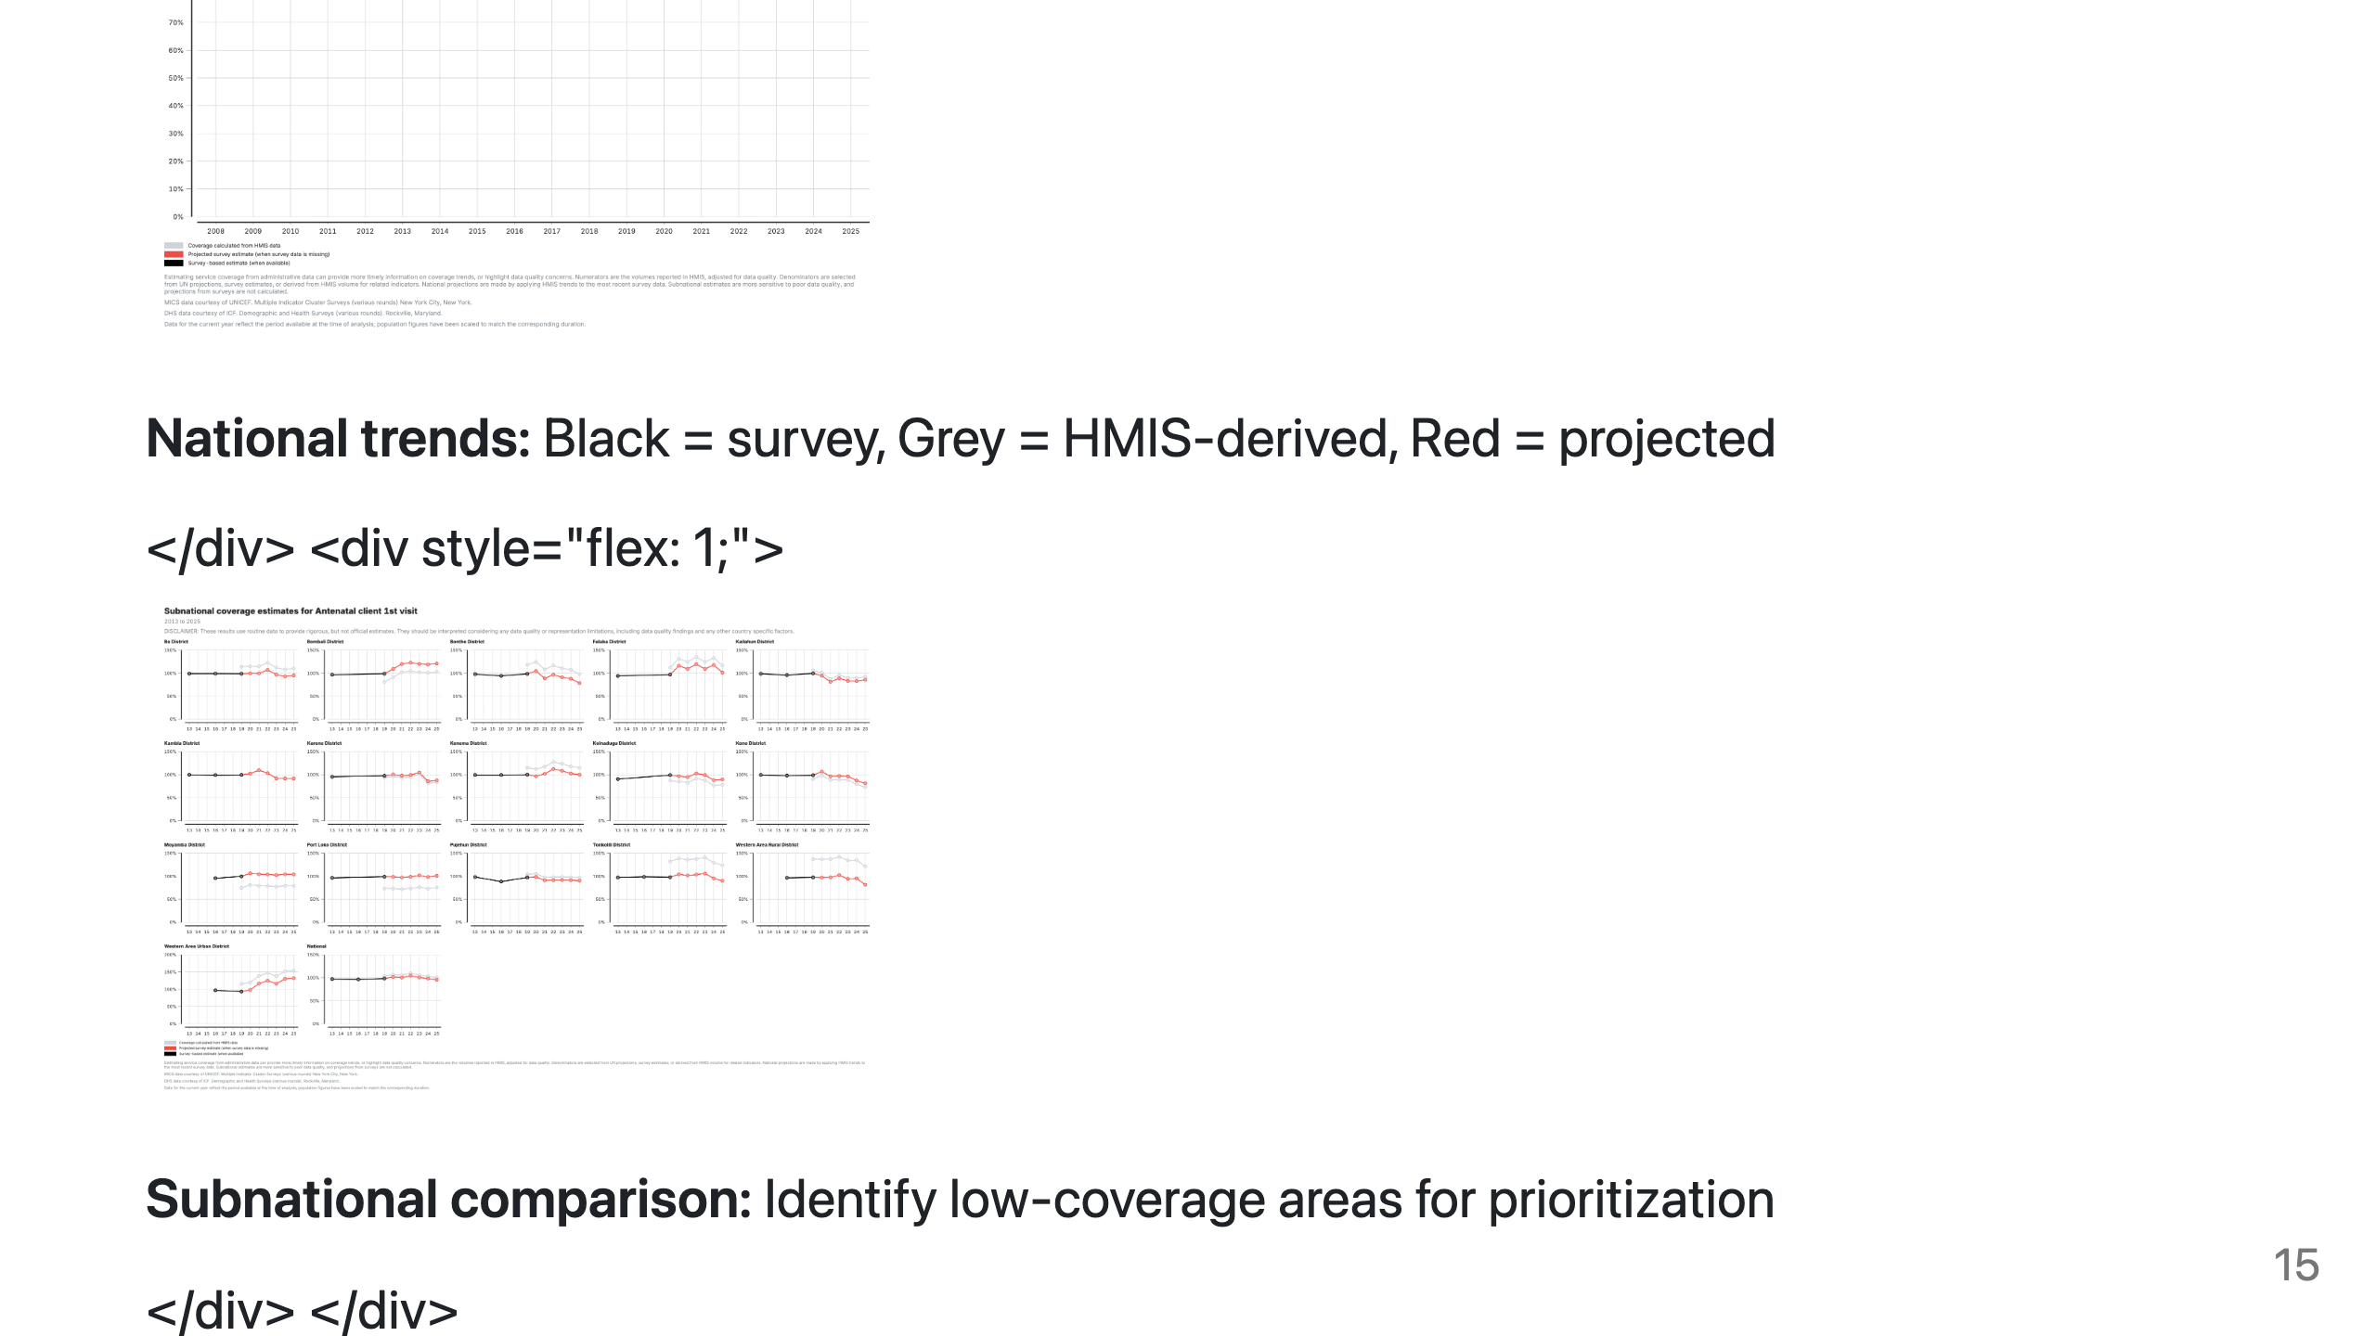
Notes:
PRESENTER NOTES: - Compare grey (HMIS) to black (survey) - gap indicates denominator accuracy - Subnational view identifies geographic disparities for targeting resources - Use these outputs to inform program planning and resource allocation

Slide 16
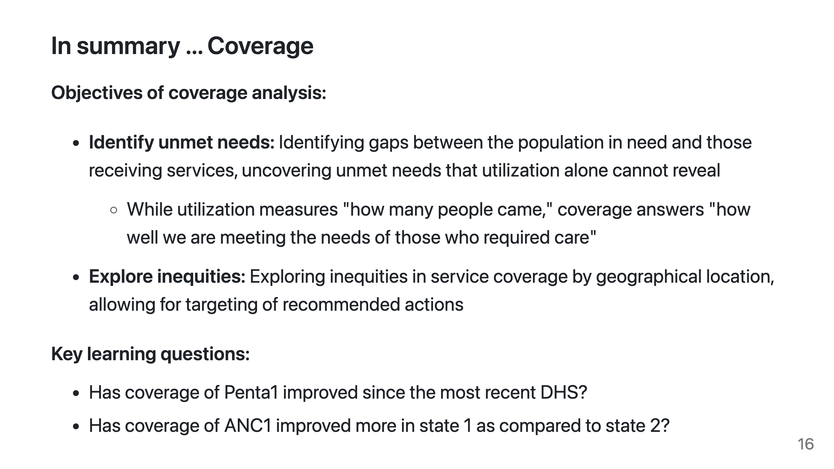
Notes:
PRESENTER NOTES: - Coverage goes beyond utilization to reveal unmet need - Subnational analysis highlights geographic inequities for targeting - Use these questions to guide discussion with stakeholders

