Slide 1
Medical Device Design and Safety (MDDS)
Mechanical Ambu-Bag Ventilator
Presented by:
Fatima Nazir (499916)
Maira Akhtar (493397)

Slide 2
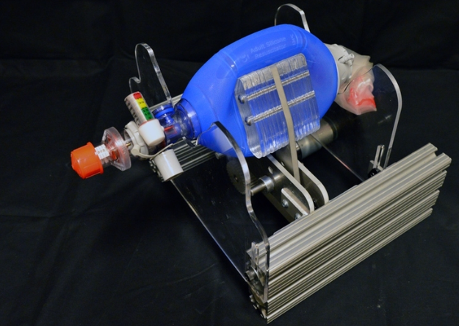
INTRODUCTION
Project Objective: The aim is to design 3D model of mechanical ventilator that automates an Ambu (bag valve mask) bag to assist patients with compromised respiratory function, using a DC motor to convert rotary motion into linear compression.
Design Features: The ventilator is modeled in Fusion 360 with a compact, lightweight plastic frame that minimizes material usage while maintaining structural strength, making it ideal for emergency and low-resource settings.
Pandemic Relevance: The COVID-19 pandemic created a global shortage of ventilators, with 3–26% of patients depending on age and severity requiring mechanical breathing support.
Supply Challenges: Due to supply chain issues and transport restrictions during the pandemic, access to conventional ventilators was limited, prompting the need for affordable alternatives.
Solution Benefits: Automated Ambu-bag ventilators are easy to produce, require minimal training to operate, and free up medical staff for other critical tasks, making them suitable for hospitals and patient transport.

Slide 3
WORKING PRINCIPLE
The working of a Mechanical Ambu-Bag Ventilator involves a DC motor rotating a crank or gear mechanism, which converts rotary motion into linear motion using a slider-crank system. This linear motion compresses the Ambu bag to deliver air into the patient’s lungs. As the arm retracts, the bag refills with air, preparing for the next cycle. This process repeats continuously at a controlled rate to mimic normal breathing.

Slide 4
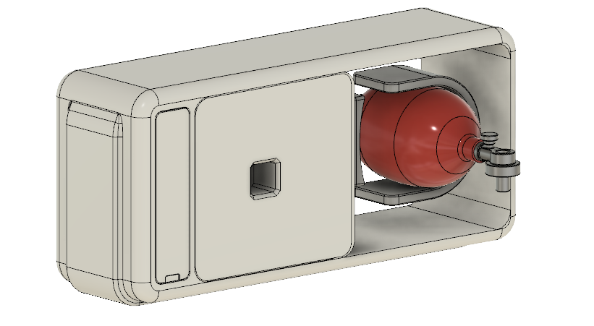
FROM VISION TO VIRTUAL MODEL

Slide 5
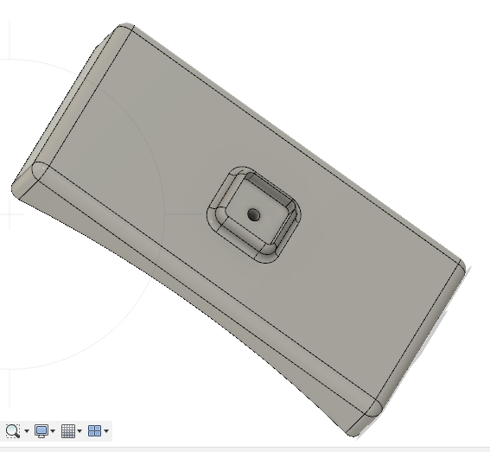
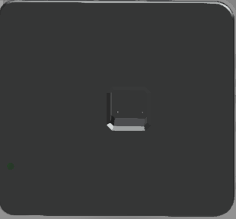
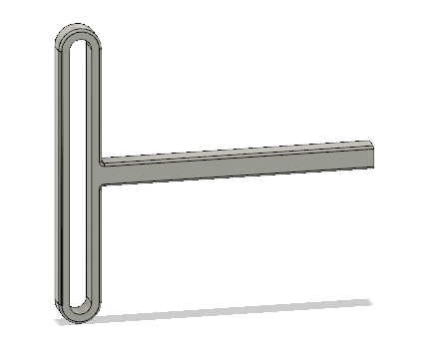
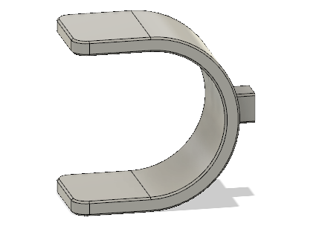
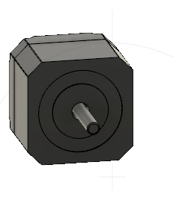
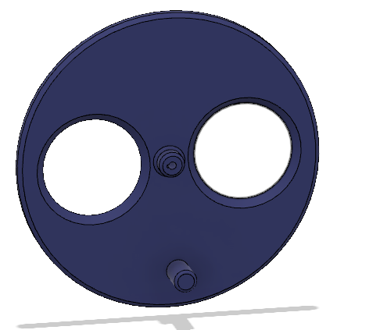
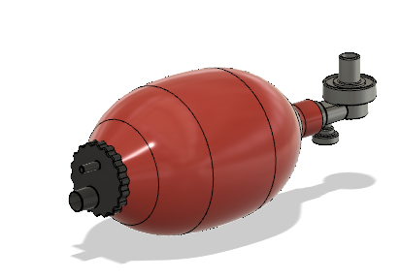
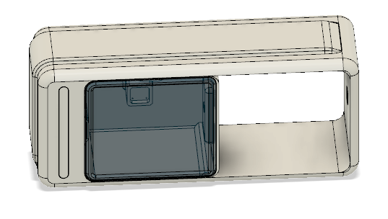
DESIGN BREAKDOWN

Slide 6
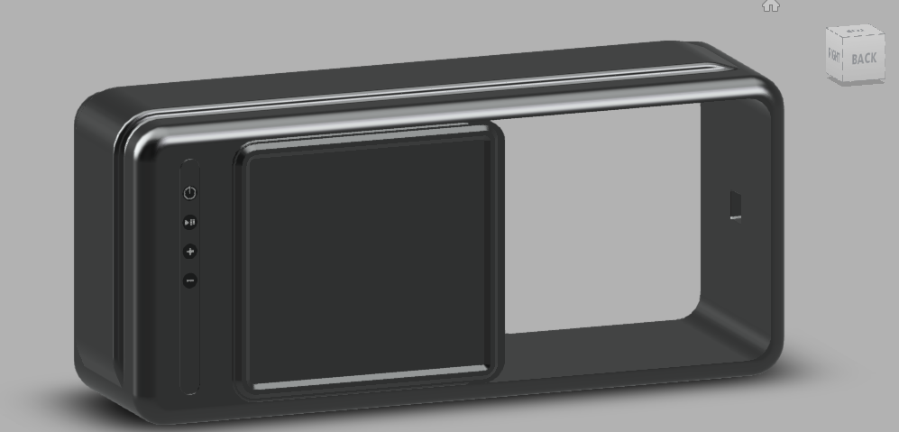
LCD + Buttons + Cover

Slide 7
Ambu Bag Base

Slide 8
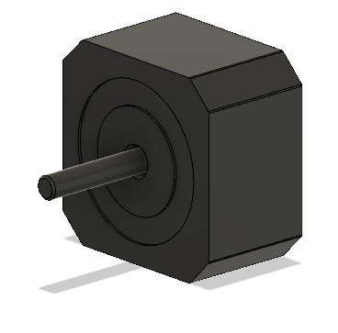
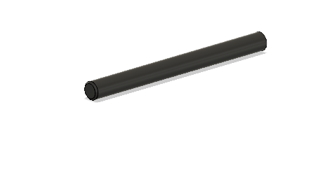
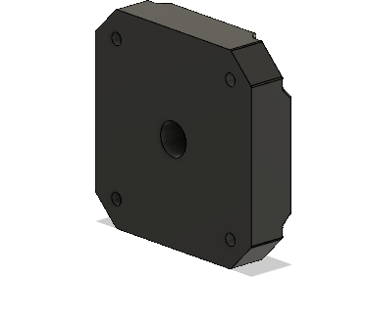
Motor

Slide 9
Pushers Arm
Pusher

Slide 10
Crank Plate

Slide 11
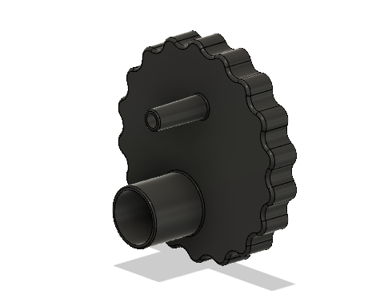
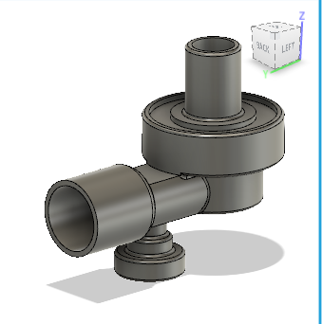
Pump

Slide 12
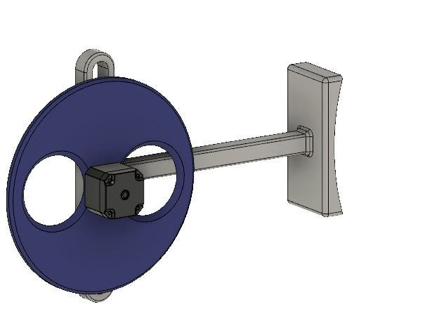
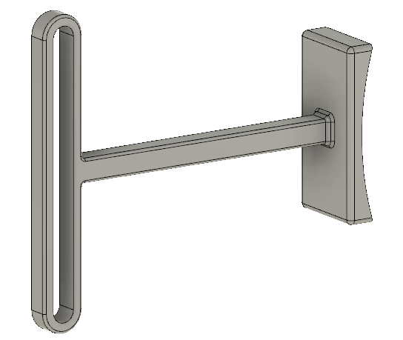
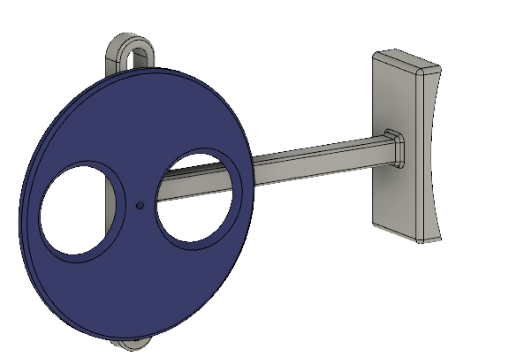
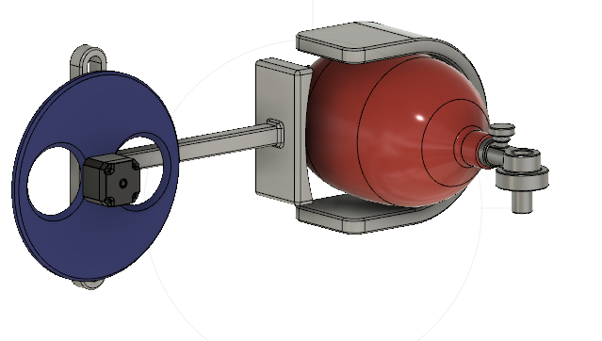
ASSEMBLY

Slide 13
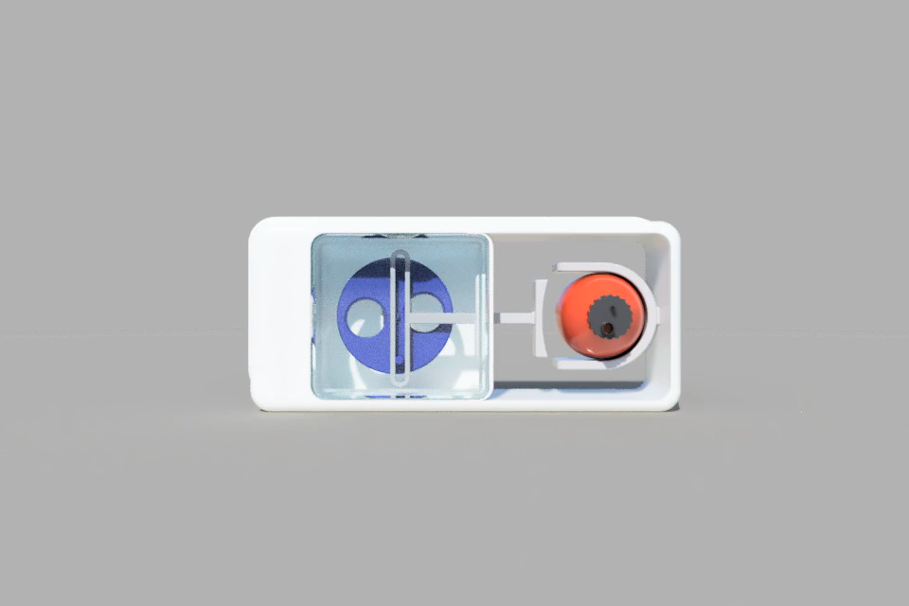
Video

Slide 14

Problem Faced
Assembly Of Moving parts
Animation

Slide 15
Merits | Demerits
Precise Delivery | Limited Load Capacity
Compact and User-Friendly Design | Lack of Automation Feedback
Cost-Effective | Power Dependency
Customizable Flow Rate | Manual Calibration Needed
Visual Clarity Through CAD

Slide 16


