Slide 1

Introduction to databases checkpoint
Réalisée par : Fatma RTIMI

Slide 2
the RDBMS and their functionalities
1) What is a Relational Database (RDBMS)?
2) MySQL
3) PostgreSQL
4) SQL Server
II. A comparison between the three RDBMS

Slide 3
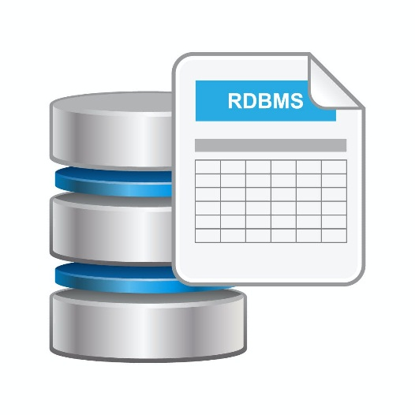
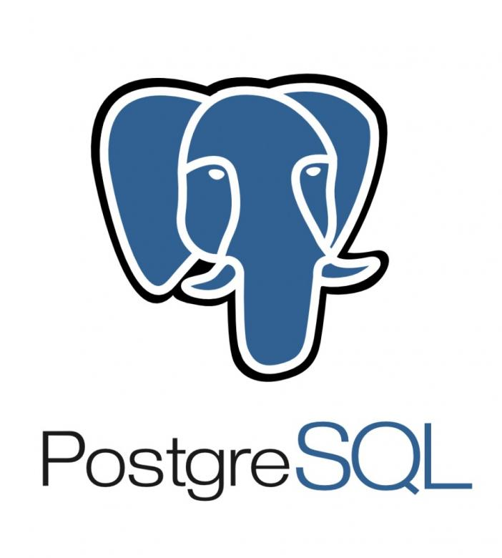
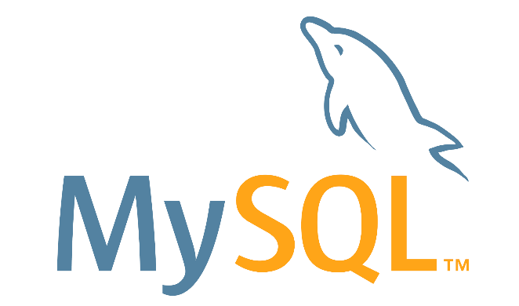
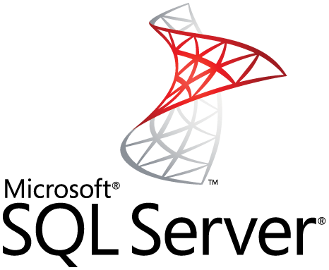
the RDBMS and their functionalities
1) What is a Relational Database (RDBMS)?
(RDBMS): Relational Database Management System
It is a more advanced version of a DBMS system based on the relational model which was introduced by E.F. Codd in 1970 and that allows access to data in a more efficient way.
Examples :

Slide 4
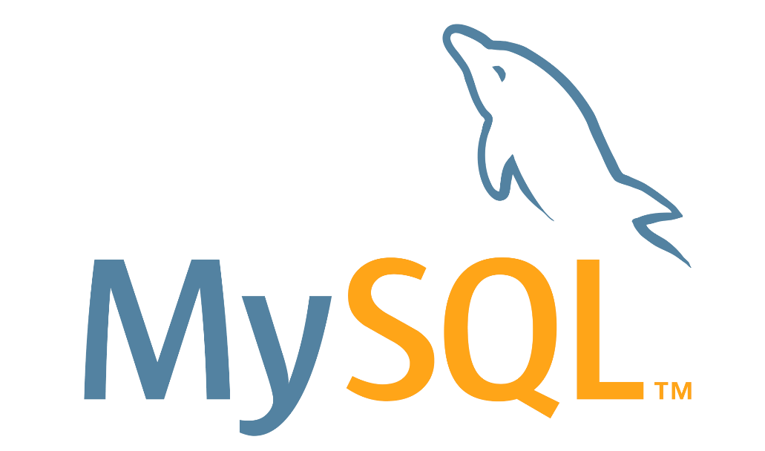
2) MySQL
MySQL is a relational database management system (RDBMS) developed by Oracle that is based on structured query language (SQL). A database is a structured collection of data. It may be anything from a simple shopping list to a picture gallery or a place to hold the vast amounts of information in a corporate network.

Slide 5
3) PostgreSQL
PostgreSQL is an advanced, enterprise class open source relational database that supports both SQL (relational) and JSON (non-relational) querying. ... PostgreSQL is used as the primary data store or data warehouse for many web, mobile, geospatial, and analytics applications. The latest major version is PostgreSQL 12.

Slide 6
4) SQL SERVER
SQL Server is a database management system (DBMS) in SQL language incorporating, among other things, an RDBMS (relational DBMS ") developed and marketed by the Microsoft company. It works on Windows and Linux OS (since March 2016), but it is possible to launch it on Mac OS via Docker, because there is a version for download on the Microsoft website2.

Slide 7

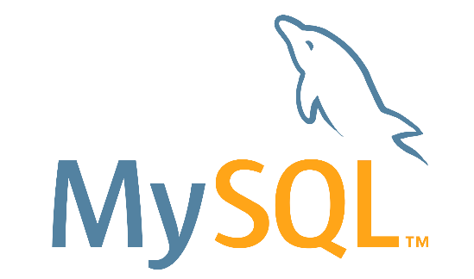

II. A comparison between the three RDBMS
Defragmentation
Overall, MySQL and SQL Server offer more of defragmentation methods that Postgresql does. They consume less CPU and provide more flexible settings.

Slide 8
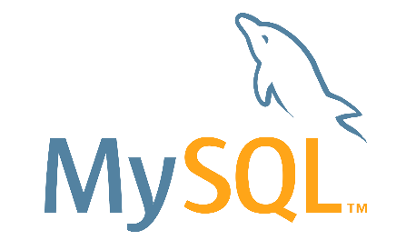

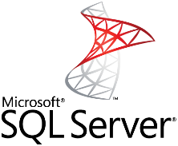

2) Temporary Tables
MySQL offers limited functionality for temporary tables.
PostgreSQL offers a lot more functionality when it comes to temporary content.
SQL Server also offers rich functionality for temporary table management. You can create local and global temporary tables,

Slide 9


3) Data Queries
If your priority is to save computing resources and storage, choose flexible solutions: the choice will be between MySQL vs SQL Server. However, if you prefer clear organization and long-term order, Postgre, with its isolated approach, might be a better fit.

Slide 10




4) Indexes
MySQL organized indexes in tables and clusters. Developers can automatically locate and update indexes in their databases. The search isn’t highly flexible – you can’t search for multiple indexes in a single query.
Postgresql also supports index-based table organization, but the early versions don’t include automated index updates
SQL Server offers rich automated functionality for index management.

Slide 11
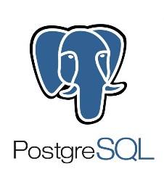


5) Memory-Optimized Tables
For now, MySQL doesn’t come close to making the most out of memory-optimized tables.
PostgreSQL doesn’t support in-memory database creation.
SQL Server uses an optimistic strategy to handle memory-optimized tables, which means they can participate in transactions along with ordinary tables.

Slide 12
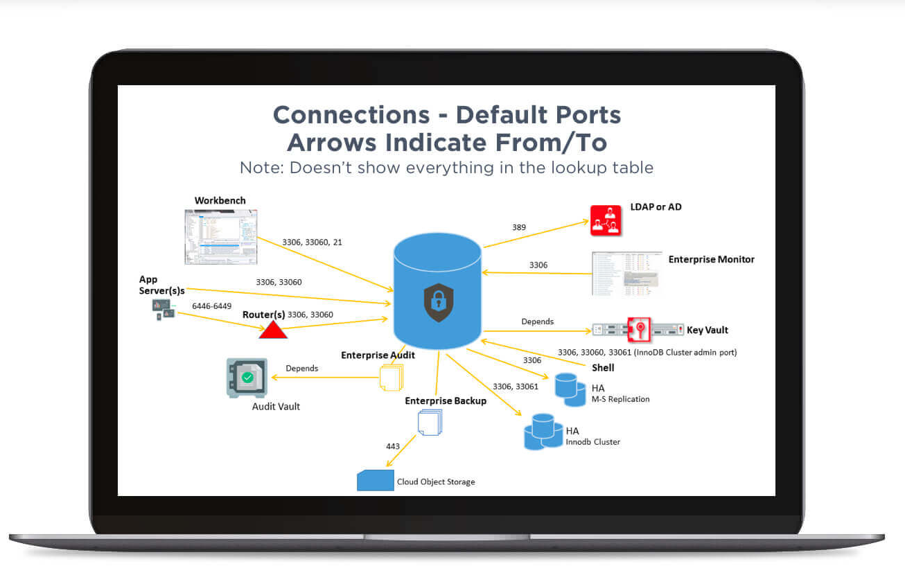
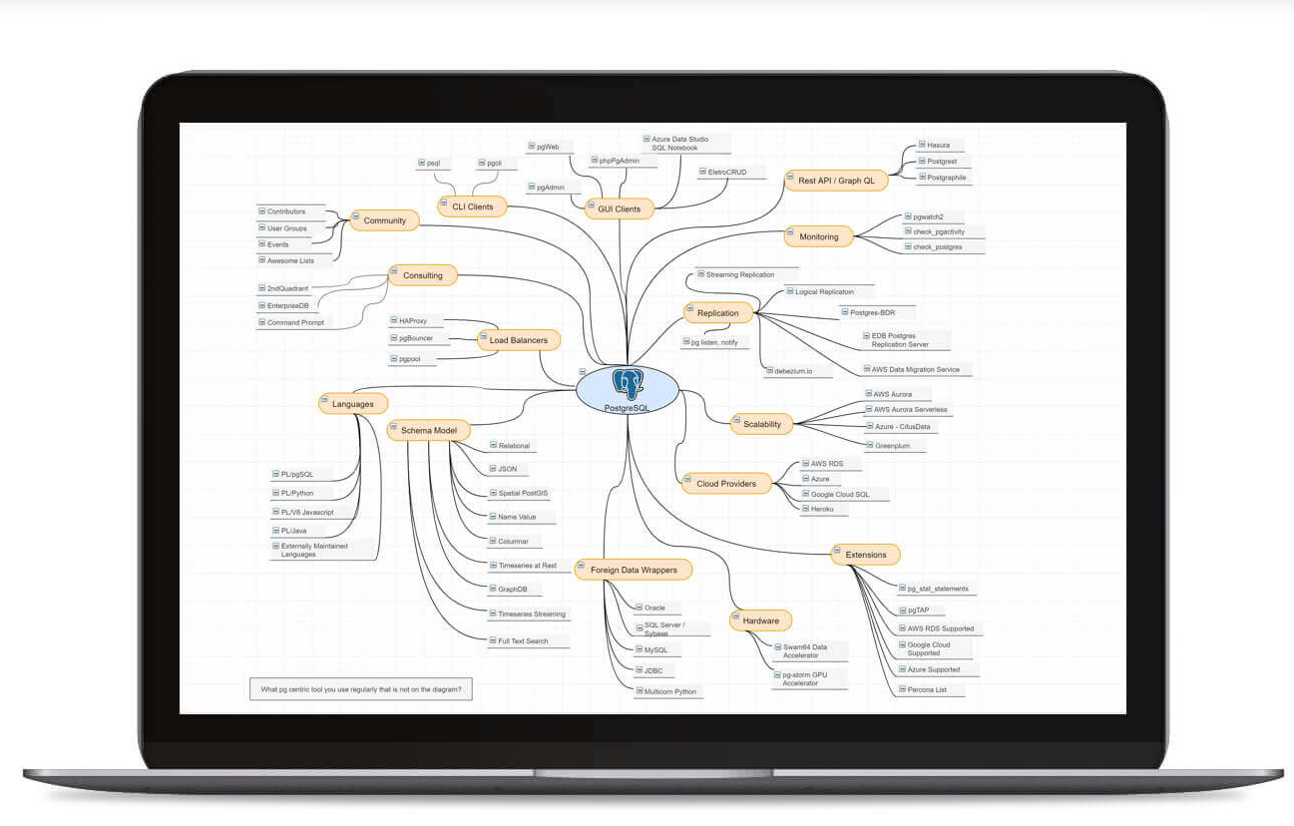
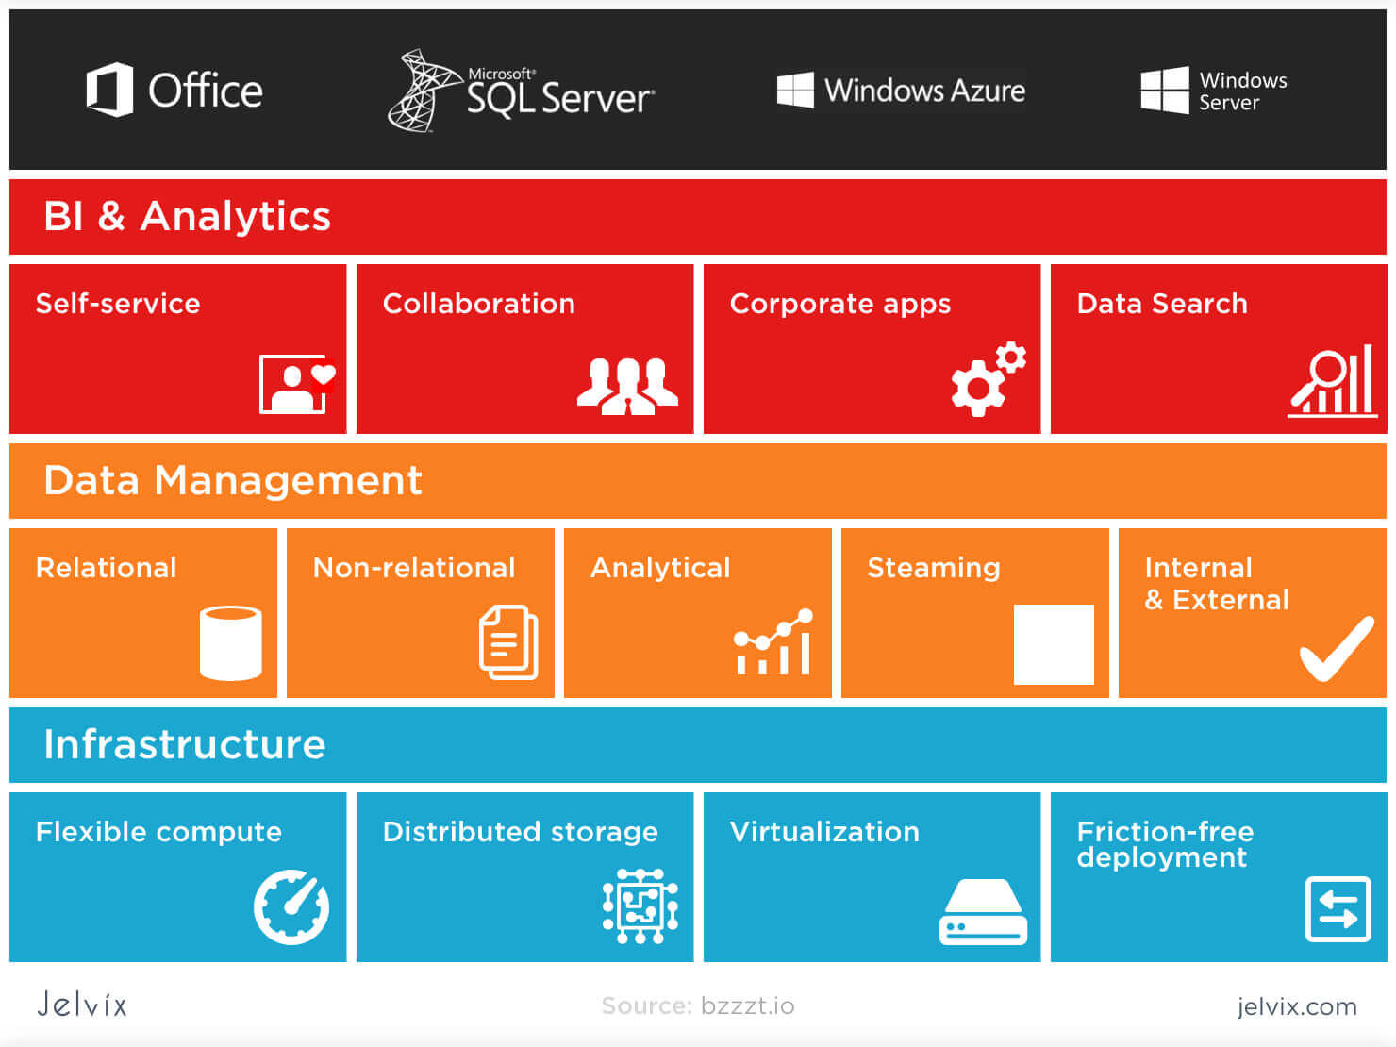
6) Ecosystem
MySQL Ecosystem
PostgerSQL Ecosystem
SQL Server Ecosystem
SQL Server is a commercial one. MySQL is more popular, but SQL Server comes close.

Slide 13
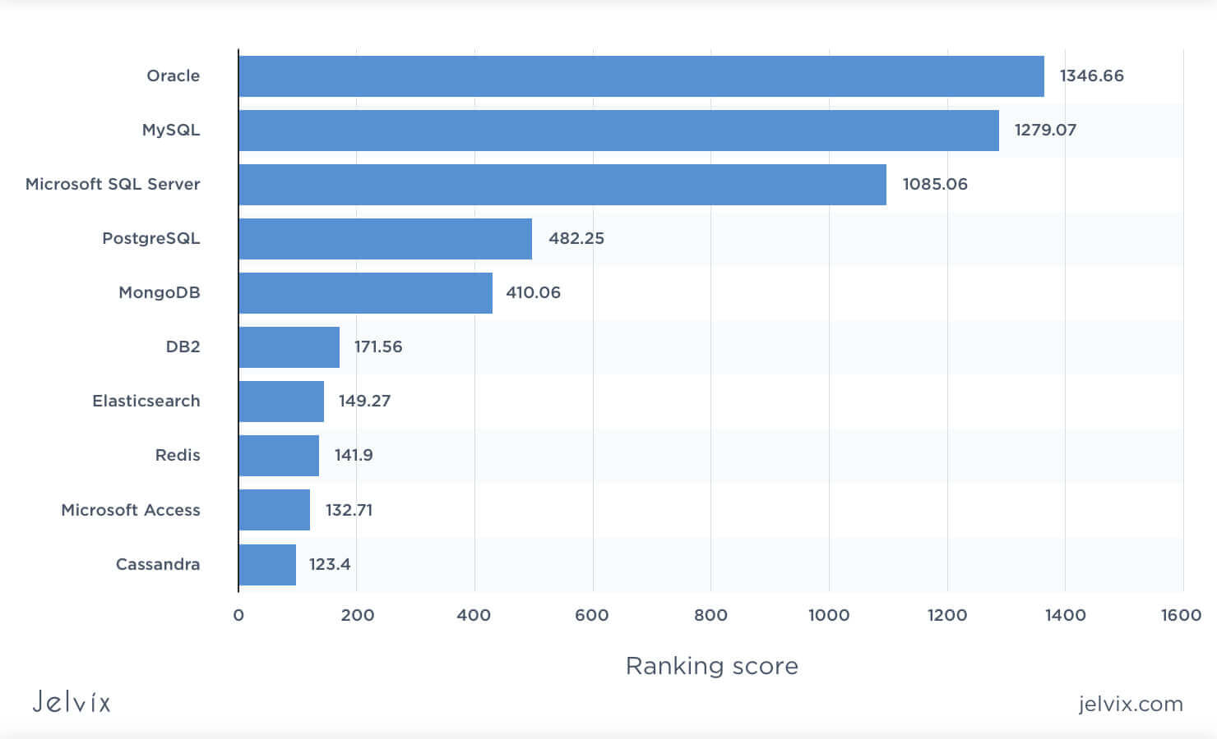

7) Popularity

Slide 14


Conclusion
Flexibility, cost-efficiency and innovation usually choose open-source solutions.
For corporations that prefer traditional commercial solutions (Entreprise projects )

