Slide 1
Checkpoint1
By: Fatma RTIMI

Slide 2

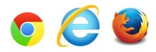
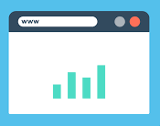



How does the web work?
HTML Codes
<html>
….
</html>
Browser
HTTP Request
INTERNET
HTTP Response
User
Server

Slide 3













What do you need to be a web developer?
Front end
Database
Back end

Slide 4

What do you need to be a web developer?
Self-learning from internet (W3school /stack overflow/ youtube,….)
Strong communication skills
Visual design
Interest in technology
- Choose specialisation
- Learn code and build projects

Slide 5

What is a role of web developper?
- Makes and maintains web sites
- Focus structure and design
- Develops page templates
- Codes HTML, CSS, JavaScript, PHP..
- Creates the database
- Experts in backend and front end developpement

