Slide 1

An LAP Experimental Techniques Ontology
Concepts and Outlook

Slide 2
Introduction
context
Experimenter
Experimenter
selects
pre-designed
interprets
designs
experiment
experiment
experiment
LAPET-Ontologie
NOMAD-OASIS
NOMAD-CAMELS
helps to
FAIR-ready data
interpret
defines
experiment
experiment
LAP-ET: LAP Experimental Techniques
NOMAD-OASIS
NOMAD-CAMELS
FAIR: Findable Accesible Interoperable Reusable
FAIR-ready data

Slide 3
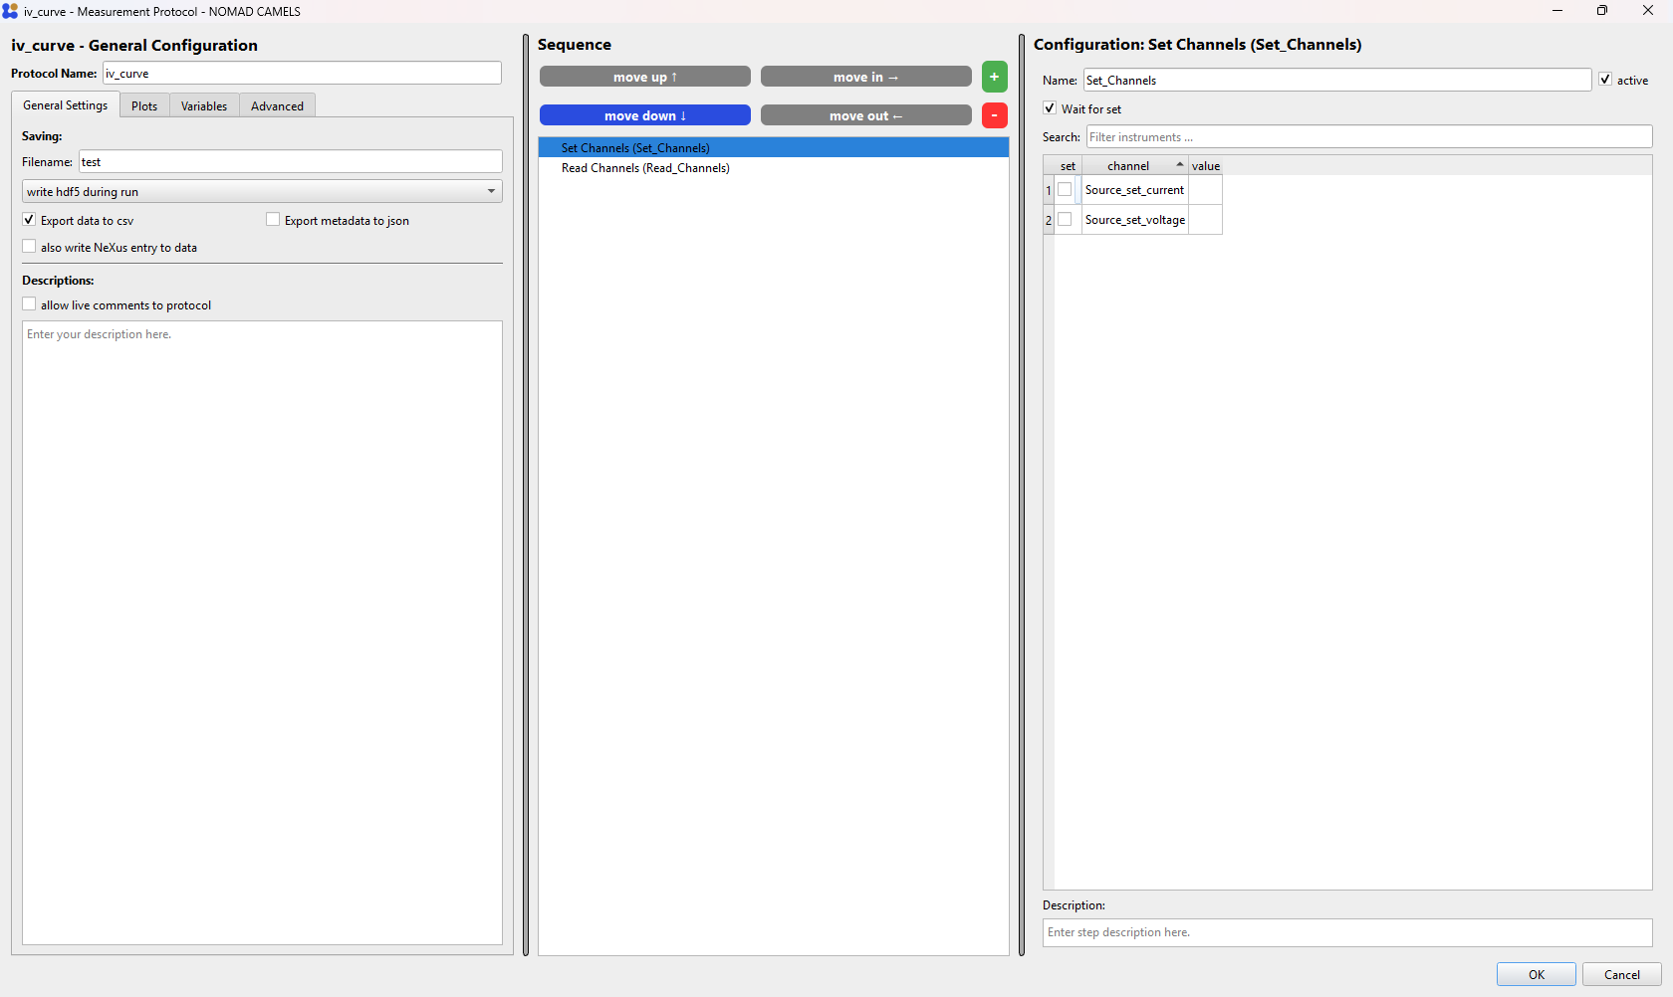
LAPET - Integration
selecting experiment
Ontology
select experiment
>
- IV_experiment
- Hall_experiment
- (…)
select specification
>
- 4-terminal

Slide 4
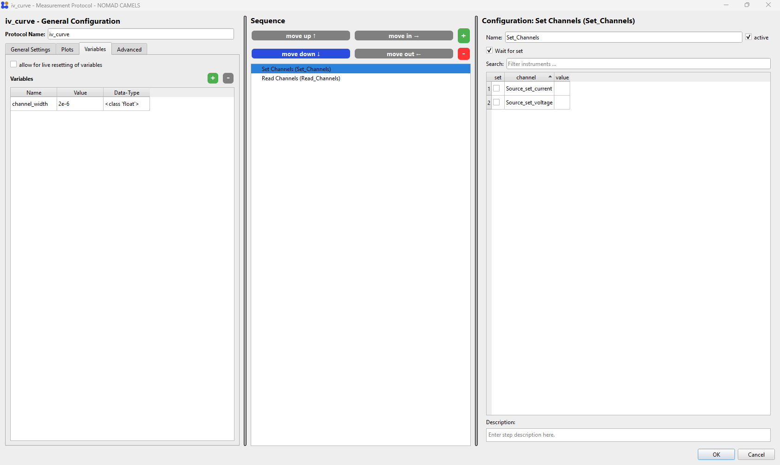
LAPET - Integration
selecting channels
Ontology
Ontology context
Ontology context
>
>
>
Ontology context
>
>
- applied_Hall_voltage
- applied_Hall_current
- channel_width
- (…)

Slide 5
LAP-ET
competency questions
Each experiment has specifications and is related to a pool of physical quantities with semantics fitting the experiment
The User gets to map the Camels channels and variables to these physical quantities
(set channels : ControlVariables, read channels: MeasuredQuantities by default, Camels variables can be Control or Measured)
The selected specification allows for a sanity check
competency questions:
- Which experiments exists at LAP, what is their type, what are their specifications
- For a given specification, which combination of ControlVariables and MeasuredObservables defines it
- show me all datasets for temperature dependent IV experiments (IV experiments with temperature as a ControlVariable)
- show me all datasets for IV experiments performed in the 4-terminal configuration (IV experiments with 4p specification)
GUI user interaction:
1. select experiment and specification
2. map instrument channels and variables

Slide 6
LAP-ET – IV example
Concept
LAPExperiment
ElectricalTransportExperiment
IVExperiment
hasSpecification
MeasurementSpecification
OpticalExperiment
hasControlVariable
hasMeasuredObservable
(…)
PhysicalQuantity
relatesToQuantity

Slide 7
LAP-ET – IV example
Concept
MeasurementSpecification
Variable
ContactGeometry
ElectricalVariable
(…)
MagneticVariable
ThermalVariable
(…)

Slide 8
LAP-ET – Hall example
HallExperiment relatesToQuantity
HallExperiment hasSpecification
4 terminal or Van der Pauw geo. hasControlVariable
device current
4 terminal geometry
device current
applied voltage
6-terminal geometry
applied voltage
longitudinal voltage drop
Van der Pauw geometry
temperature
vertical voltage drop
external magnetic field
temperature
(gate voltage)
external magnetic field
(gate voltage)
4 terminal or Van der Pauw hasMeasuredObservable
device current
applied voltage
temperature
external magnetic field
(gate voltage)
vertical voltage drop

Slide 9
LAP-ET – Hall example
6-terminal geometry hasControlVariable
device current
applied voltage
temperature
external magnetic field
(gate voltage)
6-terminal geometry hasMeasuredObservable
device current
applied voltage
temperature
external magnetic field
(gate voltage)
vertical voltage drop
longitudinal voltage drop

Slide 10
LAP-ET – Hall example
selecting Experiment:
run_Hall : HallExperiment
(UI)
run_Hall hasSpecification 6TerminalConfiguration
(UI)
assigning Channels:
run_Hall hasControlVariable DeviceCurrent
(UI)
run_Hall hasControlVariable ExternalMagneticField
(UI)
set-channels in Camels
run_Hall hasControlVariable Temperature
(UI)
run_Hall measuresObservable DeviceCurrent
(UI)
run_Hall measuresObservable VerticalVoltageDrop
(UI)
read-channels in Camels
run_Hall measuresObservable LongitadinalVoltageDrop
(UI)

