Slide 1

Diversity Dynamics basics and the divDyn R package
Ádám T. Kocsis
Friedrich-Alexander-Universität Erlangen-Nürnberg
2023-08-25

Slide 2
Diversity dynamics
Where, what, why?

Slide 3
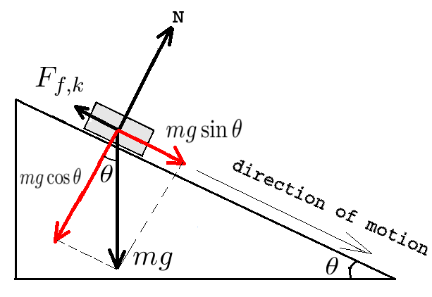
Dynamics?
The study of forcing
What is it?
How does diversity change over time?

Slide 4
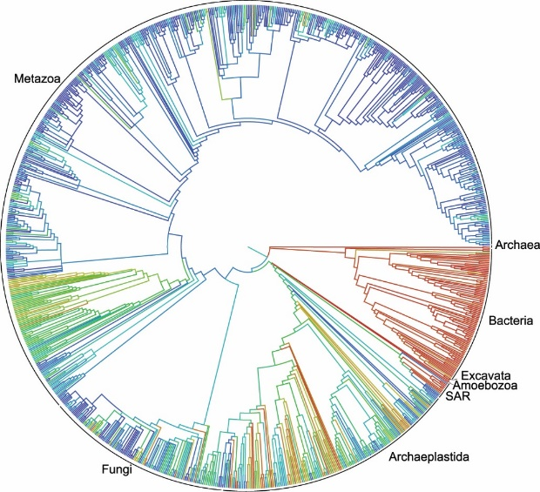
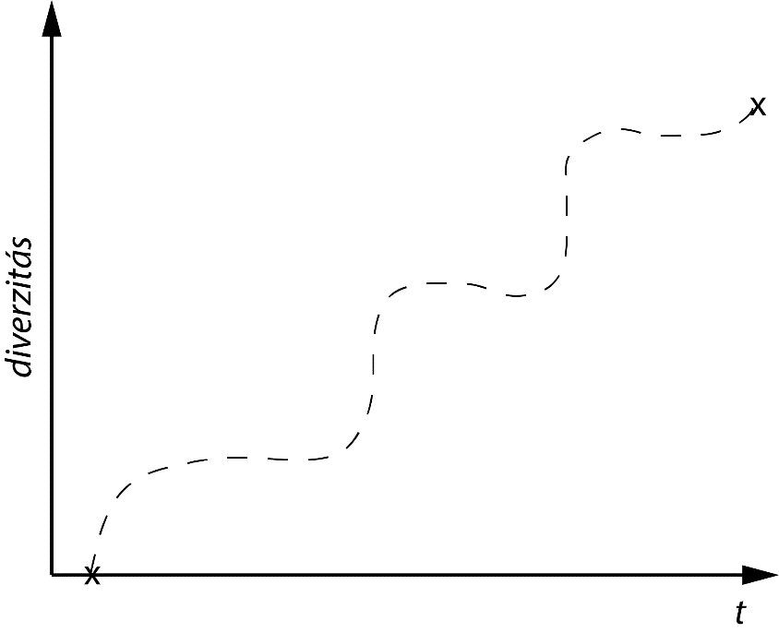
What is the story?
How did we get to today?

Slide 5
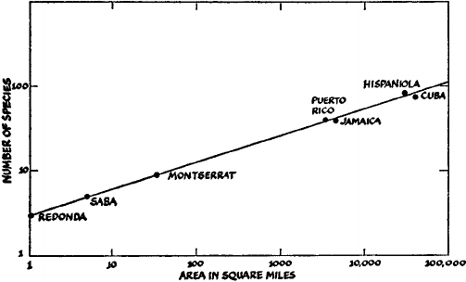
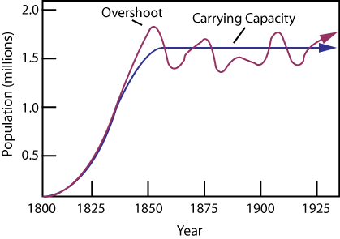


Where is the question coming from?
Malthus – population dynamics: logistic models
McArthur and Wilson (1967) – Island biogeography
x = N/K

Slide 6
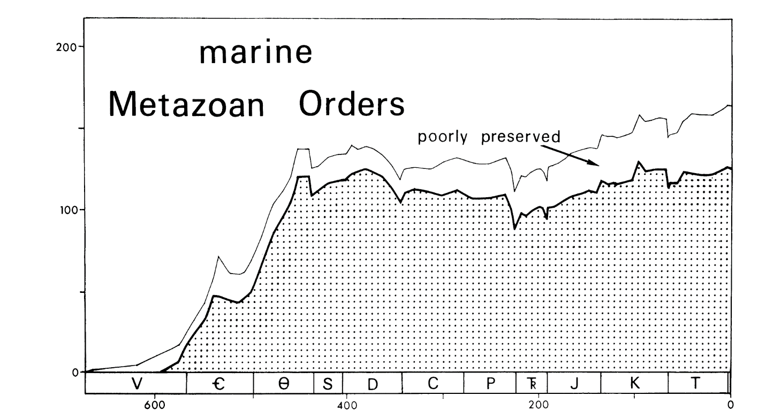
Metazoan orders (Raup and Sepkoski, 1978)
Equilibrium?

Slide 7
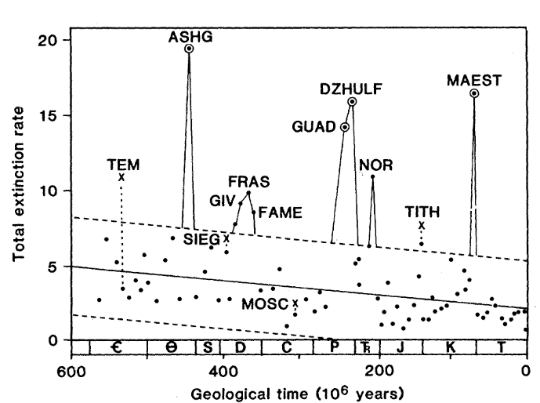
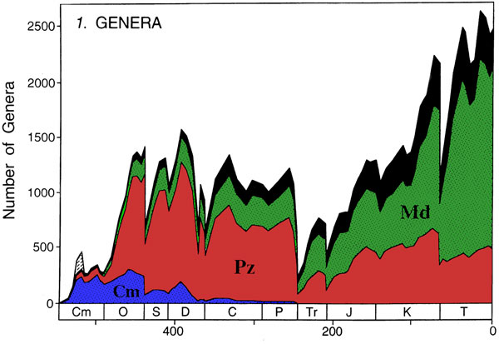
Genera
More complex patterns
Mass extinctions
(Raup and Sepkoski 1982)
Adam Kocsis
Sepkoski (2002 state)

Slide 8
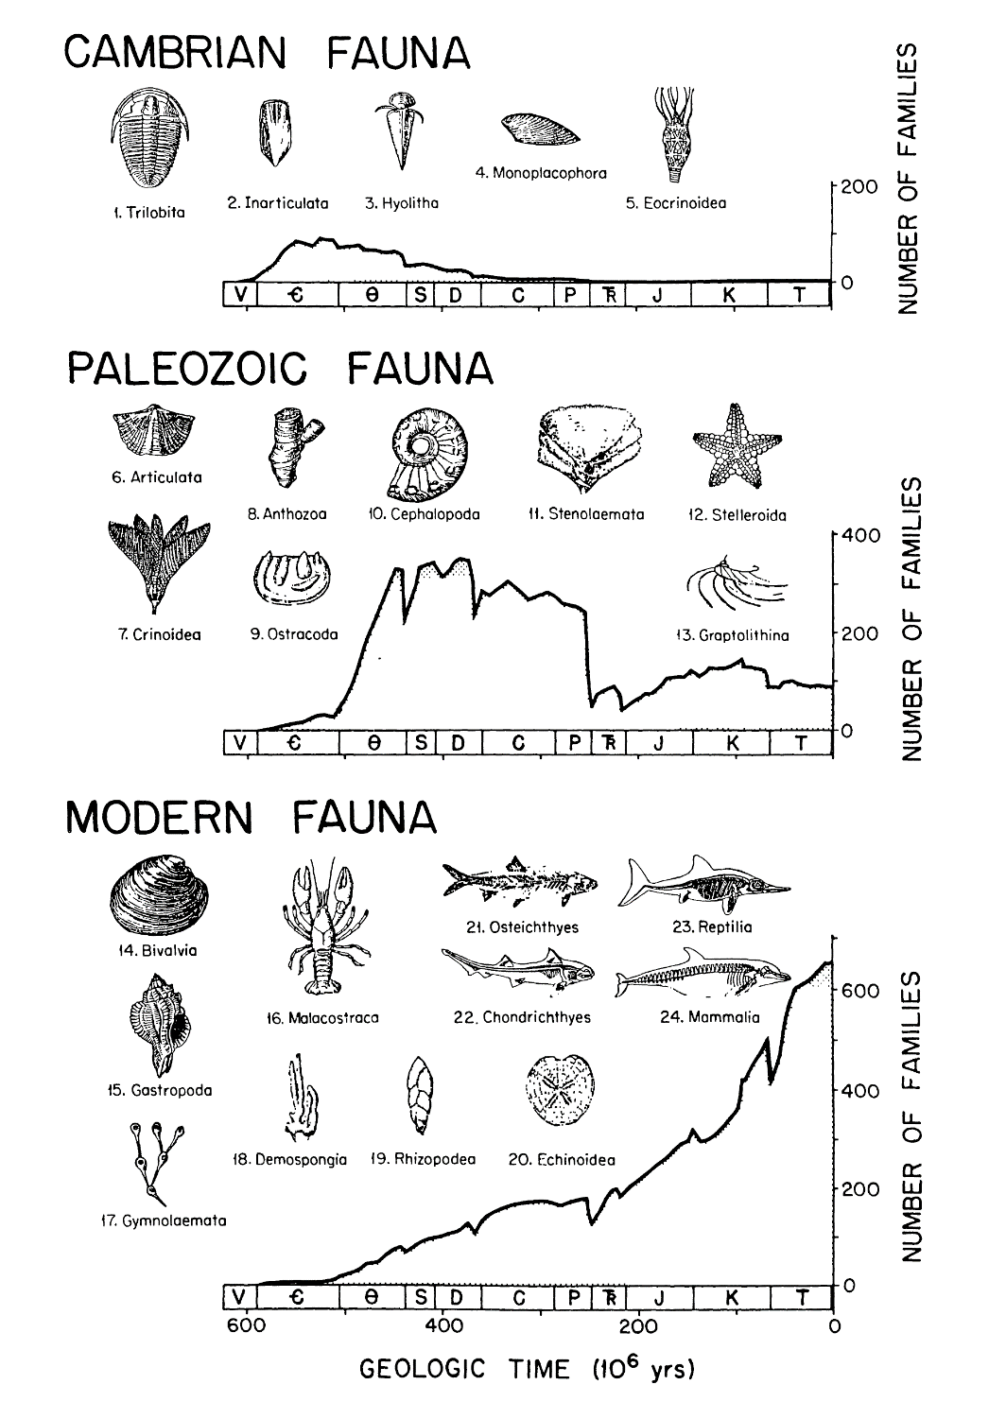
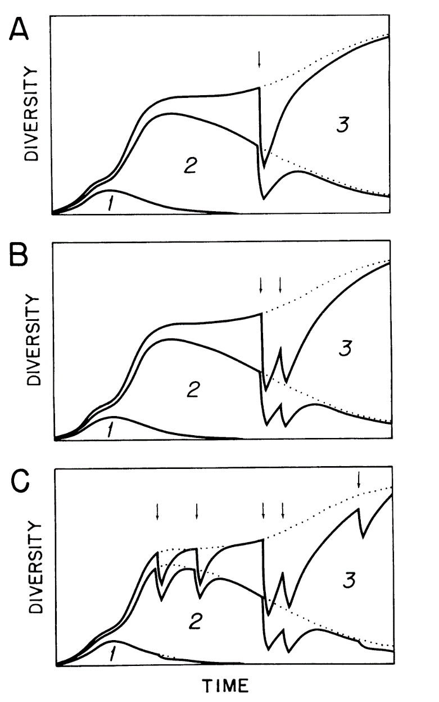
Evolutionary Faunas
Logistic diversification
Sepkoski 1978, 1982, 1984
Groups based on factor analysis of diversity
Simple numeric modelling

Slide 9
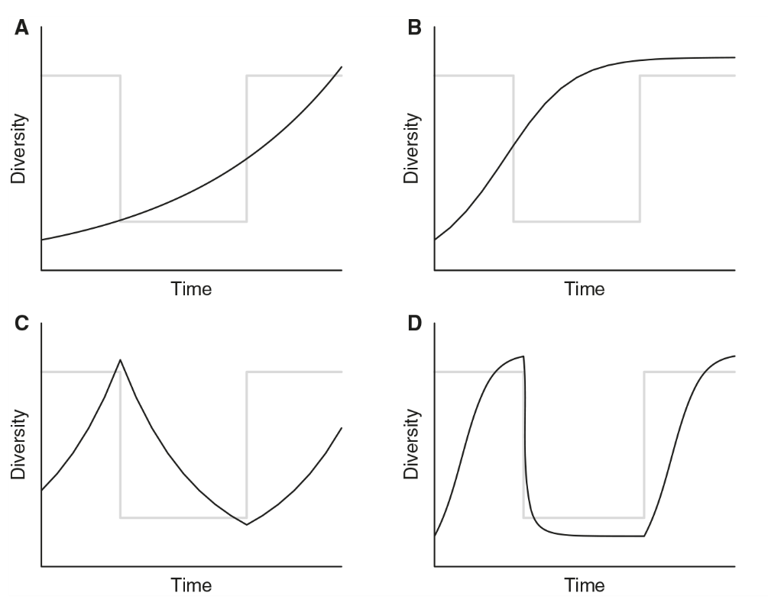


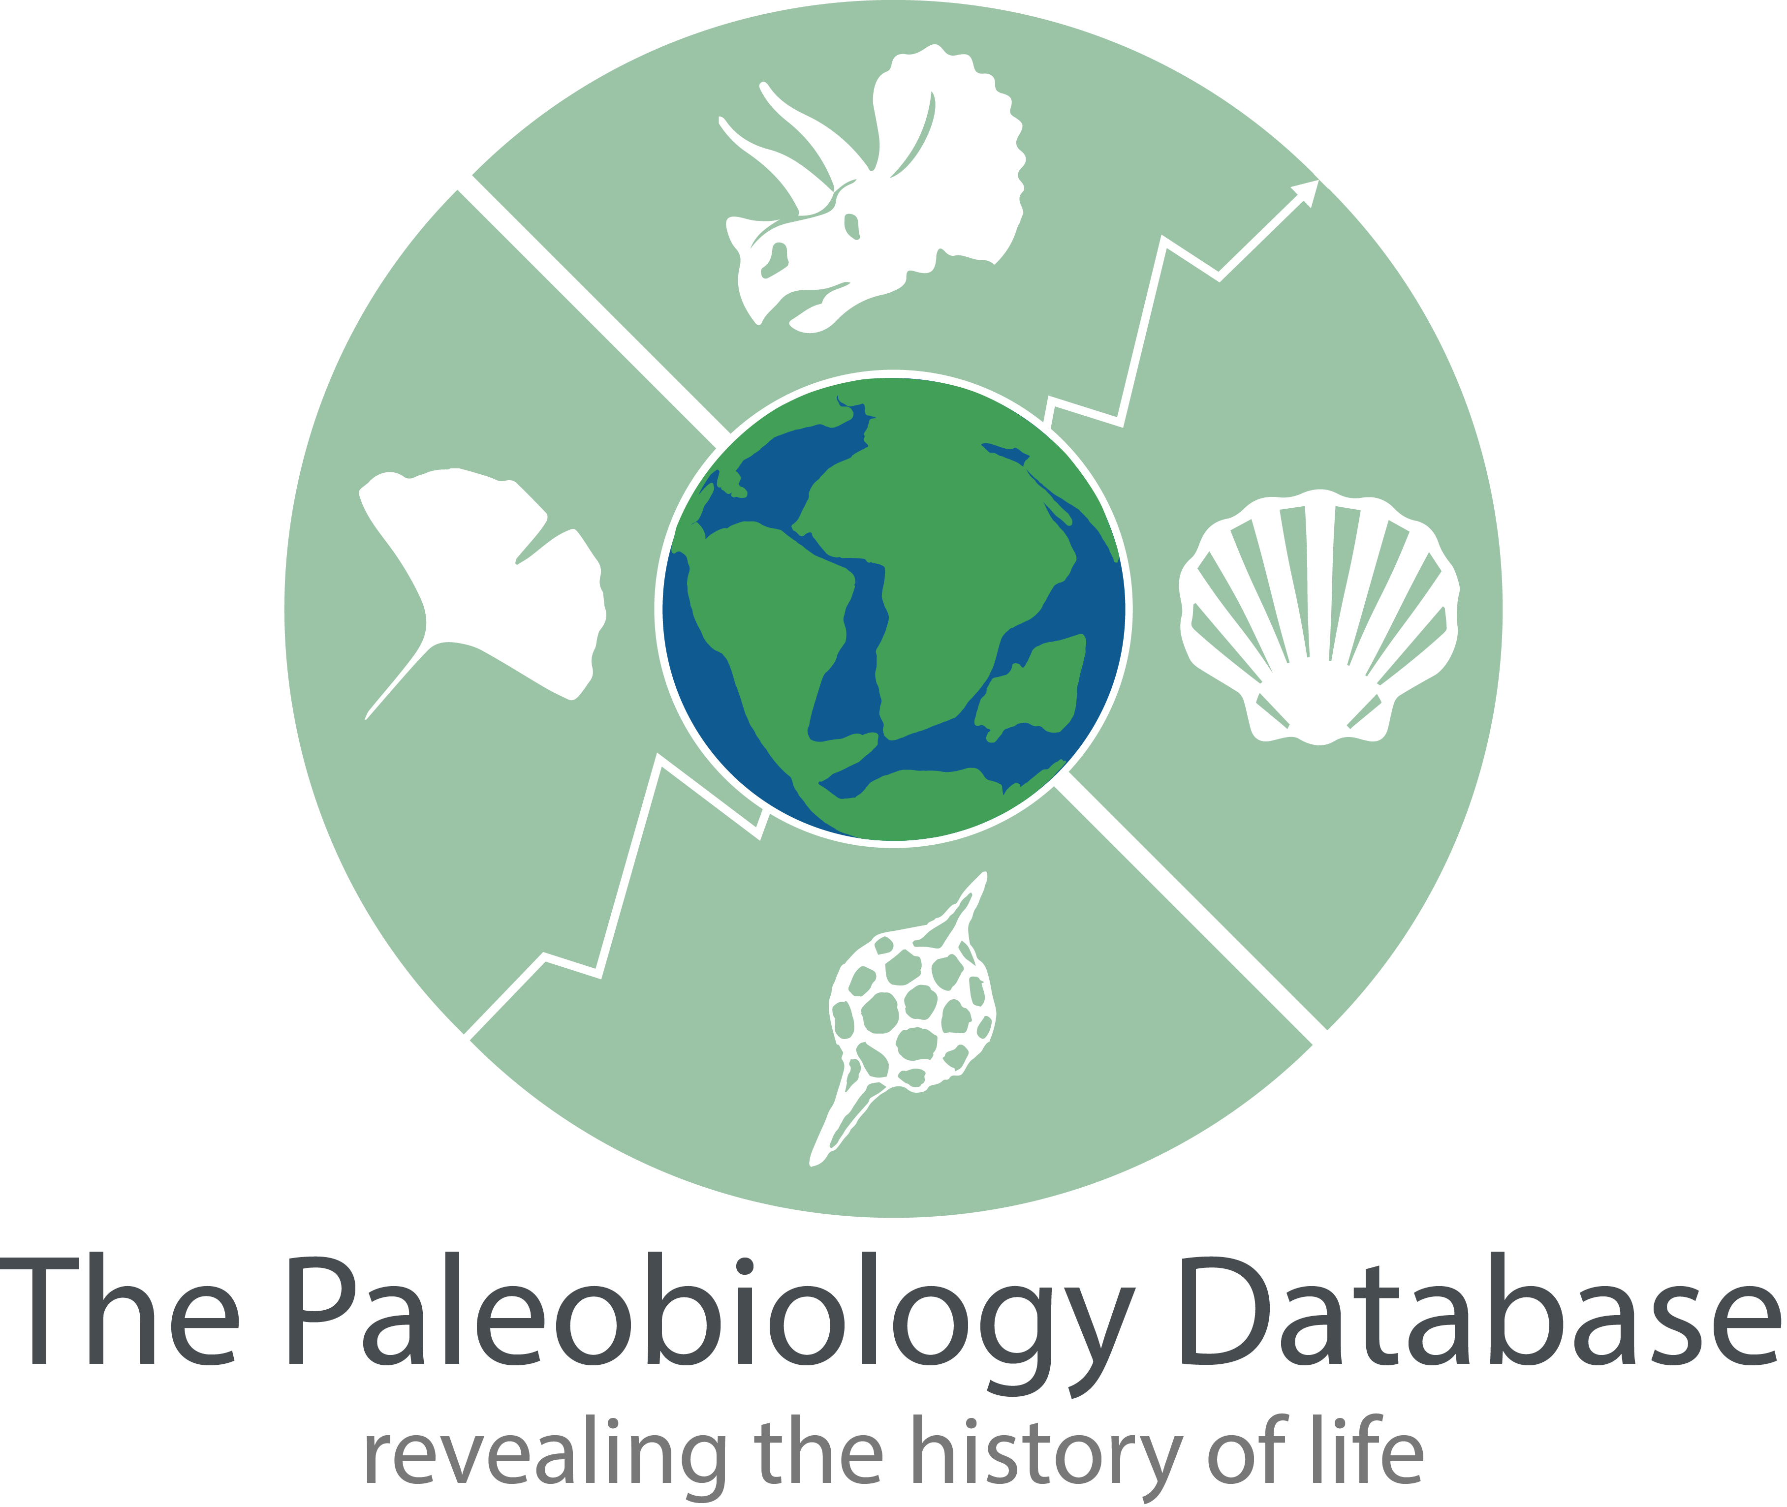
Overall dynamics
Logistic or exponential?
Biotic vs. abiotic controls of diveristy?
Marine Paleofaunal database (Alroy and Marshall 1998)

Slide 10
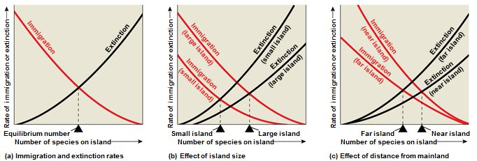
Dynamics in detail: turnover
Equilibrium dynamics in island biogeography

Slide 11
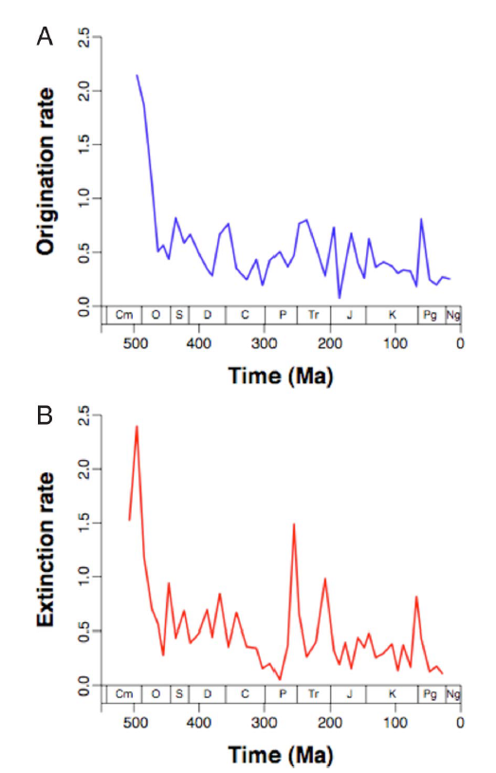
Dynamics in detail: turnover
Dynamics over time?
Additions to taxic diversity
Subtraction from taxic diversity

Slide 12
Metrics of diversity and turnover
Where, what, why?

Slide 13
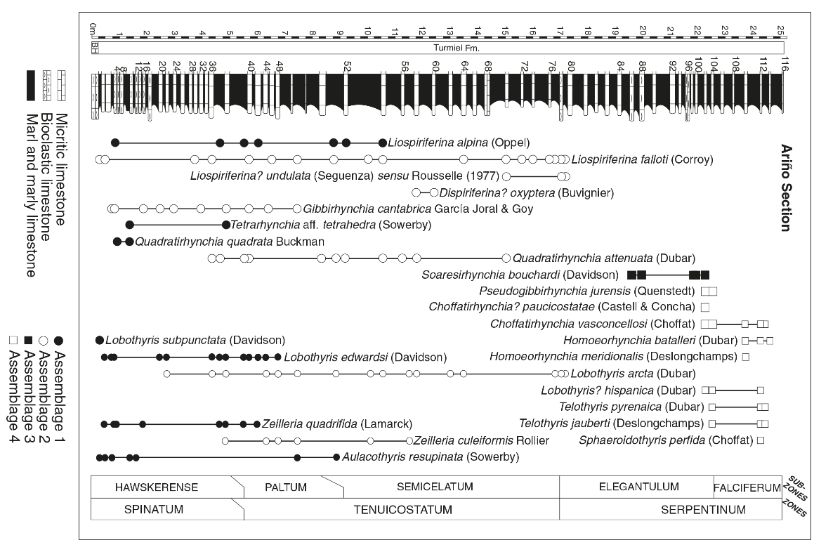
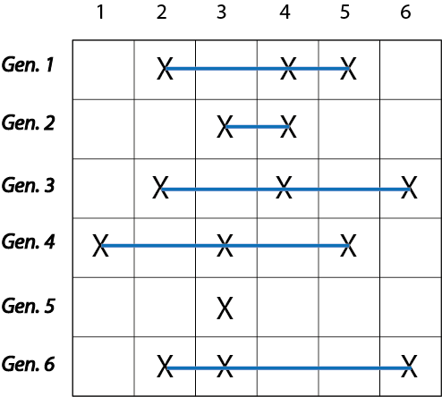
From original data...
Source data
Temporal binning
Summary matrix

Slide 14
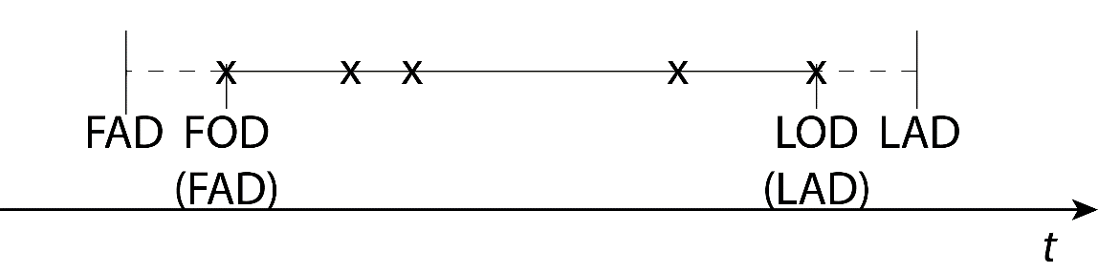
… to metrics
Time of origination
Time of extinction
RT
1
4
6
5
4
2
*SIB
3
4
3
2
2
The range-through (RT) assumption
1
*sampled-in-bin

Slide 15
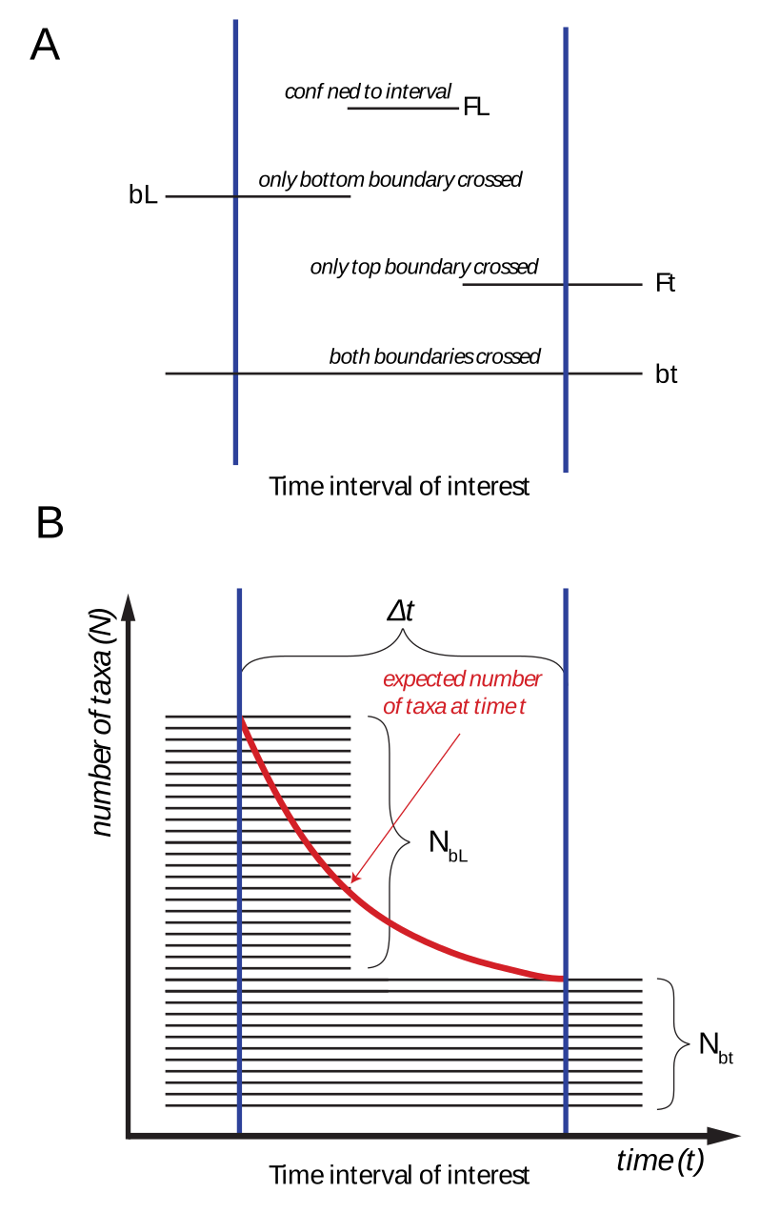
Range-based methods
The per capita rates: categories (Foote, 2000)

Slide 16
Range-based methods
The per capita rates: idea (extinction)
We do not know the precise date of extinction
We assume a constant chance for species to go extinct in the bin
The extinction rate becomes
- log(NbL / Nbt + NbL) / Δt

Slide 17
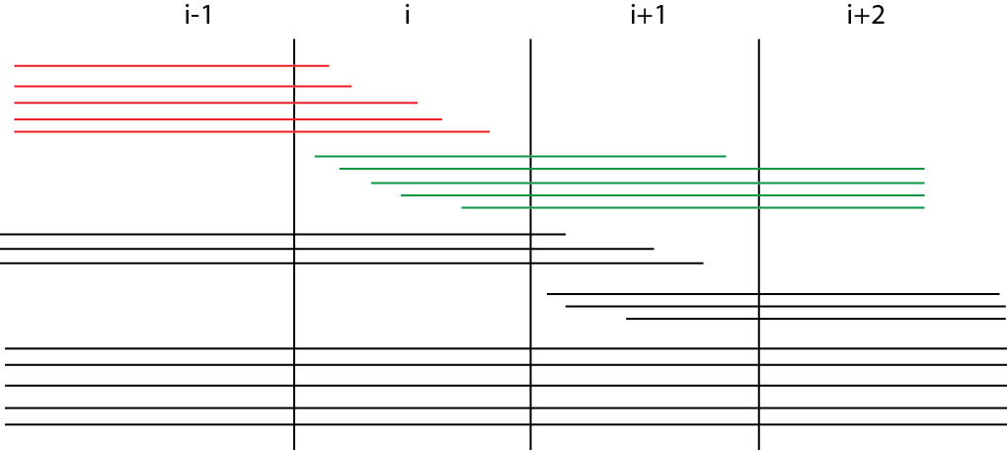
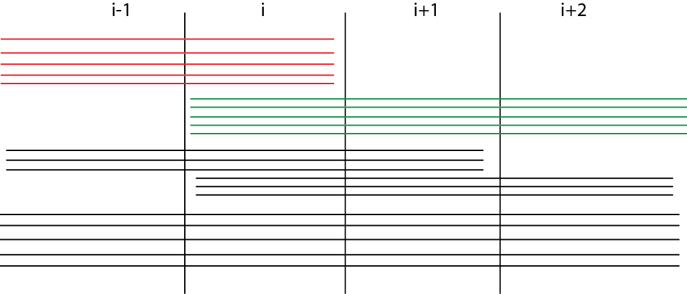
Time bins
Distribution of turnover
Continuous turnover
- log(NbL / Nbt + NbL) / Δt
Pulsed turnover
- log(NbL / Nbt + NbL)
Based on (Foote 2005)
Adam Kocsis

Slide 18
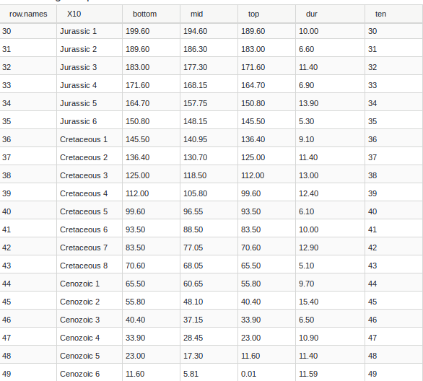
Time bins
Distribution of turnover
Stages vary quite much (95-bin time scale)
The 10/11My time scale of the PBDB (49-bin time scale)
Coarser, weaker filter on stratigraphy

Slide 19
Range-based methods
The record is gappy!
Overall gappiness (Paul 1982):
sampling events vs. opportunities

Slide 20
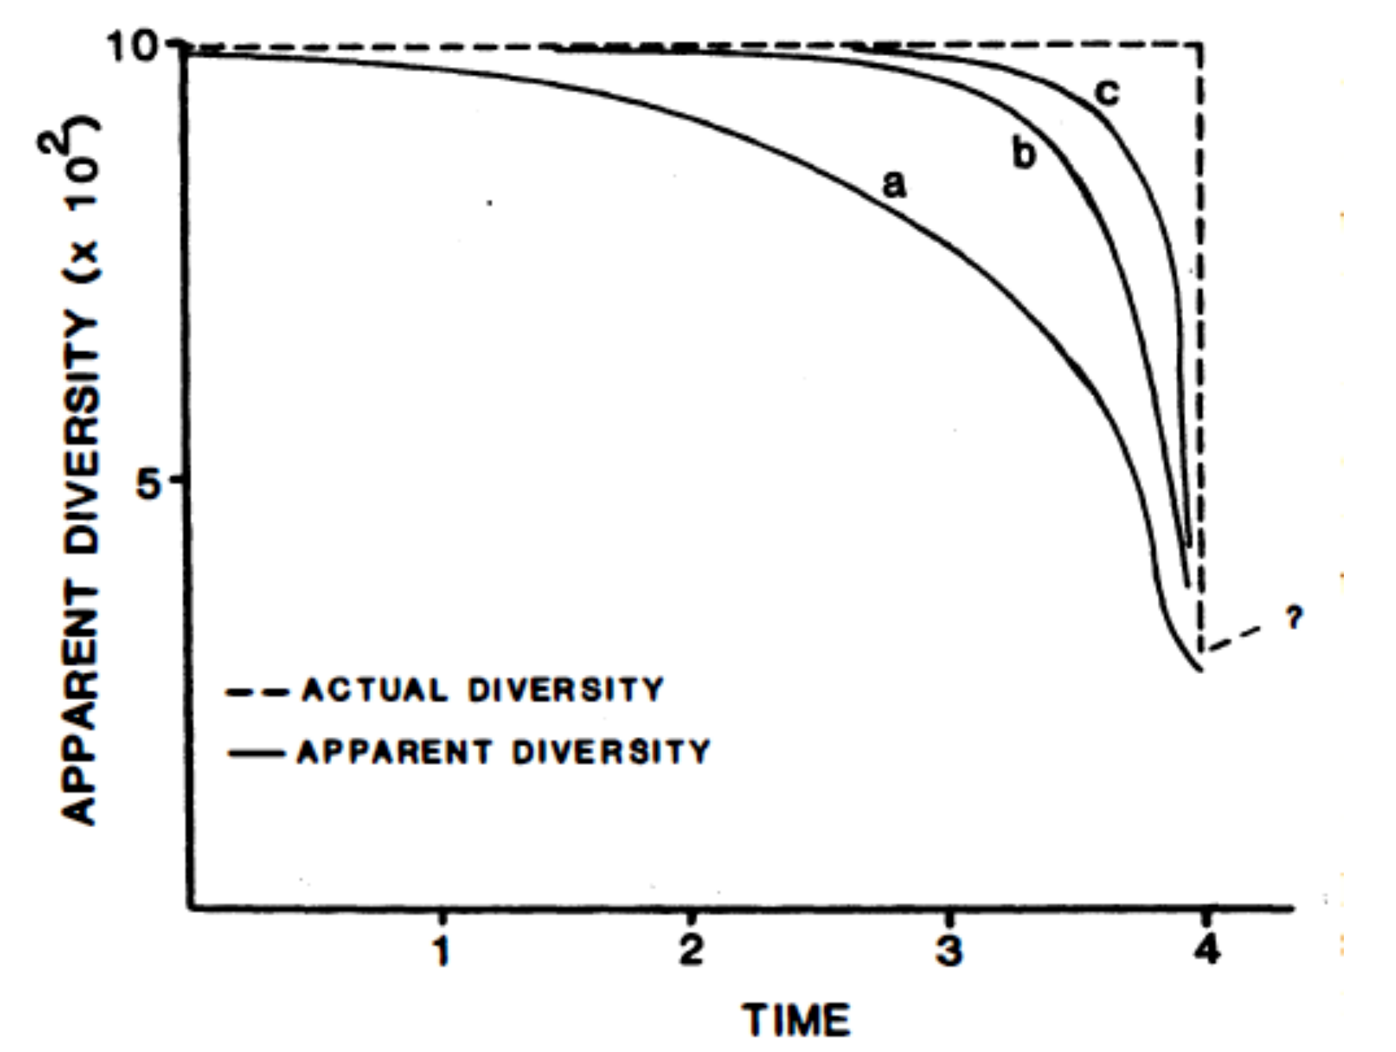
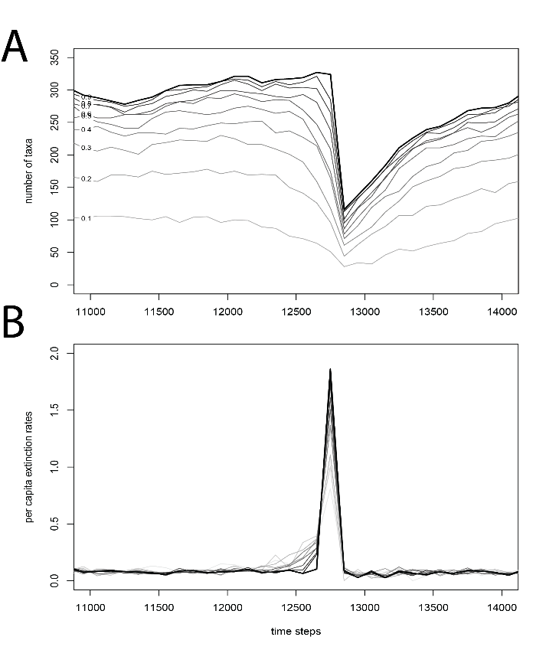
Range-based methods
Issues: The Signor-Lipps effect (1982)
Number of taxa
Extinctions

Slide 21
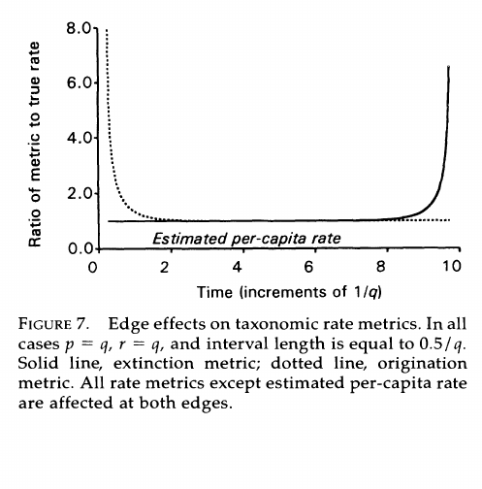
Range-based methods
Issues: Edge effects (Foote 2000)
Extinction increases towards the end
Origination increases towards the beginning
+ The Pull of the Recent (abnormally good preservation at the end increases diversity and dampens extinction in recent organisms included)

Slide 22
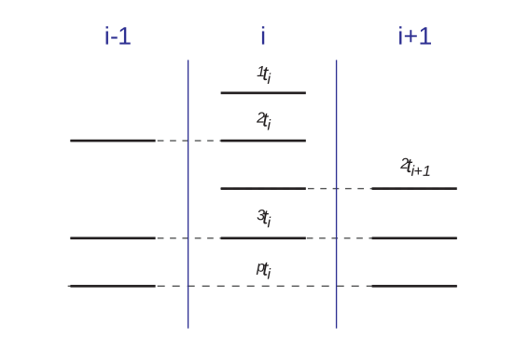
Incidence-based methods
John Alroy’s idea: use a moving window
¹ti: single interval pattern
²ti:lower two-timer pattern
²ti+1: upper two-timer pattern
³ti: three-timer pattern
^{p}ti: part-timer pattern

Slide 23
Incidence-based methods
John Alroy’s idea: use a moving window
log(²ti/³ti): extinction rate
log(²ti+i/³ti): origination rate
³ti/(³ti + ^{p}ti): three-timer sampling completeness
Corrected SIB: SIB / ³ti/(³ti + ^{p}ti)

Slide 24
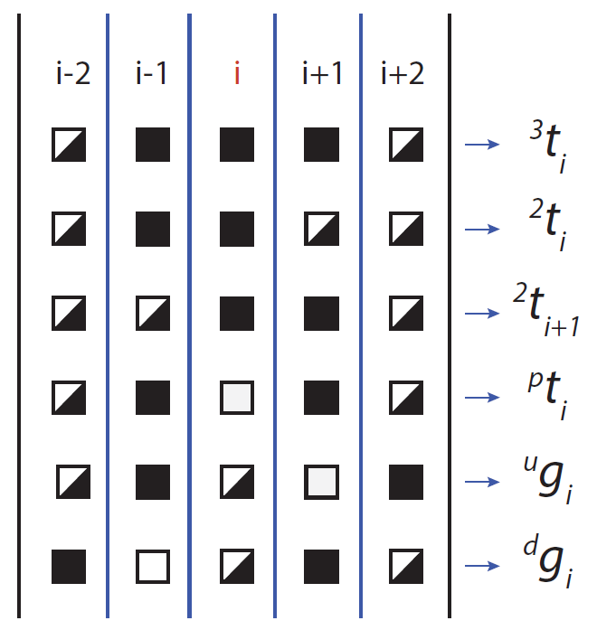
Incidence-based methods
John Alroy’s idea: use a moving window
3 Major updates
  Corrected three-timer rates (Alroy 2008)
  Gap-filler rates (Alroy 2014)
  2nd-for 3rd substitution rates Alroy (2015)

Slide 25
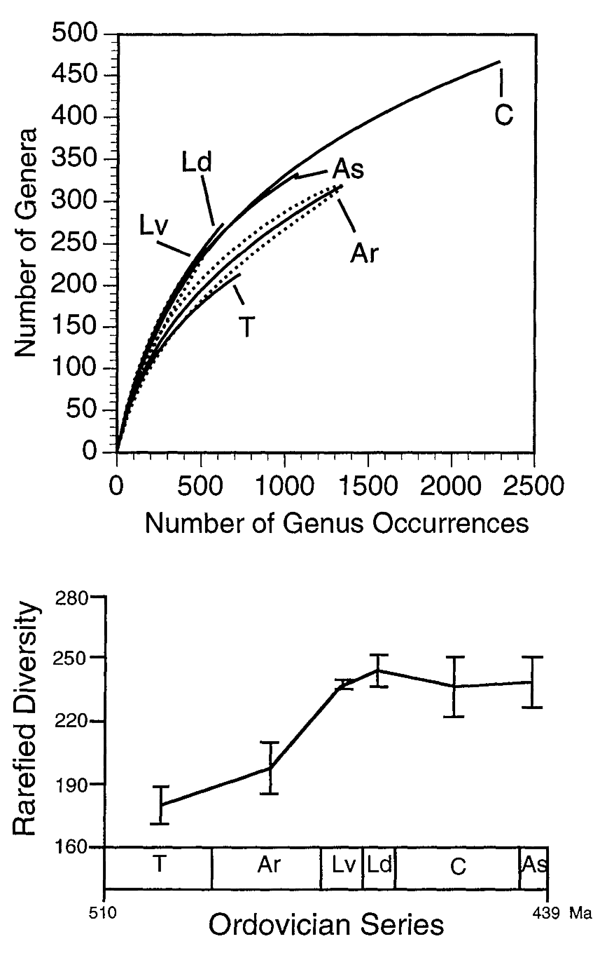
Subsampling
The metrics account for issues due to random sampling
Sampling change from one bin to bin
How do the patterns look like, when the sampling intensity is equal?
Use it as a sensitivity analysis tool! Does it affect your hypothesis?
Miller and Foote (1996)

Slide 26
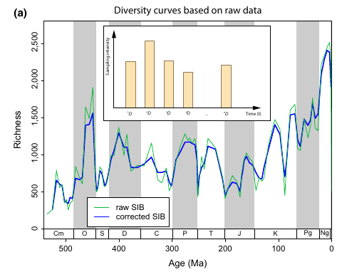
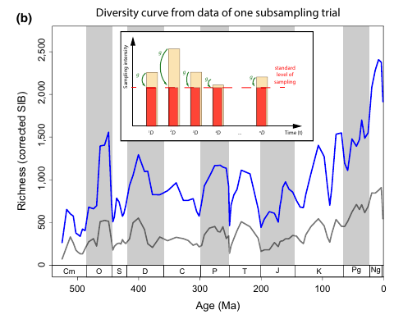
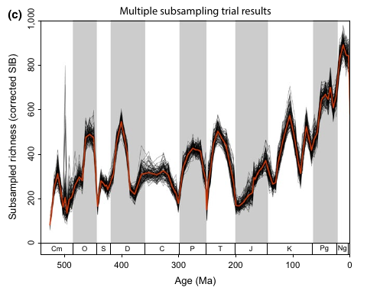
Subsampling: example
Calculating diversity
The methods depend on the entire dataset!
One replicate is based on combination of data from multiple bins

Slide 27
Adam’s impressions
John Alroy’s idea: use a moving window to get rid smearing
The methods converge with perfect sampling!
Use per-capita rates for initial analysis, they conserve the most information
The Three-time approach is designed to be less affected by smearing effects, use the most up-to-date (e.g. for extinction assessment)

Slide 28
This is not all… why?
There are multiple approaches to getting to these dimensions
Comparability with previous results
Computationally very efficient (simple)
Might not be the best...
Capture-Mark-Recapture: estimates sampling the same time as the rest
Phylogenetic Approaches: more explicit assumptions on the process creating lineages

Slide 29
About divDyn
A very short story and basics

Slide 30


Why
In Erlangen and Sydney? (2014)
Workflow from Wolfgang Kiessling
Based on discrete temporal bins
Long semi-structured scripts
Based on experiences of interactions in Erlangen and Sydney (2014)
Published in 2019 – Kocsis et al.
https://divdyn.github.io/r-package/

Slide 31
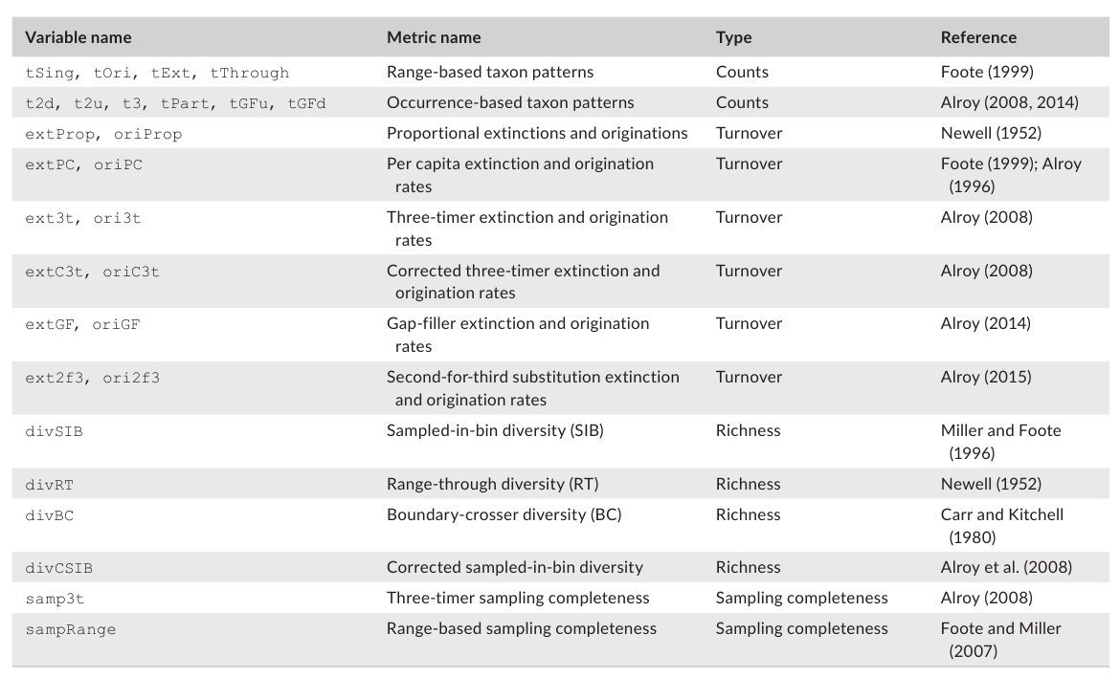
What?
Basic turnover and diversity metrics
Traditional/counting approach
Subsampling routines!

Slide 32
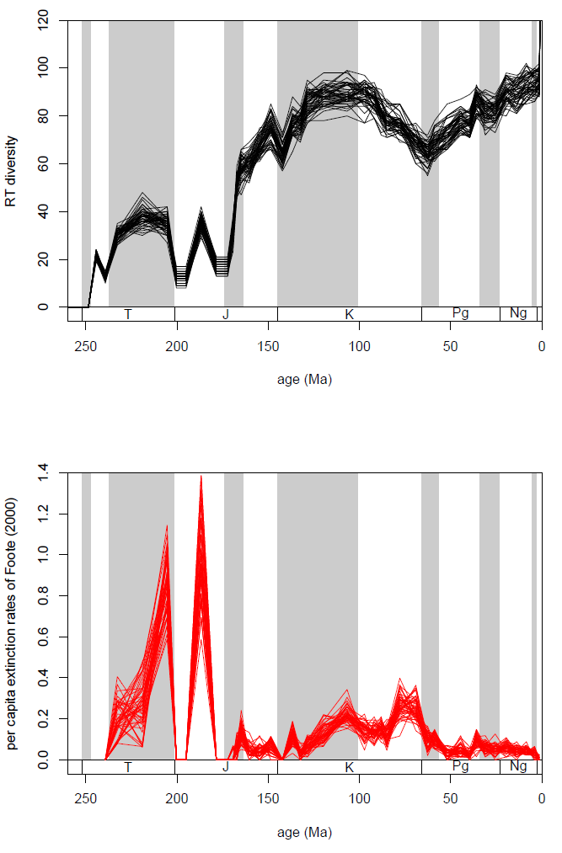
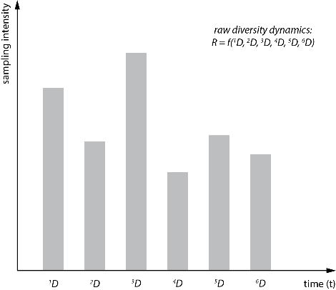
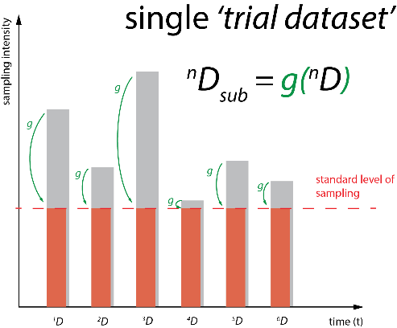
What it does
Subsampling
R_{raw} = f(¹D, ²D, ³D, ⁴D, ⁵D, ⁶D)
f:= applied function
(e.g. divDyn())
₁R_{sub} = f(g(¹D), g(²D), … g(⁶D))
g:= subsampler function
Repeated, variation of R_{sub}

Slide 33
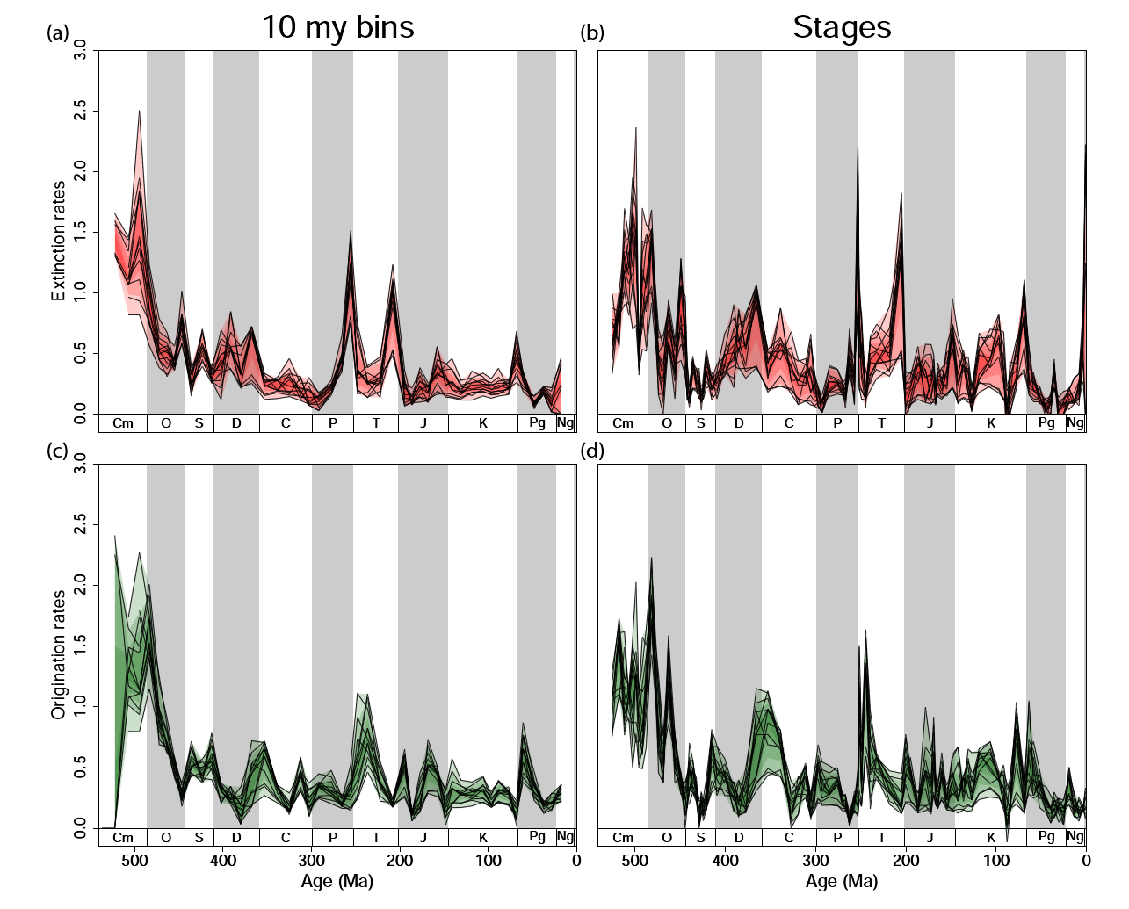
Examples
Phanerozoic diversity and turnover

Slide 34
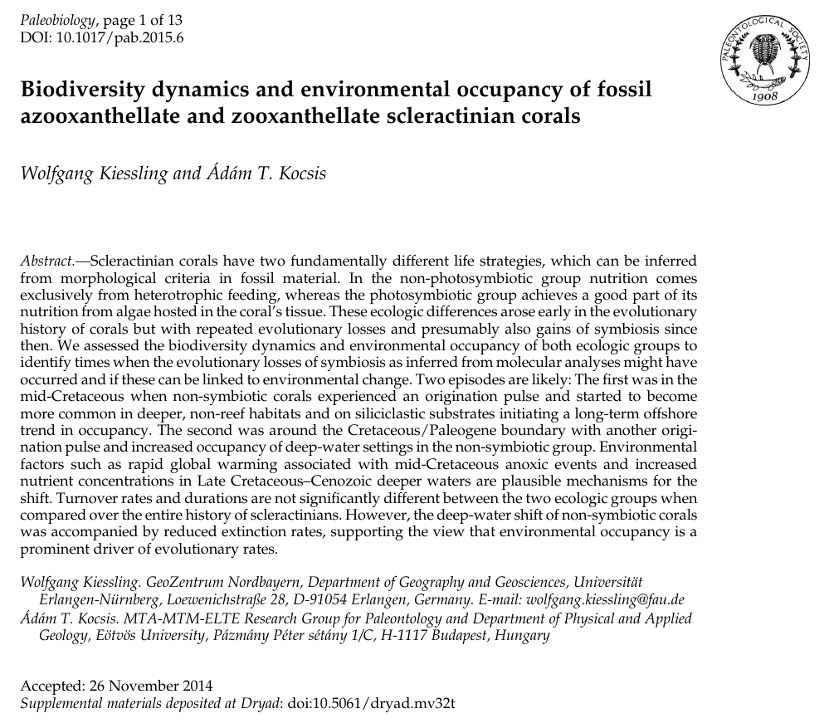
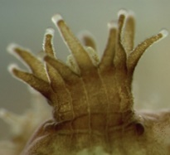
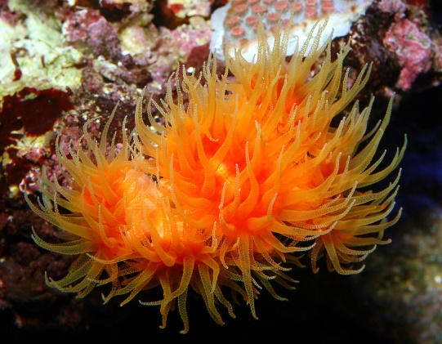
Examples
The Corals example
Zooxanthellate (Z)
Azooxanthellate (AZ + AP)

