Slide 1


Extinction/origination selectivity & logistic regression
Carl J Reddin
Museum für Naturkunde - Leibniz Institute for Evolution and Biodiversity Science (MfN)
31.08.2022
Carl J Reddin

Slide 2
Background
The study of extinction is a strength of paleobiology
The magnitude of extinction is not the only influence on ecosystem
Why do some species go extinct while others survive?
“Selectivity describes variation in extinction magnitude among taxonomic or functional groups or with respect to some parameter, such as body size or geographic range” Bush et al. 2020
Different causes produce different patterns? Relevant for modern species?
Are background vs mass extinction intervals different?
Geographic range, body size, abundance, climate/latitude of habitat, functional groups (e.g. activity level, skeletal composition, diet)
Notes:
I will focus on extinctions because we are in an extinction crisis now in the modern, trying to avert a mass extinction, but everything we will discuss can be applied to origination
Use FAD instead of LAD
Distinction here how differences between the means are calculated: grouping and continuous variables (slope = continuous differences in means vs relative differences in means)

Slide 3
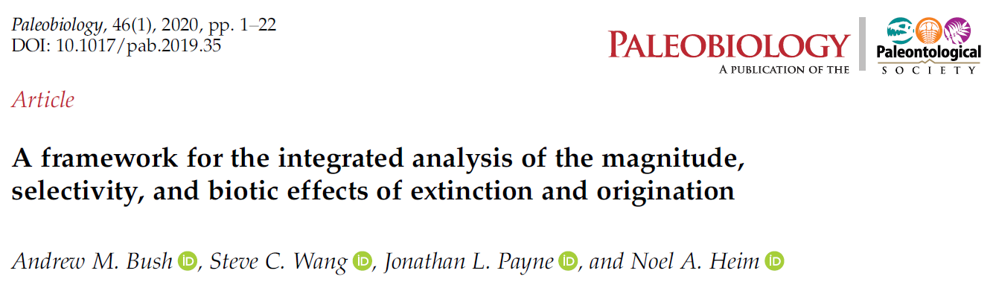
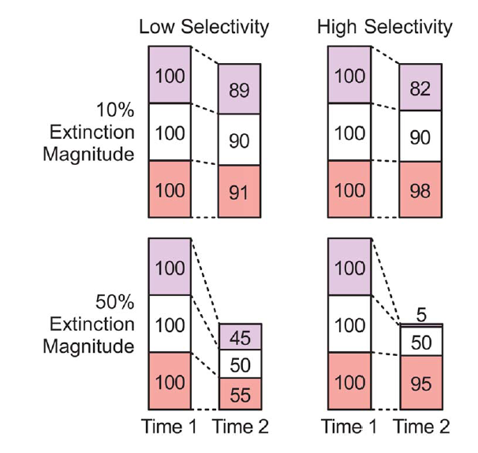
Hypothetical example
Extinction selectivity with three groups (blue, white, red), starting with 100 species in each
Total 300 species before extinction (time 1), after extinction (time 2) with either 270 or 150.

Slide 4
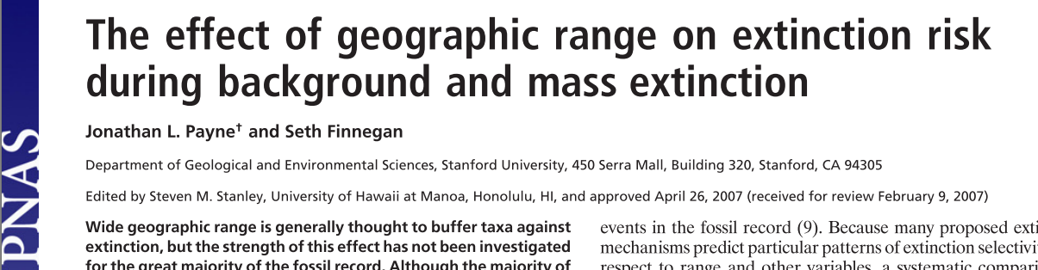
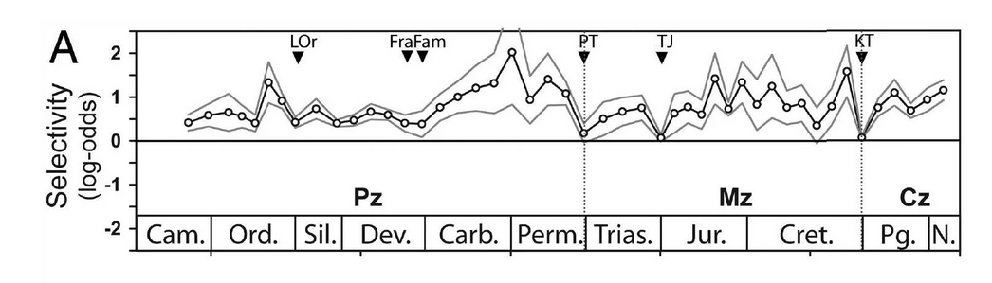
Positive log-odds indicate a positive association between geographic range and survivorship (1 – extinction_risk), and negative log-odds indicate an inverse association
Selectivity estimated from a single logistic regression of geographic range versus survivorship per 10-My bin
Larger range size linked to higher survivorship
“Note that selectivity is least pronounced at times of major extinction events (indicated with arrows)”
Notes:
Careful if 1 is extinction or survival

Slide 5
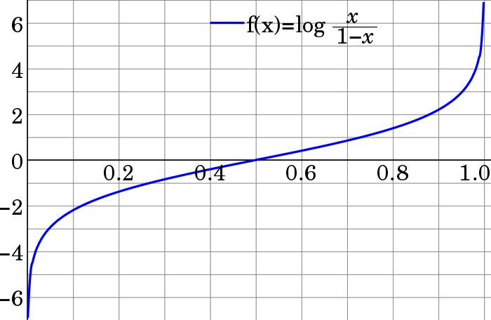
Generalized Linear Models
Assess dependencies with all sorts of data distributions
Many model link functions
Type ?family
Logistic regression
glm(formula, family = binomial,data)
Binary dependent variable, binomial(link = "logit")
Odds: extinct or survive, heads or tails
Log-odds
Odds
Notes:
Uses a distribution link e.g. binomial

Slide 6
The logit link
Logit() transforms binomial data into a normal distribution (minus infinity to infinity)
Coin flips are TRUE/FALSE or 1 and 0 in reality, but probability scales 0 to 1
This probability scale is where our extinction risk predictions fall e.g. 0.3 = 30% chance of future extinction
Linear models don’t like data with a binomial distribution, clipped from 0 to 1
Need the link to put these data on a normal distribution
https://www.geo.fu-berlin.de/en/v/soga/Basics-of-statistics/Logistic-Regression/The-Logit-Function/index.html

Slide 7
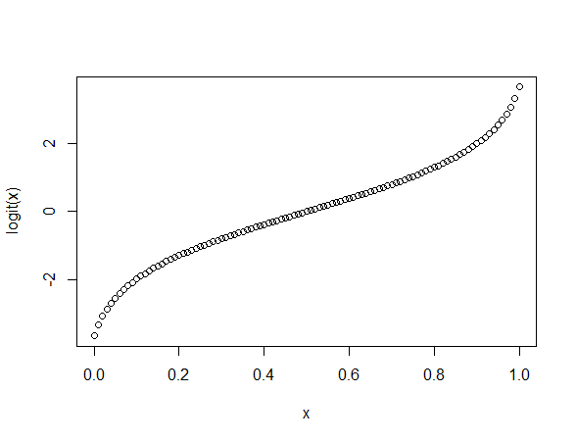
The logit link
To find out where logit comes from, we need to introduce the odds-ratio
If the probability of an event is a 0.5, the odds are even or 1:1 (often said 50:50)
The logarithm of the odds ratio is the log-odds
Negative logits represent probabilities below one half
Positive logits correspond to probabilities above one half.

Slide 8



Simulate a coin toss
Two coins are available, but are they equal? After observing the results, you use logistic regression to assess if how likely the results deviate from chance
Coin a, the reference level (“intercept”), should be log-odds ~0.5
The second coefficient is the difference (in log-odds) of coin b from that reference level
Notes:
Imagine Chigurh touring the country

Slide 9

(2016). Biology Letters, 12, doi: 10.1098/rsbl.2015.0813.
Dependent variable is binary (0 = survive, 1 = extinct)
Test with Cenozoic marine invertebrate species
Suggested reading: http://www.utstat.toronto.edu/~brunner/oldclass/appliedf11/handouts/2101f11StepwiseLogisticR.pdf
dat.10 <- read.table("dat10.csv", sep=";", header=T)
Notes:
the parameters are negative meaning that extinction risk is elevated if occupancy is low and occupancy changes negative
The interaction of standing occupancy and change at lag 2 (ch2) could mean that longer-term decline leads to lower occupancy, which increases risk
Termplot Displays the effect of a variable with all others in the model held constant
Try adding se=TRUE (crosses zero?)
Termplot: an original independent variable on x axis, dependent on y axis: fitted effects (line and partial residuals) of duration as x increases
Partial effects are with all other variables held constant

Slide 10
Plot outcome
plotGLM(forwards)
Predicted probability of extinction, log odds
e.g. occupancy data on living species
Notes:
Plot of model predictions (black dots) against observations (grey circles) of fossil extinctions along the regression equation
The object “dat.living” contains the occupancy histories of extant species in the late Pleistocene/Holocene bin. The predict() function yields a vector of probabilities for each species occurring over at least four consecutive time intervals to become extinct in the current interval.

Slide 11

VOL 10 | March 2020 | 249–253
Clade and trait extinction selectivity during hyperthermal events
Body size as continuous trait, clades as categorical
Meaning of intercept values (continuous vs categorical regression)
Fixed and random effects
Averaging coefficients
Have a hypothesis of your own? Trait/clade selectivity at a stage?

Slide 12
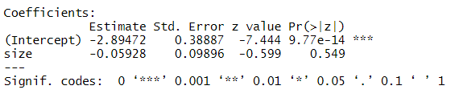
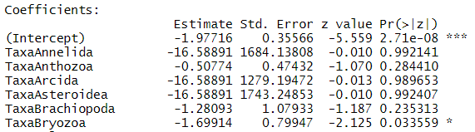
Continuous vs categorical regression
Continuous predictor
Intercept is a partial mean
Slope is relative to intercept
Categorical predictor
Intercept is reference group mean
Group coefficients are partial means relative to reference group
Intercept p-value is test whether mean = zero

Slide 13
Fixed and Random Effects
Fixed = All conditions of interest have been sampled (default lm() setting).
Random = Only a random sample of the conditions of interest have been sampled*.
Mixed Model
Fixed covariates if all levels are sampled
Remaining (random-effects) variance
The standard error of the mean will usually be larger for random effects analyses = Larger confidence interval, less power, more samples needed.
* = although there are many other reasons and possibilities for using random effects, including many ‘convenience’ attributes e.g. supplying the model a more accurate covariance matrix based on known dependencies in the data e.g. nesting, time series
Notes:
If looking at …all conditins
If looking at… sample of

Slide 14
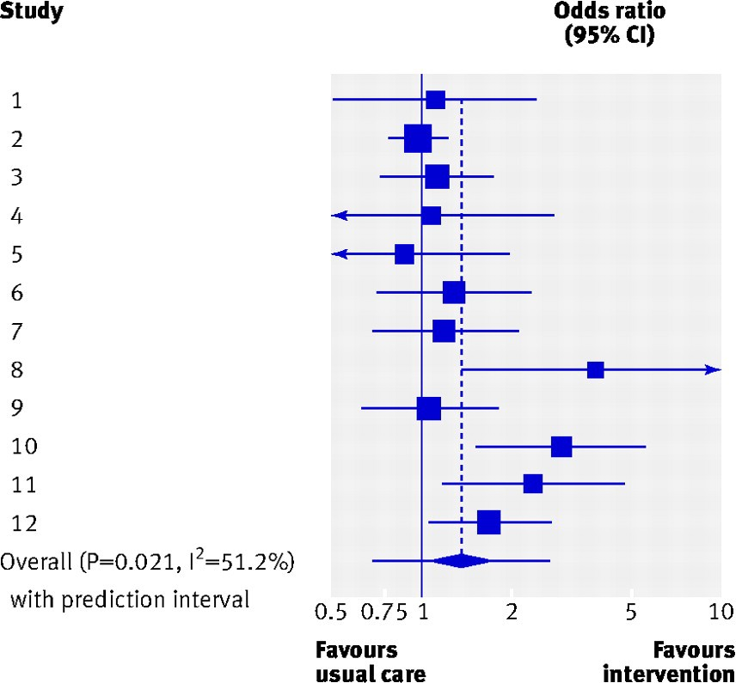
Averaging coefficients
Coefficients from multiple GLMs can be averaged in another GLM but loses error information (standard error of coefficient)
Also by including all data in one GLM and a term for the time bins but then species will be in the same GLM multiple times
I find it more elegant and useful to use a meta-analysis model
Orzechowski et al. (2015). Global Change Biology, 21(10), 3595-3607.
Reddin, Kocsis, et al. (2020). Nature Climate Change, 10(3), 249-253.
Reddin, Kocsis, et al. (2021). Global Change Biology 27(4), 868-878
Reddin, Kocsis, et al. (2022). Global Change Biology.
Notes:
Elegant because averaging coefficients is what they are built for (instead of experiments/studies we have time bins as separate studies, handled as random effects – can also incorporate time series structure). Weighting uses inverse variance weighting (more accurate coefficients are more important)
Separates within from between study variance components, which can be investigated
Between study variance can be explained by meta-regression e.g. global temperature

Slide 15
Probabilistic extinctions
Probability that LAD is true extinction time bin?
Multiplies extinction (integer) by sampling completeness (proportion)
Combines sampling completeness of time bin with that of clade e.g. holothurians have a low completeness vs. scleractinian corals have high completeness
Leftover probability (e.g. 1 – 0.936 = 0.064) is pushed into the next time bin
Species | Classic extinction | Probabilistic extinction
A | 1 | 0.936
B | 1 | 0.756
C | 0 | 0
D | 1 | 0.865
Based on Reddin, C. J., Kocsis, Á. T., Aberhan, M., & Kiessling, W. (2020). Victims of ancient hyperthermal events herald the fates of marine clades and traits under global warming. Global Change Biology 27(4), 868-878
Notes:
Will get a warning from glm that the dependent data are non-integer but this is just to check you are aware of that. The logit link can handle non-integer values between 0 and 1, as you can see
Ideally these are balanced in their distribution i.e. equal number of extinctions and survivals = maximum information (entropy), but few intervals are well-balanced
The code for converting a extinctions matrix (e.g. built by function divDyn::modeltab() ) to a probabilistic extinctions matrix is provided at the bottom of the code but needs the original dataset to obtain information

Slide 16
Complications
Can an event with few extinctions be selective? E.g. PETM
Signor Lipps effect (confidence that LAD is true disappearance), sampling completeness
If one clade tends to be selected for extinction, how do we judge their traits independently? Focus on trait variation within the clade? Exclude the clade?
E.g. ammonites are low duration, actively mobile, predatory, primarily aragonitic skeleton, etc
Not seeing the wider picture: If an extinction-prone clade is selected for extinction at a hyperthermal event, does that mean it is sensitive to hyperthermal conditions?
Analysis gives us some choices
“Selectivity describes variation in extinction magnitude among taxonomic or functional groups or with respect to some parameter, such as body size or geographic range” Bush et al. 2020

Slide 17
Alternative approaches
GAM with family = binomial
Bayesian
https://psmits.github.io/paleo_book/logistic-regression.html
Prediction via machine learning

Slide 18
Summary
“Selectivity describes variation in extinction magnitude among taxonomic or functional groups or with respect to some parameter, such as body size or geographic range” Bush et al. 2020
Generalized families permit more dependent variables
Binomial (logistic) regression predicts probabilities of binary outcomes
Factors are fine in regression
Fixed and random effects are powerful

Slide 19
Diagnostic Plot 1
Residuals (distance from regression line) versus fitted values
Potential outliers marked by numbers (positions)
There should be no distinct trend in the distribution of errors
Notes:
Always the same points marked as outliers

Slide 20
Diagnostic Plot 2 – Q-Q
Q-Q Plot: Quantile-Quantile Plot
Quantiles of standardized residuals (residuals divided by their standard deviation) versus standardized residuals
It’s good if residuals are lined well on the straight dashed line.
Notes:
‘Tests’ the assumption of normality

Slide 21
Diagnostic Plot 3 – Scale-Location
Square-root transformed standardized residuals versus fitted values
There should be no distinct trend in the distribution of errors
Variance of duration increases with geo.range
It’s good if you see a horizontal line with equally (randomly) spread points.
Notes:
Size of residuals on y axis (irrespective of sign)
assumes homoscedasticity, that the variance in the residuals doesn’t change as a function of x

Slide 22
Diagnostic Plot 4 – Residuals vs Leverage
Leverage of single data points versus standardized residuals. Cook’s distance: Effect of deleting a given observation (should be lower than 0.5 for all points)
Should not exhibit a trend and points should be within Cook’s distance
Notes:
Leverage is a measure of how much each data point influences the regression
Cook’s distance, which measures how much the regression would change if a point was deleted.
a point far from the centroid with a large residual can severely distort the regression

