Slide 1

Global diversity patterns
Wolfgang Kiessling
Paleobiology, FAU Erlangen
19 August 2026
Wolfgang Kiessling
Notes:
Global is our gamma

Slide 2
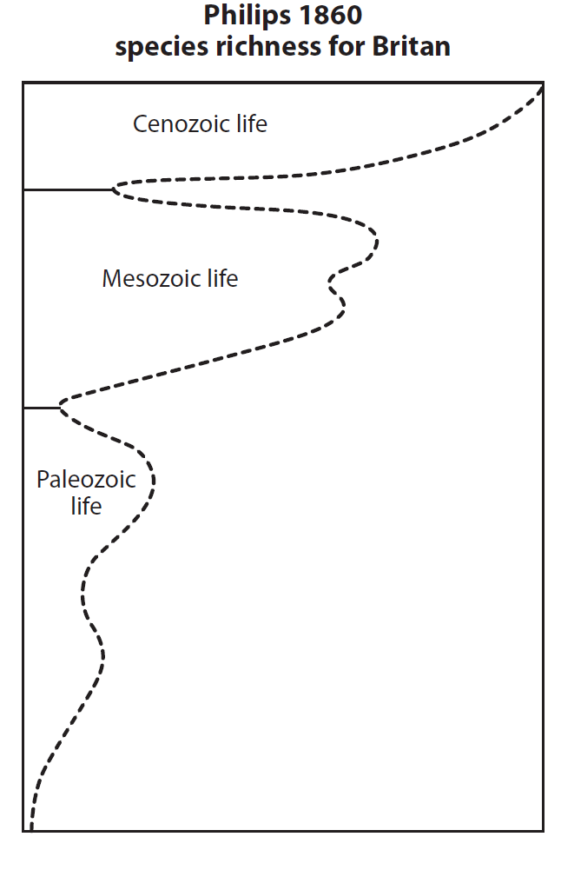
Global Diversity Patterns
First Estimates (Phillips, 1860)
Early Quantification of species richness based on number of publications in the Zoological Record (Valentine, Raup)
Compilation of ranges on marine orders (Sepkoski, 1978)
Marine families (Sepkoski, 1982, 1992)
Marine and terrestrial families (Benton ed.,1993)
Marine genera (Sepkoski, 2002)
The Paleobiology Database (since 2000)

Slide 3
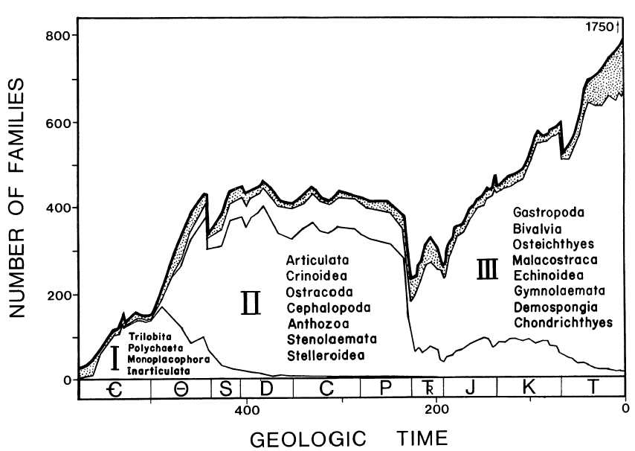
The Three Great Evolutionary Faunas
Sepkoski (1981, Paleobiology)

Slide 4
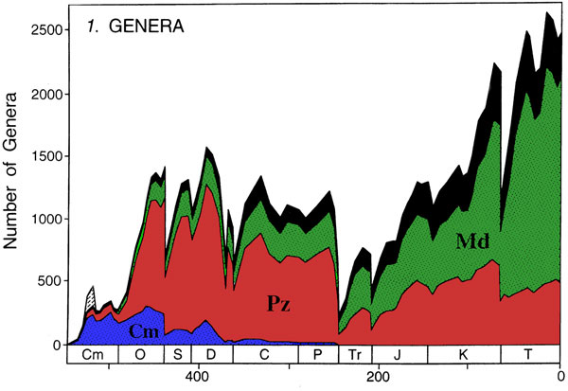
Genus level
Sepkoski (1997, J. Paleont.)

Slide 5
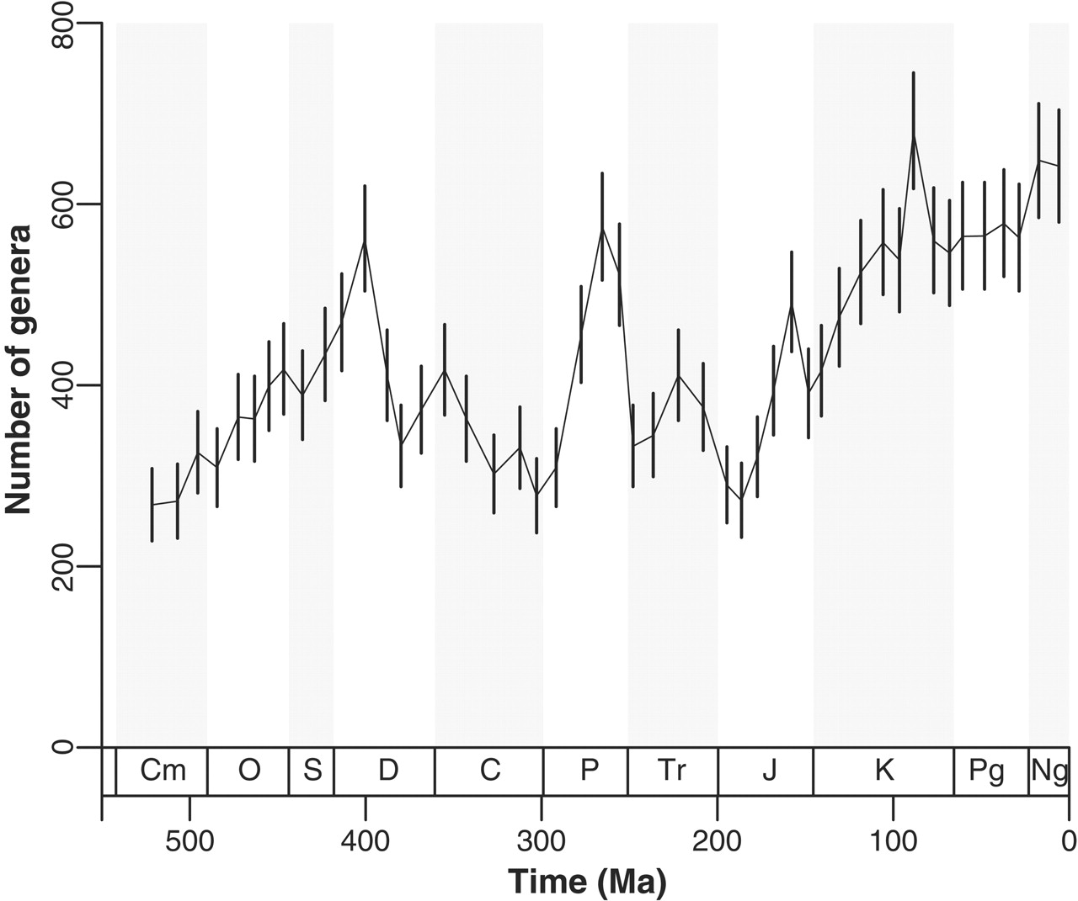
Diversity Through Time
Time series of biodiversity
Questions
How did biodiversity evolve in a region or globally?
Evolutionary principles
Are there global thresholds to biodiversity?
What controlled diversity changes?
Climate, biologic interactions, genetic factors
Alroy et al. (2008, Science)

Slide 6
Methods of Measuring Diversity
Usually above species level (genera and families)
Stratigraphic ranges of species usually too short for temporal resolution (e.g., geological stages)
Monographic effect: Many if not most species usually described in just one publication and area
Count only sampled taxa
Reasonable but what about Lazarus taxa?
Not possible when only ranges are available
Silent on dynamics
Infer diversity from ranges
Data are only present as FAD-LAD

Slide 7
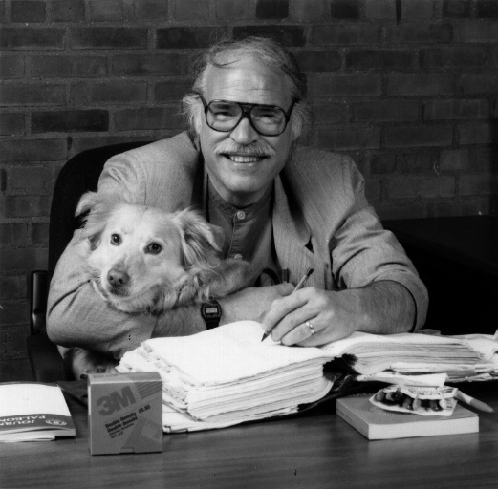
Structure of compendia
Genus | Ori-P | Ori-Stg |  | Ext-P | Ext-Stg | Reference
Acropora | T | (Eo-l) | - | R | *
Actinacis | K | (Ceno-l) | - | T | (Mi-l-l) | (2)
Actinaraea | J | (Sine) | - | K | (Apti) | (819,821,825,919)
Actinastraea | Tr | (Ladi-u) | - | K | (Maes) | (817)
Ancliffia | J | (Bath)
Anodontia | T | (Than) | - | R | * | (705)
Corals and bivalves from Sepkoski‘s compendium of marine animal genera (2002)

Slide 8
Foote, M., 2000: Origination and extinction components of taxonomic diversity: general problems. Paleobiology, 26 (supplement), 74-102.

Slide 9
Measuring Diversity Through Time
A
Through ranging
B
Extinct
C
Originating
D
Singleton
E
Through ranging

Slide 10
Measuring Diversity
A
Through ranging
B
Extinct
C
Originating
D
Singleton
E
Through ranging
Boundary crossers: 3
Range through: 5
Range through minus singletons: 4
Boundary crossers
Range through

Slide 11
Measuring Diversity Through Time
Draw Diversity Curves: SIB, range through, range through minus singletons, boundary crossers

Slide 12
Problems
Counting bias
Edge effects
Pull of the Recent
Sampling bias

Slide 13
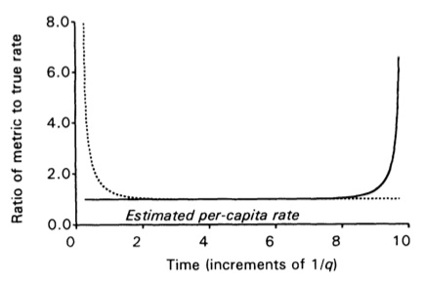
One consequence of incomplete sampling: Edge effects
If we know (roughly) the mean taxon duration, then we
know how far from the edge we need to go to avoid effects.
Origination (dotted)
Extinction (solid)
Foote (2000)

Slide 14
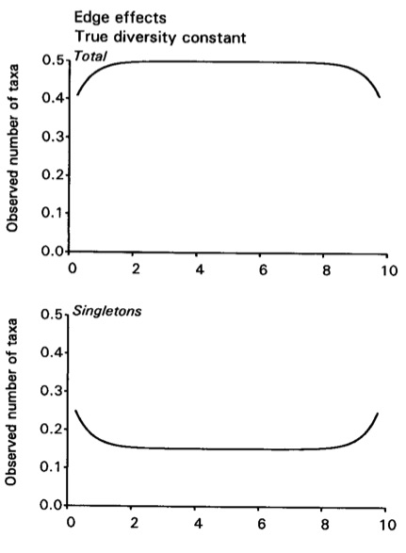
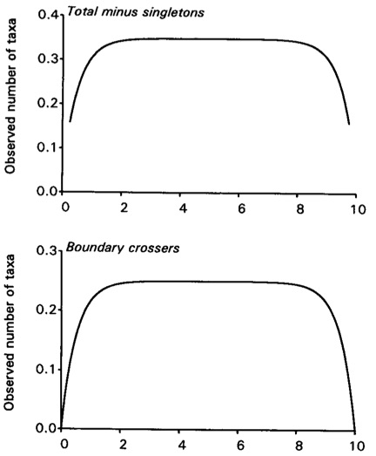
Edge effects
If we know (roughly) the mean taxon duration, then we know how far from the edge we need to go to avoid effects.
Time (multiples of mean taxon duration)→
Foote (2000)
Notes:
One consequence of incomplete sampling

Slide 15
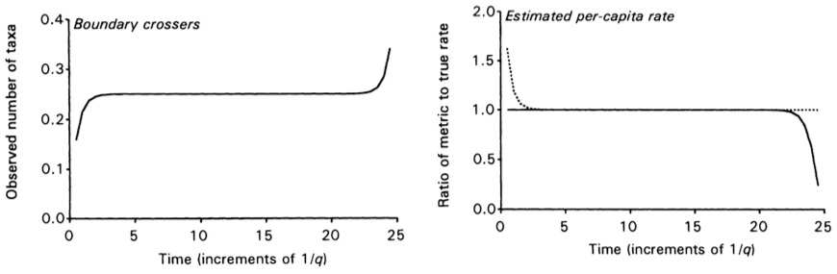
Another kind of edge effect: (nearly) complete sampling in the Recent
(part of what Raup [1979] referred to as "The Pull of the Recent”
Origination (dotted)
Extinction (solid)
Foote (2000)

Slide 16
Diversity Dynamics
Rates of diversity change
Extinction rate
Origination rate
Turnover rate
Extinction + Origination
Diversification rate
Origination – Extinction

Slide 17
A note on rates
Rates are usually reported as:
Numbers (e.g. species per lineage-million years)
Percentages
Decay rates (Foote rates, two timer rates etc.)
Problem
“Rates” are often reported without time in the denominator
This is (strictly speaking) not rates
Foote (2005)
Notes:
But we mean rate per geological interval, so all good

Slide 18
Rates
Problem with percentages
Usually bound between 0 and 1
Origination Rates can be > 1 (with BC) but not extinction rates → asymmetric treatment
Problems with very high rates
Foote Metrics
E = -ln [N_{bt}/(N_{bL} + N_{bt})]
O = -ln [N_{bt}/(N_{Ft} + N_{bt})]
N_{bt} = Number of taxa known before and after an interval; N_{bL} = Number of taxa ranging into an interval but not after; N_{Ft} = Number of Taxa first known from an interval and after
Foote (2000, 2003)

Slide 19
Effect of short-lived decrease in sampling/preservation

Slide 20
Corresponding effect of sampling increase
Time →

Slide 21
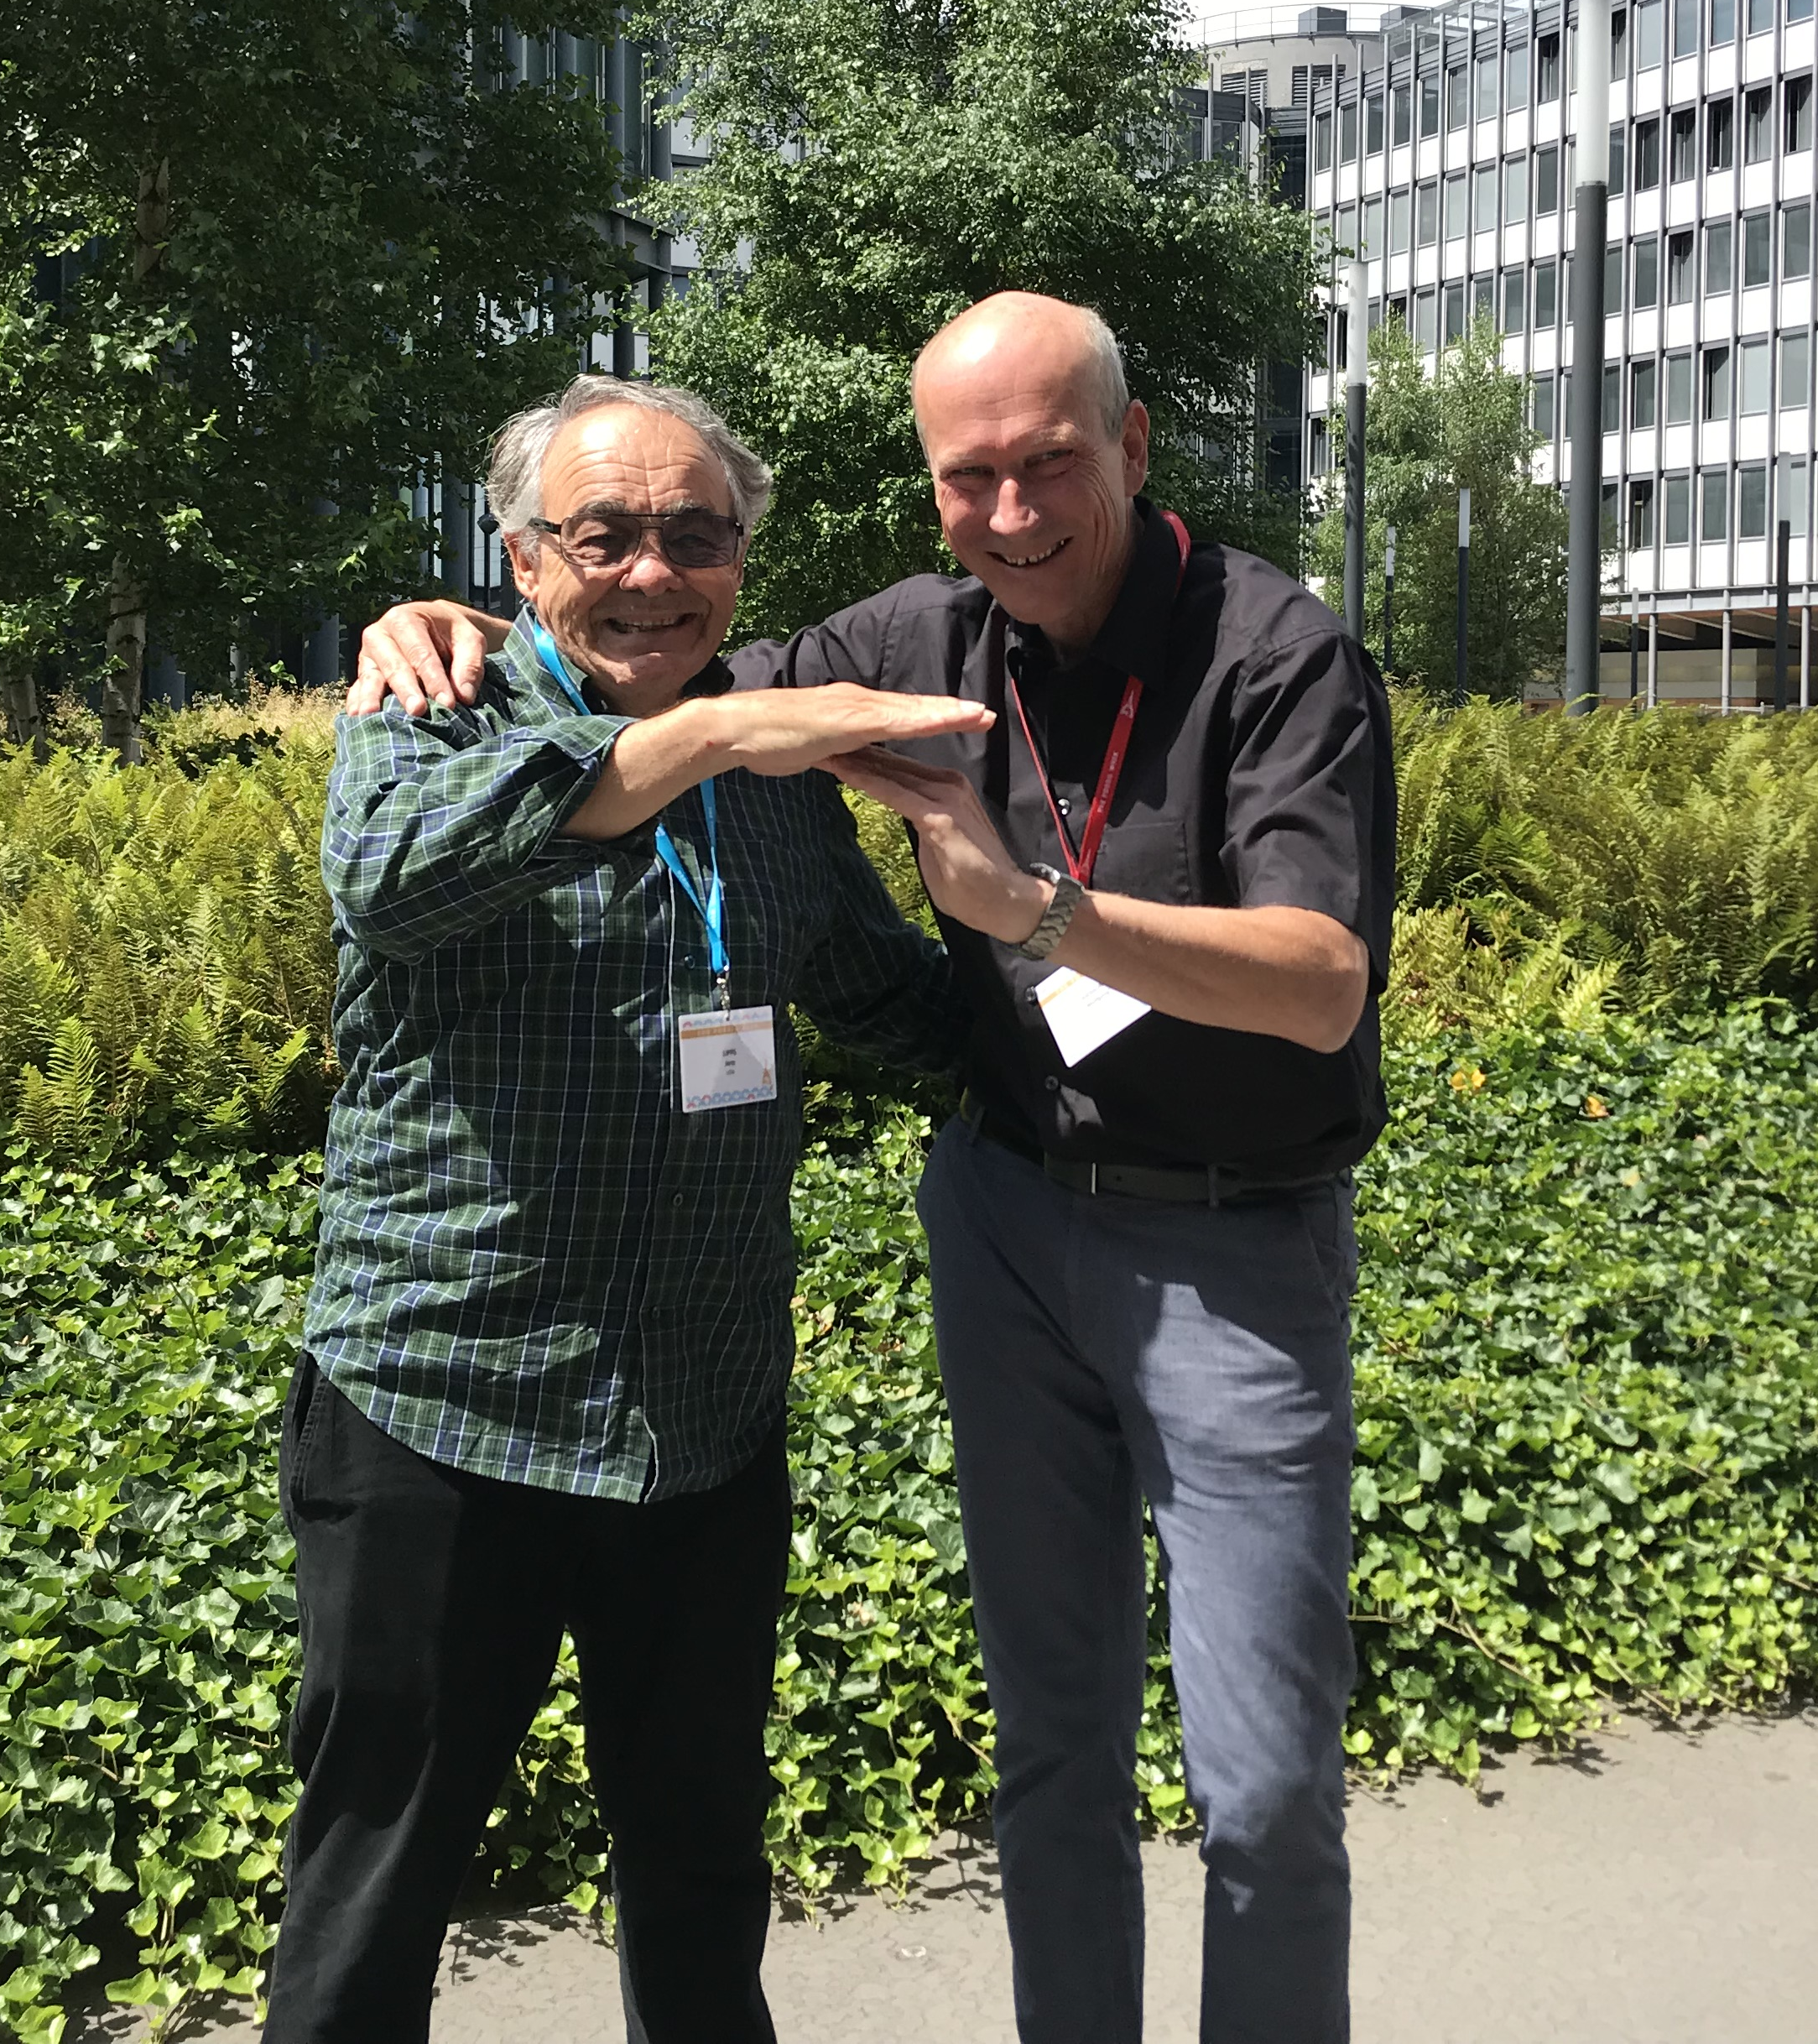
The Signor-Lipps Effect

Slide 22
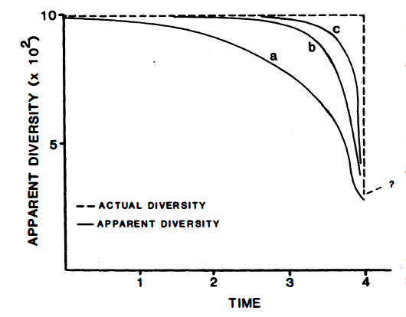
The K-T (K-Pg) debate
1980 Publication of Impact Hypothesis by Alvarez et al. in Science
1980- Strong criticism by paleontologists arguing that the extinction was too gradual to comply with a sudden extinction
Publication of Signor & Lipps: “Sampling bias, gradual extinction patterns, and catastrophes in the fossil record”
1986 Sloan et al. on the gradual extinction of dinosaurs
1989 Strauss & Sadler (1989): Confidence intervals on stratigraphic ranges
Insufficient sampling results in artificial range truncations and thereby the appearance of a gradual extinction
Notes:
There’s a lot to deal with. We can learn everything. But become familiar with concepts.
Stress but relax.
Important to speak the same language because interdiscplinarity is key

Slide 23
“Signor-Lipps effect” (backward-smearing of true extinction event)

Slide 24
Exercise
Given are 200 taxa ranging through an interval of time (N_{bt})
The number of taxa going extinct with the interval varies from 50 to 800, originations range from 50 to 1500
Calculate extinction, origination (turnover and diversification) rates based on percentages and Foote rates
How do the rates compare?
File: FooteMetrics.xlsx

Slide 25
Phanerozoic Marine Animal Diversity
Exponential post-Paleozoic rise?
Data from Sepkoski (2002, Bull. Am. Pal.)

Slide 26
Analyzing Sepkoski‘s Compendium
Sepkoski, J.J., Jr. 2002. A compendium of fossil marine animal genera. – Bulletins of American Paleontology 363: 1-563.
Global diversity of marine animals (and protozoa) in 77 geological stages
Script Sepkoski.R
Range data in Gen_link2.csv
Stratigraphic data in Stage_sepk.csv
Draw a diversity curve
Compare results among counting methods (range-through with and without singletons, boundary crossers)
Compare different taxa (corals and bivalves)

Slide 27
Sampling effects on diversity dynamics
Changes in sampling (aka preservation) may lead to effects that mimic evolutionary events
Sampling needs to be considered (but couldn’t prior to the advent of the Paleobiology Database)

Slide 28
Raw Foote extinction rates across the Phanerozoic
Exercises:
Do a plot of origination rates for all taxa
Plot diversity of bivalves and brachiopods in one graph

Slide 32
The Three Great Evolutionary Faunas
Sepkoski (1981, Paleobiology)

Slide 33
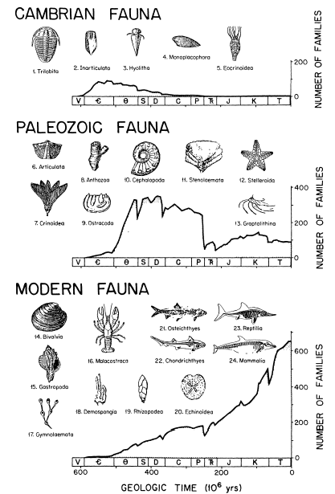
No a priori assumption on biological properties. Faunas only defined by common fate
Competitive replacement or shared response to mass extinctions?
Sepkoski (1981)

Slide 34
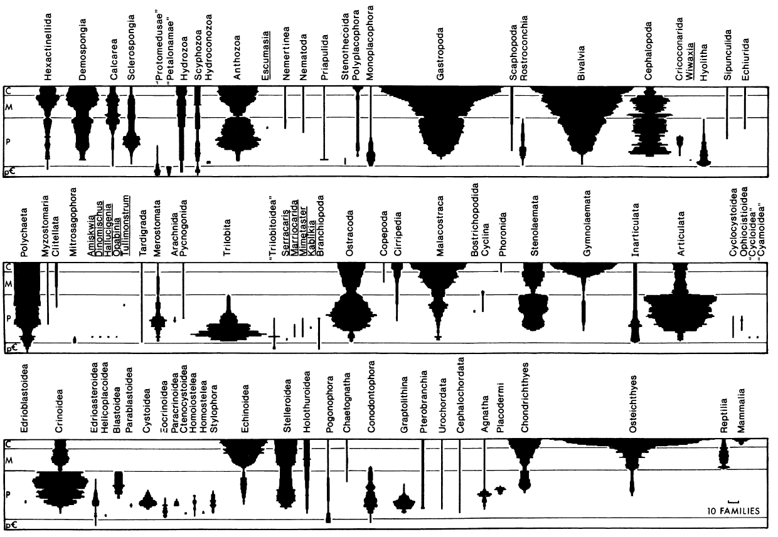
Clade Diagrams
Number of families within classes through time
Sepkoski (1981)

Slide 35
Factor Analysis
Sepkoski (1981): Correlation of diversity patterns among clades
Extraction of factors (latent variables) to explain as much of total variance as possible
Three factors explain > 90% of variance
Cumulative diversity curves of families that share respective factor loadings give trajectories of the three great evolutionary faunas

Slide 36
Exercise
Can the three great evolutionary faunas also be observed at the genus level?
Principal components of genera in 15 important classes of marine animals
Factor loadings
Which classes belong to which evolutionary fauna?
Are there systematic differences in rates among the evolutionary faunas?
ThreeFaunas_new.R

Slide 37
Sepkoski’s own analysis
Sepkoski (1997, J. Paleont.)

Slide 38
Sampling standardization
The non-linear but always positive relationship between sampling and biodiversity imposes profound issues in reconstructing diversity dynamics
We’ve learned how to deal with this issue when comparing community-level data
Rarefaction (fixed quota)
Shareholder quorum subsampling (fixed coverage)
But how do we apply sampling standardization on biodiversity dynamics over time?
Combine subsampling with range analyses

Slide 39
Subsampling
As before, but now within time series and drawing occurrences instead of specimens
2 or 3
Perhaps 2
Sure 2
Rarefaction (3)
2.23
1.89
2
This approach sufficient for sampled-in-bin (SIB) diversity, but silent on turnover

Slide 40
Diversity Over Time
Iterate subsampling and range-through analysis
Omit Singletons
S = 2, Ext = 0
S = 2, Ext = 0
S = 2, Ext = 2
S = 1, Ext = 0
S = 1, Ext = 0
S = 1, Ext = 1
S = 2, Ext = 0
S = 3, Ext = 1
S = 2, Ext = 2
S = 1.67, Ext = 0
S = 1.67, Ext = 0.33
S = 1.67, Ext = 1.67

Slide 41

Subsampling Methods
Implemented in divDyn package
Classical Rarefaction (CR)
Pool all occurrence data
Randomly draw data until quota is reached
Occurrences weigthed by-list subsampling (OW)
Pool occurrences by collections
Randomly draw collections until quota of occurrences is reached
Unweighted by-list subsampling (UW)
Pool collections
Randomly draw collections until quota of collections is reached
Occurrences-exponentiated weighted by-list subsampling (OexpW)
Pool occurrences by collections
Randomly draw collections until weighted quota of exponentiated occurrences is reached
Shareholder Quorum Method (SQ)
Sampling until a particular proportion (quorum) of the rank-abundance distribution (coverage) has been sampled
The Squares Method (Alroy 2020)

Slide 42
Why so many methods?
Rarefaction assumes that differences in diversity are entirely driven by sampling
We might lose biological signal by attempting to sampling-standardize if we don’t consider evenness
If evenness of communities is different, then rarefaction will mostly reflect these differences
SQS considers differences in evenness and is preferable for SIB diversity estimates
Chose appropriate subsampling method for respective question
Biodiversity through time: SQS
Large scale beta diversity: UW
Extinction and origination rate: CR, OW

Slide 43
Sampling standardization is not the whole story
Counting methods count
All metrics other than SIB are affected by edge effects artificially inflating of deflating estimates
Looking at only bin-to-bin changes will remove edge effects from long-term ranges
The two-timer turnover rates
Computed by log-ratio of two-timers and three-timers but corrected for sampling completeness

Slide 44

How good is the fossil record?
Fossils are unlikely accidents of the taphonomic cycle
The quality of the fossil record is linked to its completeness
Fossils are sampled in sedimentary layers
Not all layers contain fossils, fossil species are not continuously preserved
Some taxa are better preserved than others
How can we quantify completeness?
Notes:
Pure crab is not the right answer
Stratigraphic

Slide 45
Sampling Completeness Metrics
Based on the simple equation: sampling events/sampling opportunities
Problem is definition of sampling opportunities
Suitable for stratigraphic and taxonomic completeness
Three basic methods
Simple completeness metric (SCM)
Sampling probability
Three-timer metric

Slide 46
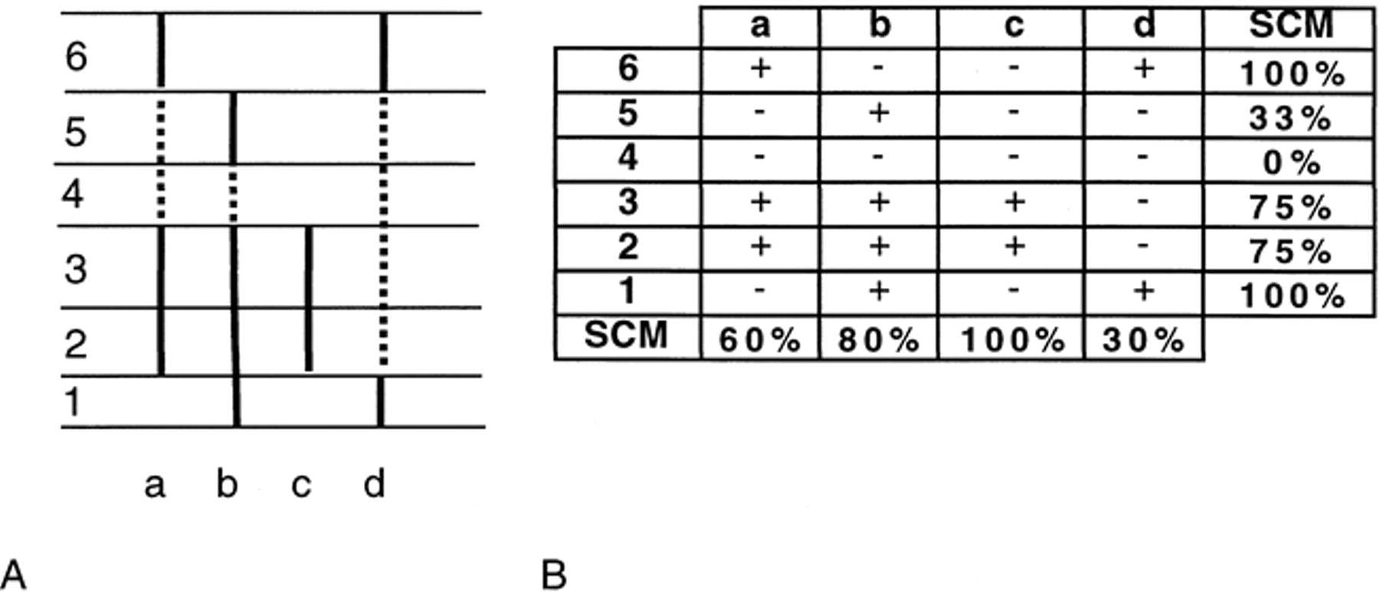
Simple Metrics
Taxonomic and stratigraphic

Slide 47
Sampling probability
Do not count range ends

Slide 48
Three-timer completeness
Usually applied to stratigraphic completeness
Focus on one focal bin and consider the ratio of three timers and part timers
A three timer (³t) taxon is sampled in three consecutive time intervals
A part timer (^{p}t) taxon is sampled before and after the focal interval but not in it
P_{s,i} = ³t_{i} /(³t_{i}+^{p}t_{i})

Slide 49
The three-timer approach
A two timer (²t) is sampled before and in the focal interval but not after
A three timer (³t) is sampled in three consecutive intervals
Extinction rate
μ_{i} = log (²t_{i}/³t_{i})
Origination rate
λ_{i} = log (²t_{i+1}/³t_{i})

Slide 50
Correcting observed rates
Raw
Three timer completeness
P_{s,i} = ³t_{i} /(³t_{i}+^{p}t_{i})
Extinction rates
μ_{i} = log (²t_{i}/³t_{i}) + log (P_{s,i+1})
Origination rates
λ_{i} = log (²t_{i+1}/³t_{i}) + log (P_{s,i-1})
Three-timer corrected
Kiessling and Simpson (2011, Global Change Biology)

Slide 51
Three-timer turnover rates
These and derivates (gap-filler equations) are the method of choice at Phanerozoic time scales and for large datasets
Random sampling error is problem
Extinction (E) in time interval i estimated only between two consecutive bins and corrected by preservation in the subsequent bin (P_{i+1})
Two-timers, three-timers and part-timers are crucial to simultaneously estimate rates and preservation
PyRate does a similar thing in a Bayesian framework (see lecture by Daniele Silvestro)

Slide 52
The timers
Example
Estimate of extinction rate in bin i (E_{i})
Three-timers (3T): 3
Two-timers (2Tb): 2 + 3
E_{i} = log(2Tb/3T) = ln(5/3) = 0.51
Preservation in next interval
P_{i+1} = 3T_{i+1}/(3T_{i+1}+PT_{i+1}) = 3/(3+2) = 0.6
Corrected extinction rate
Ec_{i} = 0.51 + ln(0.6) = 0
Time
Partly based on Alroy (2010)

Slide 53
Occurrence data are key
Stratigraphical (and geographical) ranges not suitable for sampling standardization
Must know how much has been sampled from each interval
Data on actual occurrences need to be compiled

Slide 54

The Paleobiology Database: A Core Infrastructure for the Biogeosciences
The Paleobiology Database
Founded in 1998, funded by NSF (2000-2005, 2010-2015) and other sources
Driven by a scientific question
Was the rise of marine biodiversity in the last 200 myr as dramatic as suggested by compendia of stratigraphic ranges?
Collect occurrence data, apply sampling standardization and use fossil data only

Slide 55
Paleobiology Database Endeavour
300 scientists from 150 institutions in 30 countries
241,700 collections with 1,663,000 occurrences of 513,000 taxa
20% of data from MfN/FAU
https://paleobiodb.org

Slide 56
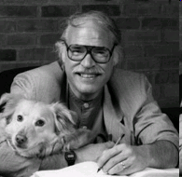

Marine Biodiversity Through Time
Old
New
Exponential post-Paleozoic rise
Logistic post-Triassic rise
Data from Sepkoski (2002, Bull. Am. Pal.)
Alroy et al. (2008, Science)

Slide 57
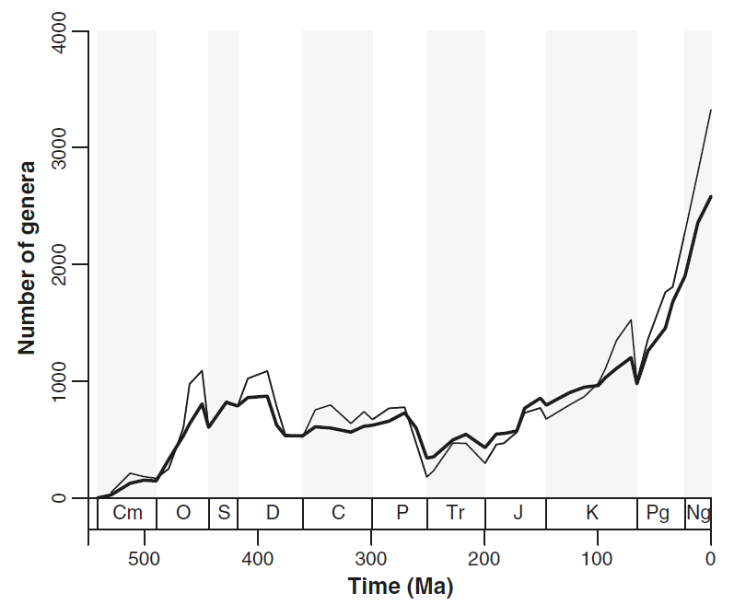
Pull-of-the-Recent as the major cause of diversity rise
Sepkoski Curve
PBDB Curve
Alroy et al. (2008, Science)

Slide 58
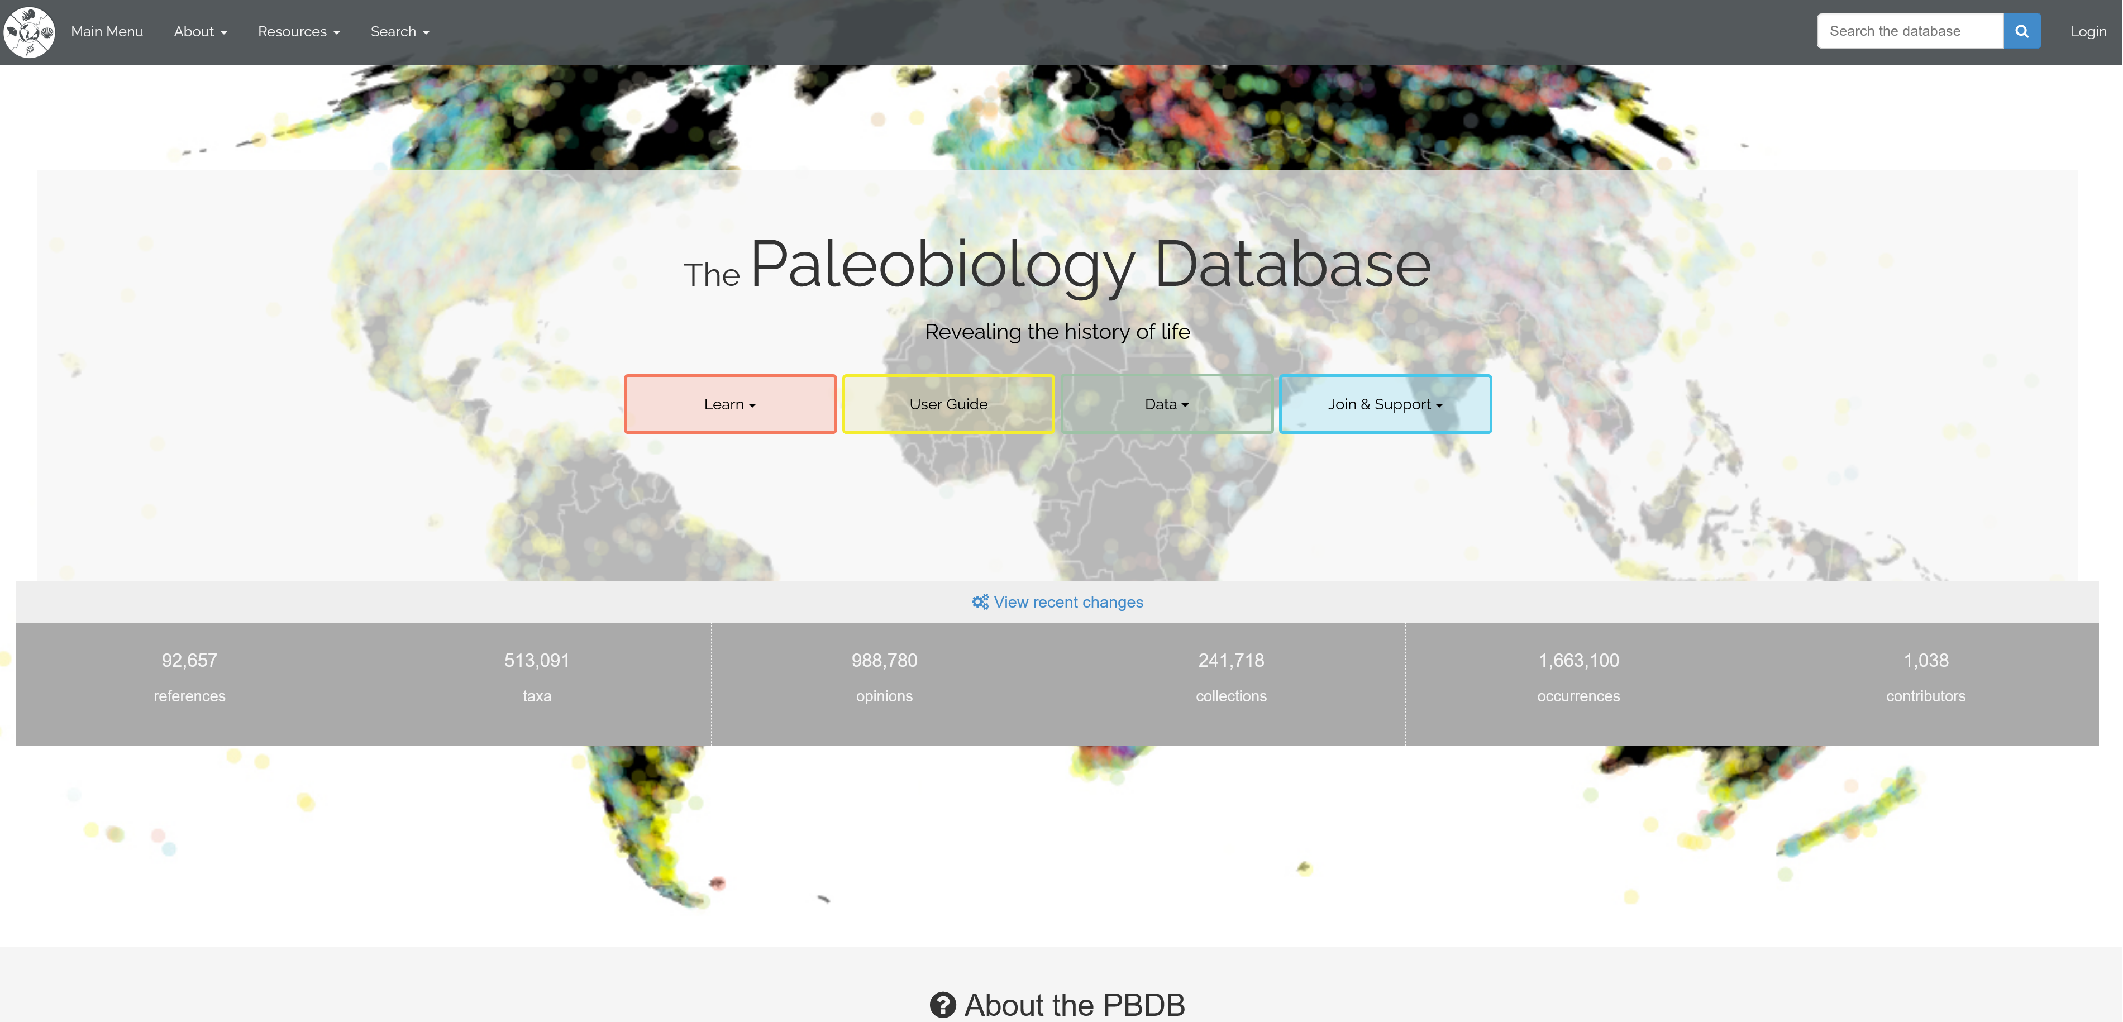

Slide 59
The Structure
Basic information is the occurrence of a particular taxon (species, genus or higher) in a particular collection (i.e. sample or outcrop …)
References linked to occurrences and collections
Geographic and geologic context stored with each collection
Taxa classified according to multiple opinions (synonymies, re-identifications)

Slide 60
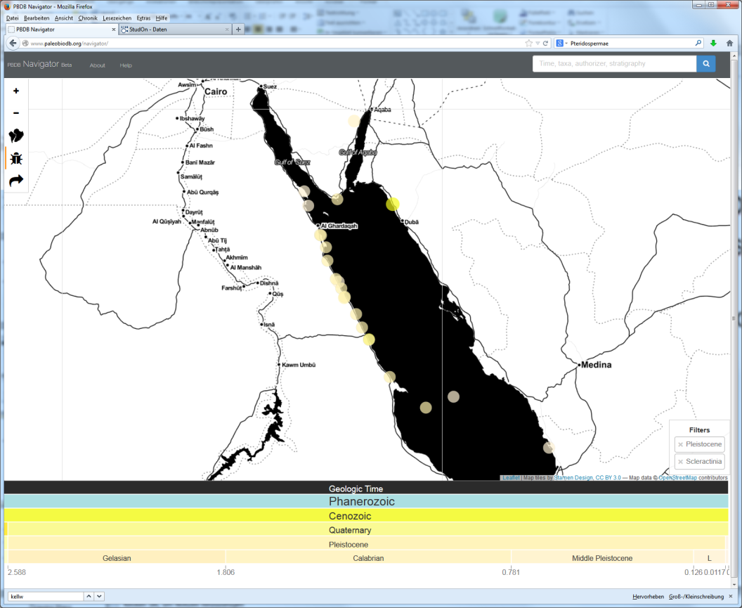
Navigator: http://www.paleobiodb.org/navigator/
Easy to use system for exploring data
Pleistocene coral occurrences from the Red Sea

Slide 61
Downloading Data (Paleobiodb)
The most important step for further analyses
Virtually all data in the PaleoDB are open access
Downloads in csv format
https://paleobiodb.org/classic/displayDownloadGenerator
Need to select something, cannot download all
Choose output options
Do not include metadata in output to facilitate workflow

Slide 62

Quick Access Options
API
https://www.paleobiodb.org/data1.2/
R interface documentation
http://cran.r-project.org/web/packages/paleobioDB/paleobioDB.pdf
Access to entire database through chronosphere package
https://cran.r-project.org/web/packages/chronosphere/index.html

Slide 63
Occurrence-Based Diversity Estimates
The most difficult step is stratigraphic binning
Occurrences must be binned into temporal increments such as stages or 10 myr intervals
Needs an extra table where bins are defined
Easiest is to use max_ma and min_ma estimate for each occurrence and see in which interval its mean falls
This and all subsequent steps are implemented in package divDyn

Slide 64
DivDyn to facilitate work flow
Tools for stratigraphic binning (stage level and 10 myr level)
Tools for computing and drawing sampling-standardized diversity dynamics
Lots of other nice stuff for analytical paleobiology

Slide 65
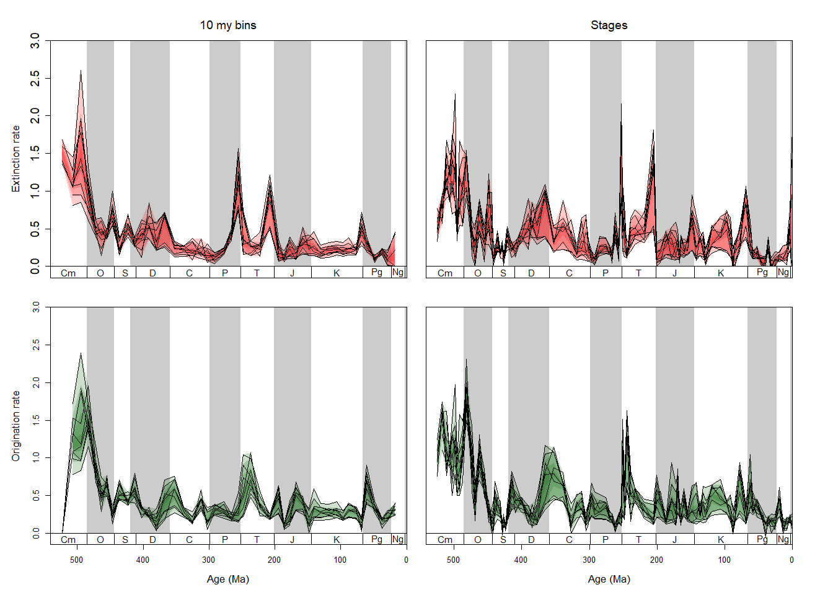

Turnover rates:
Variation across combinations of raw and two subsampling methods and three counting methods
Notes:
9 time series with colored variation

Slide 66
Final exercise
Download all Late Permian to Middle Triassic genus occurrences from the PBDB and assess
Extinction percentage at the end of the Permian
Origination percentage at the beginning of the Triassic
Which phylum exhibits the lowest extinction toll?

