Slide 1
Capture-mark-recapture approaches II
Lee Hsiang Liow
Natural History Museum and Centre for Planetary Habitability, University of Oslo, Norway
Analytical Paleobiology Workshop (Paleosynthesis, FAU, Erlangen)
2.9.2026 (Online lecture)

Slide 2
Representing detection/encounter histories
1 | 2 | 3 | 4 | 5 | 6 | 7 | 8
0 | 0 | 1 | 0 | 1 | 1 | 0 | 0
 |  |  | p₄ | p₅ | p₆ | p₇ | p₈
Detection
probabilities
 |  |  | ε₃ | ε₄ | ε₅ | ε₆ | ε₇
Extinction
probabilities
eh = 0 0 1 0 1 1 0 0
Pr(eh = 0 0 1 0 1 1 0 0 | initial encounter in interval 3) =
CJS model

Slide 3
Representing detection/encounter histories
1 | 2 | 3 | 4 | 5 | 6 | 7 | 8
0 | 0 | 1 | 0 | 1 | 1 | 0 | 0
 |  |  | p₄ | p₅ | p₆ | p₇ | p₈
Detection
probabilities
 |  |  | ε₃ | ε₄ | ε₅ | ε₆ | ε₇
Extinction
probabilities
eh = 0 0 1 0 1 1 0 0
Pr(eh = 0 0 1 0 1 1 0 0 | initial encounter in interval 3) =
(1-ε₃)(1-p₄) (1-ε₄)p₅ (1-ε₅)p₆ [ε₆ + (1-ε₆)(1-p₇){ε₇+(1- ε₇)(1- p₈)}]

Slide 4
Representing detection/encounter histories
1 | 2 | 3 | 4 | 5 | 6 | 7 | 8
0 | 0 | 1 | 0 | 1 | 1 | 0 | 0
 |  |  | p₄ | p₅ | p₆ | p₇ | p₈
Detection
probabilities
 |  |  | ε₃ | ε₄ | ε₅ | ε₆ | ε₇
Extinction
probabilities
eh = 0 0 1 0 1 1 0 0
Pr(eh = 0 0 1 0 1 1 0 0 | initial encounter in interval 3) =
(1-ε₃)(1-p₄) (1-ε₄)p₅ (1-ε₅)p₆ [ε₆ + (1-ε₆)(1-p₇){ε₇+(1- ε₇)(1- p₈)}]

Slide 5
Representing detection/encounter histories
1 | 2 | 3 | 4 | 5 | 6 | 7 | 8
0 | 0 | 1 | 0 | 1 | 1 | 0 | 0
 |  |  | p₄ | p₅ | p₆ | p₇ | p₈
Detection
probabilities
 |  |  | ε₃ | ε₄ | ε₅ | ε₆ | ε₇
Extinction
probabilities
eh = 0 0 1 0 1 1 0 0
Pr(eh = 0 0 1 0 1 1 0 0 | initial encounter in interval 3) =
(1-ε₃)(1-p₄) (1-ε₄)p₅ (1-ε₅)p₆ [ε₆ + (1-ε₆)(1-p₇){ε₇+(1- ε₇)(1- p₈)}]

Slide 6
Representing detection/encounter histories
1 | 2 | 3 | 4 | 5 | 6 | 7 | 8
0 | 0 | 1 | 0 | 1 | 1 | 0 | 0
 |  |  | p₄ | p₅ | p₆ | p₇ | p₈
Detection
probabilities
 |  |  | ε₃ | ε₄ | ε₅ | ε₆ | ε₇
Extinction
probabilities
eh = 0 0 1 0 1 1 0 0
Pr(eh = 0 0 1 0 1 1 0 0 | initial encounter in interval 3) =
(1-ε₃)(1-p₄) (1-ε₄)p₅ (1-ε₅)p₆ [ε₆ + (1-ε₆)(1-p₇){ε₇+(1- ε₇)(1- p₈)}]

Slide 7
Representing detection/encounter histories
1 | 2 | 3 | 4 | 5 | 6 | 7 | 8
0 | 0 | 1 | 0 | 1 | 1 | 0 | 0
 |  |  | p₄ | p₅ | p₆ | p₇ | p₈
Detection
probabilities
 |  |  | ε₃ | ε₄ | ε₅ | ε₆ | ε₇
Extinction
probabilities
eh = 0 0 1 0 1 1 0 0
Pr(eh = 0 0 1 0 1 1 0 0 | initial encounter in interval 3) =
(1-ε₃)(1-p₄) (1-ε₄)p₅ (1-ε₅)p₆ [ε₆ + (1-ε₆)(1-p₇){ε₇+(1- ε₇)(1- p₈)}]
"sampling" and vital parameters are both explicit! (closer to generating process of the data)

Slide 8
We have detection histories – now what?
Pr(eh = 0 0 1 0 1 1 0 0) =
(1-ε3)(1-p4) (1-ε4)p5 (1-ε5)p6 [ε6 + (1-ε6)(1-p7){ε7+(1- ε7)(1- p8)}]= H1
Likelihood (parameters|data) = H₁^{No. cases} H₂^{No. cases} H_{x}^{No. cases}
0001010010
0010001101
0101010100
1001000000
0001010111
0011101000
10
3
4
18
2
1
3
No. cases
Notes:
http://www.phidot.org/software/mark/docs/book/pdf/chap1.pdf
Ind p that miaximuized likehood

Slide 9
Maximum likelihood estimation
statistical approach for estimating the parameters of a model
parameters are chosen to maximize the likelihood for the assumed model given the data
So do to MLE, we have to
assume a model (e.g. data generating process) for the data in question
derive the likelihood function for our data, given our assumed model
Notes:
L(θ∣D)=P(D∣θ)(1)
At a glance, likelihood seems to equal probability—after all, that is what the equation (1) seems to suggest. But first, let’s clarify the fact that P(D∣θ) is probability density, not probability. Moreover, the interpretation of probability density in the context of likelihood is different from that which arises when we discuss probability; likelihood attempts to explain the fit of observed data by altering the distribution parameter. Probability, in contrast, primarily deals with the question of how probable the observed data is given some parameter θ. Likelihood and probability, therefore, seem to ask similar questions, but in fact they approach the same phenomenon from opposite angles, one with a focus on the parameter and the other on data.
https://jaketae.github.io/study/likelihood/

Slide 10
Likelihood of Detection histories
Estimate parameters (by maximizing the likelihood)
Estimate uncertainty in parameters
Compare models
e.g. same or different p’s or ε’s
e.g. with or without covariates (important factors that you think might influence p and ε)
Akaike Information Criteria, AIC
classical hypothesis testing
extendable to Bayesian approaches
Good statistical properties

Slide 11
Assumptions of the CJS model
After initial encounters, detection/encounter probabilities are equal for all taxa in the data/group of interest
After initial encounters, extinction probabilities for all taxa are equal
Sampling intervals are short relative to the time over which extinction is to be estimated
The fate of each taxon (with respect to extinction and encounter) is independent of the fate of every other taxon

Slide 12
Assumptions of the CJS model
After initial encounters, detection/encounter probabilities are equal for all taxa in the data/group of interest
Taxon specific covariates
After initial encounters, extinction probabilities for all taxa are equal
Sampling intervals are short relative to the time over which extinction is to be estimated
The fate of each taxon (with respect to extinction and encounter) is independent of the fate of every other taxon

Slide 13
Assumptions of the CJS model
After initial encounters, detection/encounter probabilities are equal for all taxa in the data/group of interest
After initial encounters, extinction probabilities for all taxa are equal
Taxon specific covariates
Sampling intervals are short relative to the time over which extinction is to be estimated
The fate of each taxon (with respect to extinction and encounter) is independent of the fate of every other taxon

Slide 14
Assumptions of the CJS model
After initial encounters, detection/encounter probabilities are equal for all taxa in the data/group of interest
After initial encounters, extinction probabilities for all taxa are equal
Sampling intervals are short relative to the time over which extinction is to be estimated
Simulations show that this is not a big problem; other models (e.g. robust design models, never applied in paleo) tackle this head-on
The fate of each taxon (with respect to extinction and encounter) is independent of the fate of every other taxon

Slide 15
Assumptions of the CJS model
After initial encounters, detection/encounter probabilities are equal for all taxa in the data/group of interest
After initial encounters, extinction probabilities for all taxa are equal
Sampling intervals are short relative to the time over which extinction is to be estimated
The fate of each taxon (with respect to extinction and encounter) is independent of the fate of every other taxon
Corrections for over-dispersion
Co-occurrence analyses

Slide 16
Covariate modeling
A way to include factors or variables that may be important in explaining variation in the parameters (e.g. extinction, sampling) you are interested in
Allows us to compare models with different [or no] covariates (Model Comparison and Selection)
models to compare
ε(constant)p(time-varying)
ε(time-varying)p(sea-levels)

Slide 17
Covariate modeling via link functions
Taxon specific covariates
size
minerology
taxonomic group

Slide 18
Covariate modeling via link functions
Time specific covariates
Duration of bin
Sea-level
Temperature

Slide 19
Covariate modeling via link functions

Slide 20
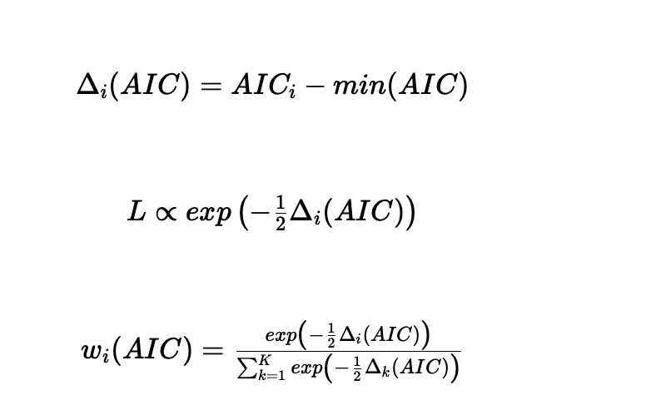
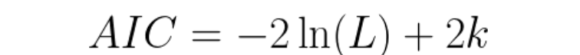
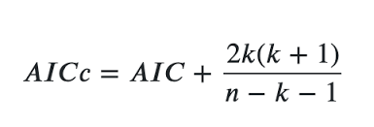
“Some simple rules of thumb are often useful in assessing the relative merits of models in the set: Models having Δ𝑖 ≤ 2 have substantial support (evidence), those in which 4 ≤ Δ𝑖 ≤ 7 have considerably less support, and models having Δ𝑖 > 10 have essentially no support.” Burnham & Anderson 2004 – see dAIC
 | Model | Npar (k) | Rank | logLik (L) | AIC | AICc | dAIC | AICwt
Model A | p~1 phi~1 | 2 | 2 | -333 | 670 | 671 | 0 | 0.79
Model B | p~1 phi~t | 7 | 7 | -330 | 673 | 676 | 2.9 | 0.19
Model C | p~t phi~1 | 7 | 7 | -332 | 678 | 678 | 7.6 | 0.02
Model D | p~t phi~t | 12 | 12 | -328 | 681 | 688 | 10.1 | 0.00

Slide 21
Model selection is cool, but don’t stop there
Look at your parameter estimates and check if
they make sense!

Slide 22
Why Capture-Mark-Recapture (CMR) ?
Detection probability
Separating between
- probability of detection (given presence)
- probability of the parameters in question
(e.g. survivorship, origination, occupancy, immigration)
and derived parameters such as species richness/diversity
The probability of detection or sampling is sometimes only a nuisance but sometimes interesting in itself.
Covariates can be EASILY included in models for both vital parameters and sampling/detection estimates.
Covariates can be modeled at a variety of levels (e.g. group factors, individual traits, temporal characteristics)

Slide 23
Chapters in MARK book most relevant (if not using MARK)
Chapter 1 (introduction)
Chapter 4 (dipper example, but skip the MARK specific bits)
Chapter 5 (goodness of fit –not covered in lectures but important)
Chapter 6 (more on covariates and link functions)
Chapter 11 (individual covariates)
Chapter 12 (Pradel) and 13 (JS models in general)
http://www.phidot.org/software/mark/docs/book/

Slide 24
Different classes of CMR (MR) models
CJS models
JS models
Cormack-Jolly-Seber models
Originally “Closed-population model”
“conditional upon the animal being released alive at first encounter, and survival and catchability refer only to these marked animals”
Developed initially for survival rates
Translation: we can get extinction rates if we are only interested in the taxa that entered the fossil record and are sampled at least once.
Jolly-Seber models
“Open-population model”
“unmarked animals in the population have the same probability of capture as marked animals in the population, i.e., that newly captured unmarked animals are a random sample of all unmarked animals in the population”
Developed for parameters like abundance, population growth, recruitment.
Translation: we can get extinction rates, origination rates, taxonomic richness and we include those taxa never sampled or have never entered the fossil record.
Q Which class of model do you expect a greater uncertainty in estimates? Why?
Notes:
http://www.phidot.org/software/mark/docs/book/pdf/chap12.pdf

Slide 25

Closed-population: births and deaths happen in your sampling universe only

Slide 26
Open-population

Slide 27
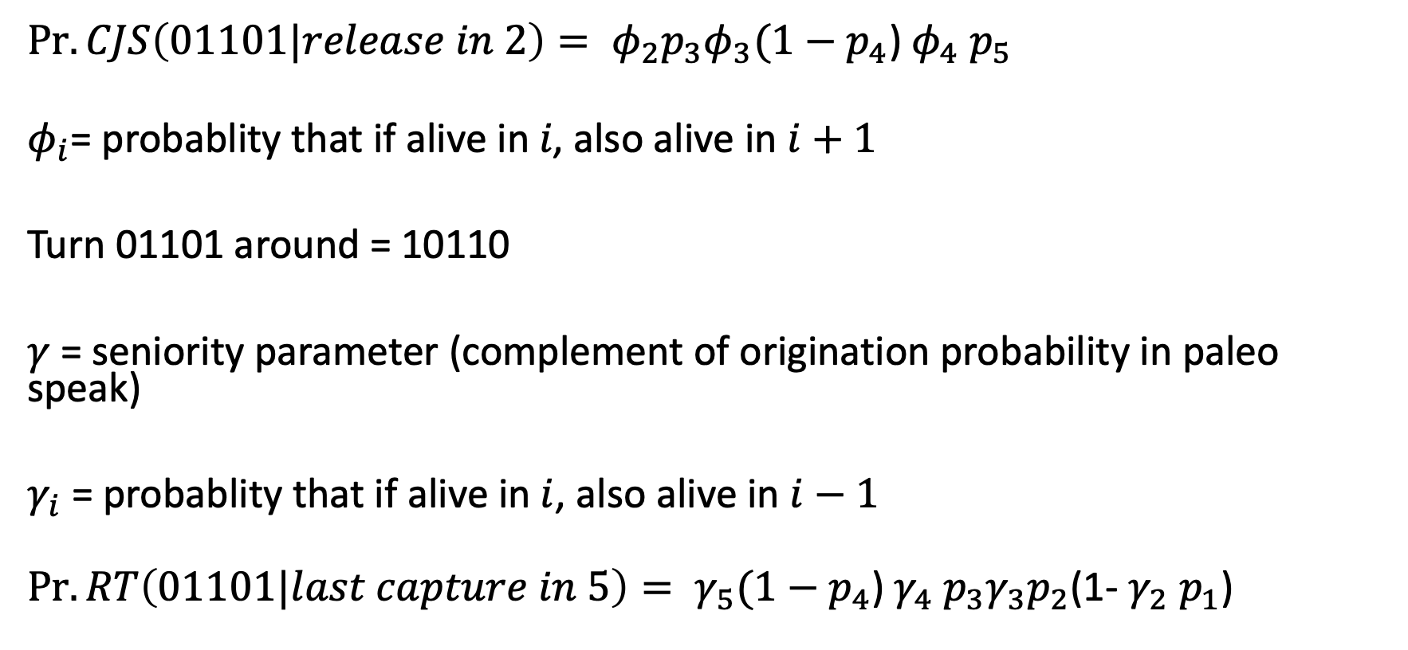
RT models
$\operatorname{Pr}{.CJS\left(01101|release in 2\right)= φ_{2}p_{3}φ_{3}{(1−p}_{4}}$) $φ_{4}$ $p_{5}$
$$φ_{i}\text{= probablity that if alive in} i\text{, also alive in }i+1$$
Turn 01101 around = 10110
$γ$ = seniority parameter (complement of origination probability in paleo speak)
$γ_{i}$= probablity that if alive in$i$, also alive in $i−1$
$\operatorname{Pr}{.RT\left(01101|last capture in 5\right)= γ_{5}{(1−p}_{4}}$) $γ_{4} p_{3}γ_{3}p_{2}$(1- $γ_{2}$ $p_{1}$)

Slide 28
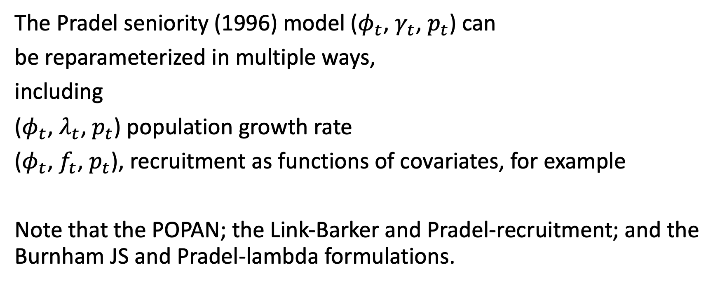
Pradel seniority model
The Pradel seniority (1996) model ($φ_{t}$, $γ_{t}$, $p_{t}$) can
be reparameterized in multiple ways,
including
($φ_{t}$, $λ_{t}$, $p_{t}$) population growth rate
($φ_{t}$, $f_{t}$, $p_{t}$), recruitment as functions of covariates, for example
Note that the POPAN; the Link-Barker and Pradel-recruitment; and the Burnham JS and Pradel-lambda formulations.

Slide 29
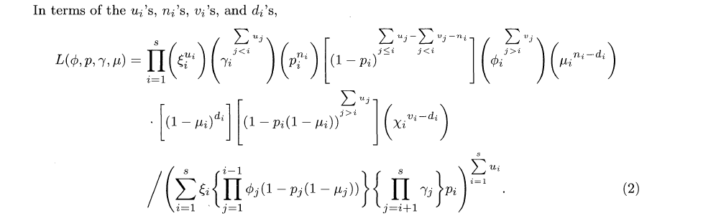
Pradel (1996): Likelihood expression to maximize
Pradel 1996

Slide 30
openCR to the rescue
Notes:
https://sites.google.com/site/cmrsoftware/lecture-lab-schedule/week-10-open-cmr-abundance-and-recruitment/jolley-seber (parameterization)
Likelihood

Slide 31
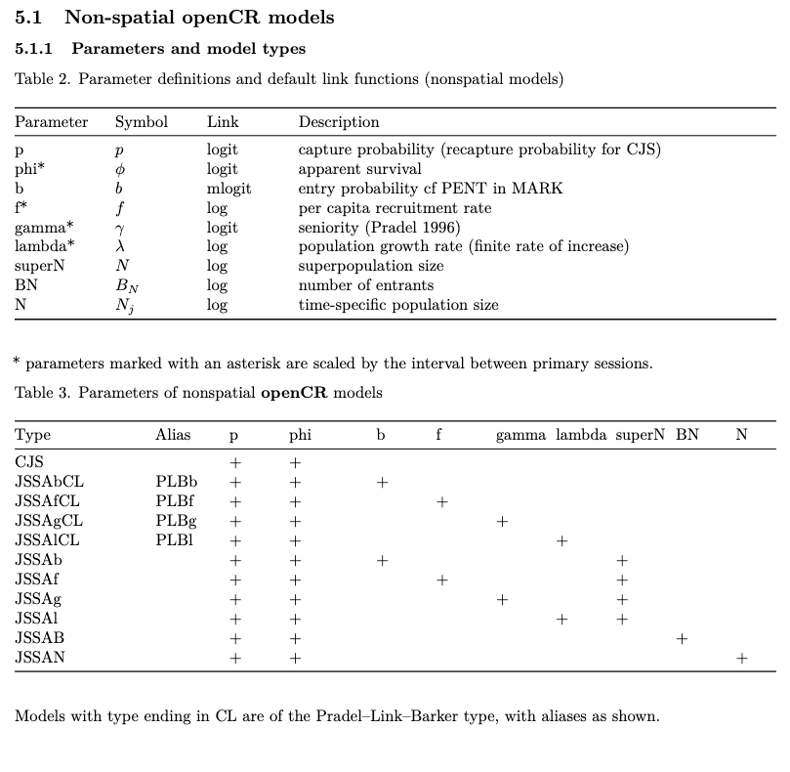
“Translations”
p | Sampling probability
phi | Survival probability (1-phi is extinction probability)
b | Similar to 1-gamma but not “scaled”
f | Per capita origination/speciation
gamma | Seniority probability (1-gamma is origination probability)
lamda | Net diversification rate
superN | Richness of the whole “data” (including those not seen)
BN | Number of new taxa appearning
N | Number of taxa in time interval
Conditional (closed populations)
Open populations, hence the estimates of some form of N
https://cran.r-project.org/web/packages/openCR/vignettes/openCR-vignette.pdf

Slide 32
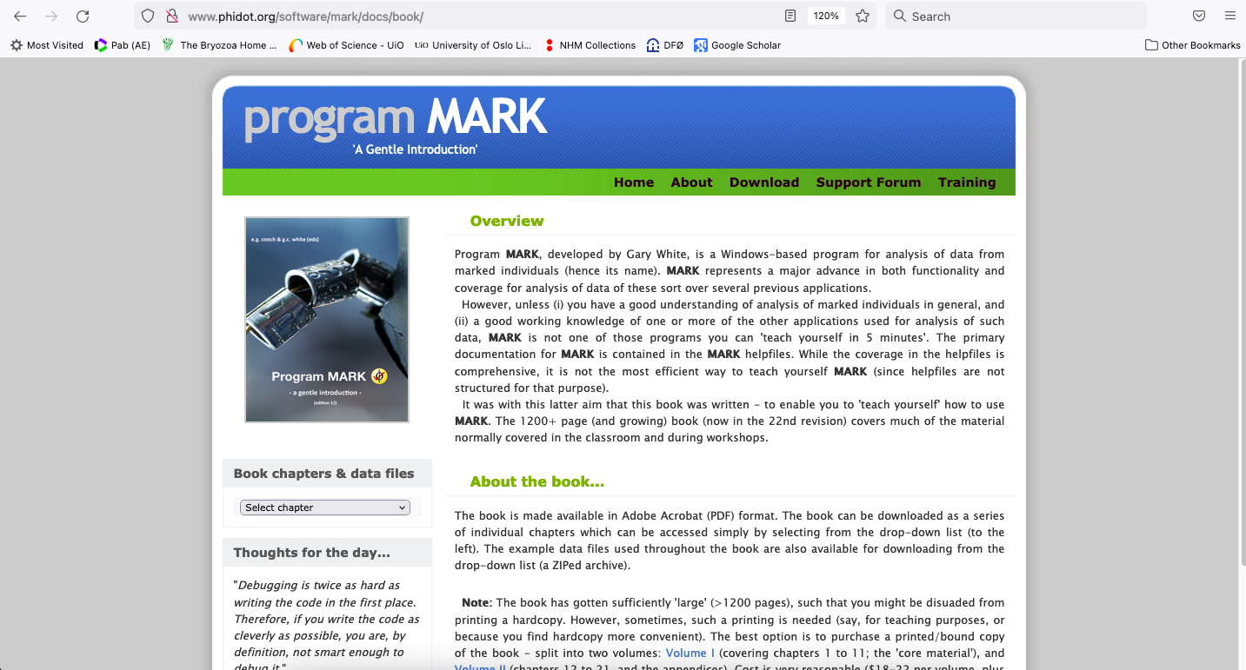
MARK is the “main” software and easy to read reference (but you must “translate”)
http://www.phidot.org/software/mark/docs/book/
Gary White

Slide 33
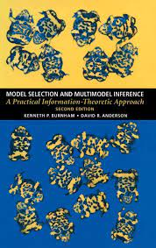
Self learning material and software
Gary White MARK
http://www.phidot.org/software/mark/
(great if you are windows user, a bit more involved if you us Mac) great to pair with Rmark (Jeff Laake)
Gary White MARK book
http://www.phidot.org/software/mark/docs/book/
Michael Conroy lecture notes (bare bones description of models; useful for Mark/Rmark code and data) https://sites.google.com/site/cmrsoftware/
Burnham and Anderson 2022:
Model Selection and Multimodel Inference: A Practical Information-Theoretic Approach

Slide 34
R packages for CMR
RMark (runs MARK from R, works best with Windows)
serc and openCR
Marked (some overlap with openCR and MARK but this doesn’t have Pradel models)
R2ucare (for goodness of fit tests and simulations for CMR)
mra, Rcapture, BaSTA

Slide 35
Brief comparisons of CMR with other approaches (paleo context)
Notes:
Also LMY
Alroy Paleobiology A more precise speciation and extinction rate estimator
2015
A new turnover rate metric is introduced that combines simplicity and precision. Like the related three-timer and gap-filler equations, it involves first identifying a cohort of taxa sampled in the time interval preceding the one of interest (call the intervals i0 and i1). Taxa sampled in i0 and i1 are two-timers (t2); those sampled in i0 and i2 but not i1 are part-timers (p); and taxa sampled only in either i1, i2, or i3 are newly notated here as either s1, s2, or s3. The gap-filler extinction proportion can be reformulated as (s1−s3)/(t2+p).

Slide 36
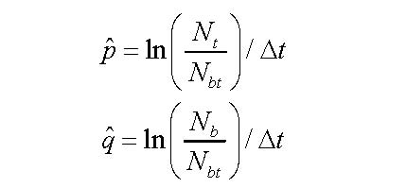
Foote’s per capita origination and extinction rates (boundary crossers)
Comparisons with other approaches
bL
FL
Easy to use
Lose information of “singletons” (FL class information not used)
Hard to compare different models
Ft
bt
Foote, M. 2000. Origination and extinction components of taxonomic diversity: general problems. Paleobiology 26:74-102.
Notes:
Also LMY
Alroy Paleobiology A more precise speciation and extinction rate estimator
2015
A new turnover rate metric is introduced that combines simplicity and precision. Like the related three-timer and gap-filler equations, it involves first identifying a cohort of taxa sampled in the time interval preceding the one of interest (call the intervals i0 and i1). Taxa sampled in i0 and i1 are two-timers (t2); those sampled in i0 and i2 but not i1 are part-timers (p); and taxa sampled only in either i1, i2, or i3 are newly notated here as either s1, s2, or s3. The gap-filler extinction proportion can be reformulated as (s1−s3)/(t2+p).

Slide 37
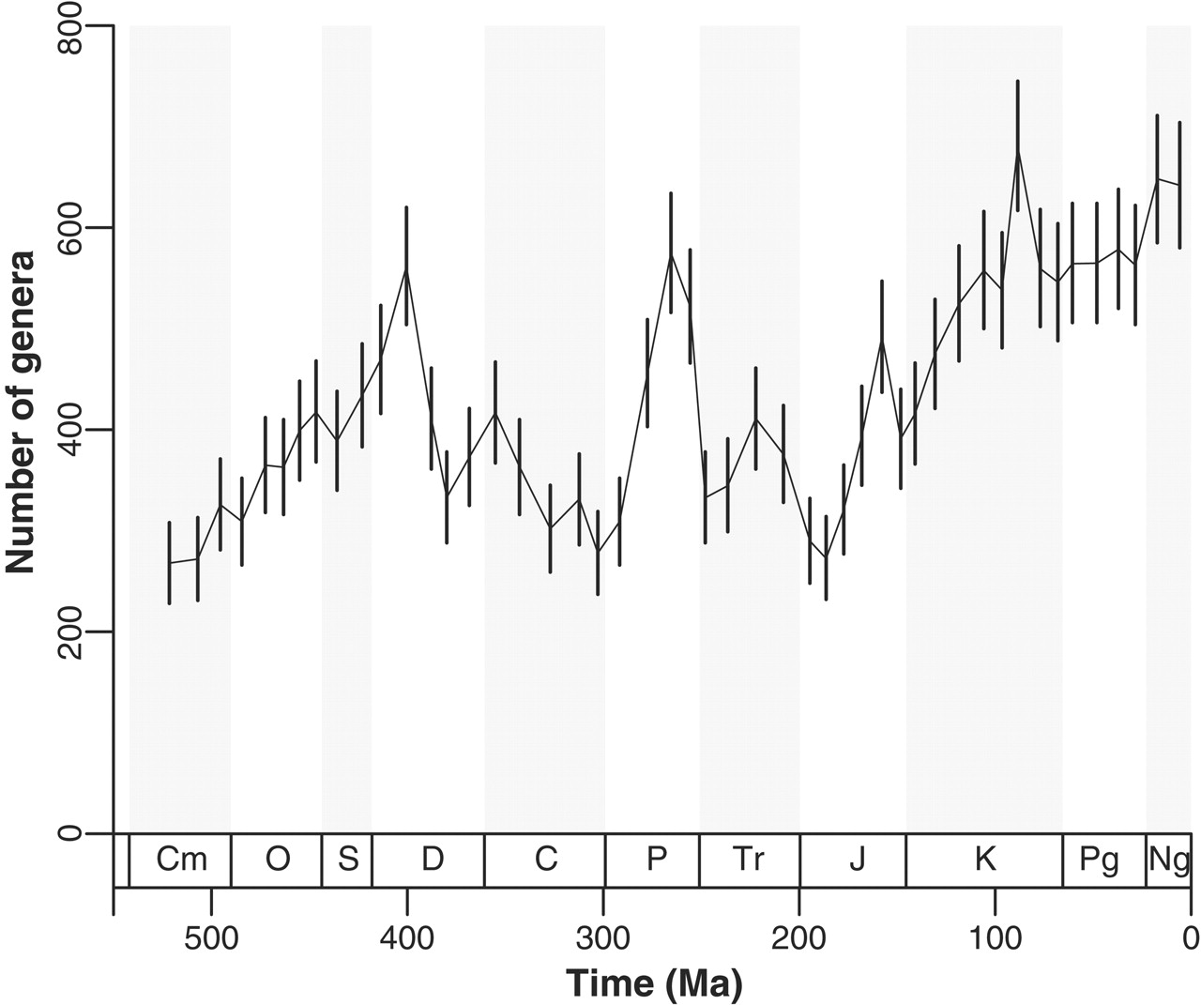
Sampling standardization approaches (including SQS)
Comparisons with other approaches
Easy to use
Assume that even sample or quorums will allow
unbiased relative change to be estimated
Ad hoc rather than modelling approach (preservation
is not modelled although it is part of the process)
Hard to compare different models
Notes:
Also LMY
Alroy Paleobiology A more precise speciation and extinction rate estimator
2015
A new turnover rate metric is introduced that combines simplicity and precision. Like the related three-timer and gap-filler equations, it involves first identifying a cohort of taxa sampled in the time interval preceding the one of interest (call the intervals i0 and i1). Taxa sampled in i0 and i1 are two-timers (t2); those sampled in i0 and i2 but not i1 are part-timers (p); and taxa sampled only in either i1, i2, or i3 are newly notated here as either s1, s2, or s3. The gap-filler extinction proportion can be reformulated as (s1−s3)/(t2+p).

Slide 38
CMR-like approaches in paleo independently developed
Comparisons with other approaches
Foote 2003 Journal of Geology
Alroy “three-timer” and related methods
Some hard, some easy to use, not easy to understand
Hard to compare different models
(very) Special cases of CMR
Notes:
Also LMY
Alroy Paleobiology A more precise speciation and extinction rate estimator
2015
A new turnover rate metric is introduced that combines simplicity and precision. Like the related three-timer and gap-filler equations, it involves first identifying a cohort of taxa sampled in the time interval preceding the one of interest (call the intervals i0 and i1). Taxa sampled in i0 and i1 are two-timers (t2); those sampled in i0 and i2 but not i1 are part-timers (p); and taxa sampled only in either i1, i2, or i3 are newly notated here as either s1, s2, or s3. The gap-filler extinction proportion can be reformulated as (s1−s3)/(t2+p).

Slide 39
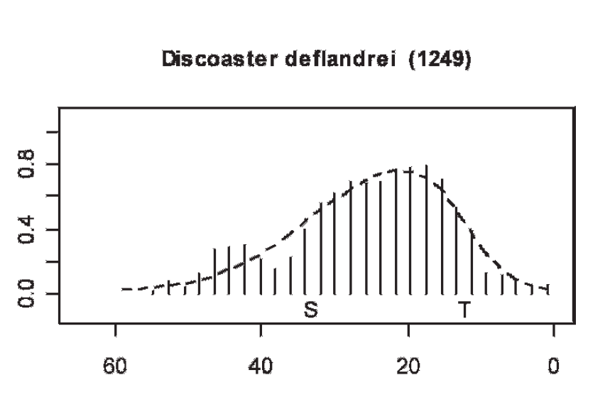
Comparisons with other approaches
PyRate (Silvestro et al. Sys Bio 2014)
Key preservation assumption (different) is the shape of species observations (beta distribution based on “hat”)
Smooths out temporal information
Conditioned on at least one observation per taxon (like the CMR models conditioned on first observation)

Slide 40
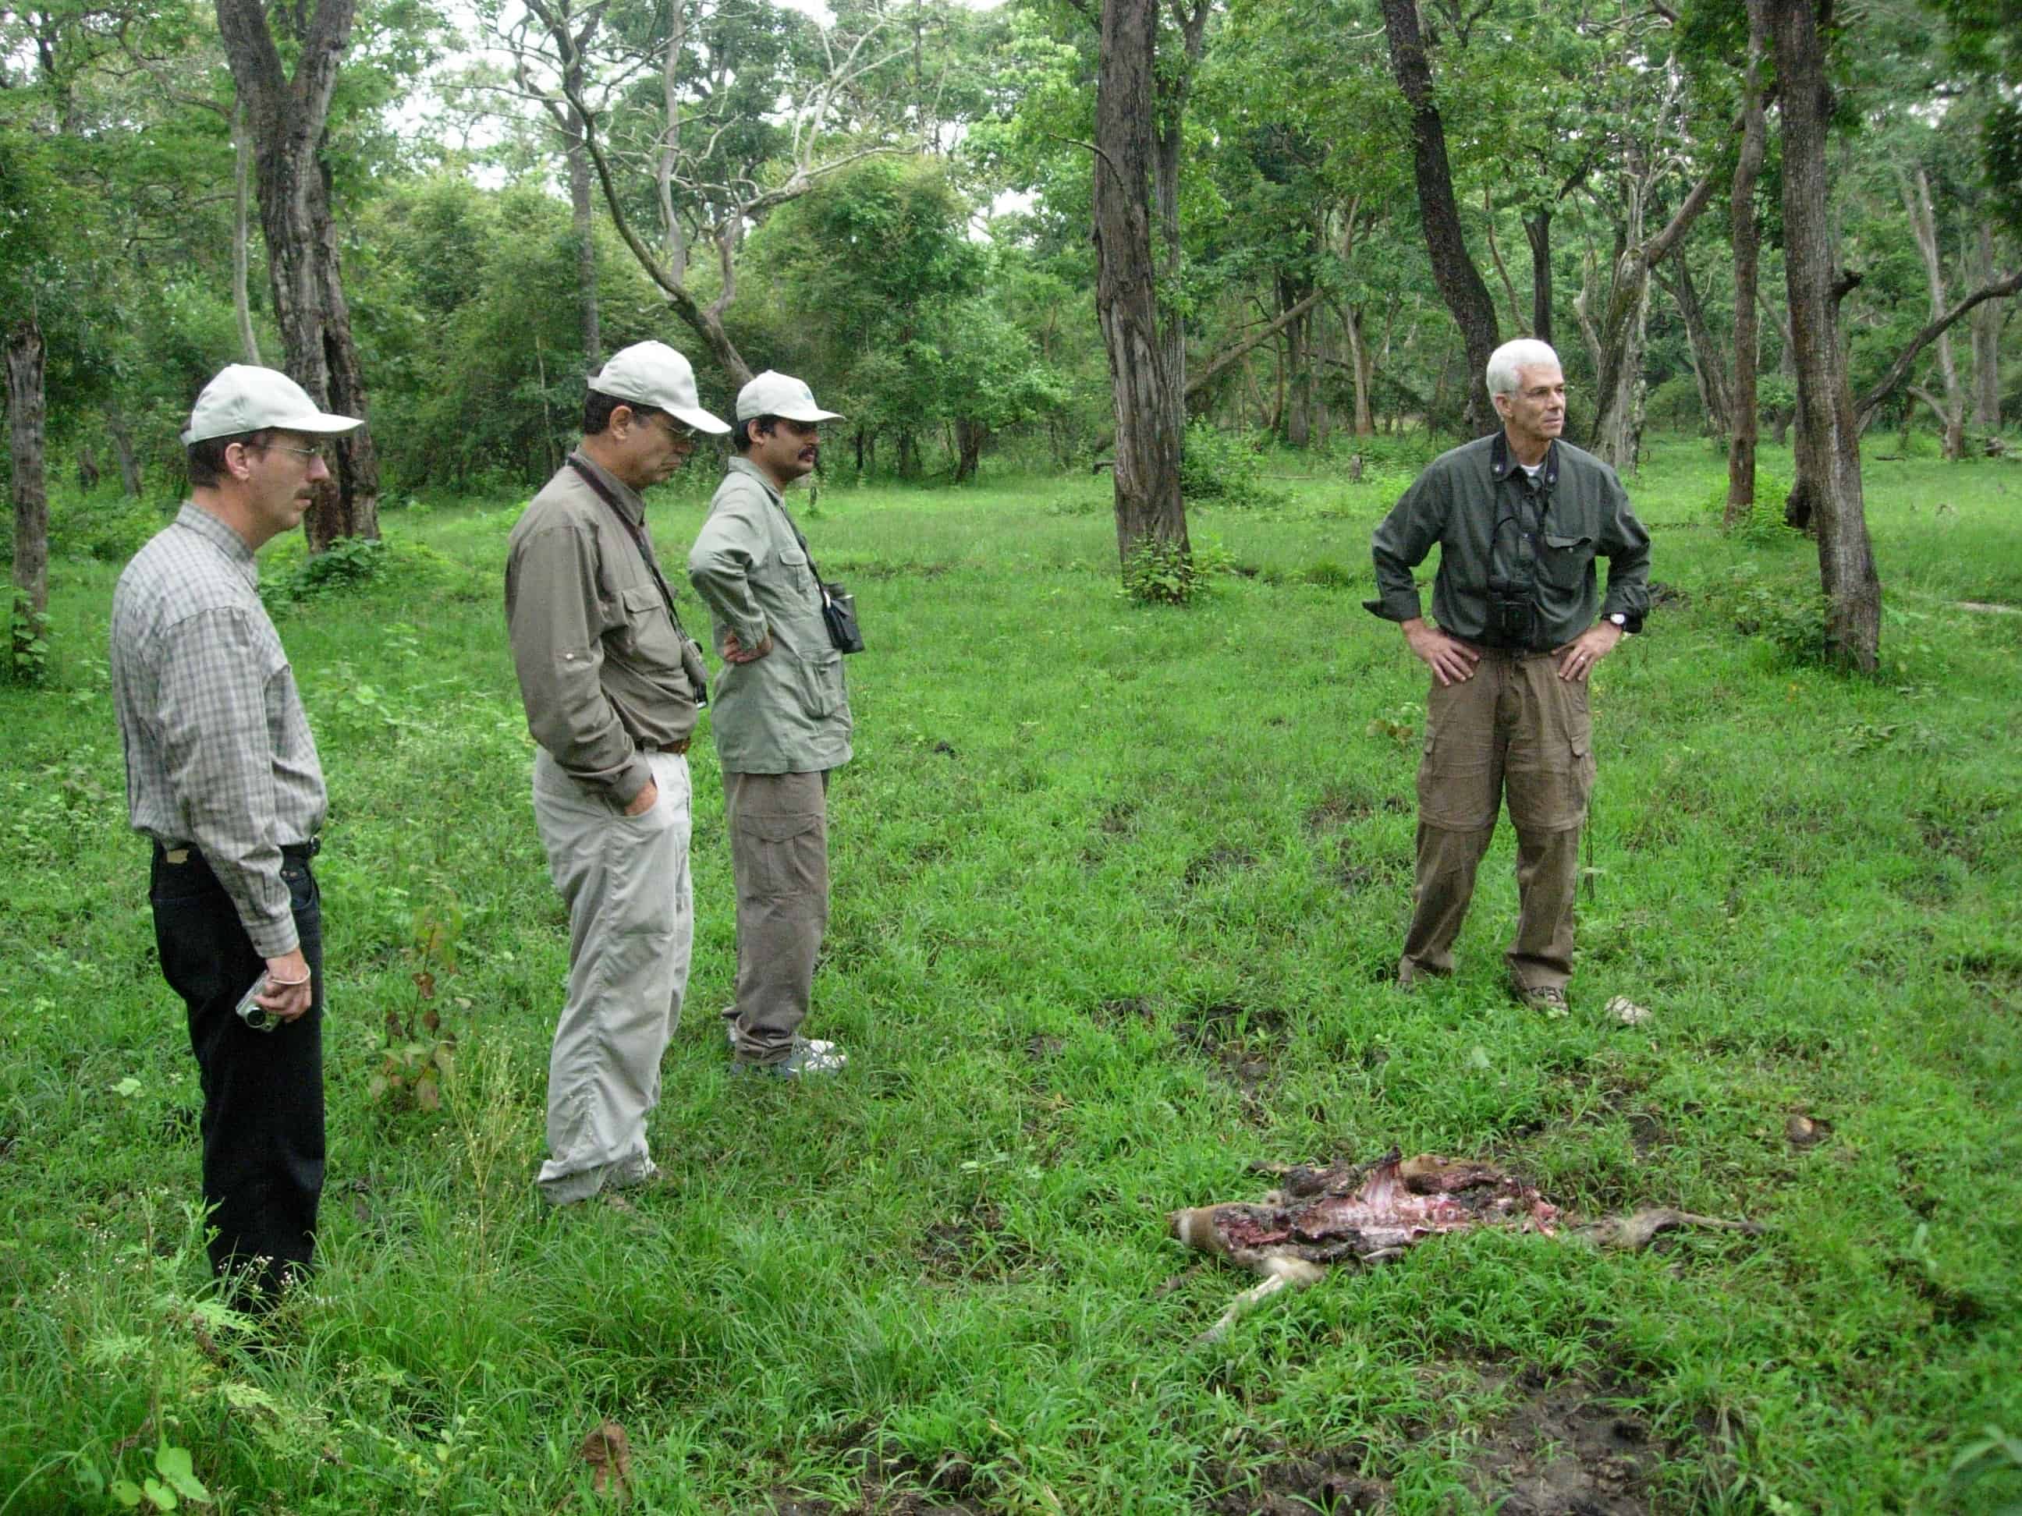
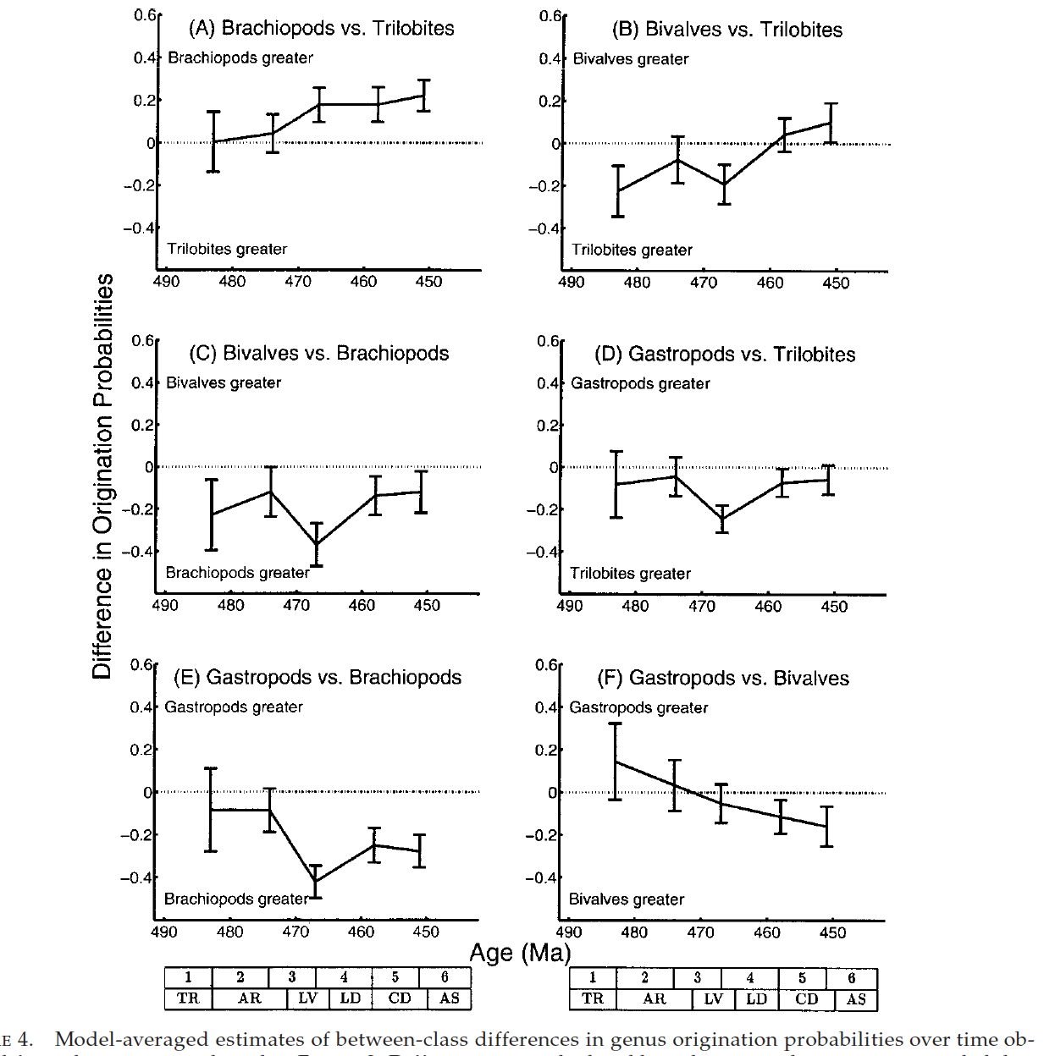
Some paleo papers using CMR
Nichols, J.D. and Pollock, K.H. (1983) Estimating taxonomic diversity, extinction rates, and speciation rates from fossil data using capture-recapture models. Paleobiology 9, 150–163
Connolly, S.R. and Miller, A.I. (2001) Joint estimation of sampling and turnover rates from fossil databases: Capture-Mark-Recapture methods revisited. Paleobiology 27, 751–767
Connolly, S.R. and Miller, A.I. (2001) Global Ordovician faunal transitions in the marine benthos: proximate causes. Paleobiology 27, 779–795
Connolly, S.R. and Miller, A.I. (2002) Global Ordovician faunal transitions in the marine benthos: ultimate causes. Paleobiology 28, 26–40

Slide 41
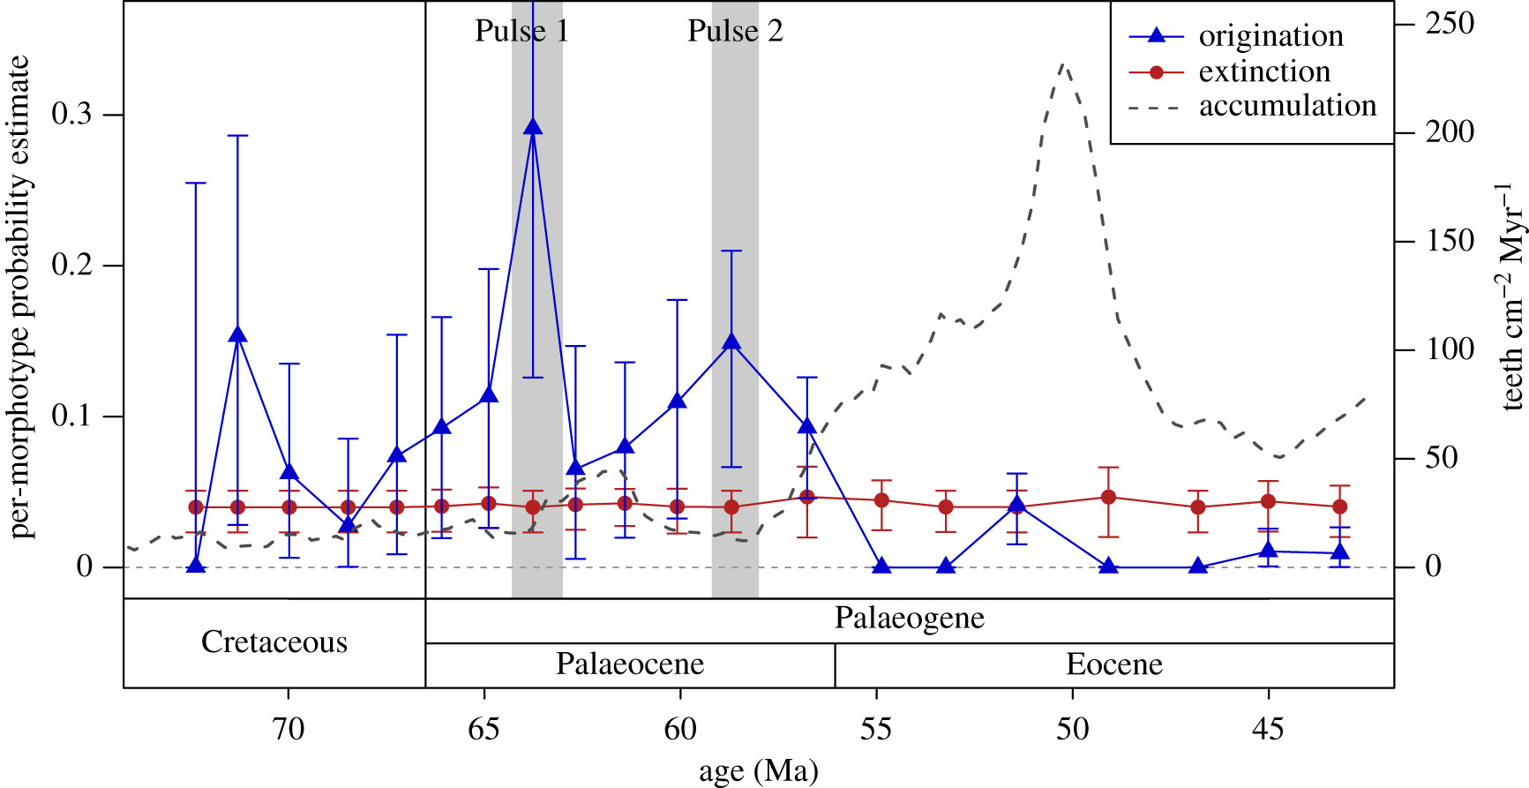
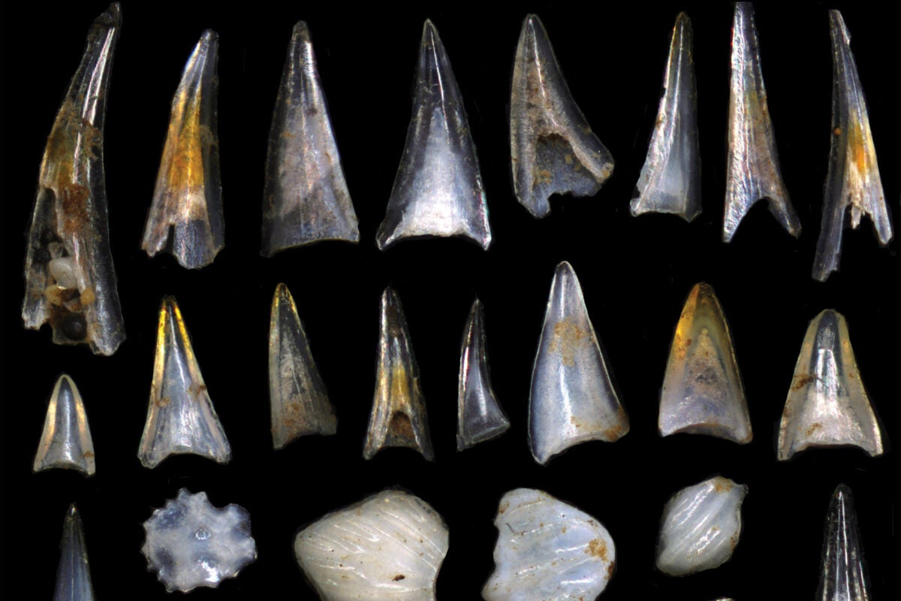
Some paleo papers using CMR
https://news.harvard.edu/gazette/story/2018/11/tiny-teeth-tell-the-story-of-two-fish-species-rapid-evolution/
Sibert, E. et al. (2018) Two pulses of morphological diversification in Pacific pelagic fishes following the Cretaceous - Palaeogene mass extinction. Proc. R. Soc. B-BIOLOGICAL Sci. 285,

Slide 42
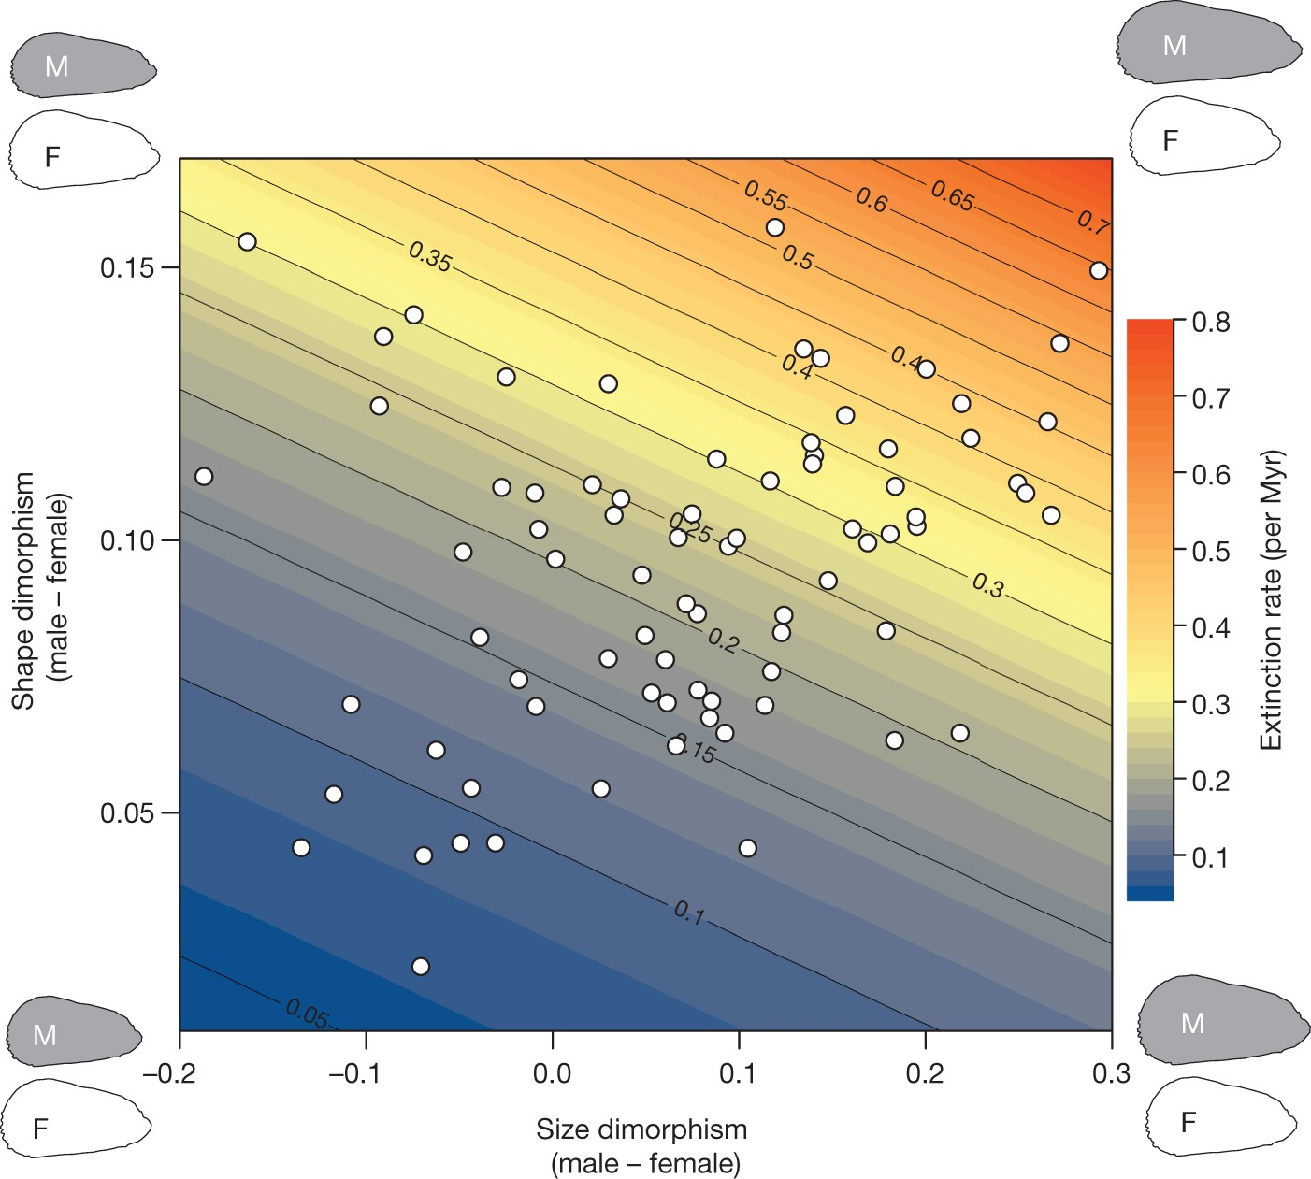
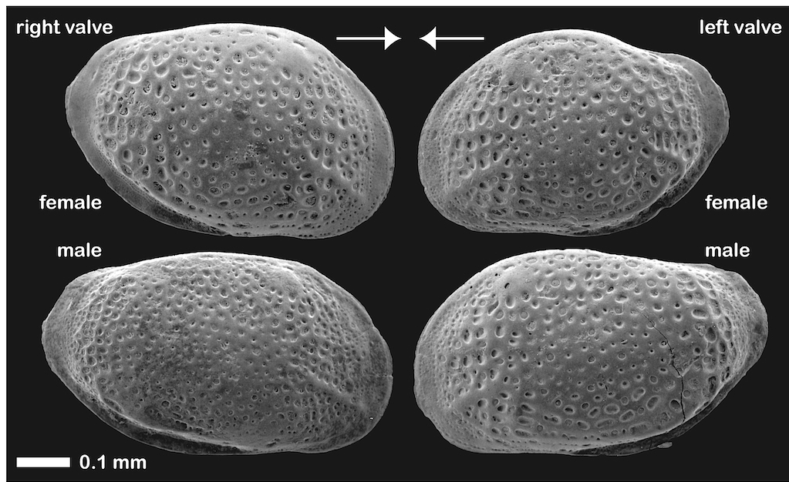
Some paleo papers using CMR
Ozawa (2012)
Martins, M.J.F. et al. (2018) High male sexual investment as a driver of extinction in fossil ostracods. Nature

Slide 43
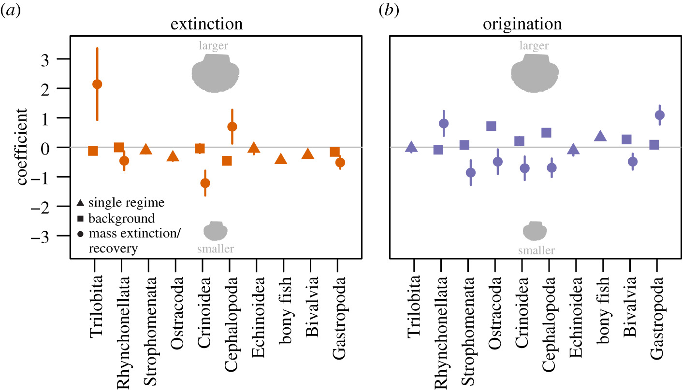
Some paleo papers using CMR
Payne, J., & Heim, N. (2020). Body size, sampling completeness, and extinction risk in the marine fossil record.
Paleobiology, 46(1), 23-40. doi:10.1017/pab.2019.43
Pedro M. Monarrez, Noel A. Heim and Jonathan L. Payne 2021
Mass extinctions alter extinction and origination dynamics with respect to body size
Proc B
“CMR analysis of the fossil record reveals a
against the sampling of smaller-bodied
genera within classes “

Slide 44
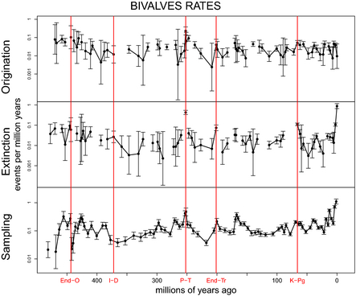
Some paleo papers using CMR
Liow, L.H. et al. (2015) Ecological interactions on macroevolutionary time scales: clams and brachiopods are more than ships that pass in the night. Ecol. Lett. 18, 1030–1039

Slide 45
Some newer fossil papers using CMR
Schachat et al. 2021. A Cretaceous peak in family-level insect diversity estimated with mark–recapture methodology. Proceedings of the Royal Society, B 286:20192054.
Cohen et al. 2022 Plio-Pleistocene environmental variability in Africa and its implications for mammalian evolution, PNAS 119 (16) e2107393119
Wilson et al. 2024. Unveiling the underlying drivers of Phanerozoic marine diversification. Proceedings of the Royal Society, B 291: 20240165
Leventhal S, Samuels-Fair M. 2025 Larval brooding correlated with high early origination rates in cheilostome Bryozoa. Paleobiology. 51(2):261-267

