Slide 1

Biodiversity in deep time
Wolfgang Kiessling
Paleobiology, FAU Erlangen
18-19 August 2026
Wolfgang Kiessling
Notes:
Perhaps better „assemblage-level“ biodiversity

Slide 2
R packages needed today
library(vegan)
All kinds of community ecology
Ordination methods
library(betapart)
All kinds of beta diversity measures
library(iNext)
All kinds of diversity analysis based on Anne Chao’s work
https://sites.google.com/view/chao-lab-website/home

Slide 3
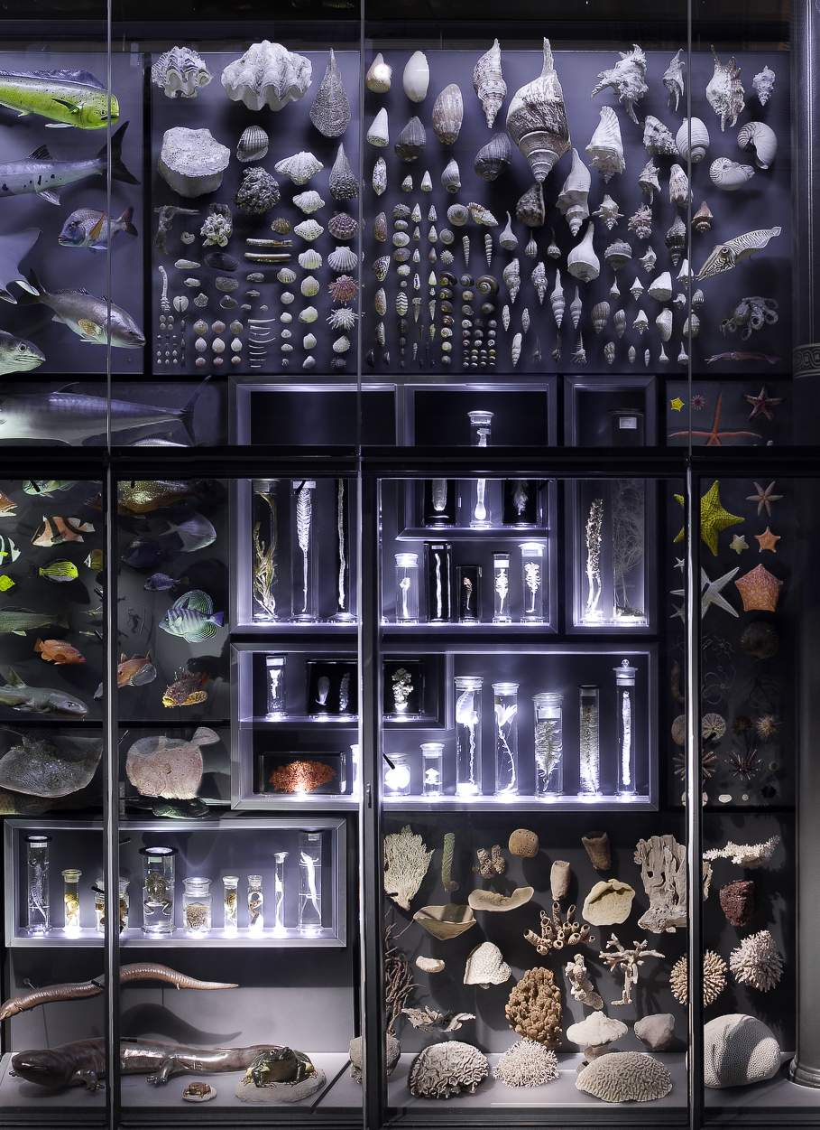
Biodiversity
The diversity of life in all its expressions on all levels of organization
Expressed by
Genetic diversity
Morphologic diversity
Resource partitioning (ecological or functional diversity)
Here: ‘Number’ of taxa coexisting in a system
Species, Genera, Families
Problem: Define number and system!

Slide 4
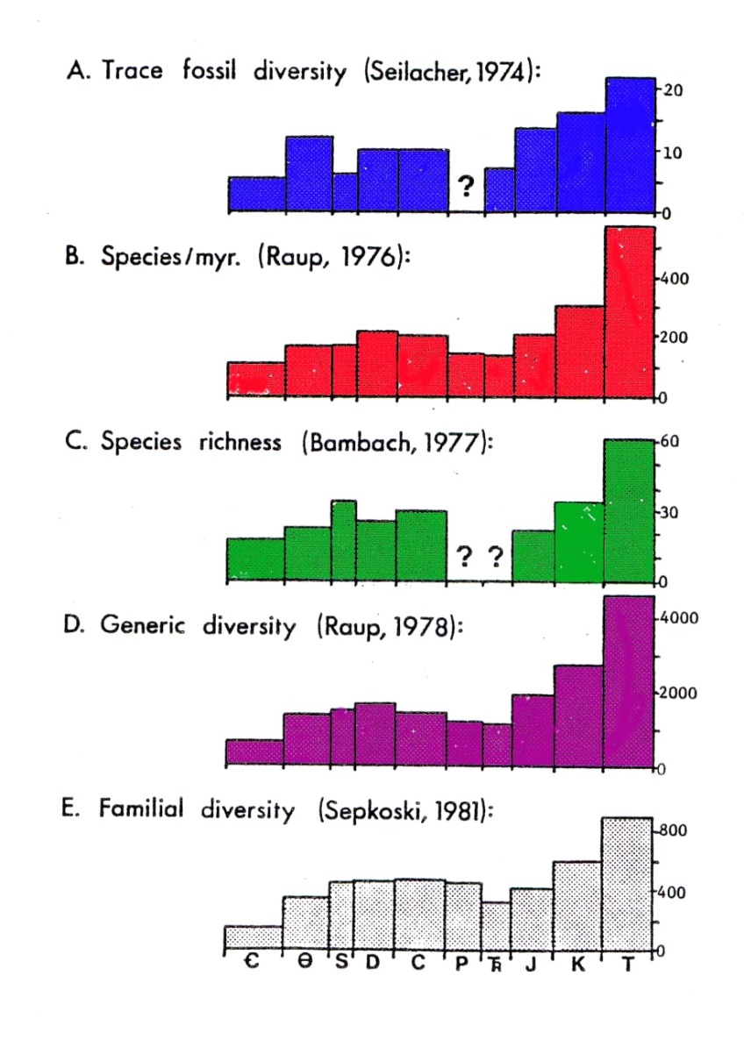
Structure
The Consensus Paper
Alpha, Beta, Gamma diversity
Concepts and metrics
Previous analyses with Phanerozoic scope
Alpha, beta and gammy diversity through time
Alpha diversity
Diversity metrics and sampling standardization
Exercise based on fossil assemblages
Beta diversity
Measuring beta
Exercise using fossil multivariate approaches
Sepkoski et al. (1981)

Slide 5
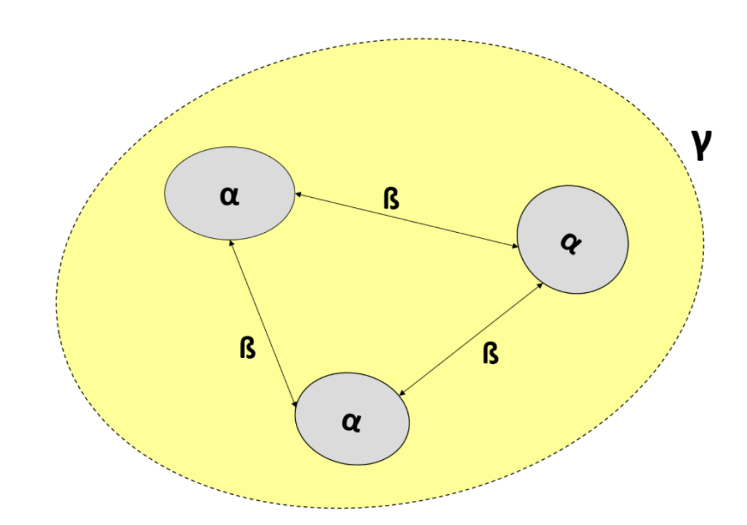
Components of biodiversity
Point diversity (Alpha) = Within community diversity
Between community diversity (Beta) = turnover
Total diversity (Gamma): Area, region, or globe
Mean(Alpha) x Beta = Gamma
Notes:
Multiplicative
Alpha can vary

Slide 6
Exercise: Alpha, Beta, Gamma
Birds in three British habitats
Species | Wood | Hedge | Open field
A | X
B | X
C | X
D | X
E | X
F | X | X
G | X | X
H | X | X
I | X | X
J | X | X
K |  | X
L |  | X | X
M |  |  | X
N |  |  | X

Slide 7
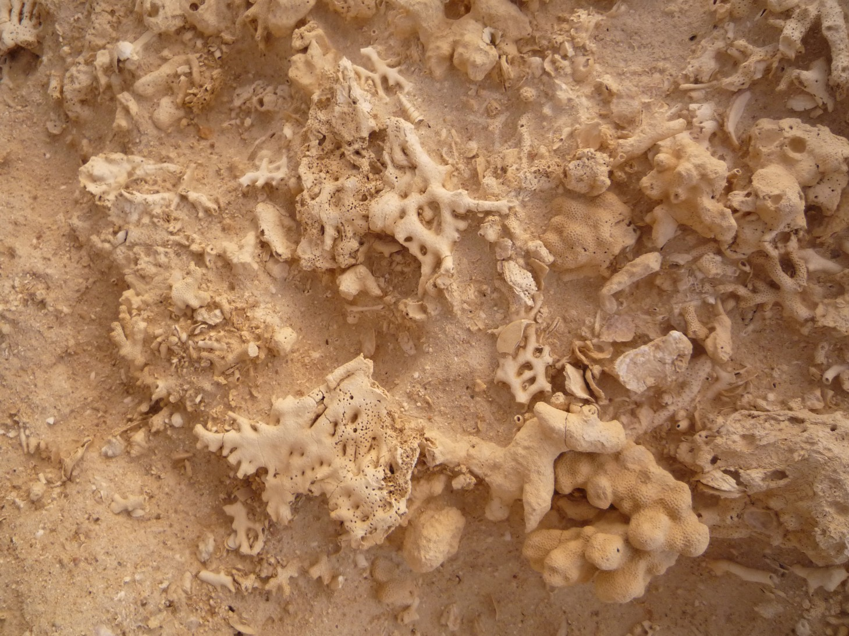
Communities, meta-communites, assemblages
Community?
Community: Interacting groups from different species living in a single habitat
Meta-communities: A set of local communities that are linked by dispersal of multiple potentially interacting species
In paleo we can only identify assemblages: a collection or group of fossils found in the same sedimentary rock layer
Notes:
But quantitative methods are the same

Slide 8
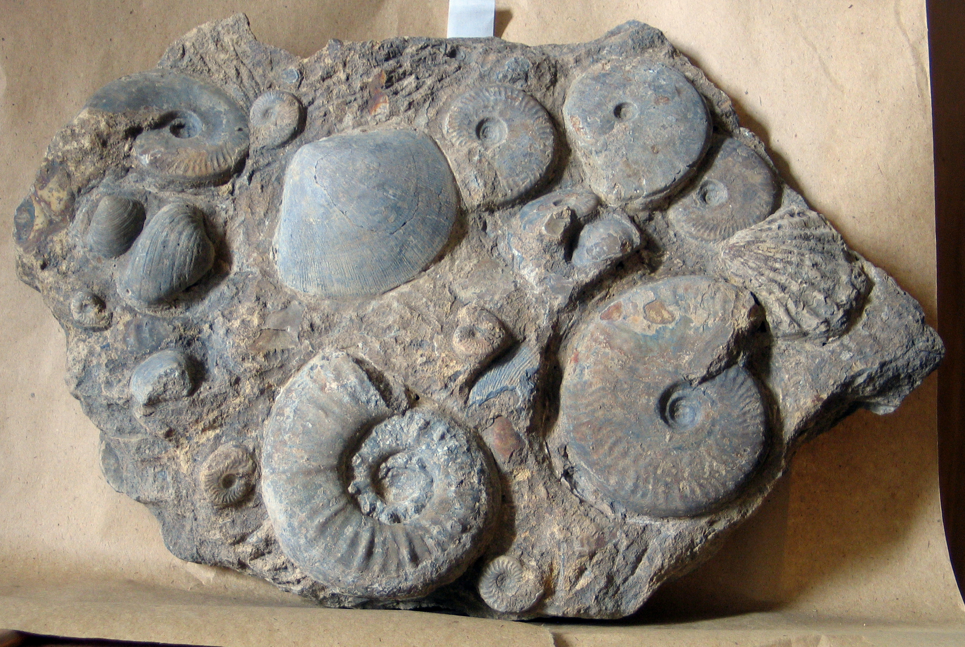
Alpha Diversity
Species richness (Number of species)
Abundance (Number of individuals per species)
Notes:
Species richness means giving maximum weight to rare species.

Slide 9
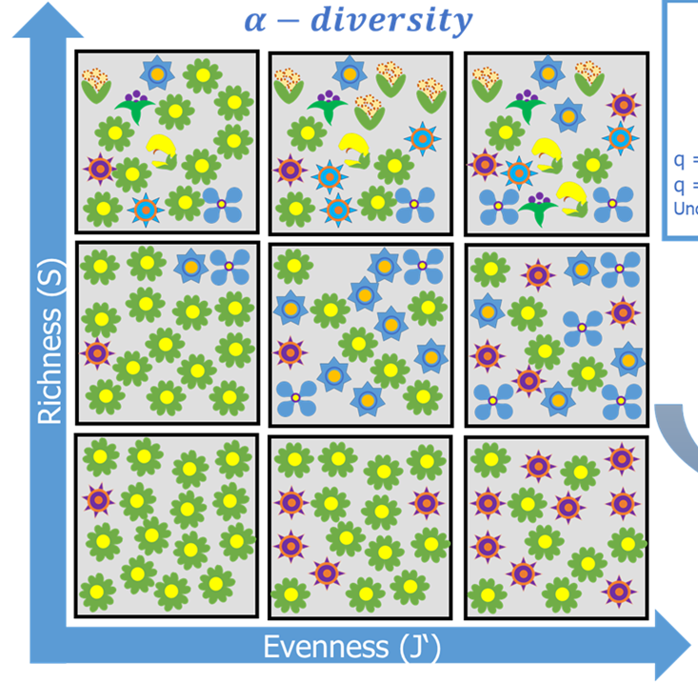
Measuring Alpha Diversity
Two essential components: richness and evenness
Simple Case
All species are equally common
Species numbers alone (S) provide sufficient information (but there is sampling bias)
Realistic case
Abundance distributions are strongly skewed
S isn‘t meaningful and sampling bias might be extreme
How to value relative abundances in diversity estimates?
Weighing rare or common species

Slide 10
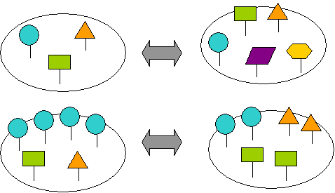
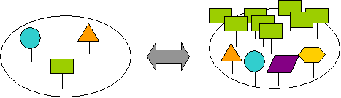
Alpha Diversity
Which community is more diverse?

Slide 11
Diversity Indices: Annotations
N = Number of Individuals
S = Number of Species
p = The proportion of a species (i) in a community
Most commonly used
Shannon-Wiener Information Index (H) aka Shannon Entropy
H = -∑ p_{i} x ln(p_{i})
p_{i} = Proportion of the i^{th} species in the community
Natural log most common, but sometimes also log₂ or log₁₀
Notes:
the cross entropy

Slide 12
Compute H for the two assemblages
H =
H =

Slide 13
Simpson’s index (dominance and diversity)
Probability that another individual belongs to the same species
More weight on abundant species
Main term (dominance) D = ∑ n (n-1) /N (N-1)
Simplified D = ∑ (n/N) ² = ∑ p_{i}²
Simpson’s Diversity index
SD = 1- D
Simpson’s Reciprocal Diversity Index
RD = 1/D
Notes:
Simpson Diversity: Sometimes also 1/D
Simpson's Reciprocal Index

Slide 14
Compute D, SD, and RD for the two assemblages
D =
SD =
RD =
D =
SD =
RD =

Slide 15
Fisher’s Alpha
Fisher‘s α based on assuming a log-series distribution
P(n)= αx^{n}/n​
Probability P that a species has n individuals
x = shape parameter of the distribution (related to proportion of individuals in the most common species)
α = diversity index
S = α ln(1+N/α)
α only determined iteratively
Calculate α for S = 30 and N = 400
Notes:
1943
Many rare species (with one or a few individuals), Few common species, A “long tail” of rarities.

Slide 16
Other Indices
Brillouin Index
N = total number of individuals
n = number of individuals in species x
Margalef-Index
D_{M} = (S-1)/ln(N)
Good if you only know gross totals
But only applicable to a log series distribution
Menhinick Index
D_{Mh} = S/√N
Berger-Parker Dominance
d = p_{max}

Slide 17
Most diversity indices are mixed signals of richness and evenness
Pure Evenness should only measure relative abundance distributions and be independent of richness
Evenness metrics
Evenness J = H/H_{max}
H_{max} = ln(S)
Equitability E = e^{H}/S
Hurlbert‘s PIE (Probability of Interspecific Encounter)
PIE =
Notes:
Hurlbert’s PIE is essentially Simpson’s Diversity

Slide 18
Compute J for the two assemblages
J =
J =

Slide 19
Can we get a metric that unifies H and J in a reasonable way?
The effective number of species
Aka Hill number, species diversity or true diversity
The number of equally abundant species that would produce the same diversity as the observed community
q is a parameter that determines the sensitivity to rare or common species:
q=0: Species richness (all species counted equally)
q=1: Shannon diversity (weighted by relative abundance)
q=2: Reciprocal simpson diversity (gives more weight to dominant species)
Notes:
If all species have equal abundances, the effective number of species equals the actual number of species.
If some species are much more dominant than others, the effective number of species is lower than the actual number.

Slide 20
Hill Numbers
For q = 0 (maximum weight to rare species)
D = S
For q = 1 (equal weight to rare and common species)
¹D = e^{H}
For q = 2 (more weight on common species)
²D = 1/D = RD
For q near infinity
The weighted generalized mean with exponent q−1 approaches the proportional abundance of the most abundant species
1/^{Inf}D = p_{max}
Hill, M. O., 1973, Diversity and evenness: A unifying notation and its consequences: Ecology, v. 54, no. 2, p. 427-432.
Notes:
For q = 2 you get Simpson's Reciprocal Index

Slide 21
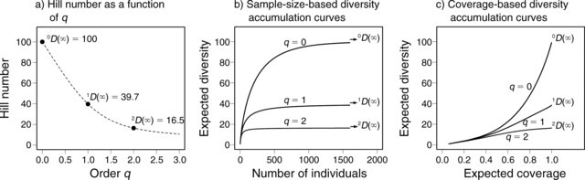
How to weigh rare species?
Critical question in diversity estimates
Rare species form the bulk of species richness but abundant species form the bulk of ecosystem services
Hill Numbers help to assess influence of to rare species on diversity

Slide 22
Use Hill numbers to generate diversity profiles
Diversity trajectories with different Hill numbers can be used to compare if true diversity is greater in one community
If diversity profiles cross, then there are no genuine diversity differences
Exercise:
Plot diversity profiles of three communities
A <- c(60, 5, 5, 5, 5, 5, 5, 5, 5, 5) # S = 10
B <- c(17, 17, 17, 16, 15, 12) # S = 6
C <- c(30, 25, 15, 10, 8, 6, 4, 2) # S = 8

Slide 23
Sampling Bias
Most indices are affected by sample size
Question: What diversity to expect if sample sizes were the same?
Problem: Relationship between sample size and diversity is not linear
N = 12
S = 3
N = 3
S = 2
Notes:
Will hear more about this tomorrow, but methods were originally developed in community ecology

Slide 24
Rarefaction
Interpolation biodiversity
Question: Which species richness would I observe if my sample A was smaller than it is (e.g., as small as sample B)
Equation:
(read N over n) = = N!/n!(N-n)!
E(S_{n}) = expected species richness; S = number of species; N_{i} = Individuals of species i, N = Individuals in total sample, n = Subsampling quota

Slide 25
Two (three) Approaches to Rarefaction
Mathematic solution:
Apply the equation
Empirical solution:
Let the computer draw specimens at random and get diversity for a given sample size
Also: Good’s expected number of species at q given relative abundances
S(q) <- S - Σ(1-p_{i})^{quota}

Slide 26
Shareholder Quorum subsampling (SQS) and Squares estimates
Rarefied diversity has a quota
Quota is a fixed number of specimens for which we estimate diversity
Diversity estimate depends on evenness
SQS has a quorum
Quorum is a fixed coverage of the frequency (=rank-abundance) distribution
Approximated by Good’s u: the proportion of the total number of individuals in a community that belong to species that have already been observed in your sample u = 1−F1/N
F1 = Number of single individual species (singletons)
N = total number of individuals in the sample​​

Slide 27
Biodiversity Indices and Rarefaction
Diversity indices and rarefaction of a Middle Triassic benthic community from China
We go through the script in plenary and spend time on playing with Rarefaction and Shareholder Quorum subsampling
Script: Alpha_div_2026.R

Slide 28
Only for the fastest
Rarefaction with Shannon Entropy and Simpson’s Reciprocal Diversity?
Use renyi() function in vegan package

Slide 29
Rank-Abundance Distributions
Patterns of relative abundances
Major tool in Community Ecology
More information than in common indices
Straightforward interpretations
Resource utilization
Complexity of community

Slide 30
Relative Abundance of Species in Communities
Middle Triassic of China
Usual case: A few species are dominant and there are many rare species.

Slide 31
Presentation
Rank usually linear on x axis
Abundances (relative of absolute) on logarithmic scale on y axis

Slide 32
Examples
100
10
Broken Stick Model
Per Species Abundance
1
0.1
Log-Normal Series
0.01
Log Series
Geometric Series
0.001
10
20
30
40
Species Addition Sequence

Slide 33
Inferences
Evenness increases from Geometric series → Log series → Log-normal → Broken stick
Dominance decreases in same direction
Geometric: Simple community with niche pre-emption
Log-normal: Complex community with diverse guilds coexisting with their own distributions

Slide 34
What model best describes the RAD of the Triassic community?
Try package “vegan” and function “radfit”

Slide 35
Model Selection with AIC
Akaike (1974): An Information Criterion
Mostly: Akaike‘s Information Criterion
“Penalize“ models for complexity (number of parameters)
AIC = -2*ln(likelihood) + 2*K
Likelihood → The fit of the model
K the number of parameters
The smaller the AIC the better
If n/K < 40 use small-sample size correction
AICc = -2*ln(likelihood) + 2*K + (2*K*(K+1))/(n-K-1)
Or BIC (Bayesian Information criterion)

Slide 36
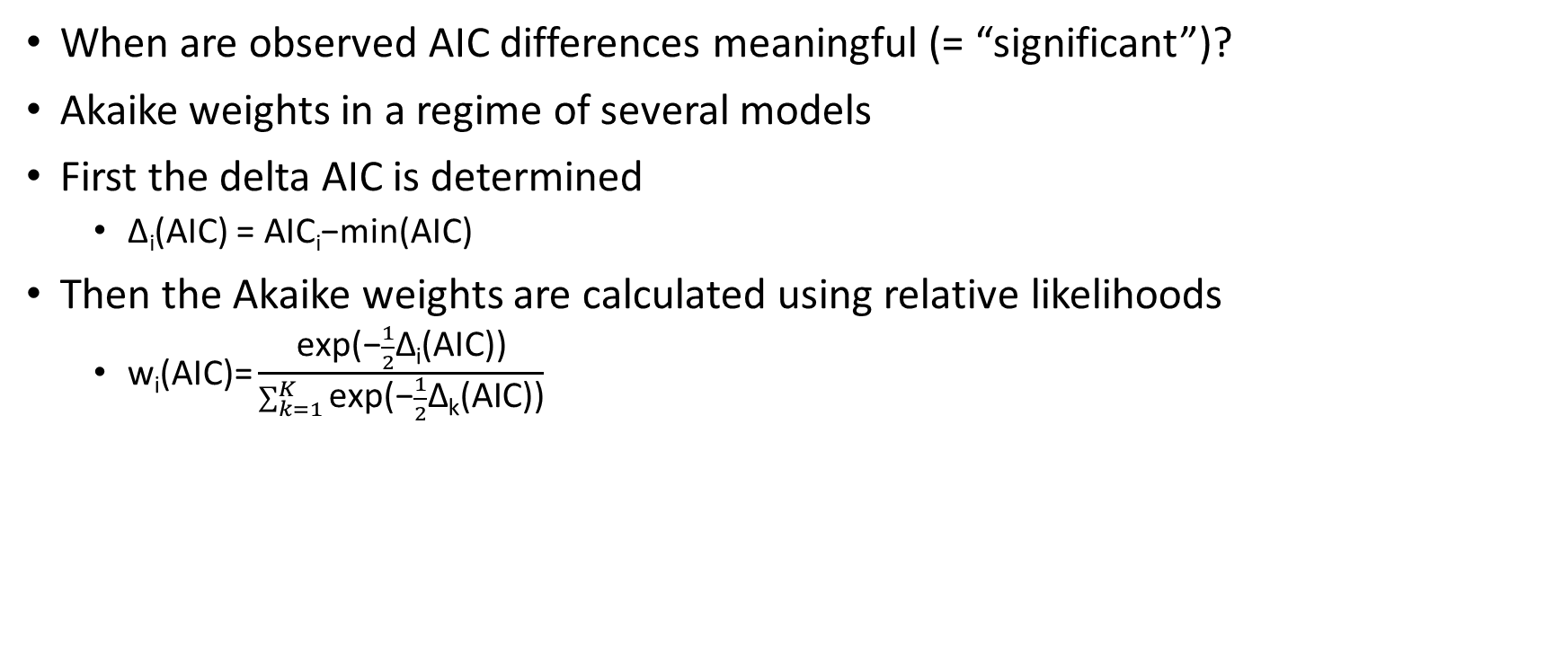
Model Selection with AIC
When are observed AIC differences meaningful (= “significant”)?
Akaike weights in a regime of several models
First the delta AIC is determined
Δ_{i}(AIC) = AIC_{i}−min(AIC)
Then the Akaike weights are calculated using relative likelihoods
$\text{w}\text{i}\text{(}\text{AIC}\text{)=}\frac{\text{exp}\text{(−}\frac{1}{2}\text{Δ}\text{i}\text{(}\text{AIC}\text{))}}{\sum_{k=1}^{K}{\text{exp}\text{(−}\frac{1}{2}\text{Δ}\text{k}\text{(}\text{AIC}\text{))}}}$
Burnham, K. P., and Anderson, D. R., 2002, Model selection and inference: a practical information-theoretic approach, New York, Springer,

Slide 38
Terms in vegan
Resource-partitioning models
Null = Broken Stick = Normal
Preemption = Geometric Series
Lognormal = Lognormal
Statistical models (power law)
Zipf = Zipf → Strong dominance and a long tail of rare species
Mandelbrot = Zipf-Mandelbrot → Weaker dominance but a long tail of rare species
Notes:
Preemption = Vorwegnahme, Zuvorkommen, Vorkaufsrecht

Slide 39
Inferences in terms of ecological complexity - 1
1. Null Model (Broken stick)
Complexity: Lowest
Assumes species abundances are random draws from a uniform or statistical distribution with no ecological structuring (e.g., broken-stick or random fission).
2. Preemption Model (Geometric Series)
Complexity: Low
Assumes a strict hierarchical resource partitioning where each species takes a fixed fraction of resources, leaving less for the next. Implies competitive exclusion but lacks flexibility.
3. Zipf Model (Power Law)
Complexity: Moderate
Implies some form of self organization or hierarchical structuring without specifying mechanisms. Can emerge from multiplicative processes or preferential attachment.

Slide 40
Inferences in terms of ecological complexity - 2
4. Lognormal Model
Complexity: Higher
Assumes that species abundances result from the multiplicative effects of many independent ecological factors (e.g., niche partitioning, stochastic demographic processes). Often interpreted as the outcome of a “neutral” or “niche + stochastic” community.
5. Mandelbrot Model
Complexity: Highest
A generalization of the Zipf model incorporating more parameters to capture deviation in both tails of the distribution. Accounts for more subtle community structuring and niche breadth variability.
Notes:
Zipf-Mandelbrot ist closest to a log series

Slide 41
Alpha Diversity Through Time: Richness
Two phases of increase (Cambro-Ordovician, Cenozoic) in normal marine habitats
One increase in variable environments and non in high-stress environments
Bambach (1977, Paleobiology)
Notes:
Seminal study but only based on raw data. Correct to simply take statistical averages?

Slide 42
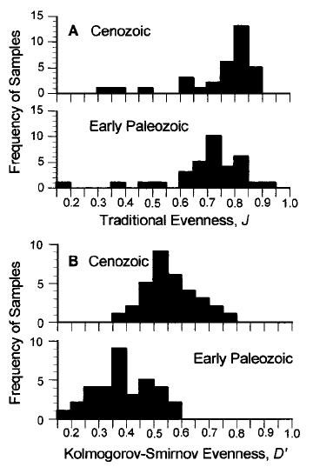
Further evenness and sampling-standardized approaches
Bush and Bambach (2004, J. Geology)
Powell & Kowalewski (2002, Geology)

Slide 43
Alpha Diversity Through Time: Rarefaction
Jurassic
Rarefaction of 400 samples
Standardized to 30 individuals
Neogene
Kowalewski et al. (2006, Paleobiology)

Slide 44
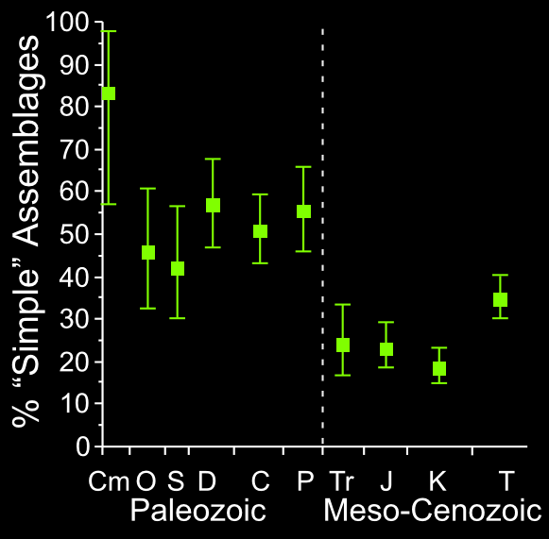
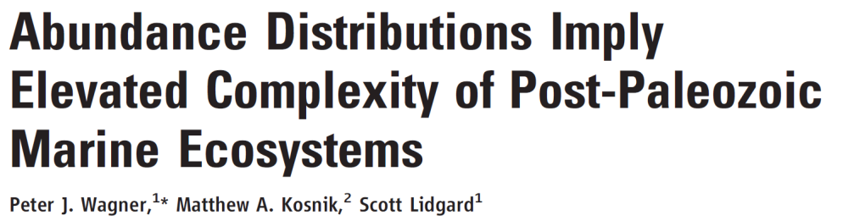
Alpha Diversity Trend Through RADs
Proportion of complex communities „suddenly“ rising after P/T boundary
Simple = Geometric series or zero-sum multinomial
Complex = Lognormal or Zipf
Wagner et al. (2006, Science)

Slide 45
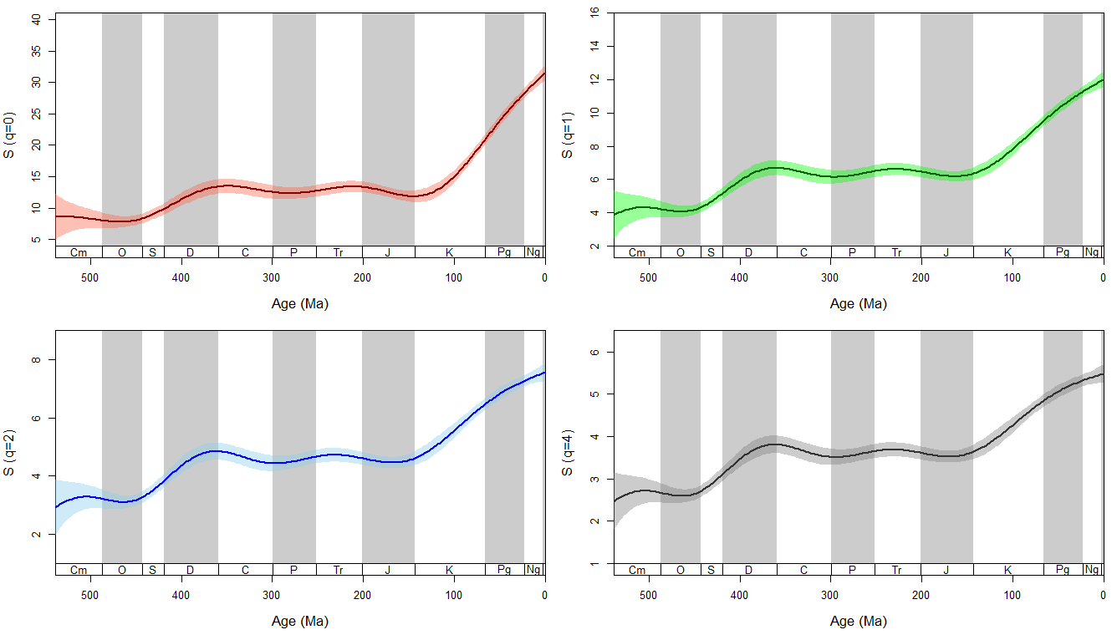
Effective number of species in marine communities
Generalized additive models (GAMs) suggest a nuanced increase of alpha diversity with two step-increases:
Devonian
Cretaceous to Cenozoic
Kiessling et al. (in prep.)

Slide 46
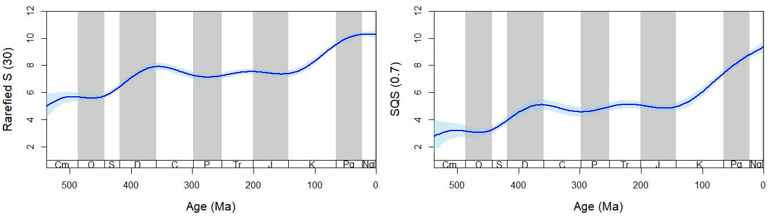
Sampling standardized S
Kiessling et al. (in prep.)

Slide 47


Slide 48
Warm-up after lunch
Alpha diversity for other Triassic samples?
How can we equivalently estimate functional diversity?

Slide 49
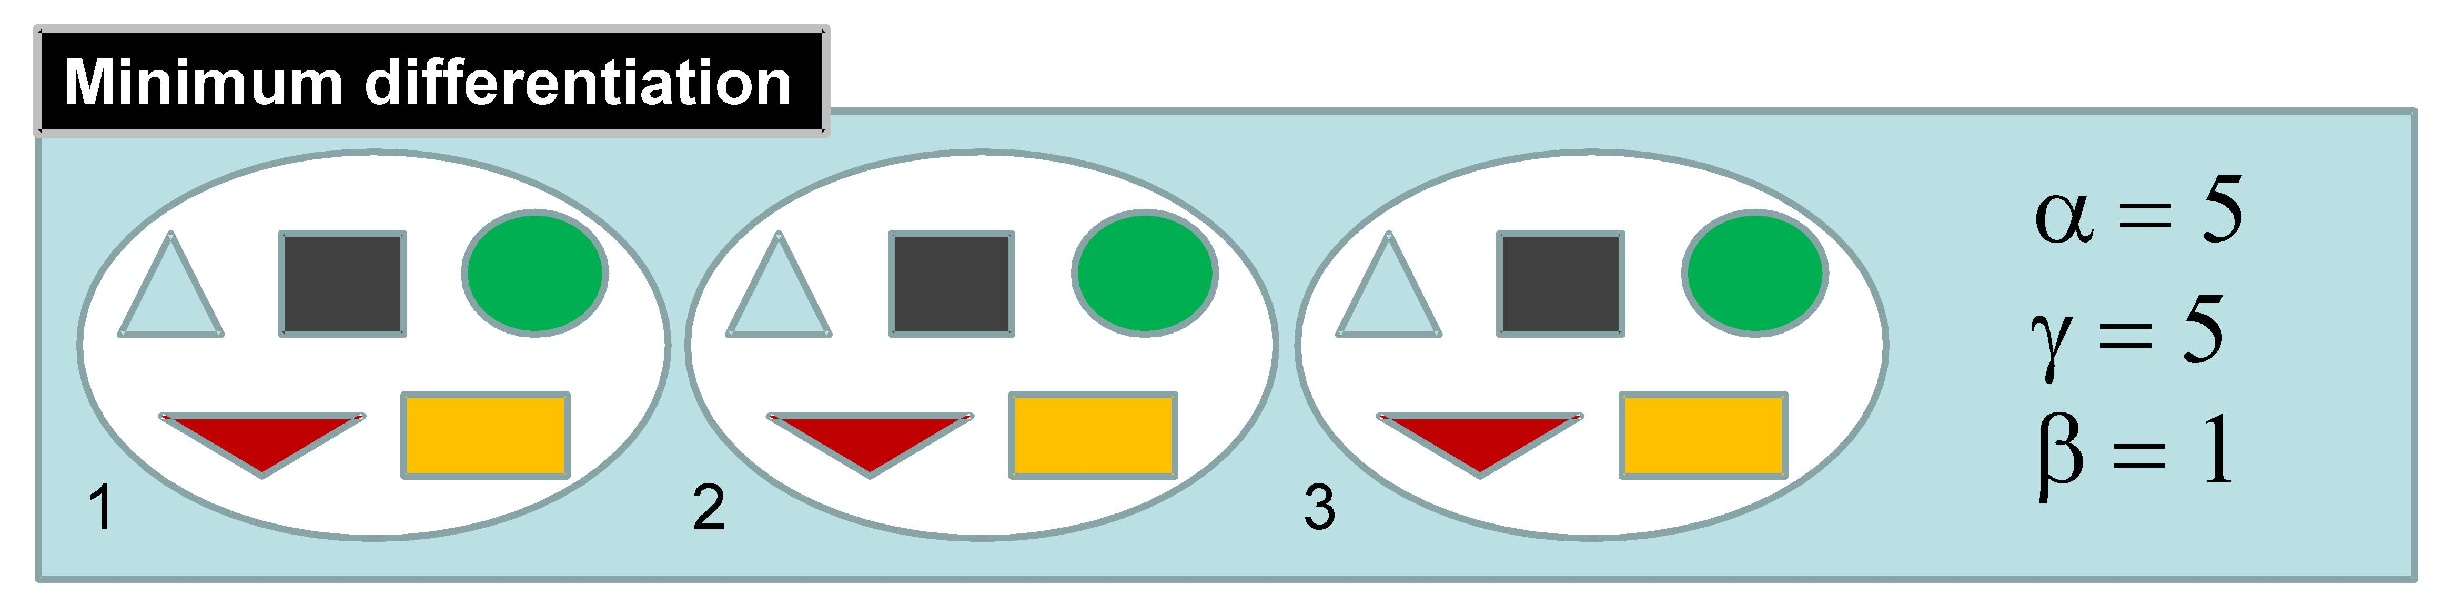
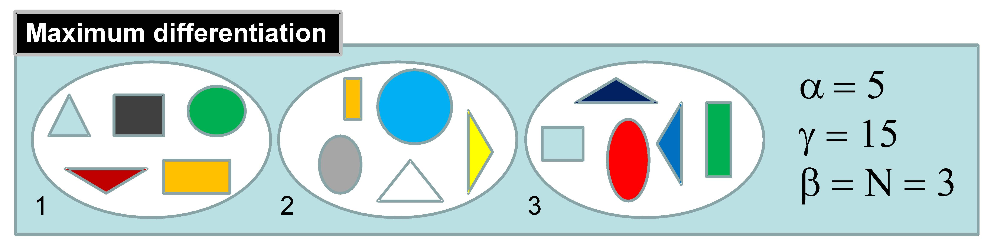
Beta diversity
https://methodsblog.com/2015/05/27/beta_diversity/

Slide 50
Beta Diversity
Assessed indirectly
Beta = Gamma/mean(Alpha)
Assessed directly
By dissimilarities between communities
Use a suitable dissimilarity metric

Slide 51
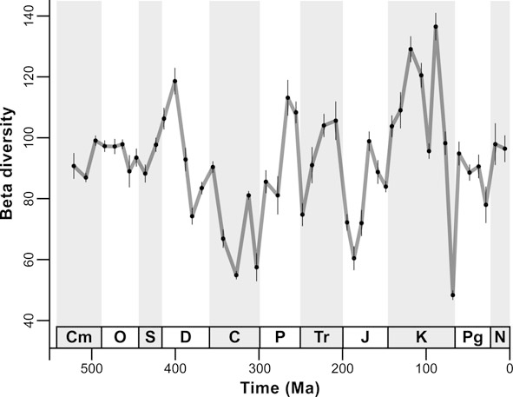
Beta Diversity Through Time
Unweigthed by-list subsampling of PBDB data
Beta = Gamma/Mean Alpha
Aberhan & Kiessling (2012)

Slide 52
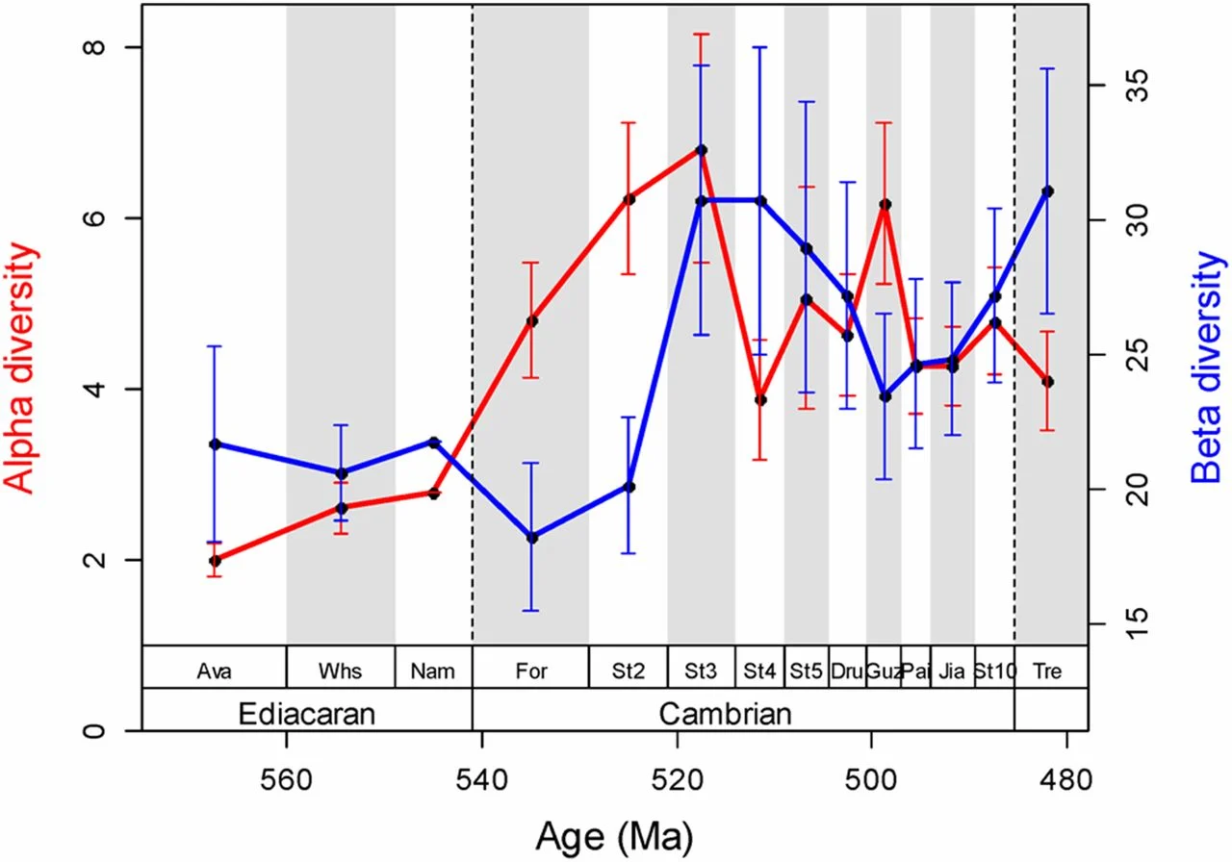
Alpha and Beta in the Cambrian Explosion
Lin and Kiessling (2015, PNAS)

Slide 53

Similarity Indices to Approach Beta Diversity
Jaccard Index:
S_{j} = a/(a+b+c)
a = Number of shared taxa between sampling sites
b = Number of taxa in site A not encountered in site B
c = Number of taxa in site B not encountered in site A
Jaccard Dissimilarity = 1 - S_{j}
Good for binary data but very sensitive of different sample sizes
Equivalent to Hill number q = 0

Slide 54
Other binary metrics
Sørensen pairwise dissimilarity
β_{Sor} = (b + c)/(2a + b + c)
Linear relationship with Whittaker’s beta
True turnover
Simpson pairwise dissimilarity
β_{Sim} = min(b,c)/(a + min(b,c))
Turnover without richness component
Nestedness (Baselga 2010)
β_{nes} = β_{sor} - β_{sim}

Slide 55
Nestedness and turnover components of beta diversity
Baselga (2010)

Slide 56
Percent similarity
Percent similarity: P = Σ min(p_{i1}, p_{i2})
Simple and very efficient for quantitative data, same as Bray-Curtis for proportional data
I J min
A 50 80 50
B 20 0 0
C 30 20 20
70%
Notes:
Corresponds to Hill numbers between 1-2

Slide 57
Hill numbers and beta diversity
For q=0 (species richness), the appropriate dissimilarity is based on the Jaccard or Sørensen index (incidence-based).
For q=1 (Shannon diversity), the best analogue is the Jaccard turnover measure based on Shannon entropy, sometimes referred to as the Shannon–Jaccard dissimilarity. This uses the effective number of species derived from Shannon entropy.
For q=2 (Simpson diversity), the corresponding measure is a Sørensen–Horn dissimilarity (Horn 1966; also called Morisita–Horn index).
Chao et al. (2014, Ecol. Monographs)

Slide 58
Exercise
Calculate beta diversity of radiolarian faunas?
Start with two samples and then go to entire matrix
Script: Beta_div.R
Notes:
In Zukunft Studenten selbst

Slide 59
What to do with a (dis)similarity matrix
Structure detection
Explore groups versus gradients over space and time
Approaches
Cluster analysis
Non-metric multidimensional scaling

Slide 60
Hierarchical Cluster Analysis
Hierarchical (nested) grouping of data
Between variables (Q-Mode)
Between cases (R-Mode)
Paleobiological
Q-Mode: Groups of samples
R-Mode: Groups of species or higher taxa
Divisive or agglomerative
Fully reproducible
Works with any similarity or distance metric

Slide 61
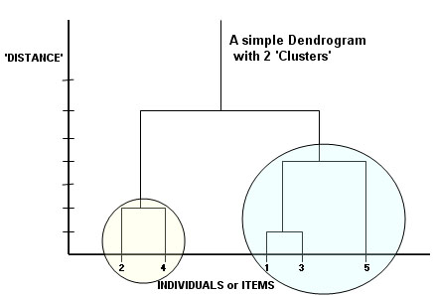
Steps in Cluster Analysis
Similarity/Dissimilarity (or distance) matrix
Agglomeration: Link pairs of objects to form small clusters
Treat small clusters as new objects and repeat procedure until all objects are related

Slide 62
Agglomeration Methods (Selection)
Nearest Neighbor or Single Linkage Clustering: Similarity between two clusters equals the maximum similarity between any two members of the clusters
Tends to produce chaining (friends of friends)
Farthest Neighbor or Complete Linkage Clustering: Similarity between two clusters equals the minimum similarity between any two members of the clusters
Tends to produce clear groups, even if similarity between members is great
Default method in R function hclust()
Unweighted Group Average or Unweighted Pair Group Method with Arithmetic Averaging: Similarity between two clusters equals the mean similarity between all possible pair-group combinations
Intermediate between single and complete. Most commonly used in paleoecology
Centroid Clustering or Unweighted Pair Group Method with Centroid Averaging: Similarity between two clusters equals their similarities as composite objects
Ward’s Method: Objects are grouped that minimize the variance of the similarities between all member objects within a cluster
Recommended method
ward.D2 in R

Slide 63
Exercise
Find the biogeographic structure in Late Jurassic-earliest Cretaceous radiolarian samples collected from
Antarctica (K, GD, LG)
The Alps (AM, Bu, PS, Sc, Sg, Stg)
Oman (JB, JH, Na)
Philippines (R)
Biogeographic vs. stratigraphic signal?
Alps: Callovian to early Tithonian
Oman: Tithonian-Valanginian
Antarctica: Kimmeridgian-Berriasian
Philippines: Tithonian

Slide 64
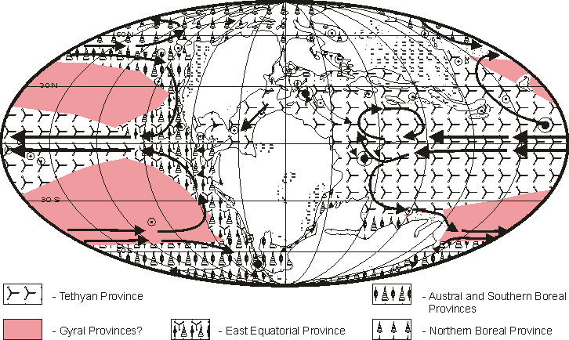
Reconstructed Radiolarian Provinces in the Tithonian
Samples in Dataset
Kiessling (1999, Micropaleontology)

Slide 66
Combined R and Q-Mode clustering using the heatmap() function in base R

Slide 67
Ordination
Complementary to clustering but
Allows better representation of larger distances
Objects arranged on continuous axes
No forced hierarchical structure
Shapes of clusters can be seen (if real)
Gradients can be seen (if real)
Explorative rather than for hypothesis testing
Principal Component and Factor Analysis
(Detrended) Correspondence Analysis
Multidimensional Scaling

Slide 68
Principal Component Analysis (PCA)
Orthogonal transformation of several potentially correlated variables into a (reduced) set of uncorrelated variables, the principal components (PCs)
Number of PCs is ideally much less than original set of variables
PCs extracted in successive form such that each explains the maximum (remaining) variance of the whole dataset
Factor analysis is a specific case of PCA
PCA most commonly applied in morphometrics

Slide 69
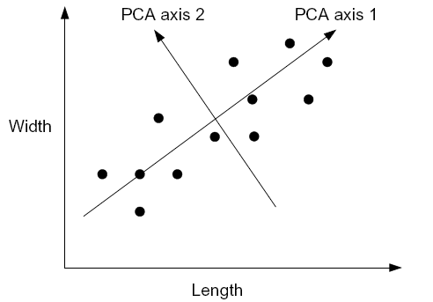
Example
Length and width of shark teeth in a species
Values well correlated but high variance
Rotate coordinate system to achieve the minimum variance
Interpretation of new axes (PCs): ?

Slide 70
Multidimensional Scaling (MDS)
An ordination technique in which the scatter of points representing samples or taxa in an ordination space is iteratively allowed to evolve until it resembles the observed dissimilarity matrix as closely as possible
Two methods
Metric (MDS): Actual values of dissimilarity are considered (aka Principal Coordinate Analysis)
Non-metric (NMDS): The ranking of dissimilarity is analyzed
Basic steps
Dissimilarity or distance matrix of objects
Specify dimensionality (usually 2D or 3D)
Project or squeeze distances on the ordination space and identify the stress this imposes
Minimize the stress by moving points in ordination space
Note: Axes are arbitrary and can be rotated as wished

Slide 71
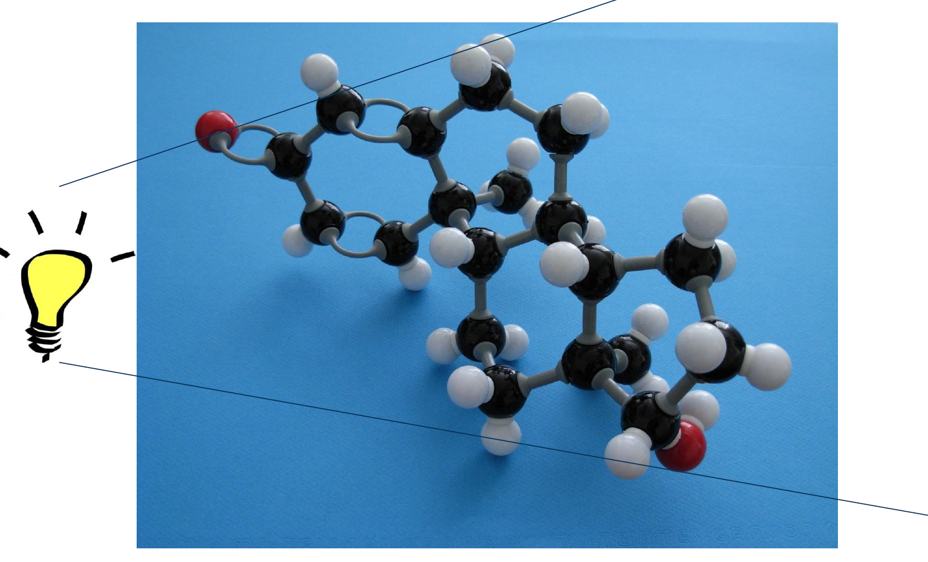
MDS (Metric = Parametric)
Projection on a plane

Slide 72
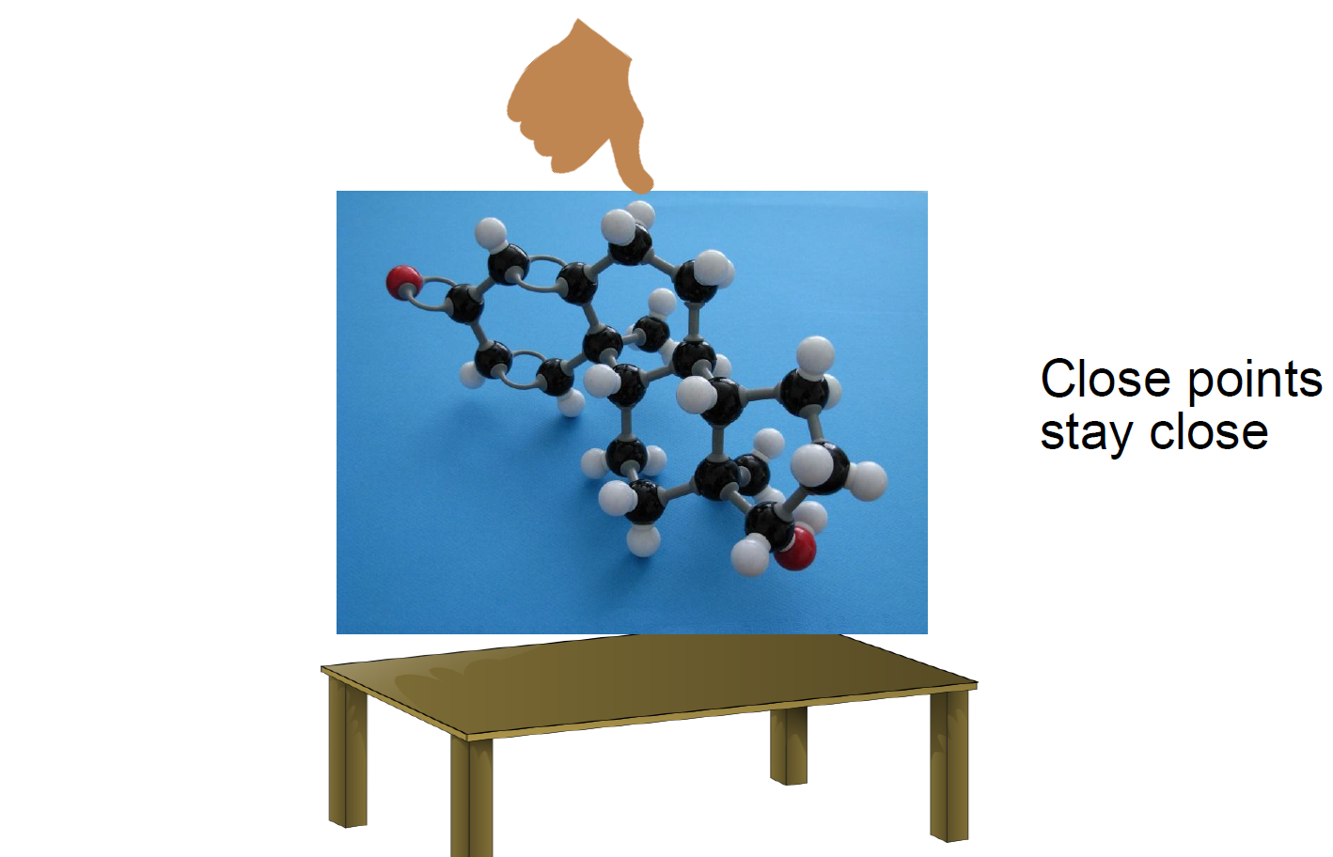
NMDS (Non-metric = non-parametric)
Squeezing on a plane

Slide 73
A simple example of MDS (Principal Coordinate Analysis)
Given: Distances of European Cities
Task: Calculate a map of Europe with just these data
eurodist
loc <- cmdscale(eurodist, k =2)
plot(loc, type="n")
text(loc, rownames(loc), cex = 0.6)
Relative positions are correct but true coordinates are wrong
Change this by transforming one variable
x <- loc[, 1]
y <- -loc[, 2]
plot(x, y, type = "n", xlab = "", ylab = "", asp = 1, axes = FALSE, main = "cmdscale(eurodist)")
text(x, y, rownames(loc), cex = 0.6)

Slide 75
Try With Radiolarian Data
As in metric approaches, the first axis explains most of the variance, but there is no strict “% variance explained”
compared with metric

Slide 76
Stress: How much pressure is needed to squeeze multidimensional object on two (or three) dimensions?
With metaMDS: Stress values >0.2 are generally poor and potentially uninterpretable; values <0.1 are good and <0.05 are excellent, leaving little danger of misinterpretation
Stress values between 0.1 and 0.2 are useable but some of the distances will be misleading (try more dimension)
mMDS$stress
# Evaluate scatter around the regression between the interpoint distances in the final configuration
stressplot(mMDS) # how well does the two-dimensional distance correspond to the true distance?

Slide 77
Sites and species together
plot(mMDS)

Slide 78
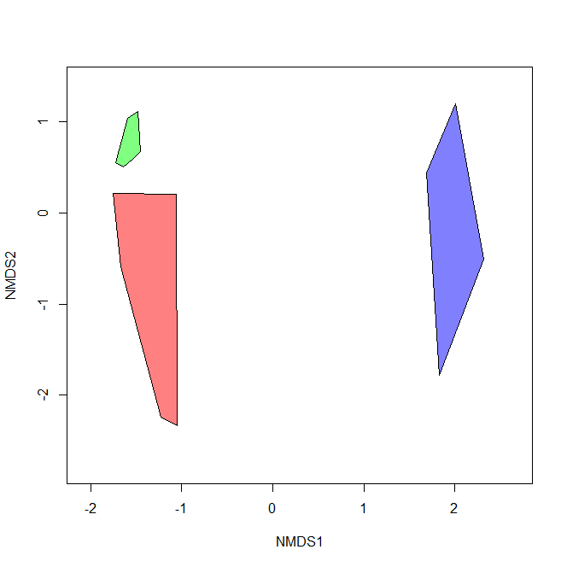
Ordihull with three significant groups
Oman
Antarctica
Alps, Philippines

Slide 79
Main Assignment
Paleoecological data are provided for the middle Triassic of South China
Compute patterns of beta diversity across all samples
Are there distinct groups of samples?
Is group membership predicted by diversity or other ecological properties?

Slide 80
Getting started
Calculate beta diversity of Triassic faunas
Use matrix
Script: Beta_div_Bangtoupo.R
Notes:
In Zukunft Studenten selbst

