Slide 1
Capture-mark-recapture approaches I
Lee Hsiang Liow
Natural History Museum and Centre for Planetary Habitability, University of Oslo, Norway
Analytical Paleobiology Workshop (Paleosynthesis, FAU, Erlangen)
2.9.2026 (Online lecture)
Notes:
https://fau.zoom-x.de/j/62518891071

Slide 2

https://www.penn.museum/img/homepage/reskin/mind-mood.jpg

Slide 3
Measuring Diversity Through Time
How many taxa in each time bin?
Notes:
2, 4,(5) , 2(4), 4?
5,5,5,5?

Slide 4


CENSUS VERSUS SAMPLING
Census and samples
1920 Census 2,649,775 persons in Norway
2022 UN estimates 5,434,319
2022 SSB estimates 5,435,536
2024 (AI generated based on listed sources) 5,590,000
Q What is the difference between a census and a sample?
Q Why not always do a census?
Q Why are the UN and SSB and 202334 numbers different?
Notes:
Hard to do complete census in any situation, mostly in we are doing sampling!

Slide 5
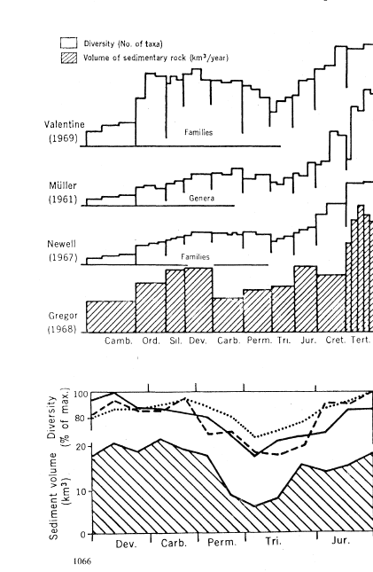
SAMPLING IN THE FOSSIL RECORD
Raup 1972: Taxonomic diversity during the Phanerozoic. Science
“systematic biases exist in the raw data ….. actual diversity picture may be
quite different from that afforded by a direct reading of the raw data.”
“﻿In spite of the fact that the patterns ﻿in Fig. 1 are correlated, a
a causal relationship ﻿is by no means demonstrated.”

Slide 6
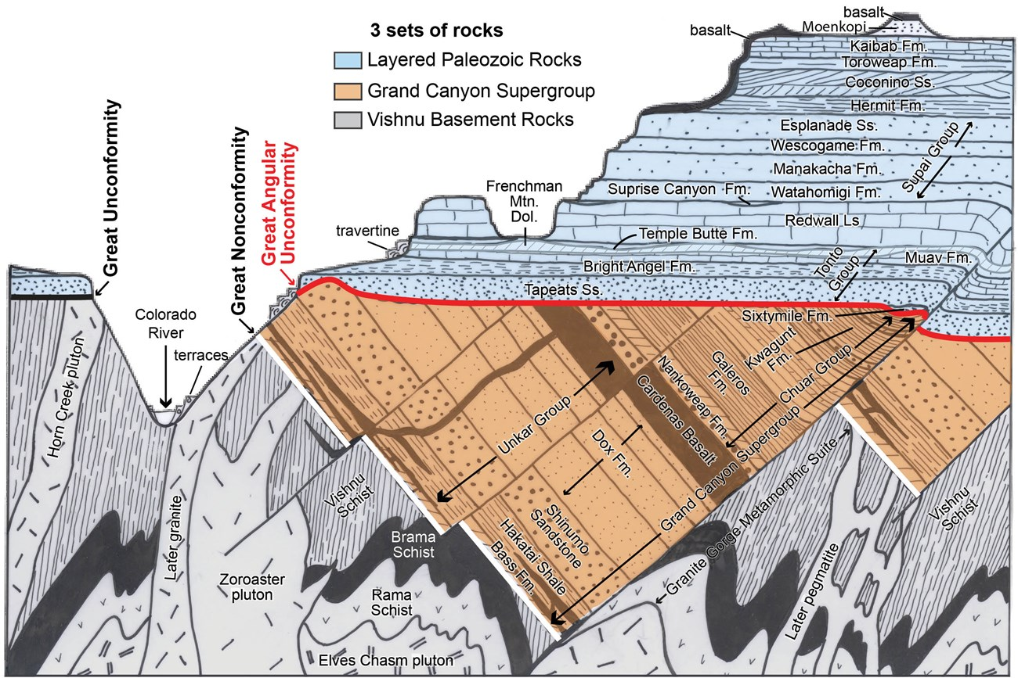
Some sampling gaps are not recoverable, ever
175 million years
https://en.wikipedia.org/wiki/Great_Unconformity

Slide 7
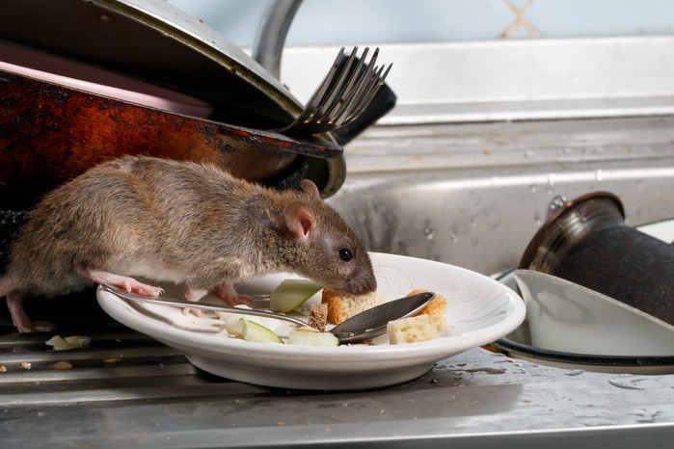
SWTICHING GEARS TO RATS/MICE

Slide 8
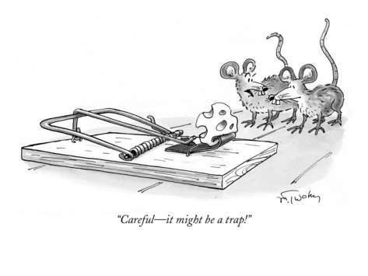
SWTICHING GEARS TO RATS/MICE
caught 10 rats
How many rats are there in the apartment?
Notes:
Parallel history in CMR (population estimation)

Slide 9
THE ESSENCE OF CAPTURE RECAPTURE APPROACHES
Day 1: caught 10 rats, put tags on them
Day 2: caught rats in the same place. 2 had your tags, but 8 didn’t
What is the capture probability?

Slide 10
THE ESSENCE OF CAPTURE RECAPTURE APPROACHES
Day 1: caught 10 rats, put tags on them
Day 2: caught rats in the same place. 2 had your tags, but 8 didn’t
What is the capture probability?
2/10=0.2
How many rats are there in that “place?”

Slide 11
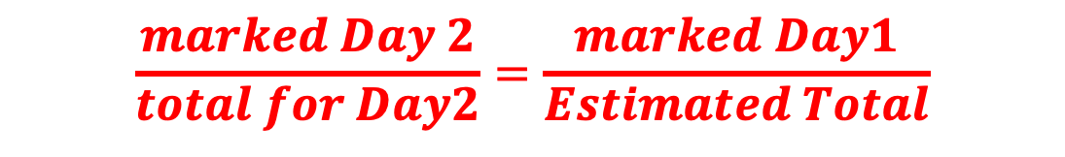
THE ESSENCE OF CAPTURE RECAPTURE APPROACHES
Day 1: caught 10 rats, put tags on them
Day 2: caught rats in the same place. 2 had your tags, but 8 didn’t
What is the capture probability?
2/10=0.2
How many rats are there in that “place?”
$$\frac{marked Day 2}{total for Day2}=\frac{marked Day1}{Estimated Total}$$

Slide 12
THE ESSENCE OF CAPTURE RECAPTURE APPROACHES
Day 1: caught 10 rats, put tags on them
Day 2: caught rats in the same place. 2 had your tags, but 8 didn’t
What is the capture probability?
2/10=0.2
How many rats are there in that “place?”
50
$$\frac{marked Day 2}{total for Day2}=\frac{marked Day1}{Estimated Total}$$
Short fun read: Laplace estimates population of France in 1783 https://rss.onlinelibrary.wiley.com/doi/pdf/10.1111/j.1740-9713.2014.00754.x
The Lincoln–Petersen method (Petersen–Lincoln index)
Notes:
2/10=10/x

Slide 13
THE ESSENCE OF CAPTURE RECAPTURE APPROACHES
Day 1: caught 10 rats, put tags on them
Day 2: caught rats in the same place. 2 had your tags, but 8 didn’t
What is the capture probability?
2/10=0.2
How many rats are there in that “place?”
50
Q What are the assumptions here made in this approach?

Slide 14
THE ESSENCE OF CAPTURE RECAPTURE APPROACHES
The Lincoln–Petersen method (Petersen–Lincoln index)
Notes:
https://rss.onlinelibrary.wiley.com/doi/pdf/10.1111/j.1740-9713.2014.00754.x Laplace estimates population of France in 1783

Slide 15
Capture recapture approaches models
Diversity / Richness
Survival (extinction)
Birth (origination or speciation)
Rate of population growth (diversification rate)
Etc
Includes the observation process (data generating process)
Notes:
https://rss.onlinelibrary.wiley.com/doi/pdf/10.1111/j.1740-9713.2014.00754.x Laplace estimates population of France in 1783

Slide 16
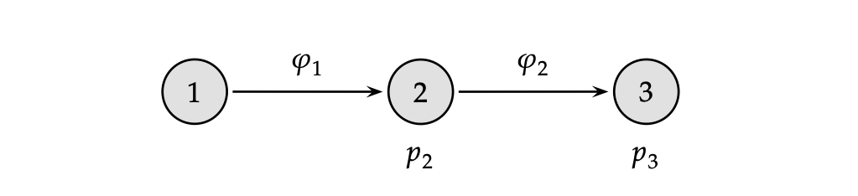
Encounter history
http://www.phidot.org/software/mark/docs/book/pdf/chap1.pdf

Slide 17
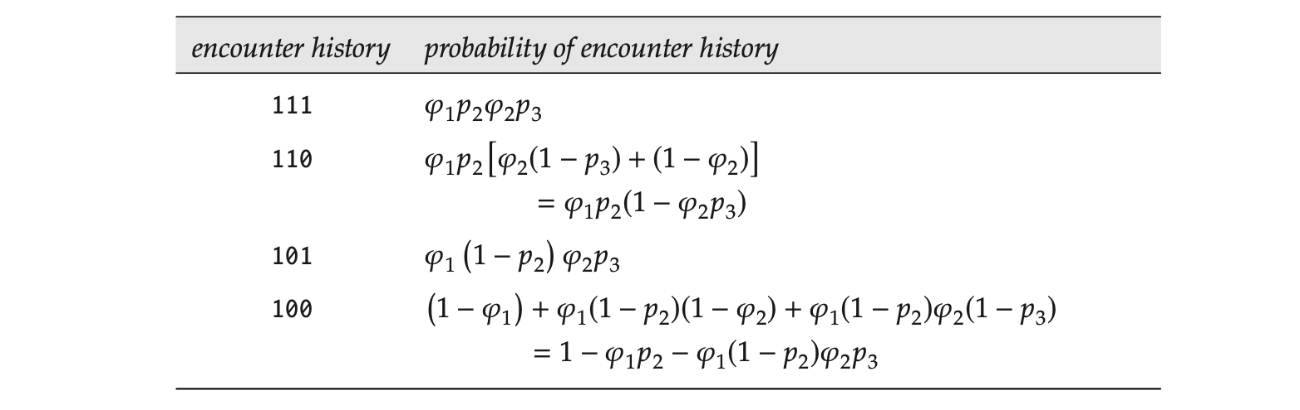
Encounter history
http://www.phidot.org/software/mark/docs/book/pdf/chap1.pdf

Slide 18
Encounter history
http://www.phidot.org/software/mark/docs/book/pdf/chap1.pdf

Slide 19
Encounter history
http://www.phidot.org/software/mark/docs/book/pdf/chap1.pdf

Slide 20

Trilobite taxa
Encounter history
http://www.phidot.org/software/mark/docs/book/pdf/chap1.pdf

Slide 21
Trilobite taxa
Encounter history
Trilobite taxon A
Trilobite taxon B
Trilobite taxon C
Trilobite taxon D
http://www.phidot.org/software/mark/docs/book/pdf/chap1.pdf

Slide 22
Trilobite taxa
Encounter history
A, X, P
B, E
C, Q R, T, S, X, Z
D, G H, J, K, Y
http://www.phidot.org/software/mark/docs/book/pdf/chap1.pdf

Slide 23
THE DATA
Taxon | Time intervals
 | 1 | 2 | 3 | 4 | 5 | 6 | 7 | 8
A | 0 | 0 | 1 | 1 | 0 | 0 | 1 | 0
B | 0 | 1 | 0 | 0 | 0 | 0 | 0 | 0
C | 0 | 0 | 0 | 0 | 0 | 1 | 1 | 1
D | 1 | 0 | 1 | 1 | 0 | 1 | 0 | 0
E | 0 | 0 | 0 | 1 | 0 | 0 | 1 | 1
F | 0 | 1 | 0 | 0 | 1 | 1 | 0 | 1
G | 0 | 0 | 0 | 1 | 0 | 1 | 1 | 0
H | 0 | 0 | 0 | 0 | 0 | 1 | 1 | 0
I | 0 | 0 | 1 | 0 | 1 | 1 | 0 | 1
J | 1 | 0 | 0 | 0 | 0 | 0 | 0 | 0
K | 0 | 0 | 0 | 0 | 1 | 0 | 1 | 1
L | 0 | 0 | 1 | 1 | 0 | 0 | 0 | 0
M | 0 | 1 | 0 | 1 | 1 | 0 | 0 | 0
N | 1 | 1 | 0 | 0 | 1 | 0 | 1 | 0
O | 0 | 0 | 0 | 1 | 0 | 1 | 1 | 1
P | 0 | 0 | 1 | 0 | 0 | 0 | 0 | 0
Q | 0 | 0 | 0 | 0 | 0 | 0 | 1 | 0
R | 0 | 0 | 1 | 0 | 1 | 1 | 0 | 1
S | 0 | 0 | 0 | 0 | 1 | 0 | 0 | 1
T | 0 | 0 | 0 | 1 | 0 | 0 | 0 | 0
Liow L.H. & Nichols, J.D. 2010 Estimating rates and probabilities of origination and extinction using taxonomic occurrence data: Capture-recapture approaches. In Quantitative Paleobiology Short Course. Eds. Alroy J. & Hunt G. Paleontological Society pp. 81-94
Notes:
Global sampling
Some relative homogenous clade we are interested in
Time intervals are well-defined (we know the ranges and let’s say for now that they are equal)

Slide 24
DECTECTION HISTORIES
Time interval | 1 | 2 | 3 | 4 | 5 | 6 | 7 | 8
L | 0 | 1 | 1 | 0 | 0 | 0 | 0 | 0
M | 0 | 1 | 0 | 1 | 1 | 0 | 0 | 0
Encounter/detection histories
- Series of ones and zeros
- Ones are taken as true presences
- Two types of zeros
- Not sampled
- Not sampled or truly absent

Slide 25
Taxon | Time intervals
 | 1 | 2 | 3 | 4 | 5 | 6 | 7 | 8
A | 0 | 0 | 1 | 1 | 0 | 0 | 1 | 0
B | 0 | 1 | 0 | 0 | 0 | 0 | 0 | 0
C | 0 | 0 | 0 | 0 | 0 | 1 | 1 | 1
D | 1 | 0 | 1 | 1 | 0 | 1 | 0 | 0
E | 0 | 0 | 0 | 1 | 0 | 0 | 1 | 1
F | 0 | 1 | 0 | 0 | 1 | 1 | 0 | 1
G | 0 | 0 | 0 | 1 | 0 | 1 | 1 | 0
H | 0 | 0 | 0 | 0 | 0 | 1 | 1 | 0
I | 0 | 0 | 1 | 0 | 1 | 1 | 0 | 1
J | 1 | 0 | 0 | 0 | 0 | 0 | 0 | 0
K | 0 | 0 | 0 | 0 | 1 | 0 | 1 | 1
L | 0 | 0 | 1 | 1 | 0 | 0 | 0 | 0
M | 0 | 1 | 0 | 1 | 1 | 0 | 0 | 0
N | 1 | 1 | 0 | 0 | 1 | 0 | 1 | 0
O | 0 | 0 | 0 | 1 | 0 | 1 | 1 | 1
P | 0 | 0 | 1 | 0 | 0 | 0 | 0 | 0
Q | 0 | 0 | 0 | 0 | 0 | 0 | 1 | 0
R | 0 | 0 | 1 | 0 | 1 | 1 | 0 | 1
S | 0 | 0 | 0 | 0 | 1 | 0 | 0 | 1
T | 0 | 0 | 0 | 1 | 0 | 0 | 0 | 0
Detection
probability
Notes:
Condition on those that are both sampled before and after time interval 6
Count up ones

Slide 26
Taxon | Time intervals
 | 1 | 2 | 3 | 4 | 5 | 6 | 7 | 8
A | 0 | 0 | 1 | 1 | 0 | 0 | 1 | 0
B | 0 | 1 | 0 | 0 | 0 | 0 | 0 | 0
C | 0 | 0 | 0 | 0 | 0 | 1 | 1 | 1
D | 1 | 0 | 1 | 1 | 0 | 1 | 0 | 0
E | 0 | 0 | 0 | 1 | 0 | 0 | 1 | 1
F | 0 | 1 | 0 | 0 | 1 | 1 | 0 | 1
G | 0 | 0 | 0 | 1 | 0 | 1 | 1 | 0
H | 0 | 0 | 0 | 0 | 0 | 1 | 1 | 0
I | 0 | 0 | 1 | 0 | 1 | 1 | 0 | 1
J | 1 | 0 | 0 | 0 | 0 | 0 | 0 | 0
K | 0 | 0 | 0 | 0 | 1 | 0 | 1 | 1
L | 0 | 0 | 1 | 1 | 0 | 0 | 0 | 0
M | 0 | 1 | 0 | 1 | 1 | 0 | 0 | 0
N | 1 | 1 | 0 | 0 | 1 | 0 | 1 | 0
O | 0 | 0 | 0 | 1 | 0 | 1 | 1 | 1
P | 0 | 0 | 1 | 0 | 0 | 0 | 0 | 0
Q | 0 | 0 | 0 | 0 | 0 | 0 | 1 | 0
R | 0 | 0 | 1 | 0 | 1 | 1 | 0 | 1
S | 0 | 0 | 0 | 0 | 1 | 0 | 0 | 1
T | 0 | 0 | 0 | 1 | 0 | 0 | 0 | 0
Estimated
no. taxa

Slide 27
Taxon | Time intervals
 | 1 | 2 | 3 | 4 | 5 | 6 | 7 | 8
A | 0 | 0 | 1 | 1 | 0 | 0 | 1 | 0
B | 0 | 1 | 0 | 0 | 0 | 0 | 0 | 0
C | 0 | 0 | 0 | 0 | 0 | 1 | 1 | 1
D | 1 | 0 | 1 | 1 | 0 | 1 | 0 | 0
E | 0 | 0 | 0 | 1 | 0 | 0 | 1 | 1
F | 0 | 1 | 0 | 0 | 1 | 1 | 0 | 1
G | 0 | 0 | 0 | 1 | 0 | 1 | 1 | 0
H | 0 | 0 | 0 | 0 | 0 | 1 | 1 | 0
I | 0 | 0 | 1 | 0 | 1 | 1 | 0 | 1
J | 1 | 0 | 0 | 0 | 0 | 0 | 0 | 0
K | 0 | 0 | 0 | 0 | 1 | 0 | 1 | 1
L | 0 | 0 | 1 | 1 | 0 | 0 | 0 | 0
M | 0 | 1 | 0 | 1 | 1 | 0 | 0 | 0
N | 1 | 1 | 0 | 0 | 1 | 0 | 1 | 0
O | 0 | 0 | 0 | 1 | 0 | 1 | 1 | 1
P | 0 | 0 | 1 | 0 | 0 | 0 | 0 | 0
Q | 0 | 0 | 0 | 0 | 0 | 0 | 1 | 0
R | 0 | 0 | 1 | 0 | 1 | 1 | 0 | 1
S | 0 | 0 | 0 | 0 | 1 | 0 | 0 | 1
T | 0 | 0 | 0 | 1 | 0 | 0 | 0 | 0
Estimated
no. taxa
Compare with
range-through
= 10

Slide 28
Taxon | Time intervals
 | 1 | 2 | 3 | 4 | 5 | 6 | 7 | 8
A | 0 | 0 | 1 | 1 | 0 | 0 | 1 | 0
B | 0 | 1 | 0 | 0 | 0 | 0 | 0 | 0
C | 0 | 0 | 0 | 0 | 0 | 1 | 1 | 1
D | 1 | 0 | 1 | 1 | 0 | 1 | 0 | 0
E | 0 | 0 | 0 | 1 | 0 | 0 | 1 | 1
F | 0 | 1 | 0 | 0 | 1 | 1 | 0 | 1
G | 0 | 0 | 0 | 1 | 0 | 1 | 1 | 0
H | 0 | 0 | 0 | 0 | 0 | 1 | 1 | 0
I | 0 | 0 | 1 | 0 | 1 | 1 | 0 | 1
J | 1 | 0 | 0 | 0 | 0 | 0 | 0 | 0
K | 0 | 0 | 0 | 0 | 1 | 0 | 1 | 1
L | 0 | 0 | 1 | 1 | 0 | 0 | 0 | 0
M | 0 | 1 | 0 | 1 | 1 | 0 | 0 | 0
N | 1 | 1 | 0 | 0 | 1 | 0 | 1 | 0
O | 0 | 0 | 0 | 1 | 0 | 1 | 1 | 1
P | 0 | 0 | 1 | 0 | 0 | 0 | 0 | 0
Q | 0 | 0 | 0 | 0 | 0 | 0 | 1 | 0
R | 0 | 0 | 1 | 0 | 1 | 1 | 0 | 1
S | 0 | 0 | 0 | 0 | 1 | 0 | 0 | 1
T | 0 | 0 | 0 | 1 | 0 | 0 | 0 | 0
Extinction
probability
Extinction prob
= 1-survival prob
Notes:
Extinction from time interval 5 to 6 is the complement of those that didn’t die (remember a few slides ago: zeros are not reliable, only ones are!)

Slide 29
Taxon | Time intervals
 | 1 | 2 | 3 | 4 | 5 | 6 | 7 | 8
A | 0 | 0 | 1 | 1 | 0 | 0 | 1 | 0
B | 0 | 1 | 0 | 0 | 0 | 0 | 0 | 0
C | 0 | 0 | 0 | 0 | 0 | 1 | 1 | 1
D | 1 | 0 | 1 | 1 | 0 | 1 | 0 | 0
E | 0 | 0 | 0 | 1 | 0 | 0 | 1 | 1
F | 0 | 1 | 0 | 0 | 1 | 1 | 0 | 1
G | 0 | 0 | 0 | 1 | 0 | 1 | 1 | 0
H | 0 | 0 | 0 | 0 | 0 | 1 | 1 | 0
I | 0 | 0 | 1 | 0 | 1 | 1 | 0 | 1
J | 1 | 0 | 0 | 0 | 0 | 0 | 0 | 0
K | 0 | 0 | 0 | 0 | 1 | 0 | 1 | 1
L | 0 | 0 | 1 | 1 | 0 | 0 | 0 | 0
M | 0 | 1 | 0 | 1 | 1 | 0 | 0 | 0
N | 1 | 1 | 0 | 0 | 1 | 0 | 1 | 0
O | 0 | 0 | 0 | 1 | 0 | 1 | 1 | 1
P | 0 | 0 | 1 | 0 | 0 | 0 | 0 | 0
Q | 0 | 0 | 0 | 0 | 0 | 0 | 1 | 0
R | 0 | 0 | 1 | 0 | 1 | 1 | 0 | 1
S | 0 | 0 | 0 | 0 | 1 | 0 | 0 | 1
T | 0 | 0 | 0 | 1 | 0 | 0 | 0 | 0
Extinction
probability
16
Notes:
Extinction from time interval 5 to 6 is the complement of those that didn’t die (remember a few slides ago: zeros are not reliable, only ones are!)

Slide 30
Taxon | Time intervals
 | 1 | 2 | 3 | 4 | 5 | 6 | 7 | 8
A | 0 | 0 | 1 | 1 | 0 | 0 | 1 | 0
B | 0 | 1 | 0 | 0 | 0 | 0 | 0 | 0
C | 0 | 0 | 0 | 0 | 0 | 1 | 1 | 1
D | 1 | 0 | 1 | 1 | 0 | 1 | 0 | 0
E | 0 | 0 | 0 | 1 | 0 | 0 | 1 | 1
F | 0 | 1 | 0 | 0 | 1 | 1 | 0 | 1
G | 0 | 0 | 0 | 1 | 0 | 1 | 1 | 0
H | 0 | 0 | 0 | 0 | 0 | 1 | 1 | 0
I | 0 | 0 | 1 | 0 | 1 | 1 | 0 | 1
J | 1 | 0 | 0 | 0 | 0 | 0 | 0 | 0
K | 0 | 0 | 0 | 0 | 1 | 0 | 1 | 1
L | 0 | 0 | 1 | 1 | 0 | 0 | 0 | 0
M | 0 | 1 | 0 | 1 | 1 | 0 | 0 | 0
N | 1 | 1 | 0 | 0 | 1 | 0 | 1 | 0
O | 0 | 0 | 0 | 1 | 0 | 1 | 1 | 1
P | 0 | 0 | 1 | 0 | 0 | 0 | 0 | 0
Q | 0 | 0 | 0 | 0 | 0 | 0 | 1 | 0
R | 0 | 0 | 1 | 0 | 1 | 1 | 0 | 1
S | 0 | 0 | 0 | 0 | 1 | 0 | 0 | 1
T | 0 | 0 | 0 | 1 | 0 | 0 | 0 | 0
Extinction
probability
Alive in T 5 and 6
Alive in T5
Survival
Probability
From T5 to T6
16
Notes:
Extinction from time interval 5 to 6 is the complement of those that didn’t die (remember a few slides ago: zeros are not reliable, only ones are!)

