Slide 1
Software

Slide 2

paleoTS
Analyze Paleontological Time-Series

Slide 3
Hunt 2006, Paleobiology

Slide 4
Hunt et al. 2008, Evolution

Slide 5
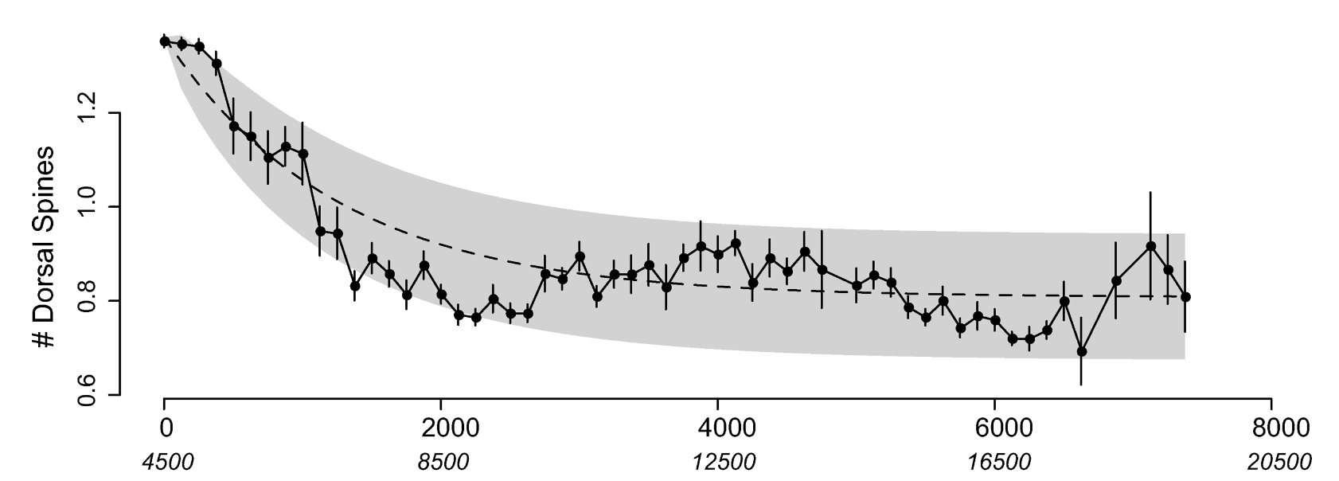
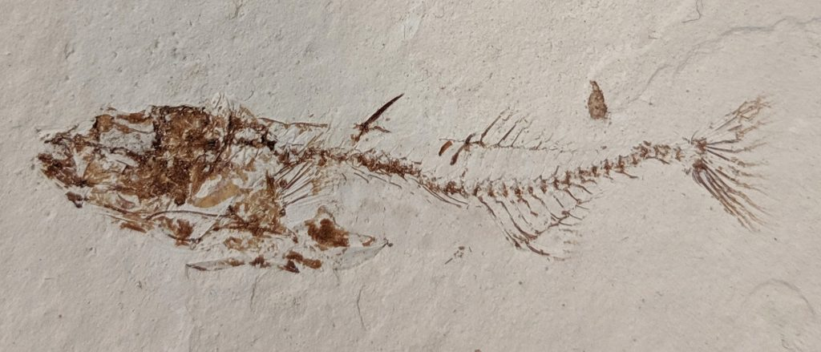
Photo:Tanner Frank
Hunt et al. 2008, Evolution

Slide 6
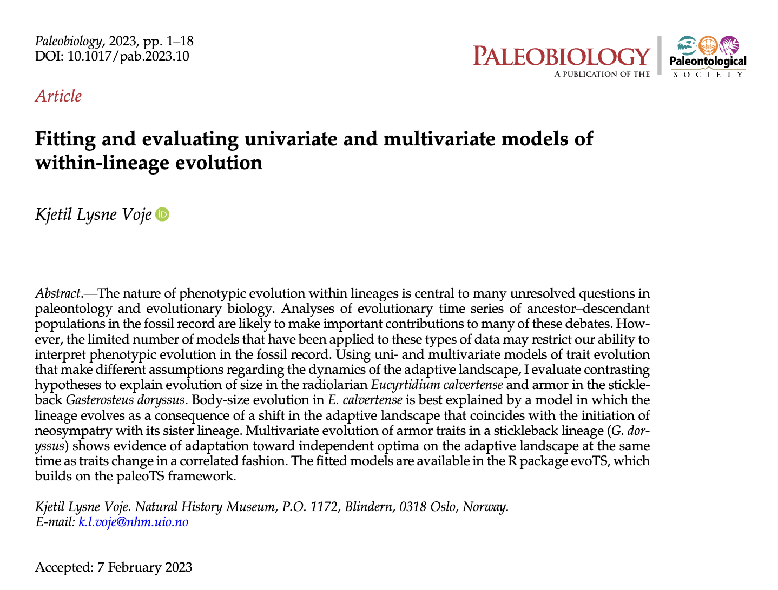
evoTS
Analyses of Evolutionary Time-Series

Slide 7

paleoTS + evoTS =

