Slide 1
Presentation on Breast Cancer Application
Alex Teichen & Laura Cruz
CEN4214
12/14/2016

Slide 2
Breast cancer information
Breast cancer is a major problem in the world today.
According to BreastCancer.org (2016), breast cancer is the most common cancer among women.
Statistics indicate that about 12% of women will develop breast cancer in the United States (BreastCancer.org, 2016).
It is important to leverage available technology in order to solve the breast cancer problem.
Many factors such as lifestyle and diet have been identified as possible contributors to the high prevalence of breast cancer in the world.
As such, research has been carried out in order to improve diagnosis and treatment.
This has resulted in more people being diagnosed and treated successfully.
The life expectancy after discovery of breast cancer has improved significantly in the recent past.

Slide 3
The breast cancer application
The breast cancer application is a tool that allows a user to enter their personal health information
The application provides users with relevant information relating to breast cancer
The application also helps to increase awareness about the disease.

Slide 4
Method
The application will allow people suffering from breast cancer to communicate with their doctors.
This is particularly useful for people who have been successfully treated of breast cancer.
Research shows that a person who has successfully been treated has a higher chance of relapsing and developing breast cancer again.
The application will allow a user to enter their information in the system.
This information will be stored in the user’s account and this information is accessible to their doctor.
The doctor will be able to advise the patient regarding the disease.
The doctor will be able to use the information to track the progress of the patient.

Slide 5
Application features
The application has a home page that requests the user to input their password.
After login in, the user is directed to the patient information page.
This page allows them to enter their personal details as well as their health details.
The application saves this information and can be accessed in the records section.
There is also a graph section of the application that allows the user to get graphical representation of their history when using the app.
The application also has an information section that provides general information concerning breast cancer.
Finally, there is a suggestion section of the app. This allows the app to make automatic suggestions to the user.

Slide 6
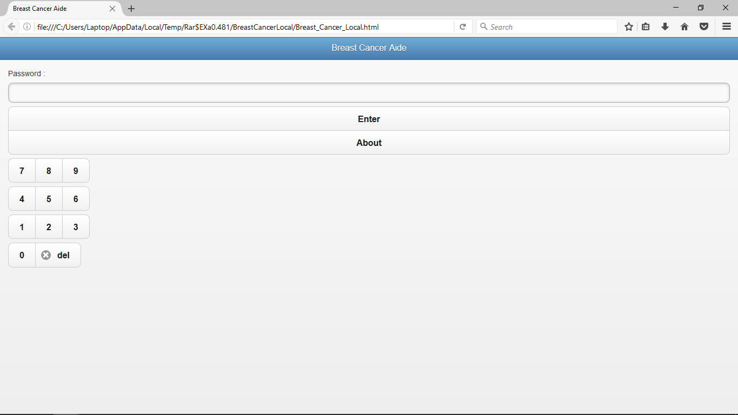
Log in page

Slide 7
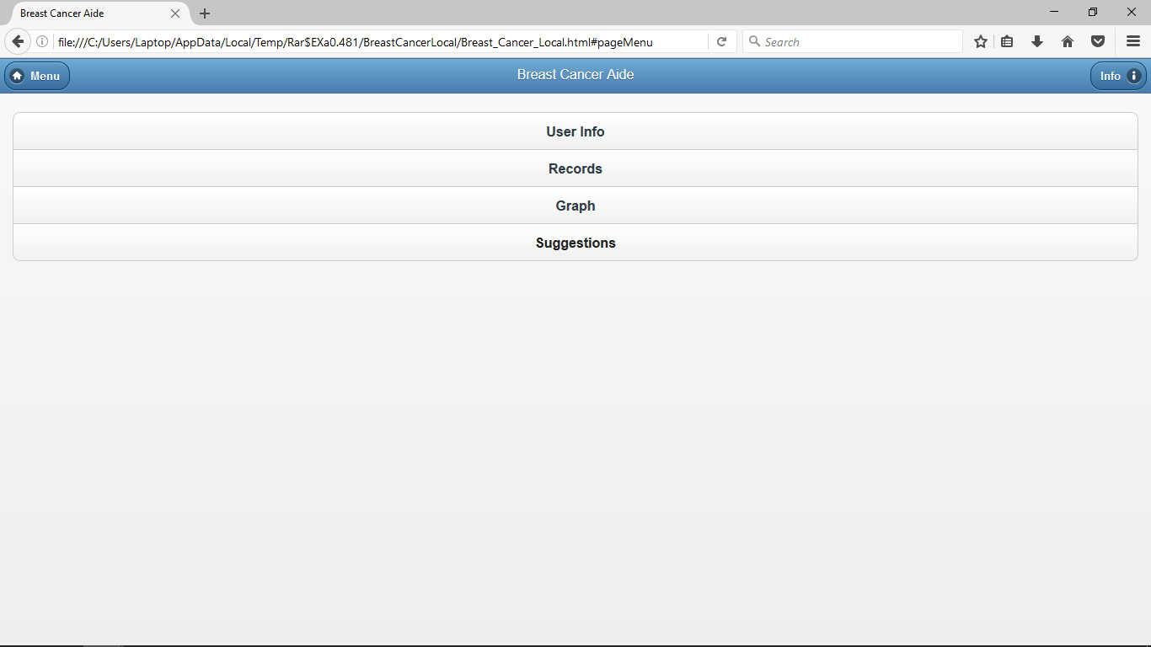
Homepage

Slide 8
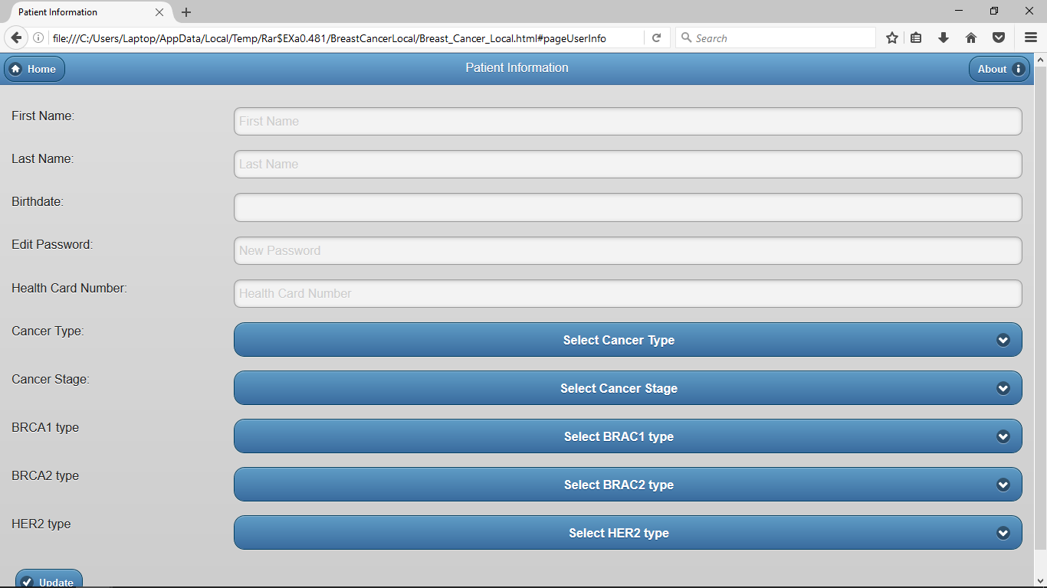
Patient information page

Slide 9
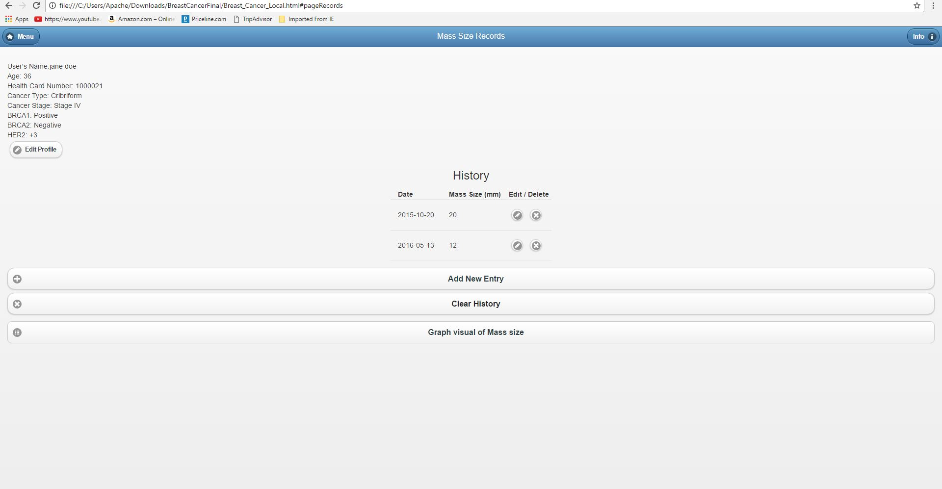
Records page

Slide 10
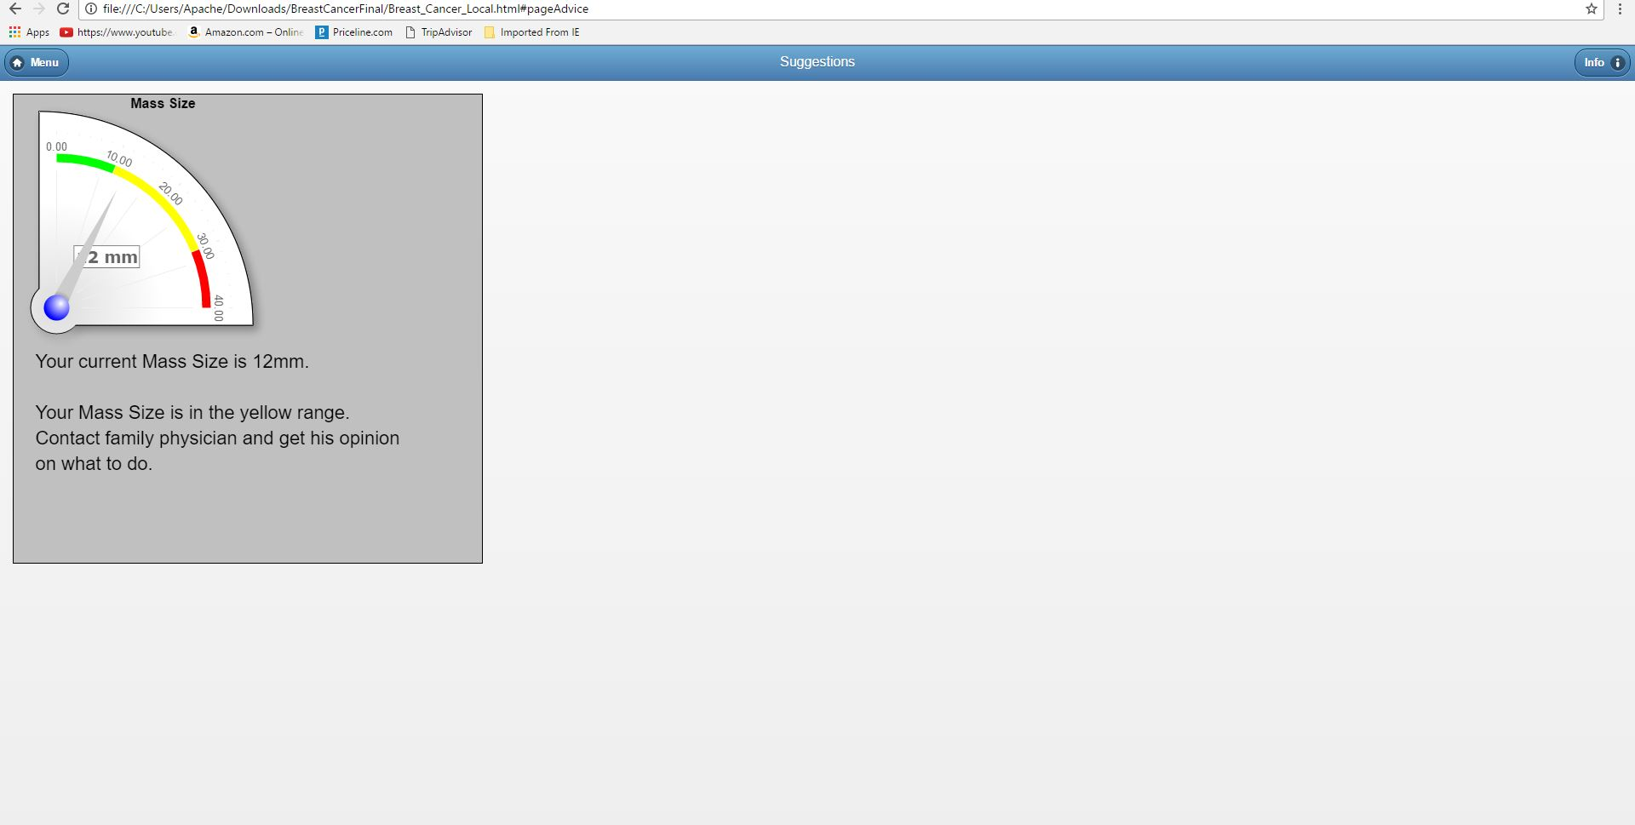
Canvas

Slide 11
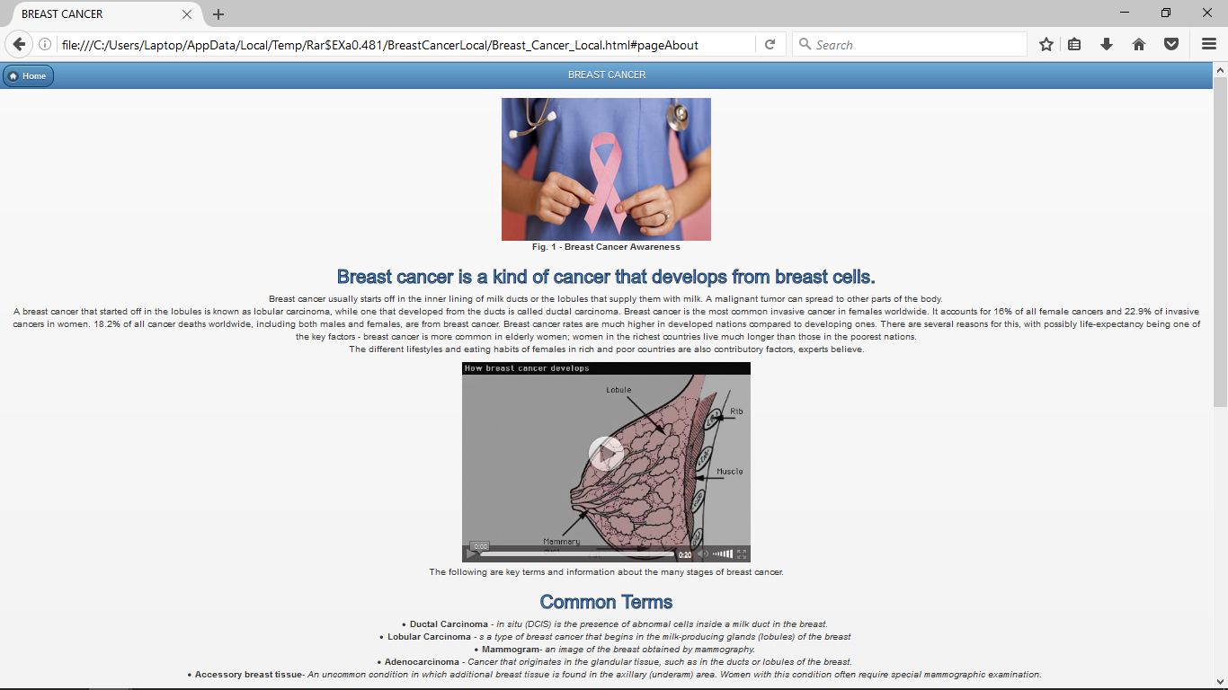
Information Page

