Slide 1


Slide 2
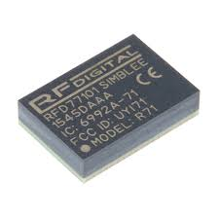
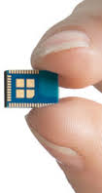
Smart Kitchen (conceptual)
Embedded Kitchen
-Simblee
7mm x 10mm x 2.2mm
29 GPIOs (flexible pin configuration)
ARM Cortex M0 processor
Temperature sensor
and more...

Slide 3


Web to device communication
IBM‘s bluemix
- node-red
IMB’s Watson
IoT Platform
Cloud servers

Slide 4
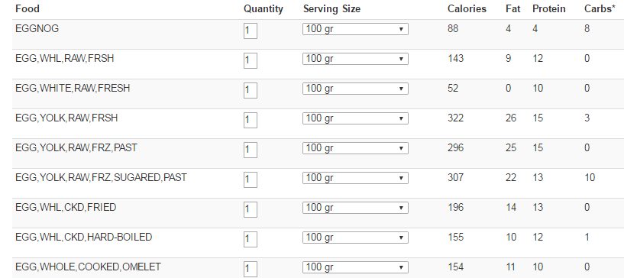
Cross platform development
Html/css, Bootstrap , Javascript, Jquery

