Slide 1


Slide 2

UNDERSTANDING THE
HOMOLOGY
By
Bineet Kumar Mohanta

Slide 3
HOMOLOGS
Definition :
Homologs are two or more sequences that descend from a COMMON ANCESTRAL sequence.
Homologs are results of divergent evolution.
HOMOLOGS
ORTHOLOGS
XENOLOGS
PARALOGS
Result of Speciation events
Result of Horizontal gene transfer
Result of Gene duplication
HOMEOLOGS
GAMETOLOGS
The genes in sex chromosome that have not recombined

Slide 4


ORTHOLOGS
Definition :
Orthologous sequences are those sequences which are the results of the speciation process.
Common Ancestor
Hemoglobin
Hemoglobin
Similar or identical sequences in DIFFERENT species

Slide 5
PARALOGUES
Definition :
Paralogous sequences are homologous sequences that have diverged within one species . i.e arise during gene duplication process.
Hemoglobin A
Hemoglobin B
Similar sequences within SAME species

Slide 6
SYMPARALOGS
Genes that have duplicated AFTER the last speciation event are known as
IN-PARALOGS or SYMPARALOGS
ALLOPARALOGS
Genes that have duplicated BEFORE the last speciation event are known as
OUT-PARALOGS or ALLOPARALOGS
OHNOLOGS
These are genes that are a result of a duplication of a WHOLE GENOME

Slide 7
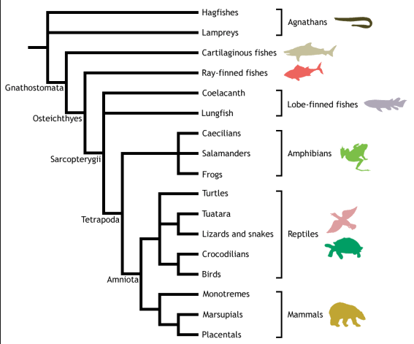
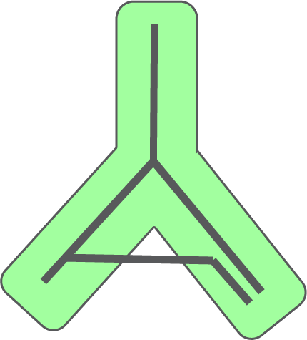
XENOLOGS
Similar sequences between DISTANTLY RELATED organisms in the evolutionary history.
HORIZONTAL GENE TRANSFER
LATERAL GENE TRANSFER
Ancestral
Species
Species
1
Species
2
Horizontal Gene Transfer
Xenologs

Slide 8
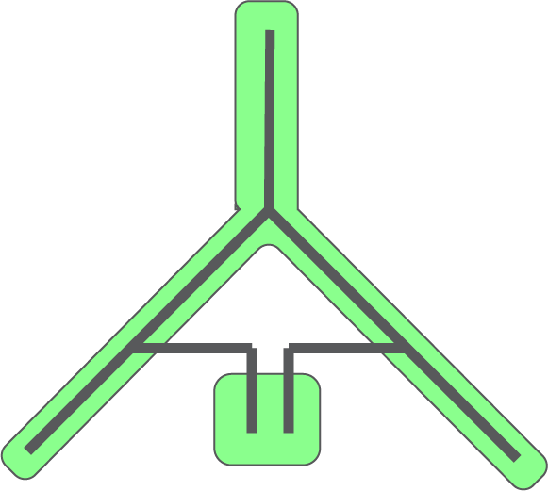
HOMEOLOGS
Homeologs are special cases of Xenologs.
The genes which are separated by a speciation event when hybridized together via lateral gene transfer, the gene sequences are known as Homeologs.
Ancestral
Species
Species
1
Species
2
Gene
A1
Hybrid
Species
Gene
A2
Gene
A1 & A2
Homeologs

Slide 9
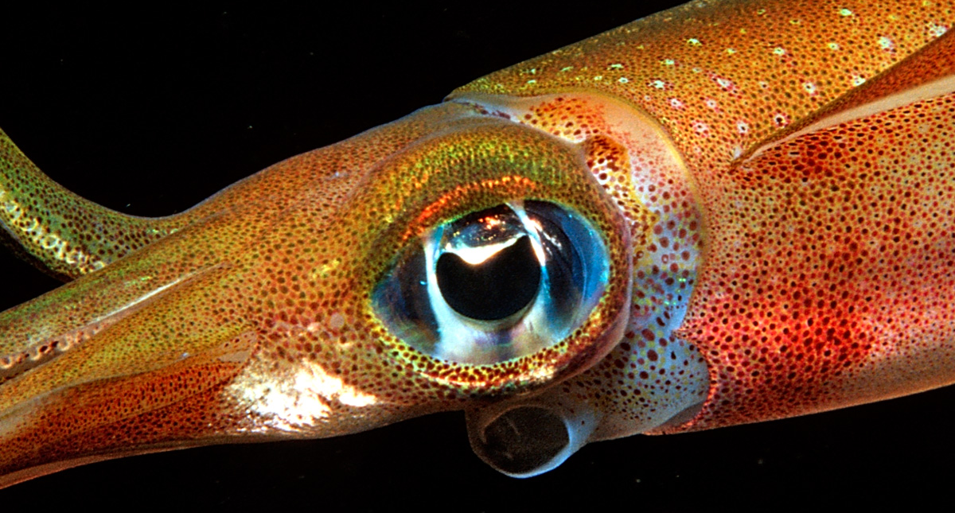

ANALOGS
Definition :
Analogous genes are genes that have IDENTICAL or SIMILAR FUNCTIONS but DON’T SHARE A COMMON ANCESTOR.
CONVERGENT EVOLUTION
Squid Eye
Human Eye
Analogs have homologous activity but heterologous origin

Slide 10
HOMOLOGS VS. ANALOGS
COMMON ANCESTORS
ANCESTRAL HNS
HUMAN
CHIMPANZEE
HISTONE H1.1
HISTONE H1.1
E . coli HNS Protein
PARALOGS
HISTONE H1.2
HISTONE H1.2
ORTHOLOGS
ANALOGS

Slide 11
SUMMARY
HOMOLOGS :
Two or more sequences that descend from a COMMON ANCESTRAL sequence.
ORTHOLOGS :
Sequences which are the results of the SPECIATION PROCESS.
PARALOGS :
Sequences which are the results of the GENE DUPLICATION PROCESS.
XENOLOGS :
Similar sequences between DISTANTLY RELATED organisms in the evolutionary history.
ANALOGS :
Sequences that show similar structure or function but don’t share any COMMON ANCESTRAL sequence.

Slide 12


