Slide 1
Chapter 14
Mendel and the Gene Idea

Slide 2
Overview: Drawing from the Deck of Genes
What genetic principles account for the transmission of traits from parents to offspring?

Slide 3
One possible explanation of heredity is a “blending” hypothesis
  The idea that genetic material contributed by two parents mixes in a manner analogous to the way blue and yellow paints blend to make green

Slide 4
An alternative to the blending model is the “particulate” hypothesis of inheritance: the gene idea
  Parents pass on discrete heritable units, genes

Slide 5
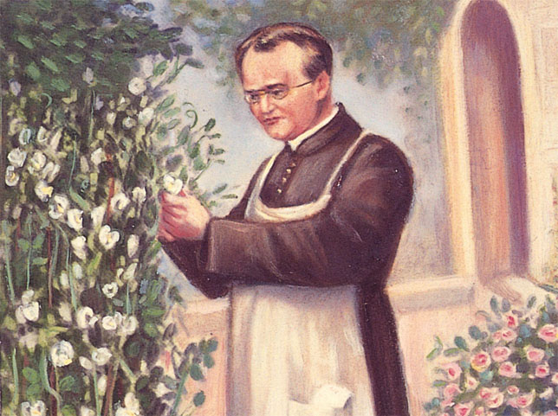
Gregor Mendel
  Documented a particulate mechanism of inheritance through his experiments with garden peas
Figure 14.1

Slide 6
Concept 14.1: Mendel used the scientific approach to identify two laws of inheritance
Mendel discovered the basic principles of heredity
  By breeding garden peas in carefully planned experiments

Slide 7
Mendel’s Experimental, Quantitative Approach
Mendel chose to work with peas
  Because they are available in many varieties
  Because he could strictly control which plants mated with which

Slide 8
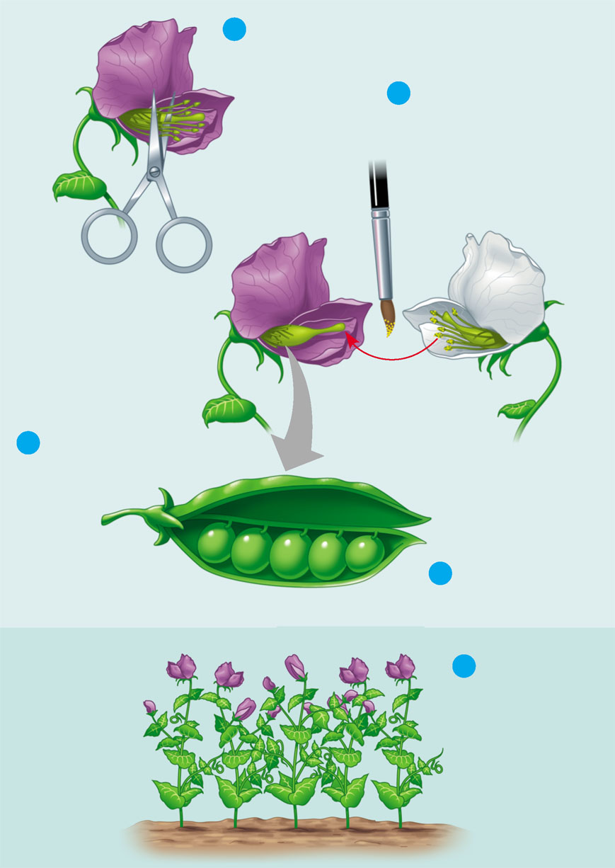
Crossing pea plants
1
Removed stamens
from purple flower
APPLICATION By crossing (mating) two true-breeding
varieties of an organism, scientists can study patterns of
inheritance. In this example, Mendel crossed pea plants
that varied in flower color.
2
Transferred sperm-
bearing pollen from
stamens of white
flower to egg-
bearing carpel of
purple flower
TECHNIQUE
Parental
generation
(P)
TECHNIQUE
Carpel
(female)
Stamens
(male)
3
Pollinated carpel
matured into pod
4
Planted seeds
from pod
When pollen from a white flower fertilizes
eggs of a purple flower, the first-generation hybrids all have purple
flowers. The result is the same for the reciprocal cross, the transfer
of pollen from purple flowers to white flowers.
Examined
offspring:
all purple
flowers
TECHNIQUE
RESULTS
5
First
generation
offspring
(F₁)
Figure 14.2

Slide 9
Some genetic vocabulary
  Character: a heritable feature, such as flower color
  Trait: a variant of a character, such as purple or white flowers

Slide 10
Mendel chose to track
  Only those characters that varied in an “either-or” manner
Mendel also made sure that
  He started his experiments with varieties that were “true-breeding”

Slide 11
In a typical breeding experiment
  Mendel mated two contrasting, true-breeding varieties, a process called hybridization
The true-breeding parents
  Are called the P generation

Slide 12
The hybrid offspring of the P generation
  Are called the F₁ generation
When F₁ individuals self-pollinate
  The F₂ generation is produced

Slide 13
The Law of Segregation
When Mendel crossed contrasting, true-breeding white and purple flowered pea plants
  All of the offspring were purple
When Mendel crossed the F₁ plants
  Many of the plants had purple flowers, but some had white flowers

Slide 14
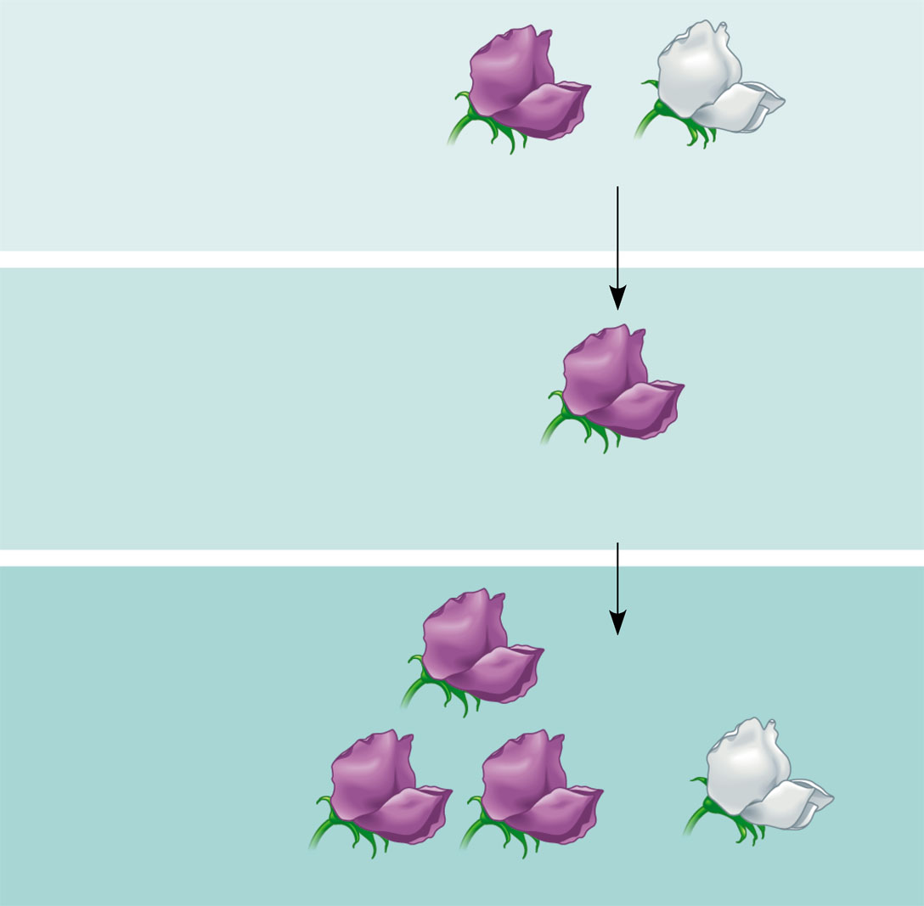
Mendel discovered
  A ratio of about three to one, purple to white flowers, in the F₂ generation
EXPERIMENT True-breeding purple-flowered pea plants and
white-flowered pea plants were crossed (symbolized by ×). The
resulting F₁ hybrids were allowed to self-pollinate or were cross-
pollinated with other F₁ hybrids. Flower color was then observed
in the F₂ generation.
P Generation
(true-breeding
parents)
×
Purple
flowers
White
flowers
F₁ Generation
(hybrids)
All plants had
purple flowers
RESULTS Both purple-flowered plants and white-
flowered plants appeared in the F₂ generation. In Mendel’s
experiment, 705 plants had purple flowers, and 224 had white
flowers, a ratio of about 3 purple : 1 white.
F₂ Generation
Figure 14.3

Slide 15
Mendel reasoned that
  In the F₁ plants, only the purple flower factor was affecting flower color in these hybrids
  Purple flower color was dominant, and white flower color was recessive

Slide 16
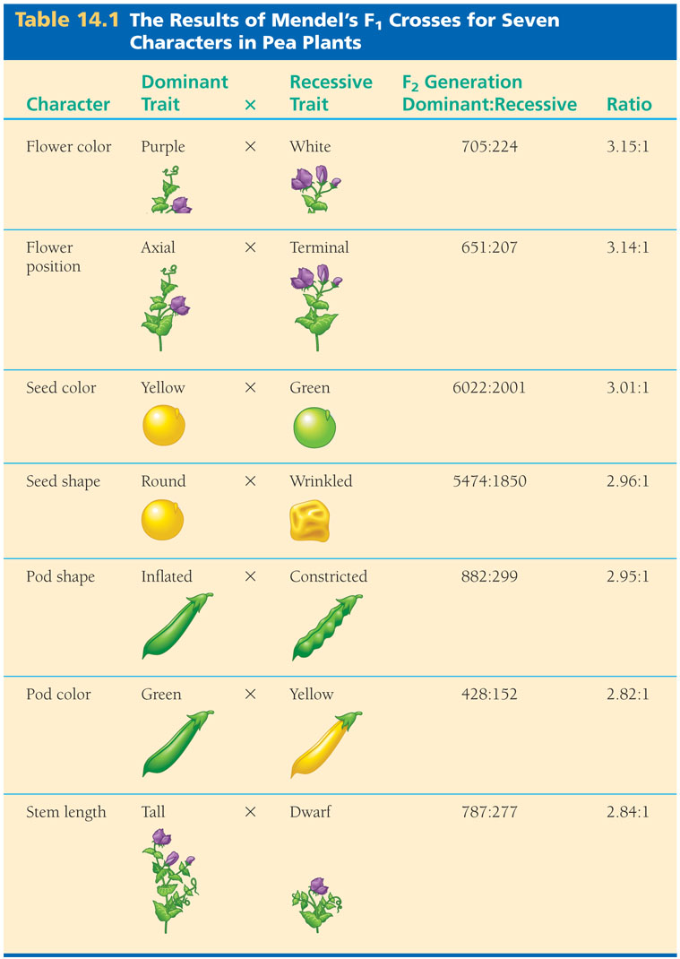
Mendel observed the same pattern
  In many other pea plant characters
Table 14.1

Slide 17
Mendel’s Model
Mendel developed a hypothesis
  To explain the 3:1 inheritance pattern that he observed among the F₂ offspring
Four related concepts make up this model

Slide 18
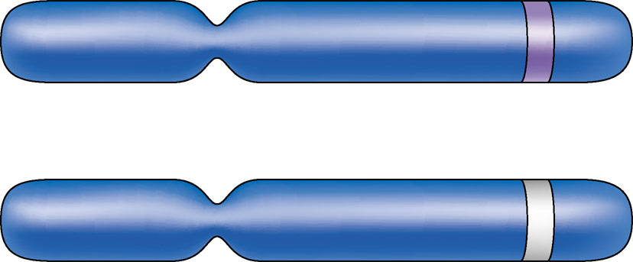
First, alternative versions of genes
  Account for variations in inherited characters, which are now called alleles
Allele for purple flowers
Homologous
pair of
chromosomes
Locus for flower-color gene
Figure 14.4
Allele for white flowers

Slide 19
Second, for each character
  An organism inherits two alleles, one from each parent
  A genetic locus is actually represented twice

Slide 20
Third, if the two alleles at a locus differ
  Then one, the dominant allele, determines the organism’s appearance
  The other allele, the recessive allele, has no noticeable effect on the organism’s appearance

Slide 21
Fourth, the law of segregation
  The two alleles for a heritable character separate (segregate) during gamete formation and end up in different gametes

Slide 22
Does Mendel’s segregation model account for the 3:1 ratio he observed in the F₂ generation of his numerous crosses?
  We can answer this question using a Punnett square

Slide 23
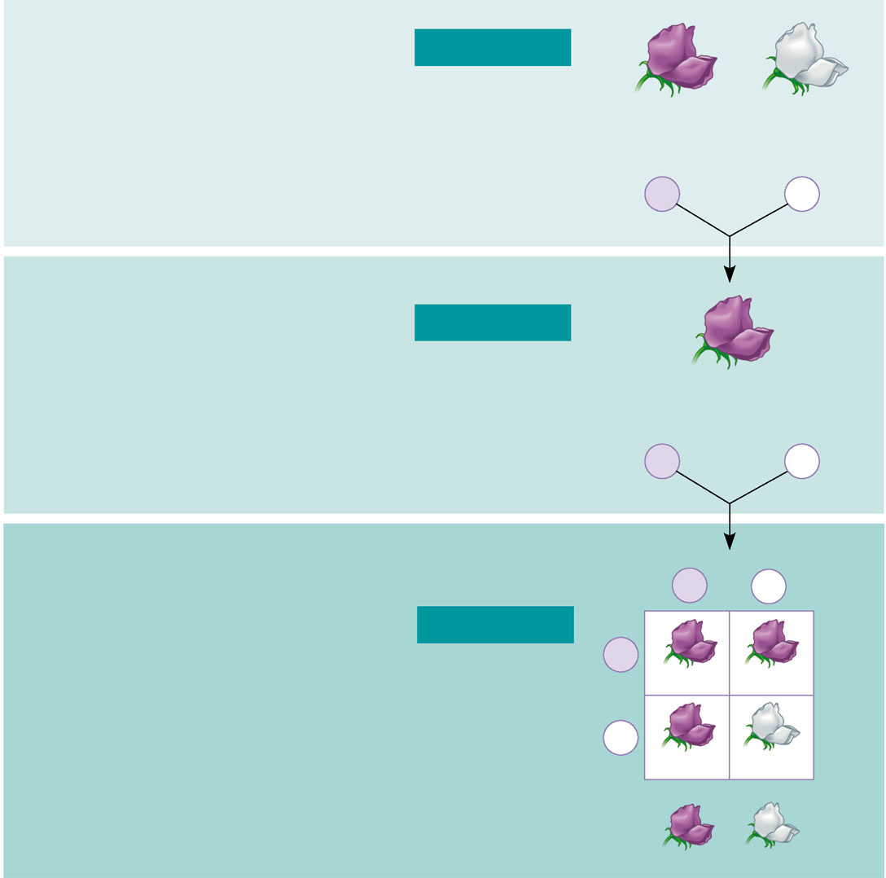
Mendel’s law of segregation, probability and the Punnett square
Each true-breeding plant of the
parental generation has identical
alleles, PP or pp.
Gametes (circles) each contain only
one allele for the flower-color gene.
In this case, every gamete produced
by one parent has the same allele.
P Generation
×
Appearance:
Genetic makeup:
Purple flowers
PP
White flowers
pp
Gametes:
P
p
Union of the parental gametes
produces F₁ hybrids having a Pp
combination. Because the purple-
flower allele is dominant, all
these hybrids have purple flowers.
When the hybrid plants produce
gametes, the two alleles segregate,
half the gametes receiving the P
allele and the other half the p allele.
F₁ Generation
Appearance:
Genetic makeup:
Purple flowers
Pp
Gametes:
¹/₂
P
¹/₂
p
This box, a Punnett square, shows
all possible combinations of alleles
in offspring that result from an
F₁ × F₁ (Pp × Pp) cross. Each square
represents an equally probable product
of fertilization. For example, the bottom
left box shows the genetic combination
resulting from a p egg fertilized by
a P sperm.
F₁ sperm
P
p
F₂ Generation
P
PP
Pp
F₁ eggs
p
Pp
pp
Random combination of the gametes
results in the 3:1 ratio that Mendel
observed in the F₂ generation.
Figure 14.5
3
: 1

Slide 24
Useful Genetic Vocabulary
An organism that is homozygous for a particular gene
  Has a pair of identical alleles for that gene
  Exhibits true-breeding
An organism that is heterozygous for a particular gene
  Has a pair of alleles that are different for that gene

Slide 25
An organism’s phenotype
  Is its physical appearance
An organism’s genotype
  Is its genetic makeup

Slide 26
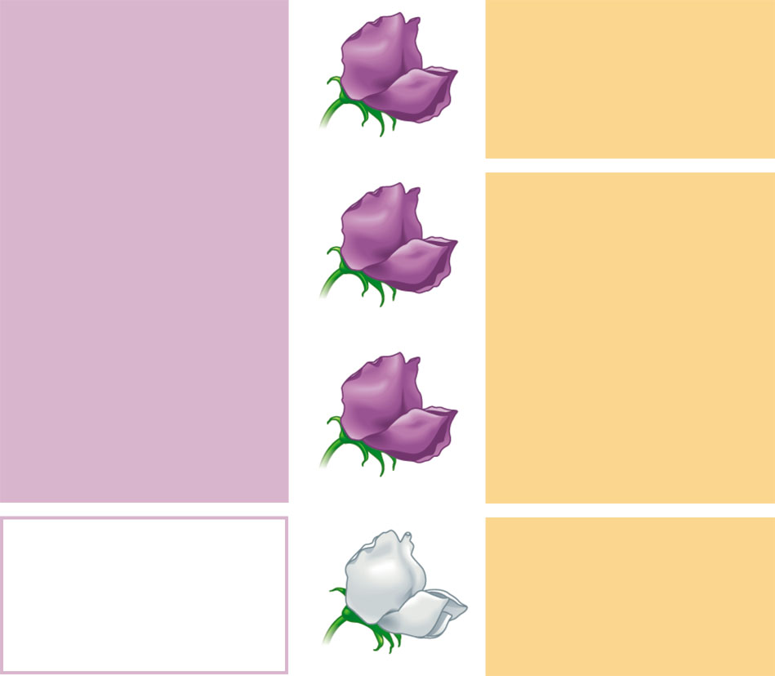
Phenotype versus genotype
Phenotype
Genotype
Purple
PP
(homozygous)
1
Pp
(heterozygous)
3
Purple
2
Pp
(heterozygous)
Purple
White
pp
(homozygous)
1
1
Figure 14.6
Ratio 3:1
Ratio 1:2:1

Slide 27
The Testcross
In pea plants with purple flowers
  The genotype is not immediately obvious

Slide 28
A testcross
  Allows us to determine the genotype of an organism with the dominant phenotype, but unknown genotype
  Crosses an individual with the dominant phenotype with an individual that is homozygous recessive for a trait

Slide 29
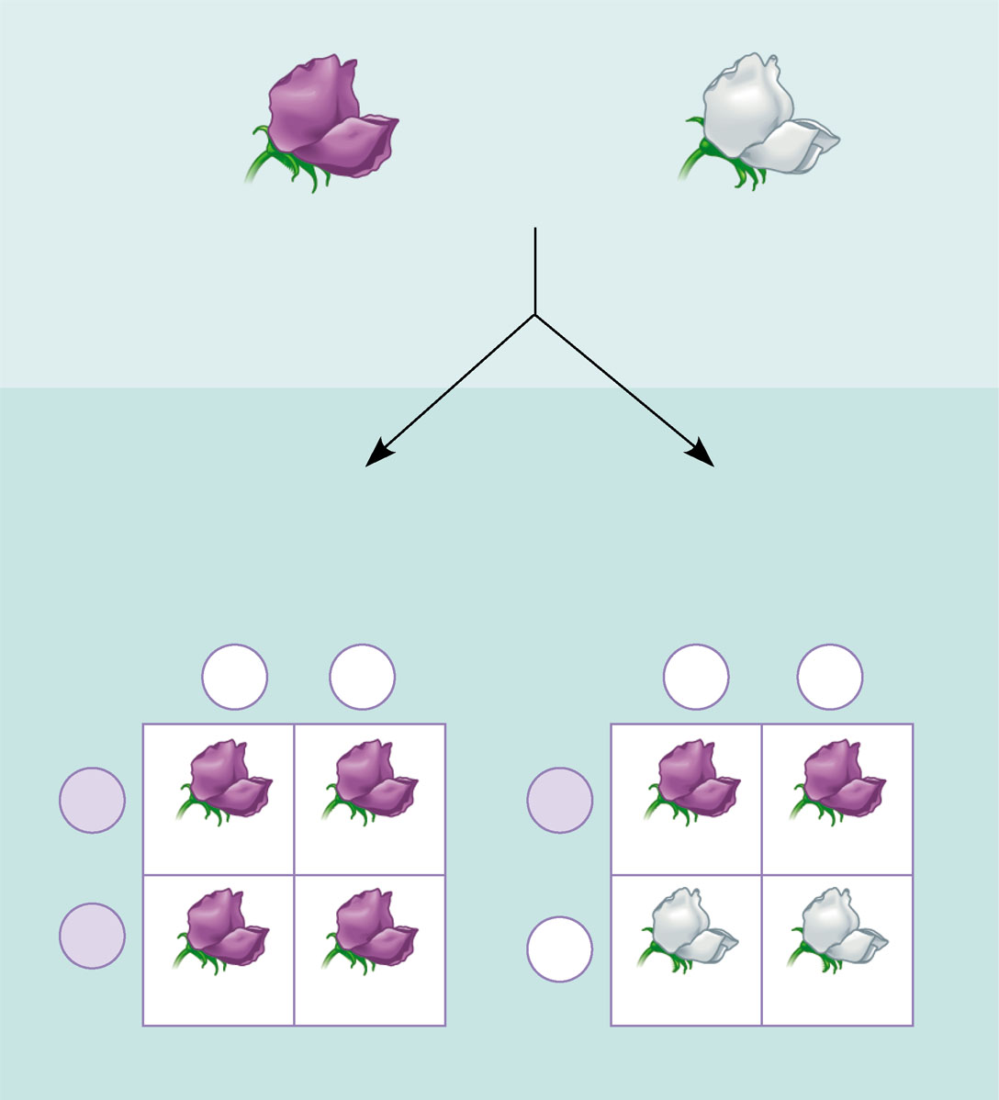
The testcross
APPLICATION An organism that exhibits a dominant trait,
such as purple flowers in pea plants, can be either homozygous for
the dominant allele or heterozygous. To determine the organism’s
genotype, geneticists can perform a testcross.
×
Dominant phenotype,
unknown genotype:
PP or Pp?
Recessive phenotype,
known genotype:
pp
TECHNIQUE In a testcross, the individual with the
unknown genotype is crossed with a homozygous individual
expressing the recessive trait (white flowers in this example).
By observing the phenotypes of the offspring resulting from this
cross, we can deduce the genotype of the purple-flowered
parent.
If PP,
then all offspring
purple:
If Pp,
then ¹⁄₂ offspring purple
and ¹⁄₂ offspring white:
p
p
p
p
RESULTS
P
P
Pp
Pp
Pp
Pp
P
p
Pp
Pp
pp
pp
Figure 14.7

Slide 30
The Law of Independent Assortment
Mendel derived the law of segregation
  By following a single trait
The F₁ offspring produced in this cross
  Were monohybrids, heterozygous for one character

Slide 31
Mendel identified his second law of inheritance
  By following two characters at the same time
Crossing two, true-breeding parents differing in two characters
  Produces dihybrids in the F₁ generation, heterozygous for both characters

Slide 32
How are two characters transmitted from parents to offspring?
  As a package?
  Independently?

Slide 33
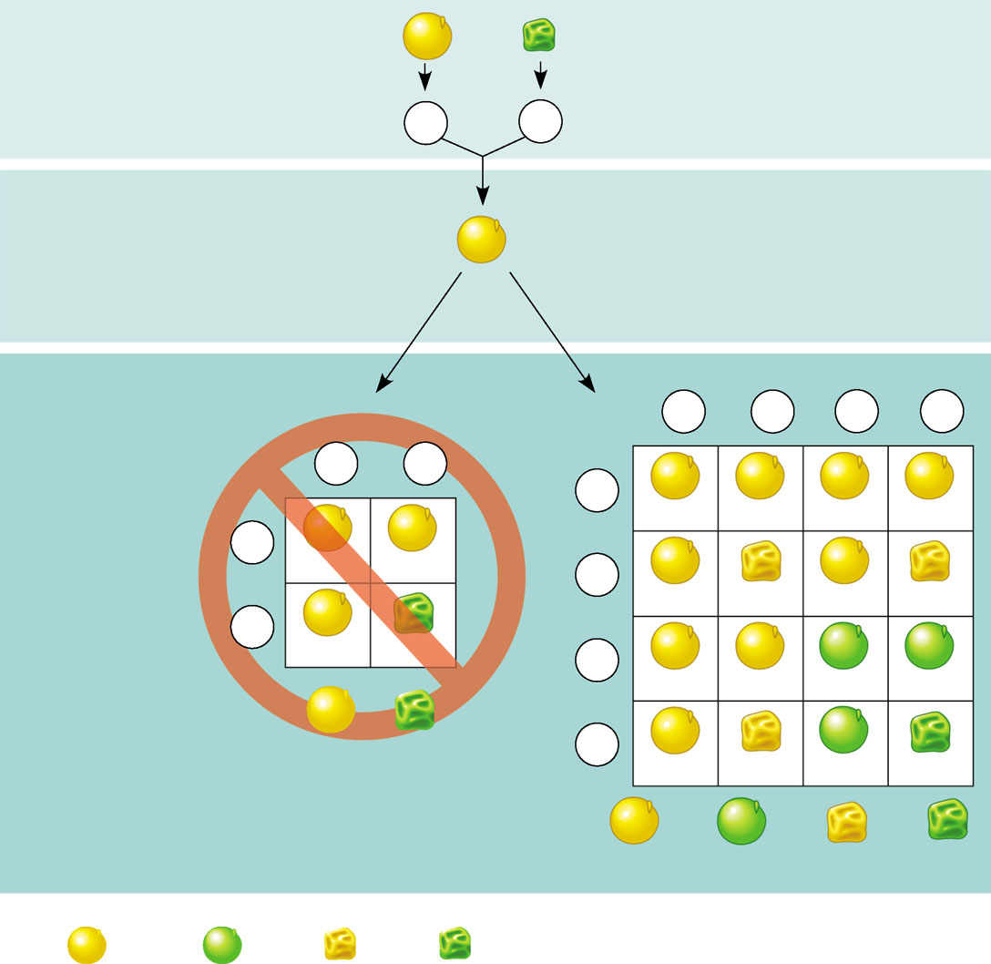
A dihybrid cross
  Illustrates the inheritance of two characters
Produces four phenotypes in the F₂ generation
EXPERIMENT Two true-breeding pea plants—
one with yellow-round seeds and the other with green-wrinkled seeds—were crossed, producing dihybrid F₁ plants. Self-pollination of the F₁ dihybrids, which are heterozygous for both characters, produced the F₂ generation. The two hypotheses predict different phenotypic ratios. Note that yellow color (Y) and round shape (R) are dominant.
P Generation
YYRR
yyrr
Gametes
YR
×
yr
F₁ Generation
Hypothesis of
dependent
assortment
YyRr
Hypothesis of
independent
assortment
Sperm
¹ ⁄₄
¹ ⁄₄
YR
Yr
¹ ⁄₄
¹ ⁄₄
Sperm
Eggs
yR
yr
¹⁄₂
¹⁄₂
yr
RESULTS
YR
¹ ⁄₄
Eggs
YR
YYRR
YYRr
YyRR
YyRr
¹ ⁄₂
F₂ Generation
(predicted
offspring)
YR
YYRR
YyRr
¹ ⁄₄
Yr
YYrr
YYrr
YyRr
Yyrr
yr
CONCLUSION The results support the hypothesis of
independent assortment. The alleles for seed color and seed
shape sort into gametes independently of each other.
¹ ⁄₂
YyRr
yyrr
¹ ⁄₄
yR
YyRR
YyRr
yyRR
yyRr
³ ⁄₄
¹ ⁄₄
Phenotypic ratio 3:1
¹ ⁄₄
yr
YyRr
Yyrr
yyRr
yyrr
⁹ ⁄₁₆
³ ⁄₁₆
³ ⁄₁₆
¹ ⁄₁₆
Phenotypic ratio 9:3:3:1
Figure 14.8
315
108
101
32
Phenotypic ratio approximately 9:3:3:1

Slide 34
Using the information from a dihybrid cross, Mendel developed the law of independent assortment
  Each pair of alleles segregates independently during gamete formation

Slide 35
Concept 14.2: The laws of probability govern Mendelian inheritance
Mendel’s laws of segregation and independent assortment
  Reflect the rules of probability

Slide 36
The Multiplication and Addition Rules Applied to Monohybrid Crosses
The multiplication rule
  States that the probability that two or more independent events will occur together is the product of their individual probabilities

Slide 37
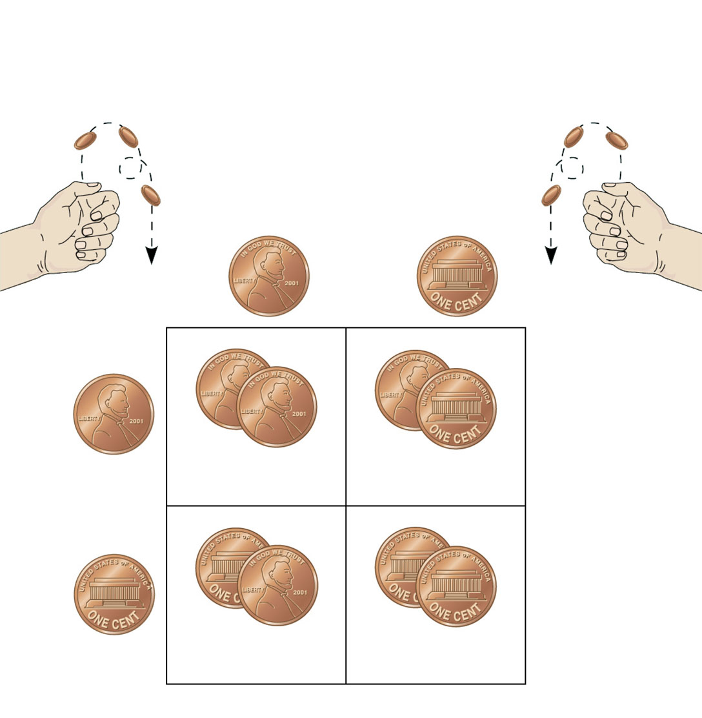
Probability in a monohybrid cross
  Can be determined using this rule
Rr
Segregation of
alleles into eggs
×
Rr
Segregation of
alleles into sperm
×
Sperm
¹⁄₂
R
¹⁄₂
r
R
R
¹⁄₂
R
R
r
¹⁄₄
¹⁄₄
Eggs
r
R
r
¹⁄₂
r
r
¹⁄₄
¹⁄₄
Figure 14.9

Slide 38
The rule of addition
  States that the probability that any one of two or more exclusive events will occur is calculated by adding together their individual probabilities

Slide 39
Solving Complex Genetics Problems with the Rules of Probability
We can apply the rules of probability
  To predict the outcome of crosses involving multiple characters

Slide 40
A dihybrid or other multicharacter cross
  Is equivalent to two or more independent monohybrid crosses occurring simultaneously
In calculating the chances for various genotypes from such crosses
  Each character first is considered separately and then the individual probabilities are multiplied together

Slide 41
Concept 14.3: Inheritance patterns are often more complex than predicted by simple Mendelian genetics
The relationship between genotype and phenotype is rarely simple

Slide 42
Extending Mendelian Genetics for a Single Gene
The inheritance of characters by a single gene
  May deviate from simple Mendelian patterns

Slide 43
The Spectrum of Dominance
Complete dominance
  Occurs when the phenotypes of the heterozygote and dominant homozygote are identical

Slide 44
In codominance
  Two dominant alleles affect the phenotype in separate, distinguishable ways
The human blood group MN
  Is an example of codominance

Slide 45
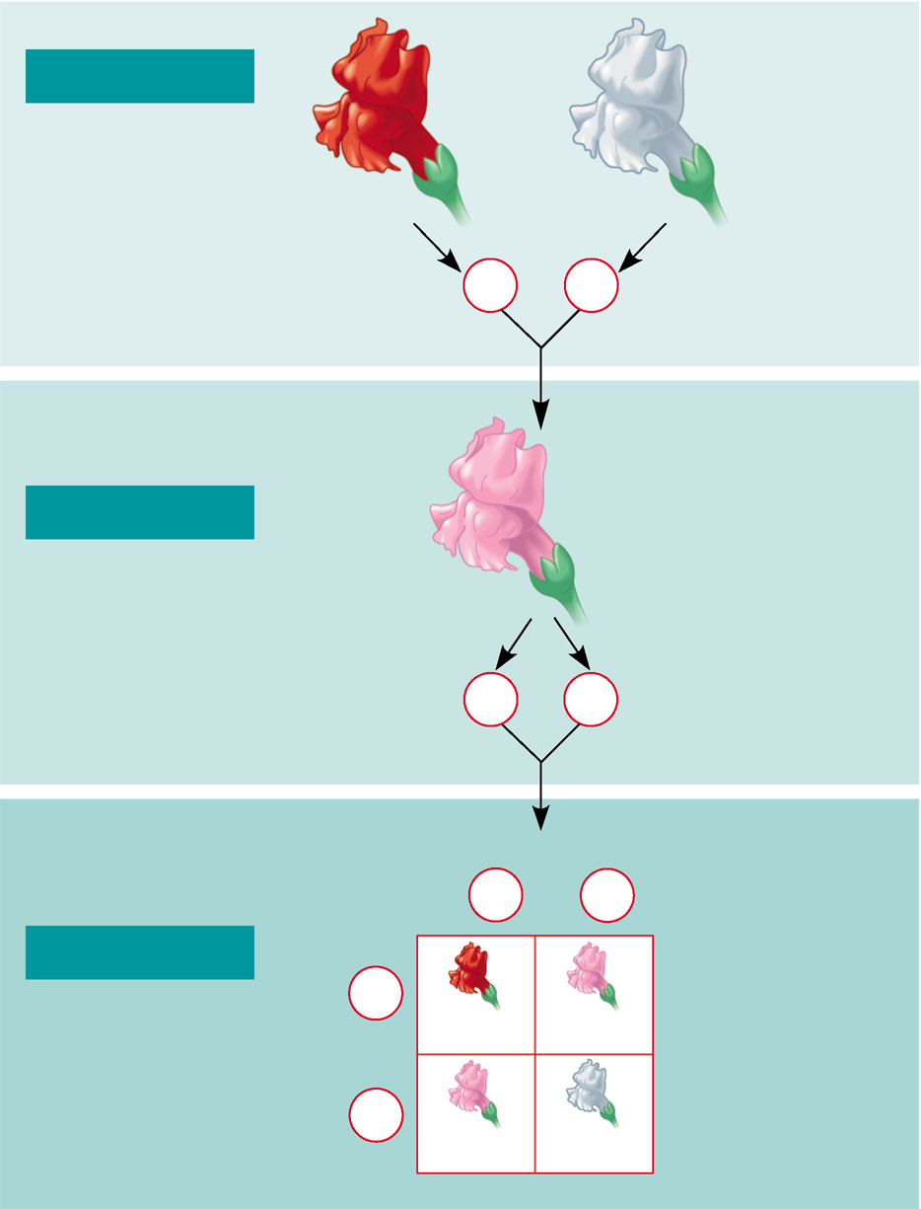
In incomplete dominance
  The phenotype of F₁ hybrids is somewhere between the phenotypes of the two parental varieties
P Generation
White
C^{W}C^{W}
Red
C^{R}C^{R}
×
Gametes
C^{R}
C^{W}
Pink
C^{R}C^{W}
F₁ Generation
Gametes
¹⁄₂
¹⁄₂
C^{R}
C^{R}
Eggs
¹⁄₂
C^{R}
¹⁄₂
C^{R}
Sperm
F₂ Generation
¹⁄₂
C^{R}
C^{R} C^{R}
C^{R} C^{W}
¹⁄₂
C^{w}
C^{R} C^{W}
C^{W} C^{W}
Figure 14.10

Slide 46
The Relation Between Dominance and Phenotype
Dominant and recessive alleles
  Do not really “interact”
  Lead to synthesis of different proteins that produce a phenotype

Slide 47
Frequency of Dominant Alleles
Dominant alleles
  Are not necessarily more common in populations than recessive alleles

Slide 48
Multiple Alleles
Most genes exist in populations
  In more than two allelic forms

Slide 49
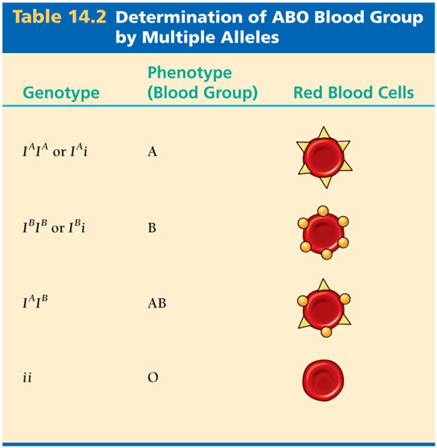
The ABO blood group in humans
  Is determined by multiple alleles
Table 14.2

Slide 50
Pleiotropy
In pleiotropy
  A gene has multiple phenotypic effects

Slide 51
Extending Mendelian Genetics for Two or More Genes
Some traits
  May be determined by two or more genes

Slide 52
Epistasis
In epistasis
  A gene at one locus alters the phenotypic expression of a gene at a second locus

Slide 53
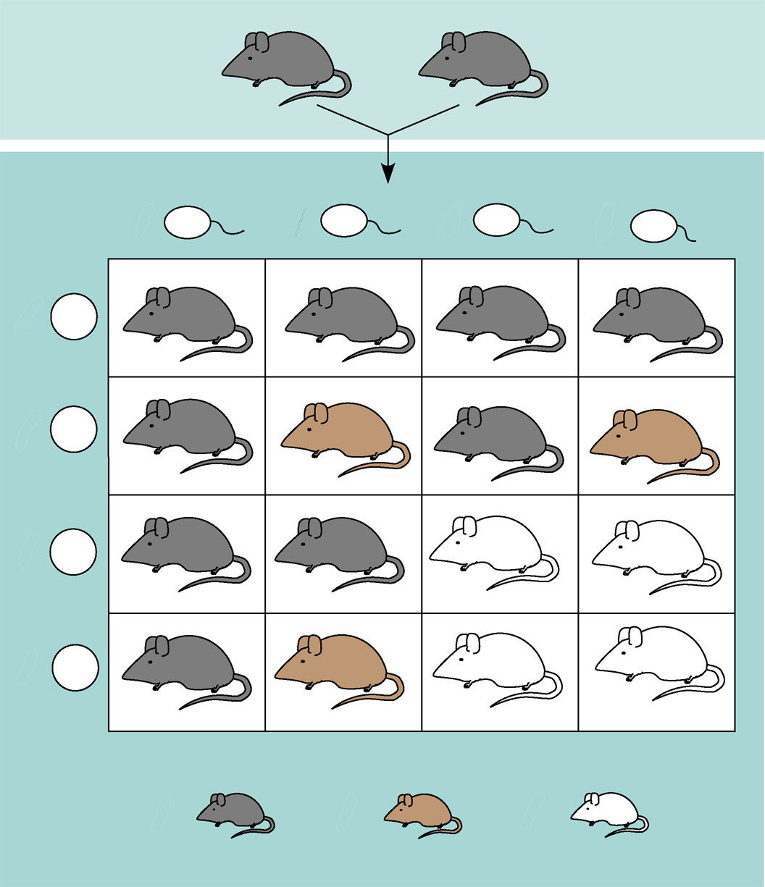
An example of epistasis
BbCc
×
BbCc
Sperm
¹⁄₄
BC
¹⁄₄
bC
¹⁄₄
Bc
¹⁄₄
bc
Eggs
¹⁄₄
BC
BBCC
BbCC
BBCc
BbCc
¹⁄₄
bC
BbCC
bbCC
BbCc
bbCc
¹⁄₄
Bc
BBCc
BbCc
BBcc
Bbcc
¹⁄₄
bc
BbCc
bbCc
Bbcc
bbcc
⁹⁄₁₆
³⁄₁₆
⁴⁄₁₆
Figure 14.11

Slide 54
Polygenic Inheritance
Many human characters
  Vary in the population along a continuum and are called quantitative characters

Slide 55
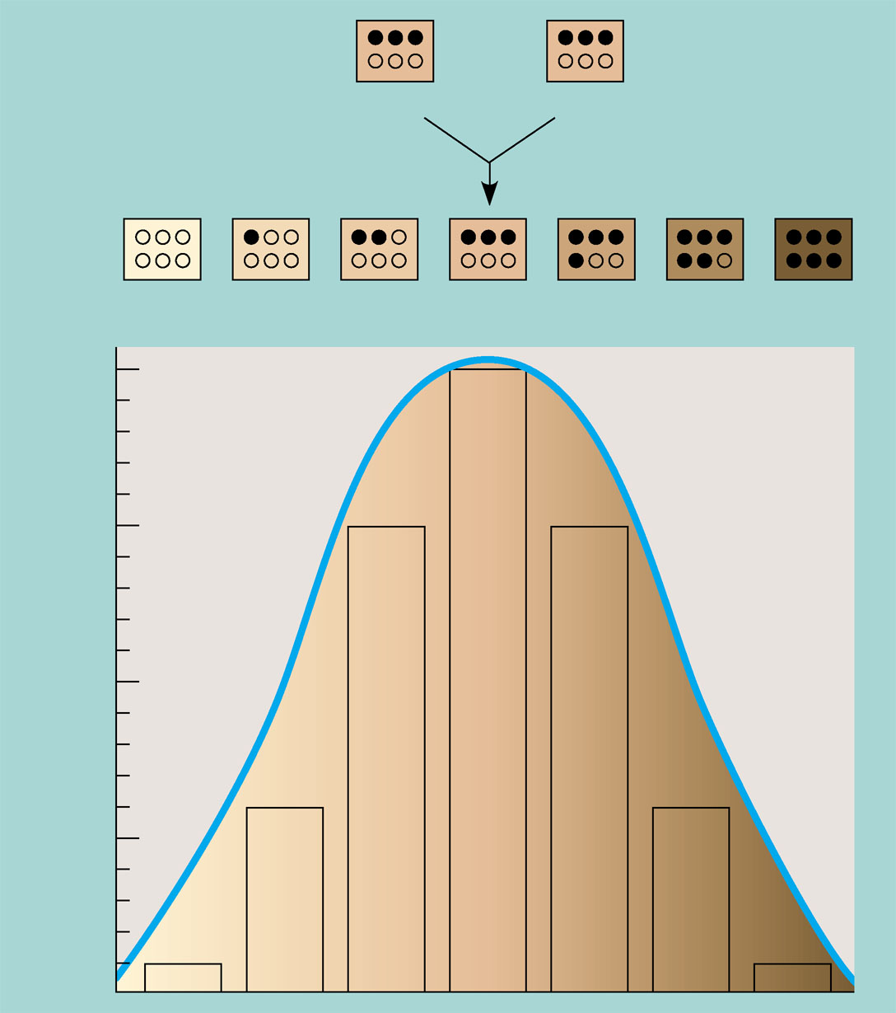
Quantitative variation usually indicates polygenic inheritance
  An additive effect of two or more genes on a single phenotype
×
AaBbCc
AaBbCc
aabbcc
Aabbcc
AaBbcc
AaBbCc
AABbCc
AABBCc
AABBCC
²⁰⁄₆₄
¹⁵⁄₆₄
Fraction of progeny
⁶⁄₆₄
Figure 14.12
¹⁄₆₄

Slide 56
Nature and Nurture: The Environmental Impact on Phenotype
Another departure from simple Mendelian genetics arises
  When the phenotype for a character depends on environment as well as on genotype

Slide 57
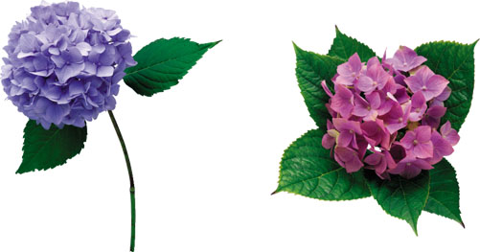
The norm of reaction
  Is the phenotypic range of a particular genotype that is influenced by the environment
Figure 14.13

Slide 58
Multifactorial characters
  Are those that are influenced by both genetic and environmental factors

Slide 59
Integrating a Mendelian View of Heredity and Variation
An organism’s phenotype
  Includes its physical appearance, internal anatomy, physiology, and behavior
  Reflects its overall genotype and unique environmental history

Slide 60
Even in more complex inheritance patterns
  Mendel’s fundamental laws of segregation and independent assortment still apply

Slide 61
Concept 14.4: Many human traits follow Mendelian patterns of inheritance
Humans are not convenient subjects for genetic research
  However, the study of human genetics continues to advance

Slide 62
Pedigree Analysis
A pedigree
  Is a family tree that describes the interrelationships of parents and children across generations

Slide 63
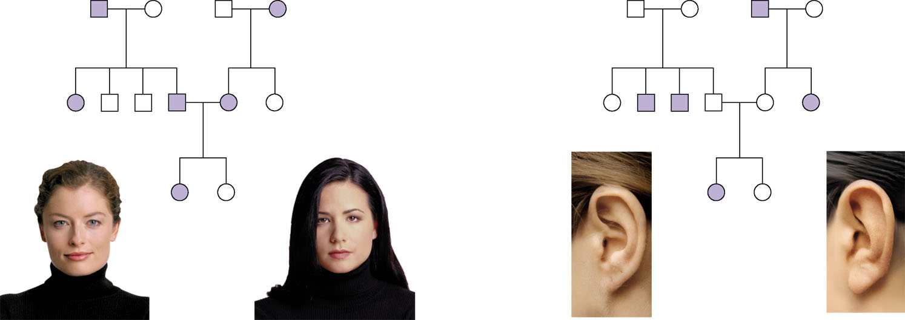
Inheritance patterns of particular traits
  Can be traced and described using pedigrees
First generation
(grandparents)
Ww
ww
ww
Ww
Ff
Ff
ff
Ff
Second generation
(parents plus aunts
and uncles)
Ww
ww
ww
Ww
Ww
ww
FF or Ff
Ff
ff
Ff
Ff
ff
Third
generation
(two sisters)
WW
or
Ww
ww
ff
FF
or
Ff
Widow’s peak
No Widow’s peak
Attached earlobe
Free earlobe
(a) Dominant trait (widow’s peak)
(b) Recessive trait (attached earlobe)
Figure 14.14 A, B

Slide 64
Pedigrees
  Can also be used to make predictions about future offspring

Slide 65
Recessively Inherited Disorders
Many genetic disorders
  Are inherited in a recessive manner

Slide 66
Recessively inherited disorders
  Show up only in individuals homozygous for the allele
Carriers
  Are heterozygous individuals who carry the recessive allele but are phenotypically normal

Slide 67
Cystic Fibrosis
Symptoms of cystic fibrosis include
  Mucus buildup in the some internal organs
  Abnormal absorption of nutrients in the small intestine

Slide 68
Sickle-Cell Disease
Sickle-cell disease
  Affects one out of 400 African-Americans
  Is caused by the substitution of a single amino acid in the hemoglobin protein in red blood cells
Symptoms include
  Physical weakness, pain, organ damage, and even paralysis

Slide 69
Mating of Close Relatives
Matings between relatives
  Can increase the probability of the appearance of a genetic disease
  Are called consanguineous matings

Slide 70
Dominantly Inherited Disorders
Some human disorders
  Are due to dominant alleles

Slide 71
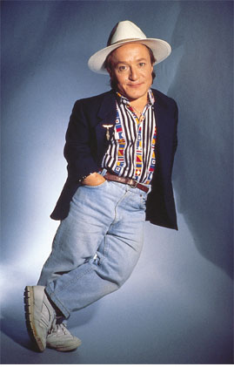
One example is achondroplasia
  A form of dwarfism that is lethal when homozygous for the dominant allele
Figure 14.15

Slide 72
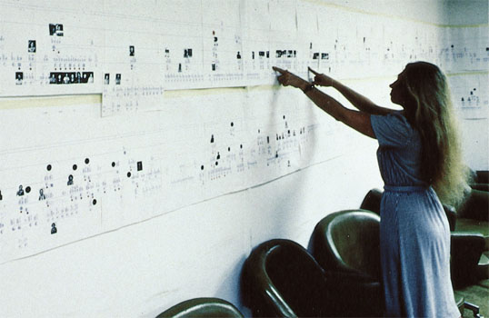
Huntington’s disease
  Is a degenerative disease of the nervous system
  Has no obvious phenotypic effects until about 35 to 40 years of age
Figure 14.16

Slide 73
Multifactorial Disorders
Many human diseases
  Have both genetic and environment components
Examples include
  Heart disease and cancer

Slide 74
Genetic Testing and Counseling
Genetic counselors
  Can provide information to prospective parents concerned about a family history for a specific disease

Slide 75
Counseling Based on Mendelian Genetics and Probability Rules
Using family histories
  Genetic counselors help couples determine the odds that their children will have genetic disorders

Slide 76
Tests for Identifying Carriers
For a growing number of diseases
  Tests are available that identify carriers and help define the odds more accurately

Slide 77
Fetal Testing
In amniocentesis
  The liquid that bathes the fetus is removed and tested
In chorionic villus sampling (CVS)
  A sample of the placenta is removed and tested

Slide 78
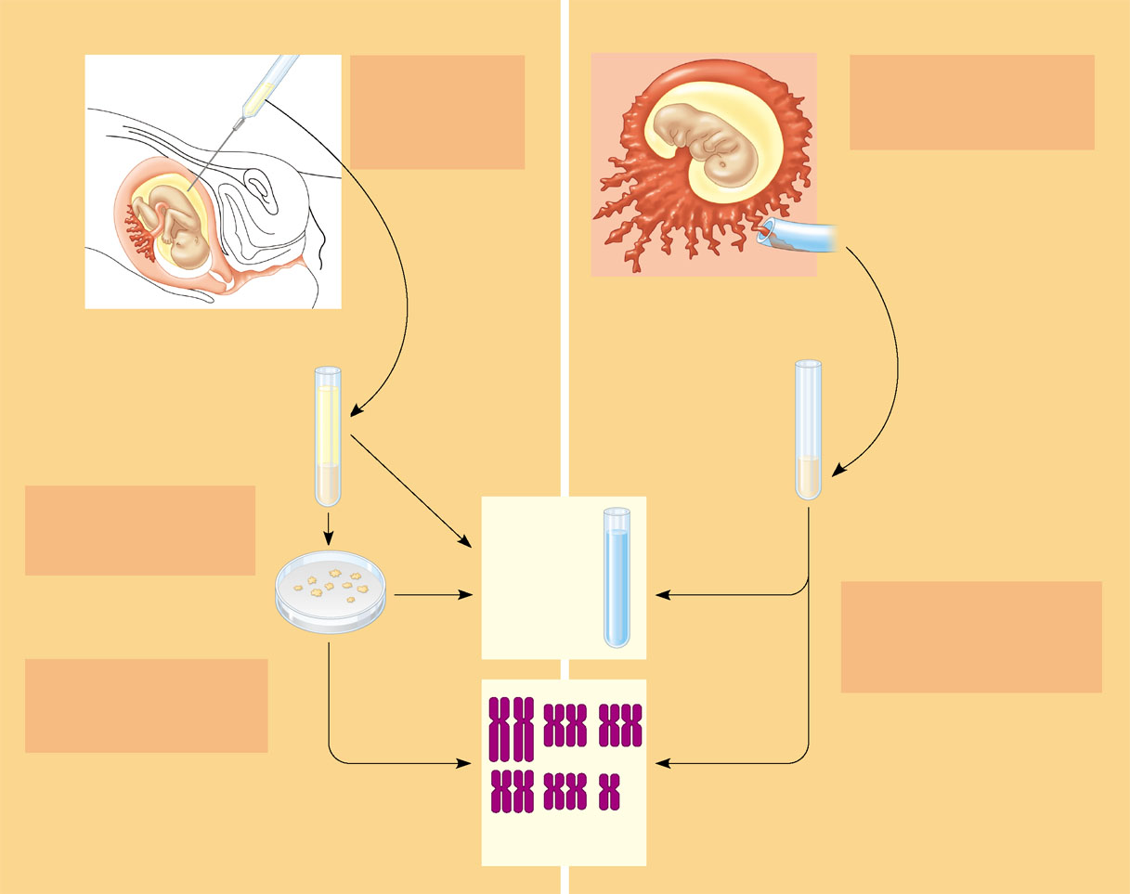
Fetal testing
(a) Amniocentesis
(b) Chorionic villus sampling (CVS)
Amniotic
fluid
withdrawn
A sample of
amniotic fluid can
be taken starting at
the 14th to 16th
week of pregnancy.
A sample of chorionic villus
tissue can be taken as early
as the 8th to 10th week of
pregnancy.
Fetus
Fetus
Centrifugation
Suction tube
Inserted through
cervix
Placenta
Chorionic viIIi
Placenta
Uterus
Cervix
Fluid
Fetal
cells
Fetal
cells
Biochemical tests can be
Performed immediately on
the amniotic fluid or later
on the cultured cells.
Biochemical
tests
Karyotyping and biochemical
tests can be performed on
the fetal cells immediately,
providing results within a day
or so.
Several
weeks
Several
hours
Fetal cells must be cultured
for several weeks to obtain
sufficient numbers for
karyotyping.
Karyotyping
Figure 14.17 A, B

Slide 79
Newborn Screening
Some genetic disorders can be detected at birth
  By simple tests that are now routinely performed in most hospitals in the United States

