Slide 1
Chapter 15
The Chromosomal Basis of Inheritance

Slide 2
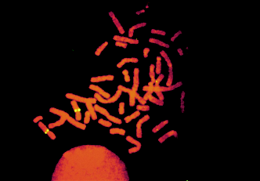
Overview: Locating Genes on Chromosomes
Genes
  Are located on chromosomes
  Can be visualized using certain techniques
Figure 15.1

Slide 3
Concept 15.1: Mendelian inheritance has its physical basis in the behavior of chromosomes
Several researchers proposed in the early 1900s that genes are located on chromosomes
The behavior of chromosomes during meiosis was said to account for Mendel’s laws of segregation and independent assortment

Slide 4
The chromosome theory of inheritance states that
  Mendelian genes have specific loci on chromosomes
  Chromosomes undergo segregation and independent assortment

Slide 5
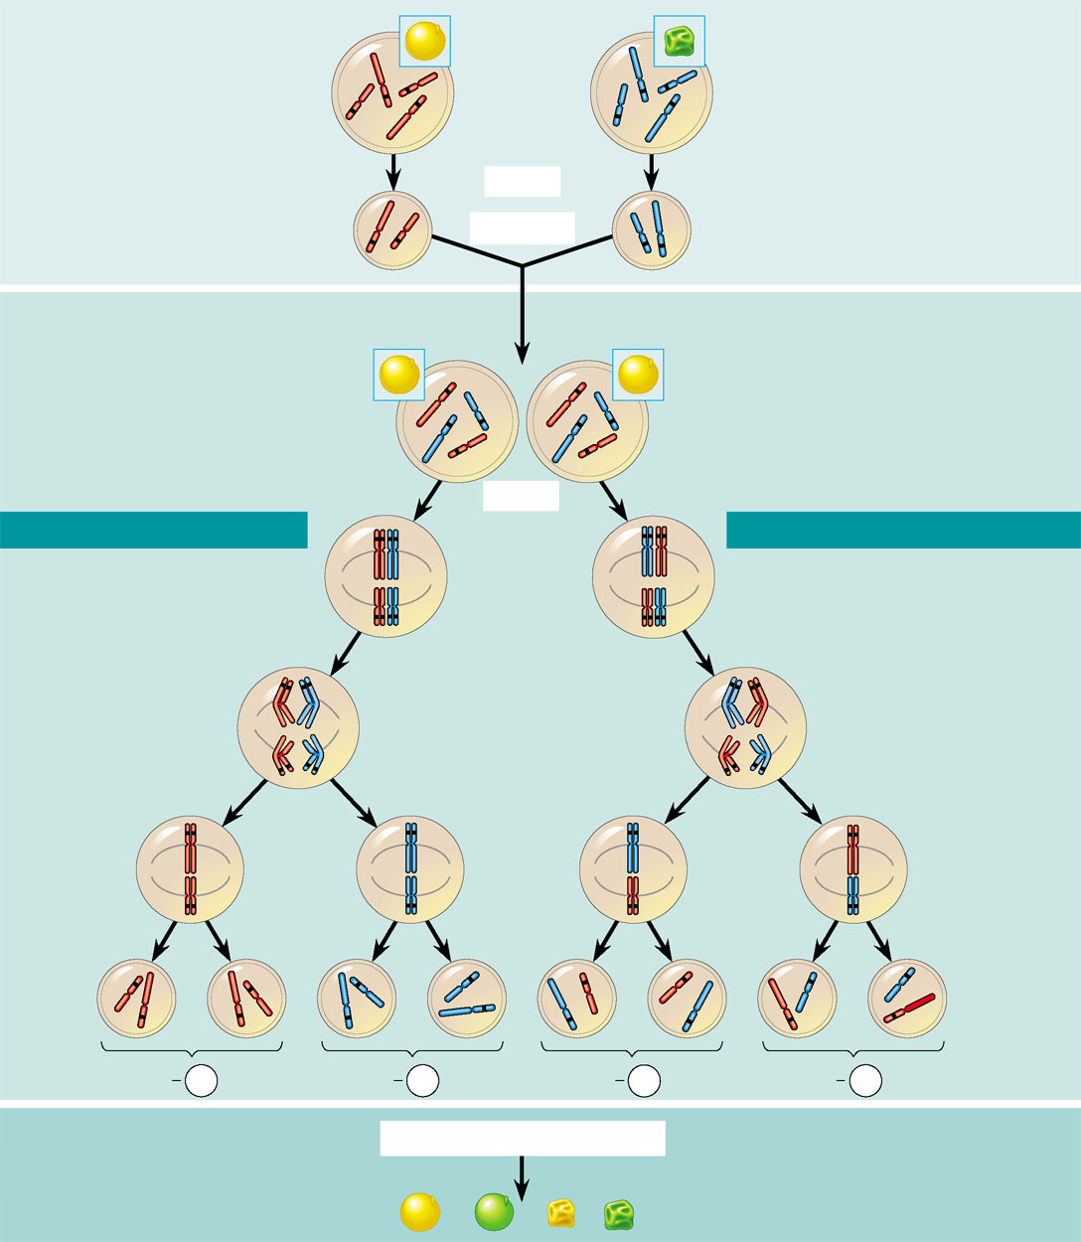
The chromosomal basis of Mendel’s laws
P Generation
Yellow-round
seeds (YYRR)
Green-wrinkled
seeds (yyrr)
Starting with two true-breeding pea plants,
we follow two genes through the F₁ and F₂
generations. The two genes specify seed
color (allele Y for yellow and allele y for
green) and seed shape (allele R for round
and allele r for wrinkled). These two genes are
on different chromosomes. (Peas have seven
chromosome pairs, but only two pairs are
illustrated here.)
Y
y
Y
R
R
r
r
y
Meiosis
Y
Fertilization
y
r
Gametes
R
All F₁ plants produce
yellow-round seeds (YyRr)
F₁ Generation
R
y
R
y
r
r
Y
Meiosis
Y
LAW OF SEGREGATION
R
r
r
R
LAW OF INDEPENDENT ASSORTMENT
Two equally
probable
arrangements
of chromosomes
at metaphase I
Y
y
Y
y
1
1
Alleles at both loci segregate
in anaphase I, yielding four
types of daughter cells
depending on the chromosome
arrangement at metaphase I.
Compare the arrangement of
the R and r alleles in the cells
on the left and right
The R and r alleles segregate
at anaphase I, yielding
two types of daughter
cells for this locus.
r
R
r
R
Anaphase I
Y
y
Y
y
2
R
r
r
R
Each gamete
gets one long
chromosome
with either the
R or r allele.
Metaphase II
2
Y
y
Each gamete gets
a long and a short
chromosome in
one of four allele
combinations.
y
y
Y
Y
Y
Y
Y
Y
y
y
Gametes
R
R
r
r
r
r
R
R
1
4
1
4
1
4
1
4
YR
yr
yr
yR
F₂ Generation
Fertilization among the F₁ plants
Fertilization results
in the 9:3:3:1
phenotypic ratio in
the F₂ generation.
3
3
Fertilization
recombines the
R and r alleles
at random.
Figure 15.2
9
: 3
: 3
: 1

Slide 6
Morgan’s Experimental Evidence: Scientific Inquiry
Thomas Hunt Morgan
  Provided convincing evidence that chromosomes are the location of Mendel’s heritable factors

Slide 7
Morgan’s Choice of Experimental Organism
Morgan worked with fruit flies
  Because they breed at a high rate
  A new generation can be bred every two weeks
  They have only four pairs of chromosomes

Slide 8
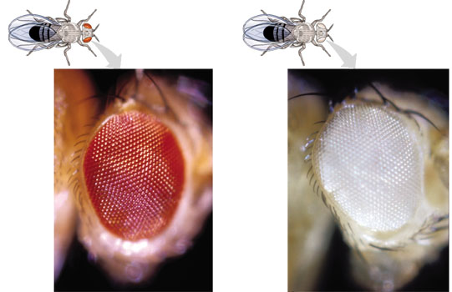
Morgan first observed and noted
  Wild type, or normal, phenotypes that were common in the fly populations
Traits alternative to the wild type
  Are called mutant phenotypes
Figure 15.3

Slide 9
Correlating Behavior of a Gene’s Alleles with Behavior of a Chromosome Pair
In one experiment Morgan mated male flies with white eyes (mutant) with female flies with red eyes (wild type)
  The F₁ generation all had red eyes
  The F₂ generation showed the 3:1 red:white eye ratio, but only males had white eyes

Slide 10
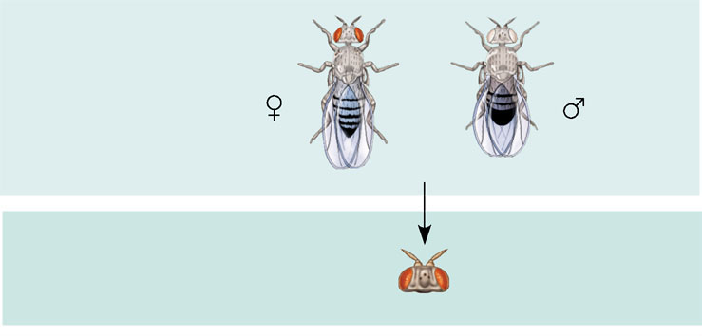

Morgan determined
  That the white-eye mutant allele must be located on the X chromosome
EXPERIMENT
Morgan mated a wild-type (red-eyed) female
with a mutant white-eyed male. The F₁ offspring all had red eyes.
P
Generation
X
F₁
Generation
Morgan then bred an F₁ red-eyed female to an F₁ red-eyed male to
produce the F₂ generation.
RESULTS
The F₂ generation showed a typical Mendelian
3:1 ratio of red eyes to white eyes. However, no females displayed the
white-eye trait; they all had red eyes. Half the males had white eyes,
and half had red eyes.
F₂
Generation
Figure 15.4

Slide 11
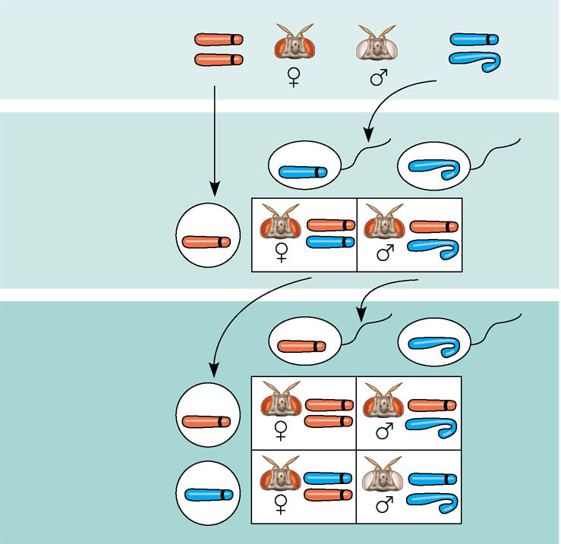
CONCLUSION
Since all F₁ offspring had red eyes, the mutant
white-eye trait (w) must be recessive to the wild-type red-eye trait (w⁺).
Since the recessive trait—white eyes—was expressed only in males in
the F₂ generation, Morgan hypothesized that the eye-color gene is
located on the X chromosome and that there is no corresponding locus
on the Y chromosome, as diagrammed here.
X
W⁺
X
W
P
Generation
X
X
Y
W⁺
Ova
(eggs)
W
Sperm
F₁
Generation
W⁺
W⁺
W⁺
W
Ova
(eggs)
W⁺
F₂
Generation
Sperm
W⁺
W⁺
W⁺
W⁺
W
W
W
W⁺

Slide 12
Morgan’s discovery that transmission of the X chromosome in fruit flies correlates with inheritance of the eye-color trait
  Was the first solid evidence indicating that a specific gene is associated with a specific chromosome

Slide 13
Concept 15.2: Linked genes tend to be inherited together because they are located near each other on the same chromosome
Each chromosome
  Has hundreds or thousands of genes

Slide 14
How Linkage Affects Inheritance: Scientific Inquiry
Morgan did other experiments with fruit flies
  To see how linkage affects the inheritance of two different characters

Slide 15
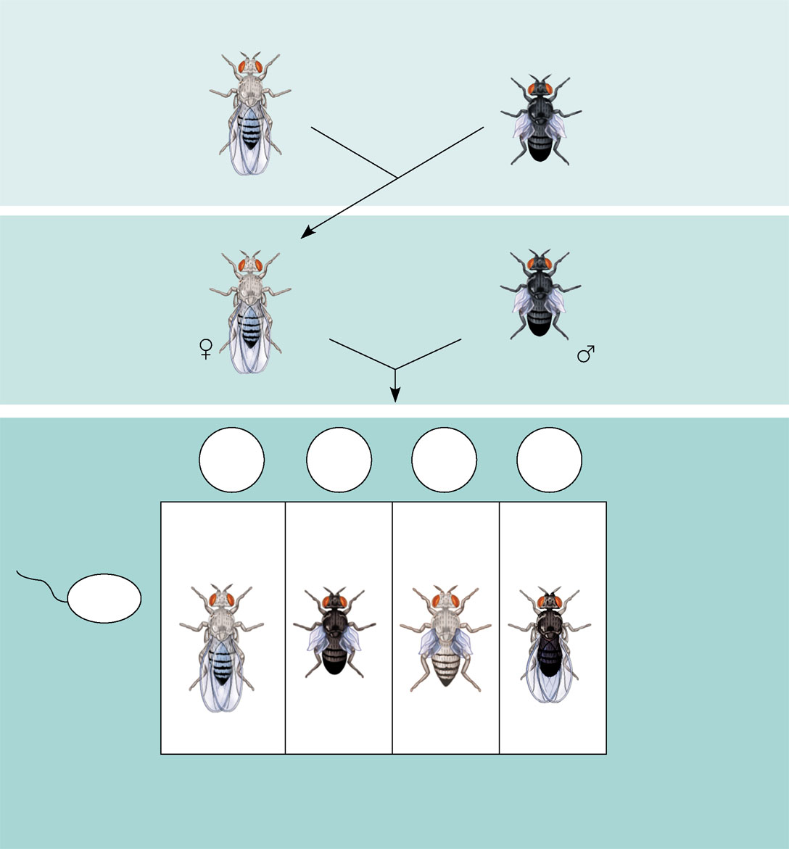
Morgan crossed flies
  That differed in traits of two different characters
P Generation
(homozygous)
Double mutant
(black body,
vestigial wings)
EXPERIMENT
Morgan first mated true-breeding
wild-type flies with black, vestigial-winged flies to produce
heterozygous F₁ dihybrids, all of which are wild-type in
appearance. He then mated wild-type F₁ dihybrid females with black, vestigial-winged males, producing 2,300 F₂ offspring, which he “scored” (classified according to
phenotype).
Wild type
(gray body,
normal wings)
x
Double mutant
(black body,
vestigial wings)
b⁺ b⁺ vg⁺ vg⁺
b b vg vg
F₁ dihybrid
(wild type)
(gray body,
normal wings)
Double mutant
(black body,
vestigial wings)
Double mutant
(black body,
vestigial wings)
TESTCROSS
x
CONCLUSION
b b vg vg
If these two genes were on
different chromosomes, the alleles from the F₁ dihybrid
would sort into gametes independently, and we would
expect to see equal numbers of the four types of offspring.
If these two genes were on the same chromosome,
we would expect each allele combination, B⁺ vg⁺ and b vg,
to stay together as gametes formed. In this case, only
offspring with parental phenotypes would be produced.
Since most offspring had a parental phenotype, Morgan
concluded that the genes for body color and wing size
are located on the same chromosome. However, the
production of a small number of offspring with
nonparental phenotypes indicated that some mechanism
occasionally breaks the linkage between genes on the
same chromosome.
b⁺ b vg⁺ vg
RESULTS
b⁺vg⁺
b vg
b⁺ vg
b vg⁺
965
Wild type
(gray-normal)
944
Black-
vestigial
206
Gray-
vestigial
185
Black-
normal
b vg
Sperm
b⁺ b vg⁺ vg
b b vg vg
b⁺ b vg vg
b b vg⁺ vg
Figure 15.5
Parental-type
offspring
Recombinant (nonparental-type)
offspring

Slide 16
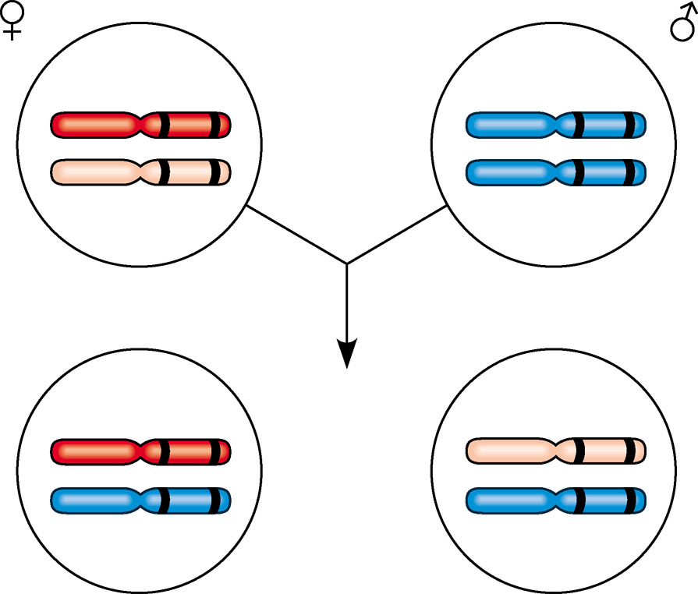
Morgan determined that
  Genes that are close together on the same chromosome are linked and do not assort independently
  Unlinked genes are either on separate chromosomes of are far apart on the same chromosome and assort independently
b⁺ vg⁺
X
b vg
Parents
in testcross
b vg
b vg
Most
offspring
b⁺ vg⁺
b vg
or
b vg
b vg

Slide 17
Genetic Recombination and Linkage

Slide 18
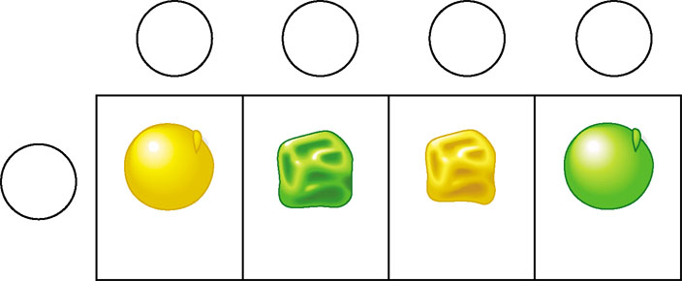
Recombination of Unlinked Genes: Independent Assortment of Chromosomes
When Mendel followed the inheritance of two characters
  He observed that some offspring have combinations of traits that do not match either parent in the P generation
Gametes from yellow-round
heterozygous parent (YyRr)
YR
yr
Yr
yR
Gametes from green-
wrinkled homozygous
recessive parent (yyrr)
yr
YyRr
yyrr
Yyrr
yyRr
Parental-
type offspring
Recombinant
offspring

Slide 19
Recombinant offspring
  Are those that show new combinations of the parental traits
When 50% of all offspring are recombinants
  Geneticists say that there is a 50% frequency of recombination

Slide 20
Recombination of Linked Genes: Crossing Over
Morgan discovered that genes can be linked
  But due to the appearance of recombinant phenotypes, the linkage appeared incomplete

Slide 21
Morgan proposed that
  Some process must occasionally break the physical connection between genes on the same chromosome
  Crossing over of homologous chromosomes was the mechanism

Slide 22
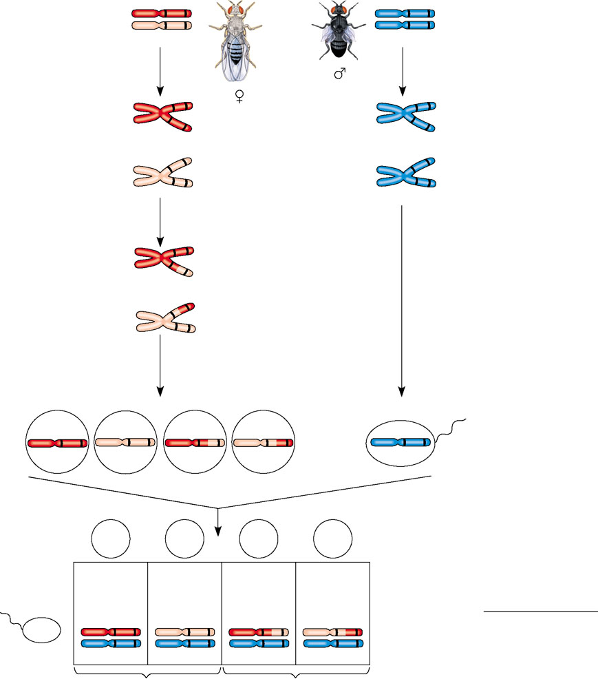
Linked genes
  Exhibit recombination frequencies less than 50%
b⁺
Testcross
parents
Gray body,
normal wings
(F₁ dihybrid)
vg⁺
b vg
Black body,
vestigial wings
(double mutant)
b
vg
×
b vg
Replication of
chromosomes
Replication of
chromosomes
vg
vg
b⁺
b
b⁺
b
vg⁺
vg
vg
vg
b
b
Meiosis I: Crossing
over between b and vg
loci produces new allele
combinations.
b
vg
b vg
Meiosis II: Segregation
of chromatids produces
recombinant gametes
with the new allele
combinations.
Meiosis I and II:
Even if crossing over
occurs, no new allele
combinations are
produced.
Recombinant
chromosome
Gametes
Ova
Sperm
b⁺vg⁺
b vg
b⁺ vg
b vg⁺
b vg
Testcross
offspring
b⁺ vg⁺
b vg
b⁺ vg
b vg⁺
Ova
Sperm
965
Wild type
(gray-normal)
944
Black-
vestigial
206
Gray-
vestigial
185
Black-
normal
Recombination
frequency
391 recombinants
×
b⁺ vg⁺
b vg⁺
b⁺ vg⁺
b vg⁺
=
100 = 17%
b vg
2,300 total offspring
Figure 15.6
b vg
b vg
b vg
b vg
Parental-type offspring
Recombinant offspring

Slide 23
Linkage Mapping: Using Recombination Data: Scientific Inquiry
A genetic map
  Is an ordered list of the genetic loci along a particular chromosome
  Can be developed using recombination frequencies

Slide 24
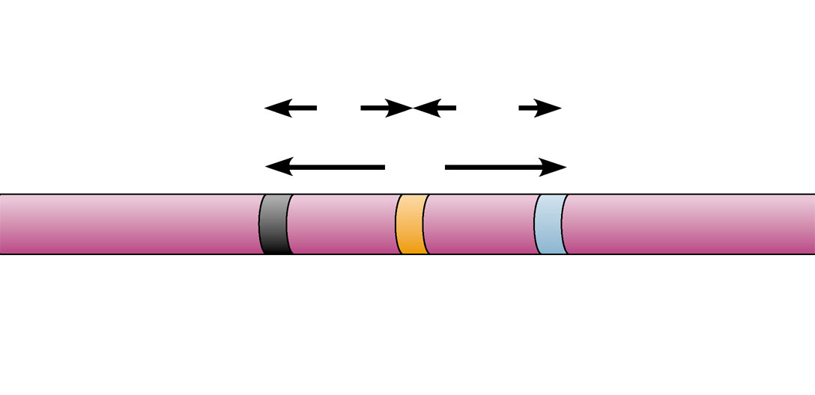
A linkage map
  Is the actual map of a chromosome based on recombination frequencies
APPLICATION
A linkage map shows the relative locations of genes along a chromosome.
TECHNIQUE
A linkage map is based on the assumption that the probability of a crossover between two
genetic loci is proportional to the distance separating the loci. The recombination frequencies used to construct
a linkage map for a particular chromosome are obtained from experimental crosses, such as the cross depicted
in Figure 15.6. The distances between genes are expressed as map units (centimorgans), with one map unit
equivalent to a 1% recombination frequency. Genes are arranged on the chromosome in the order that best fits the data.
RESULTS
In this example, the observed recombination frequencies between three Drosophila gene pairs
(b–cn 9%, cn–vg 9.5%, and b–vg 17%) best fit a linear order in which cn is positioned about halfway between
the other two genes:
Recombination
frequencies
9%
9.5%
17%
b
cn
vg
Chromosome
The b–vg recombination frequency is slightly less than the sum of the b–cn and cn–vg frequencies because double
crossovers are fairly likely to occur between b and vg in matings tracking these two genes. A second crossover
would “cancel out” the first and thus reduce the observed b–vg recombination frequency.
Figure 15.7

Slide 25
The farther apart genes are on a chromosome
  The more likely they are to be separated during crossing over

Slide 26
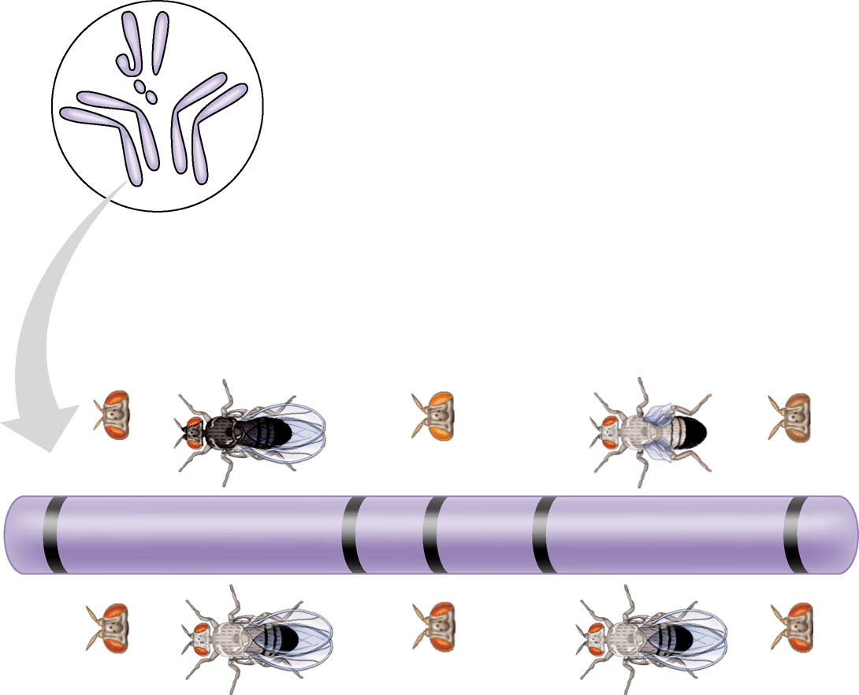
Many fruit fly genes
  Were mapped initially using recombination frequencies
I
Y
X
IV
II
III
Mutant phenotypes
Short
aristae
Black
body
Cinnabar
eyes
Vestigial
wings
Brown
eyes
0
48.5
57.5
67.0
104.5
Long aristae
(appendages
on head)
Gray
body
Red
eyes
Normal
wings
Red
eyes
Figure 15.8
Wild-type phenotypes

Slide 27
Concept 15.3: Sex-linked genes exhibit unique patterns of inheritance

Slide 28
The Chromosomal Basis of Sex
An organism’s sex
  Is an inherited phenotypic character determined by the presence or absence of certain chromosomes

Slide 29
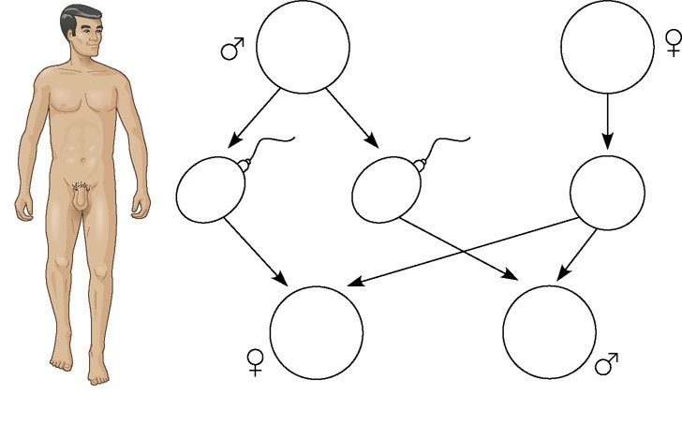
In humans and other mammals
  There are two varieties of sex chromosomes, X and Y
44 +
XY
Parents
44 +
XX
22 +
X
Sperm
22 +
Y
Ova
22 +
XY
44 +
XX
Zygotes
(offspring)
44 +
XY
(a) The X-Y system
Figure 15.9a

Slide 30
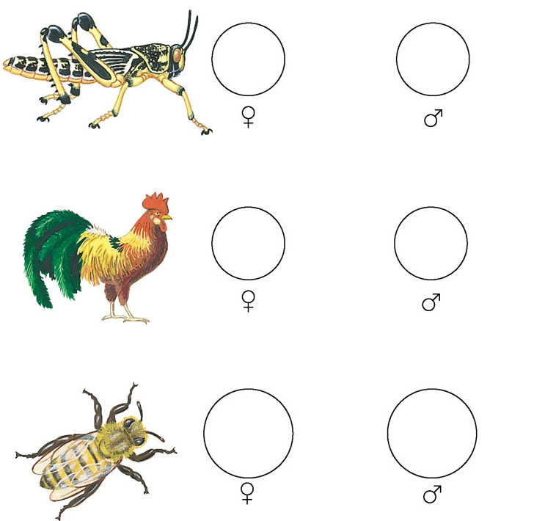
Different systems of sex determination
  Are found in other organisms
22 +
XX
22 +
X
(b) The X–0 system
76 +
ZW
76 +
ZZ
(c) The Z–W system
16
(Diploid)
16
(Haploid)
Figure 15.9b–d
(d) The haplo-diploid system

Slide 31
Inheritance of Sex-Linked Genes
The sex chromosomes
  Have genes for many characters unrelated to sex
A gene located on either sex chromosome
  Is called a sex-linked gene

Slide 32
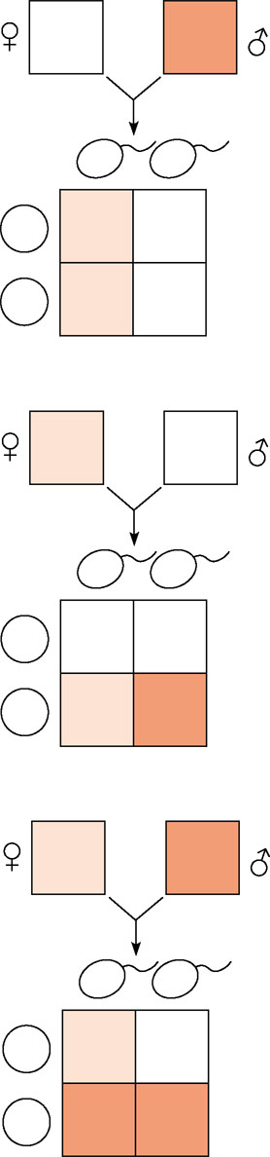
Sex-linked genes
  Follow specific patterns of inheritance
(a)
A father with the disorder will transmit the mutant allele to all daughters but to no sons. When the mother is a dominant homozygote, the daughters will have the normal phenotype but will be carriers of the mutation.
X^{A}X^{A}
XªY
Xª
Y
Sperm
Ova
X^{A}
X^{A}Xª
X^{A}Y
X^{A}
X^{A}Yª
X^{A}Y
X^{A}Xª
×
X^{A}Y
(b)
If a carrier mates with a male of normal phenotype, there is a 50% chance that each daughter will be a carrier like her mother, and a 50% chance that each son will have the disorder.
X^{A}
Y
Sperm
Ova
X^{A}
X^{A}X^{A}
X^{A}Y
Xª
XªY^{A}
XªY
(c)
If a carrier mates with a male who has the disorder, there is a 50% chance that each child born to them will have the disorder, regardless of sex. Daughters who do not have the disorder will be carriers, where as males without the disorder will be completely free of the recessive allele.
×
X^{A}Xª
XªY
Xª
Y
Sperm
Ova
X^{A}
X^{A}Xª
X^{A}Y
Figure 15.10a–c
Xª
XªYª
XªY

Slide 33
Some recessive alleles found on the X chromosome in humans cause certain types of disorders
  Color blindness
  Duchenne muscular dystrophy
  Hemophilia

Slide 34
X inactivation in Female Mammals
In mammalian females
  One of the two X chromosomes in each cell is randomly inactivated during embryonic development

Slide 35
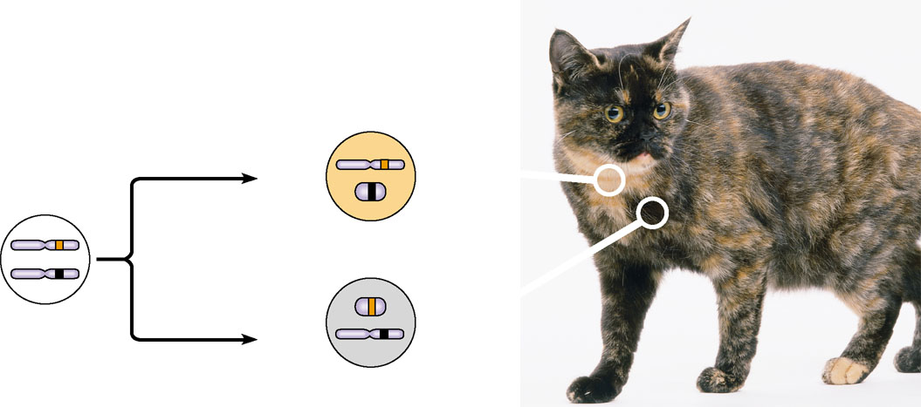
If a female is heterozygous for a particular gene located on the X chromosome
  She will be a mosaic for that character
Two cell populations
in adult cat:
Active X
Early embryo:
Orange
fur
X chromosomes
Cell division
and X
chromosome
inactivation
Inactive X
Inactive X
Black
fur
Allele for
black fur
Active X
Figure 15.11

Slide 36
Concept 15.4: Alterations of chromosome number or structure cause some genetic disorders
Large-scale chromosomal alterations
  Often lead to spontaneous abortions or cause a variety of developmental disorders

Slide 37
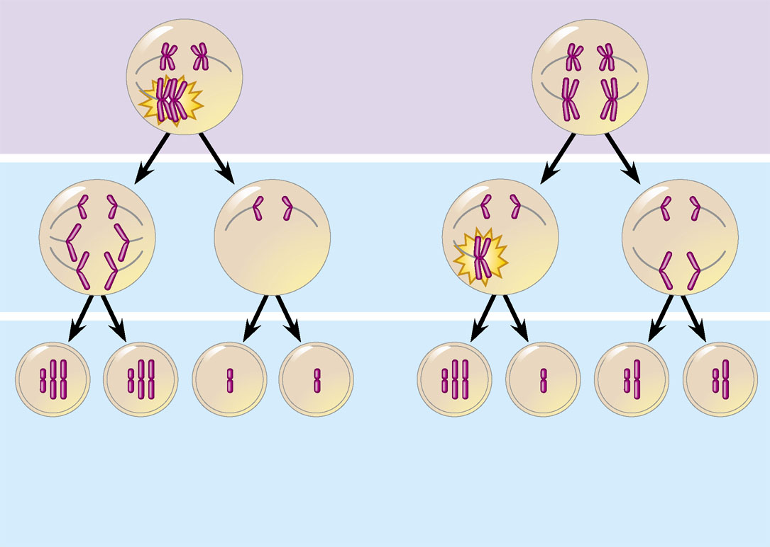
Abnormal Chromosome Number
When nondisjunction occurs
  Pairs of homologous chromosomes do not separate normally during meiosis
  Gametes contain two copies or no copies of a particular chromosome
Meiosis I
Nondisjunction
Meiosis II
Nondisjunction
Gametes
n + 1
n + 1
n − 1
n – 1
n + 1
n –1
n
n
Number of chromosomes
Figure 15.12a, b
(a)
Nondisjunction of homologous
chromosomes in meiosis I
(b)
Nondisjunction of sister
chromatids in meiosis II

Slide 38
Aneuploidy
  Results from the fertilization of gametes in which nondisjunction occurred
  Is a condition in which offspring have an abnormal number of a particular chromosome

Slide 39
If a zygote is trisomic
  It has three copies of a particular chromosome
If a zygote is monosomic
  It has only one copy of a particular chromosome

Slide 40
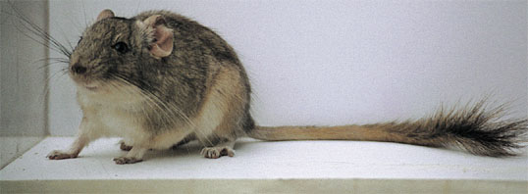
Polyploidy
  Is a condition in which there are more than two complete sets of chromosomes in an organism
Figure 15.13

Slide 41
Alterations of Chromosome Structure
Breakage of a chromosome can lead to four types of changes in chromosome structure
  Deletion
  Duplication
  Inversion
  Translocation

Slide 42
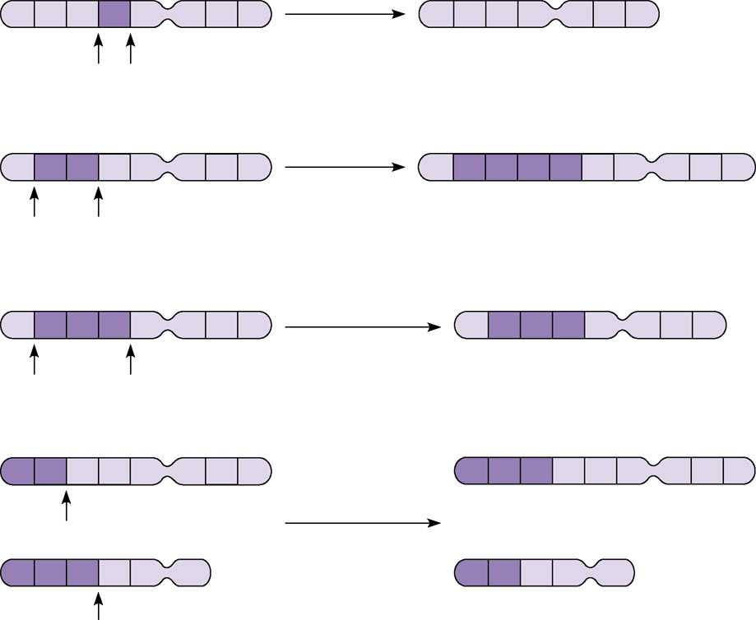
Alterations of chromosome structure
(a) A deletion removes a chromosomal
segment.
A
B
C
D
E
F
G
H
Deletion
A
B
C
E
F
G
H
A
B
C
D
E
F
G
H
Duplication
A
B
C
B
C
D
E
F
G
H
(b) A duplication repeats a segment.
A
B
C
D
E
F
G
H
Inversion
A
D
C
B
E
F
G
H
(c) An inversion reverses a segment within
a chromosome.
(d) A translocation moves a segment from
one chromosome to another,
nonhomologous one. In a reciprocal
translocation, the most common type,
nonhomologous chromosomes exchange
fragments. Nonreciprocal translocations
also occur, in which a chromosome
transfers a fragment without receiving a
fragment in return.
A
B
C
D
E
F
G
H
M
N
O
C
D
E
F
G
H
Reciprocal
translocation
M
N
O
P
Q
R
A
B
P
Q
R
Figure 15.14a–d

Slide 43
Human Disorders Due to Chromosomal Alterations
Alterations of chromosome number and structure
  Are associated with a number of serious human disorders

Slide 44
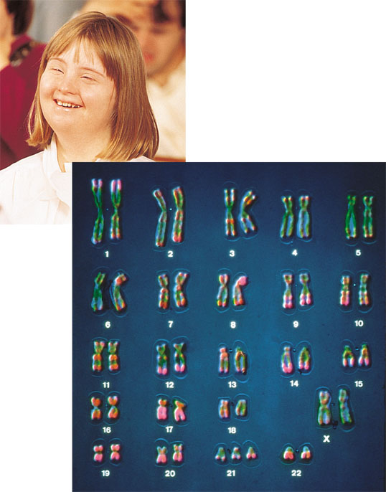
Down Syndrome
Down syndrome
  Is usually the result of an extra chromosome 21, trisomy 21
Figure 15.15

Slide 45
Aneuploidy of Sex Chromosomes
Nondisjunction of sex chromosomes
  Produces a variety of aneuploid conditions

Slide 46
Klinefelter syndrome
  Is the result of an extra chromosome in a male, producing XXY individuals
Turner syndrome
  Is the result of monosomy X, producing an X0 karyotype

Slide 47
Disorders Caused by Structurally Altered Chromosomes
Cri du chat
  Is a disorder caused by a deletion in a chromosome

Slide 48
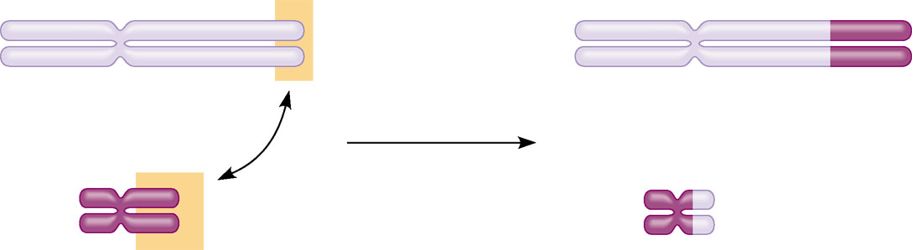
Certain cancers
  Are caused by translocations of chromosomes
Normal chromosome 9
Reciprocal
translocation
Translocated chromosome 9
Philadelphia
chromosome
Normal chromosome 22
Translocated chromosome 22
Figure 15.16

Slide 49
Concept 15.5: Some inheritance patterns are exceptions to the standard chromosome theory
Two normal exceptions to Mendelian genetics include
  Genes located in the nucleus
  Genes located outside the nucleus

Slide 50
Genomic Imprinting
In mammals
  The phenotypic effects of certain genes depend on which allele is inherited from the mother and which is inherited from the father

Slide 51
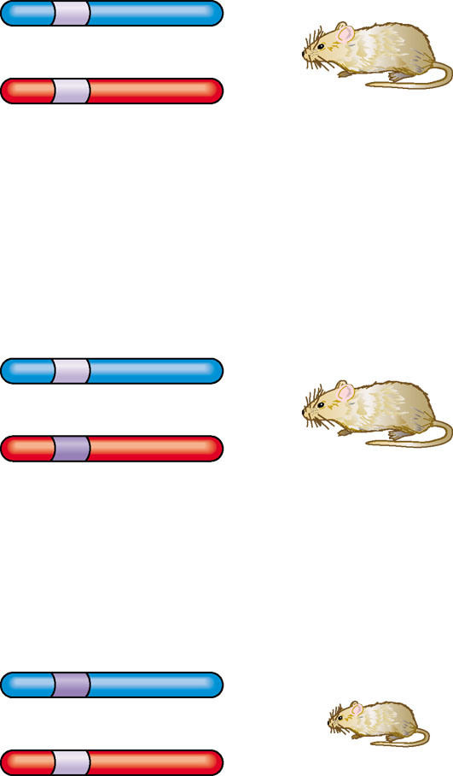
Genomic imprinting
  Involves the silencing of certain genes that are “stamped” with an imprint during gamete production
Normal Igf2 allele
(expressed)
Paternal
chromosome
Maternal
chromosome
Normal Igf2 allele
with imprint
(not expressed)
Wild-type mouse
(normal size)
(a) A wild-type mouse is homozygous for the normal igf2 allele.
Normal Igf2 allele
Paternal
Maternal
Mutant
lgf2 allele
Normal size mouse
Mutant
lgf2 allele
Paternal
Maternal
Normal Igf2 allele
with imprint
Dwarf mouse
(b) When a normal Igf2 allele is inherited from the father, heterozygous mice grow to normal size.
But when a mutant allele is inherited from the father, heterozygous mice have the dwarf
phenotype.
Figure 15.17a, b

Slide 52
Inheritance of Organelle Genes
Extranuclear genes
  Are genes found in organelles in the cytoplasm

Slide 53
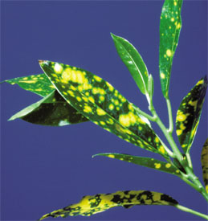
The inheritance of traits controlled by genes present in the chloroplasts or mitochondria
  Depends solely on the maternal parent because the zygote’s cytoplasm comes from the egg
Figure 15.18

Slide 54
Some diseases affecting the muscular and nervous systems
  Are caused by defects in mitochondrial genes that prevent cells from making enough ATP

