Slide 1

TEAM PALO

Slide 2
PALO MODEL T

Slide 3
HARDWARE
Sonar position issues
Steering issues
Quick building prototype

Slide 4
SOFTWARE
PID powered algorithm
Sonar exceptions

Slide 5
COSTS
To develop the Palo Model T we’ve spent a total of 1800 LeoCoins
To test the Palo model T on the circuit we’ve spent 475 more LeoCoins

Slide 6
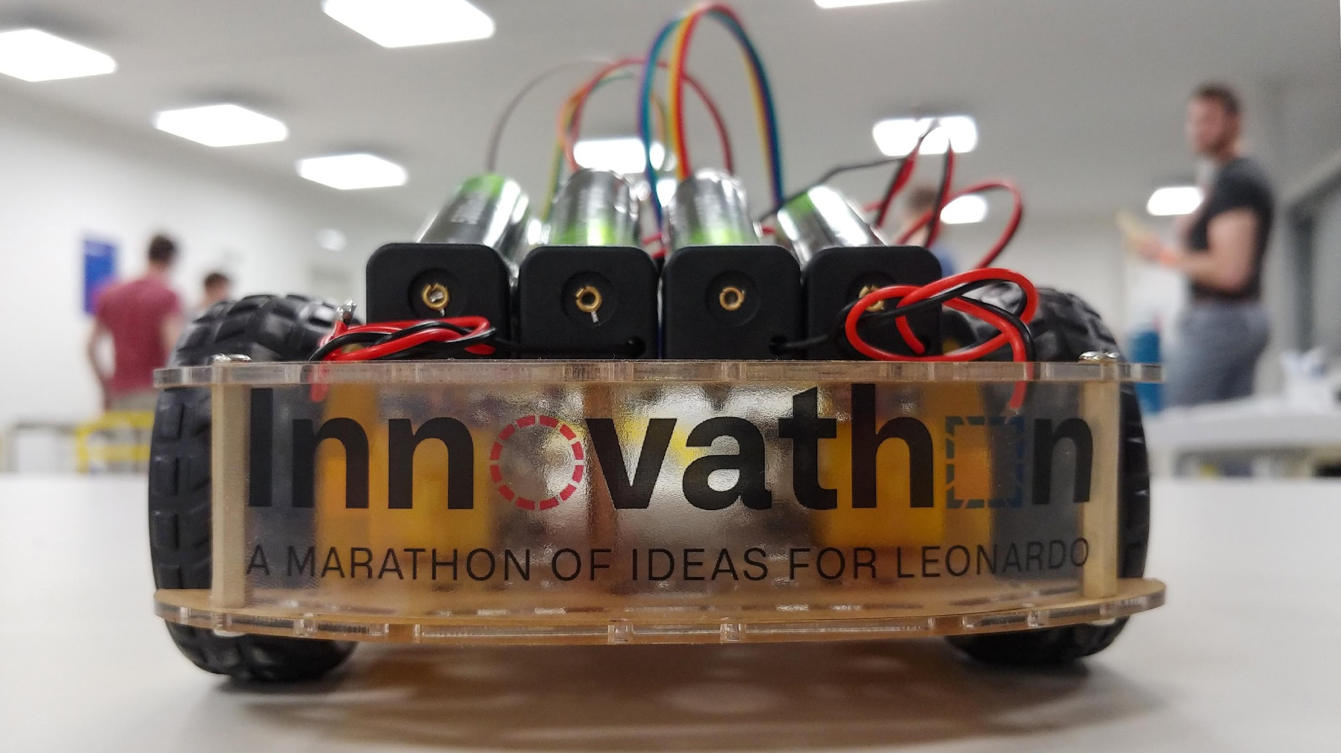
LET’S GO ON CIRCUIT

