Slide 1
Quote without Contractor
By Contractor5

Slide 2
The Problem
How much does it cost to …
Add a garage
Remodel a kitchen
Remove a room

Slide 3
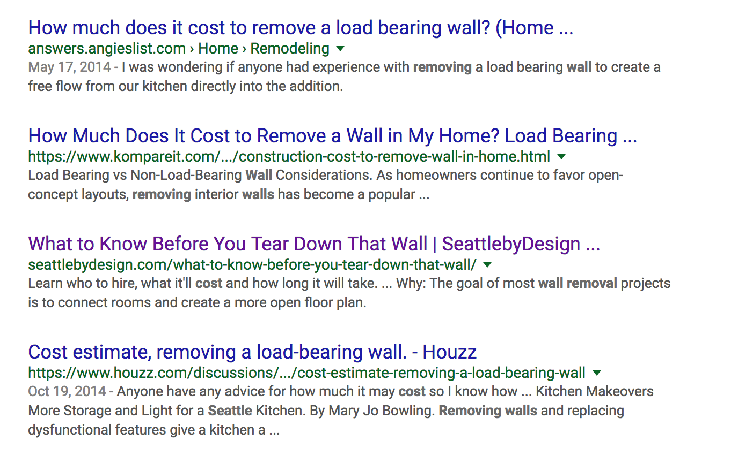
First, we go to google …

Slide 4
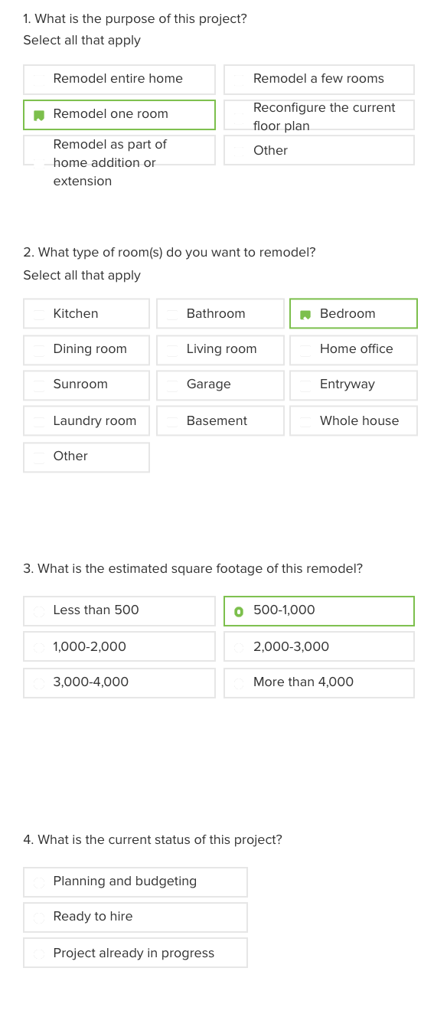
Then, there will be a long questionnaire…

Slide 5
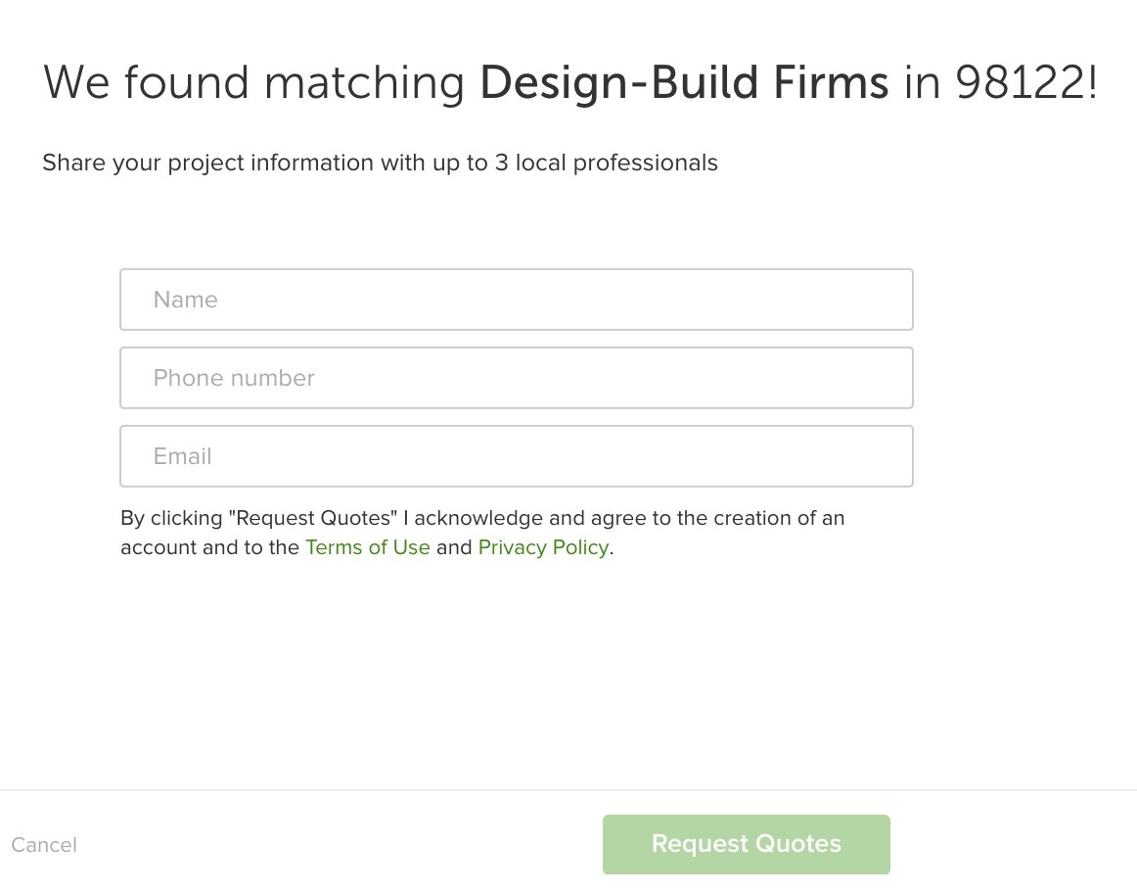
In the end, there is still no answer …

Slide 6
Data
Building permit
https://data.seattle.gov/Permitting/Building-Permits-Current/mags-97de
Place of interest via HERE Maps POI API
https://developer.here.com/
Property parcel information
http://web6.seattle.gov/dpd/parceldata/

Slide 7
Feature Engineering and Model
Variables
Permit Type: Construction, demolition, development
Category: single-family; multi-family; industrial; institutional
Time: month, holiday season, real estate peak season….
Location: zipcode, point of interest
Description: top 5000 words, LDA
SIS variable selection/RF importance: 371 variables
Model: Random Forest
Validation 5-CV: Square root of MSE $5238.77

Slide 8
