Slide 1

Exploratory Data Analysis:
World Population Insights
Portfolio Proyek Data Science
Data Science
FEBRIANTO
Email: febrianto078@gmail.com
Digital Skill Fair 39.0

Slide 2
Agenda
Pendahuluan & Tujuan
Library & Dataset
Eksplorasi Data Awal
Kesimpulan & Rekomendasi
Pembersihan Data
Analisis Outlier
Analisis Korelasi & PCA
Email: febrianto078@gmail.com
Digital Skill Fair 39.0

Slide 3
Pendahuluan & Tujuan
Tujuan utama EDA ini adalah:
Mengungkap insight dari data populasi dunia
Mengidentifikasi outlier dan pola pada data
Menyusun dasar analisis lanjutan (clustering-, predictive modeling, dsb.)
Email: febrianto078@gmail.com
Digital Skill Fair 39.0

Slide 4
Library & Dataset
Library yang digunakan:
pandas, numpy
matplotlib, seaborn
Dataset:
File: world_population2024.csv
216 baris x 12 kolom
Tabulate
sklearn (PCA, StandardScaler)
Email: febrianto078@gmail.com
Digital Skill Fair 39.0

Slide 5
Eksplorasi Data Awal
Menampilkan 5 baris pertama data
Informasi dasar: kolom, tipe data, nilai unik & statistik deskriptif
[EKSPLORASI DATA AWAL]
=== 5 BARIS PERTAMA DATA ===
+------+------------------------+------------------+---------------+------------+-----------------+
| Rank | Country (or dependency)| Population (2024)| Yearly Change | Net Change | Density (P/km^2)|
|------+------------------------+------------------+---------------+------------+-----------------+
| 1 | India | 1,450,935,791 | 0.89 | 12,866,195 | 488 |
| 2 | China | 1,419,321,278 | -0.23 | -3,263,655 | 151 |
| 3 | United States | 345,426,571 | 0.57 | 1,949,236 | 38 |
| 4 | Indonesia | 283,487,931 | 0.82 | 2,297,864 | 156 |
| 5 | Pakistan | 251,269,164 | 1.52 | 3,764,669 | 326 |
+------+------------------------+------------------+---------------+------------+-----------------+
+-----------------+----------------+-----------+----------+-------------+-------------+
| Land Area (Km^2)| Migrants (net) | Fert. Rate| Med. Age | Urban Pop % | World Share |
+-----------------+----------------+-----------+----------+-------------+-------------|
| 2,973,190 | -630,830 | 2 | 28 | 37 | 17.78 |
| 9,388,211 | -318,992 | 1 | 40 | 66 | 17.39 |
| 9,147,420 | 1,286,132 | 1.6 | 38 | 82 | 4.23 |
| 1,811,570 | -38,469 | 2.1 | 30 | 59 | 3.47 |
| 770,880 | -1,401,173 | 3.5 | 20 | 34 | 3.08 |
+-----------------+----------------+-----------+----------+-------------+-------------+
Email: febrianto078@gmail.com
Digital Skill Fair 39.0

Slide 6
NAMA KOLOM & INFORMASI DATASET
=== NAMA KOLOM YANG TERSEDIA ===
+-------------------------+
| Kolom |
|-------------------------|
| Rank |
| Country (or dependency) |
| Population (2024) |
| Yearly Change |
| Net Change |
| Density (P/km^2) |
| Land Area (Km^2) |
| Migrants (net) |
| Fert. Rate |
| Med. Age |
| Urban Pop % |
| World Share |
+-------------------------+
=== INFORMASI DATASET ===
+-------------------------+-----------+----------=-+--------------+
| Kolom | Tipe Data | Nilai Unik | Nilai Hilang |
|-------------------------+-----------+------------+--------------|
| Rank | int64 | 216 | 0 |
| Country (or dependency) | object | 216 | 0 |
| Population (2024) | object | 216 | 0 |
| Yearly Change | float64 | 169 | 0 |
| Net Change | object | 216 | 0 |
| Density (P/km^2) | object | 160 | 0 |
| Land Area (Km^2) | object | 211 | 0 |
| Migrants (net) | object | 213 | 0 |
| Fert. Rate | float64 | 44 | 0 |
| Med. Age | int64 | 37 | 0 |
| Urban Pop % | float64 | 83 | 0 |
| World Share | float64 | 74 | 0 |
+-------------------------+-----------+------------+--------------+
Email: febrianto078@gmail.com
Digital Skill Fair 39.0

Slide 7
STATISTIK DESKRIPTIF (NUMERIK)
=== STATISTIK DESKRIPTIF (NUMERIK) ===
---------------+-------+---------=--+----------+-------+-------+--------+----------+--------+
| Kolom | count | mean | std | min | 25% | 50% | 75% | max |
|---------------+-------+----------=-+---------+-------+-------+--------+----------+--------|
| Rank | 216 | 112.588 | 66.6645 | 1 | 55.75 | 110.5 | 169.25 | 233 |
| Yearly Change | 216 | 1.04884 | 1.3242 | -5.04 | 0.18 | 0.99 | 1.9325 | 5.07 |
| Fert. Rate | 216 | 2.38056 | 1.18604| 0.7 | 1.5 | 2 | 3.125 | 6 |
| Med. Age | 216 | 30.9491 | 9.49674| 14 | 22 | 31.5 | 39 | 51 |
| Urban Pop % | 216 | 59.8704 | 23.9391 | 0 | 41.75 | 62 | 80 | 100 |
| World Share | 216 | 0.459815 | 1.76066| 0 | 0.01 | 0.08 | 0.3225 | 17.78 |
+---------------+---------+----------+---------+-------+-------+--------+----------+--------+
Email: febrianto078@gmail.com
Digital Skill Fair 39.0

Slide 8
[ANALISIS MISSING VALUES] === NILAI HILANG (MISSING VALUES) === Tidak ada nilai hilang dalam dataset.
[DUPLIKAT] === CEK DUPLIKAT === +-------------------+-----------------------+ | Jumlah Duplikat | Persentase Duplikat | |-------------------+-----------------------| | 0 | 0 | +-------------------+-----------------------+
Pembersihan Data
MISSING VALUES
Duplikat
Data telah siap untuk analisis lanjutan
Email: febrianto078@gmail.com
Digital Skill Fair 39.0

Slide 9
[ANALISIS OUTLIER] === ANALISIS OUTLIER === +---------------+---------------+--------------+------------------+----------------------+ | Kolom | Batas Bawah | Batas Atas | Jumlah Outlier | Persentase Outlier | |---------------+---------------+--------------+------------------+----------------------| | Rank | -114.5 | 339.5 | 0 | 0.00% | | Yearly Change | -2.45 | 4.56 | 5 | 2.31% | | Fert. Rate | -0.94 | 5.56 | 5 | 2.31% | | Med. Age | -3.5 | 64.5 | 0 | 0.00% | | Urban Pop % | -15.62 | 137.38 | 0 | 0.00% | | World Share | -0.46 | 0.79 | 23 | 10.65% | +---------------+---------------+--------------+------------------+----------------------+
Analisis Outlier
'World Share' memiliki 23 outlier (10.65%).
Jumlah dan Persentase Tertinggi
Email: febrianto078@gmail.com
Digital Skill Fair 39.0

Slide 10
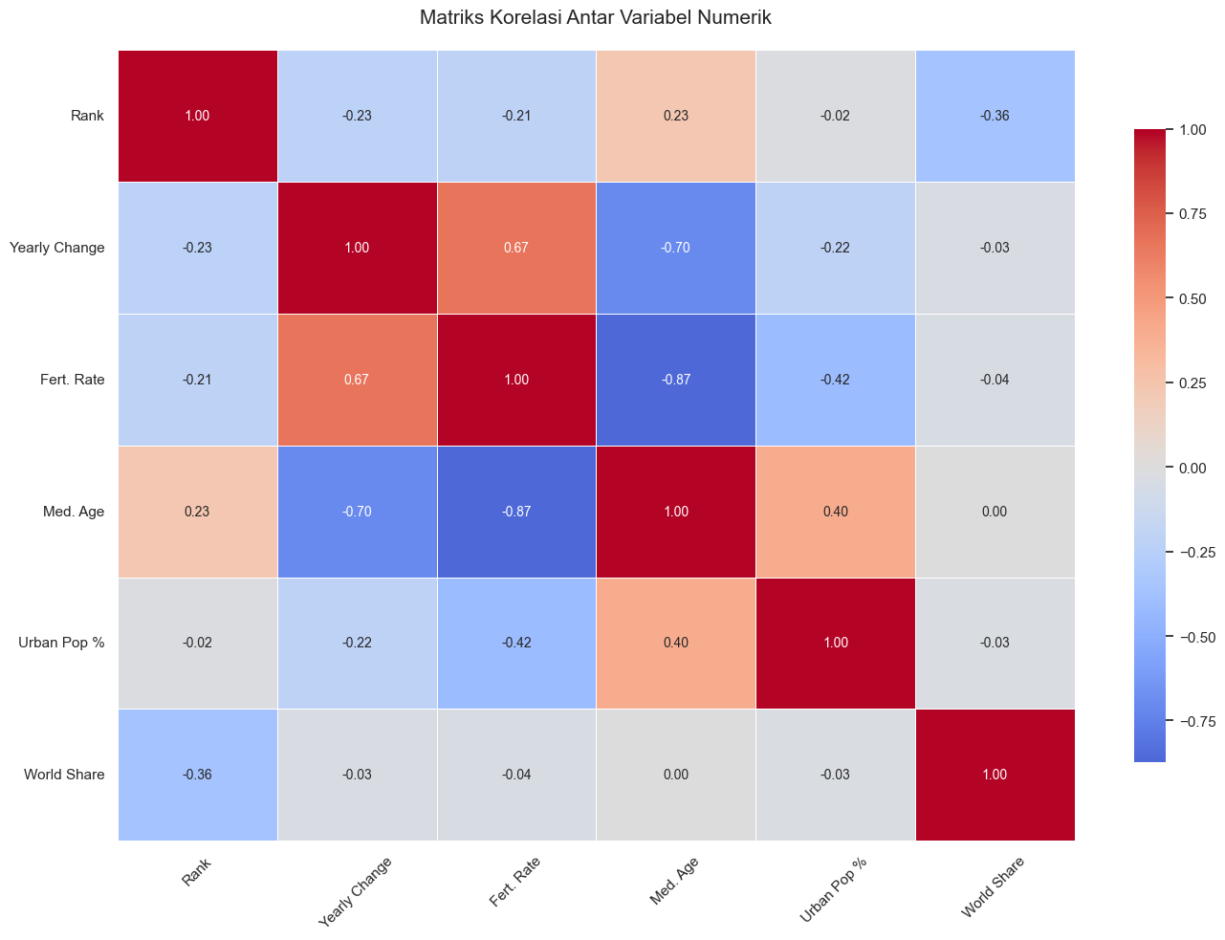
Analisis Korelasi
=> ANALISIS KORELASI ANTAR VARIABEL <=
=== PASANGAN VARIABEL DENGAN KORELASI KUAT (|R| > 0.7) ===
+--------------+--------------+----------------------+
| Variabel 1 | Variabel 2 | Koefisien Korelasi |
|--------------+--------------+----------------------|
| Fert. Rate | Med. Age | -0.872013 |
| Med. Age | Fert. Rate | -0.872013 |
+--------------+--------------+----------------------+
Email: febrianto078@gmail.com
Digital Skill Fair 39.0

Slide 11
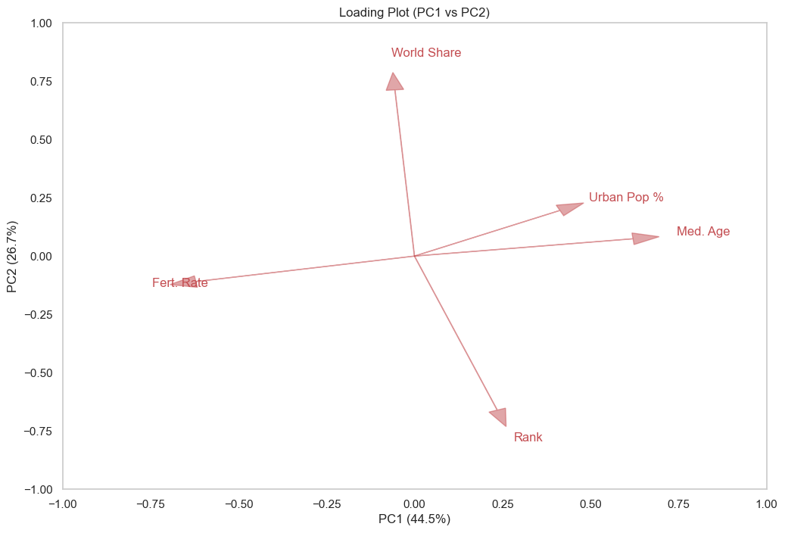
Analisis PCA
Email: febrianto078@gmail.com
Digital Skill Fair 39.0

Slide 12
Analisis PCA
Hasil Analisis PCA:
Total varians yang dijelaskan oleh 2 komponen pertama: 71.26%
Komposisi Komponen Utama:
+-------------+-----------+------------+-----------+-----------+------------+
| | PC1 | PC2 | PC3 | PC4 | PC5 |
|-------------+-----------+------------+-----------+-----------+------------|
| Rank | 0.235178 | -0.660437 | -0.347492 | 0.622659 | 0.00775744 |
| Fert. Rate | -0.620811 | -0.109289 | 0.209902 | 0.22683 | 0.712137 |
| Med. Age | 0.620824 | 0.0742642 | -0.202601 | -0.277512 | 0.700715 |
| Urban Pop % | 0.413264 | 0.195746 | 0.753598 | 0.471875 | 0.0178814 |
| World Share | -0.055455 | 0.712775 | -0.47564 | 0.511043 | 0.0384604 |
+-------------+-----------+------------+-----------+-----------+------------+
Email: febrianto078@gmail.com
Digital Skill Fair 39.0

Slide 13
Kesimpulan EDA
[KESIMPULAN EDA]
=== RINGKASAN KESIMPULAN ===
+---------------------------------+--------------------------------------------------------------+
| Kategori | Deskripsi |
|---------------------------------+--------------------------------------------------------------|
| 1. Statistik Dasar | 216 baris, 12 kolom |
| 2. Masalah yang Teridentifikasi | |
| - Nilai hilang | 0 total |
| - Duplikat | 0 baris |
| - Outlier | Terdeteksi pada beberapa kolom numerik (lihat tabel outlier) |
| 3. Rekomendasi | |
| - Missing Values | Tangani sesuai rekomendasi di tabel missing values |
| - Outlier | Pertimbangkan untuk menghapus atau menangani outlier |
| - Analisis Lanjutan | Lakukan analisis lebih dalam berdasarkan visualisasi |
+---------------------------------+--------------------------------------------------------------+
Email: febrianto078@gmail.com
Digital Skill Fair 39.0

Slide 14
Kesimpulan & Rekomendasi Analisis Lanjutan
[REKOMENDASI ANALISIS LANJUTAN]
Rekomendasi untuk Analisis Lanjutan
+------------------------------+----------------------------------------------------------------------------+
| Area Analisis | Rekomendasi |
+------------------------------+----------------------------------------------------------------------------+
| Korelasi | Lakukan analisis penyebab korelasi kuat antar variabel |
| Segmentasi | Eksplorasi perbedaan karakteristik antar segment kategori |
| Outlier | Investigasi penyebab outlier - apakah kesalahan data atau kejadian nyata? |
| Time Series | Analisis tren, musiman, dan forecasting jika data temporal tersedia |
| Dimensionality Reduction | Gunakan PCA untuk visualisasi data multidimensi |
| Clustering | Coba teknik clustering seperti K-Means untuk identifikasi kelompok alami |
| Predictive Modeling | Bangun model prediktif berdasarkan temuan EDA |
+------------------------------+----------------------------------------------------------------------------+
Email: febrianto078@gmail.com
Digital Skill Fair 39.0

Slide 15


THANK YOU
Contact
🔗 LinkedIn
WhatsApp
✉️ Email 📧 Febrianto078@gmail.com
💻 GitHub 🔗 github.com/FBTO45
Email: febrianto078@gmail.com
Digital Skill Fair 39.0

