Slide 1
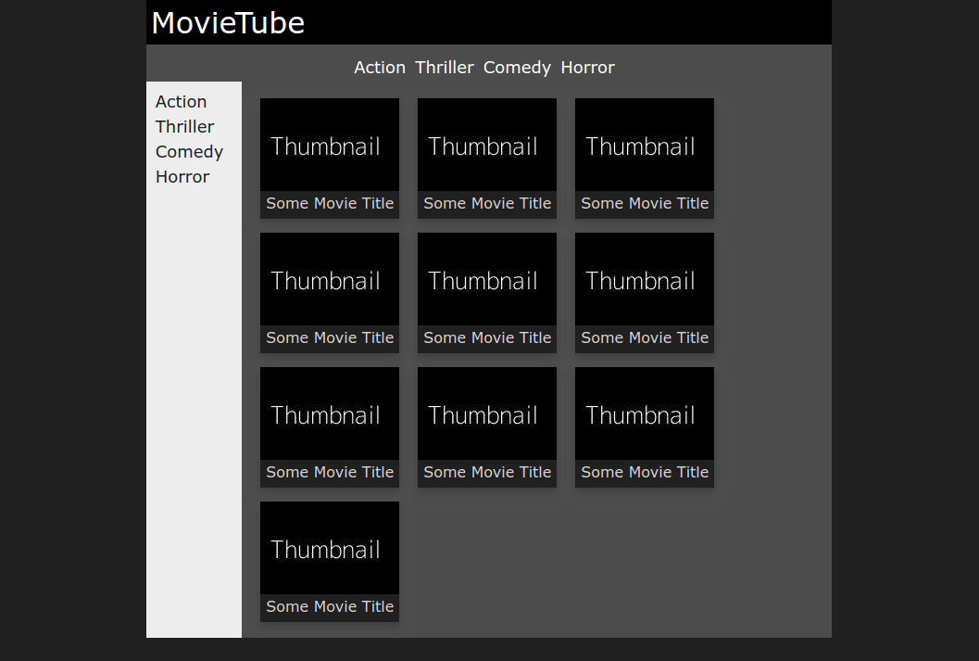
Task: Implement the following layout using Flexbox

Slide 2
Task: Implement the following layout using Flexbox
3 flexboxes

Slide 3
Task: Implement the following layout using Flexbox
#000
#1a1a1a
#4b4b4b

