Slide 1
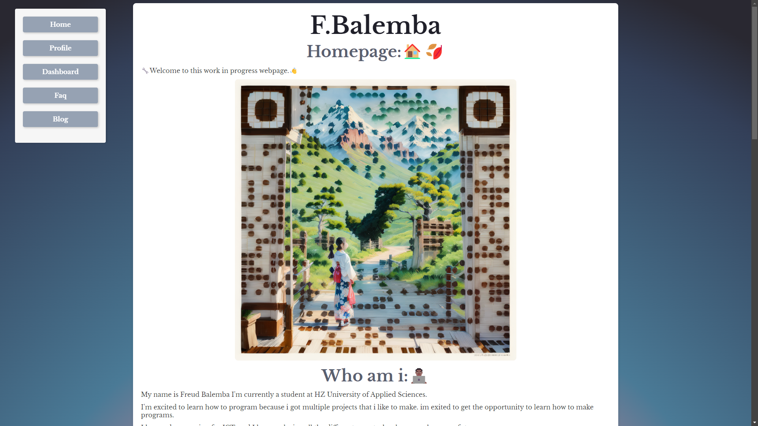
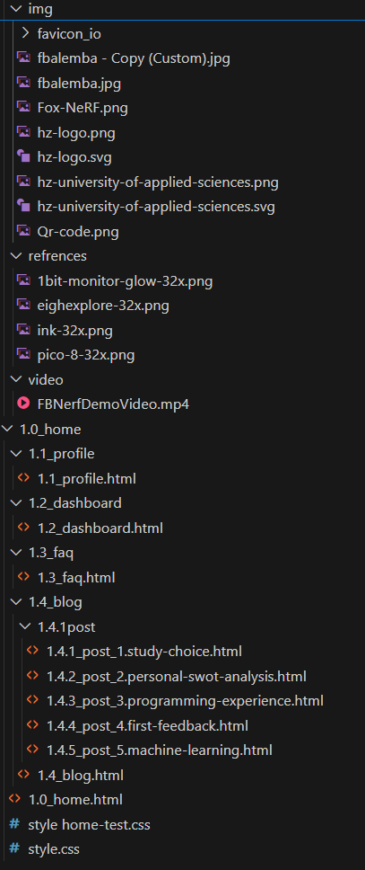
Simple Clean look
Work in progress
Folder Structure
Folder Structure
Menu Buttons
Minimal easy to redesign

Slide 2
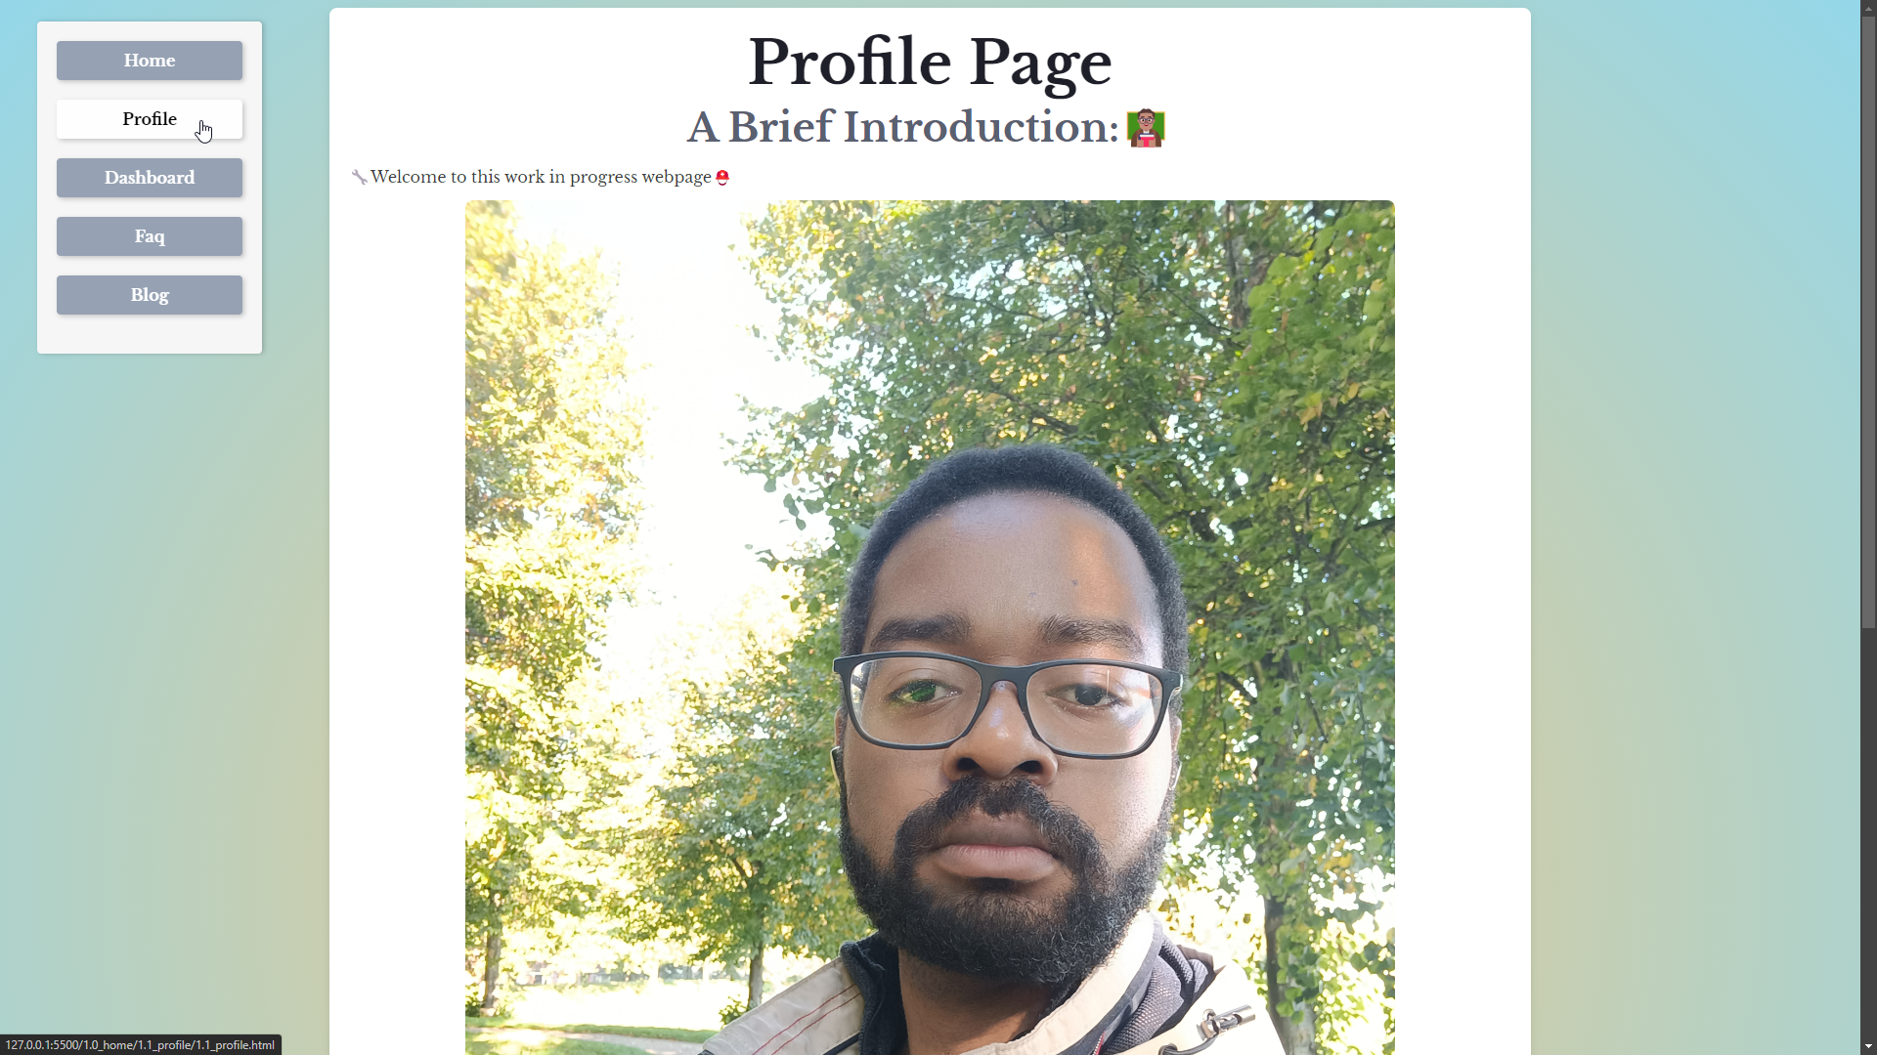

Slide 3
