Slide 1
Performance in exams
good
average
poor
Category/Class
Category/Class
Category/Class
Scale/Label
Color
blue
green
red
yellow
violet
Category/Class
Category/Class
Category/Class
Category/Class
Category/Class
Scale/Label

Slide 2
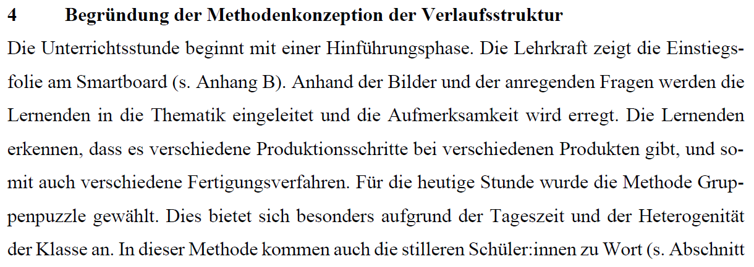
Input Data
Target Data
Categories/Classes
good
average
Scale/Label
poor

Slide 3
Input
Encoder
Latent Space
Decoder
Output

