Slide 1
Performance in exams
good
average
poor
Category/Class
Category/Class
Category/Class
Scale/Label
Color
blue
green
red
yellow
violet
Category/Class
Category/Class
Category/Class
Category/Class
Category/Class
Scale/Label

Slide 2
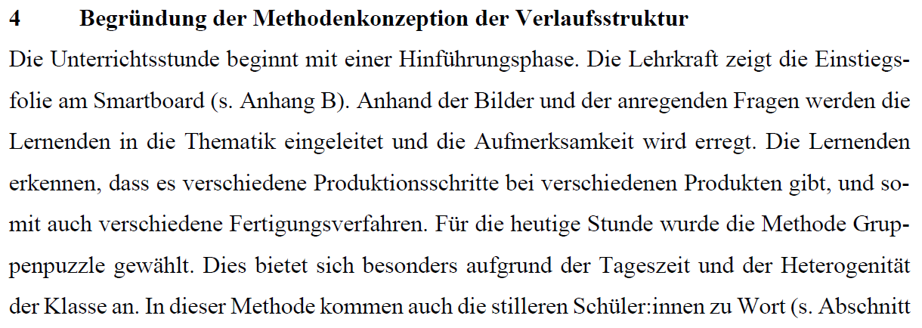
Input Data
Target Data
Categories/Classes
good
average
Scale/Label
poor

Slide 3
Coding Unit 1
Coding Unit 2
Coding Unit 3
Assigned category
True Category
A
True Category
B
True Category
C
True Data | Labeled Data
good | good
average | good
poor | good
…. | …
Coding Unit | Data
Exam 1 | good
Exam 2 | good
Exam 3 | good
…. | …
-----
-----
-----
-----
-----
-----
-----
-----
-----
-----
-----
-----
Data labeled as “good”
Exam 1
Exam 2
Exam 3
True Category
Good
True Category
Average
True Category
Poor
Coding Scheme
Category A (good)
Category B (average)
Category C (poor)
Rater A
Rater B
Rater C

Slide 4














1)
Category $i$
$$N$$
2)
Category $i$
$$n_{Iota}$$
$$+$$
$$n_{Iota Error I}$$
$$=N$$
3)
Category $i$
Other Categories
$$n_{Iota}$$
$$+$$
$$n_{Iota Error I}$$
$$+$$
$$n_{Iota Error II}$$
$$=N+n_{Iota Error II}$$

Slide 5
Performance in exams
good
average
poor
taking part in exams
Hypothesis:
The better participant’s performance the greater their confidence in their abilities
Participants
taking part in interviews
Confidence in abilities
low
medium
high

